Slide 1
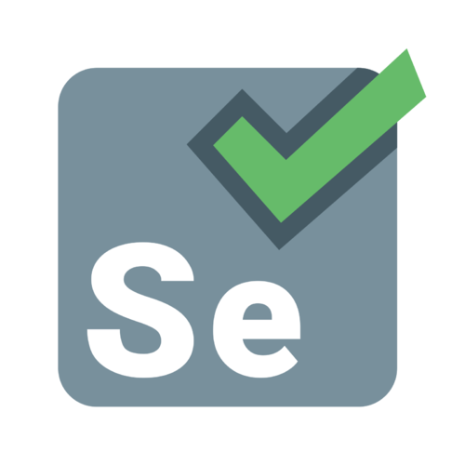
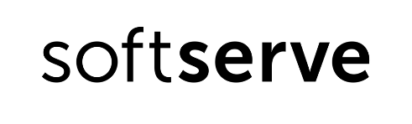
Selenium Overview
Made By Viacheslav fesenko
Sr. .NET Developer

Slide 2
Agenda
1. What is Selenium?
2. Selenium vs General Competitors
3. Selenium vs .NET Competitors
4. Recap: Why Selenium?
5. Selenium’s Intro Feature List
6. Selenium Like A Tool For Functional Tests
7. Selenium and SACS
8. Experienced Developer Feedback
9. Summary
10. Questions And Discussions

Slide 3
What is Selenium?
Selenium is a portable framework for testing web applications. It provides:
- Possibility to build UI-tests without scripting language knowledge (Selenium IDE).
- Multi-language support, including C#
- Support of the most modern browsers, like Chrome, Mozilla, IE
- Cross platform support (Windows, Linux, MacOS)
- Open-source project type, under Apache 2.0 license
Notes:
Selenium is a portable framework for testing web applications. Selenium provides a playback (formerly also recording) tool for authoring functional tests without the need to learn a test scripting language (Selenium IDE). It also provides a test domain-specific language (Selenese) to write tests in a number of popular programming languages, including C#, Groovy, Java, Perl, PHP, Python, Ruby and Scala. The tests can then run against most modern web browsers. Selenium deploys on Windows, Linux, and macOS platforms. It is open-source software, released under the Apache 2.0 license: web developers can download and use it without charge

Slide 4
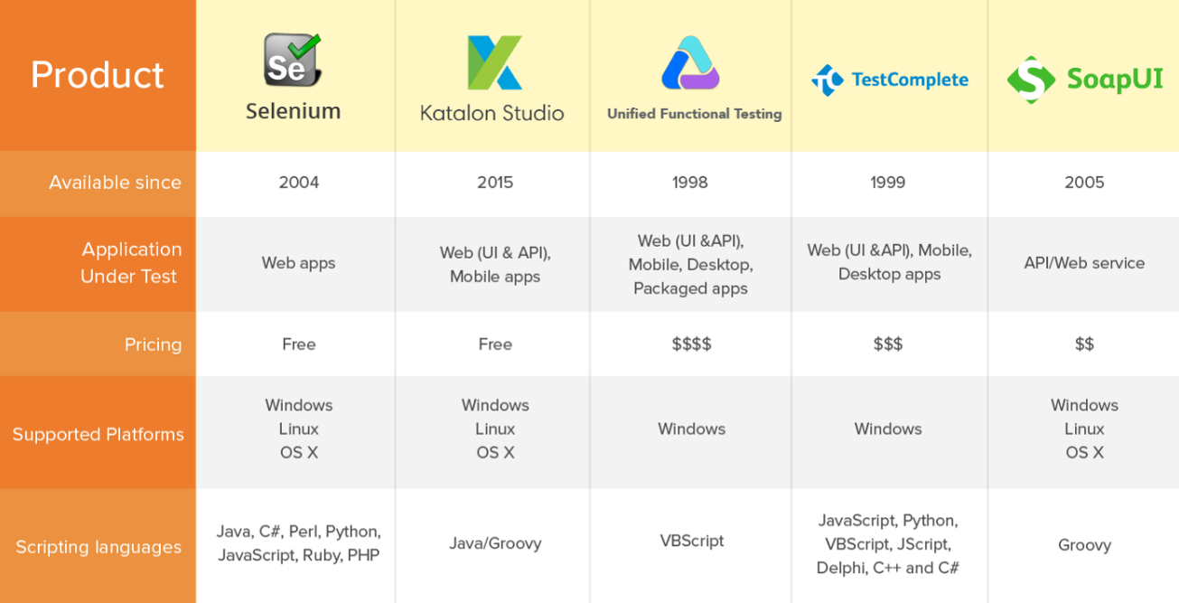
Selenium vs General Competitors
Notes:
Comparison of UI-test frameworks: https://medium.com/@briananderson2209/best-automation-testing-tools-for-2018-top-10-reviews-8a4a19f664d2
Criterias:
Supporting API and services testing
Offering some AI/ML and analytics capabilities
Popularity and maturity
More challenge info here: https://www.katalon.com/resources-center/blog/infographic-challenges-test-automation/

Slide 5
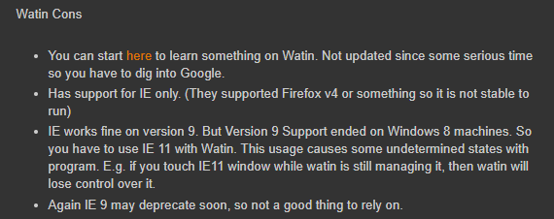
Selenium vs .NET Competitors (Watin)
Notes:
Reference: http://mehmetkurtipek.blogspot.com/2015/04/selenium-vs-watin-using-net-c.html

Slide 6
Recap: Why Selenium?
1. Best tool for UI-testing amongst others non-.NET frameworks
2. Too weak competitors in a .NET area
3. Has a good Wiki
4. Free To Use

Slide 7
Selenium’s Intro Feature List
- Automatically start selected browser
- Find and open web page by URI
- Find a DOM-element by id, class-name etc.
- Fill textboxes, press buttons etc.
- Set a smart delay for web-surfing (implicit/explicit)

Slide 8

Selenium Like A Tool For Functional Tests

Slide 9
Selenium and SACS

Slide 10
Experienced QA Developer Feedback
Pros
Good Documentation
Various Instruments
Cons
Difficulties when using non-best HTML structure
Can be accidentally thrown an “Directory not found exception”
Easy to work in general

Slide 11
Summary
- Selenium is the best free tool for UI testing on C#
- Has a lot of advantages and just small disadvantages
- Pleasant working process
- Can be successfully integrated into SACS app, considering its simple page structure

Slide 12

Questions And Discussions

