Slide 1
30 Years of video games
A data analysis of the video game industry over the last thirty years.
Ciaran Coyle & Slava Borodin

Slide 2
Outline
Introduction
Datasets & Preparation
Research Questions, Analysis and Results
Ethical Considerations
Reproducibility
Conclusion
Further work

Slide 3
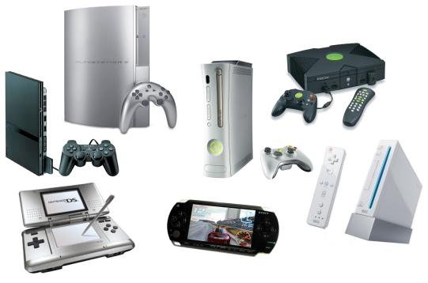
Introduction and motivations
16,000 + games that sold >100,000 copies in last 30 years
More than 27 consoles released in the last thirty years
Industry market price ~$91.5 Billion and has been growing steadily
Interesting to see how the industry has grown and changed over its lifetime

Slide 4
Research Questions
RQ1: What was the Golden year for the industry ?
RQ2: How has the industry grown over the thirty years, and what should a business do to make a profit within the gaming industry?
RQ3: What month had the highest release rate and does this correlate with overall sales and performance of a game ?
RQ4: What is the lifespan of a console?

Slide 5


Datasets
Four separate datasets, two based on videogames and two based on consoles
Both videogame datasets were sourced from Kaggle, and both console datasets were sourced from VGChartz(Video game chartz)
Video Game datasets provided us with information such as: Name, Sales, Developer, Publisher, Critic score, Genre and Release year
Console datasets provided us with information such as: Name, Year of release, Developer and Sales

Slide 6

Data Preparation
First videogame dataset: removed rows with null values, removed unnecessary columns
Second videogame dataset: Merged with part of first dataset, removed rows with null values, removed duplicate/unnecessary columns
Both console datasets: Already clean, made sure there were no null values
Saved clean datasets in pickle format

Slide 7
RQ1: Analysis and results
RQ1 - “What was the Golden year for the industry in terms of release numbers and overall sales globally and in each region” ?
Number of video games released per year

Slide 8
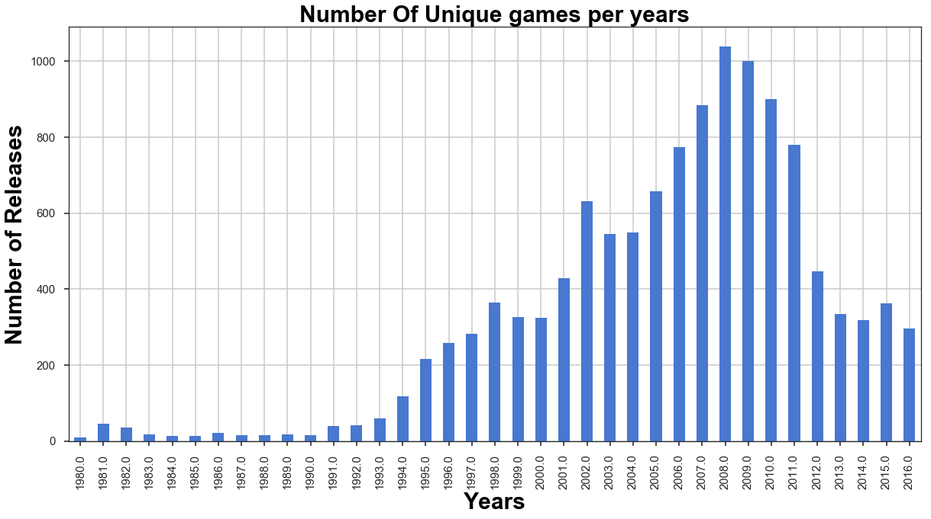

Slide 9
RQ1: Analysis and results
RQ1 - “What was the Golden year for the industry in terms of release numbers and overall sales globally and in each region” ?
Number of video games released per year
Sales By Region

Slide 10
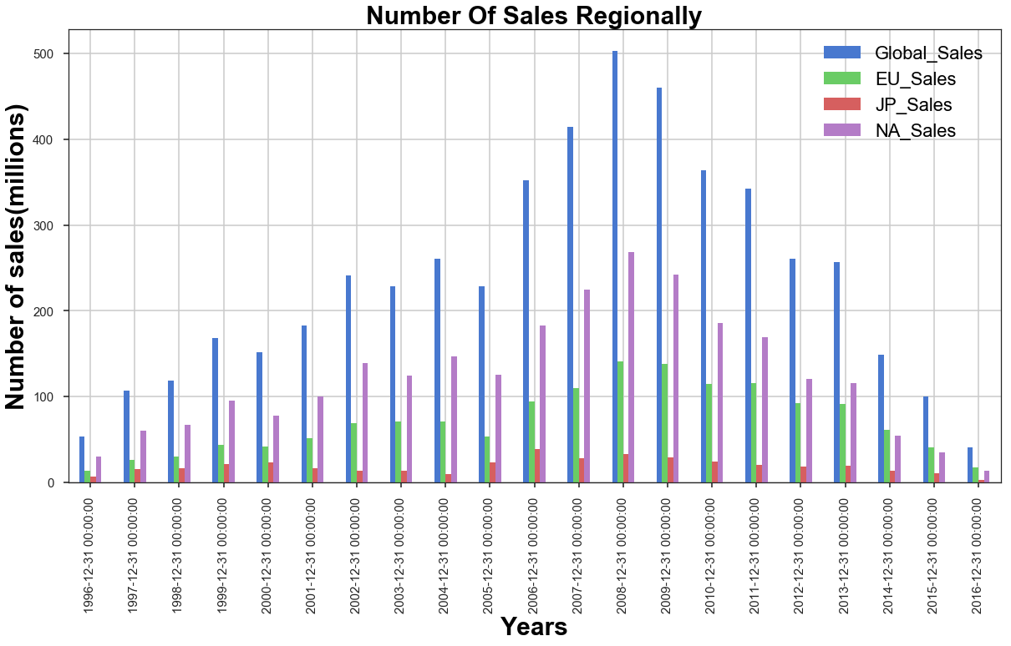

Slide 11
RQ1: Analysis and results
RQ1 - “What was the Golden year for the industry in terms of release numbers and overall sales globally and in each region” ?
Number of video games released per year
Sales By Region
Gamers golden Year

Slide 12
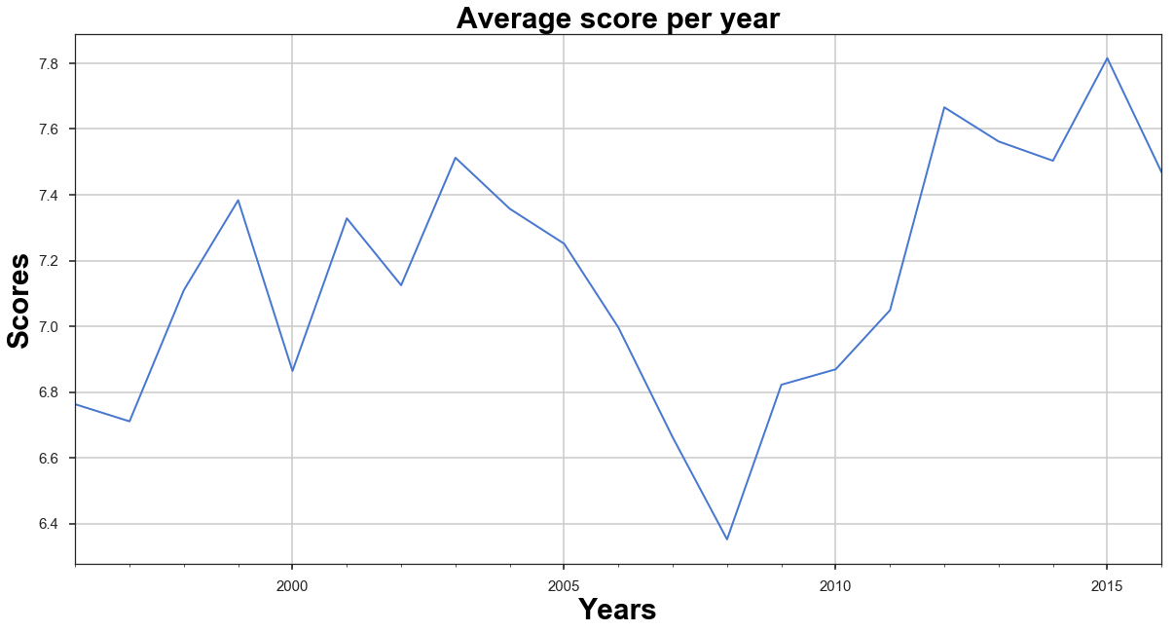
2015
2008

Slide 13
RQ1: Analysis and results
RQ1 - “What was the Golden year for the industry in terms of release numbers and overall sales globally and in each region” ?
Number of video games released per year
Sales By Region
Gamers golden Year
Top 5 Sold Genres

Slide 14
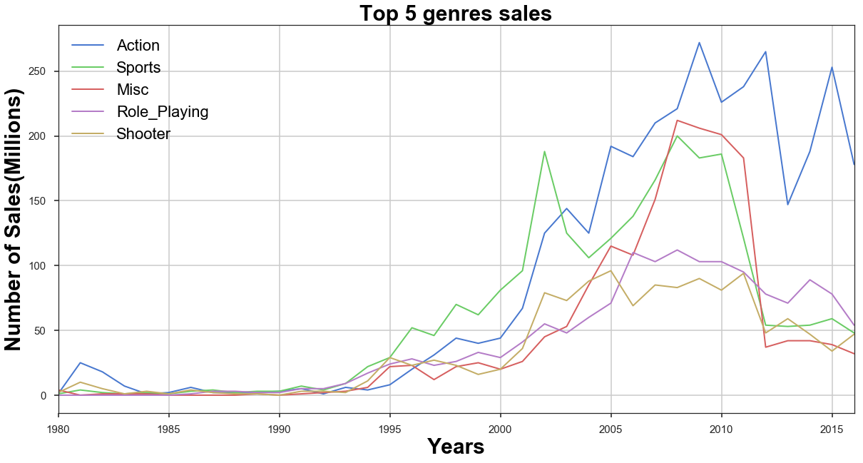

Slide 15
RQ2: Analysis and results
RQ2: How has the industry grown over the thirty years, and what should a business do to make a profit within the gaming industry
Used first video game dataset and console dataset that contained info on consoles over the last thirty years.
Created yearly data from the datasets in terms of games sales and counts

Slide 16
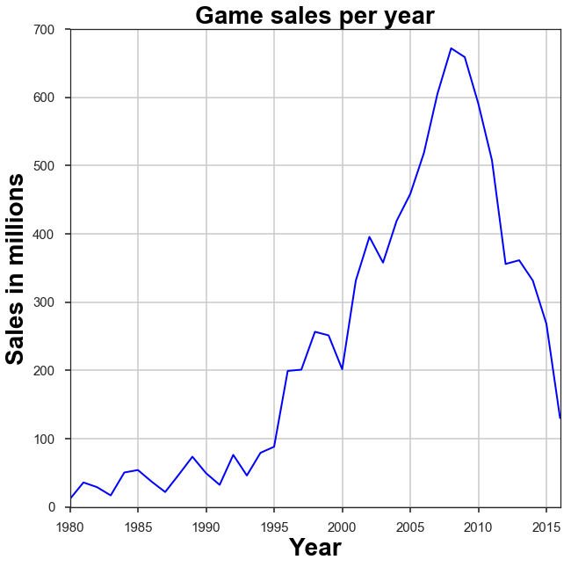
Sales quite volatile between 1980 and 1995
From 1995, grew rapidly with only a few bumps
In 2008 Sales plummeted with only a slight increase in 2012
Yet the market value continues to increase, Why?

Slide 17
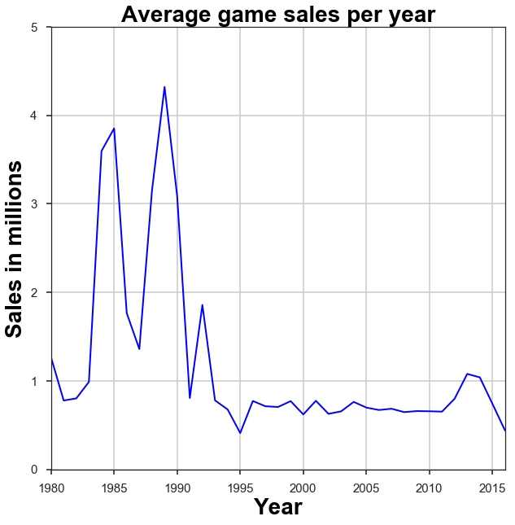
Average sales volatile from 1980 until 1996
Stayed level until 2011
Substantial growth up until 2014
Companies making more profit per game

Slide 18
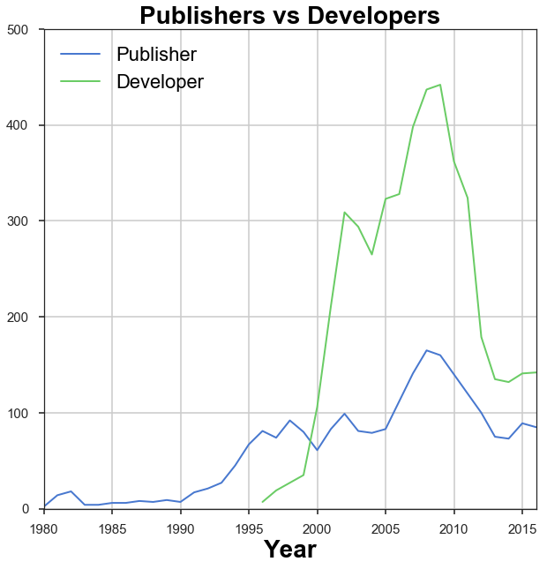
From 1990 there has been a large increase in companies within the industry
Large drop after financial crash, especially with developers
Started to increase again, showing more growth
Where to go from here?

Slide 19
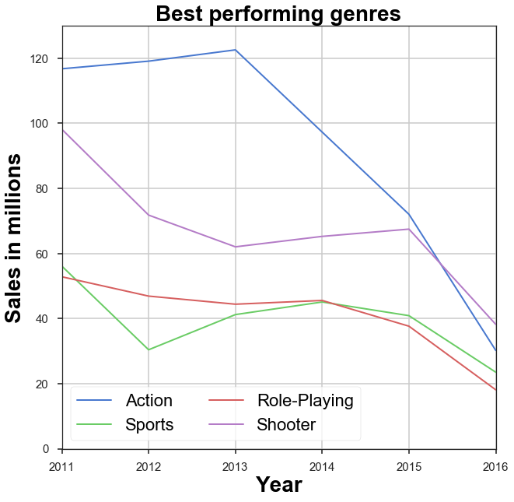
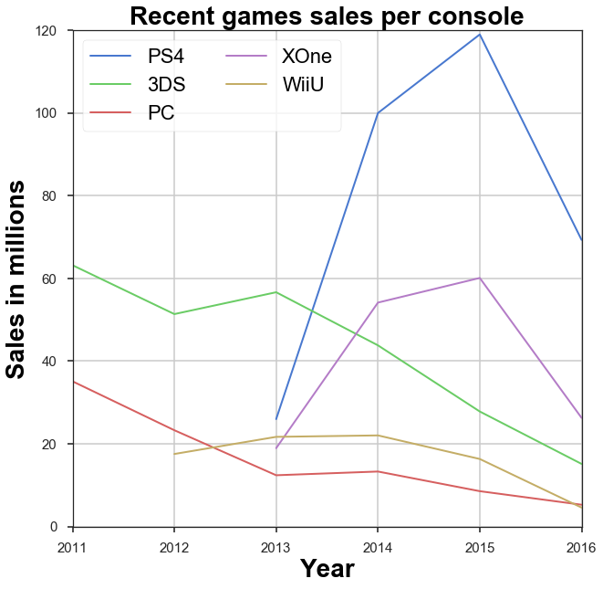

Slide 20
RQ3: Analysis and results
RQ3 - “What month had the highest release rate and does this correlate with overall sales and performance of a game”
Highest release month

Slide 21
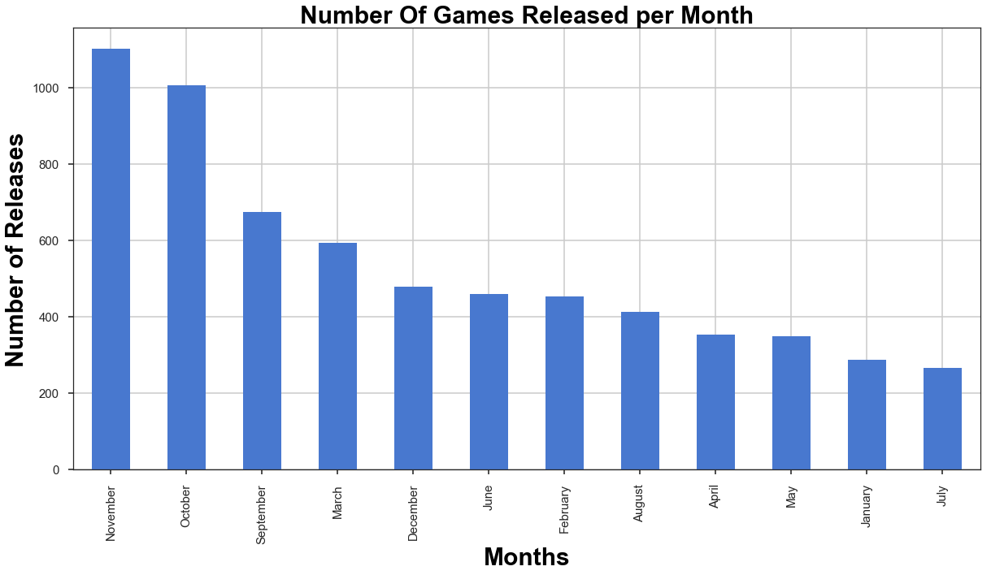

Slide 22
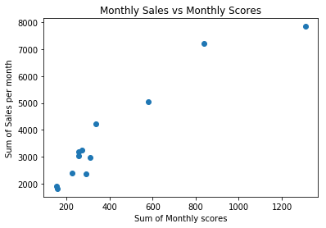
RQ3: Analysis and results
RQ3 - “What month had the highest release rate and does this correlate with overall sales and performance of a game”
Monthly Sales overall
Monthly sales vs monthly scores
corr = 0.95

Slide 23
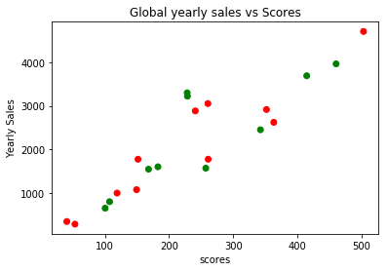
RQ3: Analysis and results
RQ3 - “What month had the highest release rate and does this correlate with overall sales and performance of a game”
Monthly Sales overall
Monthly sales vs monthly scores
Yearly sales vs yearly scores
corr = 0.89

Slide 24
RQ3: Analysis and results
RQ3 - “What month had the highest release rate and does this correlate with overall sales and performance of a game”
Monthly Sales overall
Monthly sales vs monthly scores
Yearly sales vs yearly scores
Monthly sales for top 5 genres

Slide 25
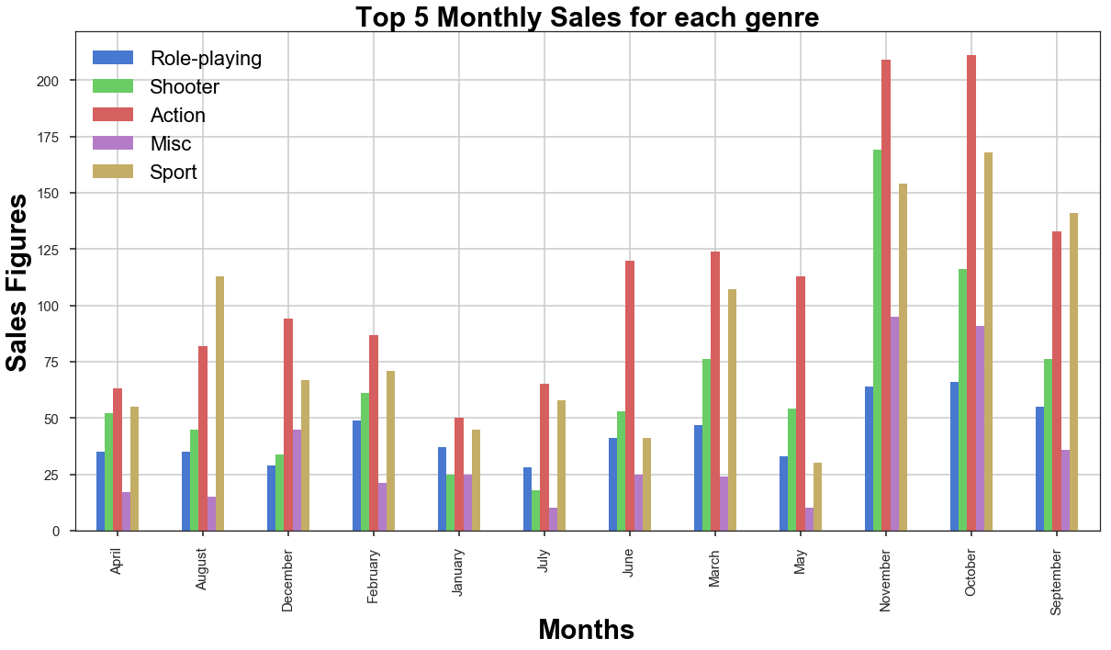

Slide 26
RQ3: Analysis and results
RQ3 - “What month had the highest release rate and does this correlate with overall sales and performance of a game”
Monthly Sales overall
Monthly sales vs monthly scores
Yearly sales vs yearly scores
Monthly sales for top 5 genres
Games per month vs monthly releases

Slide 27
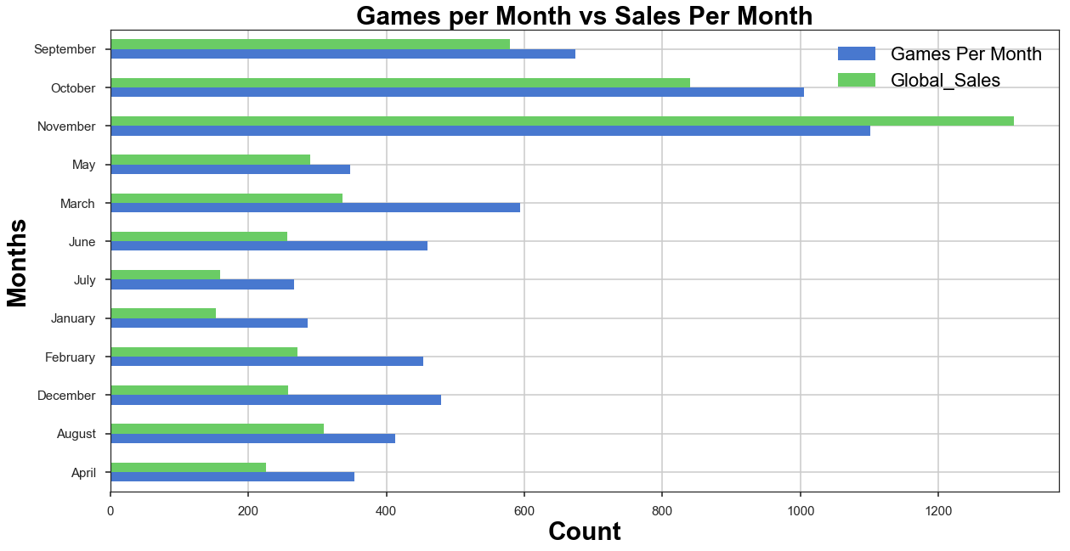

Slide 28




RQ4: Analysis and results
RQ4: What is the lifespan of a console?
Used both console datasets and the first video game dataset.
Created yearly sales and counts figures from the three datasets.

Slide 29
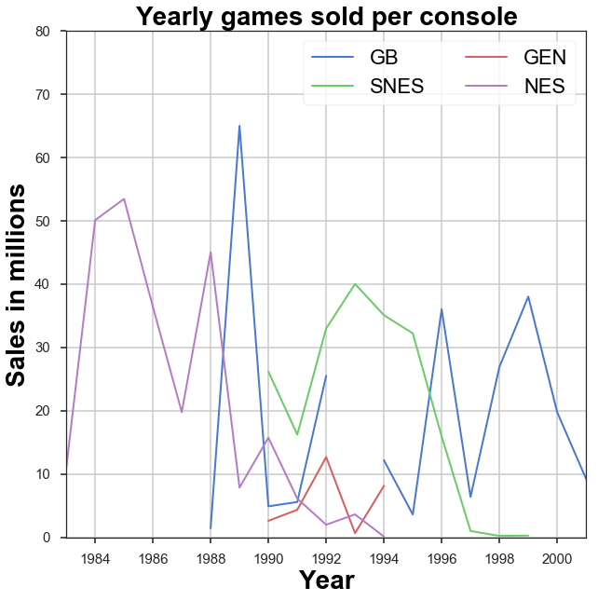
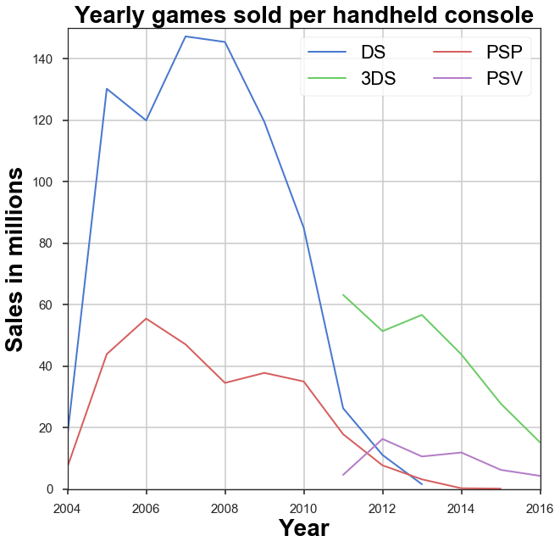

Slide 30
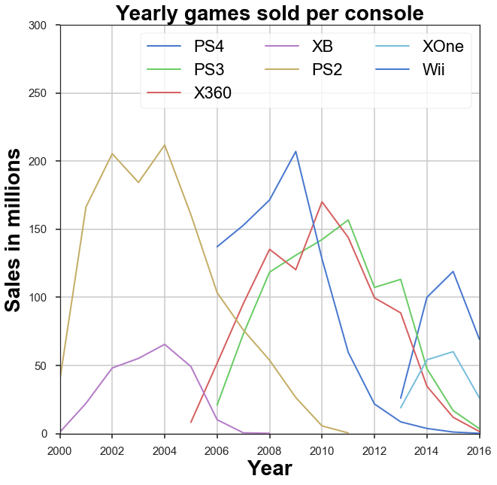
Unable to predict the normal lifespan of a console
Some consoles have larger lifespans
Lately console lifespan from separate companies are equal due to competition
Newer consoles normally reach their peak in the fourth year

Slide 31
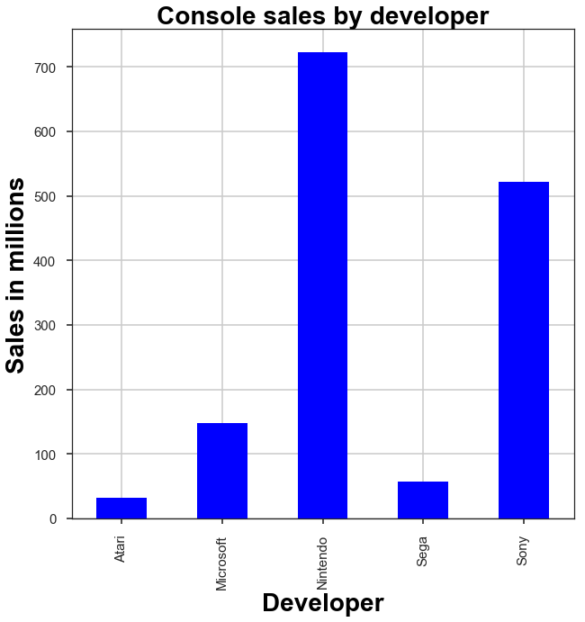
Nintendo have sold the most consoles over the thirty years
Sony tends to have the best selling consoles, apart from last gen where they were equal with microsoft
Nintendo release more console, and have been making consoles longer, thus having more sales

Slide 32
Ethical Considerations
Data was sourced from public resources and is open to public use
All information contained in the datasets are a matter of public record and is easily accessible on various websites
No ethical issues due to data being public and non sensitive information

Slide 33
Reproducibility
Both the data and python notebooks are available in the github repo
https://github.com/ciarantc/Data-SciInPractice
Markdown cells in all notebooks give clear reasoning as to what we are doing and why
Used jupyterlab Version 0.31.5 and jupyter notebook version 5.0.0

Slide 34
Conclusions
2008 best for industry, 2015 best for gamer
November best month to release a game
Sales growth until 2008, companies no longer relying on sales
Nintendo and Sony biggest console developers

Slide 35
Future work
Get more up to date data along with data on DLC and merchandise sales to see why the market price is increasing.
Look into ESports and how it is helping the industry grow
Look at how a series of games performs compared to a standalone game
See if multiplayer games sell more than single player or if a combination of the two is the best

Slide 36

Q & A

