Slide 1
30 Years of Video Games
A data analysis of the global growth of the video game
industry
Ciaran Coyle & Slava Borodin

Slide 2
Summary Aims and Objectives
To generate a dataset containing the relevant information needed for video games and consoles released over the last thirty years
To analyse the performance and growth of the video game industry over the last thirty years
Analyse video game and console trends and the popularity

Slide 3

Video Games
16,000 + games released in the last thirty years
27 consoles released in the last thirty years
Industry market price ~$91.5 Billion
100’s video games released annually
Unique data for last 30 years

Slide 4
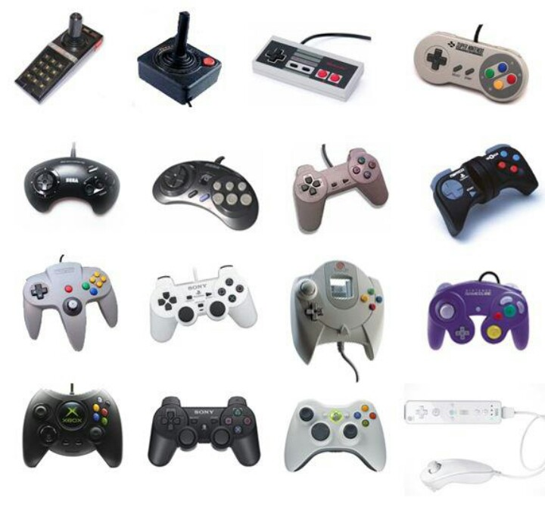
Improved Technology
Technology has improved over the years meaning that the following have improved :
Quality & Graphics
Console features i.e (multiplayer, interaction)
Realistic character design
New and improved versions of consoles
As technology improves so do video games and consoles

Slide 5
Existing Research
Current research has mainly been focussed only on analysis of games released in recent years, and not much on consoles or older games.
Research is limited and not in depth.
It mainly looks at sales numbers and review scores, without going in depth into the trends and performance

Slide 6

Primary Research Questions
We are going to split our research questions into three categories
1) - Industry
2) - Games
3) - Consoles

Slide 7
Industry
RQ1 : What was the golden year for the industry in terms of release numbers and overall sales, both globally and in the seperate regions.
RQ2: How well did the developers and publishers perform over the last thirty years in terms of releases and sales, both globally and in the seperate regions.

Slide 8


Game
RQ3: How well did a game perform
individually
in a series, if in one, where does a series normally peak
RQ4: What month has the highest release rate and does this correlate with overall sales and performance of a game ?

Slide 9

Console
RQ5: Are there visible shifts from one console to another over the thirty years.
RQ6: Which console and developer performed best in the seperate regions and overall

Slide 10
Ethical Considerations
Since our data is sourced from kaggle and is public knowledge across various other websites there are no large ethical considerations to take into account bar one thing
To ensure that the obtained datasets are ok for public use and analysis.

Slide 11
Data Collection
Sourced two datasets on video games from kaggle and two datasets on consoles from VG Chartz
Datasets from kaggle provides us with game titles, platform , year of release, sales across different regions, critic scores
Datasets from VG Chartz provide us with console release date, sales by region, individual sales(2006 - 2017) and developer

Slide 12

Focus on different datasets such as sales and performance across certain regions.
Dataset provides us with critic score, sales and overall performance.
Allows us to explore questions on sales and performance

Slide 13
Resulting Dataset
Data covers over thirty years of the video game industry
Over 16,000 games, which have sales of more than 100,000 copies
27 consoles
name, sales, sales split into region, developer, publisher, review score, platform

Slide 14
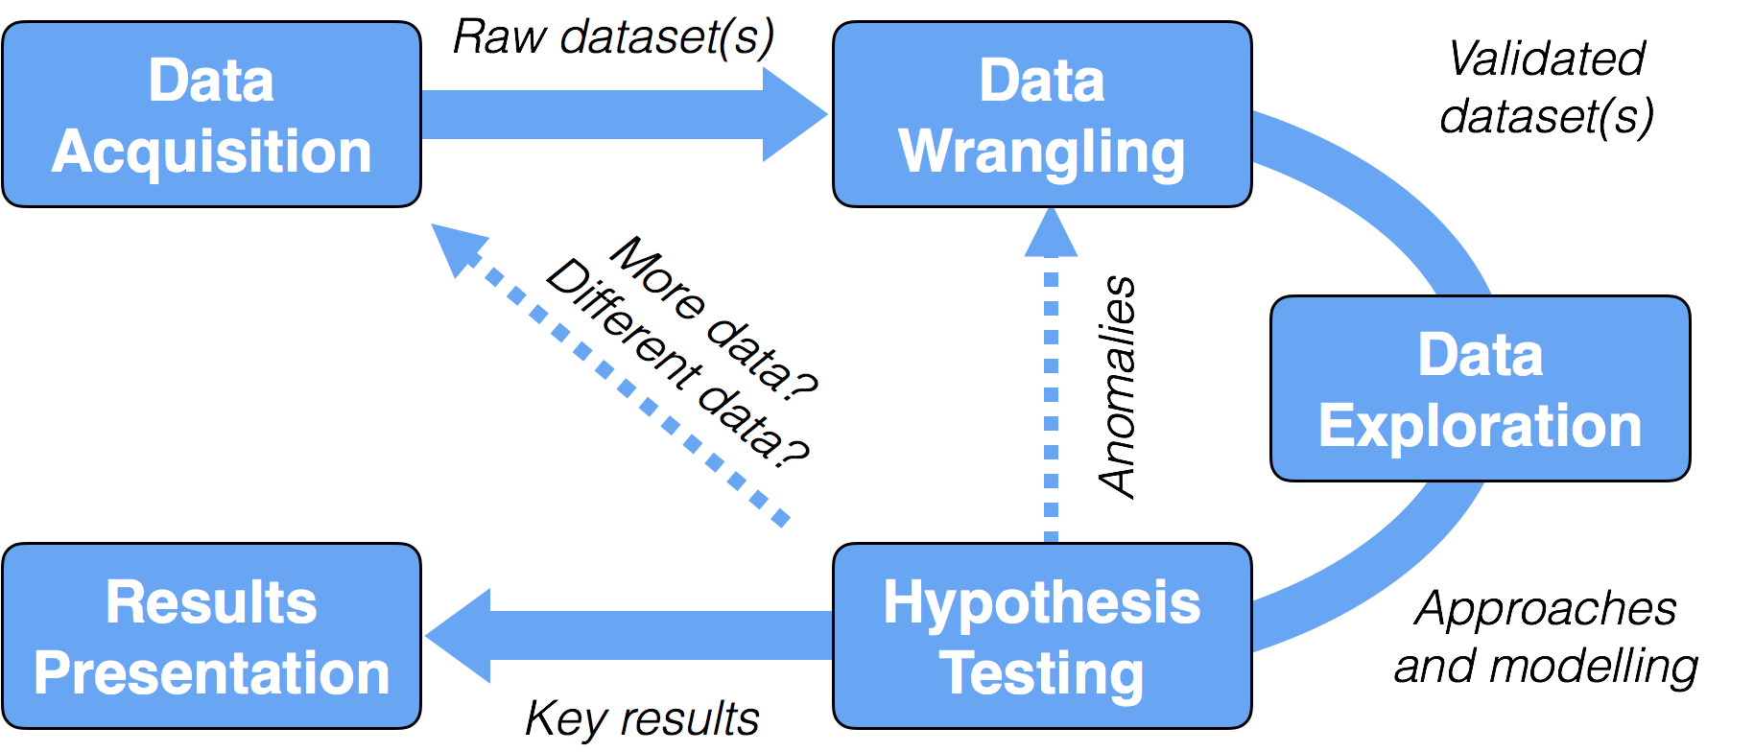
Summary Approach

Slide 15
Processing Stages
Data Wrangling/Cleaning
Merge datasets for analysis, remove unnecessary columns, find missing values
Exploratory Analysis
Get totals for games made by publisher, developer, in a series, and for each console
Get averages such as sales in a series, sales for a genre etc.
Results
Prepare a variety of plots to demonstrate answers to core research questions.

