Slide 1

МУИВ
science
Ручной запуск
Сервера ComfyUI
Reporter: Шебанов В.В

Slide 2

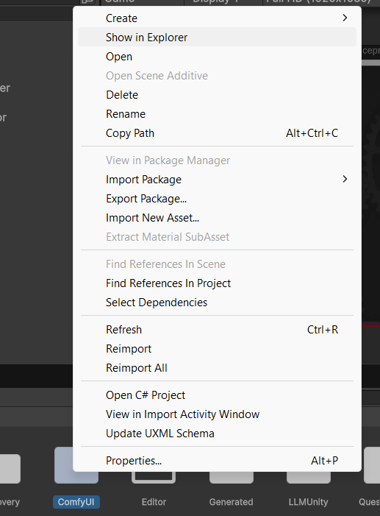
Шаг 1
05
Открыть в проводнике папку ComfyUI

Slide 3

01
VSCode
Add a short description

Slide 4
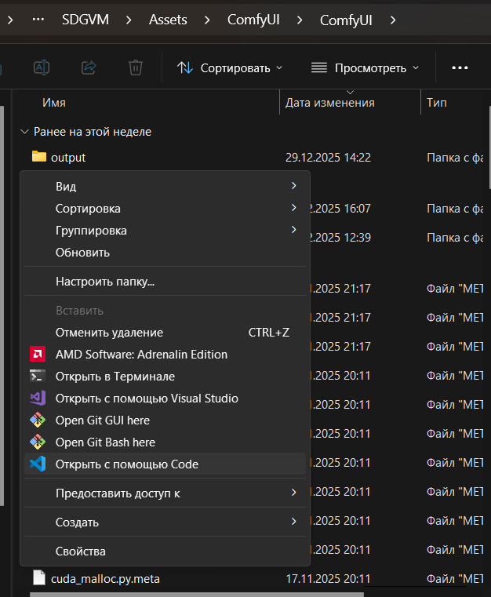
Окрыть в VS CODE
Путь: C:\Diplom_Shebanov_2026\SDGVM\Assets\ComfyUI\ComfyUI

Slide 5





YOUR TITLE HERE
Your Title Here
Presentations are communication tools.
Presentations are communication tools that can be used as demonstrations.
Presentations are communication tools.
Presentations are communication tools.
Presentations are communication tools.

Slide 6
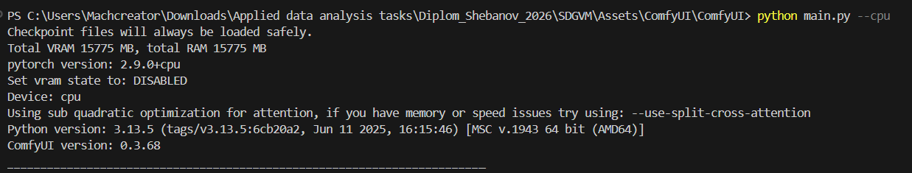

Запуск через терминал
python main.py --cpu

Slide 7
МУИВ
03
Инструкция
Окончена
Reporter: Шебанов В.В

