Slide 1
Slaviša Đurđić
Microsoft annual report for year 2022
Goal: Analysis of the Microsoft annual report for period 2020-2022.
Instructions:
- Download the 2022 PDF report from the company’s site: https://www.microsoft.com/investor/reports/ar22/download-center/index.html.
- Refer the income statement on (numerated) page 47 of the report.
- Connect to the report from Tableau and clean the data.
- Build visuals in Tableau (https://public.tableau.com/app/profile/slavisadurdic/viz/MicrosoftPLStatement-PDFannualreport/PLDashboard).
Belgrade, September 2023

Slide 2

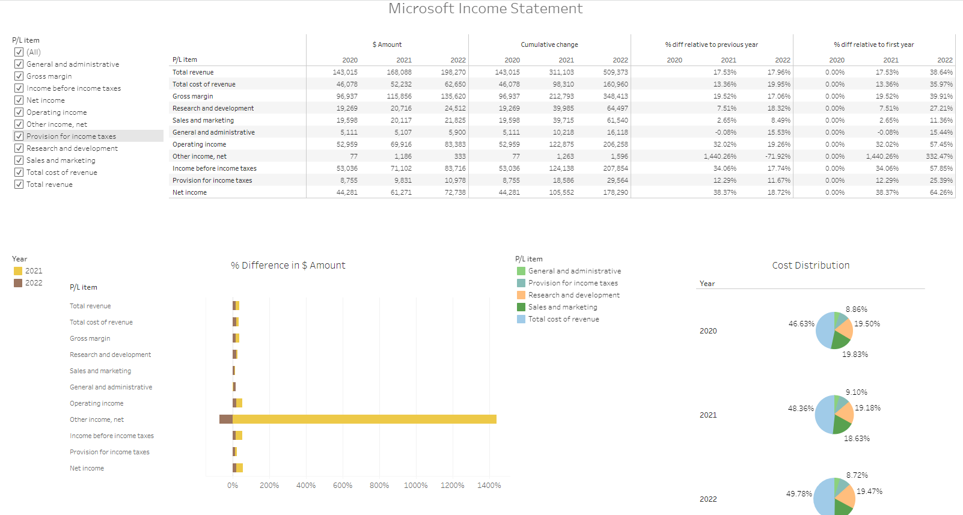

Slide 3

MSFT Annual Report Project Insights
2Y growth rate of total revenue was 38.64% for the period 2020-2022 (~17.5-18 YoY % change).
On the other hand, 2Y growth rate of net income was 64.26% for the period 2020-2022.
Research and development makes ~1/5 of total costs.

