Slide 1
Slaviša Đurđić
Belgrade Weather Data
Goal: Analysis of the Belgrade weather 3-day forecast data.
Instructions:
- Get data via API from: https://www.7timer.info/.
- Save data in .json format.
- Connect to the JSON file from Tableau.
- Build visuals in Tableau (https://public.tableau.com/app/profile/slavisadurdic/viz/BelgradeWeatherData/BelgradeWeatherData).
Belgrade, November 2023

Slide 2

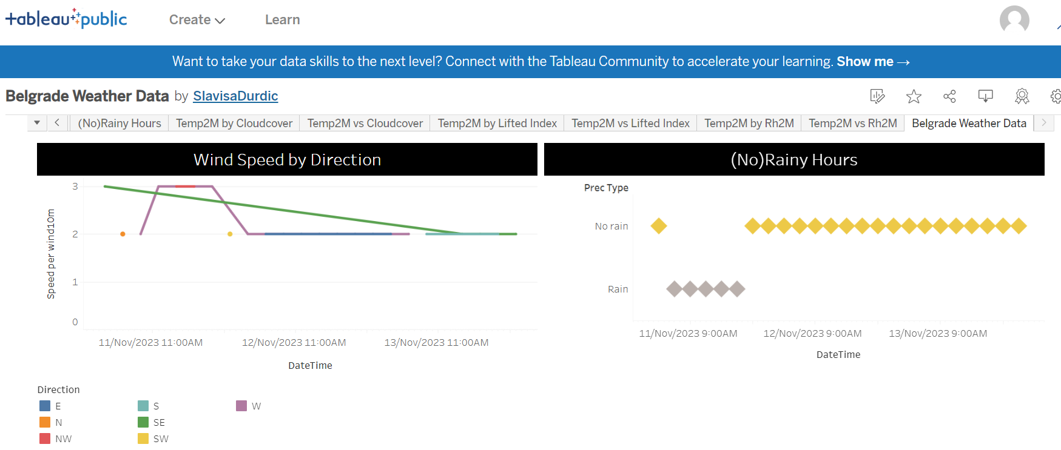

Slide 3
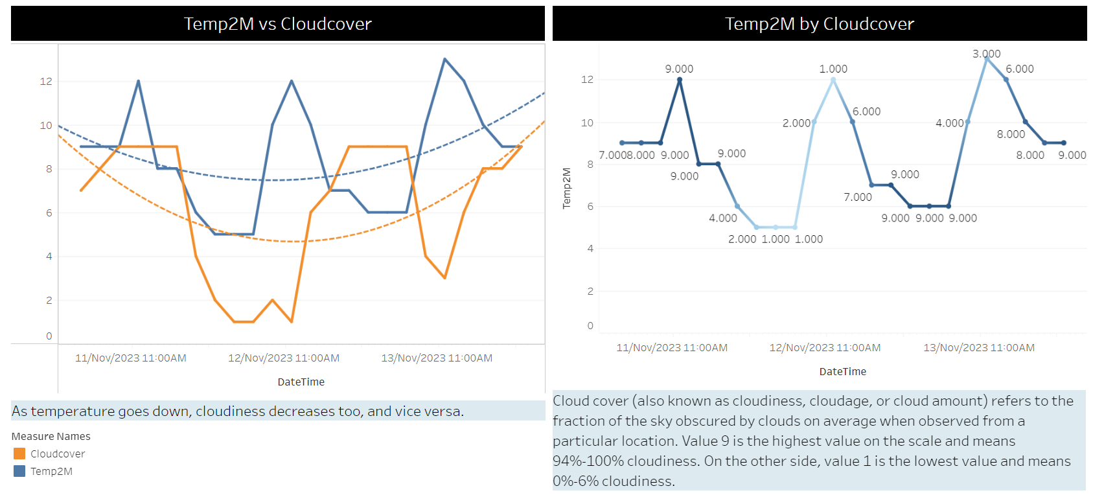

Slide 4
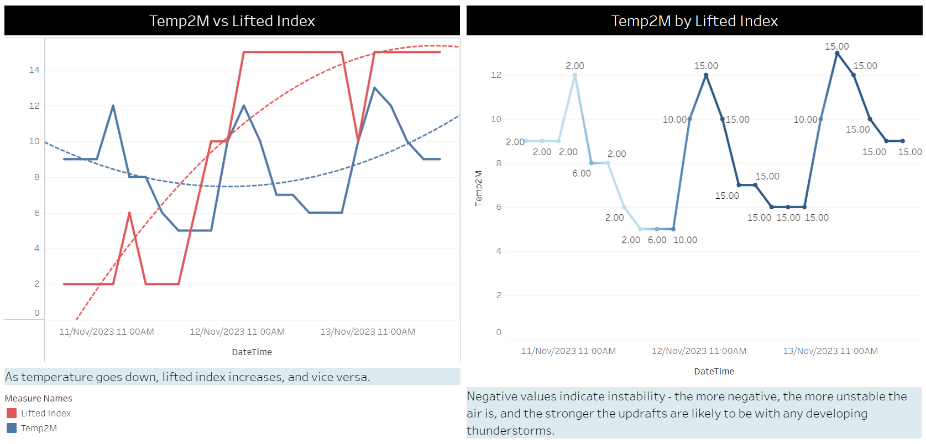

Slide 5
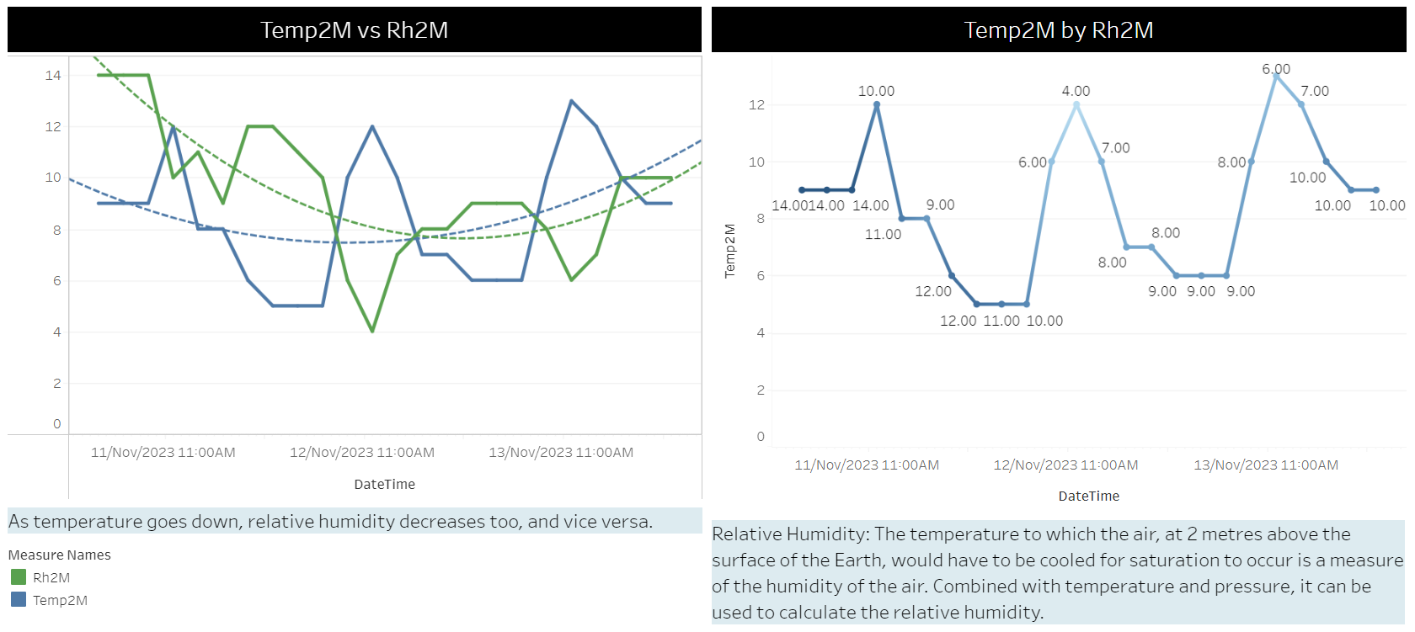

Slide 6

Belgrade Weather Project Insights
As temperature goes down, cloudiness decreases too, and vice versa.
As temperature goes down, lifted index increases, and vice versa.
As temperature goes down, relative humidity decreases too, and vice versa.

