Slide 1

Efficient MPC control of a robot leg
Kovalev V.V.

Slide 2
Content:
Physical model
Naive MPC control
MPC speed up
Results

Slide 3
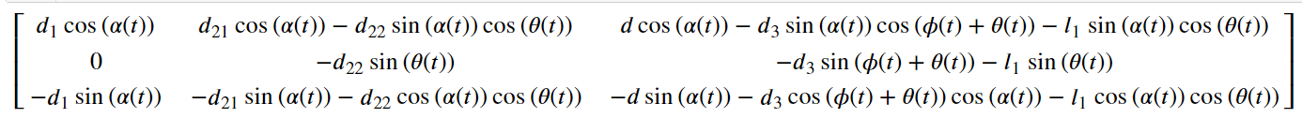
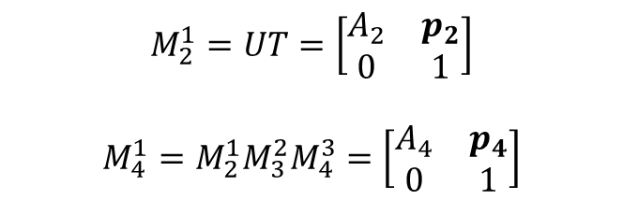
Physical model
$$M_{2}^{1}=UT=\left[\begin{matrix}A_{2} & p_{2} \\ 0 & 1\end{matrix}\right]$$
$$M_{4}^{1}=M_{2}^{1}M_{3}^{2}M_{4}^{3}=\left[\begin{matrix}A_{4} & p_{4} \\ 0 & 1\end{matrix}\right]$$
$$P=\left[p_{1},p_{2},p_{3}\right]=$$

Slide 4
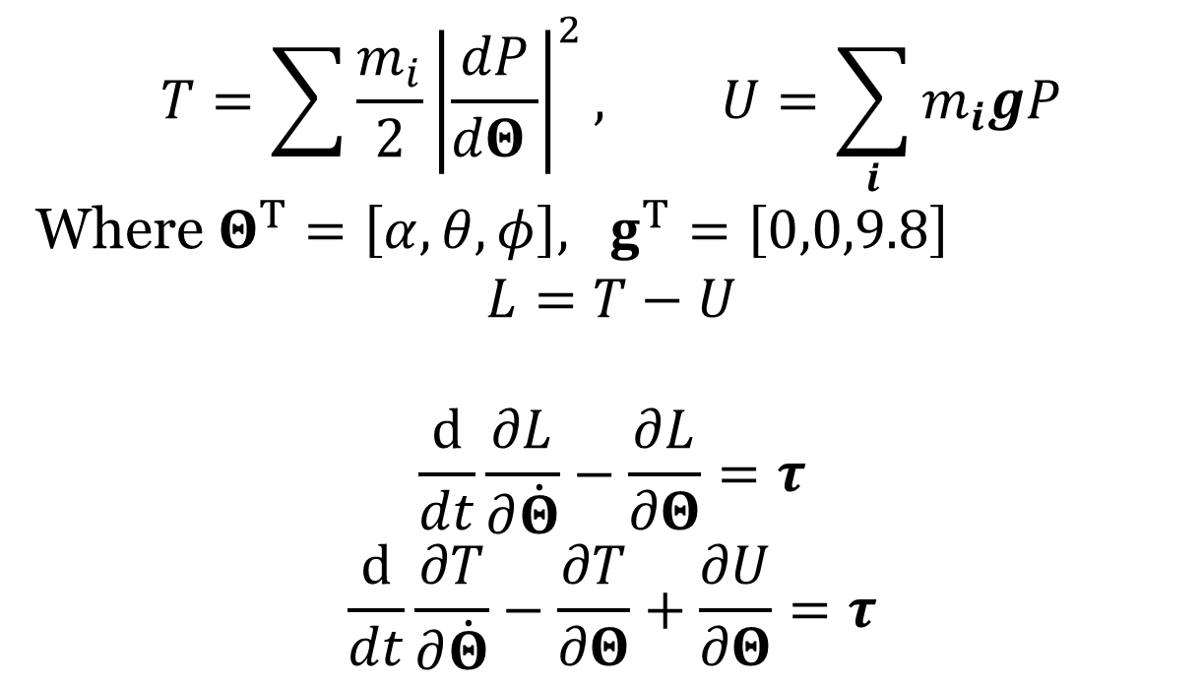
Physical model
$$T=\sum{\frac{m_{i}}{2}{\left|\frac{dP}{dΘ }\right|}^{2}}, U=\sum_{i}{m_{i}gP}$$
Where $Θ^{T}=\left[α,θ,φ\right], g^{T}=\left[0,0,9.8\right]$
$$L=T−U$$
$$\frac{d}{dt}\frac{∂L}{∂\dot{Θ}}−\frac{∂L}{∂Θ}=τ$$
$$\frac{d}{dt}\frac{∂T}{∂\dot{Θ}}−\frac{∂T}{∂Θ}+\frac{∂U}{∂Θ}=τ$$

Slide 5
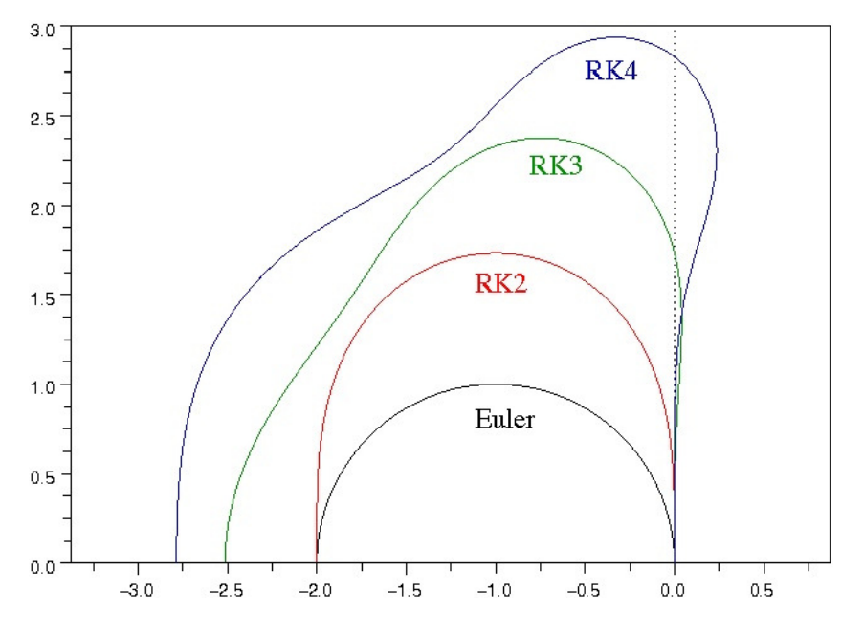
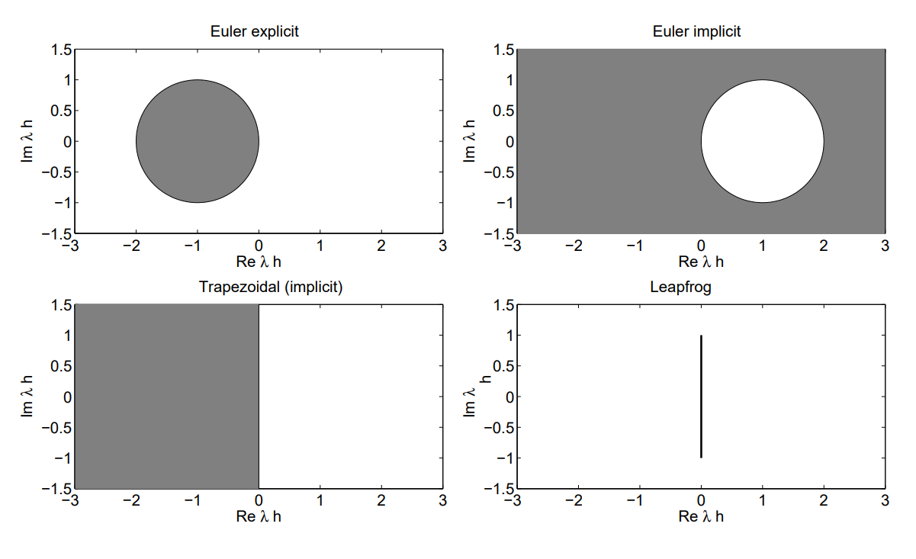
Naïve MPC controller
Integrator choice

Slide 6
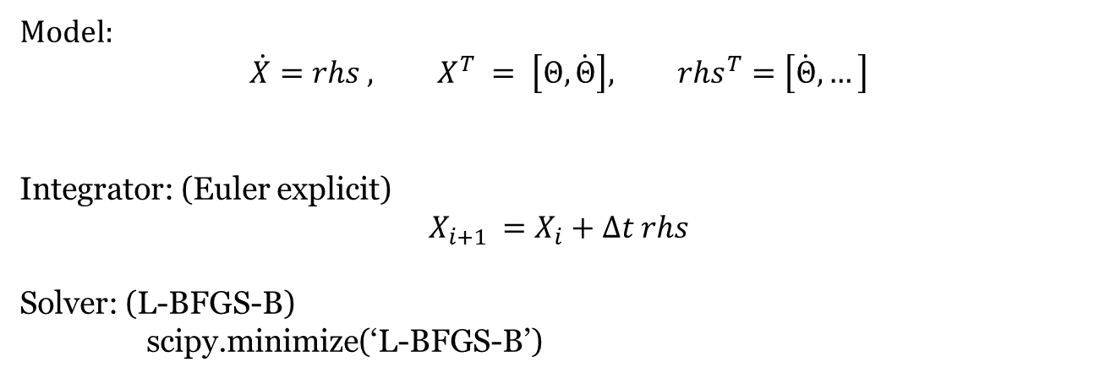
Naïve MPC controller
Model:
$$\dot{X}=rhs , X^{T} = \left[Θ,\dot{Θ}\right], rhs^{T}=\left[\dot{Θ}, …\right]$$
Integrator: (Euler explicit)
$$X_{i+1 }=X_{i}+∆t rhs$$
Solver: (L-BFGS-B)
scipy.minimize(‘L-BFGS-B’)

Slide 7



MPC speed up
$$a=sin\left(x^{2}\right)+x^{2}$$
$$a=…$$
$$a=…$$
+
+
sin
sin
^2
^2
^2
X
X
X

Slide 8

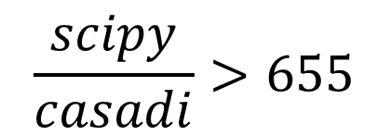
MPC speed up
+
+
scipy.minimize(‘L-BFGS-B’)
Casadi.opti.minimize(‘ipopt’,J,H)
+
$$\frac{scipy}{casadi}>655$$
JIT

Slide 9
Results
Achievable task + noize:

Slide 10
Results
Unachievable task (boundary constraints):

Slide 11
Results
Unachievable task (boundary constraints):

Slide 12
Results
Unachievable task (boundary constraints):

Slide 13
Results
Unachievable task (boundary constraints):

Slide 14
Results
Unachievable task (boundary constraints):

Slide 15
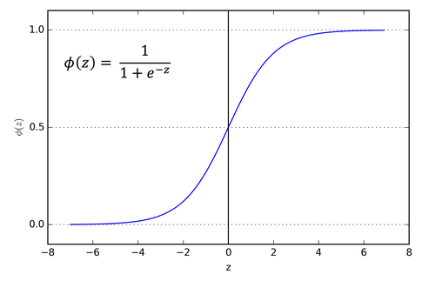
Results
Achievable task (collision constraints):

Slide 16
Results
Unachievable task (collision constraints):

Slide 17
Next step

