Slide 1
Efficient MPC control of the robot leg
Kovalev V.V.

Slide 2
Content:
Physical model
Naive MPC controller
MPC speed up
Results

Slide 3
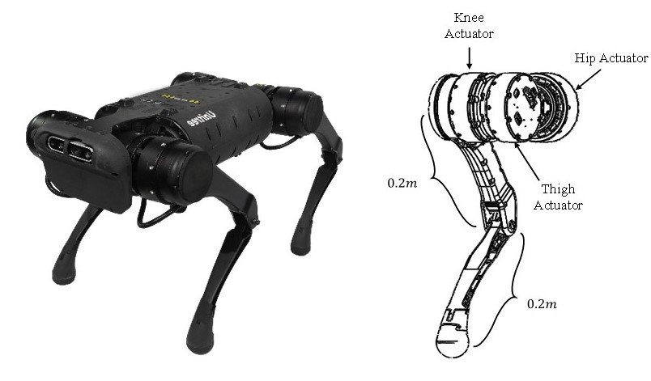
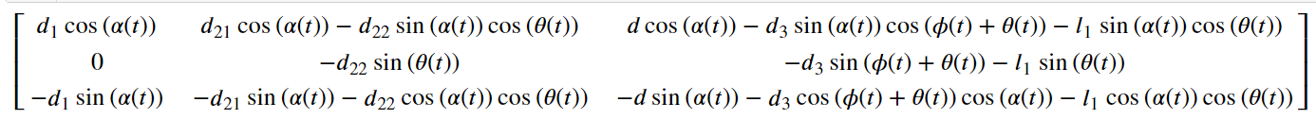
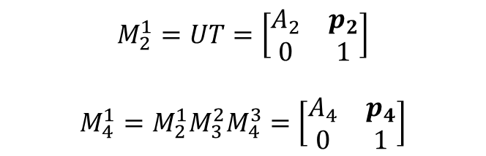
Physical model
$$M_{2}^{1}=UT=\left[\begin{matrix}A_{2} & p_{2} \\ 0 & 1\end{matrix}\right]$$
$$M_{4}^{1}=M_{2}^{1}M_{3}^{2}M_{4}^{3}=\left[\begin{matrix}A_{4} & p_{4} \\ 0 & 1\end{matrix}\right]$$
$$P=\left[p_{1},p_{2},p_{3}\right]=$$

Slide 4
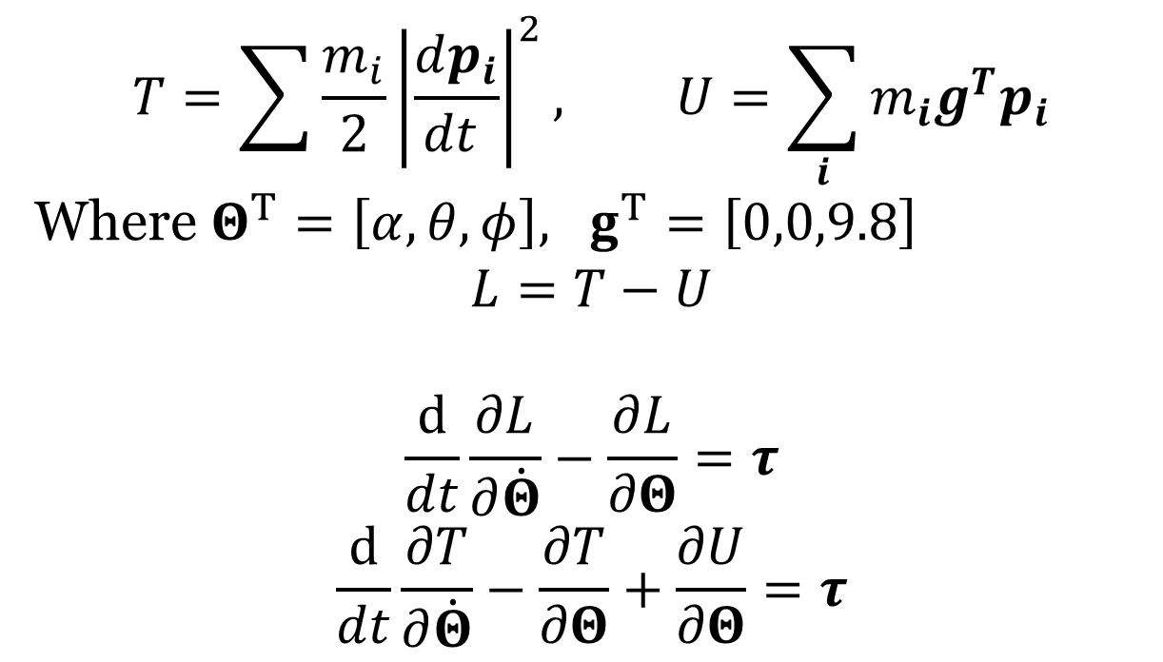
Physical model
$$T=\sum{\frac{m_{i}}{2}{\left|\frac{dp_{i}}{dt }\right|}^{2}}, U=\sum_{i}{m_{i}g^{T}p_{i}}$$
Where $Θ^{T}=\left[α,θ,φ\right], g^{T}=\left[0,0,9.8\right]$
$$L=T−U$$
$$\frac{d}{dt}\frac{∂L}{∂\dot{Θ}}−\frac{∂L}{∂Θ}=τ$$
$$\frac{d}{dt}\frac{∂T}{∂\dot{Θ}}−\frac{∂T}{∂Θ}+\frac{∂U}{∂Θ}=τ$$

Slide 5
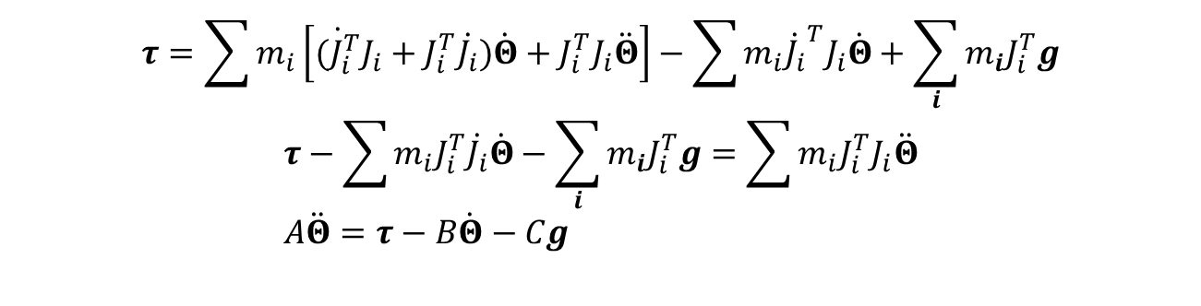
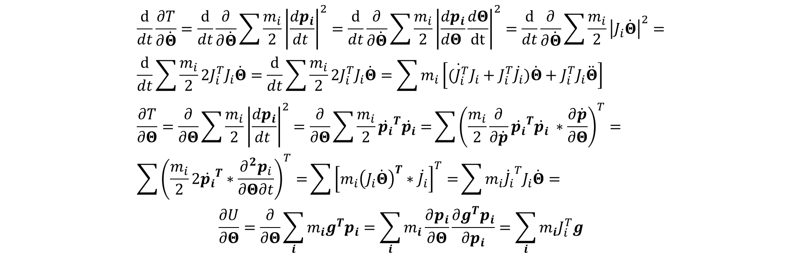
Physical model
$$\frac{d}{dt}\frac{∂T}{∂\dot{Θ}}=\frac{d}{dt}\frac{∂}{∂\dot{Θ}}\sum{\frac{m_{i}}{2}{\left|\frac{dp_{i}}{dt }\right|}^{2}}=\frac{d}{dt}\frac{∂}{∂\dot{Θ}}\sum{\frac{m_{i}}{2}{\left|\frac{dp_{i}}{dΘ }\frac{dΘ}{dt}\right|}^{2}}=\frac{d}{dt}\frac{∂}{∂\dot{Θ}}\sum{\frac{m_{i}}{2}{\left|J_{i}\dot{Θ}\right|}^{2}}= \\ \frac{d}{dt}\sum{\frac{m_{i}}{2}2J_{i}^{T}J_{i}\dot{Θ}}=\frac{d}{dt}\sum{\frac{m_{i}}{2}2J_{i}^{T}J_{i}\dot{Θ}}=\sum{m_{i}\left[\dot{(J_{i}^{T}}J_{i}+J_{i}^{T}\dot{J_{i}})\dot{Θ}+J_{i}^{T}J_{i}\ddot{Θ}\right]} \\ \frac{∂T}{∂Θ}=\frac{∂}{∂Θ}\sum{\frac{m_{i}}{2}{\left|\frac{dp_{i}}{dt }\right|}^{2}}=\frac{∂}{∂Θ}\sum{\frac{m_{i}}{2}{\dot{p_{i}}}^{T}\dot{p_{i}}=}\sum{{\left(\frac{m_{i}}{2}\frac{∂}{∂\dot{p}}{\dot{p_{i}}}^{T}\dot{p_{i}} ∗\frac{∂\dot{p}}{∂Θ}\right)}^{T}=} \\ \sum{{\left(\frac{m_{i}}{2}{2\dot{p_{i}}}^{T}∗\frac{{∂^{2}p}_{i}}{∂Θ∂t}\right)}^{T}=}\sum{{\left[m_{i}{\left(J_{i}\dot{Θ}\right)}^{T}∗\dot{J_{i}}\right]}^{T}=}\sum{m_{i}{{\dot{J}}_{i}}^{T}J_{i}\dot{Θ}}=$$
$$\frac{∂U}{∂Θ}=\frac{∂}{∂Θ}\sum_{i}{m_{i}g^{T}p_{i}}=\sum_{i}{m_{i}\frac{∂p_{i}}{∂Θ}\frac{∂g^{T}p_{i}}{∂p_{i}}}=\sum_{i}{m_{i}J_{i}^{T}g}$$
$$τ=\sum{m_{i}\left[\dot{(J_{i}^{T}}J_{i}+J_{i}^{T}\dot{J_{i}})\dot{Θ}+J_{i}^{T}J_{i}\ddot{Θ}\right]}−\sum{m_{i}{{\dot{J}}_{i}}^{T}J_{i}\dot{Θ}}+\sum_{i}{m_{i}J_{i}^{T}g}$$
$$τ−\sum{m_{i}J_{i}^{T}\dot{J_{i}}\dot{Θ}}−\sum_{i}{m_{i}J_{i}^{T}g}=\sum{m_{i}J_{i}^{T}J_{i}\ddot{Θ}} \\ A\ddot{Θ}=τ−B\dot{Θ}−Cg$$

Slide 6

Physical model
$$\ddot{Θ}=A^{−1}\left(τ−B\dot{Θ}−Cg\right)$$
$$\dot{X}=rhs , X^{T} = \left[Θ,\dot{Θ}\right], rhs^{T}=\left[\dot{Θ},A^{−1}\left(τ−B\dot{Θ}−Cg\right)\right]$$

Slide 7
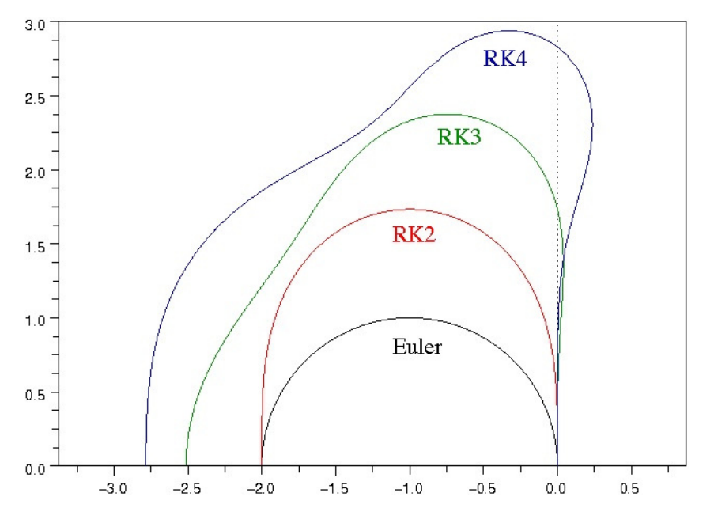
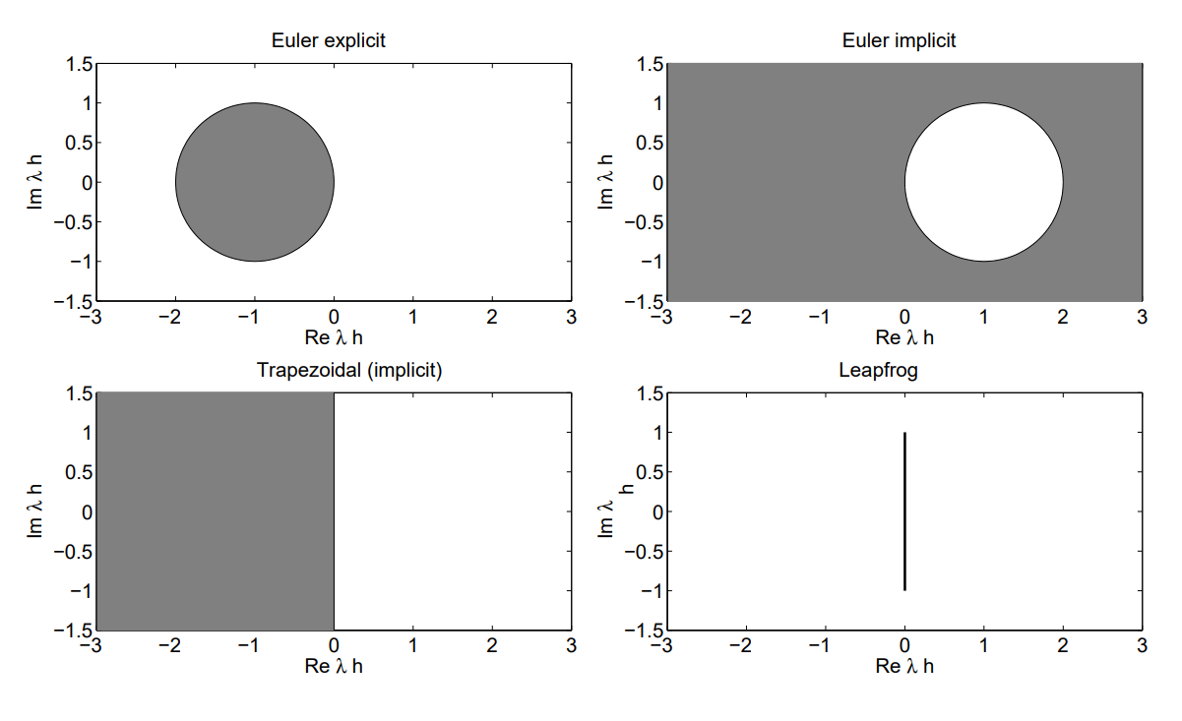
Naïve MPC controller
Integrator choice

Slide 8
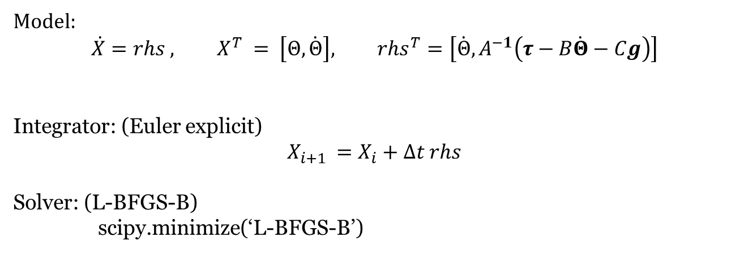
Naïve MPC controller
Model:
$$\dot{X}=rhs , X^{T} = \left[Θ,\dot{Θ}\right], rhs^{T}=\left[\dot{Θ},A^{−1}\left(τ−B\dot{Θ}−Cg\right)\right]$$
Integrator: (Euler explicit)
$$X_{i+1 }=X_{i}+∆t rhs$$
Solver: (L-BFGS-B)
scipy.minimize(‘L-BFGS-B’)

Slide 9



MPC speed up
$$a=sin\left(x^{2}\right)+x^{2}$$
$$a=…$$
$$a=…$$
+
+
sin
sin
^2
^2
^2
X
X
X

Slide 10

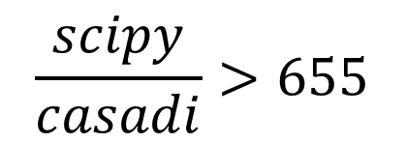
MPC speed up
+
+
Integrator: (Euler explicit)
Integrator: (RK)
+
+
Casadi.opti.minimize(‘ipopt’,J,H)
scipy.minimize(‘L-BFGS-B’)
+
$$\frac{scipy}{casadi}>655$$
JIT

Slide 11
Results
Achievable task + noize:

Slide 12
Results
Unachievable task (boundary constraints):

Slide 13
Results
Unachievable task (boundary constraints):

Slide 14
Results
Unachievable task (boundary constraints):

Slide 15
Results
Unachievable task (boundary constraints):

Slide 16
Unachievable task (boundary constraints):
Results

Slide 17
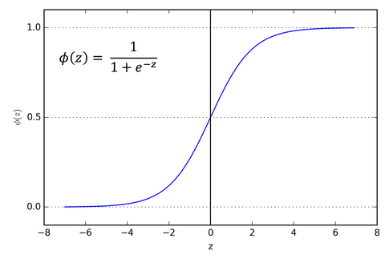
Results
Achievable task (collision constraints):

Slide 18
Results
Unachievable task (collision constraints):

Slide 19
Next step

