Slide 1
JEB159 | JEM335
Economics of Green Deal
Setting the Stage – Climate Change:
Physical Foundation and Policy Implications
by Miroslav Havránek
https://prezi.com/p/kzmuxuslhbtm/ies-physical-foundations-and-policy-implications/?present=1

Slide 2
Environment – Economy Nexus
Environmental functions
1. RESOURCES
  non-degradable (sunshine, wind, waves,…)
  degradable
    renewable (wood, biomass)
    non-renewable / exhaustible (fossil fuels, minerals)
    space
2. SINKS
  a place where undesirable outputs might be placed (i.e. assimilative capacity)
  emissions and wastes
3. DEMAND SERVICES
  aesthetic, cultural, recreational service (like provided by a forest)
4. Global Biospheric Life-Supporting Services
  climate system, hydrologic cycle, soil production, etc.
Notes:
2

Slide 3
savings
labour
P
FIRMS
(production)
C
HOUSEHOLDS
(consumption)
K
wages
rent/interest

Slide 4
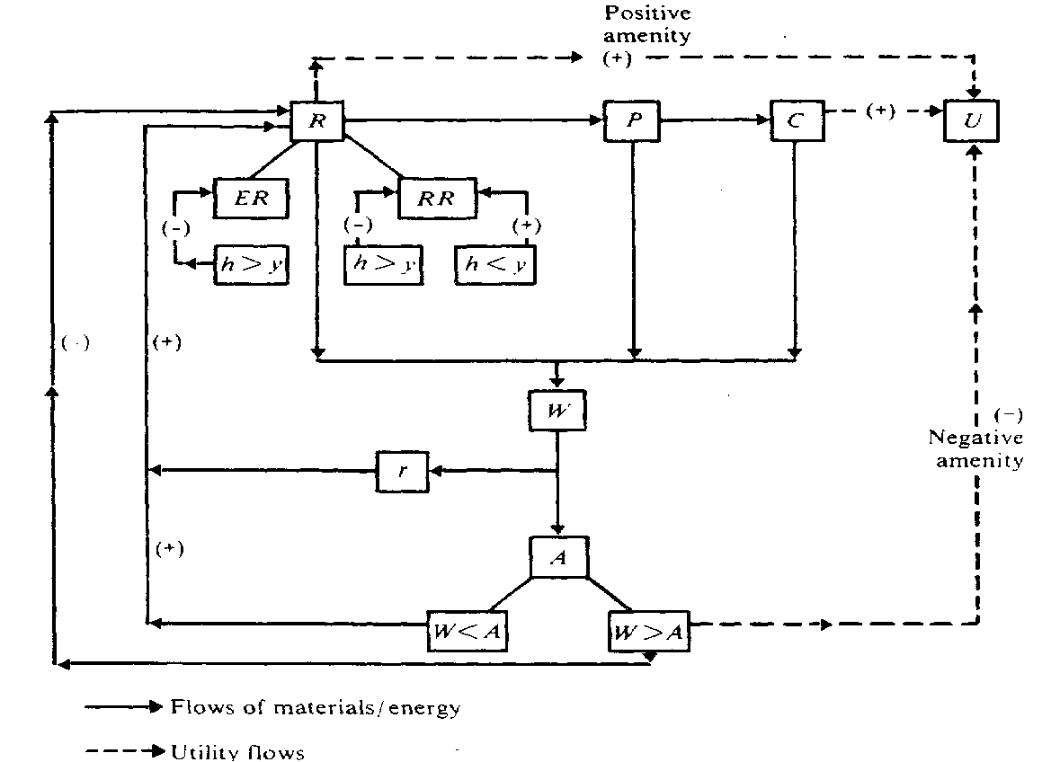
P, C, U – Production, Consumption, Utility
R, ER, RR – Natural Resources, Exhaustible and Renewable
h, y – harvest rate, yield/growth
W, A – waste, assimilative capacity
Notes:
4

Slide 5
VALUATION
GROWTH & SUSTAINABILITY
VALUAT I O N
REGULATION
EXTERNAL
I TY
RESOURCES
EXTERNALITY
P, C, U – Production, Consumption, Utility
R, ER, RR – Natural Resources, Exhaustible and Renewable
h, y – harvest rate, resource yield/growth
W, A – waste, assimilative capacity
Notes:
5

Slide 6
Lectures: I
Week 1 [September 29]
Setting the Stage – Climate Change: Physical Foundation and Policy Implications
[Miroslav Havranek, CENIA & Charles University Environment Center]
Week 2 [October 6]
Environmental Externality and Regulation
[Milan Ščasný]
Week 3-4 [October 13 & 20]
European Green Deal
[Richard Jurik, Ministry of the Environment & Vojtech Maca, Charles University Environment Center]
Week 5 [October 27]
The Dean’s Day

Slide 7
Lectures: II
Week 6 [November 3]
Climate Economics and Social Cost of Carbon
[Milan Ščasný]
Week 7-8 [November 10 & 17]
Energy System Transformation
[Vladimir Kubecek, Czech Transition System Operator & Lukas Recka, Charles University Environment Center]

Slide 8
Lectures: III
Week 9 [November 24]
Economic Impacts and Trade-offs
[Vedunka Kopecna & Inaki Veruette, Charles University Environment Center & IES]
Week 10 [December 1]
Social Impacts and Energy Poverty
[Matej Opatrny, Charles University Environment Center & IES]
Week 11 [December 8]
Behavioral Aspects
[Milan Ščasný]
Week 12 [December 15]
How Economists Model the Transition: Synthesis
[Milan Ščasný]

Slide 9
Contacts & Materials
JEB159 5 ETS (JEM335)
Lecturers: Dr. Milan Ščasný (Coordination); milan.scasny@czp.cuni.cz
        Dr. Lukáš Rečka (energy system modelling)
        Dr. Matěj Opatrný (distributional impacts)
        Dr. Vojtěch Máca (environmental policy, transportation)
        Dr. Vědunka Kopečná (CGE modelling, impact assessment)
        MSc. Iñaki Alberto Veruete Villegas (IOA, CGE, inequality)
        MSc. Miroslav Havránek (Environmental sciences, CENIA, CUNI)
        MSc. Richard Juřík (Ministry of the Environment)
        MSc. Vladimír Kubeček (ČEPS[TSO], VŠE)
Lectures: Mondays, 15:30-16:50, Room O206
Materials: SIS
Office: Institute of Economic Studies (#408)
Environment Center (José Martího 2/407, #1617)
Office hours: based on a prior communication (email or after the lectures)

Slide 10
Requirements & Grading
(1) Writing test with a satisfactory grade [65 points]
(2) Open-book (all, but electronic) exam (written) – test understanding and application, not memorisation [35 points]
(3) Active participation in the lectures [10 points]
Grading:
  91 and more A
  81 to 90 B
  71 to 80 C
  61 to 70 D
  51 to 60 E
  50 and less Failed

