Slide 1

Sensitivity analysis
Institute of Economic Studies
Faculty of Social Sciences
Charles University in Prague
Financial markets instruments

Slide 2









Basic measures
Sensitivity analysis
The objective is to quantify changes in explained variables caused by changes in explanatory variables
Two basic measures: sensitivity and elasticity
Sensitivity is an absolute change in an explained variable per unitary change in an explanatory variable
$$y$$
$$y=f(x)$$
$$∆y$$
$$\text{sensitivity}=\frac{∆y}{∆x}$$
$$\dot{=}\frac{f^{′}∆x}{∆x}=f^{′}(x)$$
[approximation using derivative]
$$\text{sensitivity}$$
$$∆x$$
$$x$$
Elasticity is a percentage change in an explained variable per one-percentage change in an explanatory variable
$$\ln{y}$$
$$\ln{y}=f(\ln{x})$$
$$∆\ln{y}$$
$$\dot{=}\frac{∆\ln{y}}{∆\ln{x}}$$
$$\text{elasticity}=\frac{∆y/y}{∆x/x}$$
[approximation using logarithmic derivative]
$$\text{elasticity}$$
$$∆\ln{x}$$
$$\ln{x}$$
Sensitivities in the B-S formula (the “Greeks”)
Option delta ($∆$) = sensitivity of an option premium to the price of an underlying asset
Option gamma ($Γ$) = sensitivity of an option delta to the price of an underlying asset
Option theta ($Θ$) = sensitivity of an option premium to the time to maturity
Option rho ($ρ$) = sensitivity of an option premium to the risk-free interest rate
Option vega ($ν$) = sensitivity of an option premium to volatility (also called epsilon, eta, kappa)

Slide 3






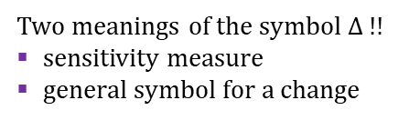
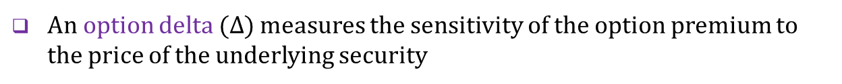

Option delta
Definition
An option delta ($Δ$) measures the sensitivity of the option premium to the price of the underlying security
Delta is equal to the slope of the short-term payoff profile
Long call
$$∆_{C}=\frac{∂C}{∂S}=N\left(d_{1}\right)$$
[non-trivial proof]
Two meanings of the symbol $∆$ !!
sensitivity measure
general symbol for a change
$$option delta$$
$$X$$
$$S$$
$$∆_{P}=\frac{∂P}{∂S}=−N\left(−d_{1}\right)$$
[put-call parity]
Option delta is positive for long calls and short puts; negative for short calls and long puts
Delta is close to zero for deep out-of-the-money options, close to one for deep in-the money calls, and close to minus one for deep in-the-money puts
Approximation property
Delta can be used for the first-order approximation of the change in the option premium using the first term of the Taylor series
$$∆C=\frac{∂C}{∂S}×∆S=\text{option} \text{delta} ×∆S$$
$$\left[∆y=\frac{dy}{dx}∆x+\frac{1}{2!}\frac{d^{2}y}{dx^{2}}Δx^{2}+\frac{1}{3!}\frac{d^{3}y}{dx^{3}}Δx^{3}+\frac{1}{4!}\frac{d^{4}y}{dx^{4}}Δx^{4}+…\right]$$
The delta of an option portfolio is the sum of individual option deltas
$${∆C}_{P} =n_{1}×\frac{∂C_{1}}{∂S}∆S+…+n_{N}×\frac{∂C_{N}}{∂S}∆S=\left(n_{1}×∆_{1}+{…+n}_{N}×∆_{N}\right)∆S=∆_{P}×∆S$$

Slide 4

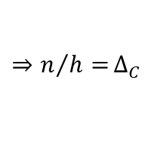



Delta hedging
Description
Delta hedging consists in creating a delta-neutral portfolio, composed of the opposite positions in shares and call options written on this stock
$$V=n×S−h×C$$
$n$ … number of shares, $h …$number of calls
The purpose of a delta neutral portfolio is to protect the value of this portfolio against price fluctuations of the underlying asset
$$∆V=\frac{dV}{dS}×∆S=\left(n−{h×∆}_{C}\right)×∆S=0$$
$${⇒n/{h=}∆}_{C}$$
A delta hedge works satisfactorily for small price changes only (larger price changes change the option delta and thus the desired proportion between shares and call options)
Example
A portfolio manager issues 100 call options with an individual delta of 0.95. The current market price of one share is €50.
Number of shares that make the original option portfolio delta neutral
$n=h×∆_{C}=100×0.95=95$ shares
The manager buys 95 shares at the current market price and pays for them €4,750 ($=50×95)$

Slide 5
Dynamic delta hedging
Description
DDH consists in periodic adjustments of delta neutral portfolio with the aim of restoring delta neutrality violated by changes in the option delta
Example
Step 1: $S_{1}=€50, ∆_{C} =0.95, h=100$ (number of issued options) ⇨ trader purchases $100×0.95=95$shares and pays $95×50=€4,750$ for them
Step 2: $S_{2}=€60, ∆_{C} =0.97$ ⇨ trader recalculates the number of shares needed ($100×0.97=97$) and restores delta neutrality by buying $97−95=2$shares at $\text{2}×60=€120$
Step 3: $S_{3}=€55, ∆_{C} =0.96$ ⇨ trader recalculates the number of shares needed ($100×0.96=96$) and restores delta neutrality by selling $97−96=1$share at $1×55=€55$
Limiting cases
Deep out-of-the-money calls: $∆_{C} →0⇨n→0$ ⇨ options are called naked
Deep in-the-money calls: $∆_{C} →1⇨n→h$ ⇨ options are fully covered
Risk of price instability
Efforts of DDH to eliminate price uncertainty at the individual level may lead to price instability at the aggregate level
A falling stock market triggers sell orders, which deepen bearish sentiment
A rising stock market triggers buy orders, which fuel bullish euphoria
Inherent risk of computerized program trading carried out on a larger scale

Slide 6




Option gamma
Definition
An option gamma ($Γ$) measures the change in the option delta as the price of the underlying security moves
$$Γ_{C}=\frac{∂∆_{C}}{∂S}=\frac{∂^{2}C}{∂S^{2}};{ Γ}_{P}=\frac{∂∆_{P}}{∂S}=\frac{∂^{2}P}{∂S^{2}}$$
$$Γ_{C}={ Γ}_{P}=\frac{1}{\sqrt{2π}}×e^{−d_{1}^{2}/2}×\frac{1}{Sσ\sqrt{T}}$$
Gamma can be used for the second-order approximation of the change in the option premium (using the first two terms of the Taylor series)
$$∆C=\frac{∂C}{∂S}×∆S+\frac{1}{2}\frac{∂^{2}C}{∂S^{2}}×∆S^{2}=\text{delta} ×∆S+\frac{1}{2}×\text{gamma}×∆S^{2}$$
Properties
The gamma of a call is equal to the gamma of a put
$$\frac{∂^{2}(C+Xe^{−rt})}{∂S^{2}}=\frac{∂^{2}(P+S)}{∂S^{2}}⇒{Γ_{C}=Γ}_{P}$$
The long option has a positive gamma while the short option has a negative gamma (the short-term payoff profile is a convex function)
Gamma is small for deep in-the-money and out-of-the-money options and changes rapidly for at-the money options

Slide 7
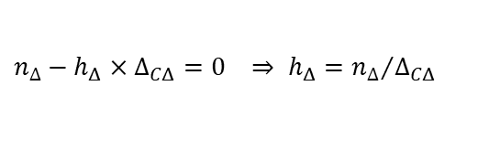
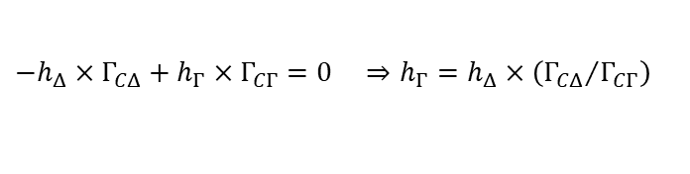
Gamma hedging
Description
Gamma hedging consists of creating a gamma-neutral portfolio whose aim is to hedge a delta-neutral portfolio against larger price changes
Variables
${C_{Δ},h}_{Δ}, Δ_{CΔ},Γ_{CΔ}…$ variables related to the option in the original delta-neutral portfolio (delta-neutral option: premium, number, delta, gamma)
${C_{Γ},h}_{Γ}, Δ_{CΓ},Γ_{CΓ}…$ variables related to the option added to the wider gamma-neutral portfolio (gamma-neutral option: premium, number, delta, gamma)
$S, n_{∆},n_{Γ} …$variables related to the share (price, number in the original delta-neutral portfolio, number added to the wider gamma-neutral portfolio)
Formation of a gamma-neutral portfolio
Composition of a gamma-neutral portfolio
$$V=n_{∆}×S−h_{Δ}×C_{Δ}+h_{Γ}×C_{Γ}−n_{Γ}S$$
Condition of gamma neutrality
$$ΔV=\left(n_{∆}−h_{Δ}×Δ_{CΔ}+h_{Γ}×Δ_{CΓ}−n_{Γ} \right)ΔS+\frac{1}{2}\left(−h_{Δ}×Γ_{CΔ}+h_{Γ}×Γ_{CΓ}\right)ΔS^{2}=0$$
Delta neutrality of the original portfolio
$$n_{∆}−h_{Δ}×Δ_{CΔ}=0 ⇒ h_{Δ}={n_{∆}}/{Δ_{CΔ}}$$
Zero value of the second term of the gamma-neutral portfolio
$${−h}_{Δ}×Γ_{CΔ}+h_{Γ}×Γ_{CΓ}=0 ⇒h_{Γ}=h_{Δ}×\left({Γ_{CΔ}}/{Γ_{CΓ}}\right)$$
Restauration of delta neutrality of the gamma-hedged portfolio
$$n_{∆}−h_{Δ}×Δ_{CΔ}+h_{Γ}×Δ_{CΓ}−n_{Γ}=h_{Γ}×Δ_{CΓ}−n_{Γ}=0 ⇒ n_{Γ}=h_{Γ}×Δ_{CΓ}$$

Slide 8

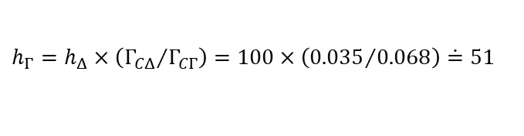

Gamma hedging – example
Data
A portfolio manager issues 100 call options (“delta-neutral options”) with a delta of 0.48 and a gamma of 0.035. The option used for the gamma hedge (“gamma-neutral option”) has a delta of 0.36 and a gamma of 0.068.
Solution
Number of shares that make the original option portfolio delta neutral
$$n_{∆}=h_{Δ}×∆_{CΔ}=100×0.48=48$$
⇨ manager buys 48 shares
Number of gamma-neutral options that make the second order approximation equal to zero
$$h_{Γ}=h_{Δ}×\left({Γ_{CΔ}}/{Γ_{CΓ}}\right)=100×\left({0.035}/{0.068}\right)\dot{=}51$$
⇨ manager buys 51 gamma-neutral options
Number of shares that restore the delta neutrality of the gamma-neutral portfolio
$$n_{Γ}=h_{Γ}×Δ_{CΓ}=51×0.36=18$$
⇨ manager sells 18 shares
Gamma-neutral portfolio consists of:
100 short positions in original delta-neutral options
51 long positions in new gamma-neutral options
48 – 18 = 30 shares

Slide 9
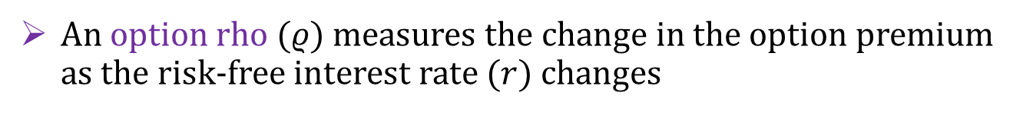
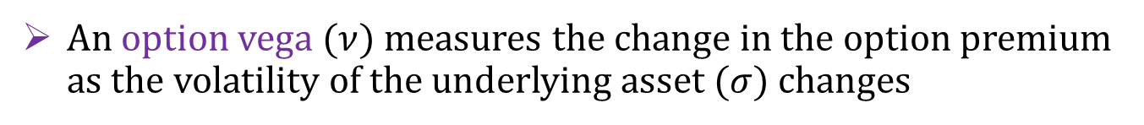

Other sensitivities
An option theta ($Θ$) measures the change in the option premium as the time to the option’s maturity ($T$) varies
Theta of long option positions always reduces the value of the option premium (option premium declines as time to maturity decreases)
Theta is not worth hedging against because the shortening of the time to maturity is inevitable
An option rho ($ρ$) measures the change in the option premium as the risk-free interest rate ($r$) changes
Rho is positive for long calls and negative for long puts
When speculating on a rising stock price, buying a cheaper call instead of buying the share saves interest costs while achieving roughly the same capital gain
When speculating on a falling stock price, buying a put with borrowed money is more costly than selling the share short
An option vega ($ν$) measures the change in the option premium as the volatility of the underlying asset ($σ$) changes
Vega is positive for long calls and long puts
Due to the asymmetric nature of options, higher volatility creates more room for favourable price development without increasing the risk of a greater loss

Slide 10

See you in the next lecture
© O.D. Lecturing Legacy
dedekold@gmail.com
Visit dedeklegacy.cz or TALKING SLIDES for the animated version of this presentation
(with English narrations and English/Czech subtitles)

Slide 11
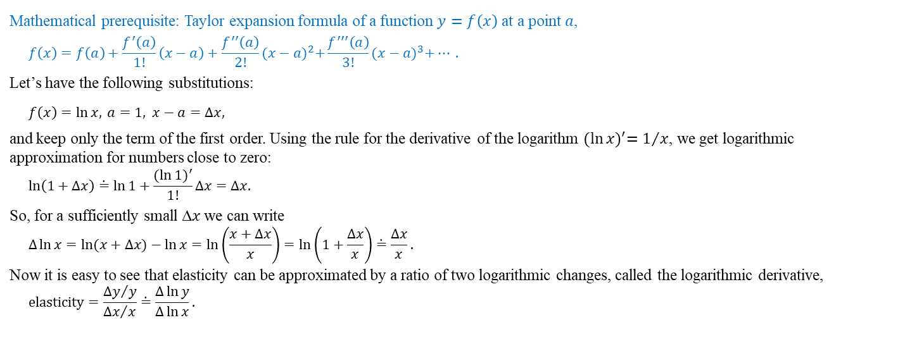
Math note – logarithmic derivative
Mathematical prerequisite: Taylor expansion formula of a function $y=f\left(x\right)$ at a point $a$,
$$f\left(x\right)=f\left(a\right)+\frac{f^{′}\left(a\right)}{1!}\left(x−a\right)+\frac{f^{′′}\left(a\right)}{2!}{(x−a)}^{2}+\frac{f^{′′′}\left(a\right)}{3!}{(x−a)}^{3}+… .$$
Let’s have the following substitutions:
$$f\left(x\right)=\ln{x,} a=1\text{, }x−a=∆x,$$
and keep only the term of the first order. Using the rule for the derivative of the logarithm ${(\ln{x})}^{′}=1/x$, we get logarithmic approximation for numbers close to zero:
$$\ln\left(1+∆x\right)\dot{=}\ln{1}+\frac{{(ln{1)}}^{′}}{1!}∆x=∆x.$$
So, for a sufficiently small ∆𝑥 we can write
$$∆\ln{x}=\ln{(x+∆x)}−\ln{x}=\text{ln}\left(\frac{x+∆x}{x}\right)=\ln\left(1+\frac{∆x}{x}\right)\dot{=}\frac{∆x}{x}.$$
Now it is easy to see that elasticity can be approximated by a ratio of two logarithmic changes, called the logarithmic derivative,
$$\text{elasticity}=\frac{{∆y}/y}{{∆x}/x}\dot{=}\frac{∆\ln{y}}{∆\ln{x}}\text{.}$$

Slide 12
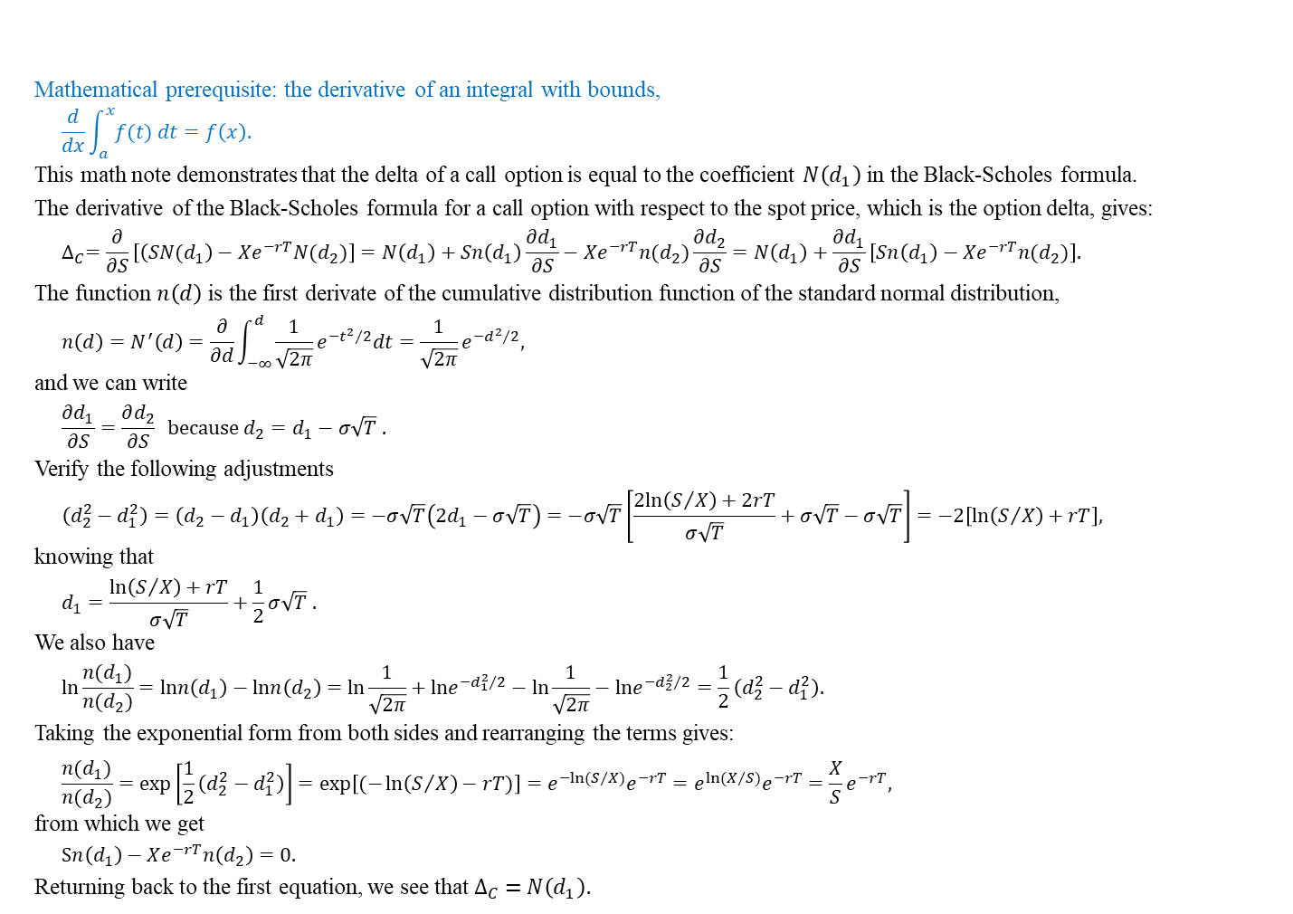
Math note – delta formula for a call option
Mathematical prerequisite: the derivative of an integral with bounds,
$$\frac{d}{dx}\int_{a}^{x}{f(t) dt}=f\left(x\right).$$
This math note demonstrates that the delta of a call option is equal to the coefficient $N\left(d_{1}\right)$in the Black-Scholes formula.
The derivative of the Black-Scholes formula for a call option with respect to the spot price, which is the option delta, gives:
$$∆_{C}=\frac{∂}{∂S}\left[\left(SN(d_{1}\right)−Xe^{−rT}N(d_{2})\right]=N\left(d_{1}\right)+Sn\left(d_{1}\right)\frac{∂d_{1}}{∂S}−Xe^{−rT}n(d_{2})\frac{∂d_{2}}{∂S}=N\left(d_{1}\right)+\frac{∂d_{1}}{∂S}\left[Sn\left(d_{1}\right)−Xe^{−rT}n(d_{2})\right].$$
The function $n\left(d\right)$ is the first derivate of the cumulative distribution function of the standard normal distribution,
$$n\left(d\right)=N^{′}\left(d\right)=\frac{∂}{∂d}\int_{−∞}^{d}{\frac{1}{\sqrt{2π}}e^{−{t^{2}}/2}dt}=\frac{1}{\sqrt{2π}}e^{−{d^{2}}/2}\text{,}$$
and we can write
$$\frac{∂d_{1}}{∂S}=\frac{∂d_{2}}{∂S} \text{because} d_{2}=d_{1}−σ\sqrt{T} .$$
Verify the following adjustments
$$\left(d_{2}^{2}−d_{1}^{2}\right)=\left(d_{2}−d_{1}\right)\left(d_{2}+d_{1}\right)=−σ\sqrt{T}\left(2d_{1}−σ\sqrt{T}\right)=−σ\sqrt{T}\left[\frac{2ln\left(S/X\right)+2rT}{σ\sqrt{T}}+σ\sqrt{T}−σ\sqrt{T}\right]=−2\left[\ln\left(S/X\right)+rT\right],$$
knowing that
$$d_{1}=\frac{\ln\left(S/X\right)+rT}{σ\sqrt{T}}+\frac{1}{2}σ\sqrt{T} \text{.}$$
We also have
$$\text{ln}\frac{n(d_{1})}{n(d_{2})}=\text{ln}n\left(d_{1}\right)−\text{ln}n\left(d_{2}\right)=\text{ln}\frac{1}{\sqrt{2π}}+\text{ln}e^{−{d_{1}^{2}}/2}−\text{ln}\frac{1}{\sqrt{2π}}−\text{ln}e^{−{d_{2}^{2}}/2}=\frac{1}{2}\left(d_{2}^{2}−d_{1}^{2}\right).$$
Taking the exponential form from both sides and rearranging the terms gives:
$$\frac{n(d_{1})}{n(d_{2})}=\exp\left[\frac{1}{2}\left(d_{2}^{2}−d_{1}^{2}\right)\right]=\text{exp}\left[(−\ln\left(S/X\right)−rT)\right]={e^{−ln⁡(S/X)}e}^{−rT}={e^{ln⁡(X/S)}e}^{−rT}=\frac{X}{S}e^{−rT},$$
from which we get
$$Sn\left(d_{1}\right)−Xe^{−rT}n\left(d_{2}\right)=0.$$
Returning back to the first equation, we see that$∆_{C} =N\left(d_{1}\right).$

