Slide 1


Slide 2
Table of Contents
What is Blender?
What is it used for?
What features does it have?
Blender UI
What are the elements?
What are they used for?
Blender hands on
Experience Blender yourself!
Complete tutorial of making a textured and animated model

Slide 3
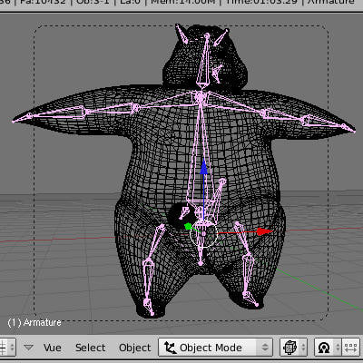
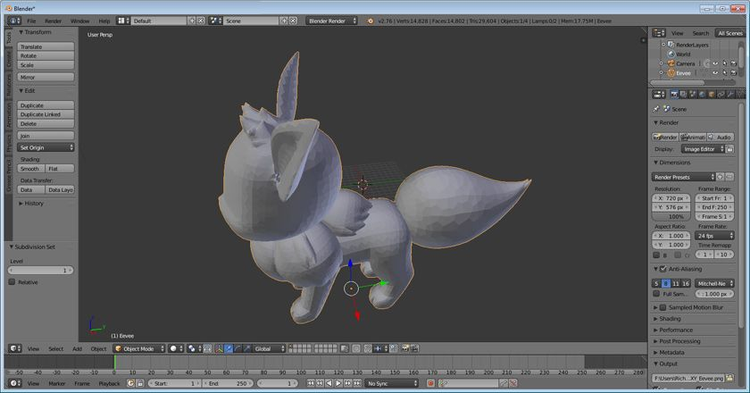
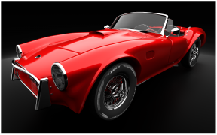
What is Blender?
Blender is one of the most popular free 3D computer grapics toolsets
It is used for creating animated films, visual effects, art, 3D printed models, interactive 3D applications and video games
Blender's features include 3D modeling, UV unwrapping, texturing, sculpting, animating, rendering

Slide 4
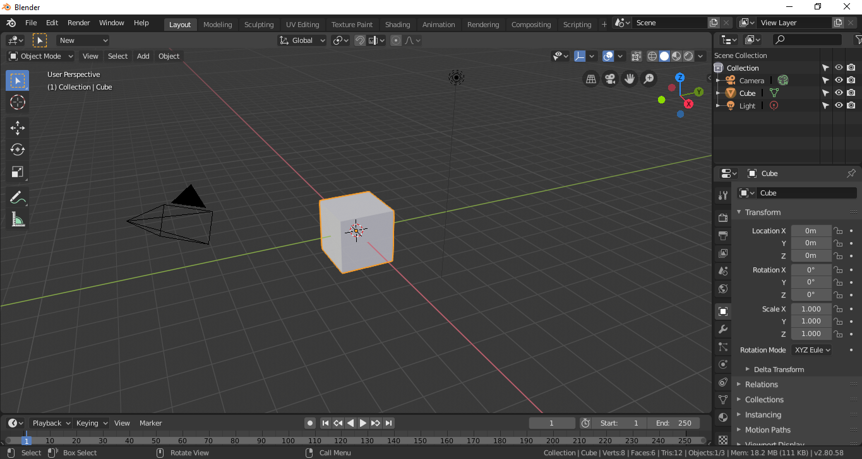
Blender UI
Main Menu
Workspaces
Scene Graph
Viewport
Editing Tools
Properties
Animation Timeline

Slide 5
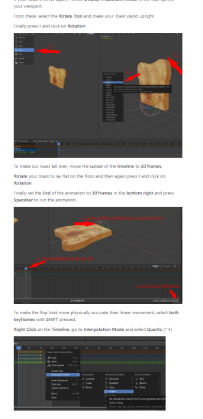
Blender hands on
https://github.com/SlaxXxX/blender-portfolio
Guided hands on in the Readme.md
A mouse is recommended
You can work in groups of two to open
the tutorial on a second screen

