Slide 1
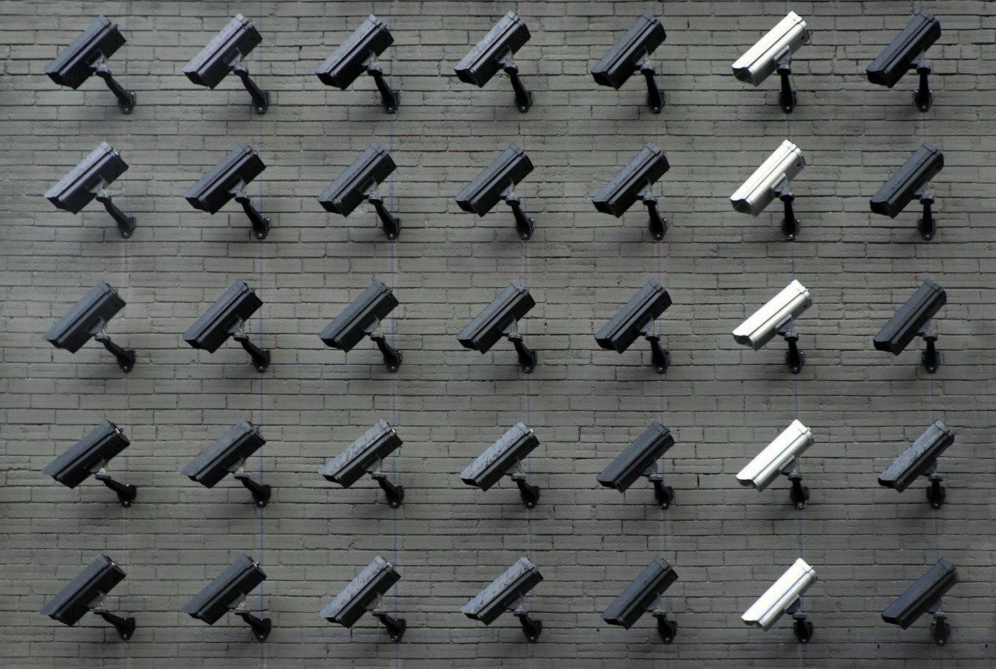
TECHLAB CCTV
Enterprise Security Surveillance & Campus Monitoring Solutions
BNI Feature Presentation | Karur

Slide 2
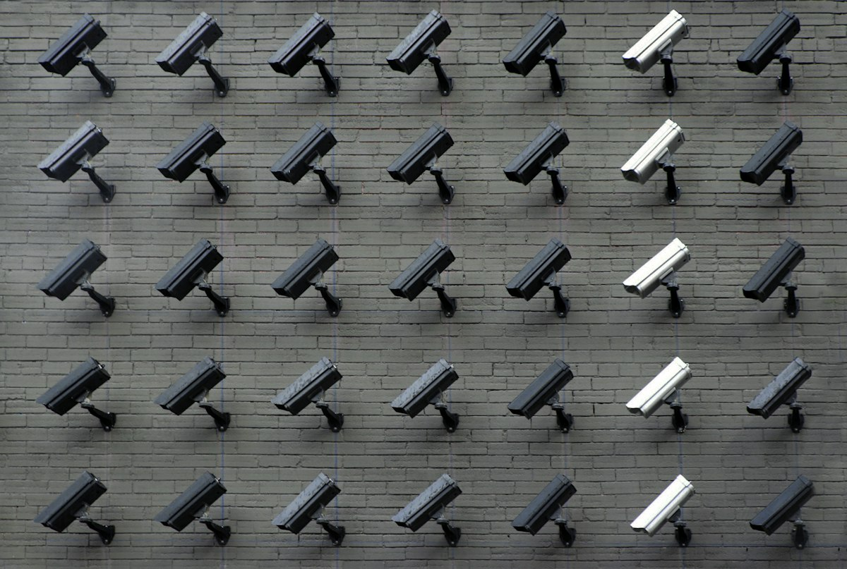



CORE CCTV SURVEILLANCE EXPERTISE
HD IP & PTZ Cameras
Centralized NVR
Structured PoE
Remote Viewing
Crystal-clear 2MP to 8MP Dome, Bullet & PTZ cameras with night vision.
Enterprise NVR & XVR systems with massive storage and zero lag.
Heavy-duty Cat6 structured wiring, PoE switches & enclosures.
Real-time smartphone & desktop monitoring accessible 24/7.

Slide 3

COMMON SECURITY VULNERABILITIES IN BUSINESSES
Blind Spots & Poor Coverage
Grainy & Unusable Footage
Unreliable Recording Failures
Inadequate camera placement leaving critical entry points, cash counters, and perimeters unmonitored.
Outdated analog systems failing to capture license plates or face details during break-ins.
Hard drive corruption or unmaintained power supplies (SMPS) failing when footage is needed most.

Slide 4

LANDMARK INSTITUTIONAL INSTALLATION: ARASU COLLEGE
Centralized Campus Recording
CAMPUS SECURITY SCALE
3 units of 32-Channel Enterprise NVRs delivering 96 total channels of high-speed secure storage.
74
Power & Distribution
HD IP Cameras Deployed
18 units of 8+2 PoE Switches providing stable power and data over long distances.
3x 32ch NVRs | 18 PoE Switches | 18 Racks
Structured Racks & Wiring
18 dedicated server racks with professional Cat6 structured cabling throughout campus.

Slide 5


THE TECHLAB CCTV ADVANTAGE
Precise Site Surveys
Transparent Quotations
Dedicated Maintenance AMC
Detailed pre-installation site surveys ensuring zero blind spots and optimal camera placement.
Itemized camera, NVR, and cabling quotes with exact HSN codes and warranty details.
Rapid response service team ensuring your cameras and NVRs remain 100% operational.

Slide 6
IDEAL REFERRAL PARTNER — WHO NEEDS CCTV UPGRADES?
Educational Institutions
01
Schools, colleges, and hostels looking to upgrade campus surveillance and monitor student safety.
Manufacturing & Textile Mills
02
Factories requiring heavy-duty perimeter security, warehouse monitoring, and night-vision cameras.
Commercial Offices & Retail
03
Businesses wanting to secure retail counters, entrances, and employee attendance monitoring.

Slide 7
Let's Secure Your Premises Together
TECHLAB CCTV Solutions | Karur
Phone: +91 94888-0-9897 | Email: service@techlab.in
Open for CCTV 1-to-1 meetings this week!

