Slide 1
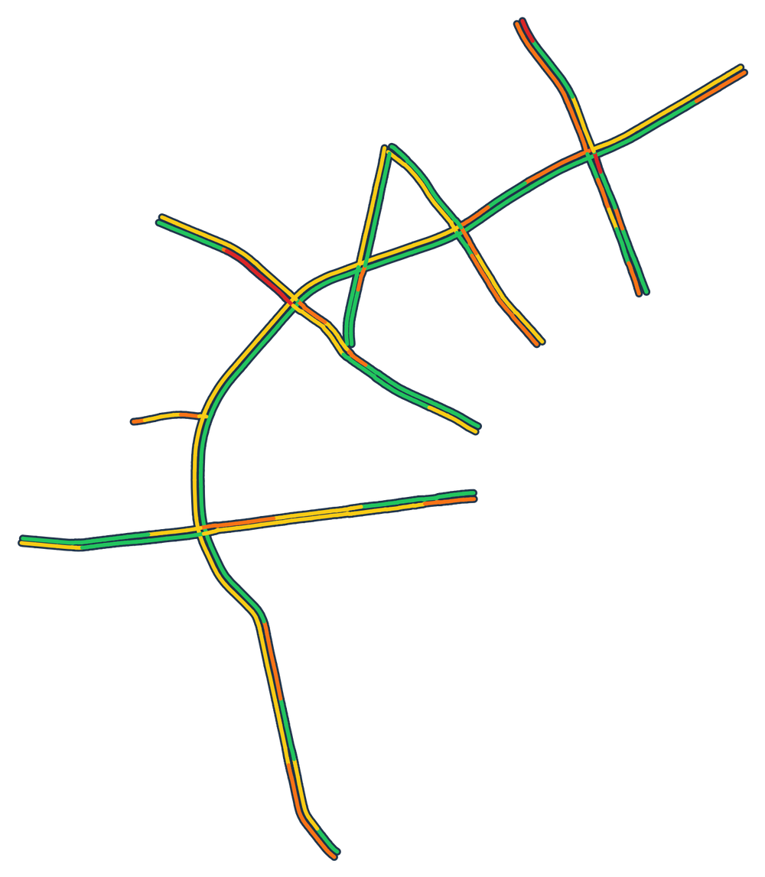
GreenWave
IoT · GROUP 5
Smart traffic in Aarhus · Presentation 2 · Project status
Real-time traffic in Aarhus: shown live, and predicted
Our 13 monitored routes, drawn from our own database.
Real TomTom speeds, Thursday 1 October 2026, 10:40.
Free flow
Light
Moderate
Heavy
Closed
Notes:
We're group 5, and this is the status of GreenWave, our smart-traffic project for Aarhus.
The biggest change since presentation 1: we're no longer building a system that controls traffic lights. We work with real-time traffic data instead. We show the current traffic state, and the next goal is to predict it.
The picture is real data from our own database: the 13 roads we monitor, with the speeds TomTom measured on Thursday 1 October at 10:40. Green is free flow; yellow, orange and red mean the speed has dropped below the road's free-flow speed.
Today: what changed and why, where each block stands, the design, the components, how it scales, and what's next.

Slide 2



From controlling traffic lights to real-time data
01 · WHAT CHANGED
PRESENTATION 1
NOW
Control the traffic lights
Show and predict the traffic
Simulated sensors
Signal plans
Traffic lights
Real-time TomTom data
Live traffic state on a map
Predicted traffic state
WHY
WHAT IT CHANGED IN THE ARCHITECTURE
Real data instead of simulation
Edge controller per intersection
Adapter per city
Aarhus Kommune shares TomTom's live speeds for 13 roads
CoAP + MQTT
MQTT only
Nothing real to control
Signal plans
Congestion state + forecasts
We can't steer real lights, so we show the state instead
Node.js or ASP.NET?
Node.js + TypeScript
History to learn from
A year of typical-weekday data makes prediction possible
Time-series DB?
PostgreSQL
Notes:
In presentation 1 the goal was to control traffic lights: simulated sensors at intersections, a backend computing signal plans, and lights following them.
Now the goal is to work with real-time data: show the traffic state on a live map, and predict where it's heading.
Three reasons. First, real data: Aarhus Kommune shares TomTom's live speeds for 13 main roads with us, plus a year of history, and real data beats simulated sensors. Second, we can't steer real traffic lights, so the value is in showing the state rather than acting on it. Third, that year of history gives us something to learn from, which is what makes prediction possible.
For the architecture that means an adapter per city instead of an edge controller per intersection, MQTT only instead of CoAP plus MQTT, and congestion state and forecasts instead of signal plans. The open choices from last time are settled: Node.js with TypeScript, and PostgreSQL.

Slide 3






Where each block stands
02 · STATUS
Adapter
MQTT broker
Backend
Database
Frontend
Prediction
fetches TomTom data and publishes it
passes messages between the parts
works out congestion, keeps state and history
routes, road segments, a year of history
login, live map, history page
forecasts traffic from history
Not implemented yet
Not implemented yet
Partly implemented
Working
Working
Not implemented yet
RUNNING TODAY: THE PROOF OF CONCEPT
13
1,079
199
Today one Next.js app does it all: it reads TomTom directly, colours the map and shows the history page. It runs on Vercel. The new design splits it into the blocks above, with MQTT in between.
routes read live from TomTom
road segments on the map
weekdays averaged in the history page
Notes:
Here's every block of the new architecture and where it stands.
Working today: the database and the frontend, with login, the live map and the history page.
Not implemented yet: the adapter, the MQTT broker, the backend and the prediction. They're designed, and the next slides show how.
At the bottom is what runs today: one Next.js app that does everything itself. It reads 13 routes from TomTom, about 1,100 road segments, colours the map, and shows a typical weekday averaged over 199 weekdays. The new design splits that app into the blocks above, with MQTT between them.

Slide 4
The new architecture at a glance
03 · SOFTWARE DESIGN · C2
DOCKER COMPOSE · ONE MACHINE
TomTom API
HTTPS
Adapter
MQTT
MQTT broker
MQTT
Backend
live speeds, 13 roads
every minute
one per city
readings
Mosquitto
readings in, state out
congestion, state, history
MQTT over WebSocket
live updates
SQL
saves state and history
Browser
HTTPS
Frontend
SQL
Database
Prediction
the live map
pages
Next.js web app
first paint
PostgreSQL
history in, forecasts out
later: forecasts from history
our code
infrastructure
external
later
Notes:
This is the new architecture as building blocks, at C4 container level.
The top row is the live path. The adapter for Aarhus fetches TomTom's data every minute and publishes it over MQTT. The broker passes it on, and the backend works out the congestion and publishes the new state.
The bottom row is what the user sees. The backend saves everything in the database, and the frontend draws the first version of the map from there. After that, the browser gets live updates straight from the broker over a WebSocket.
Prediction is the new block. It reads the history from the database and writes forecasts back, so the frontend can show them next to the live state. Everything inside the dashed box runs with Docker Compose on one machine.

Slide 5

Inside the main blocks
04 · SOFTWARE DESIGN · C3
Adapter
Backend
Frontend
Prediction
one per city
one or more copies
our existing Next.js app
planned
1
Fetch every route, every minute
1
Receive readings from the broker
1
Draw the map from the database
1
Learn from the history we have
2
Check the data is valid
2
Drop duplicates and old readings
2
Subscribe to live updates
2
Forecast each route's traffic
3
Convert it to our message format
3
Classify congestion per road segment
3
Apply only what's newer
3
Save forecasts for the map
4
Publish it over MQTT
4
Store state and history
4
Show history and forecasts
5
Publish the new state
Node.js + TypeScript. Most of the code exists in our PoC.
Node.js + TypeScript, Prisma for the database.
Next.js + Mapbox GL. Running today.
Notes:
One level deeper, in plain steps.
The adapter fetches every route each minute, checks the data, converts it to our own message format and publishes it. Most of that code already exists in our proof of concept.
The backend receives the readings, drops duplicates and anything older than what it already has, classifies the congestion on every road segment, stores the state and the history, and publishes the new state.
The frontend is our existing app. It draws the map from the database, then subscribes to live updates and only applies what's newer than what it shows.
Prediction is the newest block: learn from the history we have, the year of Traffic Stats plus what we record ourselves, forecast each route, and save the forecasts for the map. We haven't picked the method yet.
(If asked: the adapter, backend and frontend share one package with the message format and the congestion thresholds, so they can't drift apart.)

Slide 6









Components, and how they connect
05 · COMPONENTS
COMPONENTS
HOW THEY CONNECT: MQTT TOPICS PER CITY
Things & data
No hardware of our own: TomTom's vehicle data, shared by Aarhus Kommune
greenwave/v1/{city}/routes/{id}/observations
readings: adapter → backend
Broker
Mosquitto 2, MQTT 5
greenwave/v1/{city}/routes/{id}/state
state: backend → map, kept for new viewers
Adapter, backend
Node.js + TypeScript, MQTT.js, Prisma
greenwave/v1/{city}/adapter/status
'offline' if the adapter dies (Last Will)
Database
PostgreSQL 18
New city: one more adapter, plus a broker login that may only write to its own city
Frontend
Next.js 16, Mapbox GL, Better Auth
Prediction
A batch job; the method is still open
Event ids: every reading has one, so a repeat is recognised and dropped
Runs on
Docker Compose, one machine
Subscribers: backend copies share one subscription; browsers can only read
Notes:
The concrete components. We have no hardware of our own: our sensors are vehicles. TomTom turns their GPS data into a speed per road segment, and Aarhus Kommune gives us access. The broker is Mosquitto with MQTT 5. The adapter and backend are Node.js with TypeScript, the database is PostgreSQL, and the frontend is Next.js with Mapbox for the map. Prediction will be a batch job; the method is still open. Everything runs in Docker Compose.
How they connect: three MQTT topics per city. Readings go from the adapter to the backend. The state goes from the backend to the map, and the broker keeps the latest one, so a new viewer sees every road at once. The adapter's status turns 'offline' if it dies, using MQTT's Last Will.
Adding a city means one more adapter and a broker login that can only write to that city's topics. Every reading carries an event id, so repeats are dropped. Backend copies share one subscription, and browsers can only read.

Slide 7

How it scales
06 · SCALABILITY
Cities
One more adapter. Calls to a city's API grow with its routes, not with viewers
13 msgs/min
about 250 KB a minute for Aarhus: trivial for Mosquitto
Messages
One Mosquitto handles far more; beyond that, bridge regional brokers or use a clustering broker, no client changes
Processing
More backend copies on the shared subscription
1.6 M → 26 k
rows a day: per-minute history vs. hourly aggregates
Data
Latest state is one row per segment; history is aggregated, with retention or partitioning later
1 CPU core
Viewers
The broker fans out the retained state. For very large audiences: geometry once, then only speeds
Mosquitto's ceiling, but the backend and database hit theirs first
Notes:
How it grows. Another city is just another adapter, and calls to a city's API grow with its roads, not with the number of viewers. One Mosquitto handles far more than Aarhus produces: 13 messages and about 250 KB a minute. Processing scales by adding backend copies on the shared subscription. The data stays small because the latest state is one row per segment and history is aggregated; per-minute history would be 1.6 million rows a day for Aarhus alone. And viewers are cheap, because the broker fans out the state it already keeps.
It holds up because every part under load is either stateless, like the adapters and the frontend, or split by a key it already has, the city or the route. The real limits are TomTom's quota and the database, and a load test will show that with numbers.

Slide 8


What's concrete, what's open, what was hard
07 · REALIZATION & CHALLENGES
NOW CONCRETE
STILL OPEN → PLAN
Real data
How do we predict?
13 live routes and a year of history
→ Start from the typical weekday and our own recorded history
Message format and topics
one message per route, each with an event id
When is a road congested?
The backend's steps
→ Tune the rule on recorded data
from a reading to a published state
Several backend copies?
The stack
→ Start with one, split by city later
Mosquitto, Node.js, PostgreSQL, Next.js
Deployment
Where are the real limits?
everything starts with one docker compose up
→ A load test with measurements
Notes:
What has become concrete since presentation 1: the data source, the message format and topics, the backend's steps, the whole stack, and how it runs.
Still open, with our plan for each. How we predict: we start from what we have, the typical weekday from Traffic Stats and our own recorded history, and pick a method from there. When a road counts as congested needs tuning on real data. Running several backend copies needs care, so we start with one. And where the real limits are, a load test will tell.
Challenges so far. TomTom's segment ids are too big for JavaScript numbers and were silently rounded, so we keep them as strings and validate every response. Serverless didn't suit a pipeline: our hourly job on GitHub Actions failed 58 times on missing secrets, and a serverless function can't hold an MQTT connection, hence Docker Compose. And MQTT can deliver duplicate, late or stale data, which event ids, newest-wins and expiring state handle.

Slide 9
Next: the live pipeline, then prediction
08 · NEXT STEPS
PHASE 1
PHASE 2
PHASE 3
Skeleton
Live pipeline
Prediction
1
Project structure for the new services
3
Adapter publishes TomTom data
6
Record history for prediction
2
Docker Compose with the MQTT broker
4
Backend classifies and stores it
7
A first forecast job
5
Map updates live over MQTT
8
Forecasts on the map
HOW WE WILL TEST IT
Watch every message with mosquitto_sub
Stop the adapter → it shows as offline
Restart the backend → nothing lost or doubled
Load test: messages/s, lag, database writes
Notes:
Next steps. First the skeleton: the project structure for the new services, and Docker Compose with the MQTT broker. Then the live pipeline: the adapter publishing TomTom data, the backend classifying and storing it, and the map updating live over MQTT. Then prediction: record the history prediction needs, build a first forecast job, and show the forecasts on the map.
Along the way we test it: watch every message with mosquitto_sub, stop the adapter and check it shows as offline, restart the backend and check nothing is lost or doubled, and run a load test.
Thank you. Questions?

