Slide 1

Introduction to Data Mining
Department of Computer Engineering
Unit no: 1
Unit title: Introduction to Data Mining
Subject name and code: Data Mining
(3160714)
CHP-1
Prof. Aastha Masrani

Slide 2
Outlines
Definition, motivation & application
Classification of DM Systems
Integration of Data mining systems with Database or Data Warehouse
Issues in Data Mining
Knowledge Discovery Process

Slide 3
Why do we need data mining?
Really, really huge amounts of raw data!!
  In the digital age, TB of data is generated by the second
    Mobile devices, digital photographs, web documents.
    Facebook updates, Tweets, Blogs, User-generated content
    Transactions, sensor data, surveillance data
    Queries, clicks, browsing
  Cheap storage has made possible to maintain this data
Need to analyze the raw data to extract knowledge

Slide 4
Data is a Computer
Large amounts of data can be more powerful than complex algorithms and models
    Google has solved many Natural Language Processing problems, simply by looking at the data
    Example: misspellings, synonyms
  Data is power!
    Today, the collected data is one of the biggest assets of an online company
      Query logs of Google
      The friendship and updates of Facebook
      Tweets and follows of Twitter
      Amazon transactions
  We need a way to harness the collective intelligence

Slide 5
Attributes
What is Data?
Collection of data objects and their attributes
An attribute is a property or characteristic of an object
  Examples: eye color of a person, temperature, etc.
  Attribute is also known as variable, field, characteristic, or feature
A collection of attributes describe an object
  Object is also known as record, point, case, sample, entity, or instance
Objects
Size: Number of objects
Dimensionality: Number of attributes
Sparsity: Number of populated
object-attribute pairs

Slide 6
What Is Data Mining?
Data mining (knowledge discovery in databases):
  Extraction of interesting (non-trivial, implicit, previously unknown and potentially useful) information or patterns from data in large databases

Slide 7
Types Data to be Mined
Flat Files
  Data File in text form or binary data files
Relational Databases
  The collection of data organized in tables with rows and columns.
DataWarehouse
  collection of data integrated from multiple sources that will queries and decision making
Transactional Databases
  collection of data organized by time stamps, date, etc to represent transaction
Multimedia Databases
  databases consists audio, video, images and text media
Spatial Database
  Data in form of coordinates, topology, lines, polygons, etc.
Time Series Databases
  Time series databases contains stock exchange data and user logged activities.
World Wide Web(WWW)
  collection of documents and resources like audio, video, text, etc which are identified by Uniform Resource Locators (URLs) through web browsers, linked by HTML pages, and accessible via the Internet network.

Slide 8
Data Mining Systems classification
Databases to be mined
  Relational, transactional, object-oriented, object-relational, active, spatial, time-series, text, multi-media, heterogeneous, legacy,WWW, etc.
Knowledge to be mined
  Characterization, discrimination, association, classification, clustering, trend, deviation and outlier analysis, etc.
  Multiple/integrated functions and mining at multiple levels
Techniques utilized
  Database-oriented, data warehouse (OLAP), machine learning, statistics,
visualization, neural network, etc.
Applications adapted
  Retail, telecommunication, banking, fraud analysis, DNA mining, stock market analysis,Web mining,Weblog analysis, etc.

Slide 9
Data Mining Tasks
Prediction Tasks
  Use some variables to predict unknown or future values of
other variables
Description Tasks
  Find human-interpretable patterns that describe the data.
Common data mining tasks
  Classification [Predictive]
  Clustering [Descriptive]
  Association Rule Discovery [Descriptive]
  Sequential Pattern Discovery [Descriptive]
  Regression [Predictive]
  Deviation Detection/Forecasting [Predictive]
  Outlier Analysis

Slide 10
Tasks Primitives
Task Relevant Data
Kinds of Knowledge to be Mined
Background Knowledge
Interestingness Measure
Presentation and Visualization of Discovered Pattern

Slide 11
Integration of Data mining systems with Database or Data Warehouse
Types of Schemes of Data Mining of System
  No Coupling
  Loose Coupling
  Semi tight Coupling
  Tight Coupling

Slide 12
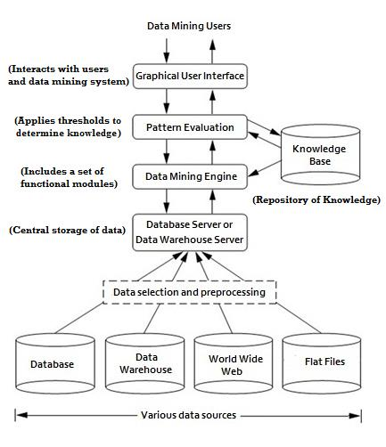
Data Mining Architecture

Slide 13
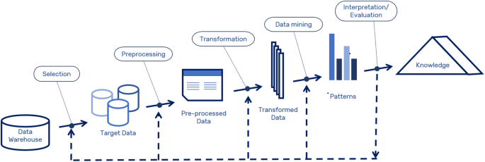
Knowlegde Discovery in Databases (KDD)

Slide 14
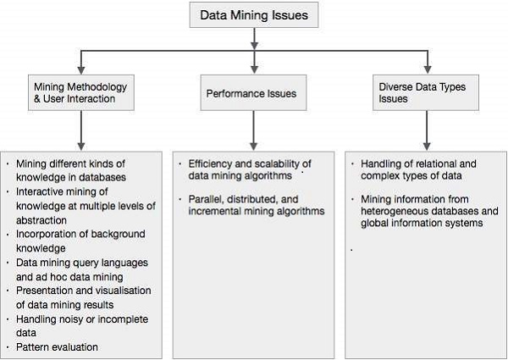
Issues in Data Mining

Slide 15
THANK YOU

