Slide 1

Data Pre-Processing
Department of Computer Engineering
Unit no: 2
Unit title: Data Pre-processing
Subject name and code: Data Mining
(3160714)
Unit-2
Prof. Aastha Masrani

Slide 2
Outlines
Data Summarizartion
Data Cleaning
Data Integration
Data Transformation
Data Reduction
Data Discretization and Concept Hierarchy
Feature Extraction
Feature Transformation
Feature Selection
Introduction to Dimensionality Reduction
CUR decomposition

Slide 3
Need of Data- Pre-processing
Data in the real world is “dirty”
  incomplete: missing attribute values, lack of certain attributes of interest, or containing only aggregate data
    e.g., occupation=“”
  noisy: containing errors or outliers
    e.g., Salary=“-10”
  inconsistent: containing discrepancies in codes or names
    e.g., Age=“42” Birthday=“03/07/1997”
    e.g., Was rating “1,2,3”, now rating “A, B, C”
    e.g., discrepancy between duplicate records

Slide 4
Need of Data- Pre-processing
No quality data, no quality mining results! (garbage in garbage out!)
  Quality decisions must be based on quality data
    e.g., duplicate or missing data may cause incorrect or even misleading statistics.
Data preparation, cleaning, and transformation comprises the majority of the work in a data mining application (could be as high as 90%).

Slide 5
Tasks in Data Pre-processing
Data Cleaning
  Fill in missing values, smooth noisy data, identify or remove outliers and noisy data, and resolve inconsistencies
Data Integration
  Integration of multiple databases, or files
Data Transformation
  Normalization and aggregation
Data Reduction
  Obtains reduced representation in volume but produces the same or similar analytical results
Data Discretization
  Discretization is the process of converting a continuous attribute into an ordinal attribute.

Slide 6
Data Sumarization
To find important measure or important insights from the given dataset.
Summarization techniques includes finding mean,median, mode and Standard deviation.

Slide 7
Mean , Median , Mode and SD
Average value (mean)
Most frequently occurring value (mode)
On average, how much each measurement deviates from the mean (standard deviation of the mean)
Span of values over which your data set occurs (range), and
Midpoint between the lowest and highest value of the set (median)

Slide 8
Measuring the Dispersion of Data
The degree to which numerical data tend to spread is called the dispersion, or variance of the data.
The most common measures of data dispersion are range, the five-number summary (based on quartiles), the interquartile range, and the standard deviation,Q1,Q3.
Boxplot can be plotted based on the five-number summary and are a useful tool for identifying outliers.

Slide 9
Percentiles And Quartiles
The k_{th} percentile of a set of data in numerical order is the value x_{i} having the property that k percent of the data entries lie at or below x_{i.} The median is the 50th percentile.
The most commonly used percentiles other than the median are quartiles.
The first quartile, denoted by Q1, is the 25th percentile; the third quartile, denoted by Q3, is the 75th percentile. The quartiles, including the median, give some indication of the center, spread, and shape of a distribution.
The distance between the first and third quartiles is a simple measure of spread that gives the range covered by the middle half of the data. This distance is called the interquartile range (IQR) and is defined as :
IQR = Q3 - Q1

Slide 10
Five Number Summary
Because Q1, the median, and Q3 together contain no information about the endpoints (e.g., tails) of the data, a fuller summary of the shape of a distribution can be obtained by providing the lowest and highest data values as well. This is known as the five-number summary.
The five-number summary can be written in the order Minimum, Q1, Median, Q3,Maximum.

Slide 11
Examples:
5, 20, 15, 25, 0, 10, 15, 5, 25, 30, 20
  Determine the Interquartile range for the following set of data:
  Determine the 5 number summary for the set of data.
88, 53, 72, 67, 48, 63, 25, 34, 46, 55, 72, 77
  What percent of the data listed below is higher than the lower quartile?
  What percent of the data listed below is higher than the median?

Slide 12
Data Cleaning
Importance
  “Data cleaning is the number one problem in data warehousing”
Data cleaning tasks
  Fill in missing values
  Identify outliers and smooth out noisy data
  Correct inconsistent data
  Resolve redundancy caused by data integration

Slide 13
Missing Data
Data is not always available
  E.g., many tuples have no recorded values for several attributes, such as customer income in sales data
Missing data may be due to
  equipment malfunction
  inconsistent with other recorded data and thus deleted
  data not entered due to misunderstanding
  certain data may not be considered important at the time of entry
  no register history or changes of the data
  expansion of data schema

Slide 14
How to Handle Missing Values/Data
Ignore the tuple (loss of information)
Fill in missing values manually: tedious, infeasible?
Fill in it automatically with
  a global constant : e.g., “unknown”, a new class?!
  the attribute mean
  the most probable value: inference-based such as Bayesian formula, decision tree, or EM algorithm

Slide 15
Noisy Data
Noise: random error or variance in a measured variable.
Incorrect attribute values may due to
  faulty data collection instruments
  data entry problems
  data transmission problems
  etc
Other data problems which requires data cleaning
  duplicate records, incomplete data, inconsistent data

Slide 16
How to Handle Noisy Data
Different data smoothing techniques
  Binning
  Outlier Analysis by Clustering
  Regression

Slide 17
Binning Method
first sort data and partition into (equi-depth) buckets or bins.
Because binning methods consult the neighborhood of values, they perform local smoothing.
then one can smooth by bin means, smooth by bin median, smooth by bin boundaries, etc.
Binning is also used as a Discretization technique.

Slide 18
Binning Method
Equal-width (distance) partitioning:
  It divides the range into N intervals of equal size: uniform grid
  if A and B are the lowest and highest values of the attribute, the width of intervals will be: W = (B-A)/N.
  The most straightforward
  But outliers may dominate presentation
  Skewed data is not handled well.
Equal-depth (frequency) partitioning:
  It divides the range into N intervals, each containing approximately same number of samples
  Good data scaling – good handing of skewed data
  Categorical data can be problem.

Slide 19
Smoothing method
The algorithm divides the data into k intervals of equal size. The width of intervals is:
w = (max-min)/k
And the interval boundaries are:
min+w, min+2w, ... , min+(k-1)w
Smoothing by bin mean, bin median, bin boundaries.

Slide 20
Example:1
Sorted data for price (in $s): 4, 8, 9, 15, 21, 21, 24, 25, 26, 28, 29, 34
Partition into (equi-depth) bins:
- Bin 1: 4, 8, 9, 15
- Bin 2: 21, 21, 24, 25
- Bin 3: 26, 28, 29, 34
* Smoothing by bin means:
- Bin 1: 9, 9, 9, 9
- Bin 2: 23, 23, 23, 23
- Bin 3: 29, 29, 29, 29
* Smoothing by bin boundaries: [4,15],[21,25],[26,34]
- Bin 1: 4, 4, 4, 15
- Bin 2: 21, 21, 25, 25
- Bin 3: 26, 26, 26, 34

Slide 21
Examples
Divide given data into bins of size 3 by bin partition ( equal Frequency), by bin means,by bin median and by bin boundaries.
Example 1: Consider data 10,2,19,18,20,18,25,28,22
Example 2: 6,9,12,13,15,25,50,70,72,92,204,232

Slide 22
Outlier Detection
Data points inconsistent with the majority of data
Different outliers
  Valid: CEOʼs salary,
  Noisy: Oneʼs age = 200, widely deviated points
Removal methods
  Clustering
  Curve-fitting/Regression
  Hypothesis-testing with a given model

Slide 23
Outlier Detection
The IQR is the length of the box in your box-and- whisker plot.
An outlier is any value that lies more than one and a half times the length of the box from either end of the box.
That is, if a data point is below Q₁ – 1.5×IQR or above Q₃ + 1.5×IQR, it is viewed as being too far from the central values to be reasonable

Slide 24
Clustering
detect and remove outliers
Outliers can be detected by clustering where similar values are organized into groups, or “clusters”.
Institutively, values that fall outside of the set of clusters may be considered outliers.

Slide 25


Clustering
salary
cluster
outlier
age

Slide 26
Regression
Data can be smoothed by fitting the data into regression functions. Linear regression involves finding the “best” line to fit two attributes (or variables), so that one attribute can be used to predict the other.
Multiple Linear regression is an extension of linear regression, where more than two attributes are involved and the data are fit to a multidimensional surface.

Slide 27
a. Linear Regression
Example of linear regression
(salary)
Y1
y = x + 1
X1

Slide 28
b. Multiple Regression
Multiple regression is a statistical technique that can be used to analyze the relationship between a single dependent variable and several independent variables.
The objective of multiple regression analysis is to use the independent variables whose values are known to predict the value of the single dependent value.
y = B_1 * x_1 + B_2 * x_2 + … + B_n * x_n + A

Slide 29
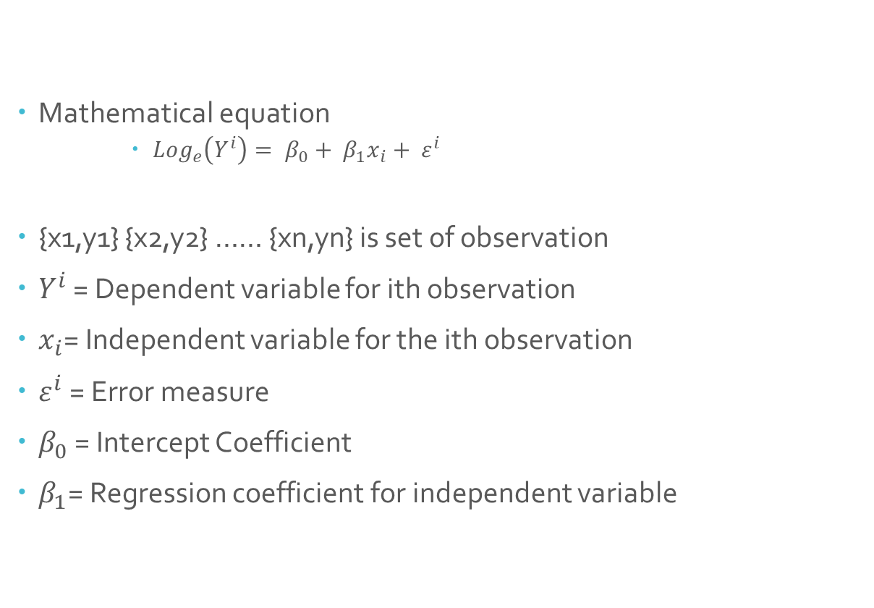
Log-Linear Regression
Mathematical equation
    ${Log}_{e}\left(Y^{i}\right)= β_{0}+ β_{1}x_{i}+ ε^{i}$
{x1,y1} {x2,y2} …… {xn,yn} is set of observation
$Y^{i}$ = Dependent variable for ith observation
$x_{i}$= Independent variable for the ith observation
$ε^{i}$ = Error measure
$β_{0}$ = Intercept Coefficient
$β_{1}$= Regression coefficient for independent variable

Slide 30
Data Integration
combines data from multiple sources(like flat files, data cubes, data bases, etc.) into a coherent store
Issues in Data Integration
1) Schema integration ( a data integration issue)
  integrate metadata from different sources
  metadata: data about the data (i.e., data descriptors) -can be used to help avoid errors in schema integration.
  Examples of metadata for each attribute include the name, meaning, data type, and range of values permitted for the attribute, and null rules for handling blank, zero, or null values.
  Entity identification problem: identify real world entities from multiple data sources, e.g., A.cust-id  B.cust-# (number)
2) Detecting and resolving data value conflicts
  for the same real world entity, attribute values from different sources are
  different (e.g., J.D.Smith and Jonh Smith may refer to the same person)
  possible reasons: different representations, different scales, e.g., metric vs. British units (inches vs. cm)

Slide 31
Data Integration
3) Redundancy in data may occur due to multiple database
Method to handle redundant data
  Chi- Square test – Nominal Data
  Correlation coefficient and covariance analysis – Numeric Data
  4) Data Value Conflict and resolution
    two types of Data Conflict
    Uncertainity
    Contradiction

Slide 32
Data Transformation
Smoothing: remove noise from data
Aggregation: summarization, data cube construction
Generalization: concept hierarchy climbing
Normalization: scaled to fall within a small, specified range
  min-max normalization
  z-score normalization
  normalization by decimal scaling
Attribute/feature construction
  New attributes constructed from the given ones

Slide 33
Concept Hierarchy Generation for Categorical Data
Specification of a set of attributes, but not of their partial ordering
Auto generate the attribute ordering based upon observation that attribute defining a high level concept has a smaller # of distinct values than an attribute defining a lower level concept
Example : country (15), state_or_province (365), city (3567),
street (674,339)
Specification of only a partial set of attributes
Try and parse database schema to determine
complete hierarchy

Slide 34
Specification of a set of Attributes
Concept hierarchy can be automatically generated based on the number of distinct values per attribute in the given attribute set. The attribute with the most distinct values is placed at the lowest level of the hierarchy.
country
province_or_ state
15 distinct values
65 distinct values
3567 distinct values
674,339 distinct values
city
street

Slide 35
Min-Max Normalization
Min-max normalization performs a linear transformation on the original data. Suppose that minA and maxA are the minimum and maximum values of an attribute, A. Min-max normalization maps a value, v, of A to v’ in the range [new minA;new maxA], by computing
Min-max normalization preserves the relationships among the original data values.
e.g. convert age=30 to range 0-1, when min=10,max=80. new_age=(30-10)/(80-10)=2/7
v − minA
v' =
(new _ maxA − new _ minA) + new _ minA
maxA − minA

Slide 36

Example 1:
Min-max normalization. Suppose that the minimum and maximum values for the attribute income are $12,000 and $98,000, respectively. We would like to map income to the range [0.0;1.0]. By min-max normalization, a value of $73,600 for income is transformed to ?
v − minA
v' =
(new _ maxA − new _ minA) + new _ minA
maxA − minA

Slide 37
Z- Score
In z-score normalization (or zero-mean normalization), the values for an attribute, A, are normalized based on the mean and standard deviation of A. A value, v, of A is normalized to v’ by computing
This method of normalization is useful when the actual minimum and maximum of attribute A are unknown, or when there are outliers that dominate the min-max normalization
_{v' =} v − meanA
stand_devA

Slide 38

Example 1:
Suppose that the mean and standard deviation of the values for the attribute income are $54,000 and $16,000, respectively. With z-score normalization, a value of $73,600 for income is transformed to ?
_{v’ =} v − meanA
stand_deva
_{v’=}

Slide 39
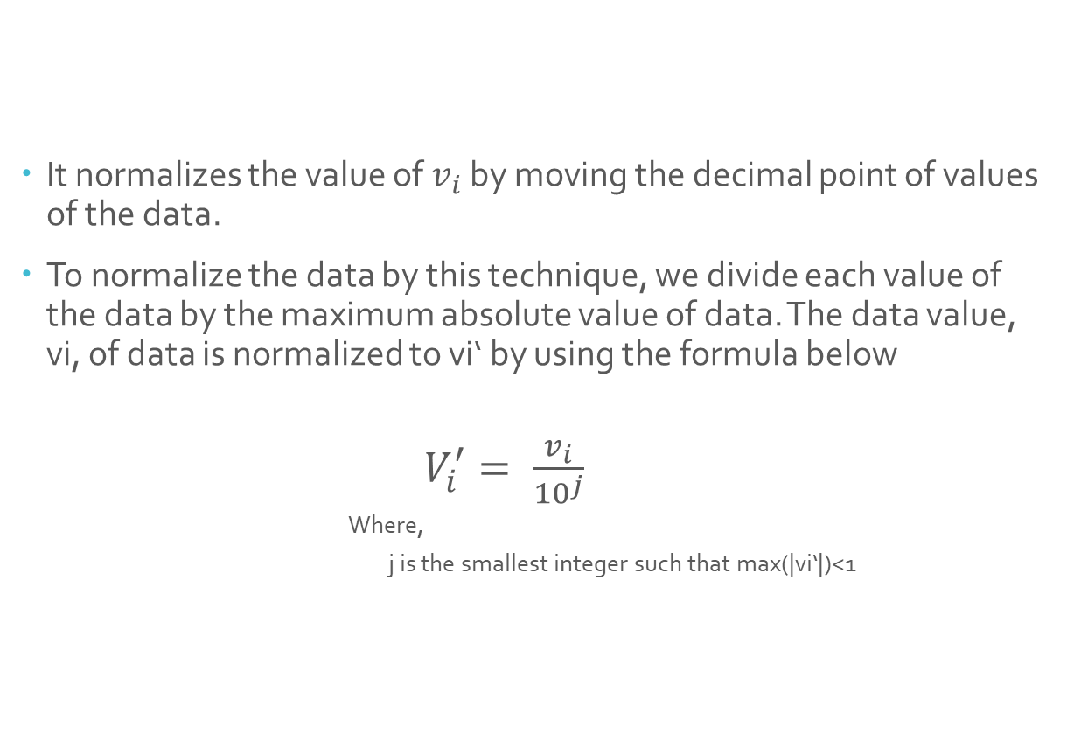
Decimal Scaling
It normalizes the value of $v_{i}$ by moving the decimal point of values of the data.
To normalize the data by this technique, we divide each value of the data by the maximum absolute value of data. The data value, vi, of data is normalized to vi‘ by using the formula below
          $V_{i}^{′}= \frac{v_{i}}{{10}^{j}}$
          Where,
          j is the smallest integer such that max(|vi‘|)<1

Slide 40
Example:
Ex.1: Let the input data is: -10, 201, 301, -401, 501, 601, 701
To normalize the above data,
Step 1: Maximum absolute value in given data(m): 701
Step 2: Divide the given data by 1000 (i.e j=3)
Result: The normalized data is: -0.01, 0.201, 0.301, -0.401, 0.501, 0.601, 0.701

Slide 41
Data Reduction
Why data reduction?
  A database/data warehouse may store terabytes of data
  Complex data analysis/mining may take a very long time to run on the complete data set
Data reduction
  Obtain a reduced representation of the data set that is much smaller in volume but yet produce the same (or almost the same) analytical results
Data reduction strategies
  Data Cube Aggregation
  Numerosity Reduction
  Sampling
  Dimensionality Reduction
  Wavelet Transforms
  Principal Component Analysis
  Feature subset selection
  Feature creation
  Discretization and Binarization
  Attribute Transformation

Slide 42
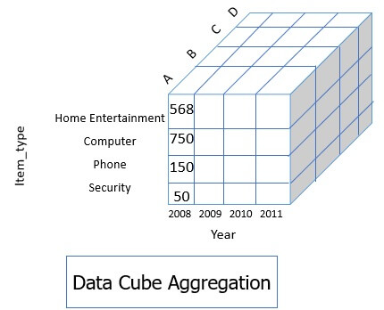
Data Cube Aggregation
Multiple levels of aggregation in data cubes Further reduce the size of data to deal with
Reference appropriate levels
Use the smallest representation which is enough to solve the task
Queries regarding aggregated information should be answered using data cube, when possible

Slide 43
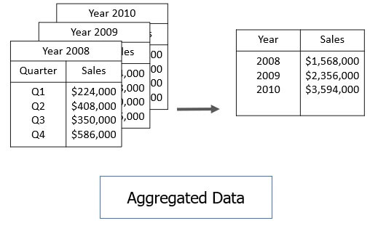
Aggregation example

Slide 44
Dimensionality Reduction
  Feature/Attribute Subset Selection
  Redundant features
    duplicate much or all of the information contained in one or more other attributes
    Example: purchase price of a product and the amount of sales tax paid
  Irrelevant features
    contain no information that is useful for the data mining task at hand
    Example: students' ID is often irrelevant to the task of predicting students' GPA

Slide 45
Attribute Selection Techniques
Forward Selection
Stepwise Backward Elimination
Combination of Forward Selection and Stepwise Backward Elimination
Decision Tree Induction

Slide 46
Data Compression
Lossless Compression
  Lossless compression involves compressing data in such a way that the original data set is fully reconstructed upon reversal of compression.
  Used for image compression and exe file compression.
Lossy Compression
  Lossy is a data encoding and compression technique that deliberately discards some data in the compression process. The lossy compression method filters and discards needless and redundant data to reduce the amount of data being compressed and later being executed on a computer.
  Used for compression of Audio and video.
  Methods like Principal component analysis and Wavelet transforms are included in lossy compression.

Slide 47
Numerosity Reduction
The numerosity reduction reduces the volume of the original data and represents it in a much smaller form. This technique includes two types parametric and non-parametric numerosity reduction.
Parametric Techniques includes:
  Linear Regression
  Log Linear Regression
Non-Parametric Techniques includes:
  Histogram
  Clustering
  Sampling

Slide 48
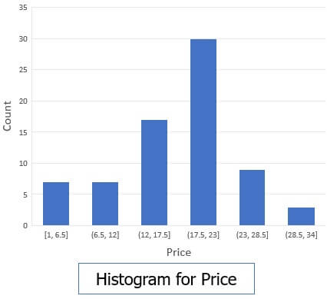
Histogram
A histogram is a ‘graph’ that represents frequency distribution which describes how often a value appears in the data. Histogram uses the binning method and to represent data distribution of an attribute. It uses disjoint subset which we call as bin or buckets.
For example Electronics data set, which contains prices for regularly sold items.
1, 1, 5, 5, 5, 5, 5, 8, 8, 10, 10, 10, 10, 12, 14, 14, 14, 15, 15, 15, 15, 15, 15, 18, 18, 18, 18, 18, 18, 18, 18, 20, 20, 20, 20, 20, 20, 20, 21, 21, 21, 21, 25, 25, 25, 25, 25, 28, 28, 30, 30, 30.

Slide 49
Sampling
Types of Sampling
Simple Random Sampling
  There is an equal probability of selecting any particular item
Sampling without replacement
  As each item is selected, it is removed from the population
Sampling with replacement
  Objects are not removed from the population as they are selected for the sample.
  In sampling with replacement, the same object can be picked up more than once

Slide 50
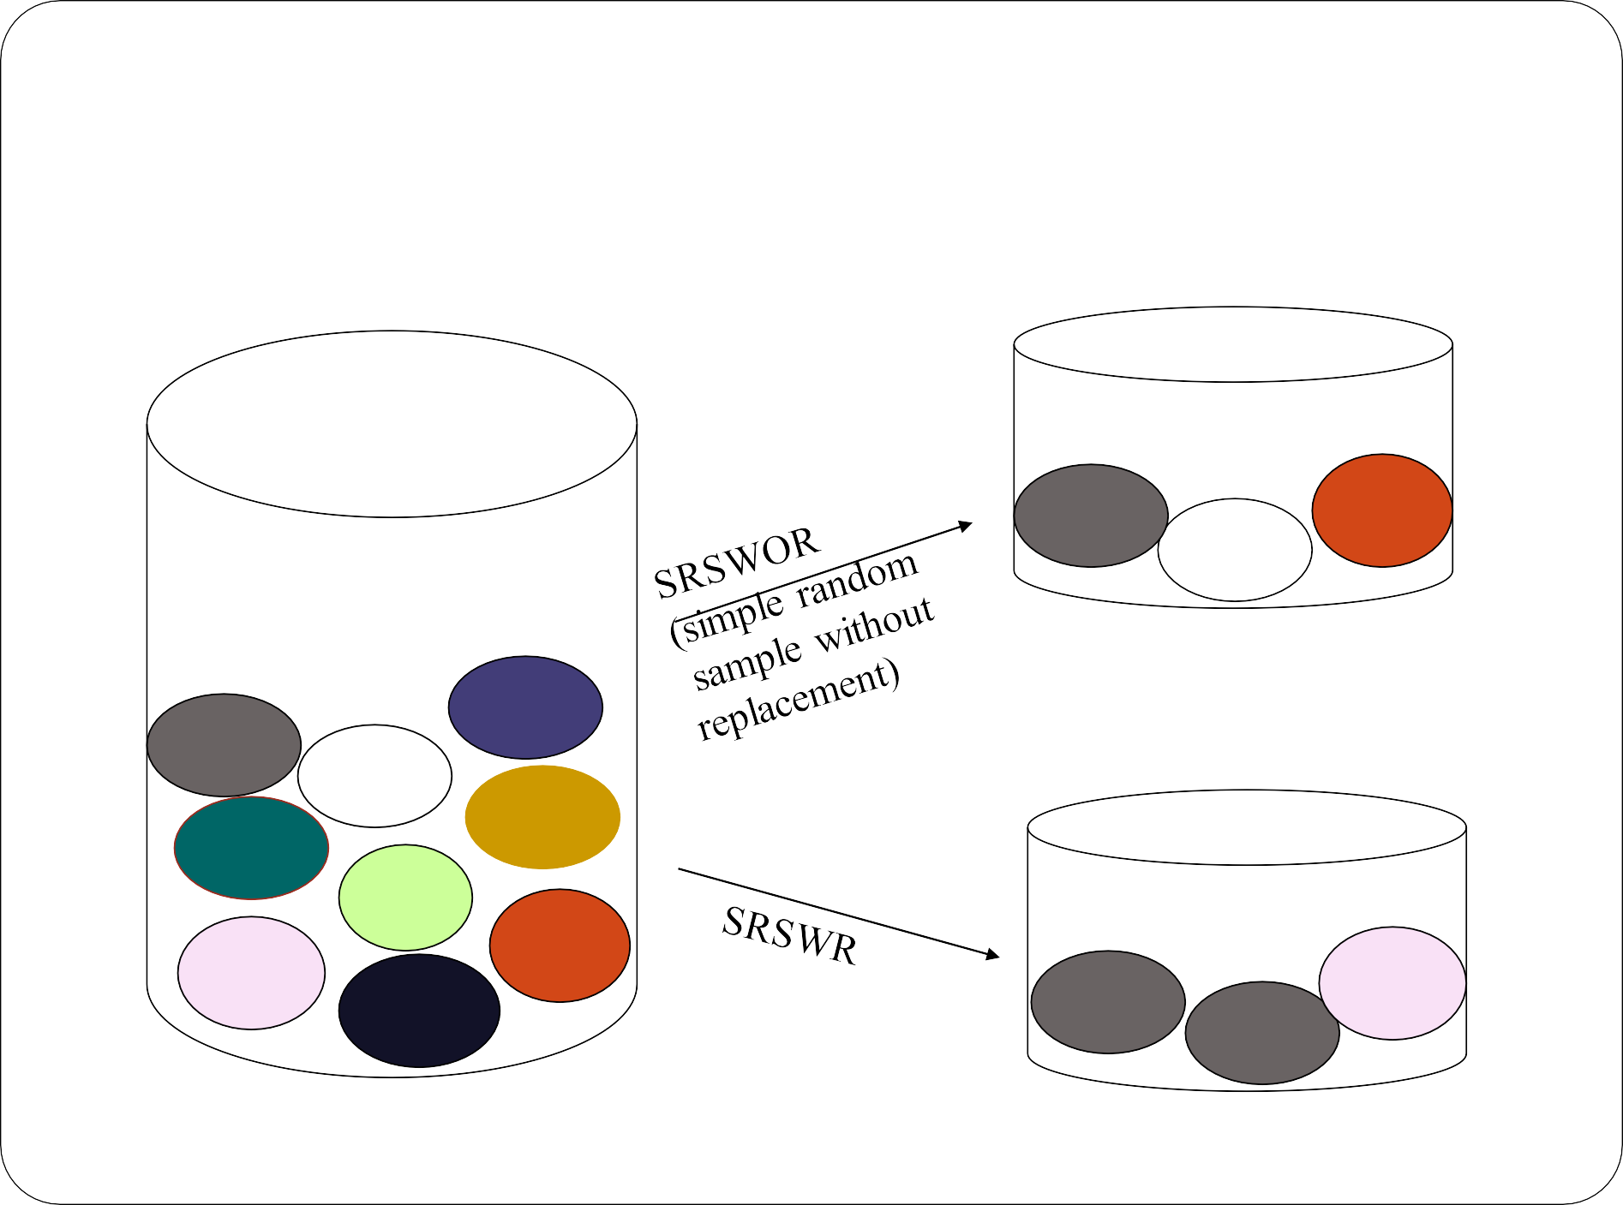
Sampling

Slide 51
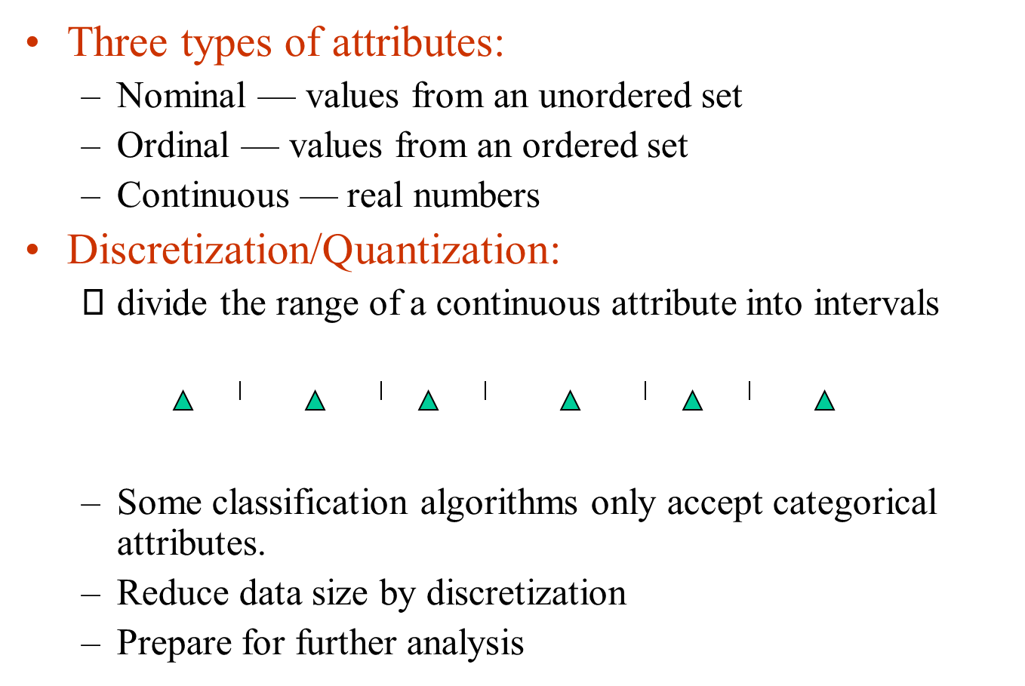
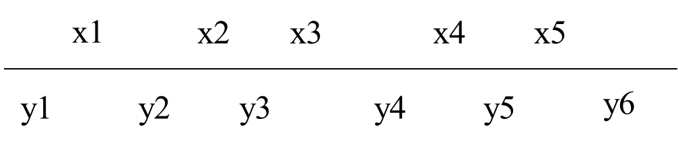
Data Discretization

Slide 52
Discretization Techniques
Discretization by binning
Discretization by Histogram Analysis
Entropy based Discretization

Slide 53
Discretization by Histogram Analysis
Equal-Width Histogram
Equal-Depth(frequency) Partitioning
V-Optimal
MaxDiff

Slide 54
Feature Engineering
It is an art of selecting the important features and transforming them into refined and meaningful features that suit the needs of the model.
Steps of Feature Engineering:
  Feature creation
  Feature Extraction
  Feature Scaling
  Feature Selection

Slide 55
Advantages of Feature Engineering
Better representation of data
Higher efficiency of the model
Easier Algorithms that fit the data
Easier for Algorithms to detect patterns in the data
Greater Flexibility of the features

Slide 56
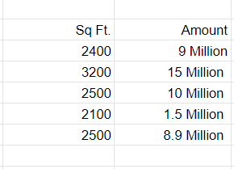
Example to understand Feature Engineering
let’s take a simple example that below are the prices of properties in x city. It shows the area of the house and total price.

Slide 57
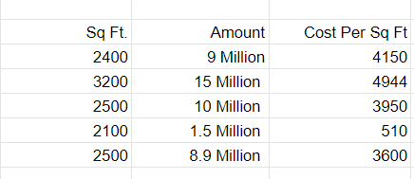
Example to understand Feature Engineering
this data might have some errors or might be incorrect, not all sources on the internet are correct. To begin, we’ll add a new column to display the cost per square foot.

Slide 58
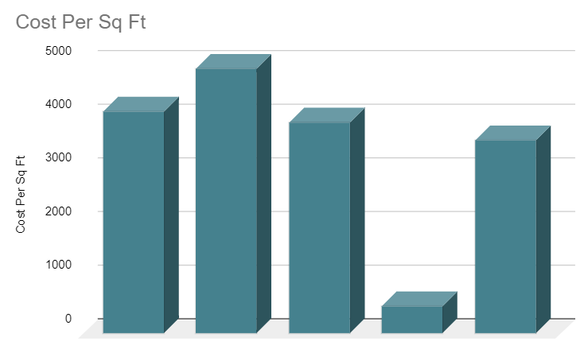
Example to understand Feature Engineering
The data can be visualized as cost per square ft. in particular city.

Slide 59
Feature Extraction
Feature Extraction aims to reduce the number of features in a dataset by creating new features from the existing ones (and then discarding the original features).
TheseFeature Extraction is basically a process of dimensionality reduction where the raw data obtained is separated into related manageable groups.
The new reduced set of features should then be able to summarize most of the information contained in the original set of features.
In this way, a summarised version of the original features can be created from a combination of the original set.
Feature extraction is based on data types.

Slide 60
Feature Scaling
Feature scaling is a method used to normalize the range of independent variables or features of data.
In data processing, it is also known as data normalization and is generally performed during the data preprocessing step.
Feature Scaling includes:
  Standardized scaling
  Min-Max Normalization
  Robust Scaling

Slide 61

Feature Scaling
Standardized Scaling:
    ss(xi)=$\frac{Xi−Mean(x) }{S.D}$
Robust Scaling
$Rs\left(xi\right)= \frac{xi−Median(x)}{{IQR}_{\left(1,3\right)}(x)}$

Slide 62
Feature Selection
Feature selection methods are intended to reduce the number of input variables to those that are believed to be most useful to a model in order to predict the target variable.
Techniques for feature selection
  Filter Methods
  Wrapper Method
  Embedded Method

Slide 63
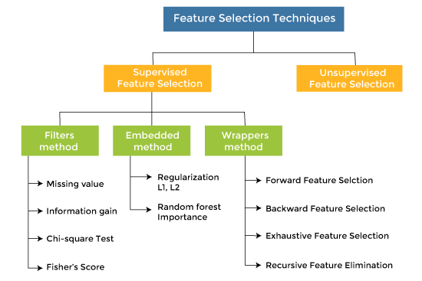
Feature Selection

Slide 64
Advantages
It helps in avoiding the curse of dimensionality.
It helps in the simplification of the model so that it can be easily interpreted by the researchers.
It reduces the training time.
It reduces overfitting hence enhance the generalization.

Slide 65
Filter Method
Filter feature selection methods use statistical techniques to evaluate the relationship between each input variable and the target variable, and these scores are used as the basis to choose (filter) those input variables that will be used in the model.

Slide 66
Wrapper Method
Wrapper feature selection methods create many models with different subsets of input features and select those features that result in the best performing model according to a performance metric.
These methods are unconcerned with the variable types, although they can be computationally expensive.

Slide 67
Embedded Methods
Embedded methods combined the advantages of both filter and wrapper methods by considering the interaction of features along with low computational cost.
These are fast processing methods similar to the filter method but more accurate than the filter method.

