Slide 1

Concept Description, Mining Frequent Patterns, Associations and Correlations
Department of Computer Engineering
Unit no: 3
Unit title: Concept Description, Mining Frequent patterns, Associations and Correlatiom
Subject name and code: Data Mining
(3160714)
Unit-3
Prof. Aastha Masrani

Slide 2
OUTLINES
Concept Description
Attribute Relevance
Class Comparisions
Frequent Item-set Mining
Association Rule Mining
Correlation Analysis in Association rule mining
Advanced Association Rule techniques

Slide 3
Concept Description
Data Mining can be classified in two categories
  Descriptive Data Mining
  Predictive Data Mining

Slide 4
Descriptive Analysis
The descriptive function deals with the general properties of data in the database.
Techniques for Descriptive analysis
  Class/Concept Description
  Mining of Frequent Patterns
  Mining of Associations
  Mining of Correlations
  Mining of Clusters

Slide 5
Concepts/Class
Data can be associated with classes or concepts.
It can be useful to describe individual classes and concepts in summarized, concise, and yet precise terms.
Such descriptions of a class or a concept are called class/concept descriptions.
These descriptions can be derived via
(1) data characterization, by summarizing the data of the class under study (often called the target class) in general terms
(2) data discrimination, by comparison of the target class with one or a set of comparative classes (often called the contrasting classes)
(3) both data characterization and discrimination.

Slide 6
Frequent pattern Mining
Frequent Pattern: a pattern (a set of items, subsequences, substructures, etc.) that occurs frequently in a data set
Goal: finding inherent regularities in data
  What products were often purchased together?— Beer and diapers?!
  What are the subsequent purchases after buying a PC?
  What kinds of DNA are sensitive to this new drug?
  Can we automatically classify Web documents?
Applications:
  Basket data analysis, cross-marketing, catalog design, sale campaign analysis, Web log (click stream) analysis, and DNA sequence analysis

Slide 7
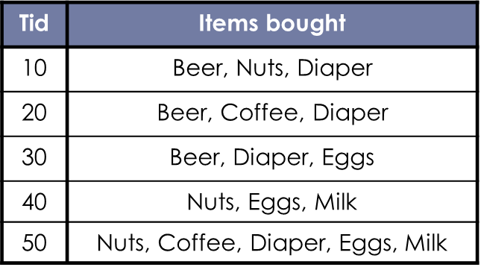
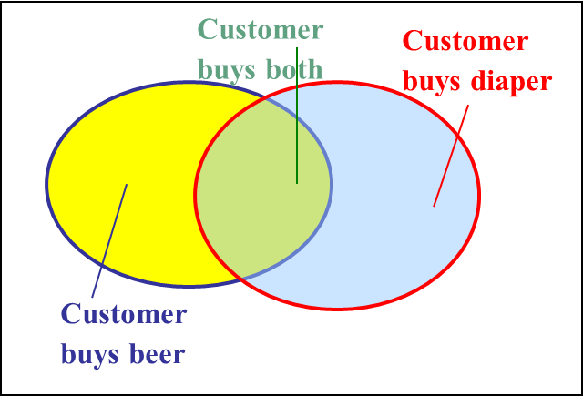

Basic Concepts: Frequent pattern Mining
itemset: A set of one or more items
k-itemset X = {x₁, …, x_{k}}
support, or, support count of X: Frequency or occurrence of an itemset X
An itemset X is frequent if X’s support is no less than a minsup threshold

Slide 8
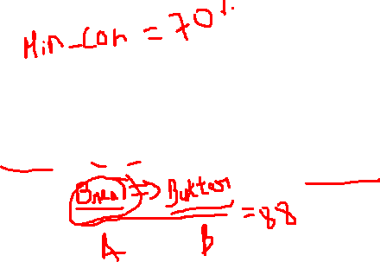
Basic Concepts: Frequent pattern Mining

Slide 9

Basic Concept: Association Rule
Find all the rules X → Y with minimum support and confidence
support, s, probability that a transaction contains X ∪ Y
confidence, c, conditional probability that a transaction having X also contains Y
Customer buys both
Customer buys diaper
Let minsup = 50%, minconf = 50%
Freq. Pat.: Beer:3, Nuts:3, Diaper:4, Eggs:3,
{Beer, Diaper}:3
Customer
buys beer
Association rules: (many more!)
Beer → Diaper (60%, 100%)
Diaper → Beer (60%, 75%)

Slide 10
Definition: Frequent Itemset
TID | Items
1 | Bread, Milk
2 | Bread, Diaper, Beer, Eggs
3 | Milk, Diaper, Beer, Coke
4 | Bread, Milk, Diaper, Beer
5 | Bread, Milk, Diaper, Coke
Itemset
  A collection of one or more items
    Example: {Milk, Bread, Diaper}
  k-itemset
    An itemset that contains k items
Support count (σ)
  Frequency of occurrence of an itemset
  E.g. σ({Milk, Bread,Diaper}) = 2
Support
  Fraction of transactions that contain an itemset
  E.g. s({Milk, Bread, Diaper}) = 2/5
Frequent Itemset
  An itemset whose support is greater than or equal to a minsup threshold

Slide 11
Definition: Association Rule
TID | Items
1 | Bread, Milk
2 | Bread, Diaper, Beer, Eggs
3 | Milk, Diaper, Beer, Coke
4 | Bread, Milk, Diaper, Beer
5 | Bread, Milk, Diaper, Coke
Association Rule
– An implication expression of the form
X → Y, where X and Y are itemsets
Example:
{Milk, Diaper} → {Beer}
Rule Evaluation Metrics
Example:
{Milk, Diaper} ⇒ Beer
Support (s)
  Fraction of transactions that contain
both X and Y
Confidence (c)
  Measures how often items in Y appear in transactions that contain X
_{s =} σ (Milk, Diaper, Beer) ₌ 2 _{= 0.4}
| T | 5
_{c =} σ (Milk, Diaper, Beer) ₌ 2 _{= 0.67}
ο (Milk, Diaper)
3

Slide 12
Scalable Methods for Mining Frequent Patterns
The downward closure property of frequent patterns
  Any subset of a frequent itemset must be frequent
  If {beer, diaper, nuts} is frequent, so is {beer, diaper}
  i.e., every transaction having {beer, diaper, nuts} also contains {beer, diaper}
Scalable mining methods: Three major approaches
  Apriori (Agrawal & Srikant@VLDB’94)
  Freq. pattern growth (FPgrowth—Han, Pei & Yin @SIGMOD’00)
  Vertical data format approach (Charm—Zaki & Hsiao @SDM’02)

Slide 13
Apriori: A Candidate Generation-and-Test Approach
Apriori pruning principle: If there is any itemset which is infrequent, its superset should not be generated/tested! (Agrawal & Srikant @VLDB’94, Mannila, et al. @ KDD’ 94)
Method:
  Initially, scan DB once to get frequent 1-itemset
  Generate length (k+1) candidate itemsets from length k frequent itemsets
  Test the candidates against DB
  Terminate when no frequent or candidate set can be generated

Slide 14
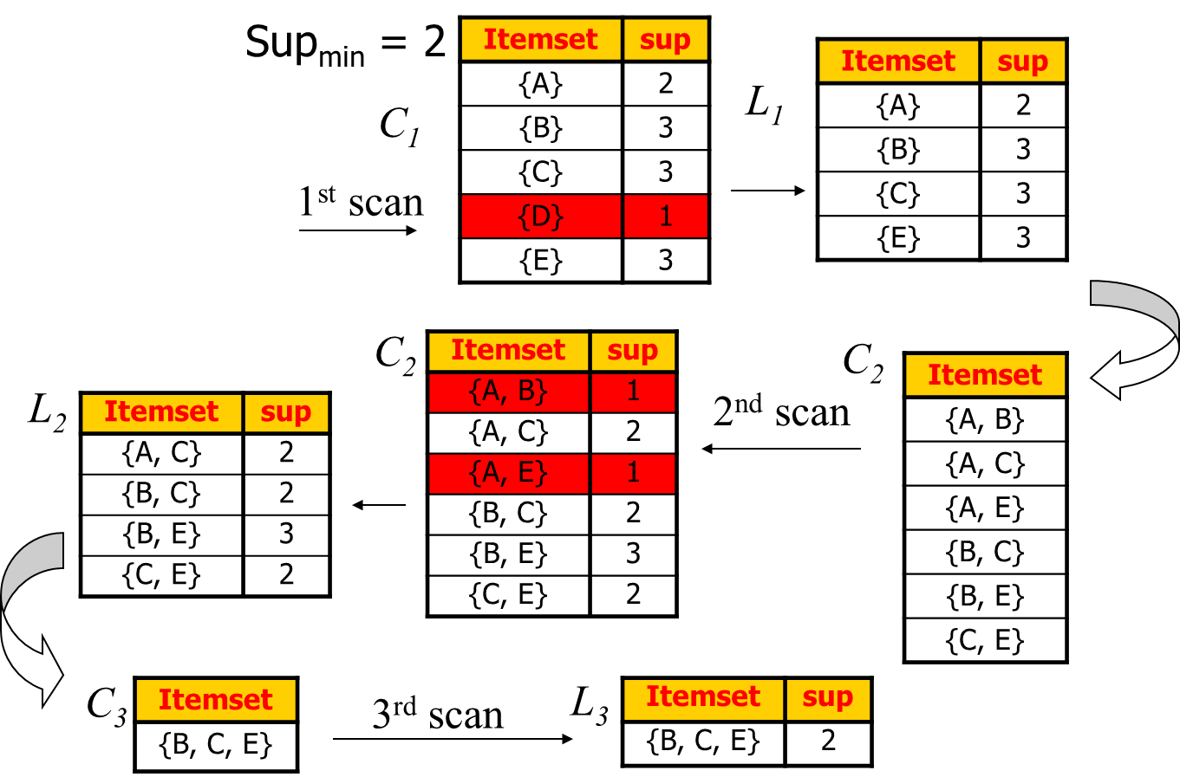
The Apriori Algorithm—An Example
Tid | Items
10 | A, C, D
20 | B, C, E
30 | A, B, C, E
40 | B, E

Slide 15
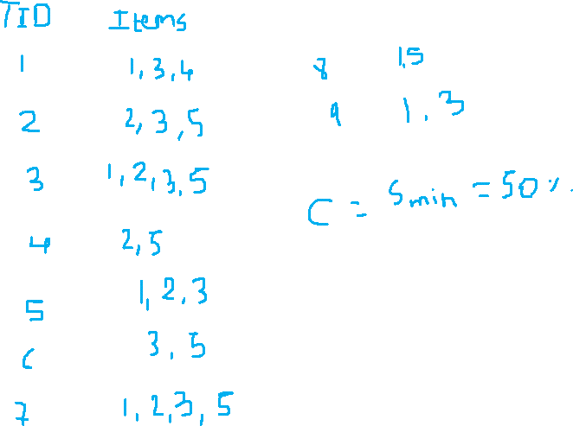

Slide 16
The Apriori Algorithm
Pseudo-code:
    C_{k}: Candidate itemset of size k
    L_{k} : frequent itemset of size k
    L₁ = {frequent items};
    for (k = 1; L_{k} !=∅; k++) do begin
    C_{k+1} = candidates generated from L_{k};
    for each transaction t in database do
      increment the count of all candidates in C_{k+1} that are contained in t
    L_{k+1} = candidates in C_{k+1} with min_support
    end
    return ∪_{k} L_{k};

Slide 17
Important Details of Apriori
How to generate candidates?
  Step 1: self-joining L_{k}
  Step 2: pruning
How to count supports of candidates?
Example of Candidate-generation
  L₃={abc, abd, acd, ace, bcd}
  Self-joining: L₃*L₃
    abcd from abc and abd
    acde from acd and ace
  Pruning:
    acde is removed because ade is not in L₃
  C₄={abcd}

Slide 18
How to Count Supports of Candidates?
Why counting supports of candidates a problem?
  The total number of candidates can be very huge
  One transaction may contain many candidates
Method:
  Candidate itemsets are stored in a hash-tree
  Leaf node of hash-tree contains a list of itemsets and counts
  Interior node contains a hash table
  Subset function: finds all the candidates contained in a transaction

Slide 19
Challenges of Frequent Pattern Mining
Challenges
  Multiple scans of transaction database
  Huge number of candidates
  Tedious workload of support counting for candidates
Improving Apriori: general ideas
  Reduce passes of transaction database scans
  Shrink number of candidates
  Facilitate support counting of candidates

Slide 20
Techiques to improve efficiency of Apriori Algorithm
Hash Based Technique
Transaction Reduction
Partitioning
Sampling

Slide 21
Hash Based Technique
A hash-based technique can be used to decrease the size of the candidate k-itemsets, Ck, for k > 1
For instance, when scanning each transaction in the database to create the frequent 1-itemsets,L1, from the candidate 1-itemsets in C1, it can make some 2-itemsets for each transaction, hash (i.e., map) them into the several buckets of a hash table structure, and increase the equivalent bucket counts.

Slide 22
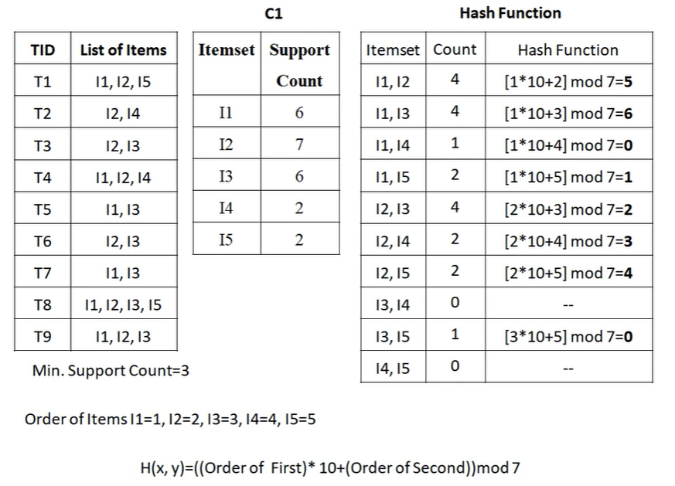
Hash Based Technique Example

Slide 23
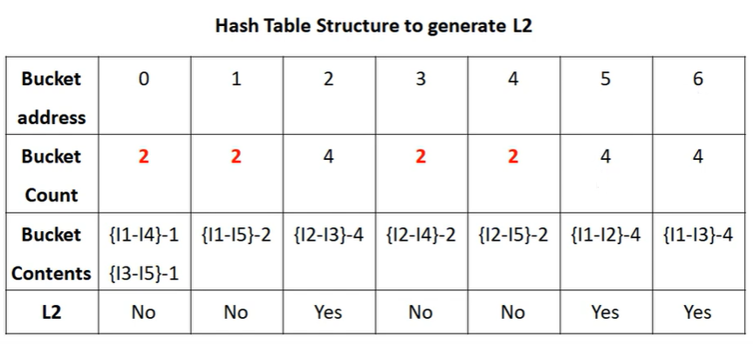
Hash Based Technique Example

Slide 24
Transaction Reduction
A transaction that does not include some frequent k-itemsets cannot include some frequent (k + 1)-itemsets.
Thus, such a transaction can be marked or deleted from further consideration because subsequent scans of the database for j-itemsets, where j > k, will not need it.

Slide 25
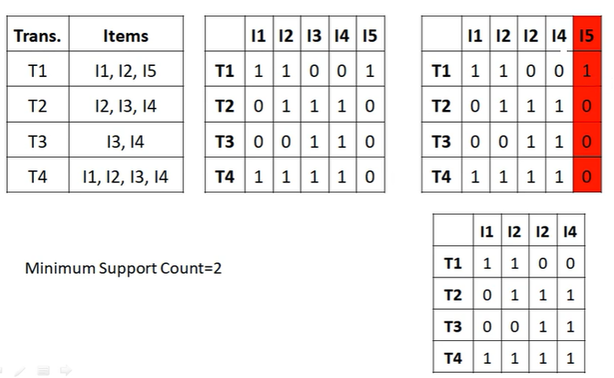
Transaction Reduction Example

Slide 26
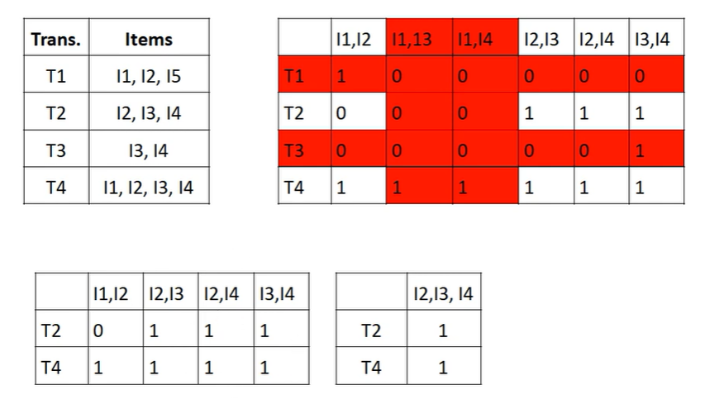
Transaction Reduction Example

Slide 27
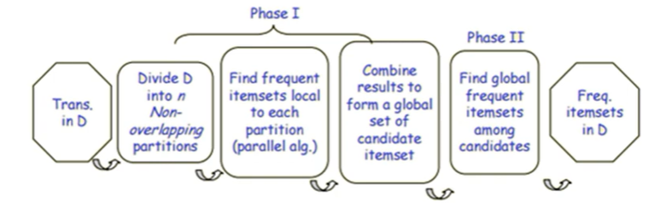
Partitioning Technique
A partitioning technique can be used that needed two database scans to mine the frequent itemsets.
It includes two phases involving In Phase I, the algorithm subdivides the transactions of D into n non-overlapping partitions
If the minimum support threshold for transactions in D is min_sup, therefore the minimum support count for a partition is min_sup × the number of transactions in that partition

Slide 28
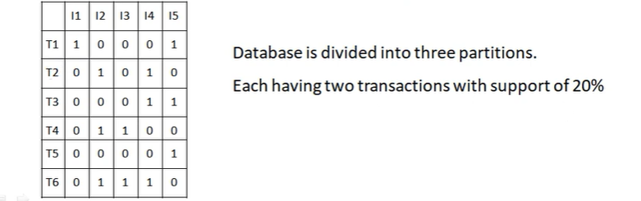
Partitioning Technique Example

Slide 29
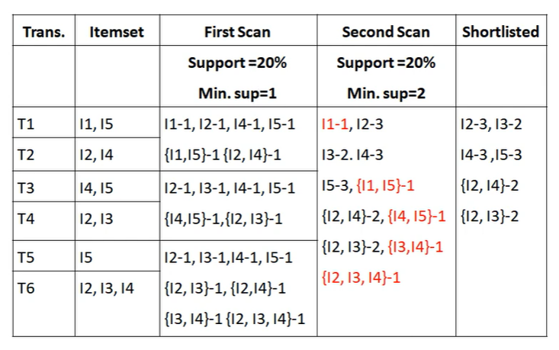
Partitioning Technique Example

Slide 30
Mining Frequent Patterns With FP-trees
Idea: Frequent pattern growth
  Recursively grow frequent patterns by pattern and database partition
Method
  For each frequent item, construct its conditional pattern-base, and then its conditional FP-tree
  Repeat the process on each newly created conditional FP-tree
  Until the resulting FP-tree is empty, or it contains only one path—single path will generate all the combinations of its sub-paths, each of which is a frequent pattern

Slide 31
Sampling
The fundamental idea of the sampling approach is to select a random sample S of the given data D, and then search for frequent itemsets in S rather than D.
In this method, it can trade off some degree of accuracy against efficiency.
The sample size of S is such that the search for frequent itemsets in S can be completed in main memory, and therefore only one scan of the transactions in S is needed overall.

Slide 32
Benefits of the FP-tree Structure
Completeness
  Preserve complete information for frequent pattern mining
  Never break a long pattern of any transaction
Compactness
  Reduce irrelevant info—infrequent items are gone
  Items in frequency descending order: the more frequently occurring, the more likely to be shared
  Never be larger than the original database (not count node-links and the count field)
  For Connect-4 DB, compression ratio could be over 100

Slide 33
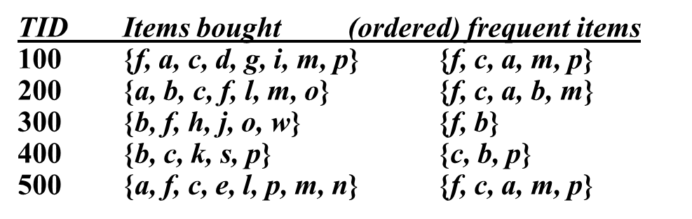
Construct FP-tree from a Transaction Database
min_support = 3
{}
Scan DB once, find frequent 1-itemset (single item pattern)
Sort frequent items in frequency descending order, f-list
Scan DB again, construct FP-tree
Header Table
Item frequency head
f 4
c 4
a 3
b 3
m 3
p 3
f:4
c:1
c:3
b:1
b:1
a:3
p:1
m:2
b:1
p:2
m:1

Slide 34
Find Patterns Having P From P-conditional Database
Starting at the frequent item header table in the FP-tree
Traverse the FP-tree by following the link of each frequent item p
Accumulate all of transformed prefix paths of item p to form p’s conditional pattern base
{}
Header Table
Item frequency head
f 4
c 4
a 3
b 3
m 3
p 3
Conditional pattern bases
item cond. pattern base
c f:3
a fc:3
b fca:1, f:1, c:1
m fca:2, fcab:1
p fcam:2, cb:1
f:4
c:1
c:3
b:1
b:1
a:3
p:1
m:2
b:1
p:2
m:1

Slide 35
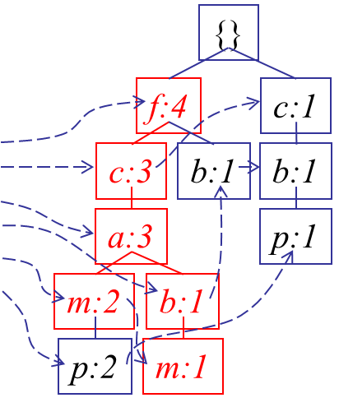
From Conditional Pattern-bases to Conditional FP-trees
For each pattern-base
  Accumulate the count for each item in the base
  Construct the FP-tree for the frequent items of the pattern base
m-conditional pattern base:
  fca:2, fcab:1
Header Table
Item frequency head
f 4
c 4
a 3
b 3
m 3
p 3
{}
All frequent patterns relate to m
m,
fm, cm, am,
fcm, fam, cam,
fcam
f:3
c:3
a:3
m-conditional FP-tree

Slide 36
Attribute Relevance
Analytical characterization is used to help and identifying the weakly relevant, or irrelevant attributes. We can exclude these unwanted irrelevant attributes when we preparing our data for the mining.

Slide 37
Attribute Relation measure
Gini index
χ2 contingency table statistics 
Gain ratio (C4.5) 
Uncertainty coefficient
information gain (ID3)

Slide 38
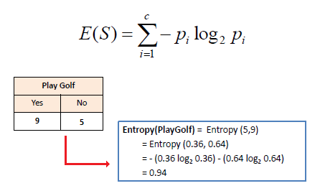
Entropy
Entropy is a measure of disorder or uncertainty and the goal of machine learning models and Data Scientists in general is to reduce uncertainty.

Slide 39
Information gain
The feature with the largest information gain should be used as the root node to start building the decision tree.
o find the best feature which serves as a root node in terms of information gain, we first use each descriptive feature and split the dataset along the values of these descriptive features and then calculate the entropy of the dataset.
This gives us the remaining entropy once we have split the dataset along the feature values.
Then, we subtract this value from the originally calculated entropy of the dataset to see how much this feature splitting reduces the original entropy which gives the information gain of a feature

Slide 40
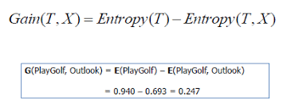

Slide 41
Gini Index
It is calculated by subtracting the sum of squared probabilities of each class from one.
It favors larger partitions and easy to implement whereas information gain favors smaller partitions with distinct values.
A feature with a lower Gini index is chosen for a split.

Slide 42
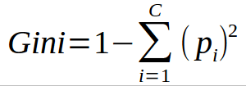

Slide 43
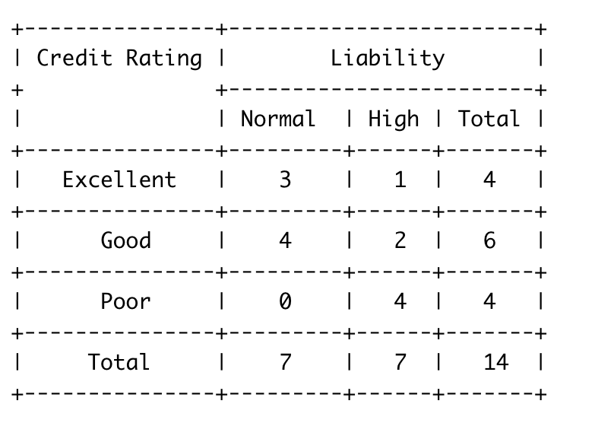
Example

Slide 44
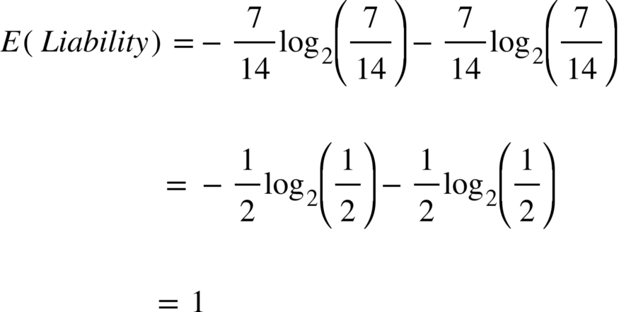

Slide 45
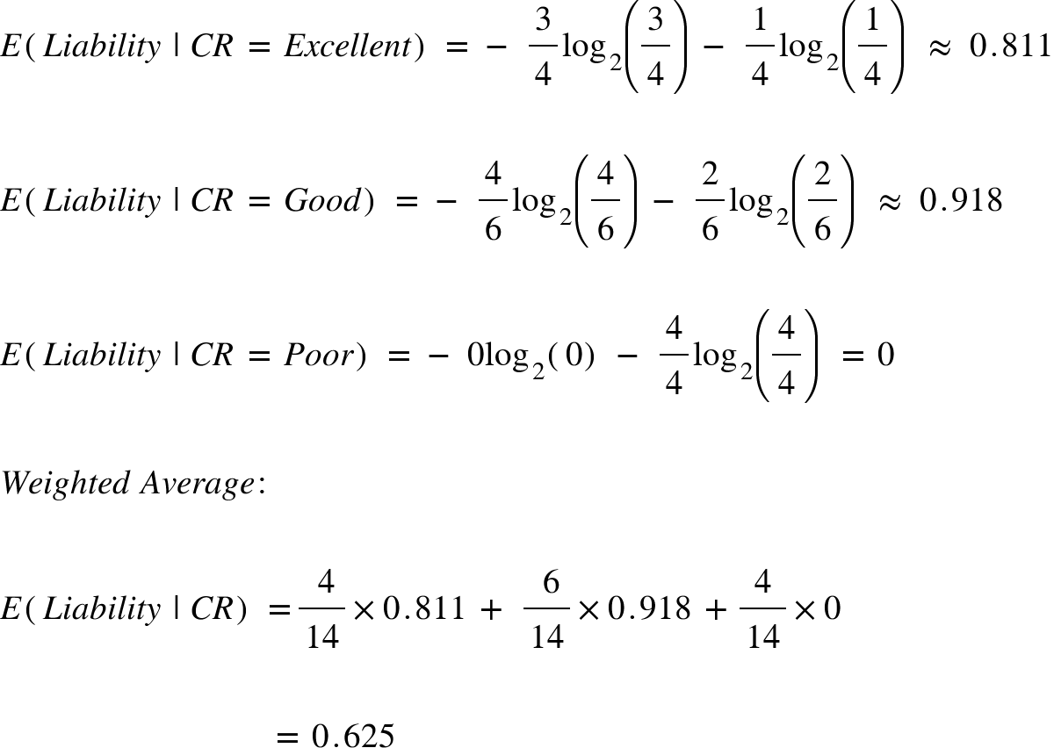

Slide 46
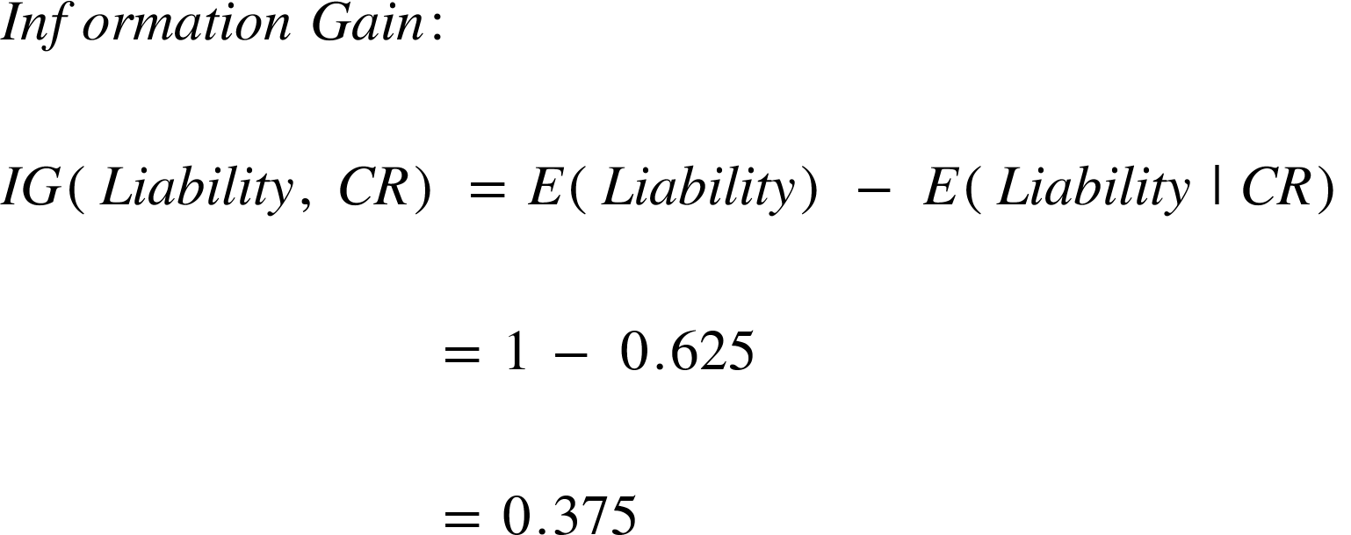

Slide 47
OLAP
Online Analytical Processing (OLAP) is a category of software that allows users to analyze information from multiple database systems at the same time.
It is a technology that enables analysts to extract and view business data from different points of view.
Analysts frequently need to group, aggregate and join data. These OLAP operations in data mining are resource intensive.
With OLAP data can be pre-calculated and pre-aggregated, making analysis faster.
OLAP databases are divided into one or more cubes. The cubes are designed in such a way that creating and viewing reports become easy. OLAP stands for Online Analytical Processing.

Slide 48
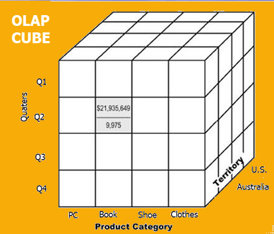
OLAP

Slide 49
Basic analytical operations of OLAP
Roll-up:
  Roll-up is also known as “consolidation” or “aggregation.” The Roll-up operation can be performed in 2 ways
  Reducing dimensions
  Climbing up concept hierarchy. Concept hierarchy is a system of grouping things based on their order or level.

Slide 50
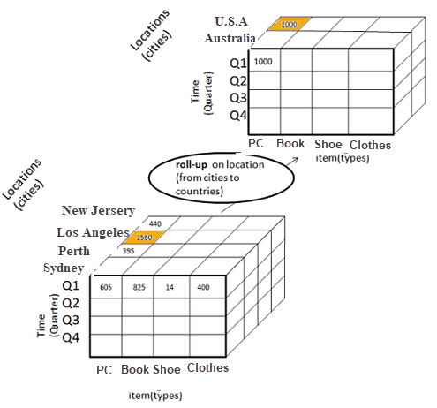
Roll-Up

Slide 51
Roll-Up
In this example, cities New jersey and Lost Angles and rolled up into country USA
The sales figure of New Jersey and Los Angeles are 440 and 1560 respectively. They become 2000 after roll-up
In this aggregation process, data is location hierarchy moves up from city to the country.
In the roll-up process at least one or more dimensions need to be removed. In this example, Cities dimension is removed.

Slide 52
Drill-down
In drill-down data is fragmented into smaller parts. It is the opposite of the rollup process. It can be done via
  Moving down the concept hierarchy
  Increasing a dimension

Slide 53
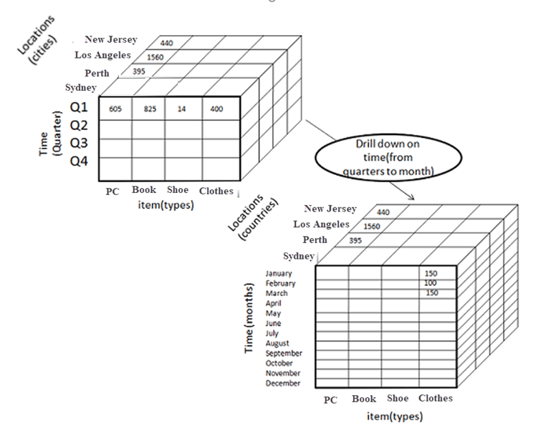
Example

Slide 54
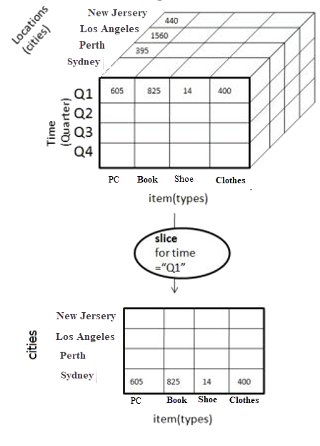
Slice
Slice
Here, one dimension is selected, and a new sub-cube is created.
Following diagram explain how slice operation performed:

Slide 55
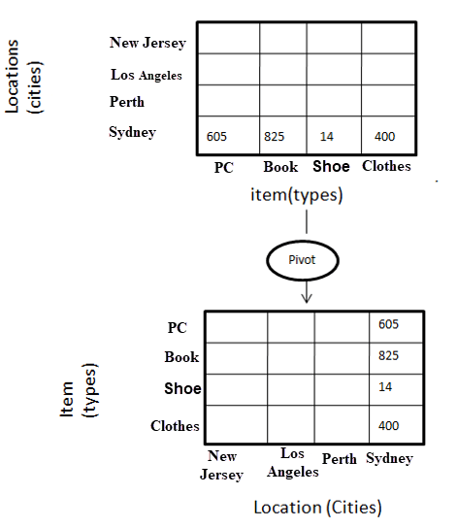
Pivot
In Pivot, you rotate the data axes to provide a substitute presentation of data.
In the following example, the pivot is based on item types.

Slide 56
OLTP
OLTP is an operational system that supports transaction-oriented applications in a 3-tier architecture.
It administers the day to day transaction of an organization. OLTP is basically focused on query processing, maintaining data integrity in multi-access environments as well as effectiveness that is measured by the total number of transactions per second. The full form of OLTP is Online Transaction Processing.

Slide 57
Characteristics of OLTP
OLTP uses transactions that include small amounts of data.
Indexed data in the database can be accessed easily.
OLTP has a large number of users.
It has fast response times
Databases are directly accessible to end-users
OLTP uses a fully normalized schema for database consistency.
The response time of OLTP system is short.
It strictly performs only the predefined operations on a small number of records.
OLTP stores the records of the last few days or a week.
It supports complex data models and tables.

Slide 58
Type of queries that an OLTP system can Process:
OLTP system is an online database changing system. Therefore, it supports database query such as insert, update, and delete information from the database.

Slide 59
Advanced Association rule
1. Associative classification
2. Multilevel Association rule

Slide 60
Pattern evaluation measures
Lift
Leverage
All_confidence
Max_confidence
Kulczynski
Cosine
Imbalance ratio

