Slide 1

E-COMMERCE PRO SHOP
Industrial Training Report
Submitted By :

Slide 2

INTRODUCTION
ProShop is the buying and selling of services, or the transmitting of funds or data, over an electronic network, primarily the internet. These business transactions occur either as business-to-business, business-to consumer, consumer-to-consumer or consumer-to-business.
E-commerce shops have become part of our daily lives. Technological advancement has made it possible for people to sit in the convenience of their homes and still shop online without going to a physical shop. Indian have also joined the trend of e-commerce business, so this project is meant to design an e-commerce online shop so that the people in India will be able to purchase their goods and services online.

Slide 3

TECHNOLOGIES USED
MERN : MERN stands for MongoDB, Express, React and Node
MongoDB : An open-source cross platform document-oriented NoSQL Database
Express : Node.js server-side web framework
React : A client-side javascript library
Node : Javascript runtime environment

Slide 4
MERN Stack Development
React JS
Express
HTML
CSS
Javascript
Bootstrap
Mongoose
Node.js Web Server
MongoDB
Frontend Development
Backend Development
Database Management

Slide 5
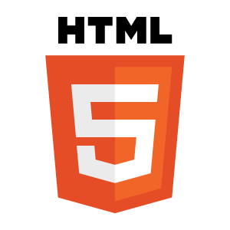
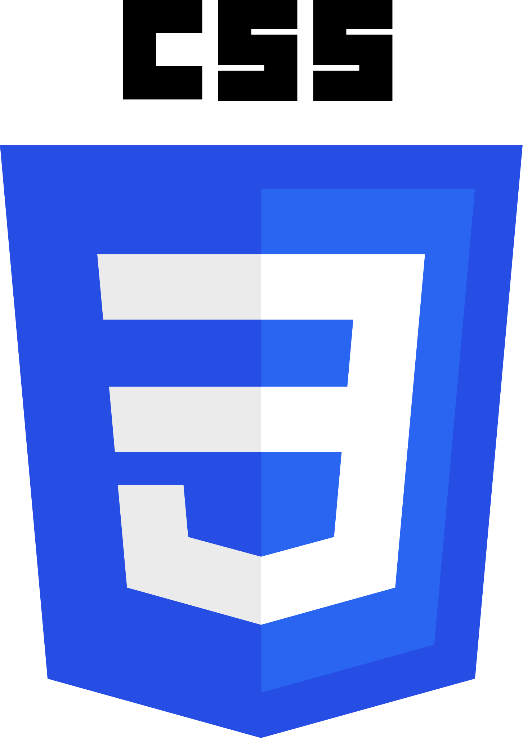
FRONTEND TECHNOLOGIES
HTML stands for Hyper Text Mark up Language . It provides a means to create structured documents by denoting structural semantics for text such as headings, paragraphs, lists etc. as well as for links, quotes, and other items.
CSS stands for Cascading Style Sheets. It is used to style a webpage. It can control the layout of multiple web pages all at once. External stylesheets are stored in CSS files.

Slide 6

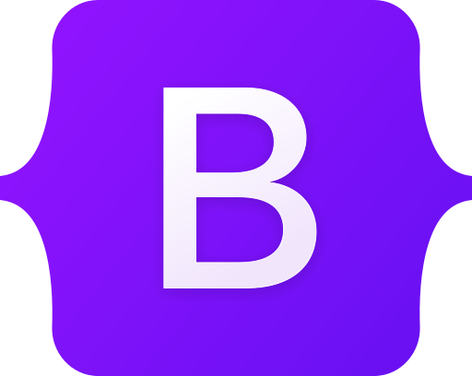

JavaScript is the most popular programming language in the world and that makes it a programmer’s great choice. Once you learnt JavaScript, it helps you developing great front-end as well as back-end software using different JavaScript based frameworks like jQuery, Node.JS etc.
Bootstrap is a free front-end framework for faster and easier web development. Bootstrap includes HTML and CSS based design templates for typography, forms, buttons, tables, navigation, modals, image carousels and many other, as well as optional JavaScript plugins.
React is a JavaScript library that is used for building user interfaces. React allows users to code in JavaScript and create UI components. React is used for the development of single-page applications and mobile applications because of its ability to handle rapidly changing data.

Slide 7
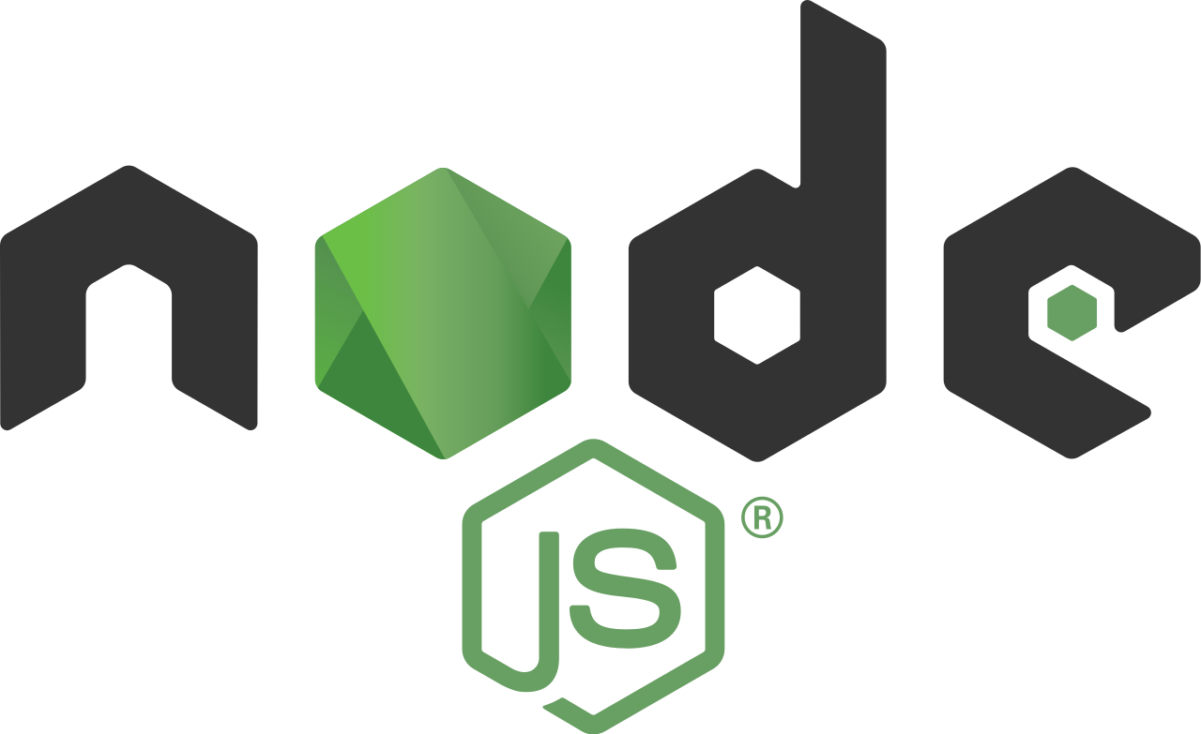

BACKEND TECHNOLOGIES
Node.js provides a JavaScript Environment which allows the user to run their code on the server (outside the browser). Node pack manager i.e. npm allows the user to choose from thousands of free packages (node modules) to download.
Express
Express is a Node.js framework. Rather than writing the code using Node.js and creating loads of Node modules, Express makes it simpler and easier to write the back-end code.
MongoDB is a NoSQL database where each record is a document comprising of key-value pairs that are similar to JSON (JavaScript Object Notation) objects. MongoDB is flexible and allows its users to create schema, databases, tables, etc. Documents that are identifiable by a primary key make up the basic unit of MongoDB

Slide 8
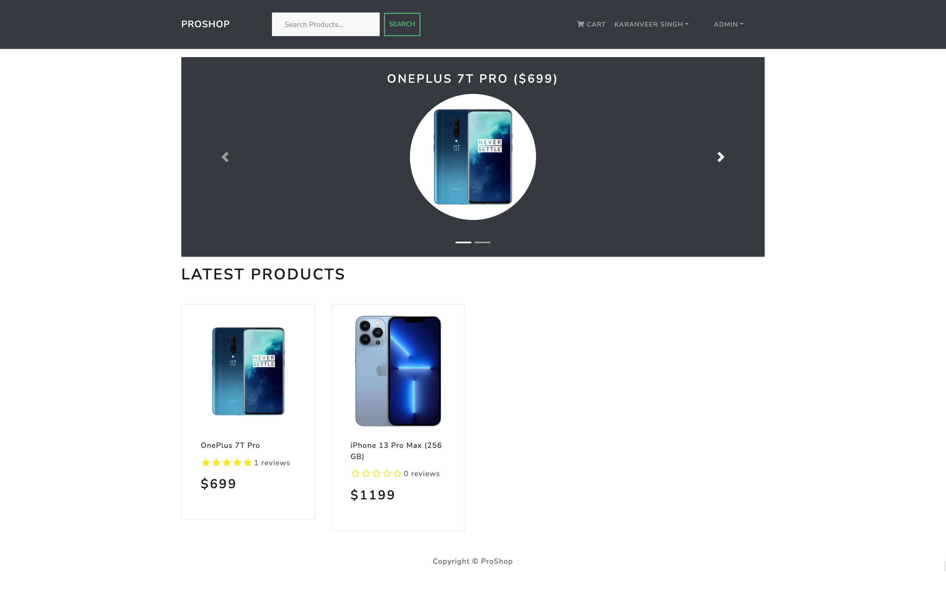

Slide 9
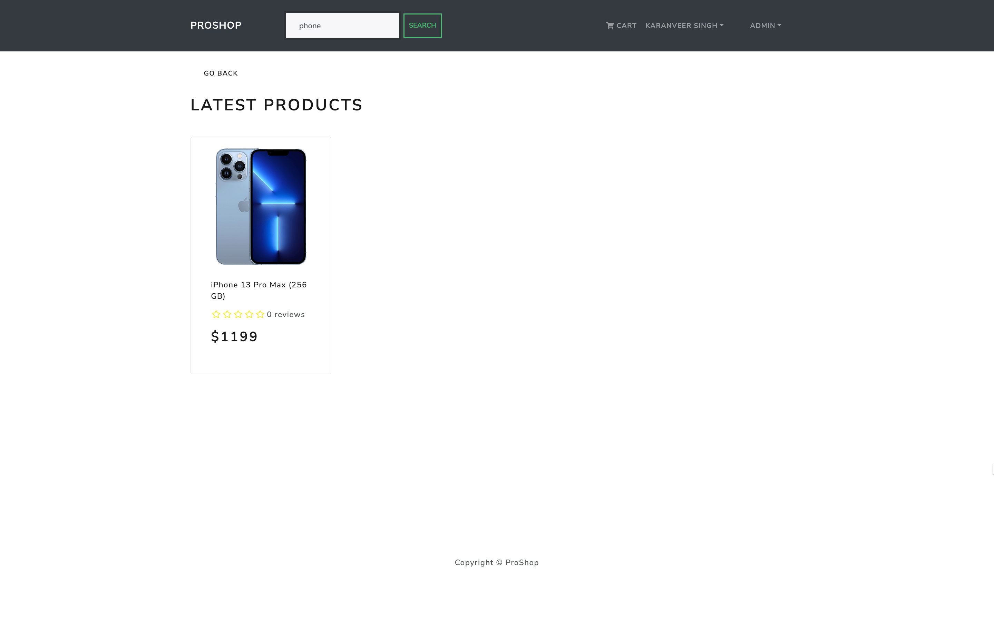

Slide 10
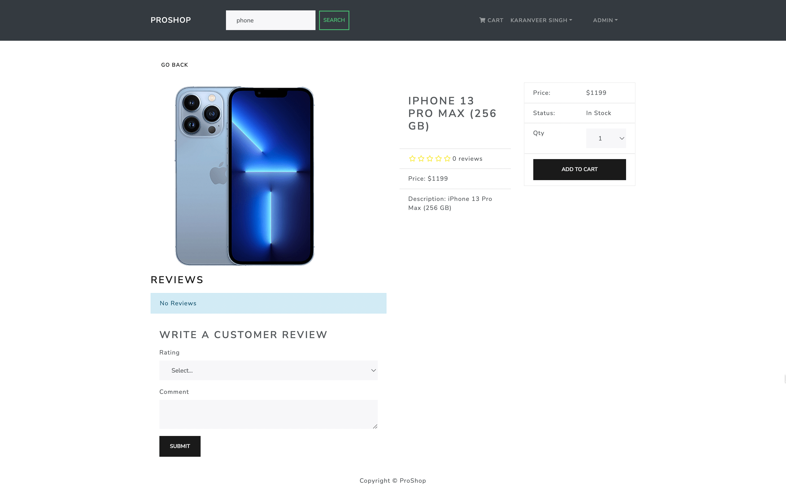

Slide 11
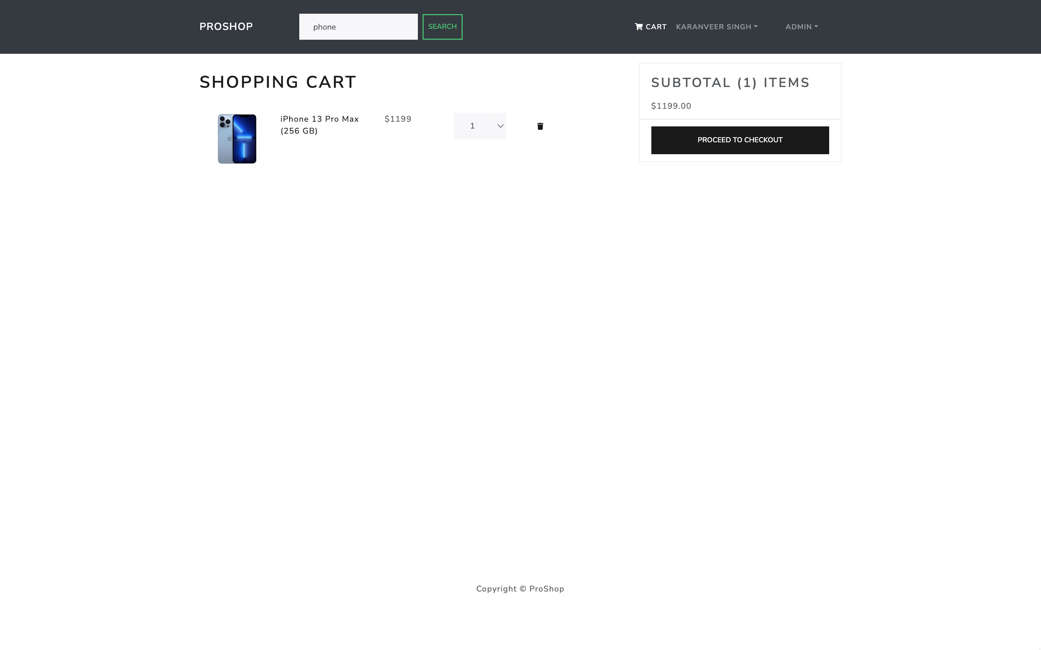

Slide 12
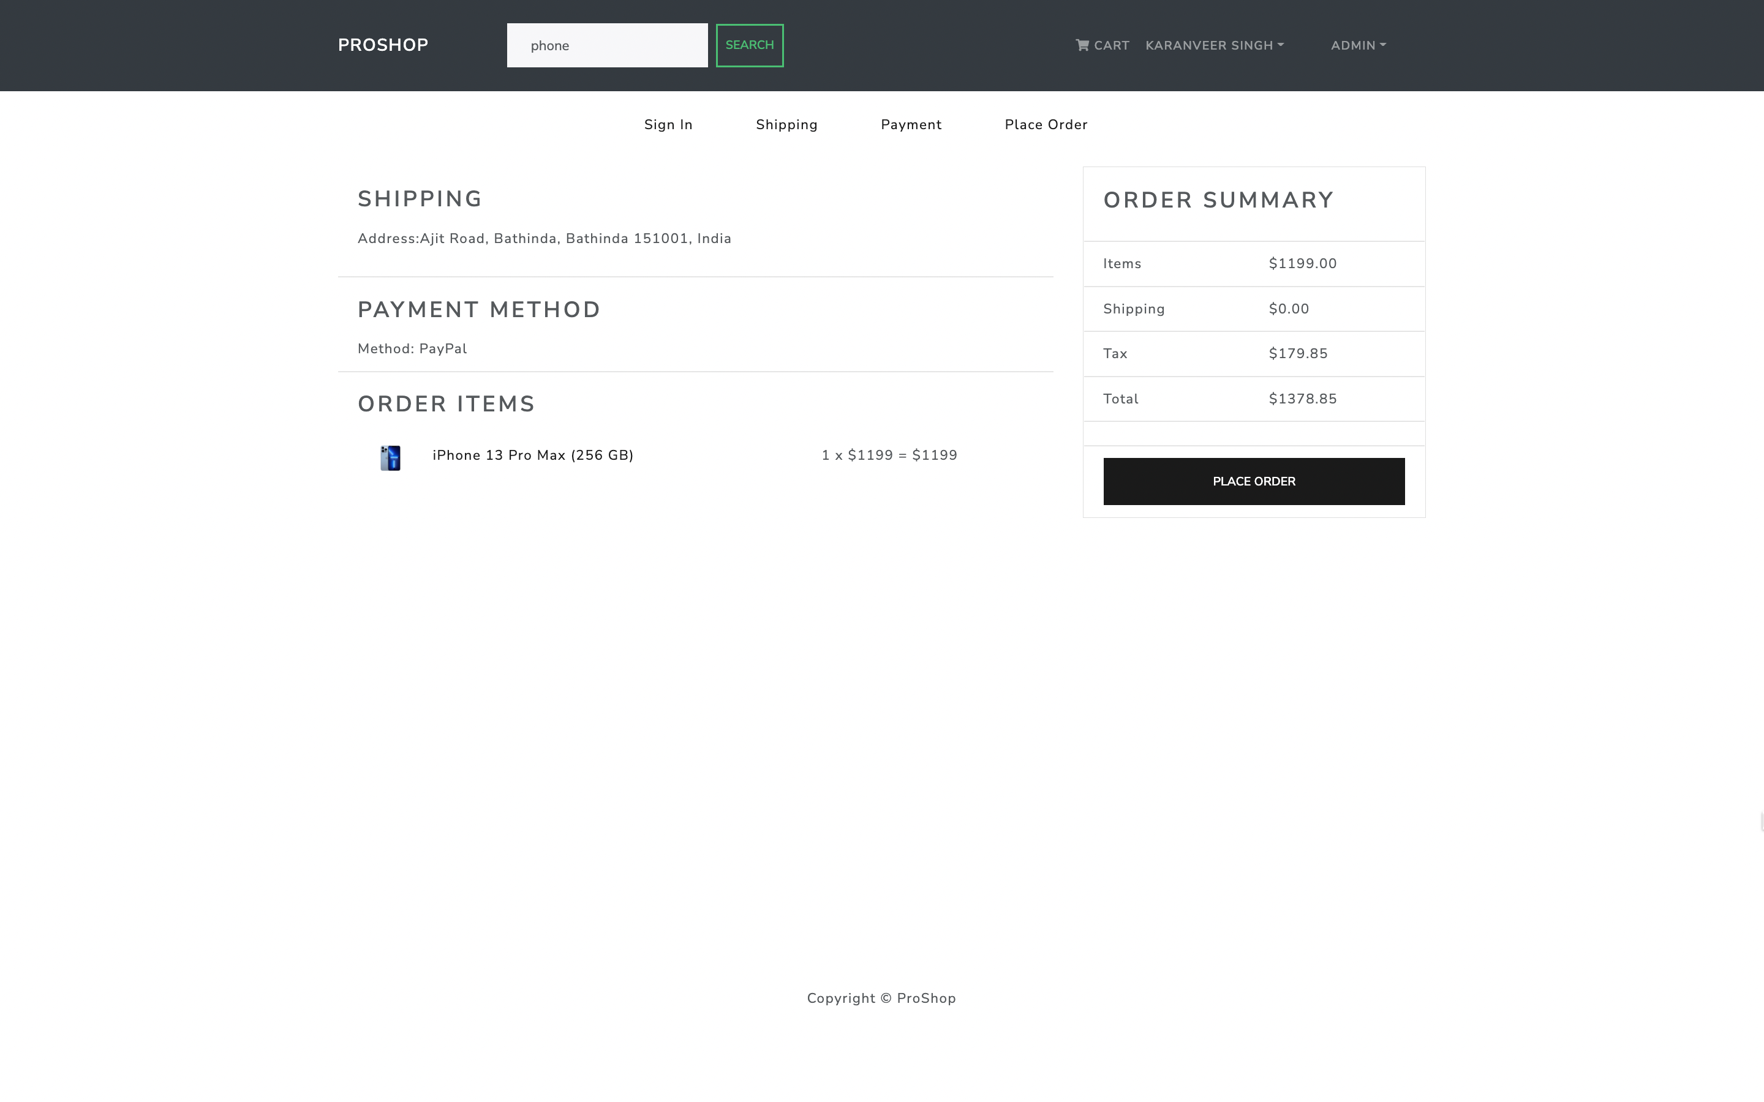

Slide 13
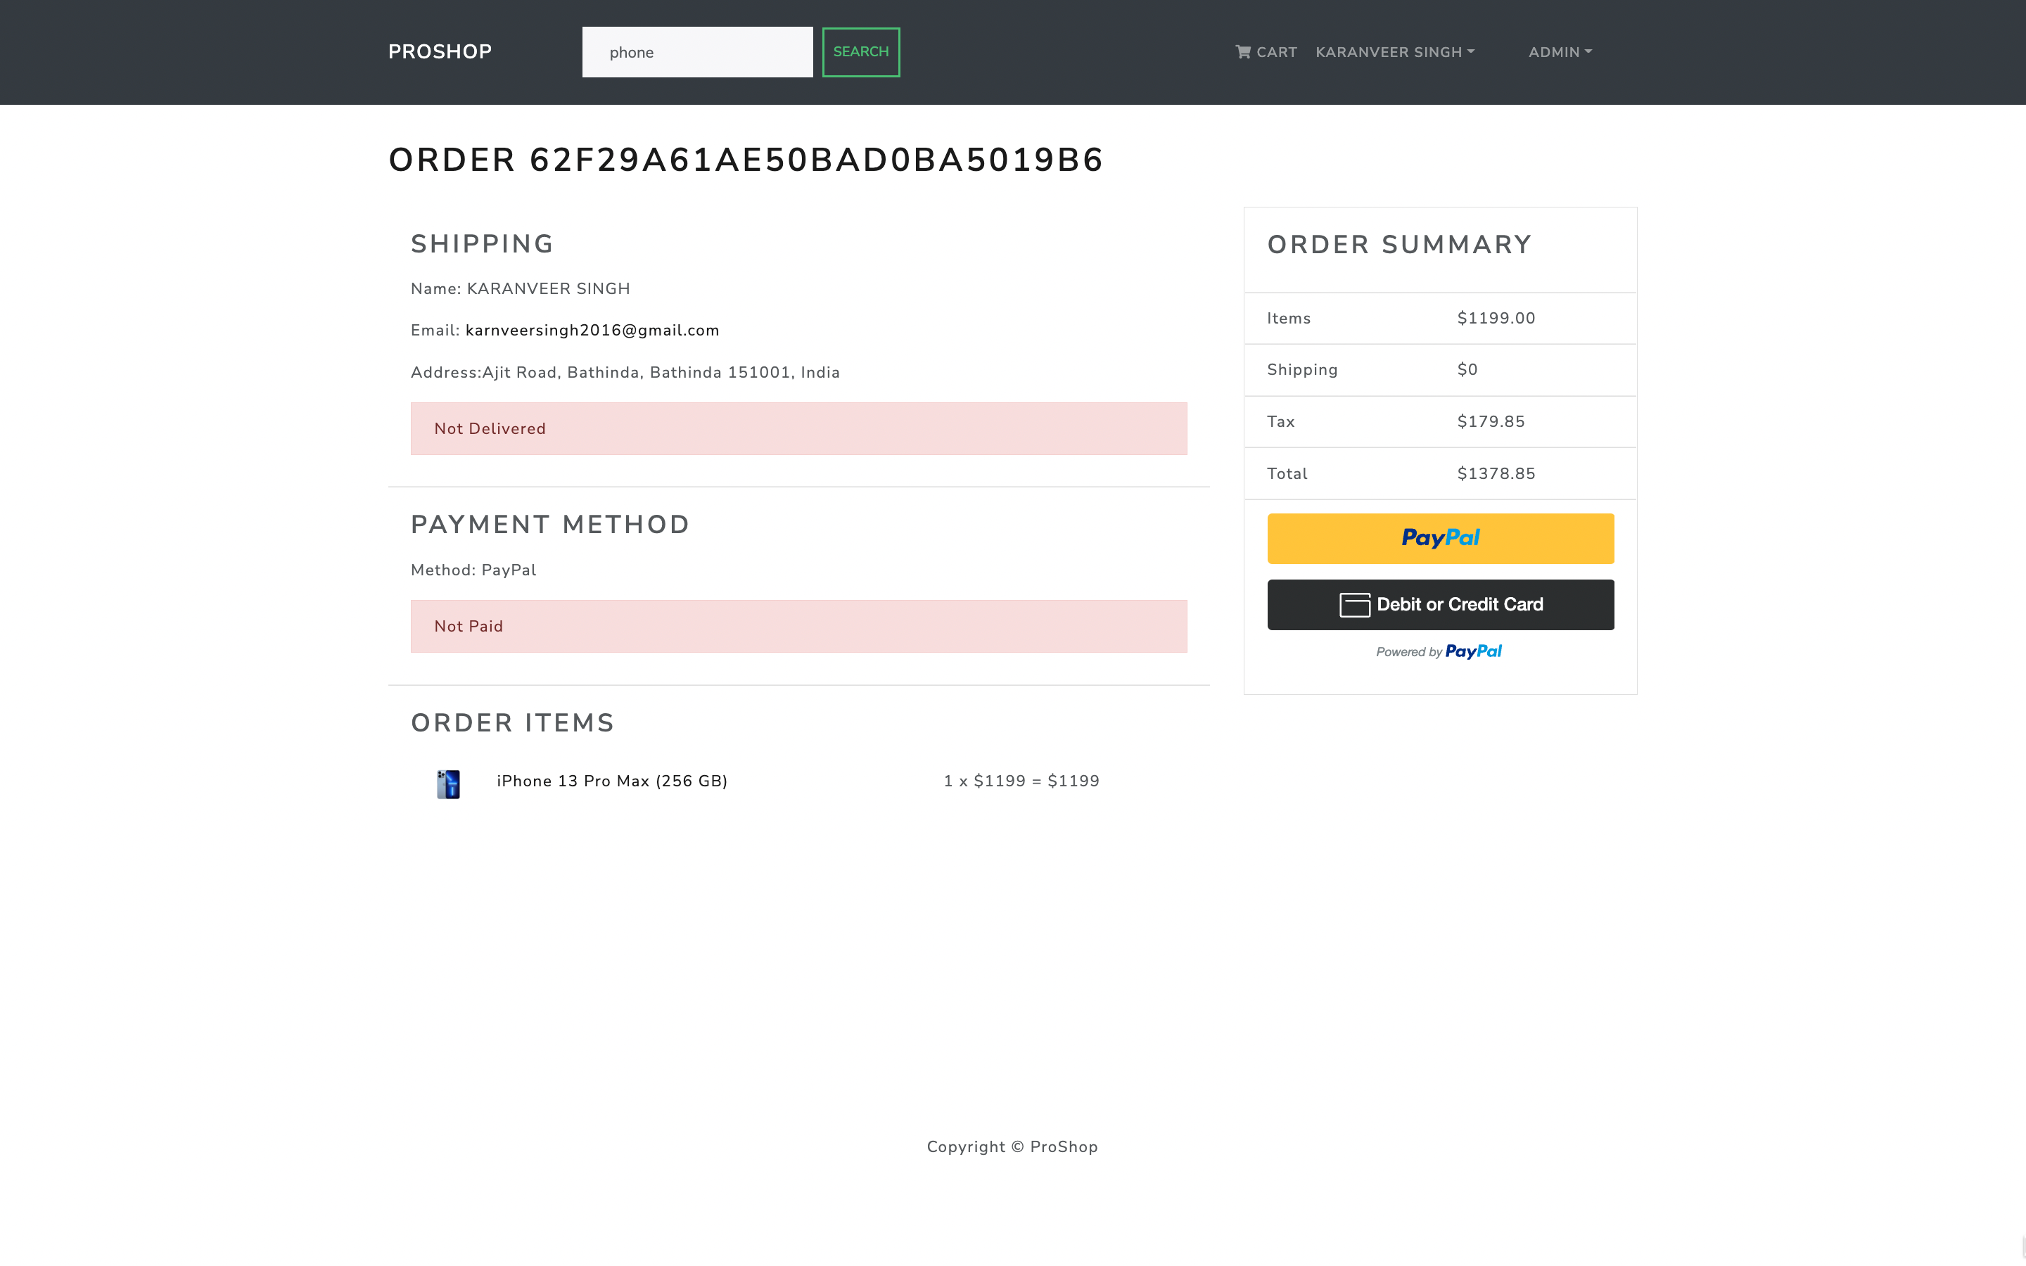

Slide 14
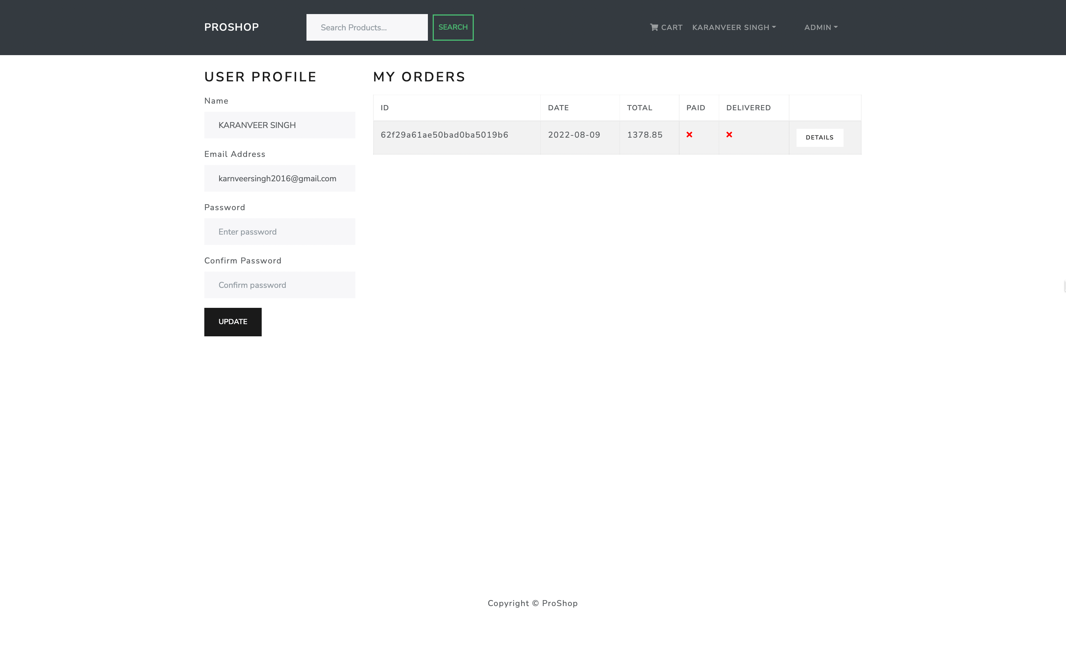

Slide 15
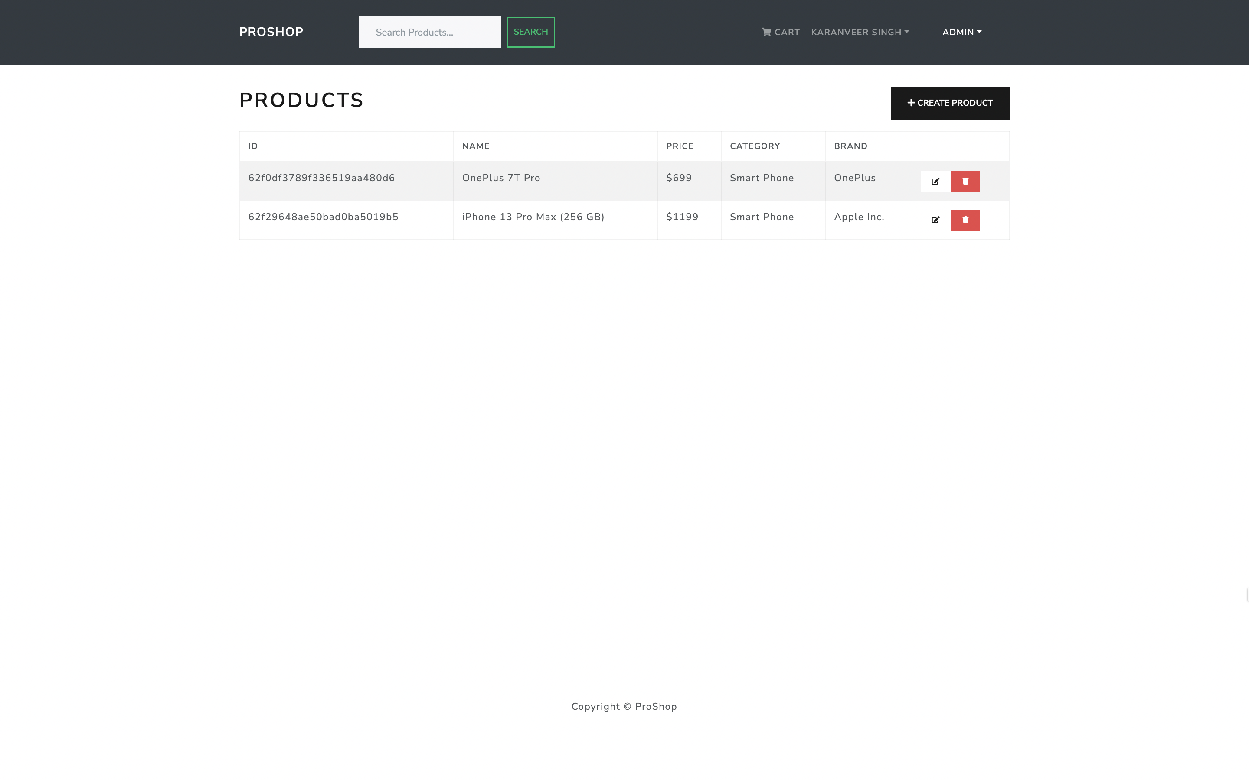

Slide 16
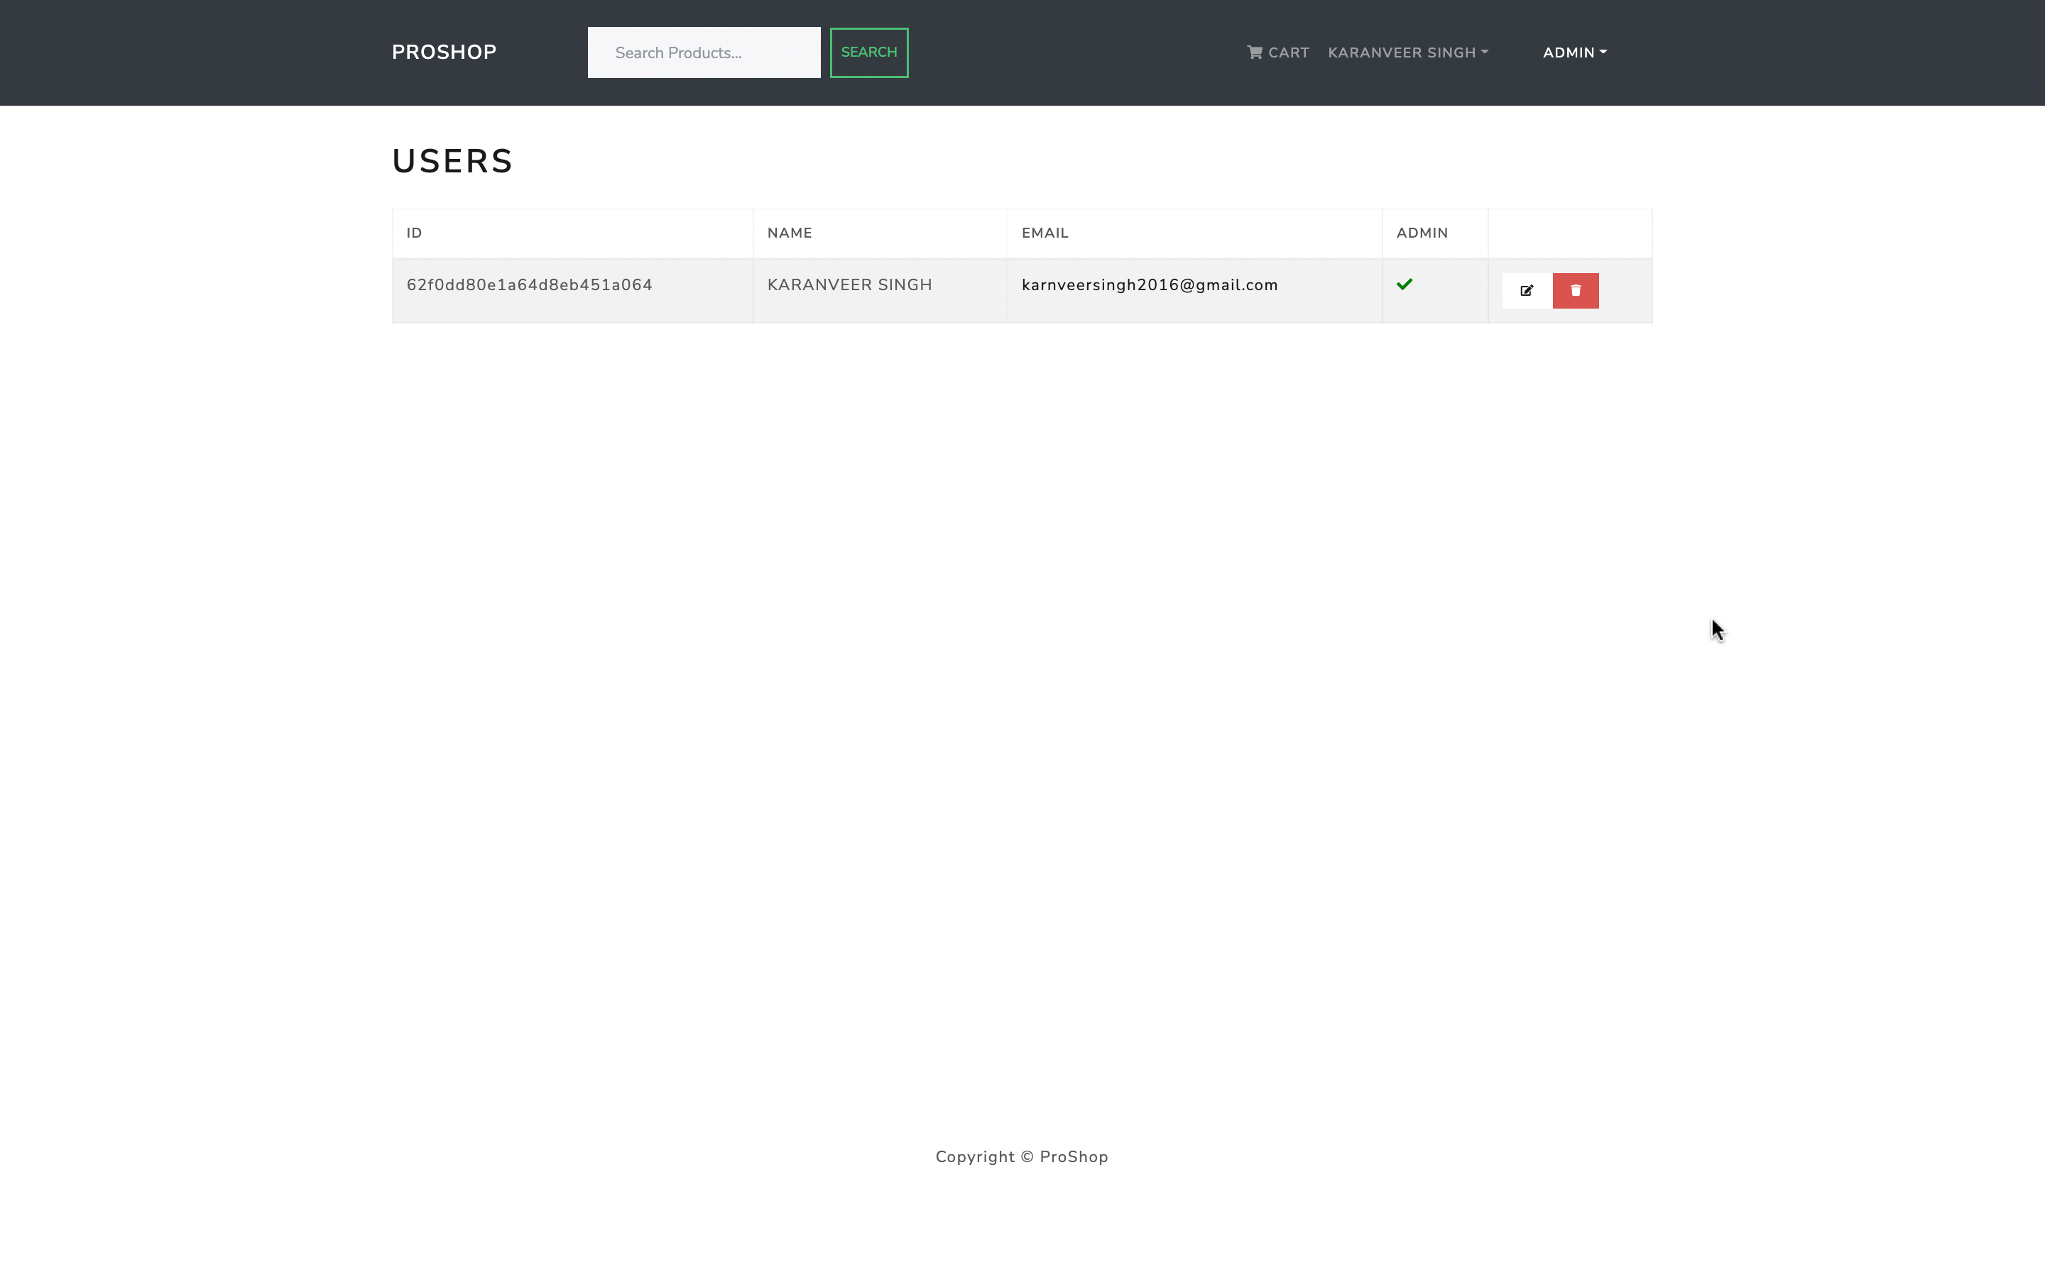

Slide 17
REFERENCES
https://www.reactjs.org/
https://www.nodejs.org/
https://www.w3schools.com/
https://www.mongodb.com/
https://www.expressjs.com/

Slide 18
THANK YOU

