Slide 1

Voter Boat
All aboard!
Casey Stauffer Jesse Stauffer Jonathan Knight Bradley Slayter Joe Gaston

Slide 2
Overview
Project Consists Of…
Tools
iOS Mobile Application
Administrator Web Portal
Student Web Portal (Checking Stats)
AxureRP
Xcode
GIMP
Komodo Edit
Amazon EC2
Amazon RDS
Languages: Objective-C, HTML, CSS, JavaScript, jQuery, MySQL & PHP

Slide 3
iOS Screenshots

Slide 4
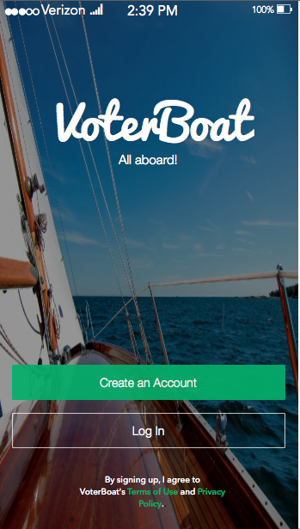
Initial View

Slide 5
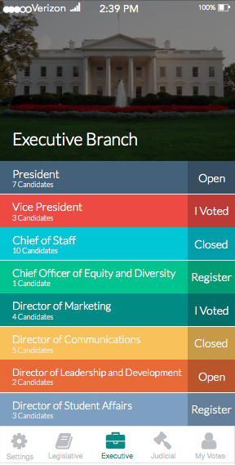
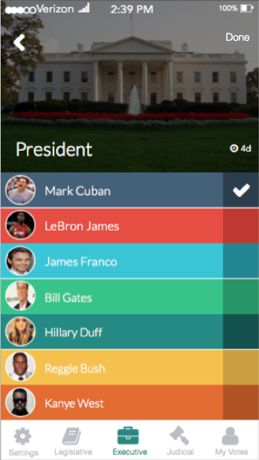
Branch & Election Views

Slide 6
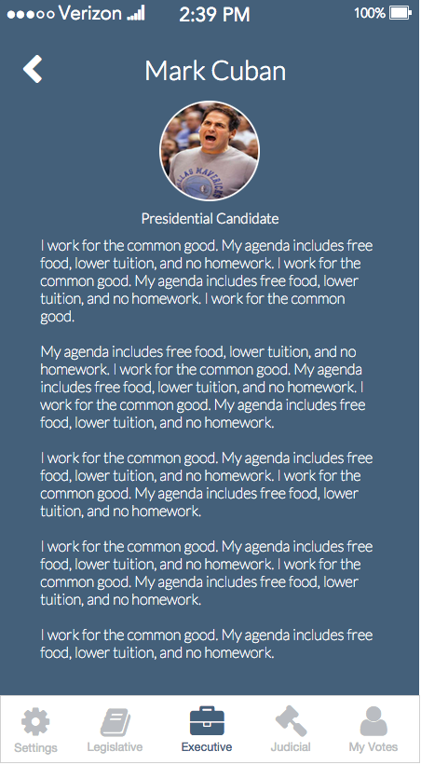
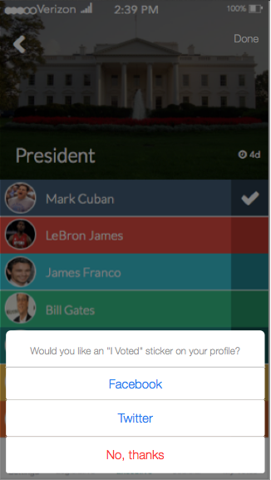
Candidate Profile
Facebook and Twitter

Slide 7
iOS Technical Details

Slide 8
Objective-C Client
Tab Bar Application
NSUserDefaults to store application data
AFNetworking Library used for asynchronous calls to our private API
Requests to API result in JSON responses, which are parsed and converted into custom data structures (an election, a vote, etc.)

Slide 9
The API
Created with FireFly (our in-house framework)
Written in PHP
Controller-based and RESTful
Returns JSON results that contain application data, as well as error and success flags
Interacts with Amazon RDS to store and retrieve system information
Ability to use oAuth 2.0 to verify API requests

Slide 10
The Crontab
Located on a separate hosting plan
Runs a file that uses the ‘wget’ command to execute an external script (send_reminders.php) every 5 minutes
Script checks for election reminders that need to be processed, does the processing, and then clears the priority flag and removes the task from the queue

Slide 11
Web Portal Screenshots

Slide 12
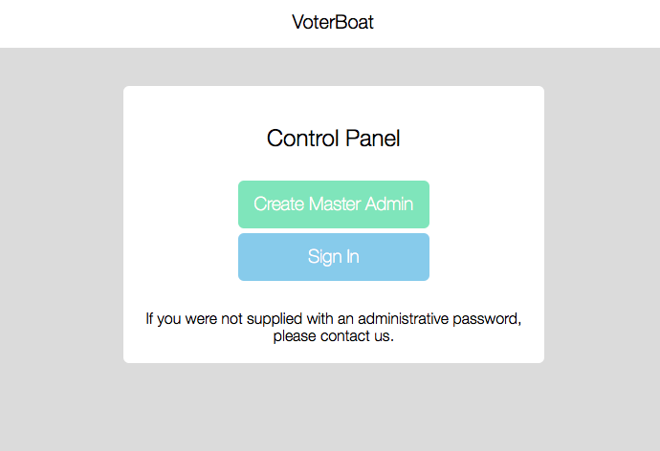
Home – On Launch

Slide 13
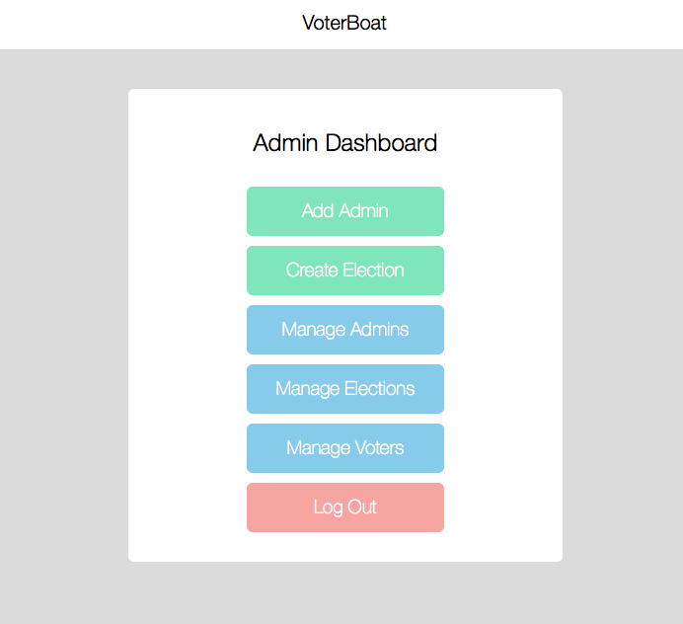
Administrator’s Dashboard

Slide 14
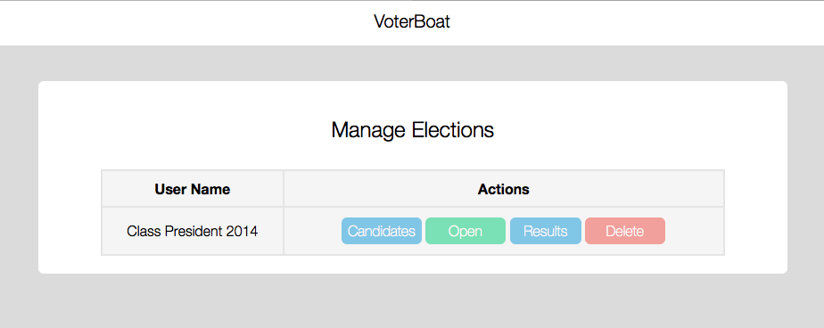
Manage Elections

Slide 15
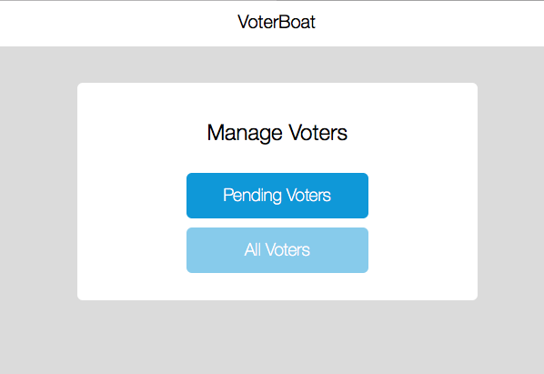
Manage Voters

Slide 16
Web Portal Technical Details

Slide 17
Web Portal
Separate permissions for Master Admin, Admin, Monitor, Student
Interface is in HTML / CSS / JavaScript / jQuery
Interacts with RDS database using PHP / MySQL
Passes database query results to Google’s Visualization API (JavaScript) to generate dynamic pie charts, bar graphs, etc.

Slide 18
The end

