Slide 1
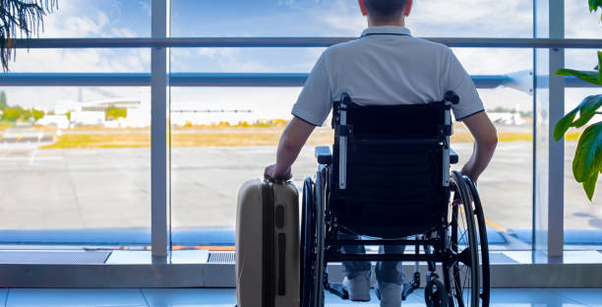
Analysis of Airport Complaints from Individuals with Disabilities
Key Insights and Recommendations

Slide 2

Overview of the Presentation:
This presentation analyzes data on airport complaints from individuals with disabilities.
It aims to highlight key findings, identify areas for improvement, and propose actionable recommendations for TSA, airports, and airlines.
Importance: Addressing these complaints is crucial for ensuring equitable travel experiences for all passengers.

Slide 3
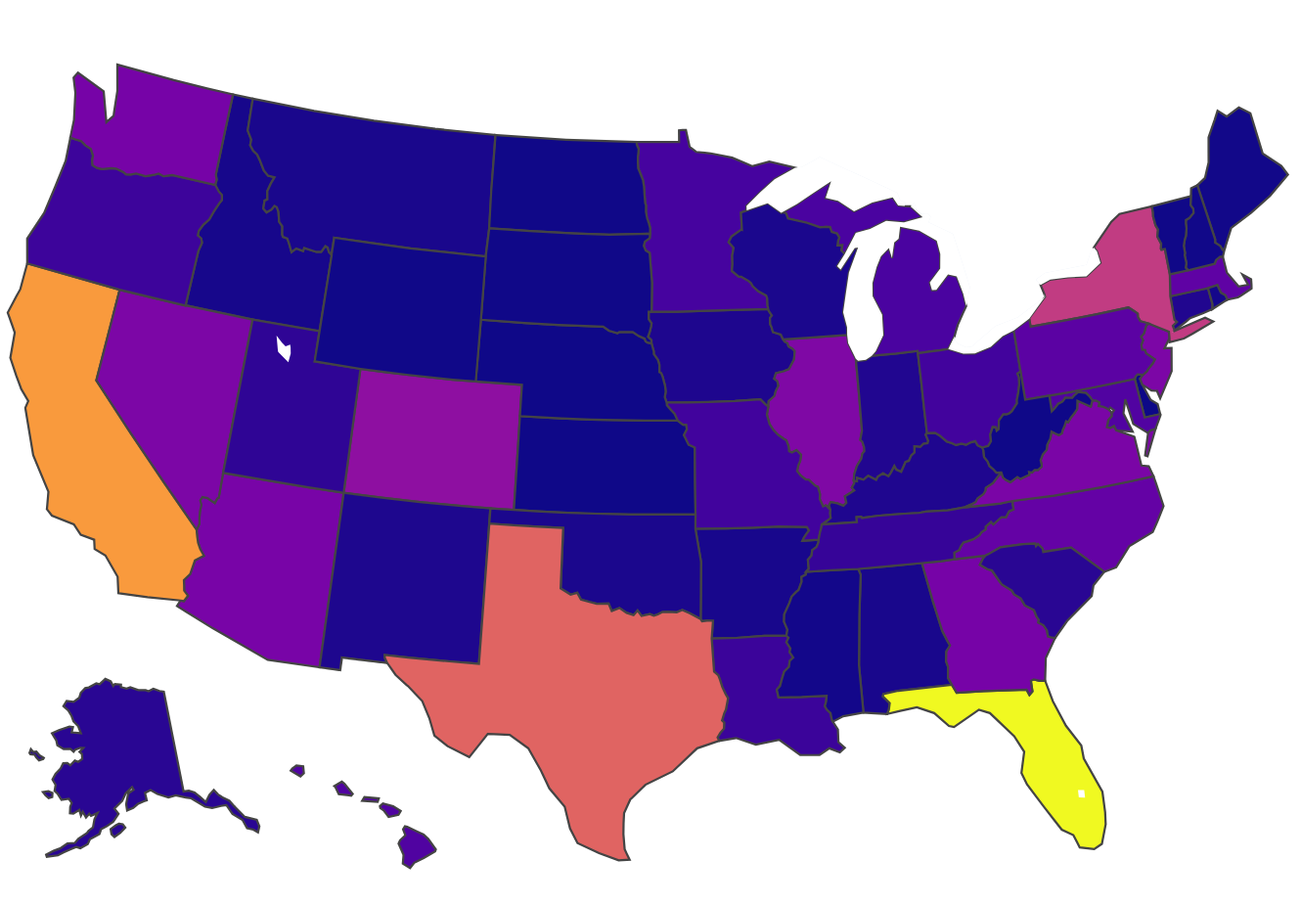
Geographic Distribution of Complaints
States with the Most Complaints: Florida, New York, California, Texas. These states host multiple large airports, leading to a higher volume of travelers and, consequently, more complaints.

Slide 4

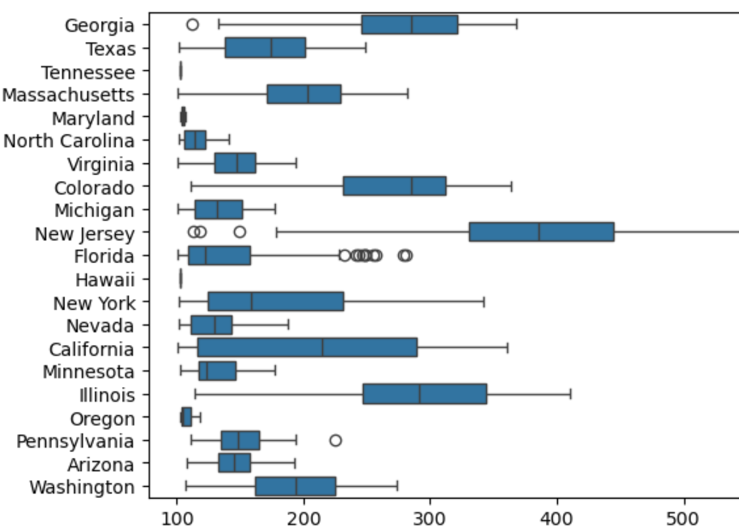
Overall Complaint Trends
If the trends in California, Florida, New York, and Texas were due to high traffic, we would expect complaints to show higher in these states when looking at overall complaints, however, when we look at overall complaints, the states that have the most frequent complaints are New Jersey, Illinois, Colorado, Georgia. This means there is a systemic issue at the California, Florida, New York, and Texas airports when it comes to serving our disabled citizens.

Slide 5
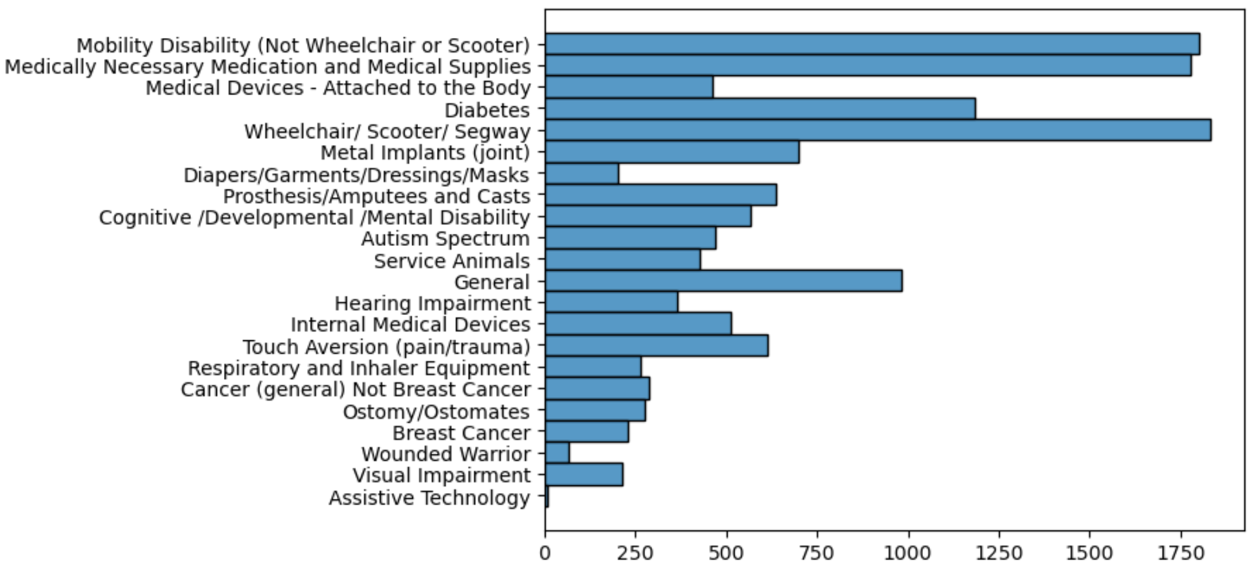
Breakdown of Disability Complaints
Most Common Complaints:
Mobility Issues: Challenges faced by travelers using wheelchairs, scooters, or those with other mobility impairments.
Medication and Medical Supply Complaints: Difficulties in traveling with necessary medical items.

Slide 6
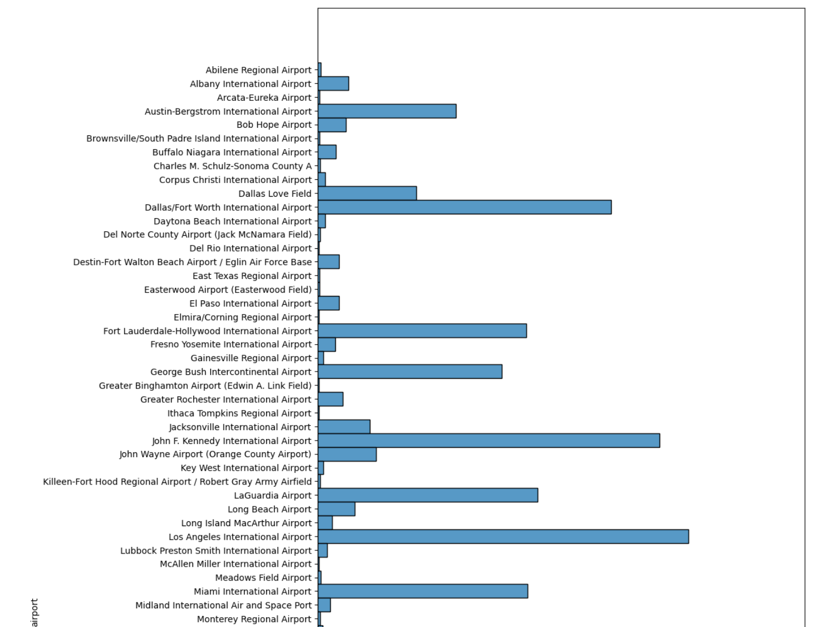
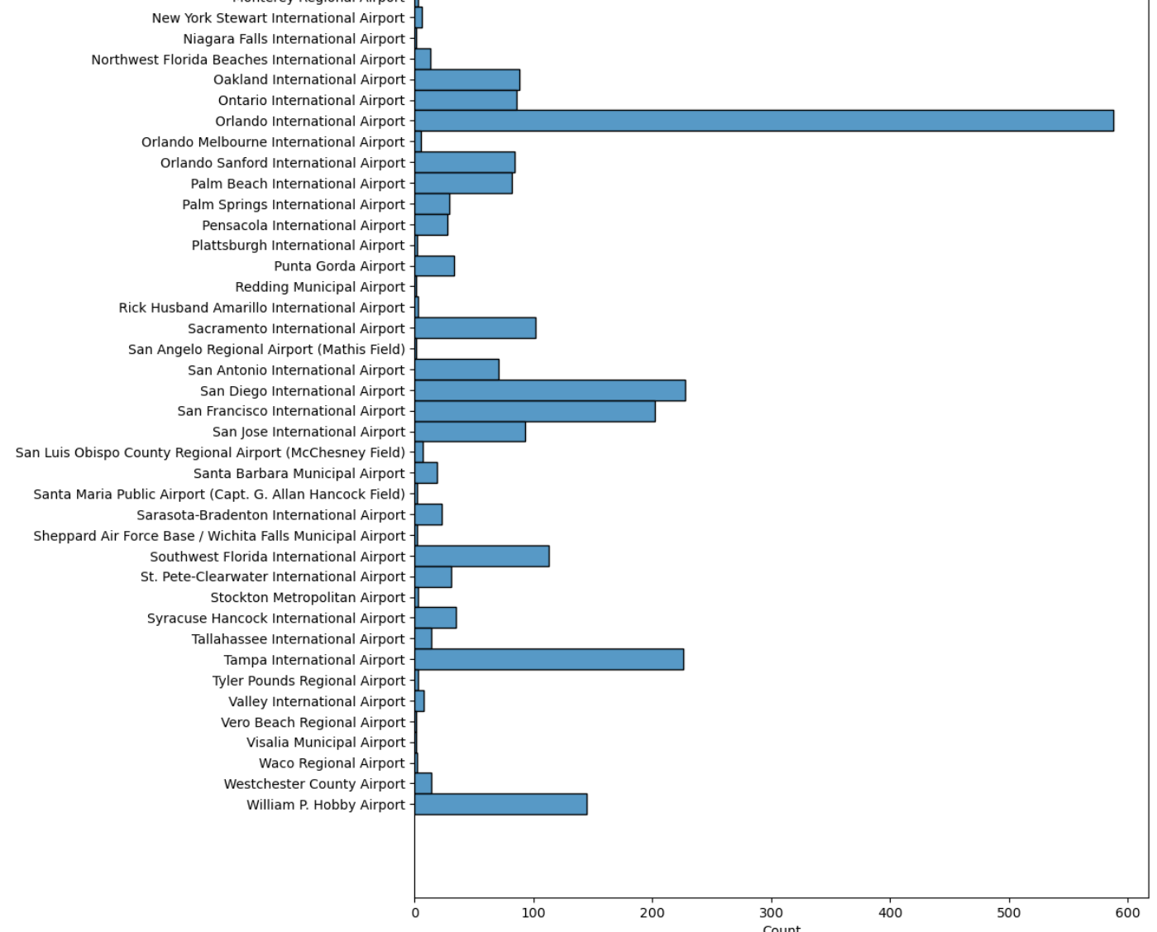
Airport-Specific Findings
Notably, Orlando International Airport accounts for about 1/3 of all disability complaints in Florida from 2015 to 2024.

Slide 7
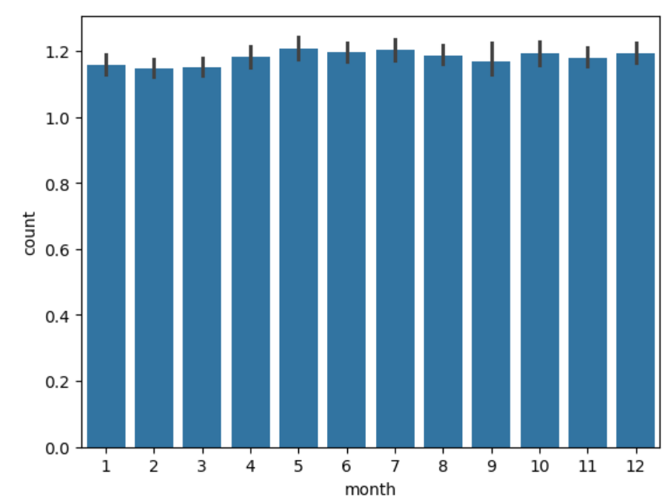
National Complaint Overview
Average Complaints: Across U.S. airports, the median number of complaints per month is slightly over 1, suggesting that while issues exist, they may not be pervasive at all locations.

Slide 8
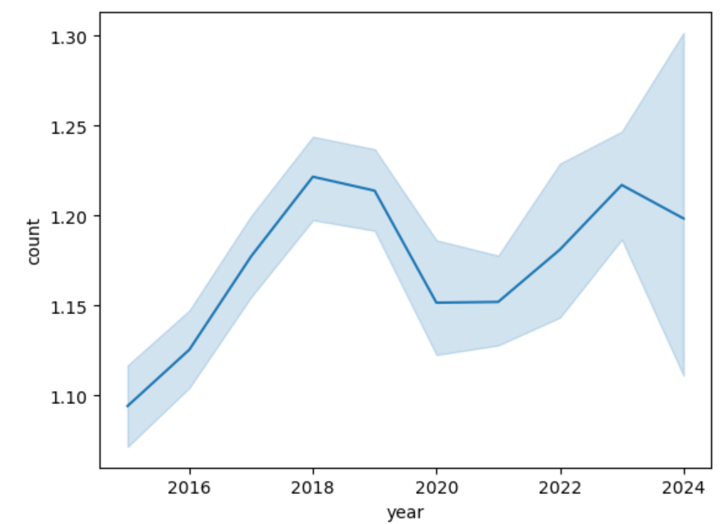
Impact of COVID-19
There was a noticeable increase in complaints leading up to 2020, suggesting growing awareness and possibly increasing challenges for travelers.
The COVID-19 pandemic likely altered travel patterns and accessibility, especially for those with disabilities, potentially impacting the volume of complaints.
Speculating on the numbers without COVID, we may have seen a continued rise in complaints based on previous trends.

Slide 9
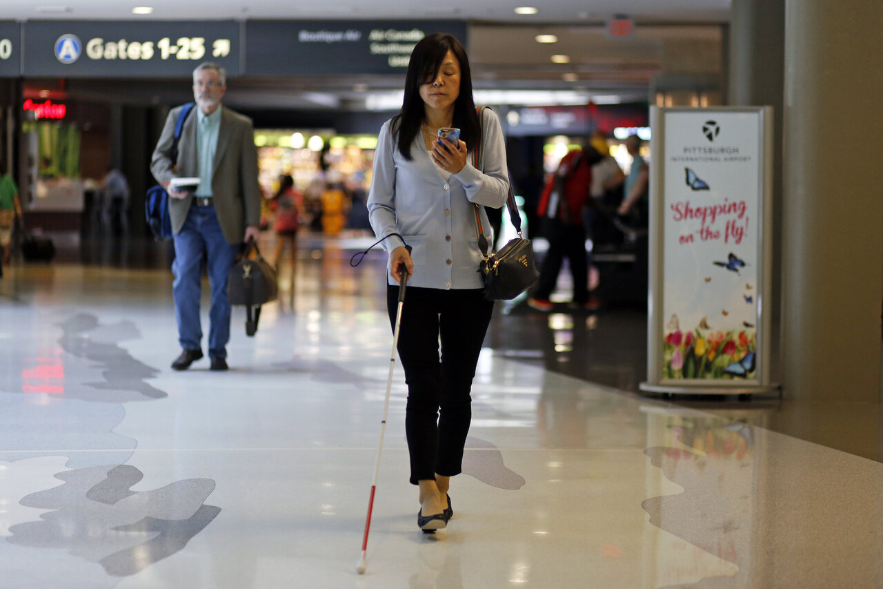
Recommendations for TSA, Airports, & Airlines
Immediate Actions:
Conduct accessibility audits at high-complaint airports to identify and rectify barriers.
Invest in comprehensive training programs for staff on disability awareness and customer service best practices.
Develop clear and transparent protocols for assisting travelers with mobility issues and medical supplies
.Long-term Goals:
Foster a culture of inclusivity that prioritizes the needs of all passengers.

Slide 10
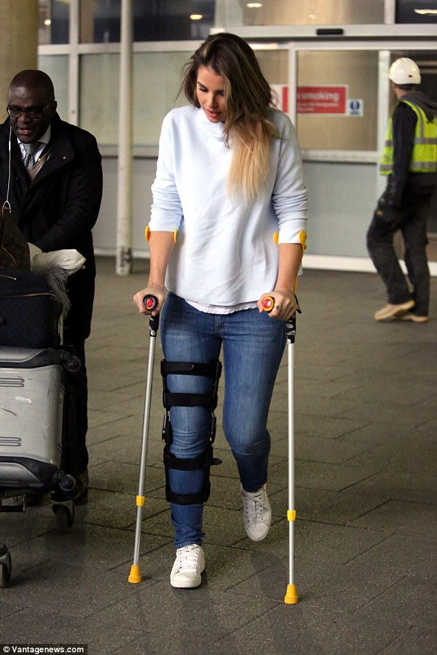
Conclusion
Summary of Key Insights:
Identified critical trends in complaints and specific challenges at major airports.
Highlighted the need for targeted improvements to enhance the travel experience for individuals with disabilities.
TSA, Airports, and Airlines – Take Action:
Collaborate to implement enhanced accessibility measures and policies.Next Steps:
Engage in immediate accessibility audits and staff training initiatives.Establish ongoing communication channels for feedback from travelers with disabilities.
Let’s Work Together: We invite your feedback and partnership to create actionable solutions that ensure equitable travel for all.

