Slide 1
Glaucoma
07/06/2022

Slide 2
WHAT IS GLAUCOMA?
Glaucoma is not a single disease process but a group of disorders characterized by a progressive optic neuropathy resulting in a characterstic appearance of the optic disc and a specific pattern of irreversible visual field defects that are associated frequently but not invariably with raised intraocular pressure (IOP).

Slide 3
APPLIED ANATOMY AND PHYSIOLOGY
Pathophysiology of glaucoma revolves around the aqueous humour dynamics. The principal ocular structures concerned with it are:
ciliary body,
angle of anterior chamber
the aqueous outflow system

Slide 4
The structures
Ciliary body
It is the seat of aqueous production.
Angle of anterior chamber
Angle of anterior chamber plays an important role in
the process of aqueous drainage. It is formed by root
of iris, anterior-most part of ciliary body, scleral spur,
trabecular meshwork and Schwalbe’s line (prominent
end of Descemet’s membrane of cornea).

Slide 5
The structures cont'd
Aqueous outflow system
It includes the trabecular meshwork, Schlemm’s canal, collector channels, aqueous veins and the episcleral veins.
Trabecular meshwork.It is a sieve-like structure
through which aqueous humour leaves the eye. It
consists of three portions.
i. Uveal meshwork. ii. Corneoscleral meshwork. IIi Juxtacanalicular (endothelial) meshworK.

Slide 6
The structures cont'd
Schlemm’s canal. This is an endothelial lined oval
channel present circumferentially in the scleral sulcus.
Collector channels. These, also called intrascleral aqueous vessels, are about 25-35 in number and leave the Schlemm’s canal at oblique angles to terminate into episcleral veins in a laminated fashion.

Slide 7
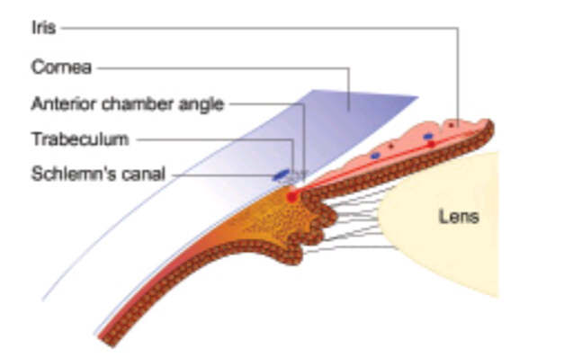

Slide 8
AQUEOUS HUMOR'S FACTORY
A.H fills the anterior chamber(0.25ml) and posterior chamber (0.06ml)
Functions include maintenance of pressure, metabolic role, optical transparency, lymph substitute.
AH has a refractive index of 1.336
Constituents include water 99.9% and 0.1% solid ( proteins, amino acid, glucose, oxygen)

Slide 9
Production
AH is derived from the plasma within the capillary network of ciliary processe( at the rate of 2.3 ul/min).
Mechanism of production includes :
Ultrafiltration to get the plasma filtrate which accumulates behind the non-pigment epithelium of ciliary processe.
Secretion of certain substances into the posterior chamber ( Na, K, ascorbic acid, bicarbonate, amino acid)
Facilitation of these constituents through diffusion into the posterior chamber.

Slide 10
Drainage
AH is drained via two routes: Trabecular meshwork and Uveoscleral outflow.
Trabecular meshwork outflow:Trabecular meshwork is the main outlet for aqueous from the anterior chamber. Approximately 90 percent of the total aqueous is drained out via this route.
Uveoscleral outflow: it's responsible for about 10 percent of the total aqueous outflow. Aqueous passes across the ciliary body into the suprachoroidal space and is drained by the venous circulation in the ciliary body, choroid and sclera.

Slide 11
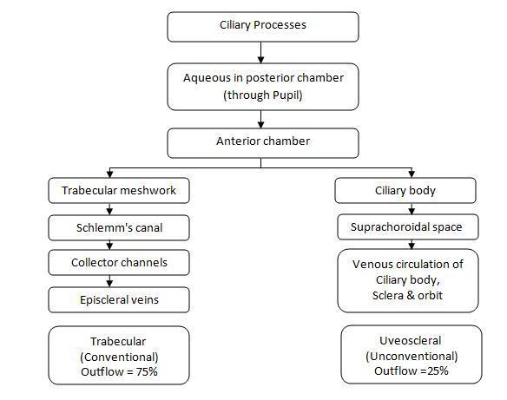
Flow chart depicting AH production & Drainage

Slide 12
PATHOGENESIS OF GLAUCOMTOUS OCULAR DAMAGE
All glaucomas are characterized by progressive optic neuropathy which results from the death of Retinal ganglion cells.
The death is initiated when the transport of growth factors (neutrophils) to the brain is obstructed.
This causes a damaging cascade as the cells are unable to perform normally.
The RGC as well as adjacent cells undergo apoptosis.

Slide 13
PATHOGENESIS OF GLAUCOMTOUS OCULAR DAMAGE
Retinal ganglion cell death is associated with loss of retinal nerve fibres.
As the loss of nerve fibres extends beyond the normal physiological overlap of functional zones, optic nerve changes occur.
The characteristic optic disc changes and specific visual field defects become apparent over the time.

Slide 14
WHAT CAN CAUSE RCG DEATH?
Primary insults such as raised IOP(mechanical theory).
Pressure independent factors (vascular insufficiency theory), such as failure of autoregulatory system, vasospasm, systemic hypotension, acute blood loss and abnormal coagulability profile.
Secondary insults (excitoxicity theory): toxins( glutamate, Oxygen free radicals or nitric oxide) released by the primary insults continue to cause neuronal degeneration even after PI has been controlled.

Slide 15
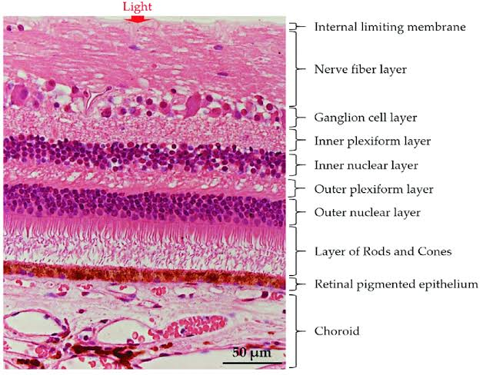

Slide 16
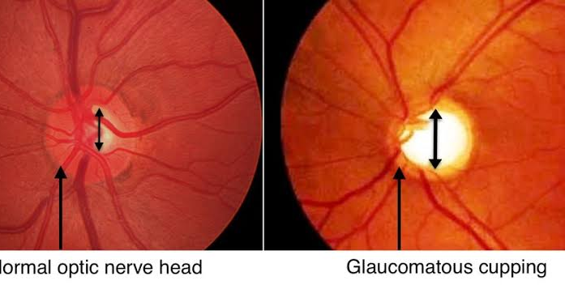
Normal ONH VS Glaucomatous cupping
Gradual retinal ganglion cell death leads to progressive optic neuropathy

Slide 17
CLASSIFICATION OF GLAUCOMA
(A) Congenital and developmental glaucomas
1. Primary congenital glaucoma (without associated
anomalies).
2. Developmental glaucoma (with associated
anomalies).
(B) Primary adult glaucomas
1. Primary open angle glaucomas (POAG)
2. Primary angle closure glaucoma (PACG)
3. Primary mixed mechanism glaucoma
(C) Secondary glaucomas

Slide 18
CONGENITAL/ DEVELOPMENTAL GLAUCOMA
The congenital glaucomas are a group of diverse disorders in which abnormal high intraocular pressure results due to developmental abnormalities of the angle of anterior chamber obstructing the drainage of aqueous humour.
Sometimes glaucoma may not occur until several years after birth; therefore, the term developmental glaucoma is preferred to describe such disorders.

Slide 19
TYPES
Primary developmental/ congenital glaucoma: high IOP due to AC angle abnormally with no associated ocular or systemic anomaly.
It can be true congenital glaucoma( child is born with ocular englargemernt i.e bulphthalmos due to hydrophthalmos.40% of cases).
Infantile glaucoma( occurs at 3 years. 50% of cases)
Juvenile glaucoma(Occurs between 3-16 years. 10% of cases).

Slide 20
The prevalence & genetic pattern of dev/congenital glaucoma.
 Most cases are sporadic. About 10 percent cases
exhibit an autosomal recessive inheritance with incomplete peneterance.
 sex linkage ( not common in
inheritance, over 65 percent of the patients are
boys).
 The disease is bilateral in 75 percent cases, though
the involvement may be asymmetric.
 The disease affects only 1 child in 10,000 births.

Slide 21
Pathogenesis
Trabeculodysgenesis:Maldevelopment of trabeculum including the iridotrabecular junction
There's impaired aqueous flow as a result.
No associated major ocular anomaly.
Clinically, trabeculodysgenesis is characterized by absence of the angle recess with a flat or concave iris insertion.

Slide 22
Clinical features
photophobia, blepharospasm, lacrimation and eye rubbing.
Cornea edema and enlargement/ haab's striae
Thin scelra
Deep AC
Flat and /subluxated lens
variable optic disc cupping and atrophy
Axial myopia

Slide 23
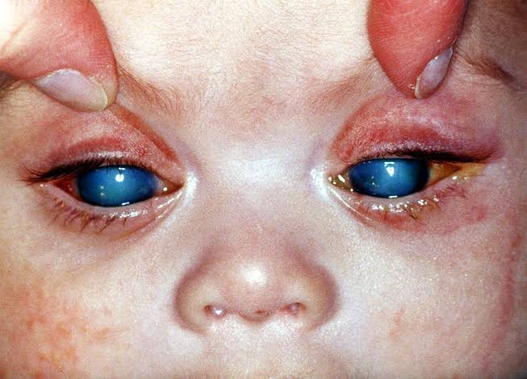
Child with congenital glaucoma
Cornea edema and enlargement.

Slide 24
Differential diagnosis
Cloudy cornea: unilateral (injury forceps). Bilateral.(trauma, mucopolysaccharidosis, interstitial keratitis and corneal endothelial dystrophy).
Large cornea ( megalocornea).
Lacrimation( congenital nasolacrimal duct blockage)
Photophobia( Keratitis or Uveitis)
Raised IOP (retinoblastoma, retinopathy of prematurity, persistent primary hyperplastic vitreous, traumatic glaucoma and secondary congenital glaucoma seen in rubella, aniridia and Sturge-Weber syndrome).

Slide 25
Treatment
Treatment of congenital glaucoma is primarily
surgical.( Goniotomy, trabeculotomy, mixed trabeculotomy).
However, IOP must be lowered by use of hyperosmotic agents, acetazolamide and betablockers till surgery is taken up.
Miotics are of no use in such cases.

Slide 26
DEVELOPMENTAL GLAUCOMA WITH ASSOCIATED ANOMALIES
Glaucoma associated with iridocorneal dysgenesis e.g Axenfeld anomaly, Rieger anomaly, Rieger syndrome, Peter’s anomaly and combined Rieger syndrome and Peter’s anomaly.
Glaucoma associated with aniridia (50% cases).
Glaucoma associated with ectopia lentis syndromes, which include Marfan’s syndrome,Weil-Marchesani syndrome and homocystinuria.
Glaucoma associated with phakomatosis is seen in Sturge-Weber syndrome ( 50% cases) and Von Recklinghausen’s neurofibromatosis (25% cases)Miscellaneous conditions. Lowe’s syndrome
Miscellaneous: (oculo-cerebro-renal syndrome), naevus of Ota,nanophthalmos, congenital ectropion uveae, congenital microcornea and rubella syndrome.

Slide 27
PRIMARY OPEN ANGLE GLAUCOMA AND RELATED CONDITIONS
There is no obvious ocular or systemic cause of IOP rise.
It occurs in eyes with open angle of the anterior chamber.
It is also known as chronic simple glaucoma.
is typically characterised by slowly progressive raised intraocular pressure (>21 mmHg recorded on at least a few occasions) associated with characteristic optic disc cupping and specific visual field defects.

Slide 28
Predisposing factors
Heredity
Age
Myopes
Race
Diabetics
Cigarette smoking
High blood pressure
Thyrotoxicosis
Long term use of corticosteroids

Slide 29
Incidence
It varies in different populations.
In general, it affects about 1 in 100 of the general population (of either sex) above the age of 40 years.
It forms about one-third cases of all glaucomas.

Slide 30
Symptoms
The disease is insidious and usually asymptomatic, until it has caused a significant loss of visual field.
Patients may experience mild headache and eyeache.
Occasionally, an observant patient may notice a defect in the visual field.
Reading and close work often present increasing difficulties owing to accommodative failure due to constant pressure on the ciliary muscle and its nerve supply. Therefore, patients usually complain of frequent changes in presbyopic glasses.
Patients develop delayed dark adaptation, a disability.

Slide 31
Clinical features
Normal finding on ocular examination initially
Later stages, pupil may become sluggish and cornea may have slight haze.
IOP changes
Optic disc changes:
early glaucomatous: loss of neuroratinal rim, difference of 0.2 in the cupping of both eyes, a cupping of 0.6> (N. 0.1-0.4), splinter haemorrhage near optic disc margin, atrophy of RNFL.

Slide 32
Cont'd
Advanced glaucoma changes: marked excavation of disk, thinning of neuro retinal rim, bayonnetting, pulsation of retinal arterioles when IOP is very high, lamellar dot sign( the pores of the lamina cribosa is visible).
Glaucomatous atrophy: as the damage progresses, all the neural tissue of the disc is destroyed and the optic nerve head appears white and deeply excavated

Slide 33
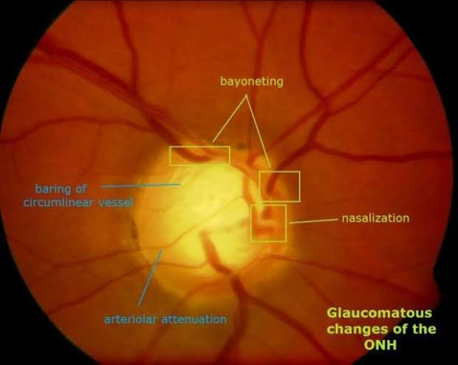

Slide 34
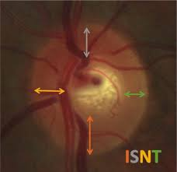

Slide 35
Ocular associations
POAG may sometimes be associated with
high myopia,
Fuchs’ endothelial dystrophy,
retinitis pigmentosa,
central retinal vein occlusion
and primary retinal detachment.

Slide 36
Investigations
Tonometry.
Diurnal variation test is especially useful in detection of early cases.
Gonioscopy. It reveals a wide open angle of anterior chamber. Its primary importance in POAG is to rule out other forms of glaucoma.
Documentation of optic disc changes is of utmost importance.
Slit-lamp examination of anterior segment to rule out causes of secondary open angle glaucoma.
Perimetry to detect the visual field defects.
Nerve fibre layer analyzer (NFLA).
Provocative tests

Slide 37
Diagnosis
Depends upon the level of intraocular pressure
(IOP), glaucomatous cupping of the optic disc and
the visual field changes.
Primary open angle glaucoma (POAG): IOP
(>21 mm of Hg) is associated with definite
glaucomatous optic disc cupping and visual field changes
Ocular hypertension or glaucoma suspect: IOP
constantly more than 21 mm of Hg but no optic disc
or visual field changes.
Normal tension glaucoma (NTG) or low tension
glaucoma:typical glaucomatous disc cupping with or without visual field changes is associated with an IOP constantly below 21 mm of Hg

Slide 38
Management
The goal agonist reduce IOP.
Therapeutic choicesinclude:
 Medical therapy(beta blockers prostaglandins, carbonic anhydrase inhibitors, alpha agonist, combination therapy etc)
 Argon or diode laser trabeculoplasty, and Filteration surgery.

Slide 39
OCULAR HYPERTENSION
IOP constantly more than 21 mm of Hg but no optic disc visual field changes.
patients should be carefully monitored by an ophthalmologist and should be treated as cases of POAG in the presence of high risk factors.
HRF includes significant diurnal variation, i.e., a difference of
more than 8 mm of Hg between the lowest and the highest values of IOP.
 Significantly positive water drinking provocative
test.
 When associated with splinter haemorrhages over or near the optic disc.
 IOP constantly more than 28 mm of Hg.
 Retinal nerve fibre large defects.
 Parapapillary changes.
 Central corneal thickness < 555 µm.

Slide 40
Treatment
 Patients with high-risk factors should be treated
on the lines of POAG. The aim should be to reduce IOP by 20%.
Patients with no high risk factors should be annually followed by examination of optic disc,perimetry and record of IOP
Treatment is not required till glaucomatous damage is documented.

Slide 41
NORMAL TENSION GLAUCOMA
typical glaucomatous disc changes with or without visual field defects are associated with an intraocular pressure (IOP) constantly below 21 mm of Hg.
Anterior chamber Is open
NTG is a varient of POAG which accounts for 16% of all cases of POAG and its prevalence above the age of 40 years is 0.2%

Slide 42
Ethiopathogenesis
Believed to result from chronic low vascular perfusion, which makes the optic nerve head susceptible to normal IOP. This view is supported by
following association which are more common in NTG
than in POAG :
 Raynauld phenomenon i.e., peripheral vascular
spasm on cooling,
 Migraine,
 Nocturnal systemic hypotension and overtreated
systemic hypertension.
 Reduced blood flow velocity in the ophthalmic artery

Slide 43
Clinical features
As described in definition the clinical features of NTG.(disc changes and visual field defects) are similar to.POAG, but the IOP is consistantaly below 21mm Hg.

Slide 44
Differential diagnosis
In early stages POAG may present with normal IOP because of a wide diurnal variation. Diurnal variation test usually depicts IOP higher than 21 mm of Hg at some hours of the day in patients with POAG.
Congentical optic disc anomalies such as large
optic disc pits or colobomas may be mistaken for
acquired glaucomatous damage. A careful examination should help in differentiation.

Slide 45
Treatment
Medical treatment to lower IOP( betaBlocker and alpha agonist, protagland in anlogues).
Trabeculectomy may be considered when progressive field loss occurs despite IOP in lower teens.
Systemic calcium channel blockers (e.g.nifedipine) may be useful in patients with confirmed peripheral vasospasm.
Monitoring of systemic blood pressure should be
done for 24 hours. If nocturnal dip is detected, it may
be necessary to avoid night dose of anti-hypertensive
medication.

Slide 46
PRIMARY ANGLE CLOSURE GLAUCOMA
rise in intraocular pressure occurs due to blockage of the aqueous humour outflow by closure of a narrower angle of the anterior chamber.
Predisposing factors can be anatomical, general or precipitating.

Slide 47
Factors
Anatomical factors. Eyes anatomically predisposed
to develop primary angle-closure glaucoma (PACG)
include:
 Hypermetropic eyes with shallow anterior chamber.
 Eyes in which iris-lens diaphragm is placed
anteriorly.
 Eyes with narrow angle of anterior chamber, which
may be due to: small eyeball, relatively large size
of the lens and smaller diameter of the cornea or
bigger size of the ciliary body.
 Plateau iris configuration.

Slide 48
Factors
General factorsinclude:
 Age. PACG is comparatively more common in 5th decade of life.
 Sex. Females are more prone to get PACG than males (male to female ratio is 1:4)
 Type of personality. It is more common in nervous individuals with unstable vasomotor system.
 Season. Peak incidence is reported in rainy season.
Family history. The potential for PACG is
generally believed to be inherited.
 Race.

Slide 49
Factors
Precipitating factors:In an eye that is predisposed to develop angle closure glaucoma, any of the following factors may precipitate an attack:
 Dim illumination,
 Emotional stress,
 Use of mydriatic drugs like atropine, cyclopentolate, tropicamide and phenylephrine

Slide 50
Mechanism of IOP rise
due to the effect of precipitating factors there occurs mid dilatation of the pupil which increases the amount of apposition between iris and anteriorly placed lens with a considerable pressure resulting in relative pupil block
Consequently the aqueous collects in the posterior chamber and pushes the peripheral flaccid iris anteriorly (Iris bombe).
Eventually there occurs rise inIOP which is transient to begin with. But slowly the appositional angle closure is converted into synechial angle closure (due to formation of peripheral anterior synechiae)

Slide 51
Clinical presentation
Latent primary angle-closure glaucoma (primary
angle-closure glaucoma suspect).
 Subacute (intermittent) primary angle-closure
glaucoma.
 Acute primary angle-closure glaucoma.
 Postcongestive angle-closure glaucoma,
 Chronic primary angle-closure glaucoma, and
 Absolute glaucoma

Slide 52
ACUTE PRIMARY ANGLE CLOSURE
An attack of acute primary angle closure glaucoma occurs due to a sudden total angle closure leading to severe rise in IOP.
It usually does not terminate of its own and thus if not treated lasts for many days.
Sight threatening emergency

Slide 53
SIGNS AND SYMPTOMS
sudden onset of very severe pain in the eye
 Nausea, vomiting and prostrations
 Rapidly progressive impairment of vision,
redness, photophobia and lacrimation develop in
all cases.
 Past history. About 5 percent patients give history
of typical previous intermittent attacks of subacute
angle-closure glaucoma.

Slide 54
Signs and symptoms
Lids may be oedematous,
 Conjunctiva is chemosed, and congested, (both
conjunctival and ciliary vessels are congested),
 Cornea becomes oedematous and insensitive,
 Anterior chamber is very shallow. Aqueous flare
or cells may be seen in anterior chamber ,
 Angle of anterior chamber is completely closed
as seen on gonioscopy (shaffer grade 0),
 Iris may be discoloured,
 Pupil is semidilated, vertically oval and fixed. It
is non-reactive to both light and accommodation
IOP is markedly elevated, usually between 40 and
70 mm of Hg, Optic disc is oedematous and hyperaemic,
 Fellow eye shows shallow anterior chamber and
a narrow angle .

Slide 55
Diagnosis
Diagnosis is usually obvious from the clinical features.
However, a differential diagnosis may have to be
considered :
From other causes of acute red eye. Acute
congestive glaucoma sometimes needs
differentiation from other causes of inflammed red eye like acute conjunctivitis and acute iridocyclitis
From secondary acute congestive glaucomas such as phacomorphic glaucoma, acute neovascular glaucoma and glaucomatocyclitic crisis.

Slide 56
Management
Medical therapy
Systemic hyperosmotic agent intravenous mannitol (1 gm/kg body weight) initially to lower IOP.
.Acetazolamide (a carbonic anhydrase inhibitor)500 mg intravenous injection followed by 250 mg tablet should be given 3 times a day.
Analgesics and anti-emetics as required.
Pilocarpine eyedrops should be started after the IOP is bit lowered by hyperosomtic agents. Initially 2 percent pilocarpine should be administered every 30 minutes for 1-2 hours and then 6 hourly.
Beta blocker eyedrops like 0.5 percent timolol maleate or 0.5 percent betaxolol should also be administered twice a day to reduce the IOP.
Corticosteroid eyedrops like dexamethasone or
betamethasone should be administered 3-4 times
a day to reduce the inflammation.

Slide 57
Surgical treatment
Peripheral irodoctomy
Filtration surgery
Clear lens extraction by phaco emulsification( recently suggested).
Prophylactic irodoctomy or peripheral iridectomy on the fellow eye.

Slide 58
Secondary glaucomas
Secondary glaucoma per se is not a disease entity,
but a group of disorders in which rise of intraocular pressure is associated with some primary ocular or systemic disease.
Therefore, clinical features comprise
that of primary disease and that due to effects of
raised intraocular pressure.

Slide 59
Classification
A) Depending upon the mechanism of rise in IOP
1. Secondary open angle glaucomas in which
aqueous outflow may be blocked by a
pretrabecular membrane, trabecular clogging,
oedema and scarring or elevated episcleral venous
pressure.
2. Secondary angle closure glaucomas which may
or may not be associated with pupil block.

Slide 60
Classification.
Depending upon the causative primary disease, secondary glaucomas are named as follows:
1. Lens-induced (phacogenic) glaucomas.
2. Inflammatory glaucoma (glaucoma due to intraocular inflammation).
3. Pigmentary glaucoma.
4. Neovascular glaucoma.
5. Glaucomas associated with irido-corneal endothelial syndromes.
6. Pseudoexfoliative glaucoma.
7. Glaucomas associated with intraocular haemorrhage.
8. Steroid-induced glaucoma.
9. Traumatic glaucoma.
10. Glaucoma-in-aphakia.
11. Glaucoma associated with intraocular tumours

Slide 61
lens-induced glaucoma
Pharcomorphic ( swollen lens which blocks the angle).
Phacolytic(Lens proteins leak from an intact capsule an intact capsule and clog the trabecular meshwork).
Lens particle glaucoma( left over lens matter from surgery floats in the aqueous which also blocks the trabecular meshwork).
Glaucoma associated with phacogenic uveitis( inflammation of uvea tissue by lens matter. TM is clogged with inflammatory cells and lens particles).
Glaucoma associated with phacoanaphylaxis( acute inflammation due to lens protein).

Slide 62
Pigmentary glaucoma
TM is clogged by pigment particles
About 50% of patients with the pigment dispersion syndrome develop glaucoma .
Exact mechanism of pigment shedding is not known.
It is believed that, perhaps, pigment release is caused by mechanical rubbing of the posterior pigment layer of iris with the zonular fibrils.
Managed like POAG.

Slide 63
Neovascular glaucoma
results due to formation of neovascular membrane involving the angle of anterior chamber.
It is usually associated with neovascularization of iris (rubeosis iridis).
Neovascularization develops following retinal ischaemia, which is a common feature of :
 Diabetic retinopathy,
 Central retinal vein occlusion,
 Sickle-cell retinopathy and
 Eales’ disease.
 Other rare causes are chronic intraocular inflammations, intraocular tumours, long-standing retinal detachment and central retinal artery occlusion.
Management by medical therapy/filtration to contro IOP and PA retinal photocoagulation to prevent further neovascularization.

Slide 64
Glaucoma associated with intraocular tumors.
Secondary glaucoma due to intraocular tumours such as malignant melanoma (of iris, choroid, ciliary body)and retinoblastoma.
Management includes enucleation of the eyeball as soon as possible.

Slide 65
Traumatic glaucoma
A secondary glaucoma may complicate perforating as well as blunt injuries.
Management. It consists of medical therapy with
topical 0.5 percent timolol and oral acetazolamide,treatment of associated causative mechanism.
Atropine and steroids for control of inflammation and surgical intervention according to the situation.

Slide 66
Ciliary block glaucoma
Rare
It may occur as as a result of intraocular operations.
It classically occurs in patients with primary angle closure glaucoma operated for peripheral iridectomy or filtration (e.g. trabeculectomy) surgery.
Malignant glaucoma may be phakic,(Lens) aphakic(IOL) or pseudophakic(ant. Hyaloid of the vitreous).
Management includes timolol, atropine and acetazolamide(250mg) QID, surgical therapy if medical fails.
Pars plana virectomy with or without lensectomy
(as the situation may be).

Slide 67
Glaucoma associated with intraocular haemorrhage
Red cell glaucoma: associated with fresh traumatic hyphema.It may be associated with pupil block due to blood clot. Blood staining of the cornea may develop, if the IOP is not lowered within a few days.
Haemolytic glaucoma. It is an acute secondary open angle glaucoma due to the obstruction (clogging) of the trabecular meshwork caused by macrophages laden with lysed RBC debris.
Ghost cell glaucoma. It is a type of secondary open angle glaucoma which occurs in aphakic or pseudophakic eyes with VH.
Hemosiderotic glaucoma. It is a rare variety of secondary glaucoma occurring due to sclerotic changes in trabecular meshwork caused by the iron from the phagocytosed haemoglobin.

Slide 68
Glaucoma with ICE syndromes
Iridocorneal endothelial (ICE) syndromes include three clinical entities:
 Progressive iris atrophy,
 Chandler’s syndrome: cornea edema, distortion of iris and glaucoma.
 Cogan-Reese syndrome: smudged, muddy iris appearance, ant. synechiae and increased IOP.
The common feature of the ICE syndromes is the presence of abnormal corneal endothelial cells which proliferate to form an endothelial membrane in the angle of anterior chamber.
All management therapies usually fail.

Slide 69
Elschnig cupping/ classification
Elschnig optic nerve head classification
- type 1 funnel: small cup, shallow depth(0.1- 0.2)
- type 2 cylinder: defined cup border, no gradual sloping, varies in CD size and depth
- type 3 saucer: temporal cup border is not sharp, gradual sloping, varies in CD size and depth
- type 4 hook: temporal cup border is not sharp, gradual sloping, nasal hook, oblique insertion/tilted(0.4-0.5)
- type 5 glaucomatous or beat pot: large deep cup (lamina cribrosa visible); vessels plunge over rolled rim(0.6>).

Slide 70
Conclusion
Glaucoma is characterized by progressive optic neuropathy, visual field defects( read at leisure) and invariably IOP.
POAG, NTG, AACG are the more common types seen in practice.
It can only be managed and not cured as reported by current researches through medical therapy and surgery.
It has no single management regime as therapies are tailored according to patient drug responses and unique conditions
Early detection is key.
Scientists are exploring the ever unpredictable area of gene therapy still ( use of certain protein treatment) and boasting of CMKIIregulator to protect RGC from initial insults, therefore reinforcing the survival rate of these cells when insults occur.

Slide 71
THANK YOU FOR LISTENING

