Slide 1
FINAL PROJECT PRESENTATION
Egyptian Automatic
License Plate Recognition
Dataset engineering, multi-stage YOLO detection, Arabic character decoding, and deployment workbench
ALPR
Notes:
[Sources]
Project repository and training artifacts (local workspace).

Slide 2
The report moves from the problem to evidence and next steps
01
Introduction & problem
02
Background & literature
03
Datasets & method
04
Metrics & results
05
Conclusions & future work
06
References
02
Notes:
[Sources]

Slide 3
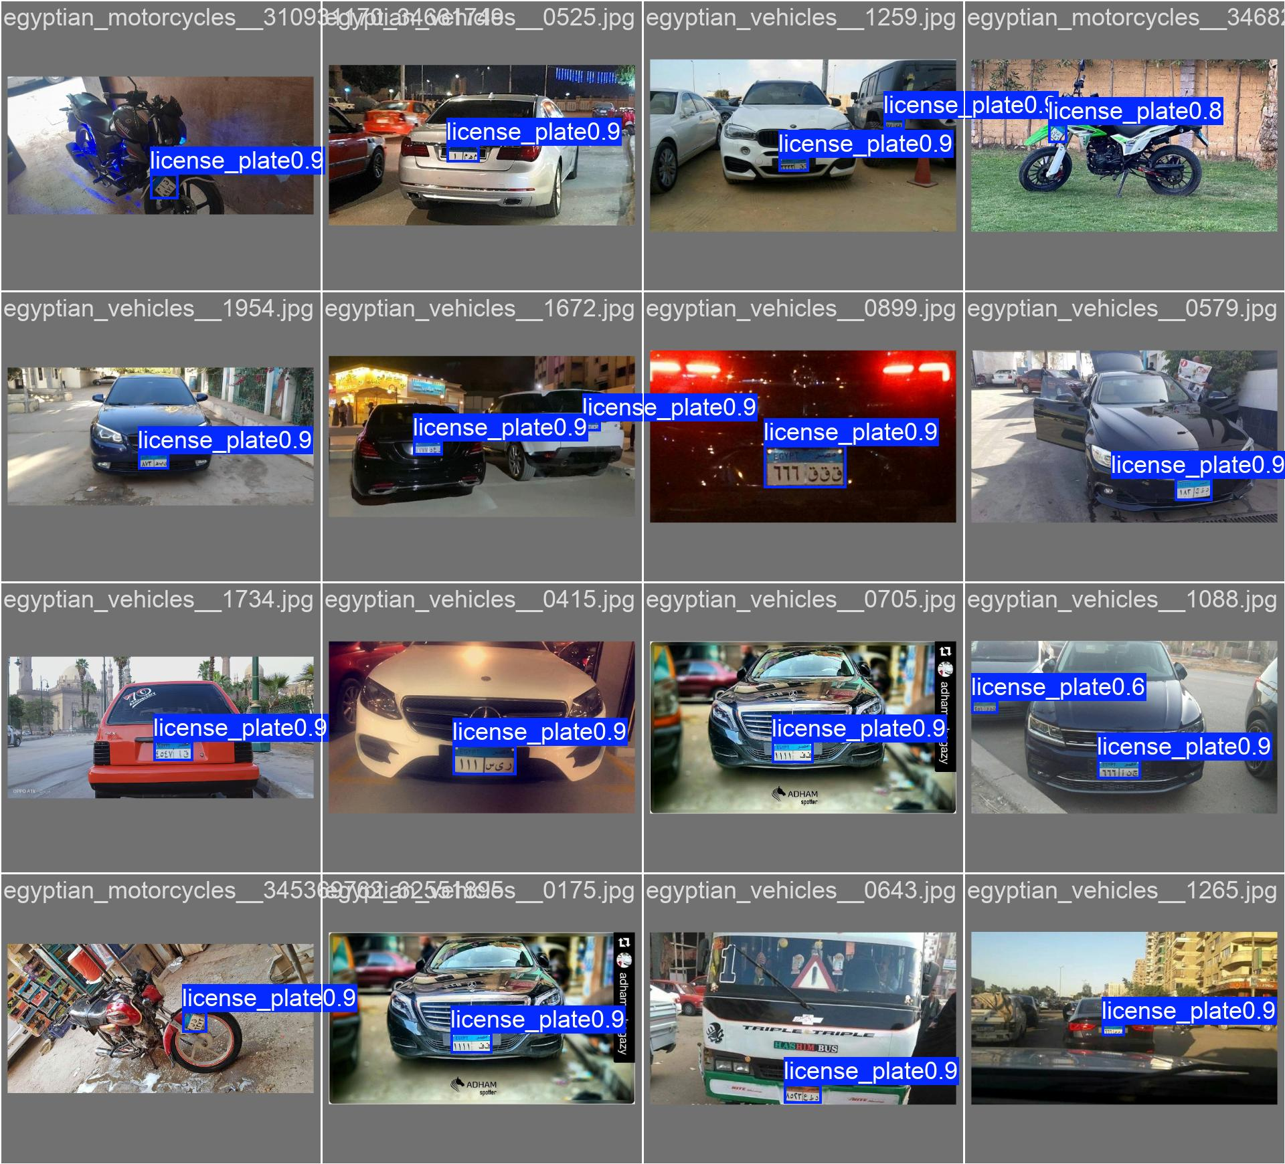
Egyptian plates turn a standard OCR task into a domain problem
Problem statement
Detect and recognize Egyptian vehicle and motorcycle plates reliably from unconstrained images and video.
• Arabic letters and digits with right-to-left ordering
• Small targets, blur, glare, occlusion, tilt, and night scenes
• Heterogeneous datasets and annotation formats
• Cascaded errors can prevent downstream recognition
03
Notes:
[Sources]
Local artifact: models/detection/master_plate_yolo11_20260727_132515/val_batch0_pred.jpg

Slide 4
Prior work progressed from handcrafted segmentation to learned cascades
2013–2014
2016–2022
2017–2025
Classical Egyptian ALPR
Deep learned localization
Sequence & domain models
Edges, morphology, connected components, skew correction, and template matching.
YOLO and CNN cascades improve robustness to background, pose, and lighting variation.
CRNN/CTC and newer Arabic-focused systems reduce reliance on perfect segmentation.
Project position: reproducible data engineering + plate detection + 38-class character detection + locale-aware decoding + web workbench
04
Notes:
[Sources]
https://doi.org/10.1016/j.aej.2013.02.005
https://arxiv.org/abs/1506.02640
https://arxiv.org/abs/1703.07330
https://arxiv.org/abs/1507.05717
https://doi.org/10.1109/ACIRS55390.2022.9845514

Slide 5
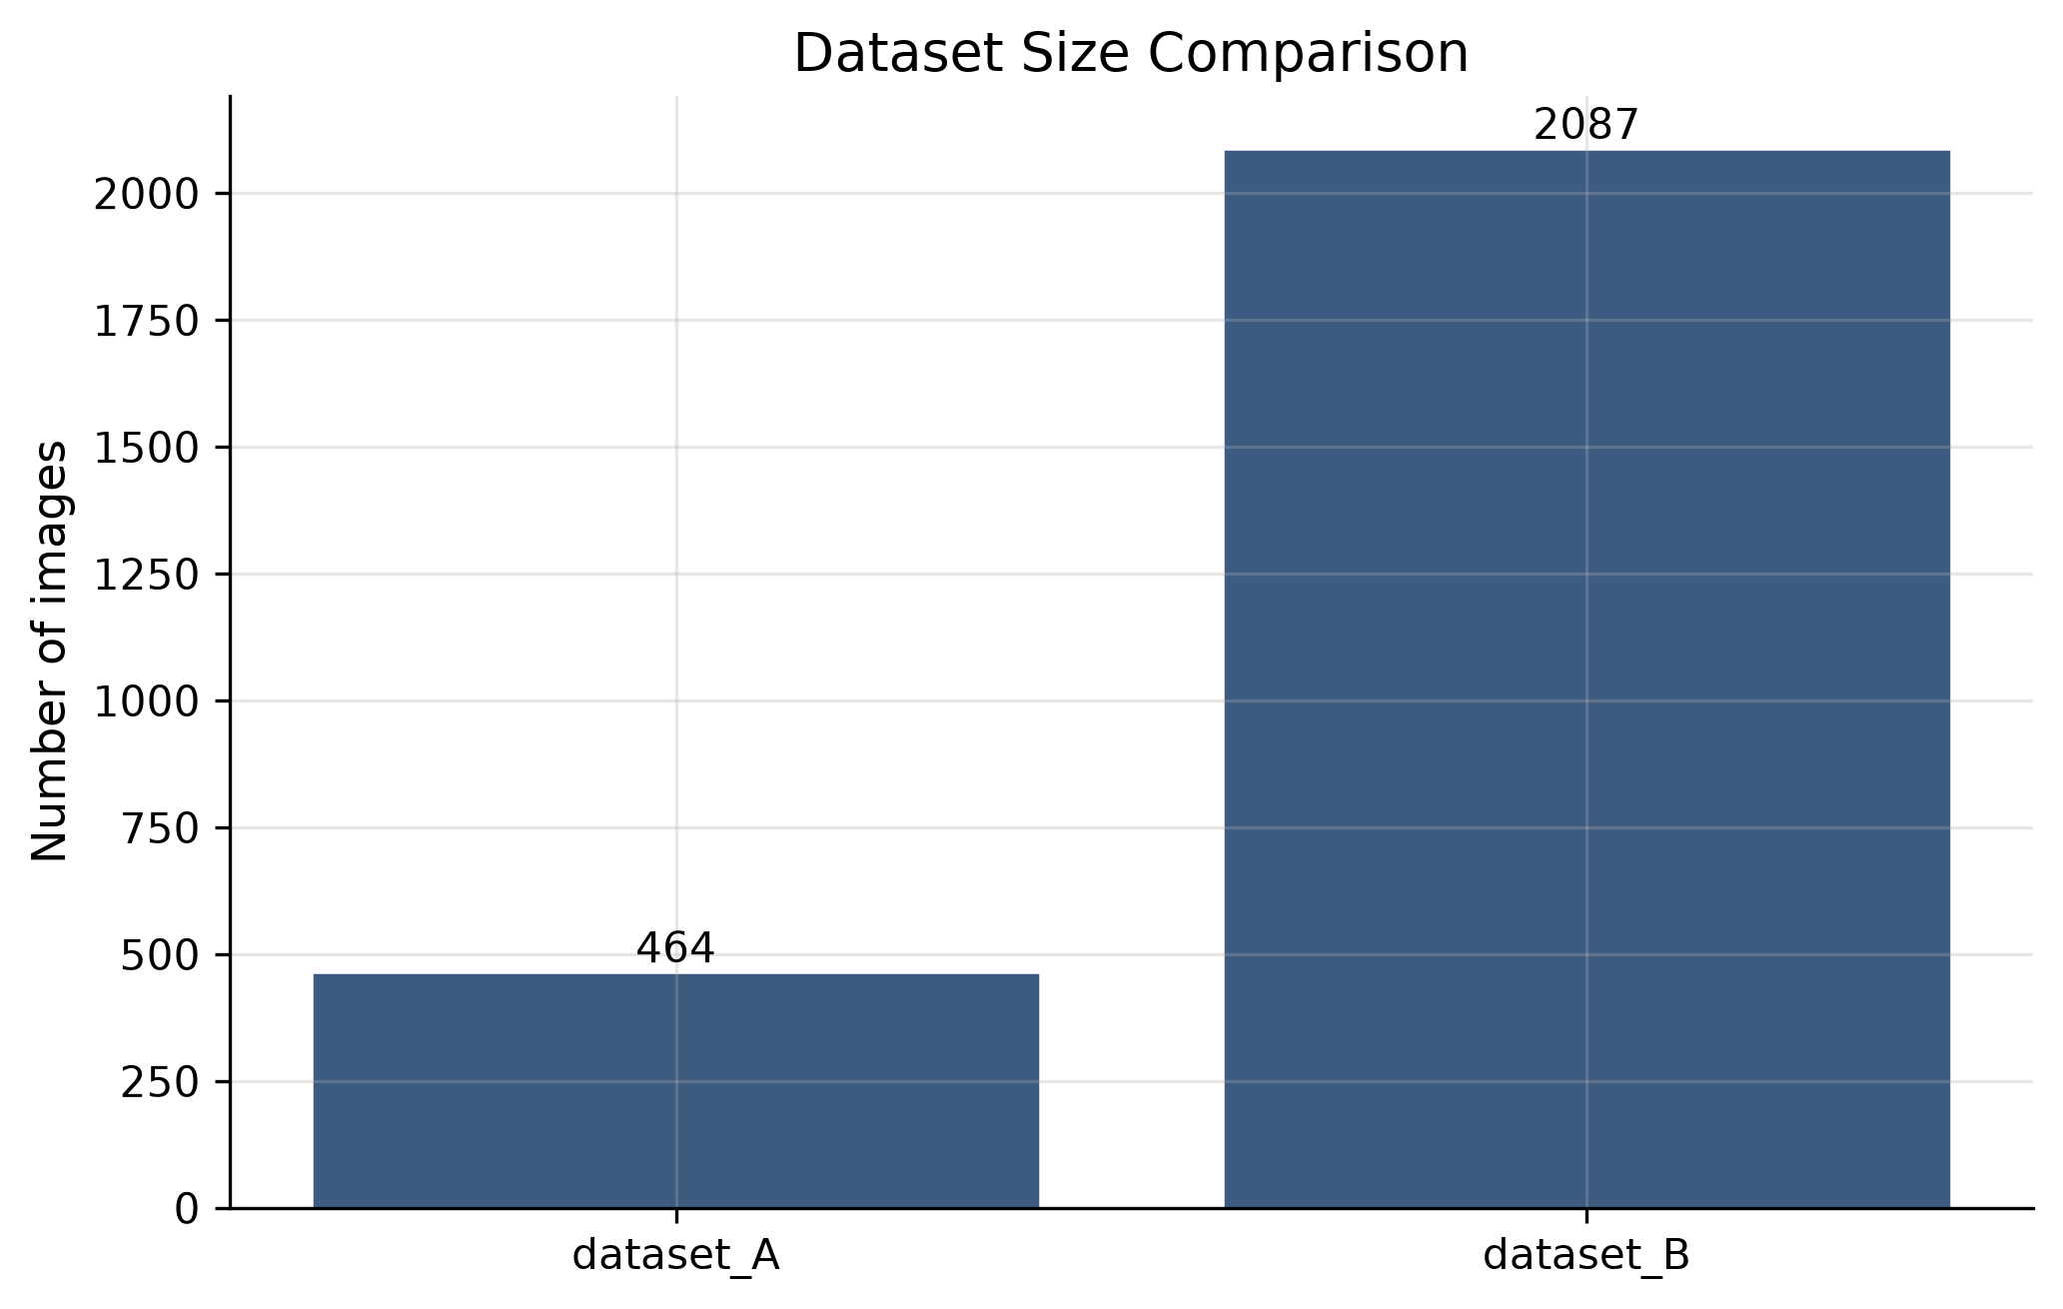
Two plate sources became one reproducible 2,317-image corpus
2,551
2,317
raw images
harmonized
1,622
348
train
validation
347
6,332
test
character crops
QA flags: near duplicates, two missing Dataset A annotations, one corrupted Dataset B image, and identity overlap in the character export.
05
Notes:
[Sources]
Local reports: reports/eda/dataset_summary.md; reports/splits/split_manifest.json; reports/harmonization/harmonization_metadata.json.
Character dataset metadata: https://universe.roboflow.com/alyalsayed-vyx6g/egyptian-car-plates/dataset/13

Slide 6
The cascade narrows the search area at every stage
1
2
3
4
Vehicle detection
Plate localization
Character detection
Locale decoding
COCO-pretrained YOLO11n
custom YOLO11n
38-class YOLO26n
row clustering + RTL sort
An optional CRNN/CTC recognizer is retained as a fallback when segmented-character weights are unavailable.
06
Notes:
[Sources]
https://docs.ultralytics.com/models/yolo11/
https://arxiv.org/abs/1507.05717
Local design: docs/two_stage_yolo.md and configs/model/two_stage.yaml.

Slide 7
Evaluation separates detection quality from whole-plate recognition
Precision
Recall
How many reported detections are correct
How many true objects are found
mAP@0.50
mAP@0.50:0.95
Average precision at IoU 0.50
Localization quality across stricter IoUs
CER
Exact match
Character-level edit error
Perfect plate strings / all plates
Current status
Detector metrics are available; CER, exact-match accuracy, end-to-end recall, latency, and FPS remain to be benchmarked.
07
Notes:
[Sources]
https://docs.ultralytics.com/guides/yolo-performance-metrics/

Slide 8
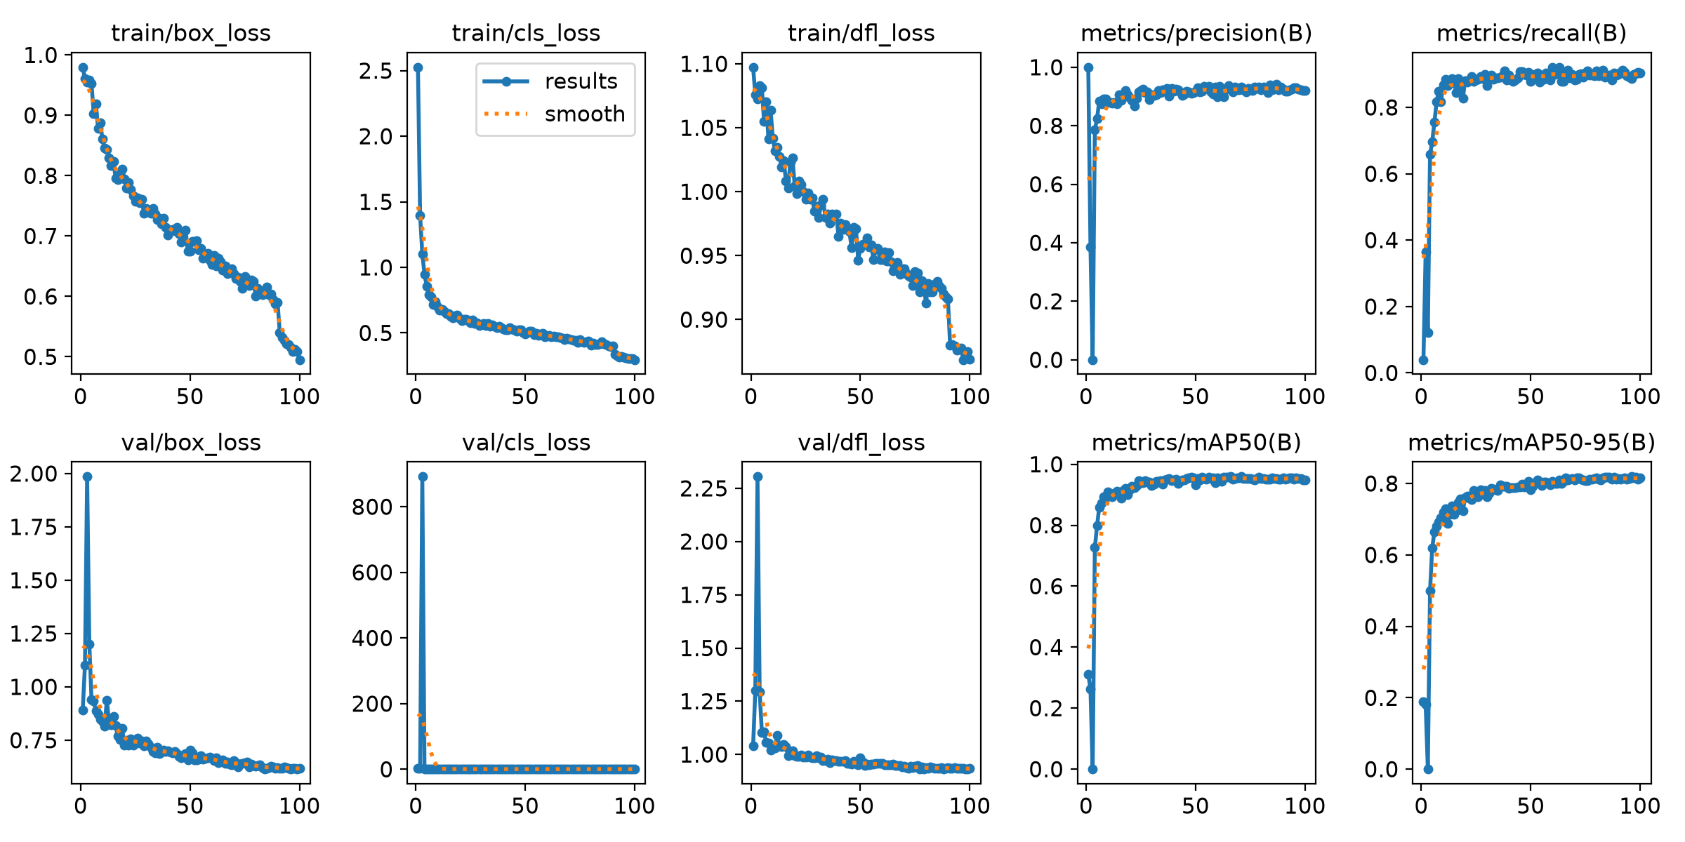
Plate localization is strong, and the 50-epoch run is the best checkpoint
96.24%
82.38%
mAP@0.50
mAP@0.50:0.95
92.02%
91.24%
precision
recall
Best recorded at epoch 49. The longer 100-epoch run did not improve the stricter mAP metric.
08
Notes:
[Sources]
Local metrics: models/detection/master_plate_yolo11_20260727_060023/results.csv and models/detection/master_plate_yolo11_20260727_132515/results.csv.

Slide 9
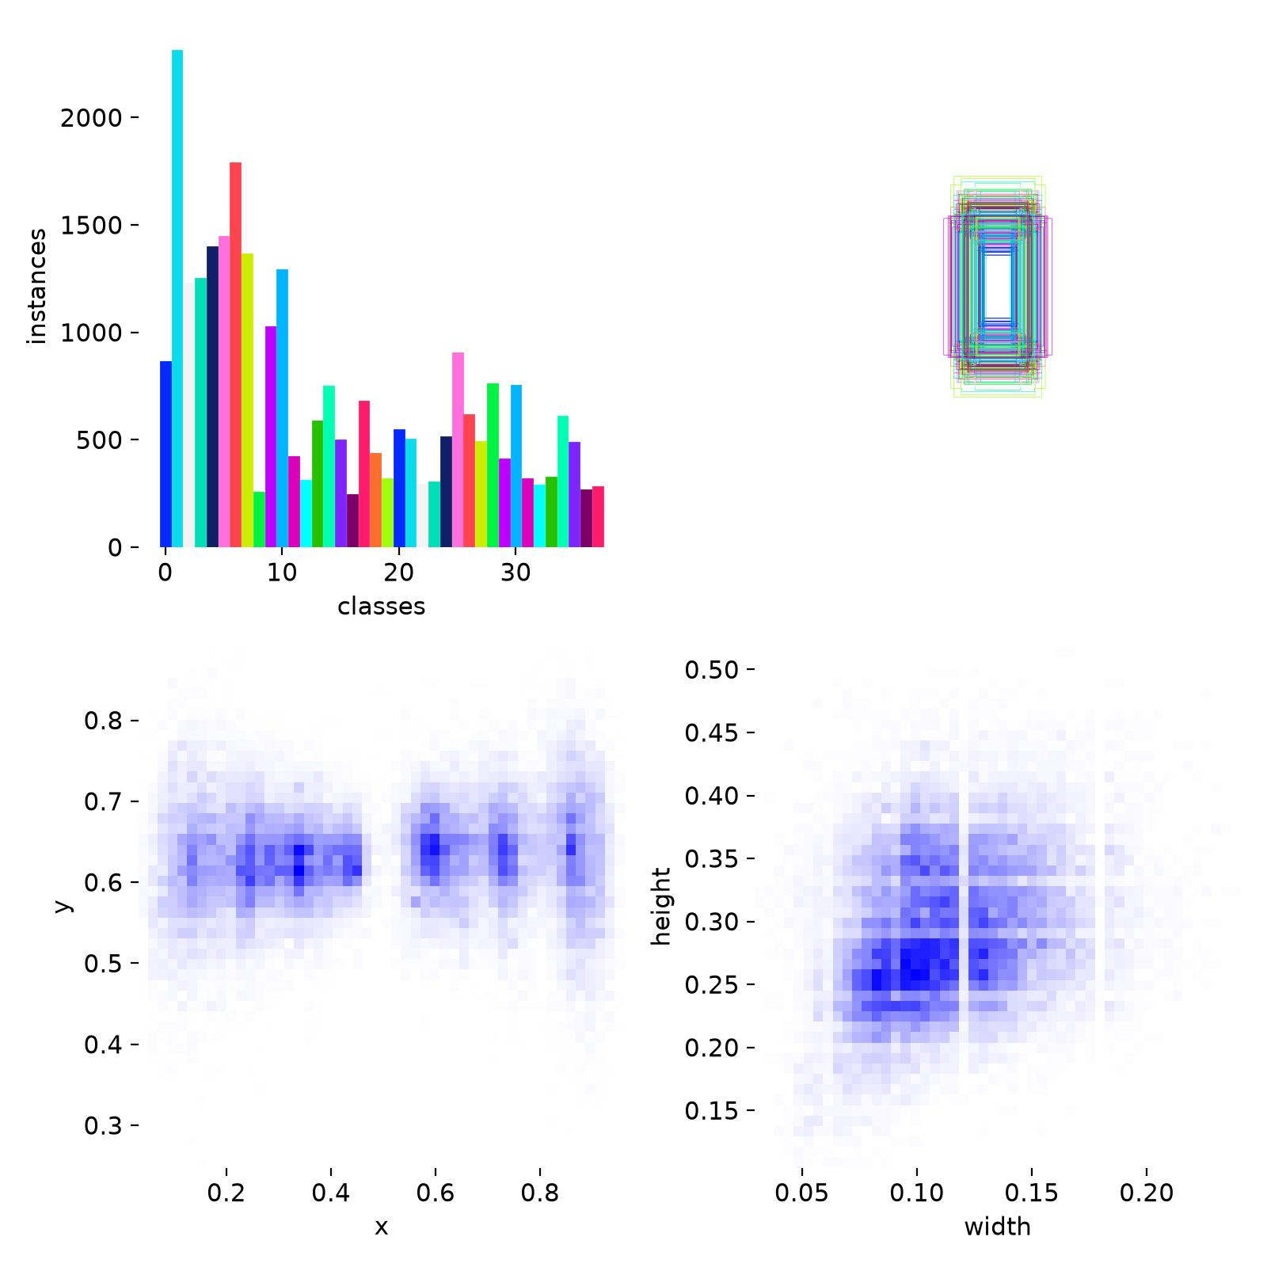
Character detection finds symbols well but localizes them less precisely
97.93%
63.75%
mAP@0.50
mAP@0.50:0.95
94.90%
94.37%
precision
recall
Best recorded at epoch 27 across 38 digit and Arabic-letter classes.
Interpretation: characters are usually detected, but tight small-object boxes remain harder at stricter IoU thresholds.
09
Notes:
[Sources]
Local metrics: models/character/yolo26_characters/results.csv.
Local artifact: models/character/yolo26_characters/labels.jpg.

Slide 10
The present evidence supports component readiness—not a final ALPR claim
What is working
What the curves suggest
Reproducible data pipeline; plate detector; 38-class character detector; right-to-left decoder; API and React workbench.
Plate performance stabilizes early. Longer training trades recall for a small precision increase without better strict mAP.
What limits interpretation
What is still missing
Near duplicates and nine shared base identities across character splits can inflate validation performance.
Leakage-controlled end-to-end exact match, CER, latency, FPS, and video-level robustness.
10
Notes:
[Sources]
Local README.md and training artifacts.

Slide 11
A leakage-controlled benchmark is the next milestone
Conclusion
The project has a solid, reproducible foundation and strong component metrics. Final value depends on proving full-string recognition under an unbiased test protocol.
Now
Next
Then
Deploy
Freeze grouped splits
Benchmark the cascade
Improve hard cases
Optimize and learn
Group by source, vehicle, and original plate identity.
Report exact match, CER, recall, FP/image, latency, and FPS.
Per-class balancing, tilt/night/motorcycle analysis, threshold calibration.
Tracking + multi-frame voting, edge export, active learning from reviews.
11
Notes:
[Sources]
Local project conclusions based on repository metrics and QA reports.

Slide 12
References
[1] El-Adawi et al., Automated New License Plate Recognition in Egypt, 2013.
[2] Abd El Rahman et al., Automatic Arabic Number Plate Recognition, 2013.
[3] Redmon et al., You Only Look Once, CVPR 2016.
[4] Masood et al., License Plate Detection and Recognition Using Deeply Learned CNNs, 2017.
[5] Shi et al., CRNN for Image-Based Sequence Recognition, TPAMI 2017.
[6] Youssef et al., A New Benchmark Dataset for Egyptian LPR, ACIRS 2022.
[7] Youssef et al., Real-time Egyptian LPR using YOLO, IJACSA 2022.
[8] Abdellatif et al., Low-Cost IoT-Based Arabic LPR, ASEJ 2023.
[9] Ultralytics, YOLO11 and performance-metrics documentation.
[10] EALPR dataset repository and Roboflow Egyptian character dataset.
12
Notes:
[Sources]
https://doi.org/10.1016/j.aej.2013.02.005
https://arxiv.org/abs/1506.02640
https://arxiv.org/abs/1703.07330
https://arxiv.org/abs/1507.05717
https://doi.org/10.1109/ACIRS55390.2022.9845514
https://docs.ultralytics.com/models/yolo11/
https://docs.ultralytics.com/guides/yolo-performance-metrics/
https://github.com/ahmedramadan96/EALPR

