Slide 1
Final project - Daniel Zalewski

Slide 2

Short reminder
The aim of the study was to investigate whether specific gut microorganisms influence liver tumor burden and the tumor immune microenvironment in patients with HBV-related hepatocellular carcinoma.
For the analysis of 16S rRNA, fecal samples were collected from 133 patients with HBV-related HCC and 100 healthy volunteers.
For the RNA-seq analysis, paired tumor and adjacent non-tumor tissue samples were collected from 32 patients with HCC.
In the project, 15 samples for 16S rRNA and 20 samples for RNA-seq were used due to hardware limitations and data availability.

Slide 3
16S rRNA

Slide 4

16S rRNA analysis steps
Sequence analysis
Read merging
Artifact removal
Taxonomy assignment

Slide 5
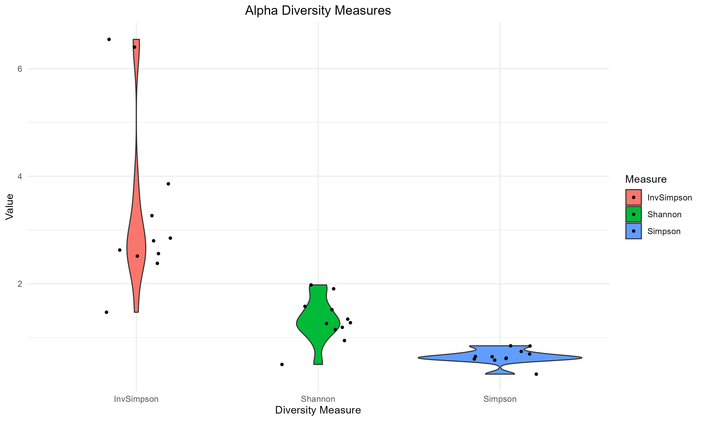

Slide 6
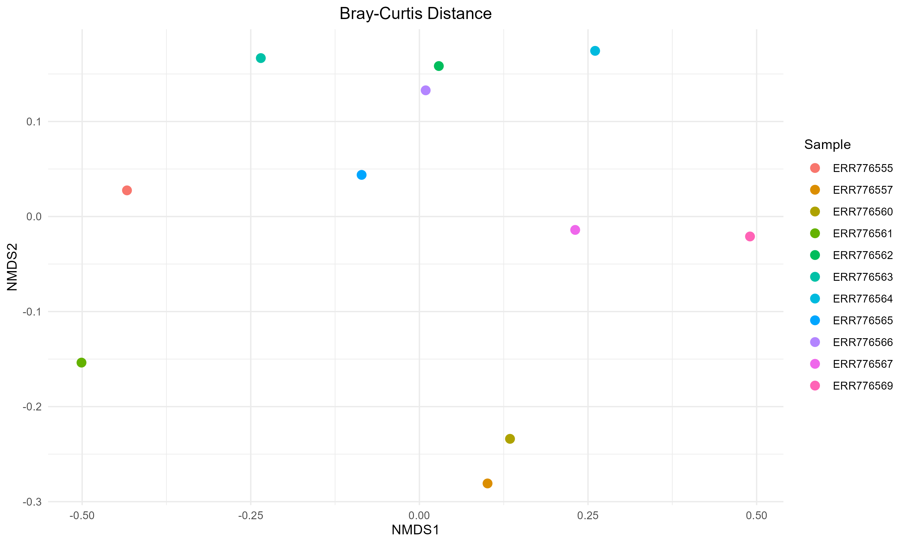

Slide 7
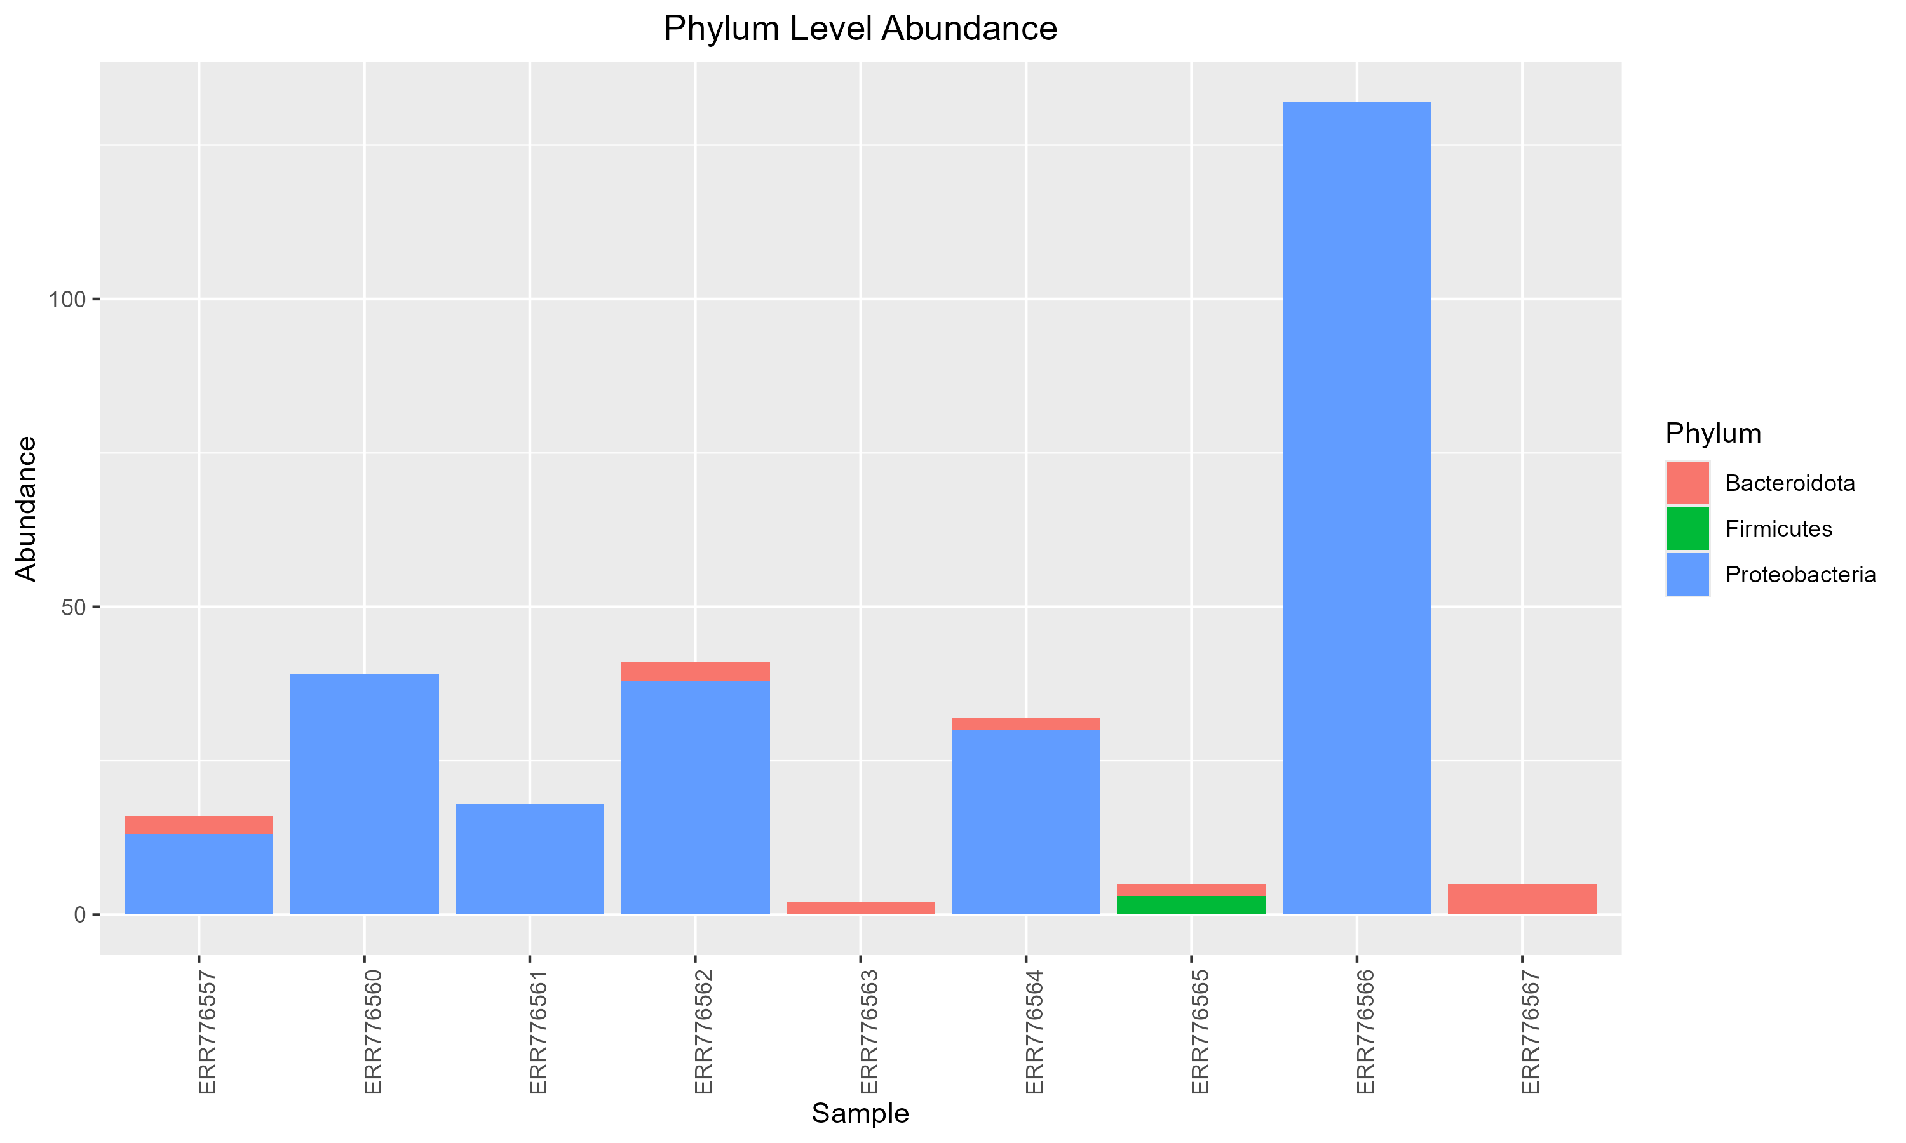

Slide 8
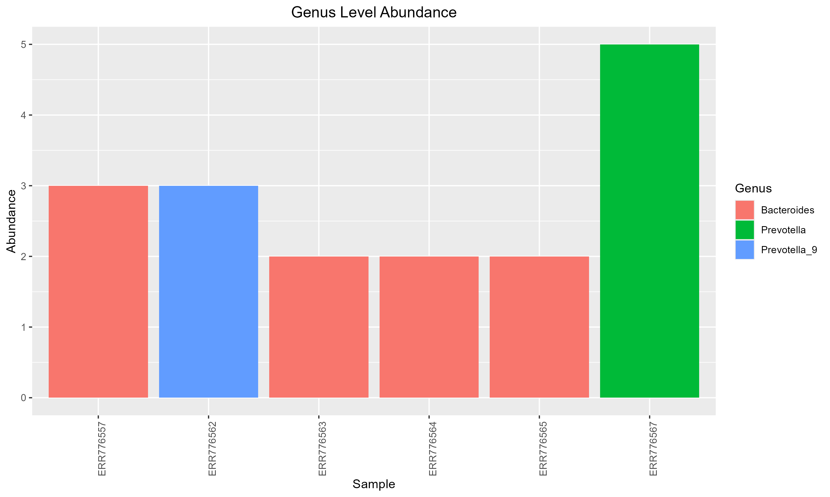

Slide 9
RNA-seq

Slide 10

RNA-seq analysis steps
Mapping RNA-seq reads to the reference genome (HISAT2)
Counting reads assigned to genes (featureCounts)
Data normalization and model design
Differential expression analysis
Selection of significant genes

Slide 11
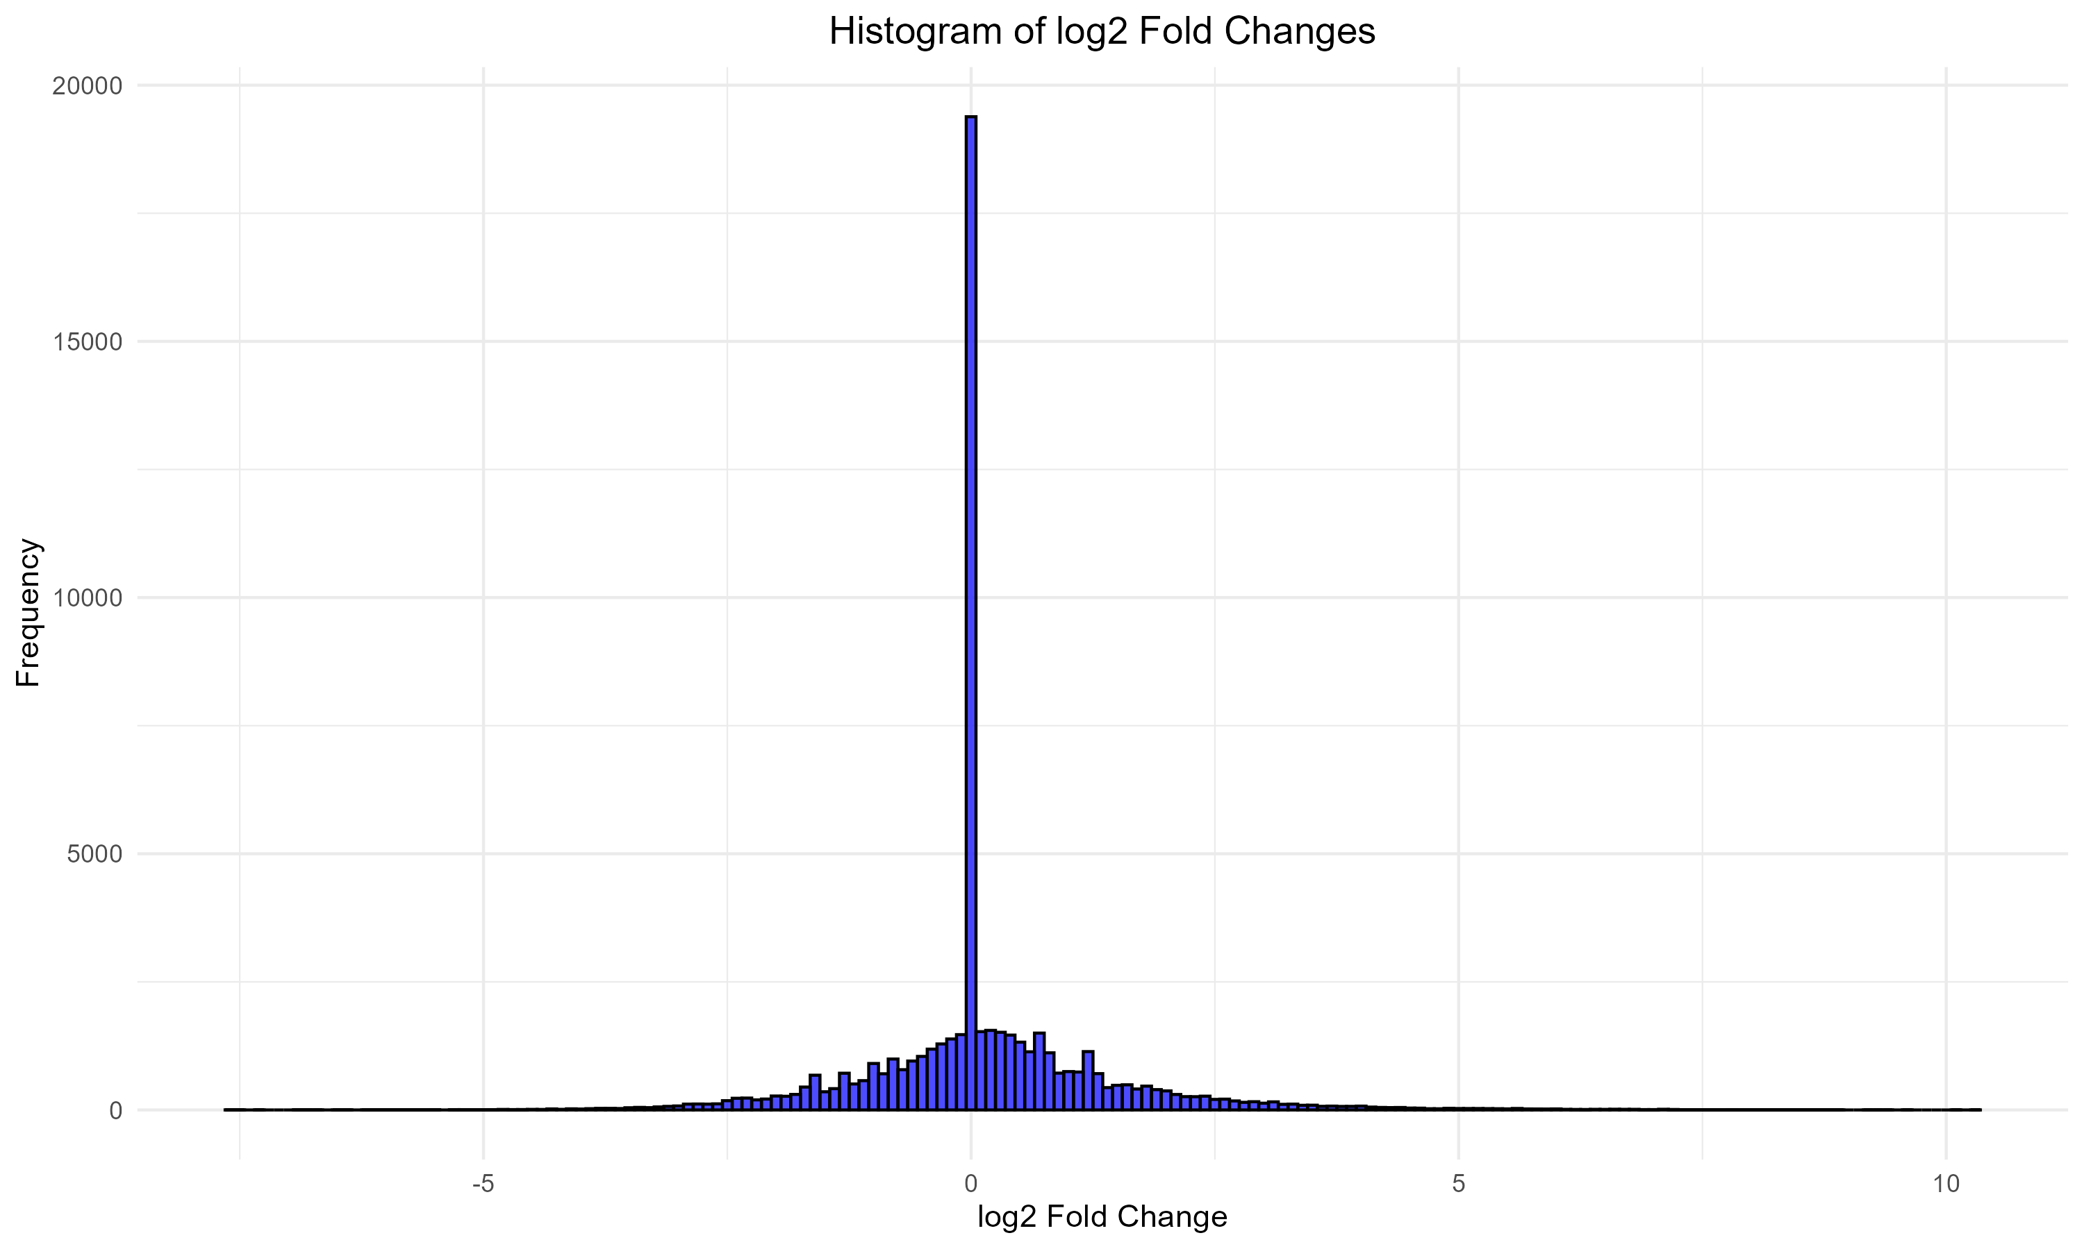

Slide 12
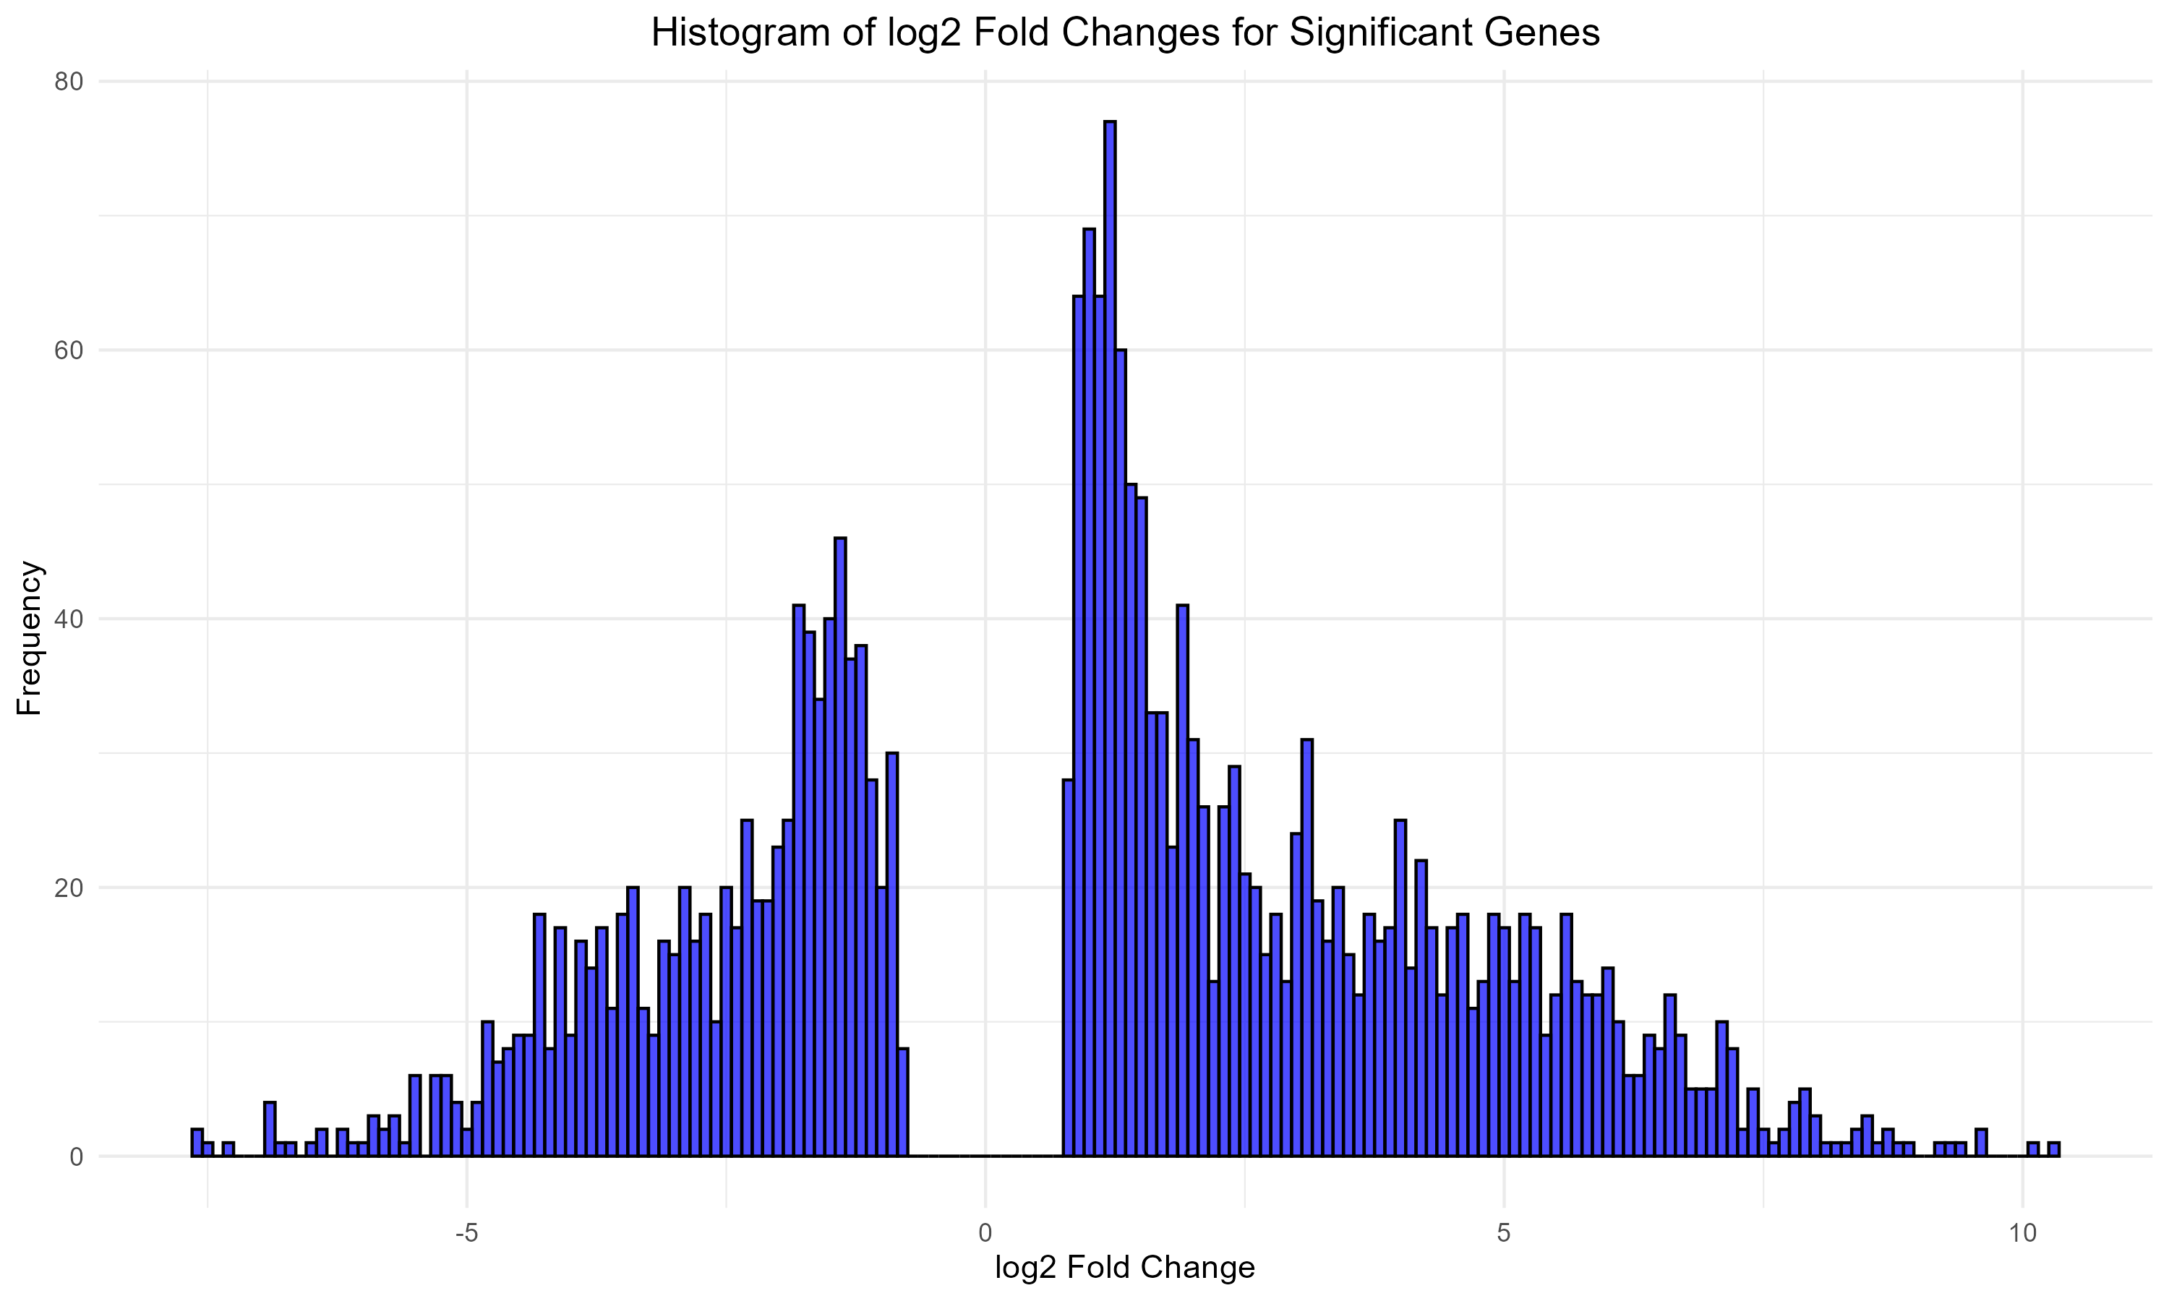

Slide 13
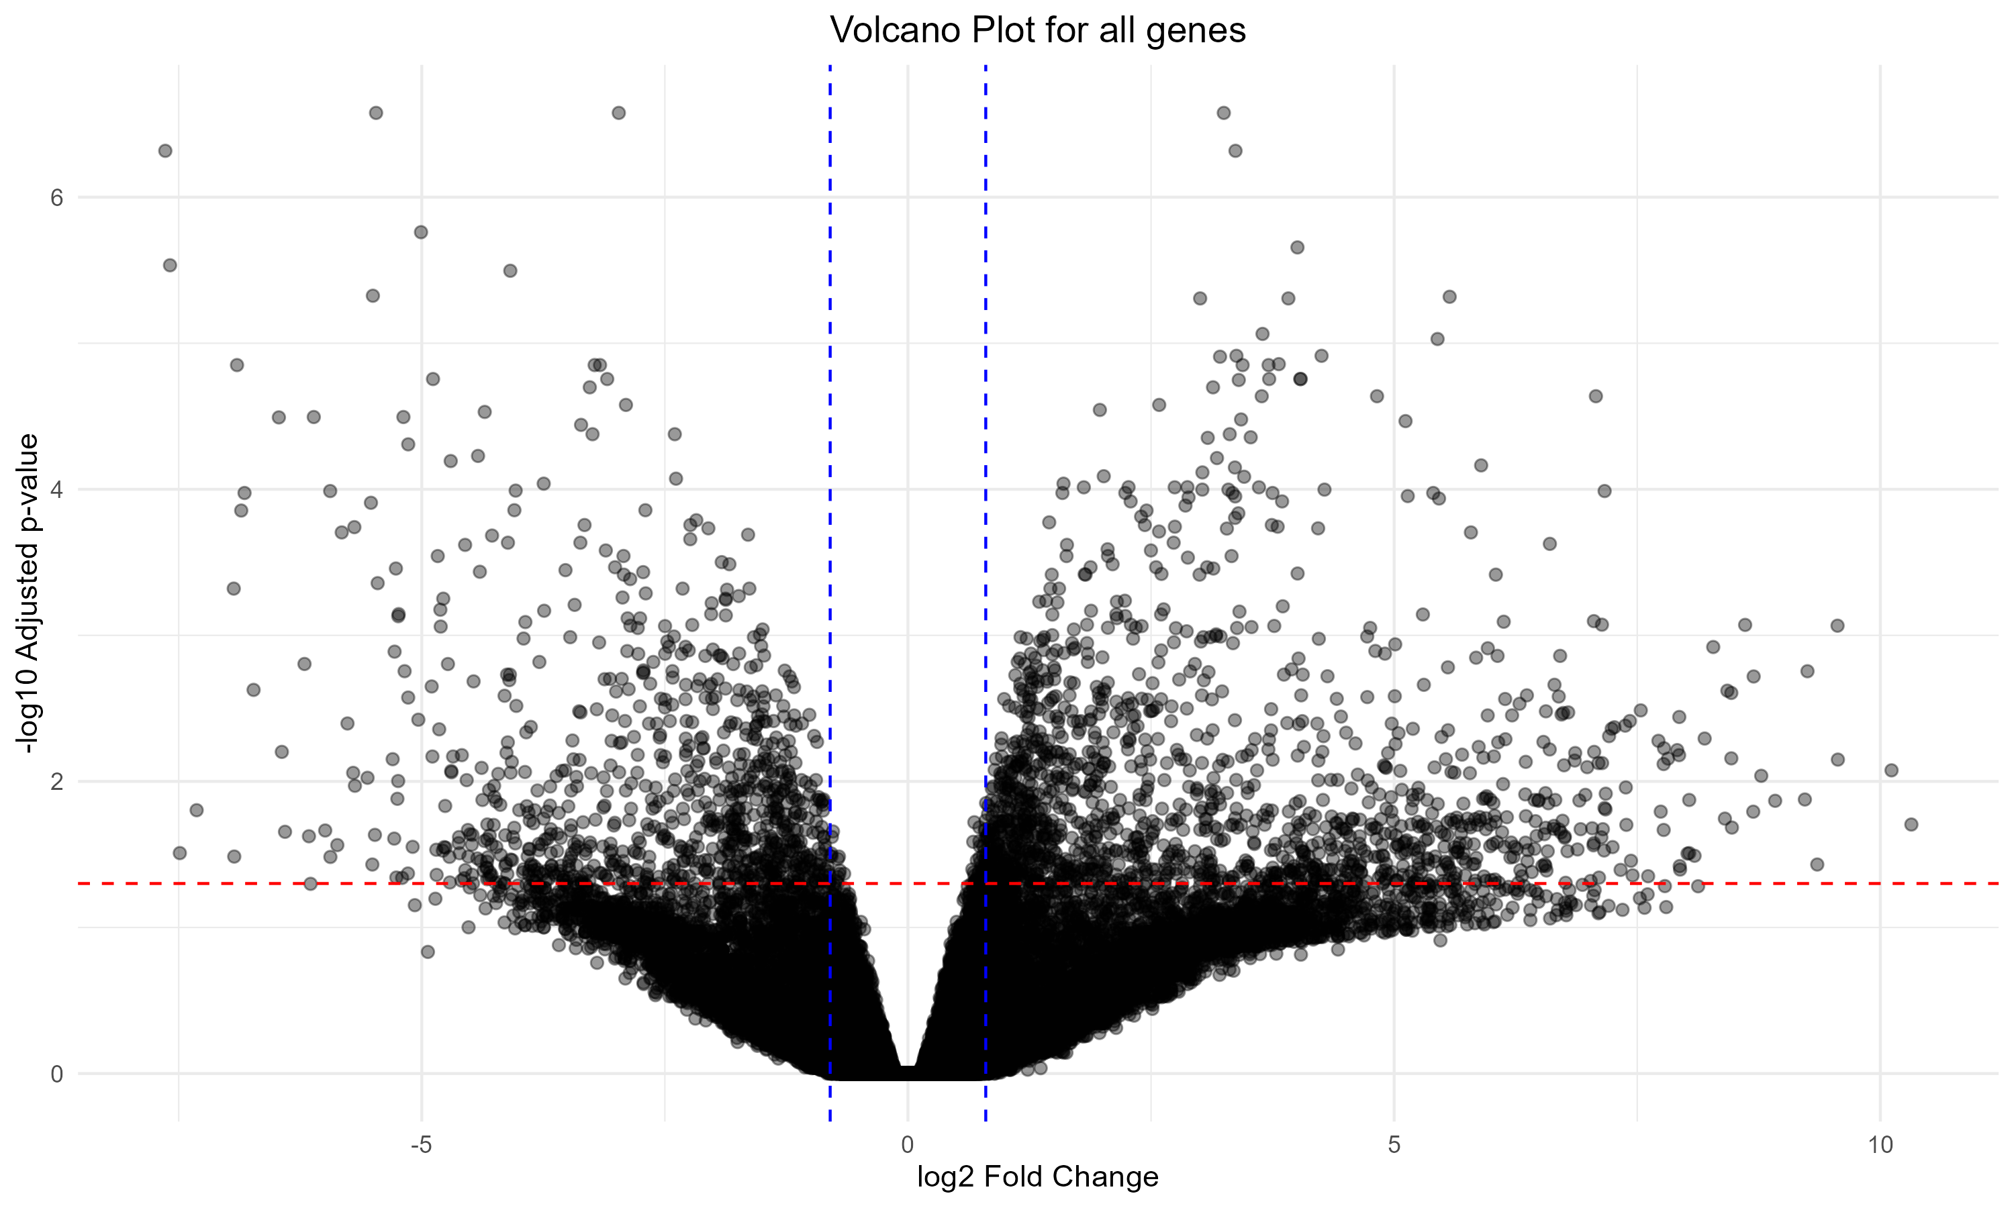

Slide 14
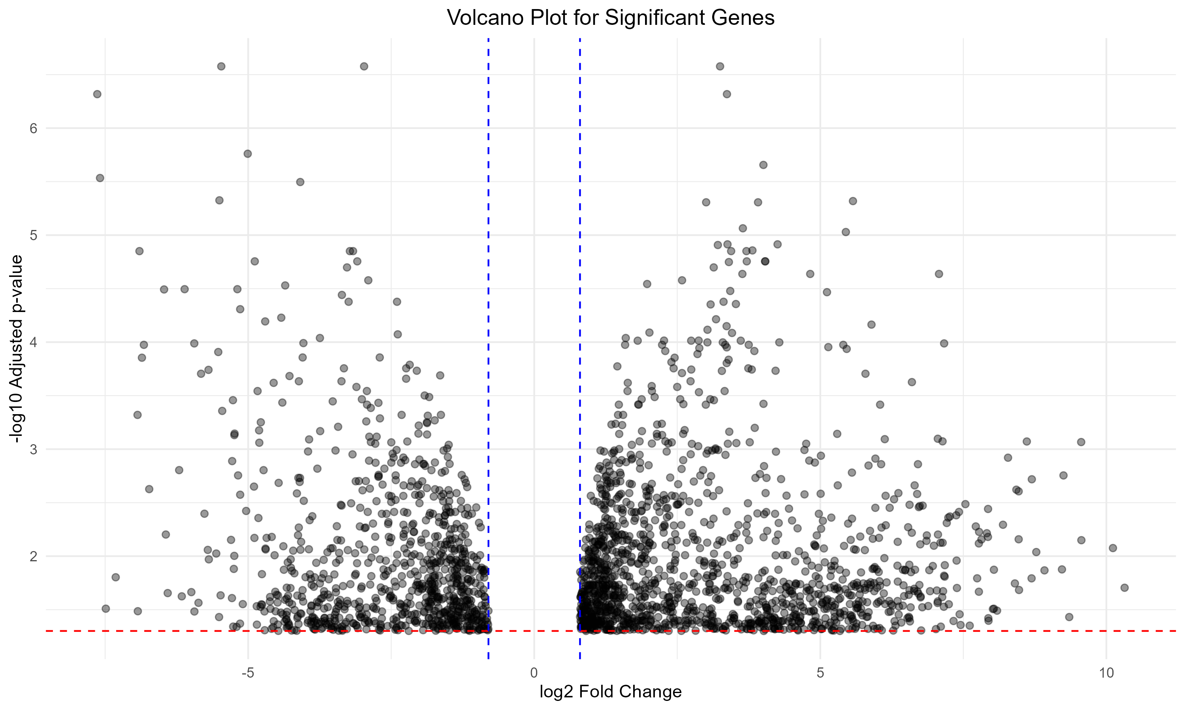

Slide 15
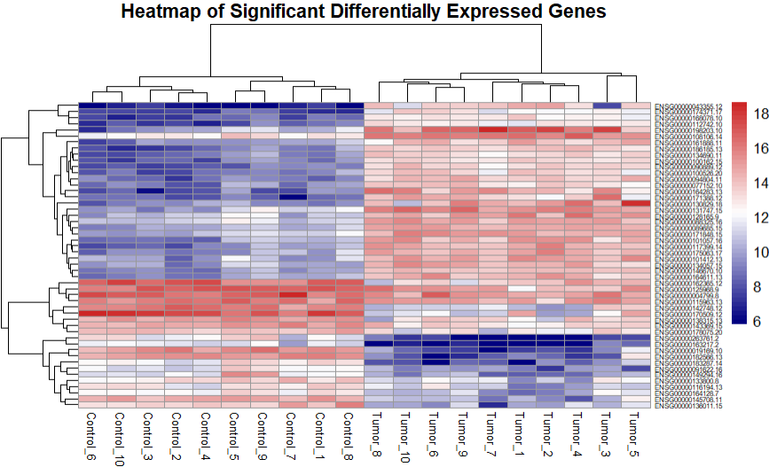

Slide 16
Correlation and prediction model construction

Slide 17
Correlation and prediction model construction steps
Data normalization
Correlation calculation
Predictive model building (randomForest)

Slide 18
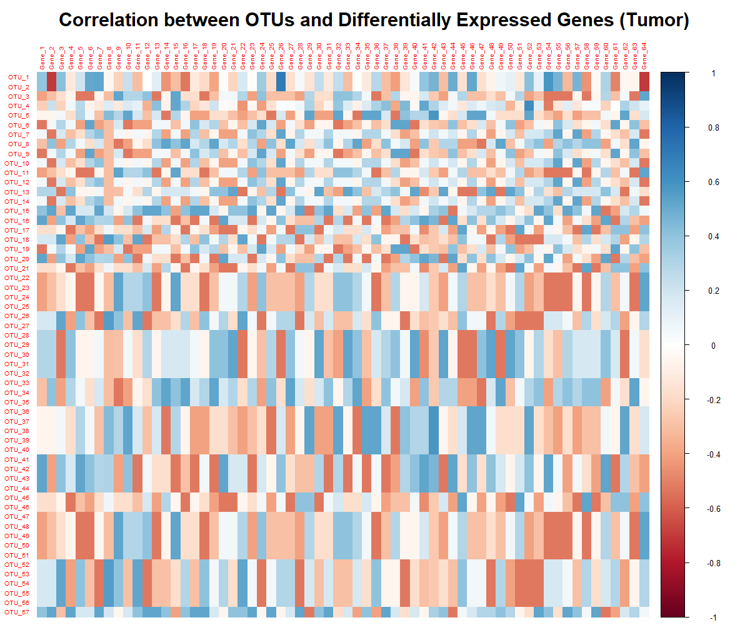

Slide 19
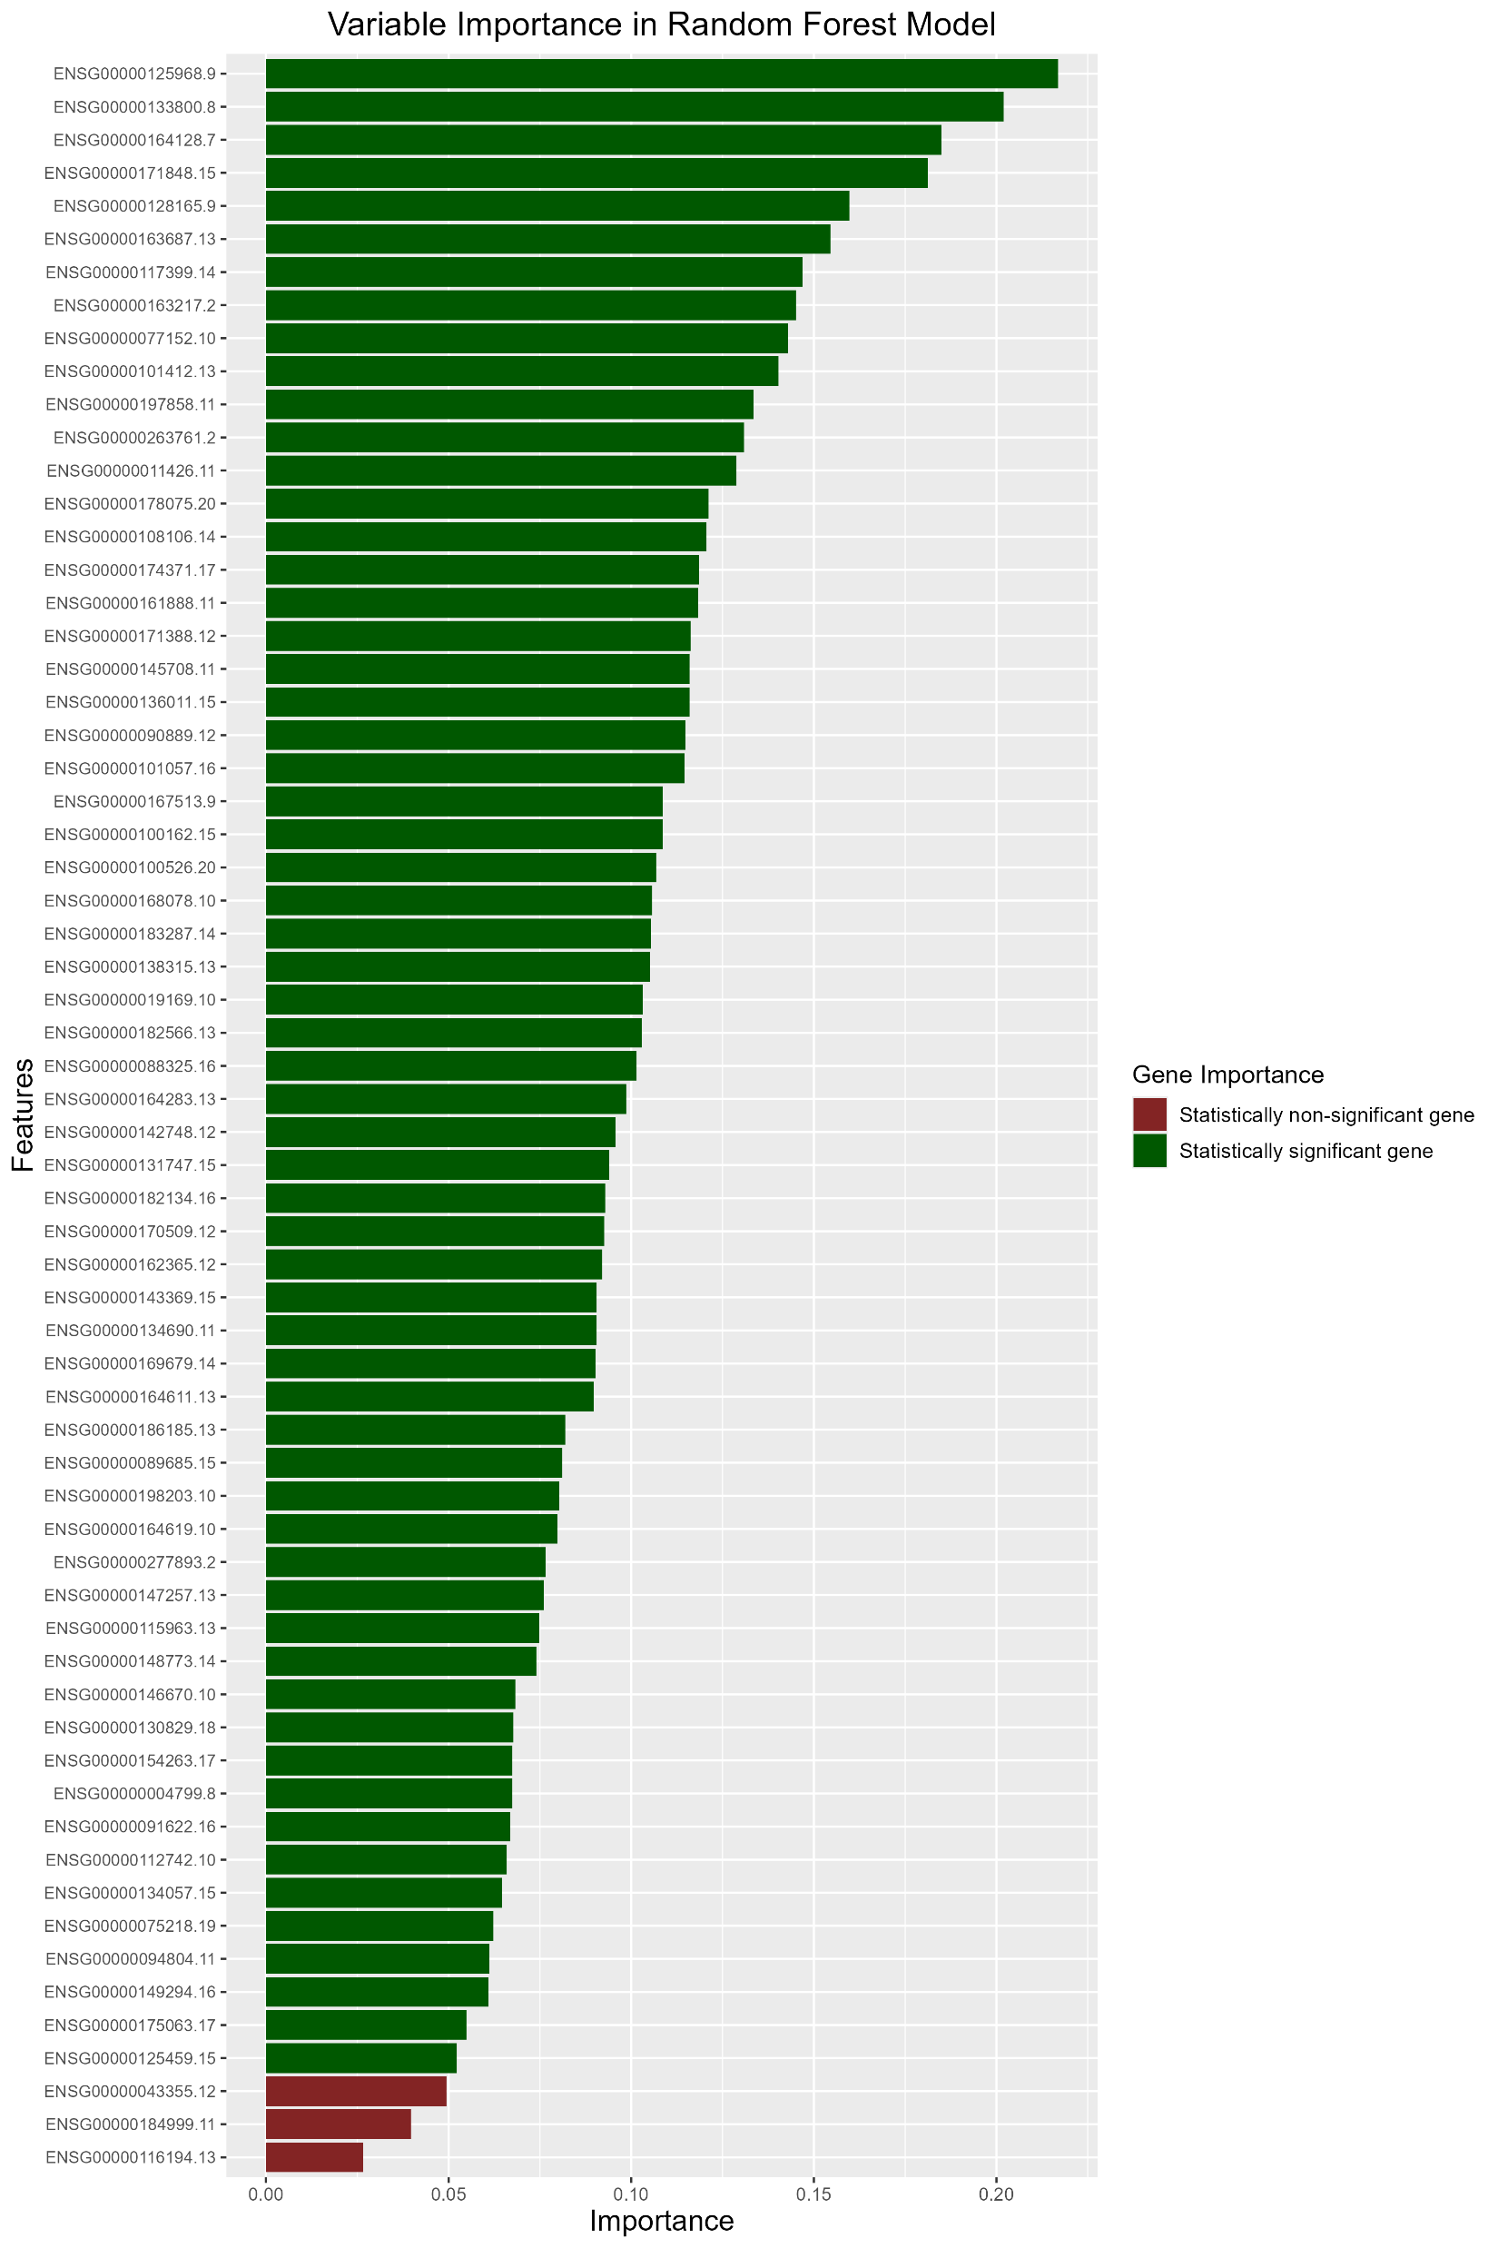

Slide 20
Bibliography:
Huang, Hechen, et al. "Integrated analysis of microbiome and host transcriptome reveals correlations between gut microbiota and clinical outcomes in HBV-related hepatocellular carcinoma." Genome medicine 12 (2020): 1-14.

Slide 21
Q&A

