Slide 1
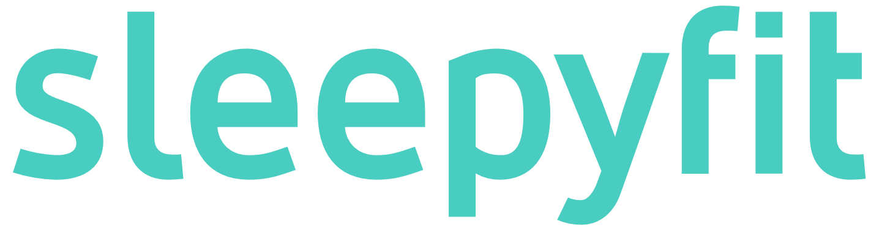
Feel refreshed Reach your potential Enjoy life

Slide 2
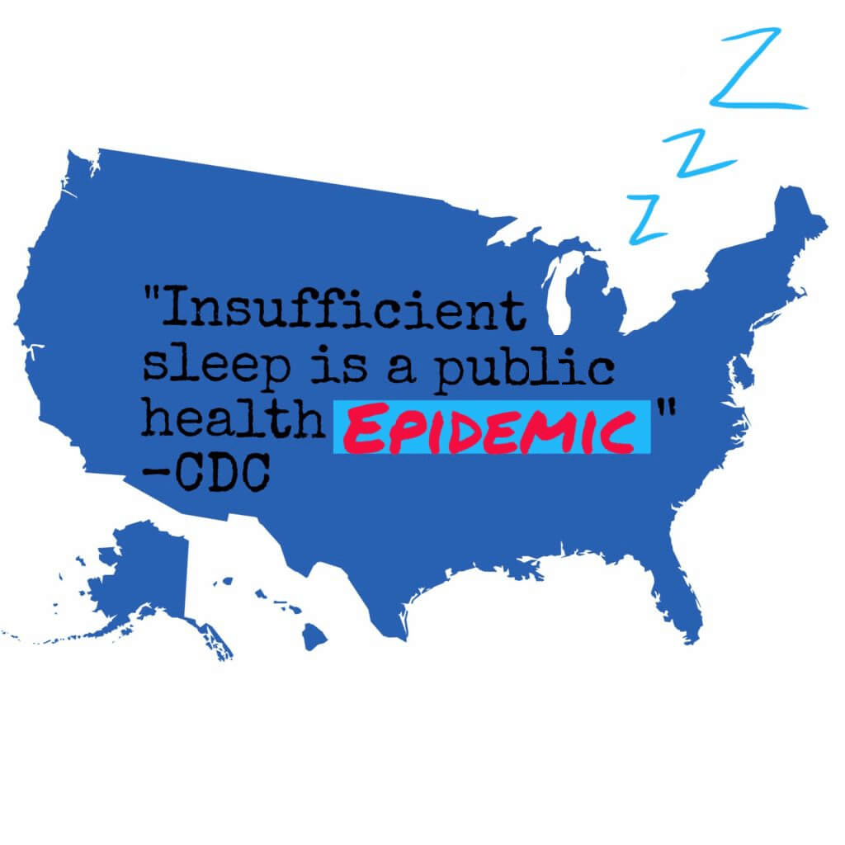
Global sleep loss epidemic Majority of us are affected, with significant health implications
Two thirds of people in the developed world are not getting enough sleep.¹
Health implications from lack of sleep:
Alzheimer’s
Cancer
Cardiovascular disease
Anxiety & depression
Economic implication of more than $1 trillion globally³
Record investments into this space:
Dreem, US: $57 million
SmartSleep, Germany: €1.5 million
Beddit, USA: acquired by Apple for undisclosed sum
Notes:
https://www.esquire.com/uk/life/fitness-wellbeing/a18577/sleep-loss-epidemic-insomnia-treatment/
https://www.webmd.com/sleep-disorders/features/10-results-sleep-loss#1
https://www.tuck.com/economics-of-sleep/

Slide 3
Preventive care is the answer Empower people through insights and actions
Sleepyfit
DATA
INSIGHTS
ACTIONS
This is where we are right now, data overload.
Trillions of sensors in the world, and this is growing exponentially.
Overview of your sleep.
Detail view with drivers and negative actions impacting your sleep efficiency.
Calendar view to see over time.
Coaching how to plan your day to help your sleep.
Real-time advice to improve your sleep.

Slide 4








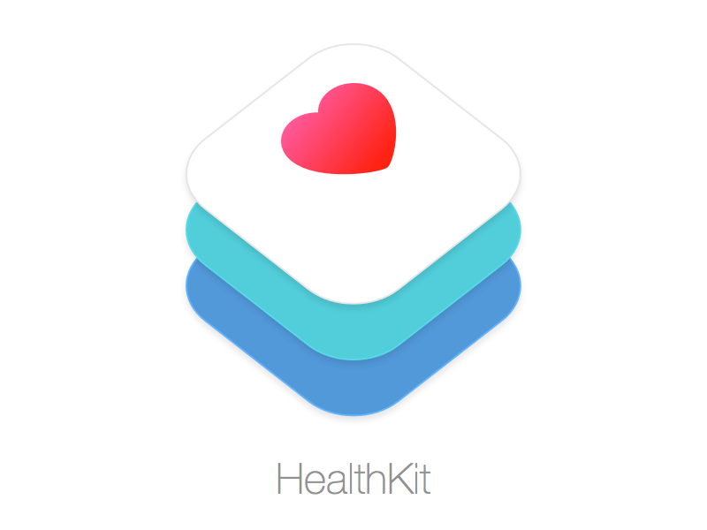
Ease of use Submit your data to receive personalized AI powered advice
Optional
Database
(also includes population data)
Personalized
Sleep profile

Slide 5
DEMO

Slide 6
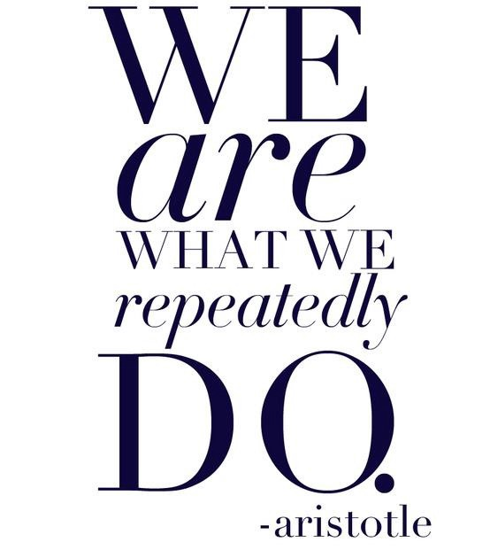
Time is right Conquer our habits, reach your full potential
Sleep is just the beginning, our technology is applicable to any human behavior we want to improve:
How can you live longer by improving your health?
How can you reach your goals?
Understand and control your own “cause and effect”

Slide 7


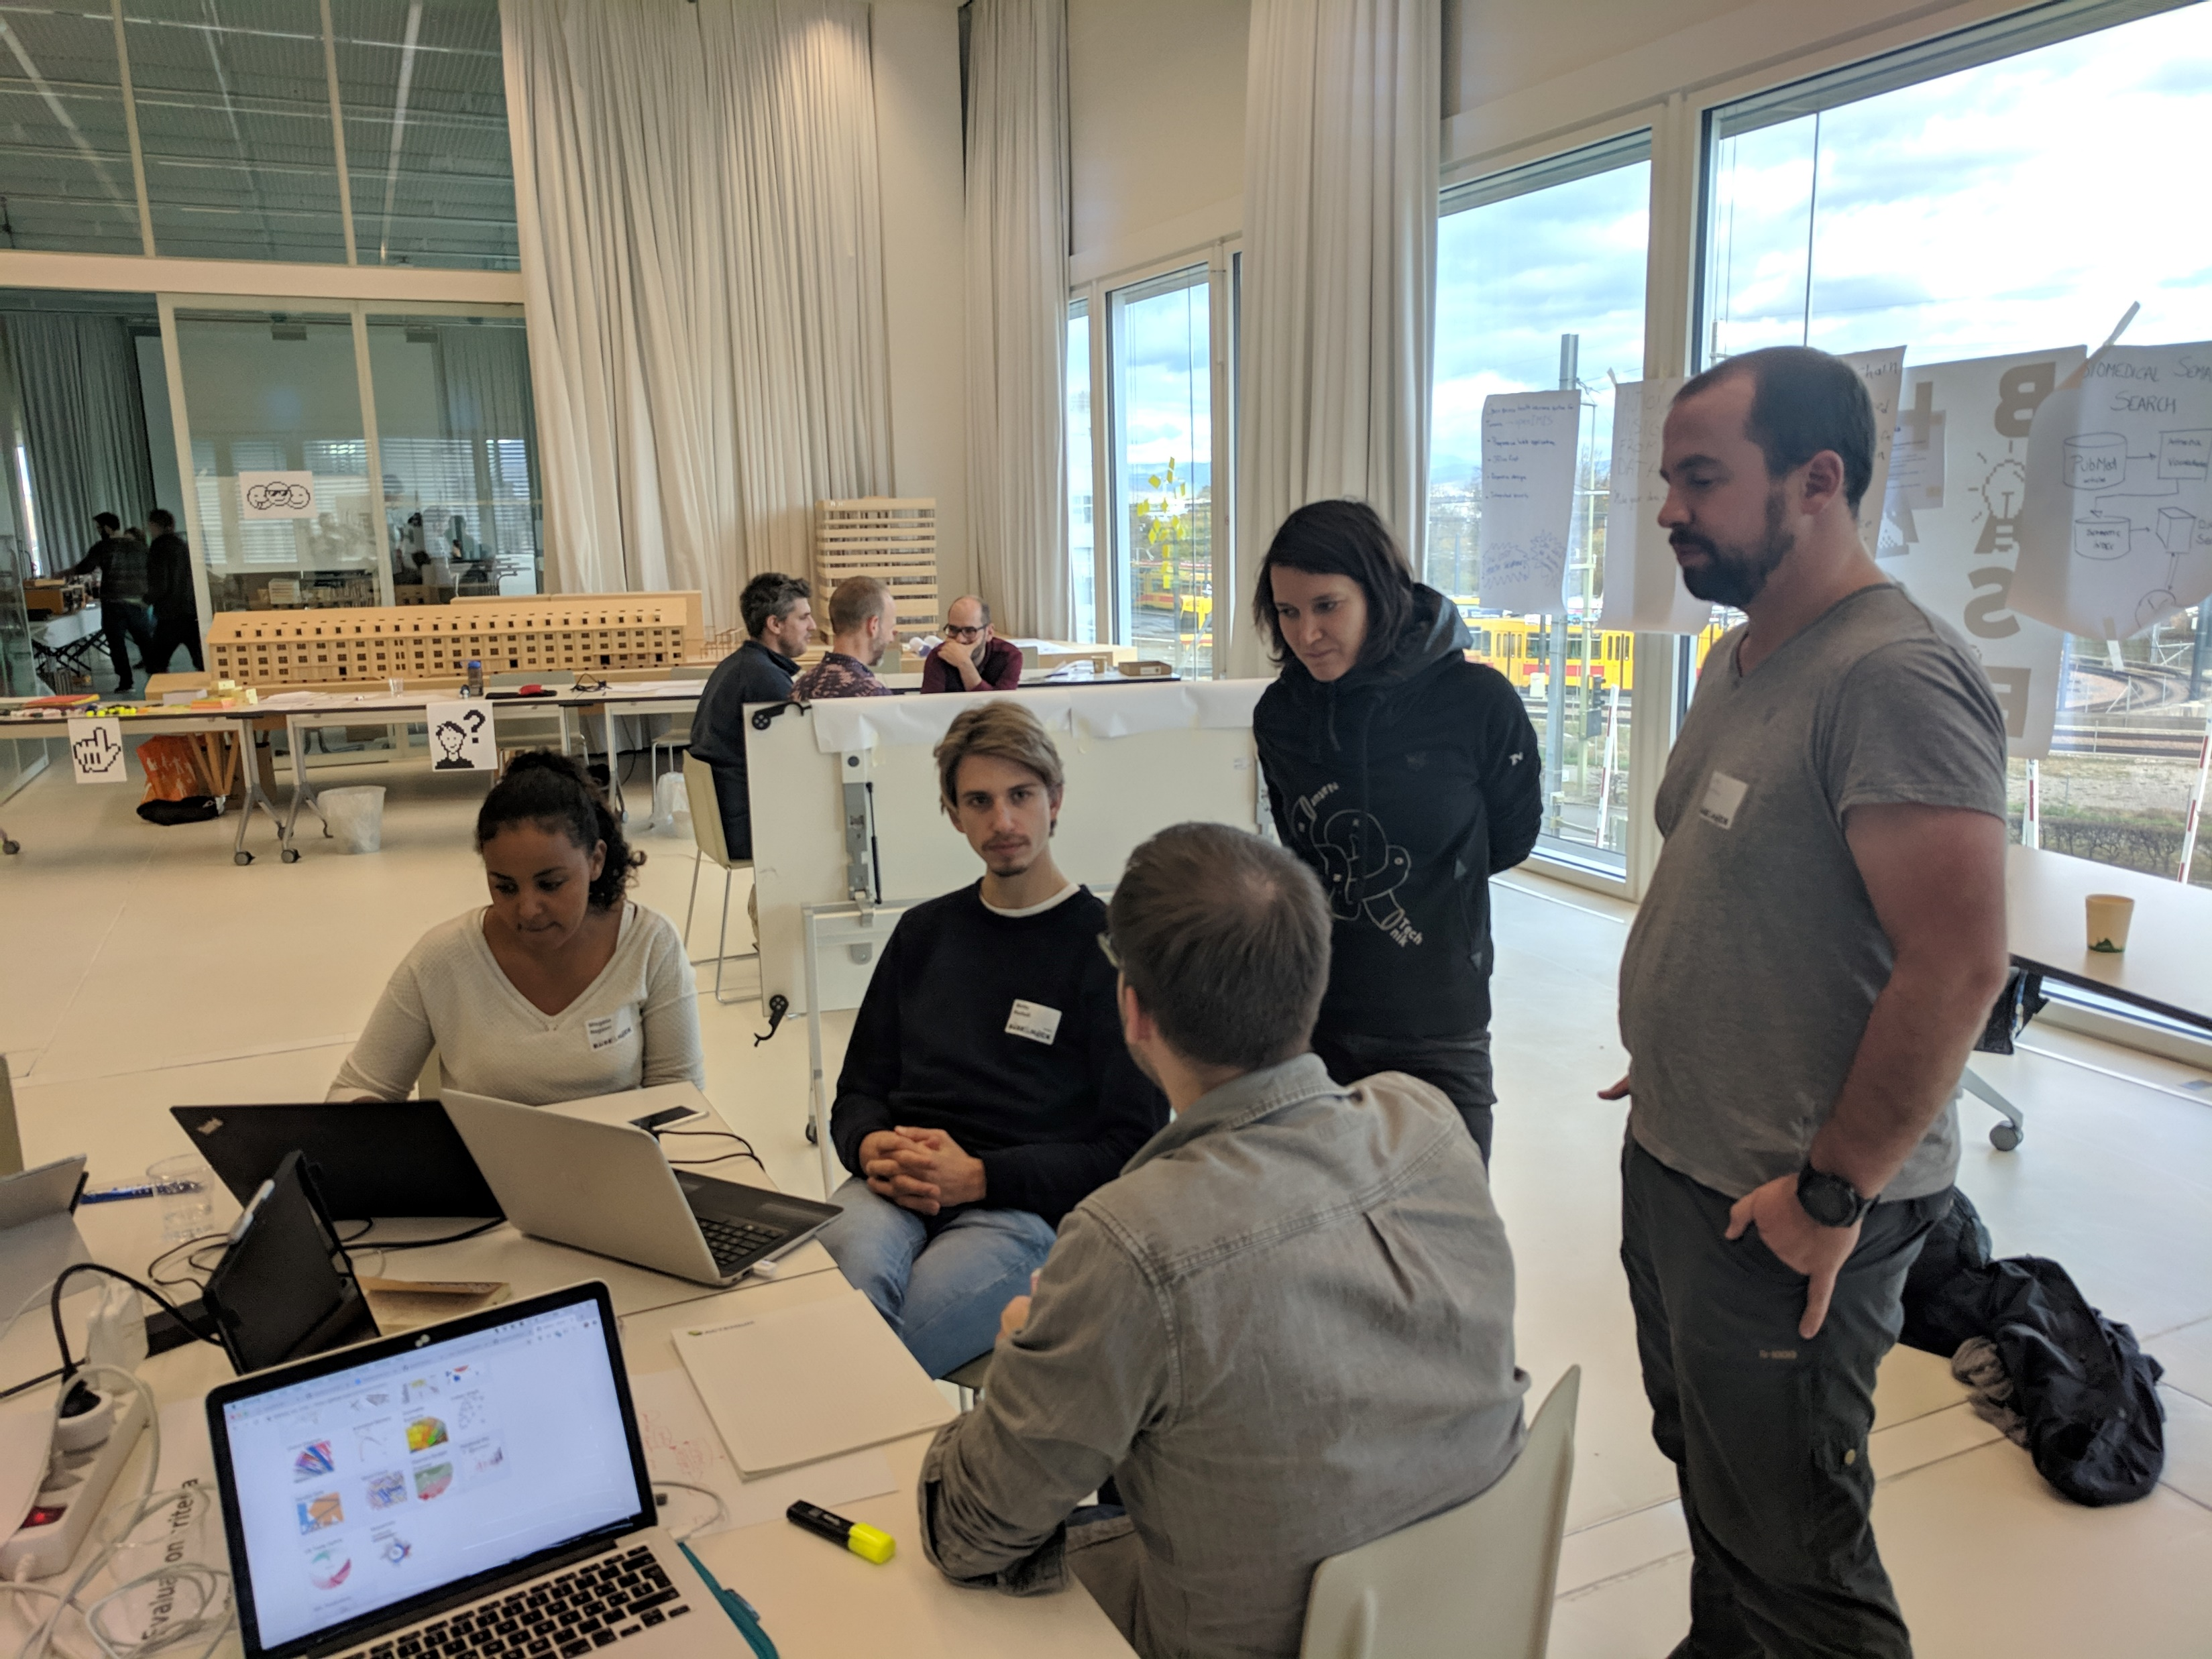
Our hackathon journey Python and “because of science”
Why don’t we use data to improve sleep!
Sleepyfit team
Dash plotly – “not that bad, but goes against everything in webdev”
Weather is more than sunny / not sunny

Slide 8





Acknowledgements Big thank you to BaselHack and the developers of the tools we used

