Slide 1
Quicksort
Efficient sorting algorithm
--Proposed by C.A.R. Hoare in 1962
--Divide-and-Conquer algorithm
--Sorts “in place” (like insertion sort, but not like merge sort)
--Very practical (with tuning)
--Can be viewed as a randomized Las Vegas algorithm
--Worst-case running time: Θ(n²)
--Expected running time: Θ(nlogn)
--Constant hidden in Θ(nlogn) are small.

Slide 2
Divide and Conquer
Quicksort an n-element array:
--Divide: Partition the array into two subarrays around a pivot x such that elements in lower subarray ≤ x ≤ elements in upper subarray
--Conquer: Recursively sort the subarrays.
--Combine: Trivial.
Key: Linear-time partitioning subroutine.

Slide 3
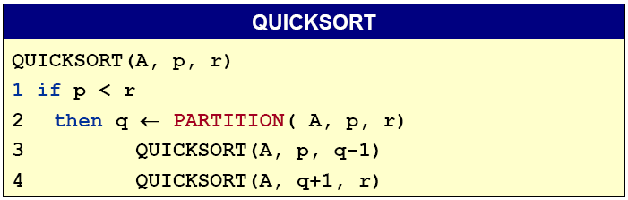
Divide and Conquer
Initial call Quicksort(A, 1, n)

Slide 4
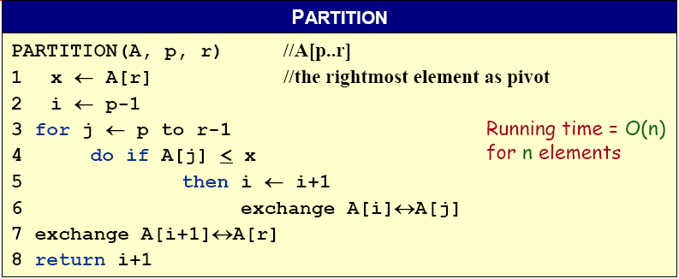
Partitioning subroutine

Slide 5










Example of Partitioning
The operation of Partition on a sample array. Lightly shaded array elements are all with values no greater than x (the pivot). Heavily shaded array elements are all with values greater than x.

Slide 6
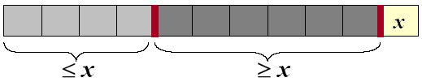
Analysis of quicksort
Assume all input elements are distinct.
In practice, there are better partitioning algorithms for when duplicate input elements may exist.
Let T(n) = worst-case running time on an array of n elements.

Slide 7
Worst-case of quicksort
Input sorted or reverse sorted.
Partition around min or max element.
One side of partition always has no elements.
T(n) = T(n - 1) + T(0) + Θ(n)
= T(n - 1) + Θ(1) + Θ(n)
= T(n - 1) + Θ(n)
= Θ(n²) (Arithmetic series)

Slide 8
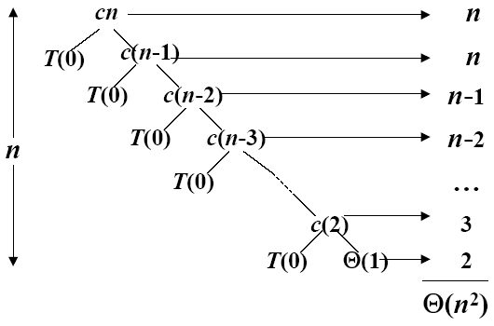
Worst-case recursive tree
T(n) = T(n - 1) + T(0) + Θ(n)
A recursion tree for QUICKSORT in which the Partition procedure always puts only a single element on one side of the partition (the worst case). The resulting running time is Θ(n²)

Slide 9
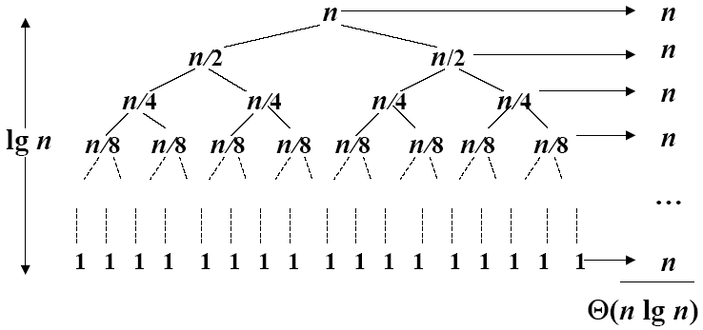
Best Case Partitioning
Θ(nlgn)
A recursion tree for QUICKSORT in which the Partition always balances the two sides of the partition equally (the best case). The resulting running time is Θ(nlgn)

Slide 10
Best-case analysis
If we’re lucky, PARTITION splits the array evenly:
--T(n) = 2T(n/2) + Θ(n) = Θ(nlogn).
What if the split is always 1/10:9/10?
--T(n) ≤ T(9n/10) + T(n/10) + Θ(n)
--What is the solution to this recurrence?

Slide 11
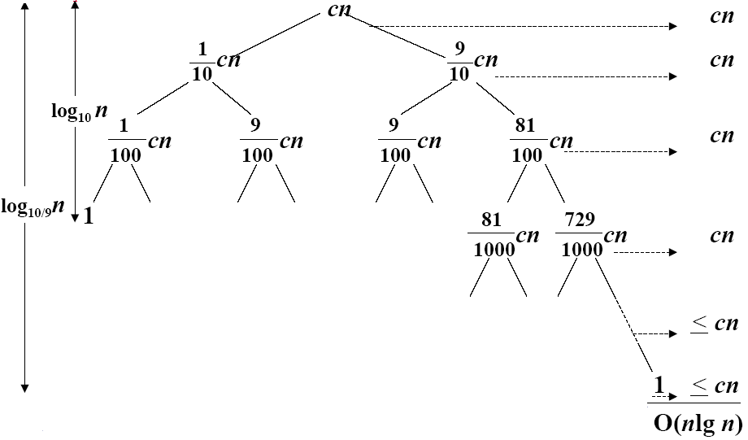
A Recursion tree
Worst case Θ(n²), why we prefer Quicksort to Mergesort
A recursion tree for QUICKSORT in which PARTITION always produces a 9-to-1 split, yielding a running time of O(n lgn)

Slide 12
Sorting in linear time

Slide 13
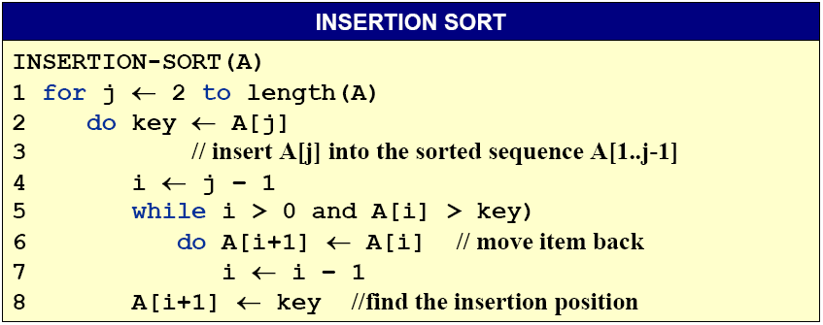
Sorting Lower Bound
For comparison-based sort algorithms, the optimal time complexity is O(n log n) for input size n?
Is there a faster algorithm for different model of computation?

Slide 14
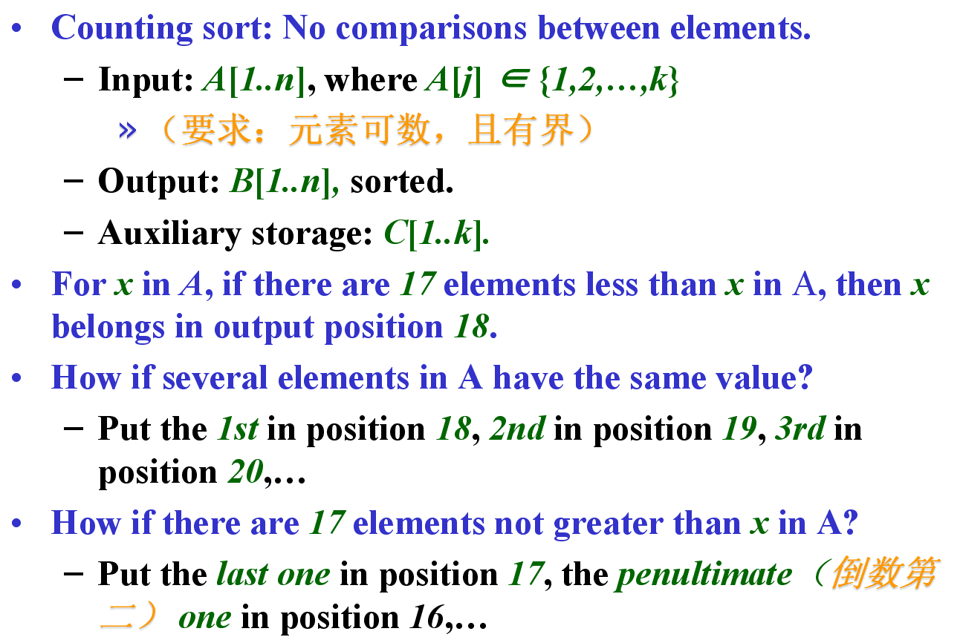
Counting Sort

Slide 15
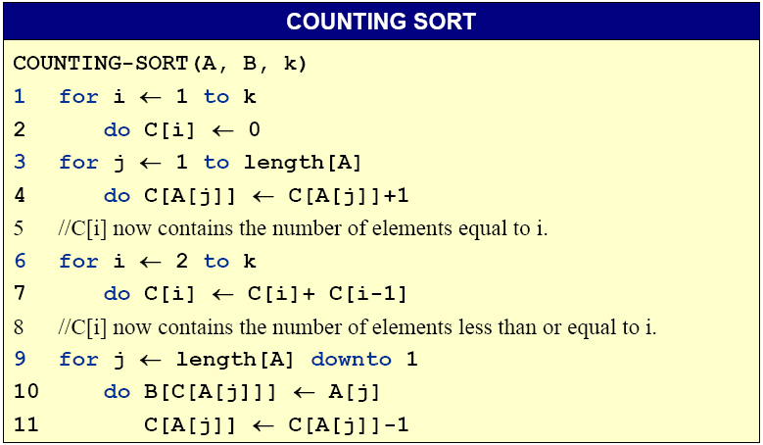
Counting Sort

Slide 16
Counting-sort example
n=5,k=4
1 | 2 | 3 | 4 | 5
1 | 2 | 3 | 4
A:
4 | 1 | 3 | 4 | 3
C:
1 | 2 | 3 | 4 | 5
B:

Slide 17
Counting-sort example
1 | 2 | 3 | 4 | 5
1 | 2 | 3 | 4
A:
4 | 1 | 3 | 4 | 3
C:
1 | 2 | 3 | 4 | 5
B:

Slide 18
Counting-sort example
1 | 2 | 3 | 4 | 5
1 | 2 | 3 | 4
A:
4 | 1 | 3 | 4 | 3
C:
0 | 0 | 0 | 0
1 | 2 | 3 | 4 | 5
B:

Slide 19
Counting-sort example
1 | 2 | 3 | 4 | 5
1 | 2 | 3 | 4
A:
4 | 1 | 3 | 4 | 3
C:
0 | 0 | 0 | 0
1 | 2 | 3 | 4 | 5
B:

Slide 20
Counting-sort example
1 | 2 | 3 | 4 | 5
1 | 2 | 3 | 4
4
1
3
4
3
0
0
0
1
A:
C:
0
1 | 2 | 3 | 4 | 5
B:

Slide 21
Counting-sort example
1 | 2 | 3 | 4 | 5
1 | 2 | 3 | 4
4
1
3
4
3
0
0
0
A:
C:
1
1
1 | 2 | 3 | 4 | 5
B:

Slide 22
Counting-sort example
1 | 2 | 3 | 4 | 5
1 | 2 | 3 | 4
4
1
3
4
3
1
0
0
A:
C:
1
1
1 | 2 | 3 | 4 | 5
B:

Slide 23
Counting-sort example
1 | 2 | 3 | 4 | 5
1 | 2 | 3 | 4
4
1
3
4
3
1
0
1
2
A:
C:
1
1 | 2 | 3 | 4 | 5
B:

Slide 24
Counting-sort example
1 | 2 | 3 | 4 | 5
1 | 2 | 3 | 4
4
1
3
4
3
1
0
1
A:
C:
2
2
1 | 2 | 3 | 4 | 5
B:

Slide 25
Counting-sort example
1 | 2 | 3 | 4 | 5
1 | 2 | 3 | 4
4
1
3
4
3
1
0
1
A:
C:
2
2
1 | 2 | 3 | 4 | 5
B:

Slide 26
Counting-sort example
1 | 2 | 3 | 4 | 5
1 | 2 | 3 | 4
4
1
3
4
3
1
0
2
A:
C:
0
2
1 | 2 | 3 | 4 | 5
B:

Slide 27
Counting-sort example
1 | 2 | 3 | 4 | 5
1 | 2 | 3 | 4
4
1
3
4
3
1
0
2
A:
C:
1
2
1 | 2 | 3 | 4 | 5
B:

Slide 28
Counting-sort example
1 | 2 | 3 | 4 | 5
1 | 2 | 3 | 4
4
1
3
4
3
1
1
2
A:
C:
3
2
1 | 2 | 3 | 4 | 5
B:

Slide 29
Counting-sort example
1 | 2 | 3 | 4 | 5
1 | 2 | 3 | 4
4
1
3
4
3
1
1
3
5
A:
C:
2
1 | 2 | 3 | 4 | 5
B:

Slide 30
Counting-sort example
1 | 2 | 3 | 4 | 5
1 | 2 | 3 | 4
4
1
3
4
3
1
1
1
A:
C:
3
5
1 | 2 | 3 | 4 | 5
B:

Slide 31
Counting-sort example
1 | 2 | 3 | 4 | 5
1 | 2 | 3 | 4
4
1
3
4
3
1
1
1
A:
C:
3
5
1 | 2 | 3 | 4 | 5
B:

Slide 32
Counting-sort example
1 | 2 | 3 | 4 | 5
1 | 2 | 3 | 4
4
1
3
4
3
1
1
3
A:
C:
3
5
1 | 2 | 3 | 4 | 5
B:
3

Slide 33
Counting-sort example
1 | 2 | 3 | 4 | 5
1 | 2 | 3 | 4
4
1
3
4
3
1
1
2
A:
C:
3
5
1 | 2 | 3 | 4 | 5
B:
3

Slide 34
Counting-sort example
1 | 2 | 3 | 4 | 5
1 | 2 | 3 | 4
4
1
3
4
3
1
1
1
A:
C:
2
5
1 | 2 | 3 | 4 | 5
B:
3

Slide 35
Counting-sort example
1 | 2 | 3 | 4 | 5
1 | 2 | 3 | 4
4
1
3
4
3
1
1
2
5
A:
C:
5
1 | 2 | 3 | 4 | 5
B:
3
4

Slide 36
Counting-sort example
1 | 2 | 3 | 4 | 5
1 | 2 | 3 | 4
4
1
3
4
3
1
1
2
4
A:
C:
5
1 | 2 | 3 | 4 | 5
B:
3
4

Slide 37
Counting-sort example
1 | 2 | 3 | 4 | 5
1 | 2 | 3 | 4
4
1
3
4
3
1
1
1
A:
C:
2
4
1 | 2 | 3 | 4 | 5
B:
3
4

Slide 38
Counting-sort example
1 | 2 | 3 | 4 | 5
1 | 2 | 3 | 4
4
1
3
4
3
1
1
2
A:
C:
2
4
1 | 2 | 3 | 4 | 5
B:
3
3
4

Slide 39
Counting-sort example
1 | 2 | 3 | 4 | 5
1 | 2 | 3 | 4
4
1
3
4
3
1
1
1
A:
C:
2
4
1 | 2 | 3 | 4 | 5
B:
3
3
4

Slide 40
Counting-sort example
1 | 2 | 3 | 4 | 5
1 | 2 | 3 | 4
4
1
3
4
3
1
1
1
A:
C:
1
4
1 | 2 | 3 | 4 | 5
B:
3
3
4

Slide 41
Counting-sort example
1 | 2 | 3 | 4 | 5
1 | 2 | 3 | 4
4
1
3
4
3
1
A:
C:
1
1
1
4
1 | 2 | 3 | 4 | 5
B:
1
3
3
4

Slide 42
Counting-sort example
1 | 2 | 3 | 4 | 5
1 | 2 | 3 | 4
4
1
3
4
3
0
A:
C:
1
1
1
4
1 | 2 | 3 | 4 | 5
B:
1
3
3
4

Slide 43
Counting-sort example
1 | 2 | 3 | 4 | 5
1 | 2 | 3 | 4
4
1
3
4
3
0
1
1
A:
C:
1
4
1 | 2 | 3 | 4 | 5
B:
1
3
3
4

Slide 44
Counting-sort example
1 | 2 | 3 | 4 | 5
1 | 2 | 3 | 4
4
1
3
4
3
0
1
1
4
A:
C:
4
1 | 2 | 3 | 4 | 5
B:
1
3
3
4
4

Slide 45
Counting-sort example
1 | 2 | 3 | 4 | 5
1 | 2 | 3 | 4
4
A:
4
1
3
4
3
C:
0
1
1
3
1 | 2 | 3 | 4 | 5
B:
1
3
3
4
4

Slide 46
Counting-sort example
1 | 2 | 3 | 4 | 5
1 | 2 | 3 | 4
4
1
3
4
3
0
1
1
A:
C:
1
3
1 | 2 | 3 | 4 | 5
B:
1
3
3
4
4

Slide 47
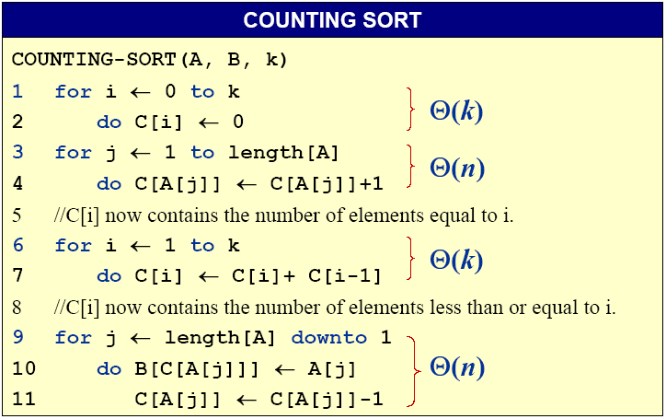
Analysis of Counting Sort
Θ(k)
Θ(n)
Θ(k)
Θ(n)
The overall time is Θ(k+n)

Slide 48
Running time
If k = O(n), then counting sort takes Θ(n) time.
--But, sorting takes Ω(n lgn) time!
--Where’s the fallacy?
Answer:
--Comparison sorting takes Ω(n lgn) time.
--Counting sort is not a comparison sort.
-- In fact, not a single comparison between elements occurs!

Slide 49
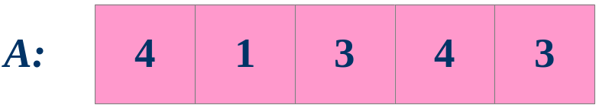
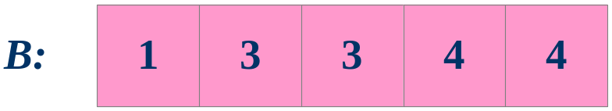
Stable sorting
Exercise: Where other sorts have this property?

