Slide 1
Back-Tracking Algorithms

Slide 2
Back-Tracking Paradigm
A design technique, like divide-and-conquer.
Useful for optimization problems and finding feasible solutions.
  Solution to a problem is defined as an n-tuple: (x₁, x₂, …, x_{n}), where x_{i} is taken from a finite set S_{i} . Generally, we need to:
    finding a (or all) vector(s) that satisfy a specific criterion function P(x₁, x₂, …, x_{n}).
    finding a vector which maximize (or minimize) a specific objective function P(x₁, x₂, …, x_{n}).

Slide 3
Back-Tracking——General Method
Constraints
  Explicit constraints
    constrain values of each component x_{i};
    All tuples that satisfy explicit constraints make up a possible solution space.
  Implicit constraints:
    inter-components constraints;
    Implicit constraints identify those satisfying the criterion function in the solution space.

Slide 4
8-Queen problem 八皇后问题
Place 8 queens on a 8×8 chessboard, yielding that any two of them do not conflict, i.e., any two of them do not reside in the same row, column or diagonal.
1 2 3 4 5 6 7 8
1
2
3
4
5
6
7
8

Slide 5
8-Queen problem
Label the rows and columns by 1 to 8, and the queens too.
Assume that queen i resides in row i.
Solutions can be defined as a 8-tuple (x₁, x₂, …, x₈), where x_{i} is the column number of queen i.
The solution above is (4，6，8，2，7，1，3，5).
1 2 3 4 5 6 7 8
1
2
3
4
5
6
7
8

Slide 6
8-Queen problem (cont.)
Explicit constraints: x_{i} ∈ S_{i}，S_{i}={1,2,3,4,5,6,7,8}, 1≤ i≤ 8. The solution space consists of 8⁸ 8-tuples.
Implicit constraints: any two of them do not reside in the same row, column( any two of x_{i} differ ) or diagonal.
1 2 3 4 5 6 7 8
1
2
3
4
5
6
7
8

Slide 7
8-Queen problem
1 2 3 4 5 6 7 8
1
2
3
4
5
6
7
8
Q
Q
Q
Q
Q

Slide 8
8-Queen problem
1 2 3 4 5 6 7 8
1
2
3
4
5
6
7
8
Q
Q
Q
Q
Q

Slide 9
8-Queen problem
1 2 3 4 5 6 7 8
1
2
3
4
5
6
7
8
Q
Q
Q
Q
Q
Q
Q

Slide 10
8-Queen problem
1 2 3 4 5 6 7 8
1
2
3
4
5
6
7
8
Q
Q
Q
Q
Q

Slide 11
8-Queen problem
1 2 3 4 5 6 7 8
1
2
3
4
5
6
7
8
Q
Q
Q
Q
Q

Slide 12
8-Queen problem
1 2 3 4 5 6 7 8
1
2
3
4
5
6
7
8
Q
Q
Q
Q

Slide 13
8-Queen problem
1 2 3 4 5 6 7 8
1
2
3
4
5
6
7
8
Q
Q
Q
Back-Tracking Paradigm finds answers by systematic searching the solution space of a given problem.

Slide 14
State Space Tree 状态树
The solution space consists of all the paths from the root to each leaf, e.g.（4，2，3，1）。
x₁ = 1
x₁ = 4
x₁ = 2
x₁ = 3
x₂ = 1
2
3
4
1
2
3
4
1
2
3
4
1
2
3
4
x₃ = 1
4
1
4
x₃ = 1
4
2
3
…
2
3
………………………
2
3
x₄ = 1
4
x₄ = 1
4
2
3
…………………………………………………………
2
3

Slide 15
State Space Tree
x₁ = 1
x₁ = 4
x₁ = 2
x₁ = 3
x₂ = 1
2
3
4
1
2
3
4
1
2
3
4
1
2
3
4
x₃ = 1
4
1
4
x₃ = 1
4
2
3
…
2
3
………………………
2
3
x₄ = 1
4
x₄ = 1
4
2
3
…………………………………………………………
2
3
Problem State 问题状态
  Each node in the tree identifies a problem state when solving the problem.

Slide 16
State Space Tree
x₁ = 1
x₁ = 4
x₁ = 2
x₁ = 3
x₂ = 1
2
3
4
1
2
3
4
1
2
3
4
1
2
3
4
x₃ = 1
4
1
4
x₃ = 1
4
2
3
…
2
3
………………………
2
3
x₄ = 1
4
x₄ = 1
4
2
3
…………………………………………………………
2
3
State Space 状态空间（可以从根到每个节点，不一定是子节点）
  All the paths from the root to each node

Slide 17
State Space Tree
x₁ = 1
x₁ = 4
x₁ = 2
x₁ = 3
x₂ = 1
2
3
4
1
2
3
4
1
2
3
4
1
2
3
4
x₃ = 1
4
1
4
x₃ = 1
4
2
3
…
2
3
………………………
2
3
x₄ = 1
4
x₄ = 1
4
2
3
…………………………………………………………
2
3
State Space Tree 状态空间树
  The above tree of the solution space

Slide 18
State Space Tree
x₁ = 1
x₁ = 4
x₁ = 2
x₁ = 3
only leaves in this problem.
x₂ = 1
2
3
4
1
2
3
4
1
2
3
4
1
2
3
4
x₃ = 1
4
1
4
x₃ = 1
4
2
3
…
2
3
………………………
2
3
x₄ = 1
4
x₄ = 1
4
2
3
…………………………………………………………
2
3
Solution States 解决状态
  Those problem states to which the path from the root identifies a vector in the solution space (Satisfying explicit constraints).

Slide 19
State Space Tree
x₁ = 1
x₁ = 4
x₁ = 2
x₁ = 3
x₂ = 1
2
3
4
1
2
3
4
1
2
3
4
1
2
3
4
x₃ = 1
4
1
4
x₃ = 1
4
2
3
…
2
3
………………………
2
3
x₄ = 1
4
x₄ = 1
4
2
3
…………………………………………………………
2
3
Answer States 答案状态
  Those solution states to which the path from the root identifies an answer (Satisfying implicit constraints).

Slide 20
State Space Tree
state space tree
problem state
state space
x₁ = 1
x₁ = 4
x₁ = 2
x₁ = 3
solution states
answer states
x₂ = 1
2
3
4
1
2
3
4
1
2
3
4
1
2
3
4
x₃ = 1
4
1
4
x₃ = 1
4
2
3
…
2
3
………………………
2
3
x₄ = 1
4
x₄ = 1
4
2
3
…………………………………………………………
2
3

Slide 21
State Space Tree
how did we solve the queen
problem just now ?
DFS, this is the way how Back
Tracking algorithms solve a problem
Begin
x₁ = 4
x₁ = 1
x₁ = 2
x₁ = 3
Identify state space tree
x₂ = 1
2
3
4
1
Yes
4
1
4
1
4
All states?
2
3
2
3
2
3
No
Generate problem state
x₃ = 1
4
1
4
x₃ = 1
4
2
3
…
2
3
………………………
2
3
Is solution state?
x₄ = 1
4
x₄ = 1
4
2
3
…………………………………………………………
2
3
Is answer state?
End

Slide 22
Searching in State Space Tree
Basic Concepts
  Alive node(活动节点): a generated node whose sons have not all been generated.(是绿色的，祖父节点)
  E-node: the node whose son is generating currently.(当前节点，儿子正在产生)
  Dead node(死节点): a node that all his sons have been generated or there is no need to generate his sons.
Generating problem states in DFS way
  Once a son C of the E-node R is generated, the generated son C become the new E-node, node R will become E-node again after all the tree rooted by node C is checked.
E-node
E-node
Back Tracking Paradigm

Slide 23
Searching in State Space Tree
Basic Concepts
  Alive node: a generated node whose sons have not all been generated.
  E-node: the node whose son is generating currently.
  Dead node: a node that all his sons have been generated or there is no need to generate his sons.
Generating problem states in BFS way
  A E-node remains E-node until it becomes a dead node.
E-node
E-node
Branch & Bound Paradigm
分支算法

Slide 24
State Space Tree
Begin
x₁ = 1
x₁ = 4
x₁ = 2
x₁ = 3
Identify state space tree
DFS in back Tracking paradigm
Yes
x₂ = 1
4
1
4
1
4
1
4
2
3
2
3
2
3
All states?
2
3
No
Trying to generate all problem states?
Generate problem state
x₃ = 1
4
1
4
x₃ = 1
4
2
3
…
2
3
………………………
2
3
Is solution state?
x₄ = 1
4
No! using bound functions to kill alive nodes
x₄ = 1
4
Is answer state?
2
3
…………………………………………………………
2
3
End
This is how Back-Tracking varies from Brute-Force

Slide 25
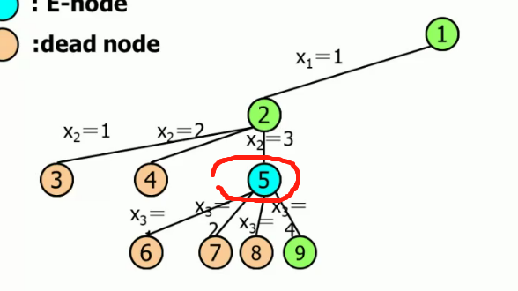
上面的1、2是活动节点，5是当前节点，因为他的儿子正在产生。
（就是当前正在产生的结点是蓝色的儿子，但是是绿色的孙子或者曾孙之类）
E是alive，但alive不一定是E。（蓝色是绿色的一种，但绿色不一定是蓝色）

Slide 26
4-Queen problem
1
1
2
1
. | 2
1
. | . | 2
1
. | . | 2
3
1
. | . | 2
. | 3
1
. | . | 2
. | . | 3
:alive node
1
. | . | 2
. | . | . | 3
1
. | . | . | 2
1
. | . | . | 2
3 |  |  | .
: E-node
1
1
:dead node
1
x₁＝1
1
. | . | . | 2
. | 3 |  | .
1
. | . | 2
. | 3
4
1
. | . | 2
. | 3
. | 4
2
2
2
2
2
x₂＝1
x₂＝2
2
x₂＝3
x₂＝4
3
3
4
4
5
5
5
10
10
10
10
10
x₃＝1
x₃＝2
x₃＝4
x₃＝1
x₃＝2
x₃＝4
x₃＝3
x₃＝3
1
. | . | 2
. | 3
. | . | 4
1
. | . | 2
. | 3
. | . | . | 4
1
. | . | . | 2
. | . | 3
6
6
7
7
8
8
9
9
11
11
12
12
12
17
17
18
18
1
. | . | . | 2
. | . | . | 3
x₄＝1
x₄＝2
x₄＝4
x₄＝3
13
13
14
14
15
15
16
16

Slide 27
4-Queen problem
 | 1
 |  |  | 2
3
 |  | 4
:alive node
: E-node
1
1
:dead node
1
x₁＝2
x₁＝1
2
19
2
2
2
2
2
x₂＝1
x₂＝4
x₂＝1
x₂＝2
x₂＝3
x₂＝4
x₂＝3
x₂＝3
3
4
5
20
21
22
23
5
10
10
10
3
4
5
10
10
x₃＝2
x₃＝4
x₃＝2
x₃＝4
x₃＝1
x₃＝3
x₃＝4
x₃＝1
x₃＝3
x₃＝1
x₃＝3
x₃＝2
6
24
29
30
31
6
7
7
8
8
9
9
11
11
12
12
12
17
17
18
18
x₄＝1
x₄＝2
x₄＝4
x₃＝1
x₄＝3
x₃＝4
x₄＝3
x₃＝2
13
25
26
13
14
14
15
15
16
16
27
28

Slide 28
General Method of Back Tracking
BACKTRACKING
BACKTRACKING(n)
k←1;
while k>0 do
if there are unchecked X(k), X(k)∈T(X(1),…,X(k-1)) and B(X(1),…,X(k))=true
then if (X(1),…,X(k) is an answer）
then print (X(1),…,X(k))
if (k < n)
k←k+1
else
k←k-1
Construct solution in X(1:n), an answer is output immediately after it is determined.
T(X(1),...,X(k-1)) : returns all possible X(k) ,given X(1),…,X(k-1).
B(X(1),…,X(k)): returns whether X(1),…,X(k) satisfies the implicit constraints.

Slide 29
General Method of Back Tracking
BACKTRACKING
Whether there is any son that has not been generated for the current node.
Bound function is used here.
BACKTRACKING(n)
k←1;
while k>0 do
if there are unchecked X(k), X(k)∈T(X(1),…,X(k-1)) and B(X(1),…,X(k))=true
then if (X(1),…,X(k) is an answer）
then print (X(1),…,X(k))
if (k < n)
k←k+1
else
k←k-1
Construct solution in X(1:n), an answer is output immediately after it is determined.
T(X(1),...,X(k-1)) : returns all possible X(k) ,given X(1),…,X(k-1).
B(X(1),…,X(k)): returns whether X(1),…,X(k) satisfies the implicit constraints.

Slide 30
General Method of Back Tracking
BACKTRACKING
BACKTRACKING(n)
k←1;
while k>0 do
if there are unchecked X(k), X(k)∈T(X(1),…,X(k-1)) and B(X(1),…,X(k))=true
then if (X(1),…,X(k) is an answer）
then print (X(1),…,X(k))
if (k < n)
k←k+1
else
k←k-1
If the new generated node is an answer state, print the answer.
Construct solution in X(1:n), an answer is output immediately after it is determined.
T(X(1),...,X(k-1)) : returns all possible X(k) ,given X(1),…,X(k-1).
B(X(1),…,X(k)): returns whether X(1),…,X(k) satisfies the implicit constraints.

Slide 31
General Method of Back Tracking
BACKTRACKING
BACKTRACKING(n)
k←1;
while k>0 do
if there are unchecked X(k), X(k)∈T(X(1),…,X(k-1)) and B(X(1),…,X(k))=true
then if (X(1),…,X(k) is an answer）
then print (X(1),…,X(k))
if (k < n)
k←k+1
else
k←k-1
DFS: the new generated node becomes the E-node.
Construct solution in X(1:n), an answer is output immediately after it is determined.
T(X(1),...,X(k-1)) : returns all possible X(k) ,given X(1),…,X(k-1).
B(X(1),…,X(k)): returns whether X(1),…,X(k) satisfies the implicit constraints.

Slide 32
General Method of Back Tracking
BACKTRACKING
BACKTRACKING(n)
k←1;
while k>0 do
if there are unchecked X(k), X(k)∈T(X(1),…,X(k-1)) and B(X(1),…,X(k))=true
then if (X(1),…,X(k) is an answer）
then print (X(1),…,X(k))
if (k < n)
k←k+1
else
k←k-1
All sons have been checked, Tracking back.
Construct solution in X(1:n), an answer is output immediately after it is determined.
T(X(1),...,X(k-1)) : returns all possible X(k) ,given X(1),…,X(k-1).
B(X(1),…,X(k)): returns whether X(1),…,X(k) satisfies the implicit constraints.

Slide 33
Back-Tracking Algorithm for n-Queen problem
NQUEENS
NQUEENS(n)
X(1)←0;k←1
while k>0 do
X(k)←X(k)+1
while X(k) ≤ n and not PLACE(k) do
X(k)←X(k)+1
if X(k) ≤ n
then if k=n
then print (X)
else k←k+1;X(k)←0
else k←k-1;
k : current row;
X(k) : column NO of queen k
Finding next valid column NO using bound function PLACE.
Found or not?
Found! Is it an answer?
Print the answer, or shift to the next row and find a place for next queen.
No! Tracking back.

Slide 34
Bound function -- PLACE
NQUEENS
PLACE(k)
i←1
while i<k do
if X(i)=X(k) or |X(i)-X(k)| = |i-k|
then return false
i←i+1
return true

Slide 35
4-Queen Problem
NQUEENS(n)
X(1)←0;k←1
while k>0 do
X(k)←X(k)+1
while X(k) ≤ n and not PLACE(k) do
X(k)←X(k)+1
if X(k) ≤ n
then if k=n
then print (X);
else k←k+1;X(k)←0
else k←k-1;
1
1
1
。
。
2
。
。
2
。
。
。
。
k＝1
k＝2
k＝3
1
1
1
。
。
。
2
。
。
。
2
。
。
。
2
。
3
。
3
。
。
。
。
k＝2
k＝3
k＝4
1
1
。
1
。
1
。
1
。
1
。
。
。
2
。
。
。
。
。
。
。
2
。
。
。
2
。
。
。
2
。
。
。
。
3
3
。
。
4
k＝3
k＝2
k＝1
k＝2
k＝3
k＝4

Slide 36
Further Reading
Further reading:
  O(1) time PLACE.
  Generate answers for n-queen problem w/o searching.

Slide 37
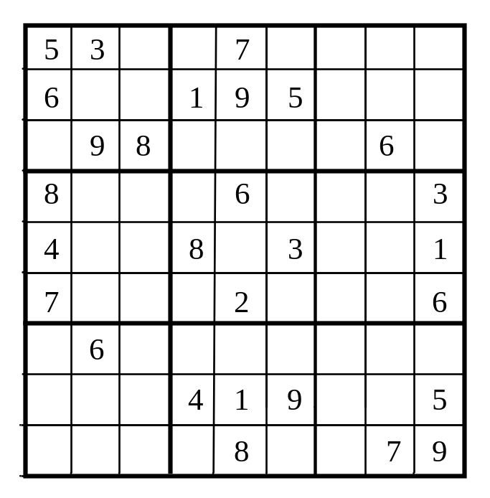
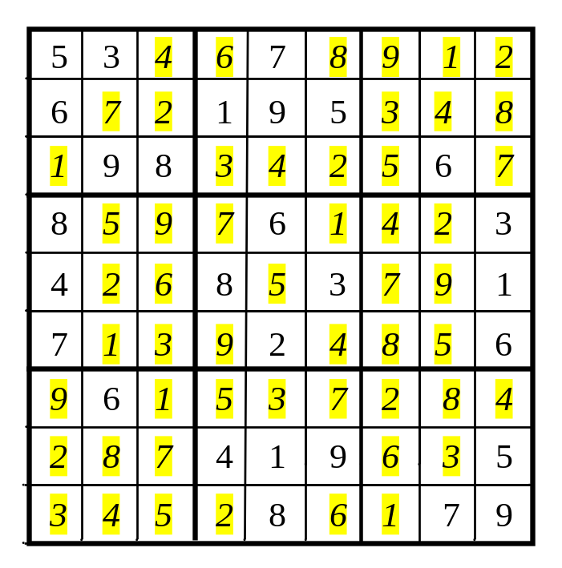
Case Study: Sudoku (Optional)
The objective is to fill the grid so that every row, every column, and every 3×3 box contain the numbers 1 to 9, as shown in the right Figure.

Slide 38
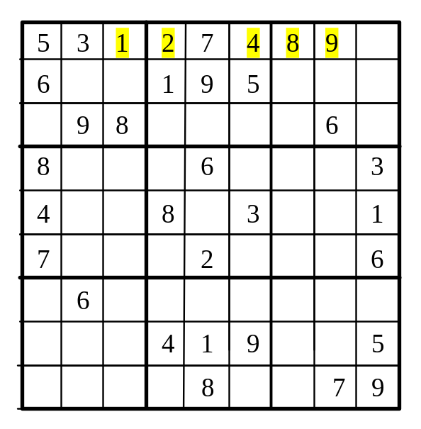
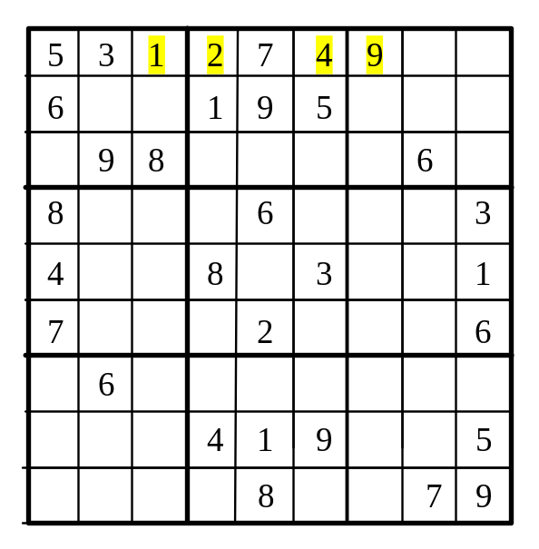
Case Study: Sudoku
Rule 1: Fill in an empty cell from the first to the last.
Rule 2: Fill in a smallest number possible.
Rule 3: If no number can fill in a cell, backtrack.

Slide 39
What is Sudoku?

Slide 40
Every row contains the numbers 1 to 9

Slide 41
Every column contains the numbers 1 to 9
5 3
4
6
7
8
9
1
2
6
7
2
1 9 5
3
4
8
1
9 8
3
4
2
5
6
7
8
5
9
7
6
1
4
2
3
4
2
6
8
5
3
7
9
1
7
1
3
9
2
4
8
5
6
9
6
1
5
3
7
2
8
4
2
8
7
4 1 9
6
3
5
3
4
5
2
8
6
1
7 9

Slide 42
Every 3×3 box contains the numbers 1 to 9
5 3
4
6
7
8
9
1
2
6
7
2
1 9 5
3
4
8
1
9 8
3
4
2
5
6
7
8
5
9
7
6
1
4
2
3
4
2
6
8
5
3
7
9
1
7
1
3
9
2
4
8
5
6
9
6
1
5
3
7
2
8
4
2
8
7
4 1 9
6
3
5
3
4
5
2
8
6
1
7 9

Slide 43
Solve a Sudoku Puzzle
Run

Slide 44
Strategy
Rule 1: Fill in an empty cell from the first to the last.
Rule 2: Fill in a smallest number possible.
Rule 3: If no number can fill in a cell, backtrack.

Slide 45
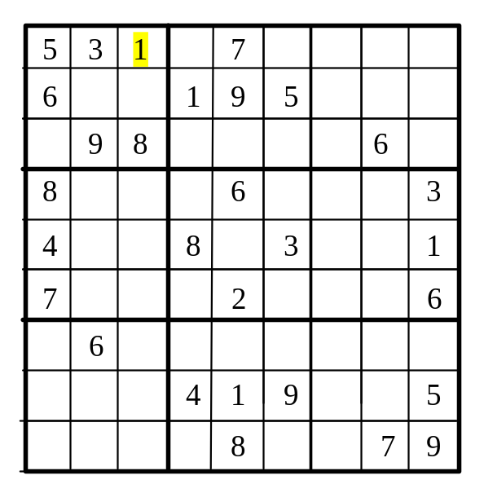
Strategy
Rule 1: Fill in an empty cell from the first to the last.
Rule 2: Fill in a smallest number possible.
Rule 3: If no number can fill in a cell, backtrack.

Slide 46
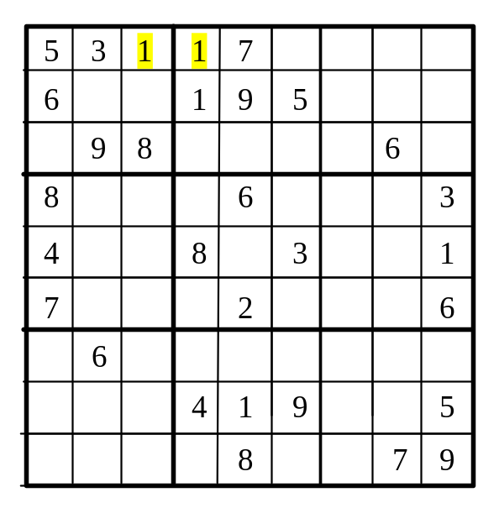
Strategy
Rule 1: Fill in an empty cell from the first to the last.
Rule 2: Fill in a smallest number possible.
Rule 3: If no number can fill in a cell, backtrack.

Slide 47
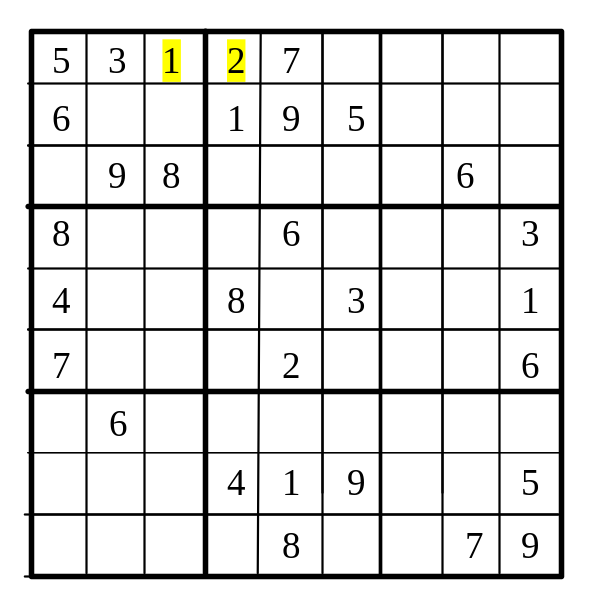
Strategy
Rule 1: Fill in an empty cell from the first to the last.
Rule 2: Fill in a smallest number possible.
Rule 3: If no number can fill in a cell, backtrack.

Slide 48
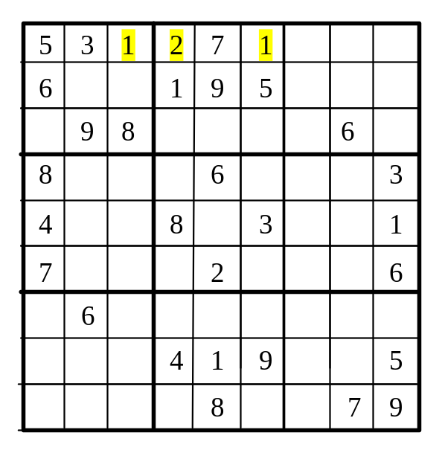
Strategy
Rule 1: Fill in an empty cell from the first to the last.
Rule 2: Fill in a smallest number possible.
Rule 3: If no number can fill in a cell, backtrack.

Slide 49

Strategy
Rule 1: Fill in an empty cell from the first to the last.
Rule 2: Fill in a smallest number possible.
Rule 3: If no number can fill in a cell, backtrack.

Slide 50

Strategy
Rule 1: Fill in an empty cell from the first to the last.
Rule 2: Fill in a smallest number possible.
Rule 3: If no number can fill in a cell, backtrack.

Slide 51

Strategy
Rule 1: Fill in an empty cell from the first to the last.
Rule 2: Fill in a smallest number possible.
Rule 3: If no number can fill in a cell, backtrack.

Slide 52
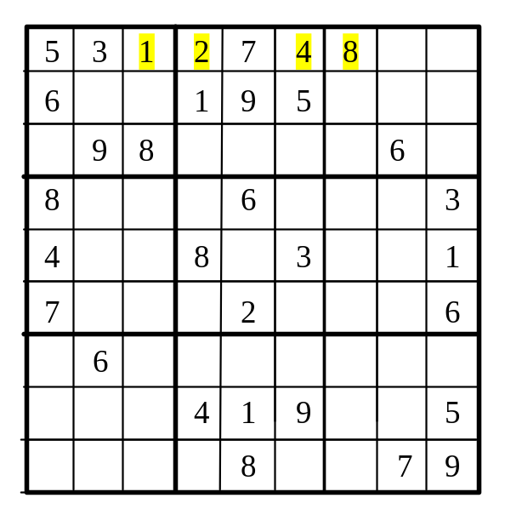
Strategy
Try 1, 2, …, 7, not valid, 8 is OK.
Rule 1: Fill in an empty cell from the first to the last.
Rule 2: Fill in a smallest number possible.
Rule 3: If no number can fill in a cell, backtrack.

Slide 53
Strategy
Try 1, 2, …, 7, 8, not valid, 9 is OK.
Rule 1: Fill in an empty cell from the first to the last.
Rule 2: Fill in a smallest number possible.
Rule 3: If no number can fill in a cell, backtrack.

Slide 54
Strategy
Try 1, 2, …, 7, 8, 9, none is valid, so you have to backtrack.
Rule 1: Fill in an empty cell from the first to the last.
Rule 2: Fill in a smallest number possible.
Rule 3: If no number can fill in a cell, backtrack.

Slide 55
Strategy
Backtrack to the preceding free cell. It is 9, you have to backtrack again to the preceding free cell
Rule 1: Fill in an empty cell from the first to the last.
Rule 2: Fill in a smallest number possible.
Rule 3: If no number can fill in a cell, backtrack.

Slide 56

Strategy
No try number 9. It is valid.
Rule 1: Fill in an empty cell from the first to the last.
Rule 2: Fill in a smallest number possible.
Rule 3: If no number can fill in a cell, backtrack.

Slide 57
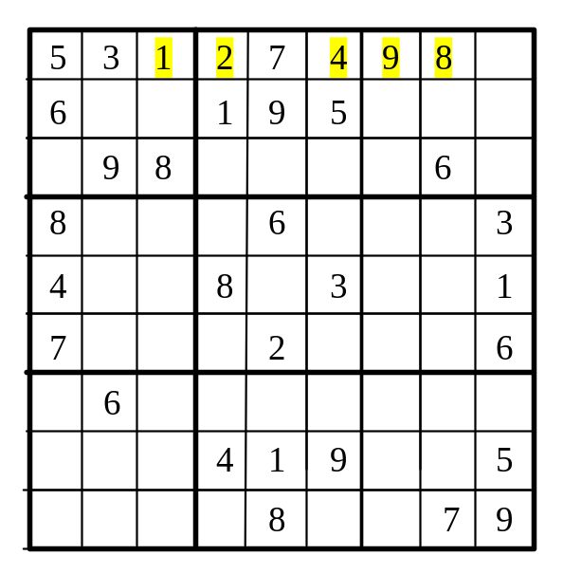
Strategy
Simulation of the Search Process
Rule 1: Fill in an empty cell from the first to the last.
Rule 2: Fill in a smallest number possible.
Rule 3: If no number can fill in a cell, backtrack.

Slide 58
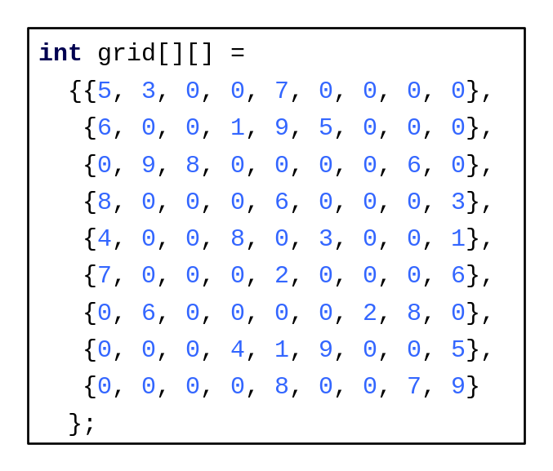
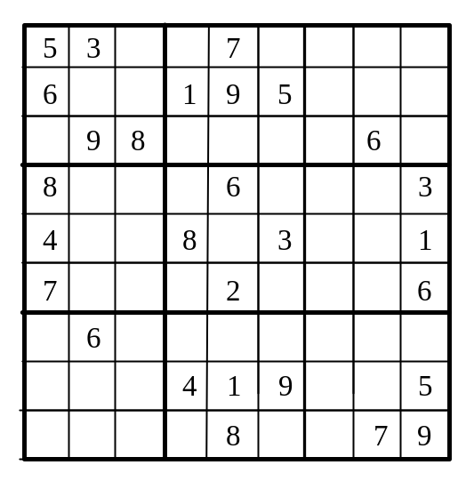
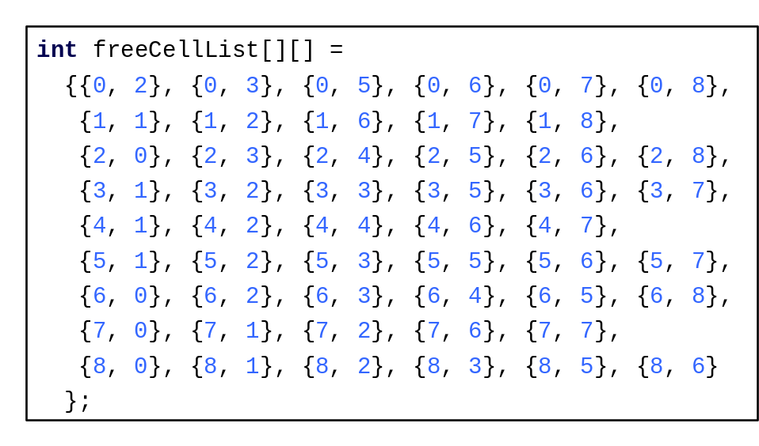
Identify All Free Cells
0 1 2 3 4 5 6 7 8
0 1 2 3 4 5 6 7 8

Slide 59
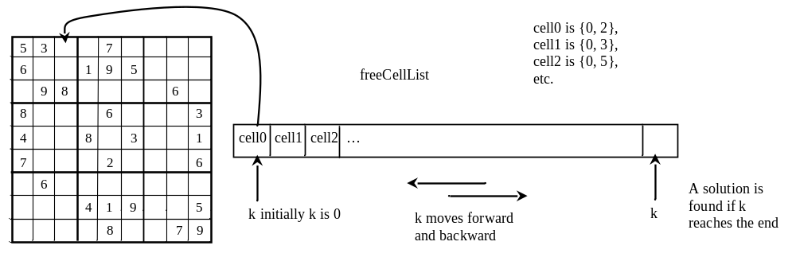
Search for a solution
The search(int grid[][9]) function starts search from the first free cell with k = 0, where k is the position of the current free cell being considered in the free cell list.

Slide 60
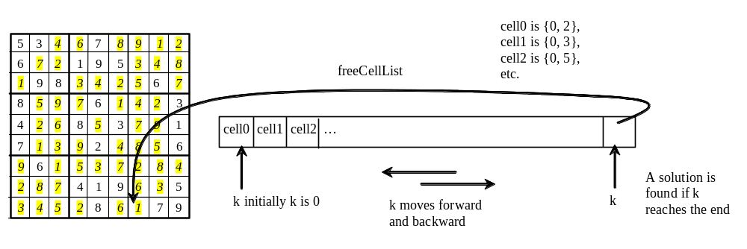
Search ends successfully
The search function returns true when the search advances but no more free cells are left. A solution is found.

Slide 61
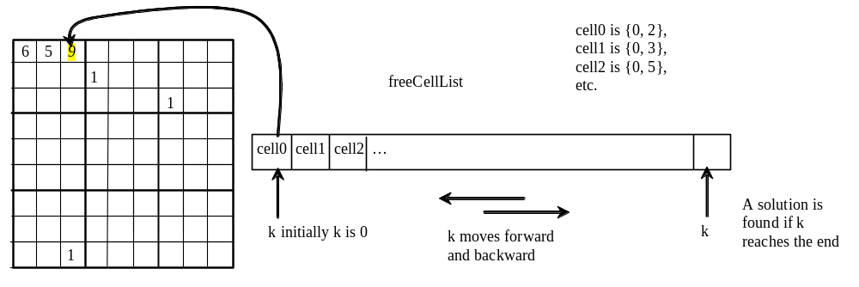
Search ends with no solution
The search returns false when the search is backtracked to the first cell and all possible values are exhausted for the cell. No solution can be found.

Slide 62
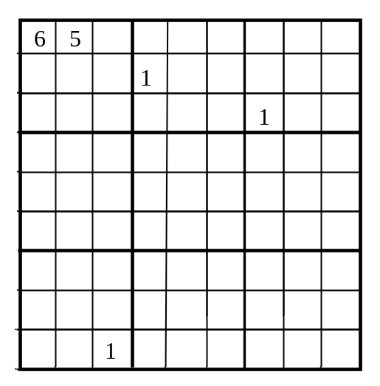
Example of no solution

