Slide 1
NP-Completeness: Preliminary
Computational Complexity
Topics:
-- Computability
-- Analysis of Algorithms

Slide 2
Computability: undecidable Problems
In computability theory and computational complexity theory, an undecidable problem is a decision problem for which it is known to be impossible to construct a single algorithm that always leads to a correct yes-or-no answer.

Slide 3
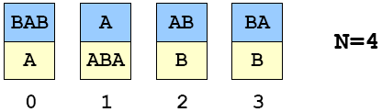
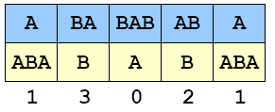
Post’s Correspondence Problem
Given a set of cards:
-- N card types (can use as many of each type as possible)
-- Each card has a top string and bottom string.
Example 1:
Puzzle:
-- Is it possible to arrange cards so that top and bottom strings are the same?
Solution 1:

Slide 4
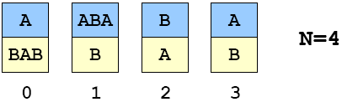
A Puzzle (“Post’s Correspondence Prob.”)
Given a set of cards:
-- N card types (can use as many of each type as possible)
-- Each card has a top string and bottom string.
Example 2:
Puzzle:
-- Is it possible to arrange cards so that top and bottom strings are the same?
Solution 2: ?

Slide 5
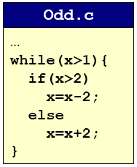
Undecidable Problems
Post’s Correspondence Problem.
Halting Problem
Halting Problem停机问题.
  Write a C program that reads in another program and its inputs, and decides whether or not it goes into an infinite loop.
    loop infinite often signifies a bug
  Program 1.
    8 6 4 2 4 2 4 2 4 2 4 2 4 2 4
    9 7 5 3 1

Slide 6
Undecidable Problems不可解问题
Hilbert’s 10th Problem.
Post’s Correspondence Problem.邮差问题
Halting Problem.
Program Equivalence.
Optimal Data Compression.
Virus Identification.
Impossible to write C program to solve any of these problem!

Slide 7
Consequences
Halting problem is “not artificial.”
  Undecidable problem reduced to simplest form to simplify proof.
  Closely related to practical problems.
  Hilbert’s 10th problem, Post’s correspondence problem, program equivalence, optimal data compression
How to show new problem X is undecidable?
  Use fact that Halting problem is undecidable.
  Design algorithm to solve Halting problem, using (alleged) algorithm for X as a subroutine.
  Reduction

Slide 8
Implications
Practical:
  Work with limitations.
  Recognize and avoid unsolvable problems.
  Learn from structure.
    Same theory tells us about efficiency of algorithms
Philosophical (caveat: ask a philosopher):
  We “assume” that any step-by-step reasoning will solve any technical or scientific problem.
  “Not quite” says the halting problem.
  Anything that is like (could be) a computer has the same flaw.

Slide 9
Summary
What is an algorithm?
  Informally: a step-by-step procedure for solving a problem.
  Formally: a Turing machine
Is it possible, in principle, to write a program to solve any problem?
  No.

Slide 10
Analysis of Algorithm
For many problems, there may be several competitive algorithms.
  Which one should I use?
Analysis of algorithms.
  framework for comparing algorithms and performance prediction.
  case study: sorting
Computational complexity.
  framework for studying intrinsic difficulty of problems.

Slide 11
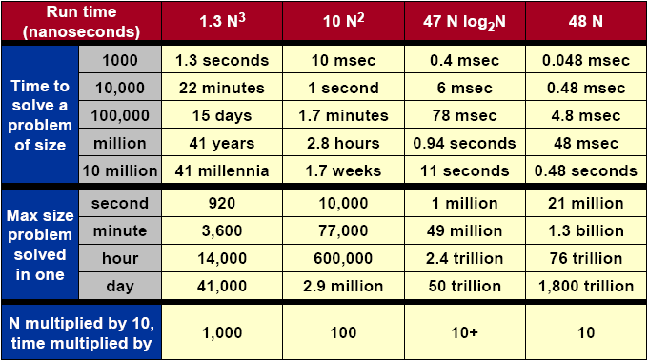
What Does It Matter?

Slide 12
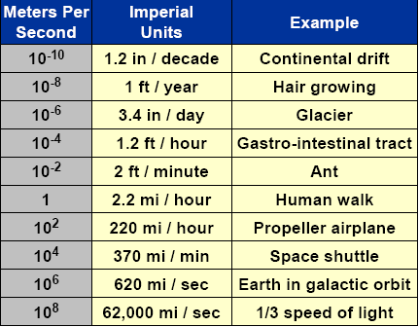
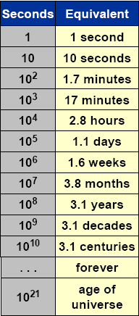

Orders of Magnitude

Slide 13
Better Machines vs. Better Algorithms
New machine.
  Costs $$$ or more.
  Makes “everything” finish sooner.
  Incremental quantitative improvements (Moore’s Law).
  May not help much with some problems.
New algorithm.
  Costs $ or less.
  Dramatic qualitative improvements possible! (million time faster)
  May make the difference, allowing specific problem to be solved.
  May not help much with some problems.

Slide 14
Implementation of Algorithms
Algorithm.
  “Step-by-step recipe” used to solve a problem.
  Generally independent of programming language or machine on which it is to be executed.
Design.
  Find a method to solve the problem.
Analysis.
  Evaluate its effectiveness and predict theoretical performance.
Implementation.
  Write actual code and test your theory.

