Slide 1
1. Introduction to Genetic Algorithms

Slide 2


“Genetic Algorithms and Engineering Design”
“Genetic Algorithms and Engineering Design”
by Mitsuo Gen, Runwei Cheng (Contributor)
List Price: $140.00
Our Price: $140.00
Used Price: $124.44
Availability: Usually ships within 2 to 3 days
Hardcover - January 7, 1997: 432 pages, John Wiley & Sons, NY
About the Author：
MITSUO GEN, PhD, is a professor in the Department of Industrial and Systems Engineering at the Ashikaga Institute of Technology in Japan. An associate editor of the Engineering Design and Automation Journal and Journal of Engineering Valuation & Cost Analysis, he is also a member of the international editorial advisory board of Computers & Industrial Engineering. He is the author of two other books, Linear Programming Using Turbo C and Goal Programming Using Turbo C.
RUNWEI CHENG, PhD, is a visiting associate professor at the Ashikaga Institute of Technology in Japan and also an associate professor at the Institute of Systems Engineering at Northeast University in China. Both authors are internationally known experts in the application of genetic algorithms and artificial intelligence to the field of manufacturing systems.
汪定偉・唐加福・黄敏訳：遺伝算法与工程設計，科学出版社，1999

Slide 3

“Genetic Algorithms and Engineering Optimization”
“Genetic Algorithms and Engineering Optimization”
(Wiley Series in Engineering Design and Automation)
by Mitsuo Gen, Runwei Cheng
List Price: $125.00
Our Price: $125.00
Used Price: $110.94
Availability: Usually ships within 24 hours
Hardcover - January 2000; 512 pages, John Wiley & Sons, NY
Book Description
Genetic algorithms are probabilistic search techniques based on the principles of biological evolution. As a biological organism evolves to more fully adapt to its environment, a genetic algorithm follows a path of analysis from which a design evolves, one that is optimal for the environmental constraints placed upon it. Written by two internationally-known experts on genetic algorithms and artificial intelligence, this important book addresses one of the most important optimization techniques in the industrial engineering/manufacturing area, the use of genetic algorithms to better design and produce reliable products of high quality. The book covers advanced optimization techniques as applied to manufacturing and industrial engineering processes, focusing on combinatorial and multiple-objective optimization problems that are most encountered in industry.
于歆杰・周根貴訳：遺伝算法与工程優化，清華大学出版社，2004

Slide 4
1. Introduction of Genetic Algorithms
Foundations of Genetic Algorithms
  1.1 Introduction of Genetic Algorithms
  1.2 General Structure of Genetic Algorithms
  1.3 Major Advantages
Example with Simple Genetic Algorithms
  2.1 Representation
  2.2 Initial Population
  2.3 Evaluation
  2.4 Genetic Operators
Encoding Issue
  3.1 Coding Space and Solution Space
  3.2 Selection

Slide 5
1. Introduction of Genetic Algorithms
Genetic Operators
  4.1 Conventional Operators
  4.2 Arithmetical Operators
  4.3 Direction-based Operators
  4.4 Stochastic Operators
Adaptation of Genetic Algorithms
  5.1 Structure Adaptation
  5.2 Parameters Adaptation
Hybrid Genetic Algorithms
  6.1 Adaptive Hybrid GA Approach
  6.2 Parameter Control Approach of GA
  6.3 Parameter Control Approach using Fuzzy Logic Controller
  6.4 Design of aHGA using Conventional Heuristics and FLC

Slide 6
1. Introduction of Genetic Algorithms
Foundations of Genetic Algorithms
  1.1 Introduction of Genetic Algorithms
  1.2 General Structure of Genetic Algorithms
  1.3 Major Advantages
Example with Simple Genetic Algorithms
Encoding Issue
Genetic Operators
Adaptation of Genetic Algorithms
Hybrid Genetic Algorithms

Slide 7
1.1 Introduction of Genetic Algorithms
Since 1960s, there has been being an increasing interest in imitating living beings to develop powerful algorithms for NP hard optimization problems.
A common term accepted recently refers to such techniques as Evolutionary Computation or Evolutionary Optimization methods.
The best known algorithms in this class include:
  Genetic Algorithms (GA), developed by Dr. Holland.
    Holland, J.: Adaptation in Natural and Artificial Systems, University of Michigan Press, Ann Arbor, MI, 1975; MIT Press, Cambridge, MA, 1992.
    Goldberg, D.: Genetic Algorithms in Search, Optimization and Machine Learning, Addison-Wesley, Reading, MA, 1989.
  Evolution Strategies (ES), developed by Dr. Rechenberg and Dr. Schwefel.
    Rechenberg, I.: Evolution strategie: Optimierung technischer Systeme nach Prinzipien der biologischen Evolution, Frommann-Holzboog, 1973.
    Schwefel, H.: Evolution and Optimum Seeking, John Wiley & Sons, 1995.
  Evolutionary Programming (EP), developed by Dr. Fogel.
    Fogel, L. A. Owens & M. Walsh: Artificial Intelligence through Simulated Evolution, John Wiley & Sons, 1966.
  Genetic Programming (GP), developed by Dr. Koza.
    Koza, J. R.: Genetic Programming, MIT Press, 1992.
    Koza, J. R.: Genetic Programming II, MIT Press, 1994.

Slide 8
1.1 Introduction of Genetic Algorithms
The Genetic Algorithms (GA), as powerful and broadly applicable stochastic search and optimization techniques, are perhaps the most widely known types of Evolutionary Computation methods today.
In past few years, the GA community has turned much of its attention to the optimization problems of industrial engineering, resulting in a fresh body of research and applications.
  Goldberg, D.: Genetic Algorithms in Search, Optimization and Machine Learning, Addison-Wesley, Reading, MA, 1989.
  Fogel, D.: Evolutionary Computation: Toward a New Philosophy of Machine Intelligence, IEEE Press, Piscataway, NJ, 1995.
  Back, T.: Evolutionary Algorithms in Theory and Practice, Oxford University Press, New York, 1996.
  Michalewicz, Z.: Genetic Algorithm + Data Structures = Evolution Programs. 3rd ed., New York: Springer-Verlag, 1996.
  Gen, M. & R. Cheng: Genetic Algorithms and Engineering Design, John Wiley, New York, 1997.
  Gen, M. & R. Cheng: Genetic Algorithms and Engineering Optimization, John Wiley, New York, 2000.
  Deb, K.: Multi-objective optimization Using Evolutionary Algorithms, John Wiley, 2001.
A bibliography on genetic algorithms has been collected by Alander.
  Alander, J.: Indexed Bibliography of Genetic Algorithms: 1957-1993, Art of CAD Ltd., Espoo, Finland, 1994.

Slide 9
1.2 General Structure of Genetic Algorithms
In general, a GA has five basic components, as summarized by Michalewicz.
  Michalewicz, Z.: Genetic Algorithm + Data Structures = Evolution Programs. 3rd ed., New York: Springer-Verlag, 1996.
  A genetic representation of potential solutions to the problem.
  A way to create a population (an initial set of potential solutions).
  An evaluation function rating solutions in terms of their fitness.
  Genetic operators that alter the genetic composition of offspring (selection, crossover, mutation, etc.).
  Parameter values that genetic algorithm uses (population size, probabilities of applying genetic operators, etc.).

Slide 10
1.2 General Structure of Genetic Algorithms
Genetic Representation and Initialization:
  The genetic algorithm maintains a population P(t) of chromosomes or individuals v_{k}(t), k=1, 2, …, popSize for generation t.
  Each chromosome represents a potential solution to the problem at hand.
Evaluation:
  Each chromosome is evaluated to give some measure of its fitness eval(v_{k}).
Genetic Operators:
  Some chromosomes undergo stochastic transformations by means of genetic operators to form new chromosomes, i.e., offspring.
  There are two kinds of transformation:
    Crossover, which creates new chromosomes by combining parts from two chromosomes.
    Mutation, which creates new chromosomes by making changes in a single chromosome.
  New chromosomes, called offspring C(t), are then evaluated.
Selection:
  A new population is formed by selecting the more fit chromosomes from the parent population and the offspring population.
Best solution:
  After several generations, the algorithm converges to the best chromosome, which hopefully represents an optimal or suboptimal solution to the problem.

Slide 11
1.2 General Structure of Genetic Algorithms
The general structure of genetic algorithms
Gen, M. & R. Cheng: Genetic Algorithms and Engineering Design, John Wiley,
New York, 1997.
1100101010
1011101110
encoding
1100101010
1011101110
0011011001
1100110001
crossover
Initial
solutions
C_{C}(t)
t 0 P(t)
offspring
1100101110
1011101010
start
chromosome
mutation
0011011001
C_{M}(t)
0011001001
offspring
selection
N
1100101110
1011101010
0011001001
new
population
termination
condition?
P(t) + C(t)
decoding
Y
roulette wheel
solutions candidates
stop
fitness computation
best solution
evaluation

Slide 12
1.2 General Structure of Genetic Algorithms
Procedure of Simple GA
procedure: Simple GA
input: GA parameters
output: best solution
begin
t ← 0; // t: generation number
initialize P(t) by encoding routine; // P(t): population of chromosomes
fitness eval(P) by decoding routine;
while (not termination condition) do
crossover P(t) to yield C(t); // C(t): offspring
mutation P(t) to yield C(t);
fitness eval(C) by decoding routine;
select P(t+1) from P(t) and C(t);
t ← t+1;
end
output best solution;
end

Slide 13
1.3 Major Advantages
Conventional Method (point-to-point approach)
  Generally, algorithm for solving optimization problems is a sequence of computational steps which asymptotically converge to optimal solution.
  Most of classical optimization methods generate a deterministic sequence of computation based on the gradient or higher order derivatives of objective function.
  The methods are applied to a single point in the search space.
  The point is then improved along the deepest descending direction gradually through iterations.
  This point-to-point approach takes the danger of falling in local optima.
Conventional Method
start
initial single point
improvement
(problem-specific)
No
termination
condition?
Yes
stop

Slide 14
1.3 Major Advantages
Genetic Algorithm (population-to-population approach)
  Genetic algorithms performs a multiple directional search by maintaining a population of potential solutions.
  The population-to-population approach is hopeful to make the search escape from local optima.
  Population undergoes a simulated evolution: at each generation the relatively good solutions are reproduced, while the relatively bad solutions die.
  Genetic algorithms use probabilistic transition rules to select someone to be reproduced and someone to die so as to guide their search toward regions of the search space with likely improvement.
Genetic Algorithm
start
Initial population
initial point
initial point
...
initial point
improvement
(problem-independent)
No
termination
condition?
Yes
stop

Slide 15
1.3 Major Advantages
Random Search + Directed Search
max f (x)
s. t. 0 ≤ x ≤ u_{b}
f(x)
global optimum
local optimum
local optimum
Fitness
local optimum
0
x₁
x₂
x₃
x₄
x₅
x
Search space

Slide 16
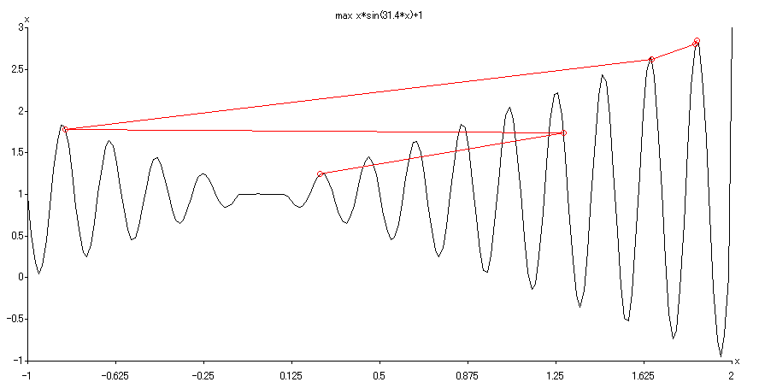


1.3 Major Advantages
Example of Genetic Algorithm for Unconstrained Numerical Optimization (Michalewicz, 1996)

Slide 17
1.3 Major Advantages
Genetic algorithms have received considerable attention regarding their potential as a novel optimization technique. There are three major advantages when applying genetic algorithms to optimization problems.
  Genetic algorithms do not have much mathematical requirements about the optimization problems.
    Due to their evolutionary nature, genetic algorithms will search for solutions without regard to the specific inner workings of the problem.
    Genetic algorithms can handle any kind of objective functions and any kind of constraints, i.e., linear or nonlinear, defined on discrete, continuous or mixed search spaces.
  The ergodicity of evolution operators makes genetic algorithms very effective at performing global search (in probability).
    The traditional approaches perform local search by a convergent stepwise procedure, which compares the values of nearby points and moves to the relative optimal points.
    Global optima can be found only if the problem possesses certain convexity properties that essentially guarantee that any local optima is a global optima.
  Genetic algorithms provide us a great flexibility to hybridize with domain dependent heuristics to make an efficient implementation for a specific problem.

Slide 18
1. Introduction of Genetic Algorithms
Foundations of Genetic Algorithms
Example with Simple Genetic Algorithms
  2.1 Representation
  2.2 Initial Population
  2.3 Evaluation
  2.4 Genetic Operators
Encoding Issue
Genetic Operators
Adaptation of Genetic Algorithms
Hybrid Genetic Algorithms

Slide 19
2. Example with Simple Genetic Algorithms
We explain in detail about how a genetic algorithm actually works with a simple examples.
We follow the approach of implementation of genetic algorithms given by Michalewicz.
  Michalewicz, Z.: Genetic Algorithm + Data Structures = Evolution Programs. 3rd ed., Springer-Verlag: New York, 1996.
The numerical example of unconstrained optimization problem is given as follows:
max f (x_{1,} x₂) = 21.5 + x₁·sin(4π x₁) + x₂·sin(20π x₂)
s. t. -3.0 ≤ x₁ ≤ 12.1
4.1 ≤ x₂ ≤ 5.8

Slide 20
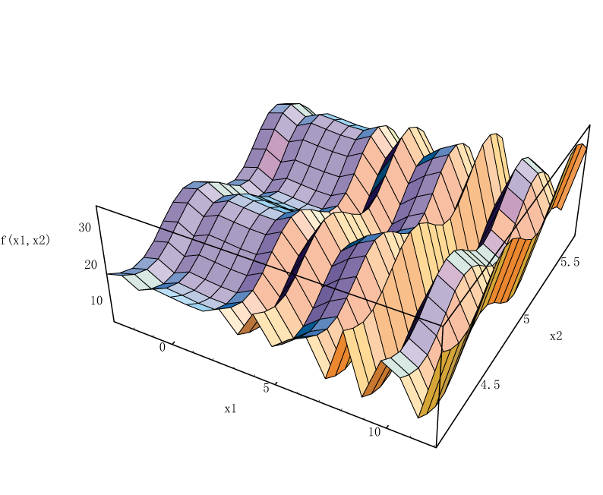
2. Example with Simple Genetic Algorithms
max f (x_{1,} x₂) = 21.5 + x₁·sin(4π x₁) + x₂·sin(20π x₂)
s. t. -3.0 ≤ x₁ ≤ 12.1
4.1 ≤ x₂ ≤ 5.8
by Mathematica 4.1
f = 21.5 + x1 Sin [ 4 Pi x1 ] + x2 Sin [ 20 Pi x2 ];
Plot3D[f, {x1, -3, 12.1}, {x2, 4.1, 5.8},
PlotPoints ->19,
AxesLabel -> {x1, x2, “f(x1, x2)”}];

Slide 21
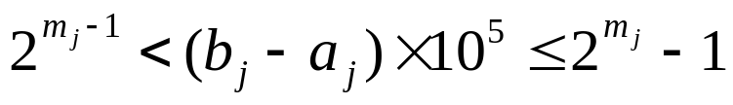
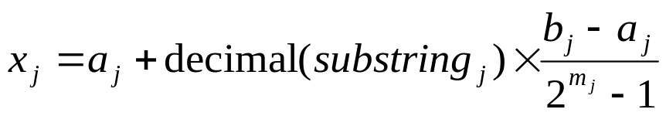
2.1 Representation
Binary String Representation
The domain of x_{j} is [a_{j}, b_{j}] and the required precision is five
places after the decimal point.
The precision requirement implies that the range of domain of
each variable should be divided into at least (b_{j} - a_{j} )×10⁵ size ranges.
The required bits (denoted with m_{j}) for a variable is calculated as
follows:
The mapping from a binary string to a real number for variable x_{j}
is completed as follows:

Slide 22
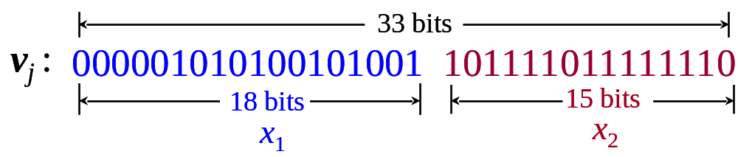
2.1 Representation
Binary String Encoding
The precision requirement implies that the range of domain of each variable should be divided into at least (b_{j} - a_{j} )×10⁵ size ranges.
The required bits (denoted with m_{j}) for a variable is calculated as follows:
x₁ : (12.1-(-3.0)) × 10,000 = 151,000
2¹⁷ <151,000 ≤ 2¹⁸, m₁ = 18 bits
x₂ : (5.8-4.1) × 10,000 = 17,000
2¹⁴ <17,000 ≤ 2¹⁵, m₂ = 15 bits
precision requirement: m = m₁ + m₂ = 18 +15 = 33 bits

Slide 23

2.1 Representation
Procedure of Binary String Encoding
input: domain of x_{j} [a_{j}, b_{j}], (j=1,2)
output: chromosome v
step 1: The domain of x_{j} is [a_{j}, b_{j}] and the required precision is five
places after the decimal point.
step 2: The precision requirement implies that the range of domain of
each variable should be divided into at least (b_{j} - a_{j} )×10⁵ size ranges.
step 3: The required bits (denoted with m_{j}) for a variable is calculated as
follows:
step 4: A chromosome v is randomly generated, which has the number of genes m,
where m is sum of m_{j} (j=1,2).

Slide 24
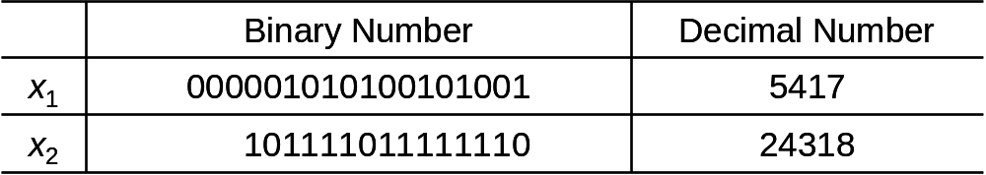
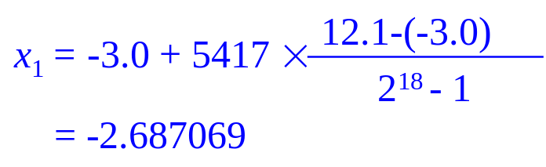
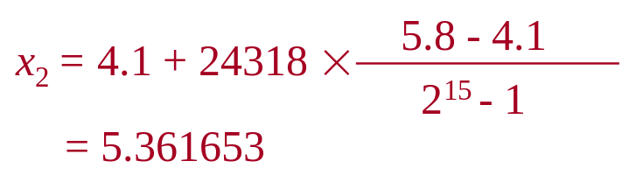
2.1 Representation
Binary String Decoding
The mapping from a binary string to a real number for variable x_{j} is completed as follows:

Slide 25
2.1 Representation
Procedure of Binary String Decoding
input: substring_{j}
output: a real number x_{j}
step 1: Convert a substring (a binary string) to a decimal number.
step 2: The mapping for variable x_{j} is completed as follows:

Slide 26
2.2 Initial Population
Initial population is randomly generated as follows:
v₁ = [000001010100101001101111011111110] = [x₁ x₂] = [-2.687969 5.361653]
v₂ = [001110101110011000000010101001000] = [x₁ x₂] = [ 0.474101 4.170144]
v₃ = [111000111000001000010101001000110] = [x₁ x₂] = [10.419457 4.661461]
v₄ = [100110110100101101000000010111001] = [x₁ x₂] = [ 6.159951 4.109598]
v₅ = [000010111101100010001110001101000] = [x₁ x₂] = [ -2.301286 4.477282]
v₆ = [111110101011011000000010110011001] = [x₁ x₂] = [11.788084 4.174346]
v₇ = [110100010011111000100110011101101] = [x₁ x₂] = [ 9.342067 5.121702]
v₈ = [001011010100001100010110011001100] = [x₁ x₂] = [ -0.330256 4.694977]
v₉ = [111110001011101100011101000111101] = [x₁ x₂] = [11.671267 4.873501]
v₁₀ = [111101001110101010000010101101010] = [x₁ x₂] = [11.446273 4.171908]

Slide 27
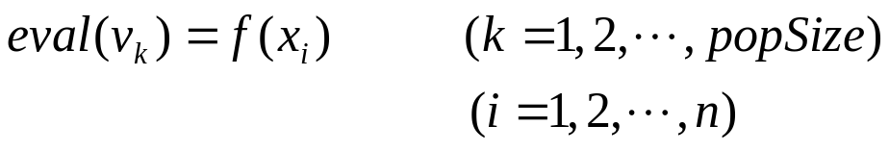
2.3 Evaluation
The process of evaluating the fitness of a chromosome consists of the following three steps:
input: chromosome v_{k}, k=1, 2, ..., popSize
output: the fitness eval(v_{k})
step 1: Convert the chromosome’s genotype to its phenotype, i.e., convert binary string into relative real values x_{k} =(x_{k1}, x_{k2}), k = 1,2, …, popSize.
step 2: Evaluate the objective function f (x_{k}), k = 1,2, …, popSize.
step 3: Convert the value of objective function into fitness. For the maximization problem, the fitness is simply equal to the value of objective function:
eval(v_{k}) = f (x_{k}), k = 1,2, …, popSize.
f (x₁, x₂) = 21.5 + x₁·sin(4π x₁) + x2·sin(20π x₂)
Example: (x₁=-2.687969, x₂= 5.361653)
eval(v₁) = f (-2.687969, 5.361653) =19.805119

Slide 28
2.3 Evaluation
An evaluation function plays the role of the environment, and it rates chromosomes in terms of their fitness.
The fitness function values of above chromosomes are as follows:
It is clear that chromosome v₄ is the strongest one and that chromosome v₃ is the weakest one.
eval(v₁) = f (-2.687969, 5.361653) =19.805119
eval(v₂) = f (0.474101, 4.170144) = 17.370896
eval(v₃) = f (10.419457, 4.661461) = 9.590546
eval(v₄) = f (6.159951, 4.109598) = 29.406122
eval(v₅) = f (-2.301286, 4.477282) = 15.686091
eval(v₆) = f (11.788084, 4.174346) = 11.900541
eval(v₇) = f (9.342067, 5.121702) = 17.958717
eval(v₈) = f (-0.330256, 4.694977) = 19.763190
eval(v₉) = f (11.671267, 4.873501) = 26.401669
eval(v₁₀) = f (11.446273, 4.171908) = 10.252480

Slide 29
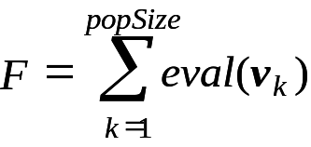
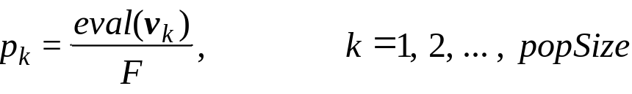
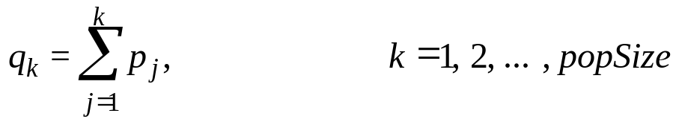
2.4 Genetic Operators
Selection:
  In most practices, a roulette wheel approach is adopted as the selection procedure, which is one of the fitness-proportional selection and can select a new population with respect to the probability distribution based on fitness values.
  The roulette wheel can be constructed with the following steps:
input: population P(t-1), C(t-1)
output: population P(t), C(t)
step 1: Calculate the total fitness for the population
step 2: Calculate selection probability p_{k} for each chromosome v_{k}
step 3: Calculate cumulative probability q_{k} for each chromosome v_{k}
step 4: Generate a random number r from the range [0, 1].
step 5: If r ≤ q₁, then select the first chromosome v₁; otherwise, select the kth chromosome v_{k} (2 ≤ k ≤ popSize) such that q_{k-1}< r ≤ q_{k} .

Slide 30
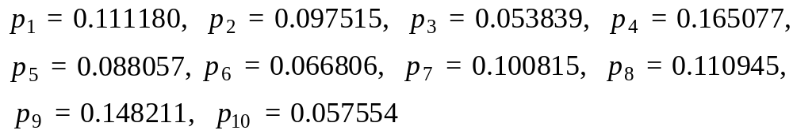
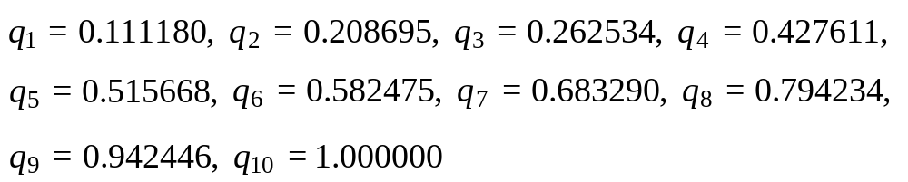
2.4 Genetic Operators
Illustration of Selection:
input: population P(t-1), C(t-1)
output: population P(t), C(t)
step 1: Calculate the total fitness F for the population.
10
=
∑
=
F
eval
(
v
k
)
178
.
135372
k
=
1
step 2: Calculate selection probability p_{k} for each chromosome v_{k}.
step 3: Calculate cumulative probability q_{k} for each chromosome v_{k}.
step 4: Generate a random number r from the range [0,1].
0.301431,
0.322062,
0.766503,
0.881893,
0.350871,
0.583392,
0.177618,
0.343242,
0.032685,
0.197577

Slide 31
2.4 Genetic Operators
Illustration of Selection:
step 5: q₃< r₁ = 0.301432 ≤ q₄, it means that the chromosome v₄ is selected
for new population; q₃< r₂ = 0.322062 ≤ q₄, it means that the chromosome
v₄ is selected again, and so on. Finally, the new population consists of the
following chromosome.
v₁' = [100110110100101101000000010111001] (v₄ )
v₂' = [100110110100101101000000010111001] (v₄ )
v₃' = [001011010100001100010110011001100] (v₈ )
v₄' = [111110001011101100011101000111101] (v₉ )
v₅' = [100110110100101101000000010111001] (v₄ )
v₆' = [110100010011111000100110011101101] (v₇ )
v₇' = [001110101110011000000010101001000] (v₂ )
v₈' = [100110110100101101000000010111001] (v₄ )
v₉' = [000001010100101001101111011111110] (v₁ )
v₁₀' = [001110101110011000000010101001000] (v₂ )

Slide 32
2.4 Genetic Operators
Crossover (One-cut point Crossover)
  Crossover used here is one-cut point method, which random selects one cut point.
  Exchanges the right parts of two parents to generate offspring.
  Consider two chromosomes as follow and the cut point is randomly selected after the 17th gene:
crossing point at 17th gene
v₁ = [100110110100101101000000010111001]
v₂ = [001110101110011000000010101001000]
c₁ = [100110110100101100000010101001000]
c₂ = [001110101110011001000000010111001]

Slide 33

2.4 Genetic Operators
Procedure of One-cut Point Crossover:
procedure: One-cut Point Crossover
input: p_{C}, parent P_{k}, k=1, 2, ..., popSize
output: offspring C_{k}
begin
for k ← 1 to do // popSize: population size
if p_{c} ≥ random [0, 1] then // p_{C}: the probability of crossover
i ← 0;
j ← 0;
repeat
i ← random [1, popSize];
j ← random [1, popSize];
until (i≠j )
p ← random [1, l -1]; // p: the cut position, l: the length of chromosome
C_{i} ← P_{i} [1: p-1] // P_{j} [p: l ];
C_{j} ← P_{j} [1: p-1] // P_{i} [p: l ];
end
end
output offspring C_{k};
end

Slide 34
2.4 Genetic Operators
Mutation
  Alters one or more genes with a probability equal to the mutation rate.
  Assume that the 16th gene of the chromosome v₁ is selected for a mutation.
  Since the gene is 1, it would be flipped into 0. So the chromosome after mutation would be:
mutating point at 16th gene
v₁ = [100110110100101101000000010111001]
c₁ = [100110110100101000000010101001000]

Slide 35
2. Example with Simple Genetic Algorithms
Procedure of Mutation:
Illustration of Mutation:
procedure: Mutation
input: p_{M}, parent P_{k}, k=1, 2, ..., popSize
output: offspring C_{k}
begin
for k ← 1 to popSize do // popSize: population size
for j ← 1 to l do // l: the length of chromosome
if p_{M} ≥ random [0, 1] then // p_{M}: the probability of mutation
p ← random [1, l -1]; // p: the cut position
C_{k} ← P_{k} [1: j-1] // P_{k} [ j ] // P_{k}[ j+1: l ];
end
end
end
output offspring C_{k} ;
end
Assume that p_{M} = 0.01
bitPos chromNum bitNo randomNum
105 4 6 0.009857
164 5 32 0.003113
199 7 1 0.000946
329 10 32 0.001282

Slide 36
2. Example with Simple Genetic Algorithms
Next Generation
v₁' = [100110110100101101000000010111001], f (6.159951, 4.109598) = 29.406122
v₂' = [100110110100101101000000010111001], f (6.159951, 4.109598) = 29.406122
v₃' = [001011010100001100010110011001100], f (-0.330256, 4.694977) = 19.763190
v₄' = [111110001011101100011101000111101], f (11.907206, 4.873501) = 5.702781
v₅' = [100110110100101101000000010111001], f (8.024130, 4.170248) = 19.91025
v₆' = [110100010011111000100110011101101], f (9.34067, 5.121702) = 17.958717
v₇' = [100110110100101101000000010111001], f (6.159951, 4.109598) = 29.406122
v₈' = [100110110100101101000000010111001], f (6.159951, 4.109598) = 29.406122
v₉' = [000001010100101001101111011111110], f (-2.687969, 5.361653) = 19.805199
v₁₀' = [001110101110011000000010101001000], f (0.474101, 4.170248) = 17.370896

Slide 37
2. Example with Simple Genetic Algorithms
Procedure of GA for Unconstrained Optimization
procedure: GA for Unconstrained Optimization (uO)
input: uO data set, GA parameters
output: best solution
begin
t ← 0;
initialize P(t) by binary string encoding;
fitness eval(P) by binary string decoding;
while (not termination condition) do
crossover P(t) to yield C(t) by one-cut point crossover;
mutation P(t) to yield C(t);
fitness eval(C) by binary string decoding;
select P(t+1) from P(t) and C(t) by roulette wheel selection;
t ← t+1;
end
output best solution;
end

Slide 38
2. Example with Simple Genetic Algorithms
Final Result
  The test run is terminated after 1000 generations.
  We obtained the best chromosome in the 884th generation as follows:
max f (x_{1,} x₂) = 21.5 + x₁·sin(4π x₁) + x₂·sin(20π x₂)
s. t. -3.0 ≤ x₁ ≤ 12.1
4.1 ≤ x₂ ≤ 5.8
eval
(
v
*
)
=f
(
11
.
622766
,
5
.
624329
)
=
38
.
737524
x
*
=
11
.
622766
1
x
*
=
5
.
624329
2
f
(
x
*
,x
*
)
=
38
.
737524
1
2

Slide 39
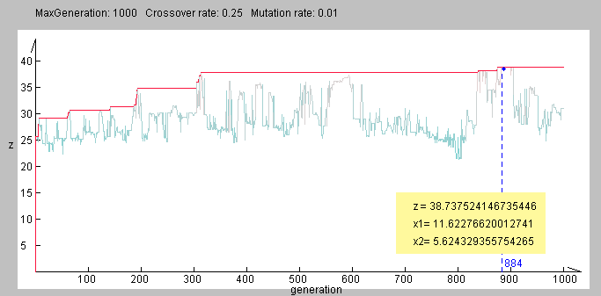
2. Example with Simple Genetic Algorithms
Evolutional Process
Simulation
maxGen: 1000 p_{C}: 0.25 p_{M}: 0.01

Slide 40
2. Example with Simple Genetic Algorithms
Evolutional Process
max f (x_{1,} x₂) = 21.5 + x₁·sin(4π x₁) + x₂·sin(20π x₂)
s. t. -3.0 ≤ x₁ ≤ 12.1
4.1 ≤ x₂ ≤ 5.8
by Mathematica 4.1
f = 21.5 + x1 Sin [ 4 Pi x1 ] + x2 Sin [ 20 Pi x2 ];
Plot3D[f, {x1, -3.0, 12.1}, {x2, 4.1, 5.8},
PlotPoints ->19,
AxesLabel -> {x1, x2, “f(x1, x2)”}];
ContourPlot[ f, {x, -3.0, 12.1},{y, 4.1, 5.8}];

Slide 41
1. Introduction of Genetic Algorithms
Foundations of Genetic Algorithms
Example with Simple Genetic Algorithms
Encoding Issue
  3.1 Coding Space and Solution Space
  3.2 Selection
Genetic Operators
Adaptation of Genetic Algorithms
Hybrid Genetic Algorithms

Slide 42
3. Encoding Issue
How to encode a solution of the problem into a chromosome is a key issue for genetic algorithms.
  In Holland's work, encoding is carried out using binary strings.
  For many GA applications, especially for the problems from industrial engineering world, the simple GA was difficult to apply directly as the binary string is not a natural coding.
During last ten years, various nonstring encoding techniques have been created for particular problems. For example:
  The real number coding for constrained optimization problems
  The integer coding for combinatorial optimization problems.
Choosing an appropriate representation of candidate solutions to the problem at hand is the foundation for applying genetic algorithms to solve real world problems, which conditions all the subsequent steps of genetic algorithms.
For any application case, it is necessary to analysis carefully to result in an appropriate representation of solutions together with meaningful and problem-specific genetic operators.

Slide 43
3. Encoding Issue
According to what kind of symbol is used:
  Binary encoding
  Real number encoding
  Integer/literal permutation encoding
  A general data structure encoding
According to the structure of encodings:
  One-dimensional encoding
  Multi-dimensional encoding
According to the length of chromosome:
  Fixed-length encoding
  Variable length encoding
According to what kind of contents is encoded:
  Solution only
  Solution + parameters

Slide 44
3.1 Coding Space and Solution Space
Basic features of genetic algorithms is that they work on coding space and solution space alternatively:
  Genetic operations work on coding space (chromosomes)
  While evaluation and selection work on solution space.
  Natural selection is the link between chromosomes and the performance of their decoded solutions.
Coding space
(genotype space)
Solution space
(phenotype space)
Decoding
Genetic
Operations
Evaluation and
Selection
Encoding

Slide 45
3.1 Coding Space and Solution Space
For nonstring coding approach, there are three critical issues emerged concerning with the encoding and decoding between chromosomes and solutions (or the mapping between phenotype and genotype):
  The feasibility of a chromosome
    The feasibility refers to the phenomenon that whether or not a solution decoded from a chromosome lies in the feasible region of a given problem.
  The legality of a chromosome
    The legality refers to the phenomenon that whether or not a chromosome represents a solution to a given problem.
  The uniqueness of mapping

Slide 46
3.1 Coding Space and Solution Space
Feasibility and Legality as shown in Figure 1.1
illegal one
Coding space
Solution space
infeasible one
Feasible area
feasible one
Fig. 1.1 Feasibility and Legality

Slide 47
3.1 Coding Space and Solution Space
The infeasibility of chromosomes originates from the nature of the constrained optimization problem.
  Whatever methods, conventional ones or genetic algorithms, must handle the constraints.
  For many optimization problems, the feasible region can be represented as a system of equalities or inequalities (linear or nonlinear).
  For such cases, many efficient penalty methods have been proposed to handle infeasible chromosomes.
  In constrained optimization problems, the optimum typically occurs at the boundary between feasible and infeasible areas.
  The penalty approach will force genetic search to approach to optimum from both side of feasible and infeasible regions.

Slide 48
3.1 Coding Space and Solution Space
The illegality of chromosomes originates from the nature of encoding techniques.
  For many combinatorial optimization problems, problem-specific encodings are used and such encodings usually yield to illegal offspring by a simple one-cut point crossover operation.
  Because an illegal chromosome can not be decoded to a solution, it means that such chromosome can not be evaluated, repairing techniques are usually adopted to convert an illegal chromosome to a legal one.
For example, the well-known PMX operator is essentially a kind of two-cut point crossover for permutation representation together with a repairing procedure to resolve the illegitimacy caused by the simple two-cut point crossover.
Orvosh and Davis have shown many combinatorial optimization problems using GA.
  Orvosh, D. & L. Davis: Using a genetic algorithm to optimize problems with feasibility constraints, Proc. of 1st IEEE Conf. on Evol. Compu., pp.548-552, 1994.
  It is relatively easy to repair an infeasible or illegal chromosome and the repair strategy did indeed surpass other strategies such as rejecting strategy or penalizing strategy.

Slide 49
3.1 Coding Space and Solution Space
The mapping from chromosomes to solutions (decoding) may belong to one of the following three cases:
  1-to-1 mapping
  n-to-1 mapping
  1-to-n mapping
The 1-to-1 mapping is the best one among three cases and 1-to-n mapping is the most undesired one.
  We need to consider these problems carefully when designing a new nonstring coding so as to build an effective genetic algorithm.
Coding space
1-to-n mapping
Solution space
n-to-1 mapping
1-to-1 mapping

Slide 50
3.2 Selection
The principle behind genetic algorithms is essentially Darwinian natural selection.
Selection provides the driving force in a genetic algorithm and the selection pressure is a critical in it.
  Too much, the search will terminate prematurely.
  Too little, progress will be slower than necessary.
  Low selection pressure is indicated at the start to the GA search in favor of a wide exploration of the search space.
  High selection pressure is recommended at the end in order to exploit the most promising regions of the search space.
The selection directs GA search towards promising regions in the search space.
During last few years, many selection methods have been proposed, examined, and compared.

Slide 51
3.2 Selection
Sampling Space
  In Holland's original GA, parents are replaced by their offspring soon after they give birth.
    This is called as generational replacement.
  Because genetic operations are blind in nature, offspring may be worse than their parents.
    To overcome this problem, several replacement strategies have been examined.
  Holland suggested that each offspring replaces a randomly chosen chromosome of the current population as it was born.
  De Jong proposed a crowding strategy.
    DeJong, K.: An Analysis of the Behavoir of a Class of Genetic Adaptive Systems, Ph.D. thesis, University of Michigan, Ann Arbor, 1975.
    In the crowding model, when an offspring was born, one parent was selected to die. The dying parent was chosen as that parent was most closely resembled the new offspring using a simple bit-by-bit similarity count to measure resemblance.

Slide 52
3.2 Selection
Sampling Space
  Note that in Holland's works, selection refers to choosing parents for recombination and new population was formed by replacing parents with their offspring. They called it as reproductive plan.
  Since Grefenstette and Baker's work, selection is used to form next generation usually with a probabilistic mechanism.
    Grefenstette, J. & J. Baker: “How genetic algorithms work: a critical look at implicit parallelism,” Proc. of the 3rd Inter. Conf. on GA, pp.20-27, 1989.
  Michalewicz gave a detail description on simple genetic algorithms where offspring replaced their parents soon after they were born at each generation and next generation was formed by roulette wheel selection (Michalewicz, 1994).

Slide 53
3.2 Selection
Stochastic Sampling
  The selection phase determines the actual number of copies that each chromosome will receive based on its survival probability.
  The selection phase is consist of two parts:
    Determine the chromosome’s expected value;
    Convert the expected values to the number of offspring.
  A chromosome’s expected value is a real number indicating the average number of offspring that a chromosome should receive. The sampling procedure is used to convert the real expected value to the number of offspring.
    Roulette wheel selection
    Stochastic universal sampling

Slide 54
3.2 Selection
Deterministic Sampling
  Deterministic procedures which select the best chromosomes from parents and offspring.
    (μ+λ)-selection
    (μ, λ)-selection
    Truncation selection
    Block selection
    Elitist selection
    The generational replacement
    Steady-state reproduction

Slide 55
3.2 Selection
Mixed Sampling
  Contains both random and deterministic features simultaneously.
    Tournament selection
    Binary tournament selection
    Stochastic tournament selection
    Remainder stochastic sampling

Slide 56
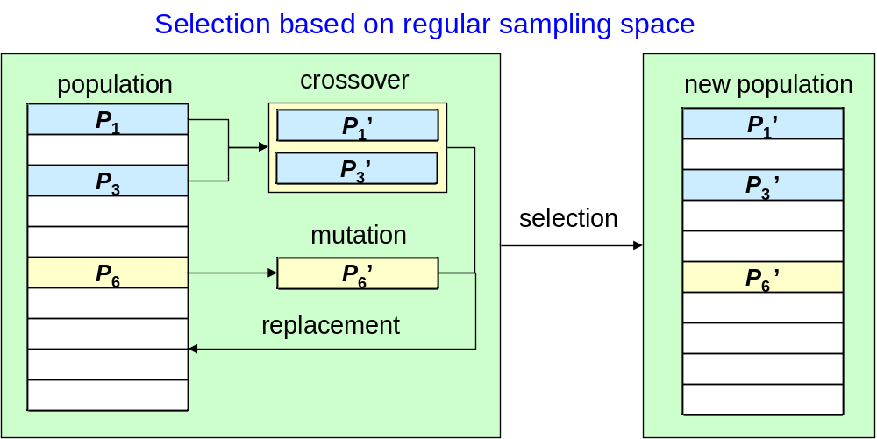
3.2 Selection
Regular Sampling Space
  Containing all offspring but just part of parents

Slide 57
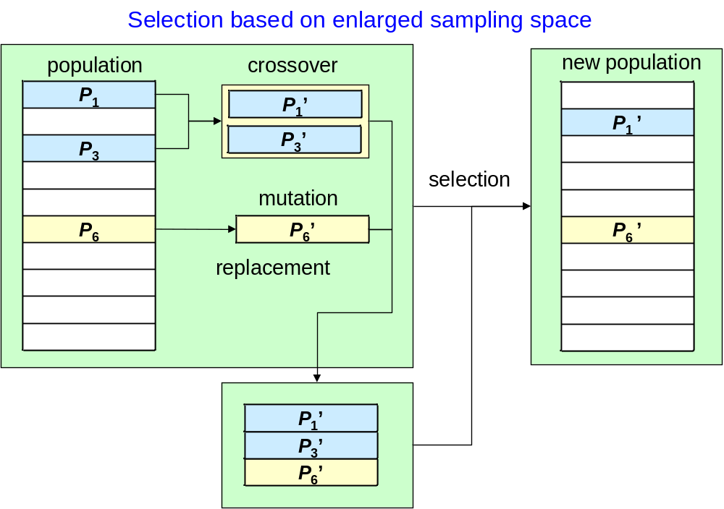
3.2 Selection
Enlarged sampling space
  containing all parents and offspring

Slide 58
3.2 Selection
Selection Probability
  Fitness scaling has a twofold intention:
    To maintain a reasonable differential between relative fitness ratings of chromosomes.
    To prevent a too-rapid takeover by some supper chromosomes in order to meet the requirement to limit competition early on, but to stimulate it later.
  Suppose that the raw fitness f_{k} (e.g. objective function value) for the k-th chromosomes, the scaled fitness f_{k}' is:
  Function g(·) may take different form to yield different scaling methods.
f_{k}' = g( f_{k} )

Slide 59
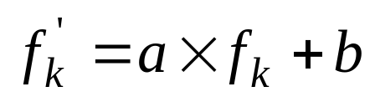
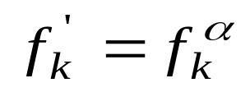
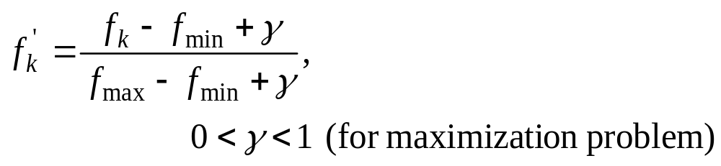
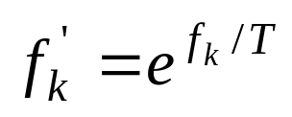
3.2 Selection
Scaling Mechanisms
Linear scaling
Power low scaling
Normalizing scaling
Boltzmann scaling

Slide 60
1. Introduction of Genetic Algorithms
Foundations of Genetic Algorithms
Example with Simple Genetic Algorithms
Encoding Issue
Genetic Operators
  4.1 Conventional operators
  4.2 Arithmetical operators
  4.3 Direction-based operators
  4.4 Stochastic operators
Adaptation of Genetic Algorithms
Hybrid Genetic Algorithms

Slide 61
4. Genetic Operators
Genetic operators are used to alter the genetic composition of chromosomes during representation.
There are two common genetic operators:
  Crossover
    Operating on two chromosomes at a time and generating offspring by combining both chromosomes’ features.
  Mutation
    Producing spontaneous random changes in various chromosomes.
There are an evolutionary operator:
  Selection
    Directing a GA search toward promising region in the search space.

Slide 62
4. Genetic Operators
Crossover can be roughly classified into four classes:
  Conventional operators
    Simple crossover (one-cut point, two-cut point, multi-cut point, uniform)
    Random crossover (flat crossover, blend crossover)
    Random mutation (boundary mutation, plain mutation)
  Arithmetical operators
    Arithmetical crossover (convex, affine, linear, average, intermediate)
    Extended intermediate crossover
    Dynamic mutation (nonuniform mutation)
  Direction-based operators
    Direction-based crossover
    Directional mutation
  Stochastic operators
    Unimodal normal distribution crossover
    Gaussian mutation

Slide 63
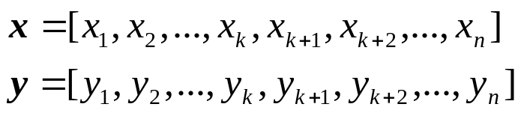
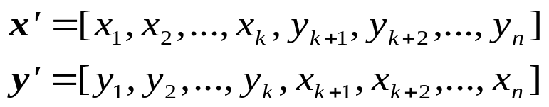


4.1 Conventional Operators
One-cut Point Crossover:
crossing point at kth position
parents
offspring
Random Mutation (Boundary Mutation):
mutating point at kth position
parent
offspring

Slide 64

4.2 Arithmetical Operators
  Crossover
    Suppose that these are two parents x₁ and x₂, the offspring can be obtained by λ₁x₁+ λ₂x₂ with different multipliers λ₁ and λ₂ .
x₁’=λ₁x₁+ λ₂x₂
x₂’=λ₁x₂+ λ₂x₁
x
2
2
linear hull = R
solution space
Convex Crossover
x
2
If λ₁+λ₂=1, λ₁ >0, λ₂ >0
x
affine hull
1
convex hull
Affine Crossover
If λ₁+λ₂=1
Linear Crossover
x
If λ₁+λ₂ ≤ 2, λ₁ >0, λ₂ >0
1
Fig 1.2 Illustration showing convex, affine, and linear hull

Slide 65


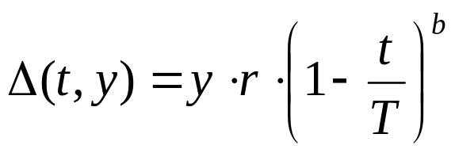
4.2 Arithmetical Operators
  Nonuniform Mutation (Dynamic Mutation)
    For a given parent x, if the element x_{k} of it is selected for mutation, the resulting offspring is x' = [x₁ … x_{k'} … x_{n}],
    where x_{k'} is randomly selected from two possible choice:
    where x_{k}^{U} and x_{k}^{L} are the upper and lower bounds for x_{k} .
    The function Δ(t, y) returns a value in the range [0, y] such that the value of Δ(t, y) approaches to 0 as t increases (t is the generation number):
    where r is a random number from [0, 1], T is the maximal generation number, and b is a parameter determining the degree of nonuniformity.
or

Slide 66
4.3 Direction-based Operators
  This operation use the values of objective function in determining the direction of genetic search:
  Direction-based crossover
    Generate a single offspring x' from two parents x₁ and x₂ according to the following rules:
    where 0< r ≤1.
  Directional mutation
    The offspring after mutation would be:
x' = r · (x₂ - x₁)+ x₂
x' = x + r · d
f
(
x
,
☹
,
x
+
Δ
x
,
☹
,
x
)
−
f
(
x
,
☹
,
x
,
☹
,
x
)
where
d
=
1
i
i
n
1
i
n
Δ
x
i
r = a random nonnegative real number

Slide 67

4.4 Stochastic Operators
Unimodal Normal Distribution Crossover (UNDX)
  The UNDX generates two children from a region of normal distribution defined by three parents.
  In one dimension defined by two parents p₁ and p₂, the standard deviation of the normal distribution is proportional to the distance between parents p₁ and p₂.
  In the other dimension orthogonal to the first one, the standard deviation of the normal distribution is proportional to the distance of the third parent p₃ from the line.
  The distance is also divided by in order to reduce the influence of the third parent.
p
3
σ
σ
Normal Distribution
2
1
p
d
d
2
2
1
p
1
Axis Connecting two Parents

Slide 68
4.4 Stochastic Operators
Unimodal Normal Distribution Crossover (UNDX)
Assume
P₁ & P₂ : the parents vectors
C₁ & C₂ : the child vectors
n: the number of variables
d₁: the distance between parents p₁ and p₂
d₂: the distance of parents p₃ from the axis
connecting parents p₁ and p₂
z₁: a random number with normal
distribution N(0, σ² )
z_{k} : a random number with the normal
distribution N(0, σ² ), k=1,2,…, n
α & β: certain constants
The children are generated as follows:
n
=
+
+
∑
C
1
m
z
1
e
1
z
k
e
k
k
=
2
n
=
−
−
∑
C
2
m
z
1
e
1
z
k
e
k
k
=
2
m
=
(
P
+
P
)
/
2
1
2
2
z
~
N
(
0
,
σ
2
),
z
~
N
(
0
,
σ
)
₁
1
1
k
k
k
=
2
,
3
,
...,
n
_{k}
σ
=
α
d
,
σ
=
β
d
n
1
1
2
2
e
=
(
P
−
P
)
|
P
−
P
|
1
2
1
2
1
e
⊥
e
,
i
,
j
=
1
,
2
,...,
n
,
i ≠ j
i
j

Slide 69
4.4 Stochastic Operators
Gaussian Mutation
An chromosome in evolution strategies consists of two components (x, σ ), where the first vector x represents a point in the search space, the second vector σ represents standard deviation.
An offspring (x', σ ') is generated as follows:
′
N
(
0
,
Δ
σ
)
σ
=
σ
e
x
′
=
x
+
N
(
0
,
Δ
σ
′
)
where N(0, Dσ ') is a vector of independent random Gaussian numbers with a mean of zero and standard deviations σ.

Slide 70
1. Introduction of Genetic Algorithms
Foundations of Genetic Algorithms
Example with Simple Genetic Algorithms
Encoding Issue
Genetic Operators
Adaptation of Genetic Algorithms
  5.1 Structure Adaptation
  5.2 Parameters Adaptation
Hybrid Genetic Algorithms

Slide 71
5. Adaptation of Genetic Algorithm
Since the genetic algorithms are inspired from the idea of evolution, it is natural to expect that the adaptation is used not only for finding solutions to a given problem, but also for tuning the genetic algorithms to the particular problem.
There are two kinds of adaptation of GA.
  Adaptation to Problems
    Advocates modifying some components of genetic algorithms, such as representation, crossover, mutation, and selection, to choose an appropriate form of the algorithm to meet the nature of a given problem.
  Adaptation to Evolutionary processes
    Suggests a way to tune the parameters of the changing configurations of genetic algorithms while solving the problem.
    Divided into five classes:
      Adaptive parameter settings
      Adaptive genetic operators
      Adaptive selection
      Adaptive representation
      Adaptive fitness function

Slide 72
5.1 Structure Adaptation
This approach requires a modification of an original problem into an appropriated form suitable for the genetic algorithms.
This approach includes a mapping between potential solutions and binary representation, taking care of decodes or repair procedures, etc.
For complex problems, such an approach usually fails to provide successful applications.
Problem
adaptation
Adapted problem
Genetic Algorithms
Fig. 1.3 Adapting a problem to the genetic algorithms.

Slide 73
5.1 Structure Adaptation
Various non-standard implementations of the GAs have been created for particular problems.
This approach leaves the problem unchanged and adapts the genetic algorithms by modifying a chromosome representation of a potential solution and applying appropriate genetic operators.
It is not a good choice to use the whole original solution of a given problem as the chromosome because many real problems are too complex to have a suitable implementation of genetic algorithms with the whole solution representation.
Adapted problem
Problem
adaptation
Genetic Algorithms
Fig. 1.4 Adapting the genetic algorithms to a problem.

Slide 74
5.1 Structure Adaptation
The approach is to adapt both GAs and the given problem.
GAs are used to evolve an appropriate permutation and/or combination of some items under consideration, and a heuristic method is subsequently used to construct a solution according to the permutation.
The approach has been successfully applied in the area of industrial engineering and has recently become the main approach for the practical use of the GAs.
Problem
Adapted GAs
Adapted problem
Genetic Algorithms
Fig. 1.5 Adapting both the genetic algorithms and the problem.

Slide 75
5.2 Parameters Adaptation
The behaviors of GA are characterized by the balance between exploitation and exploration in the search space, which is strongly affected by the parameters of GA.
  Usually, fixed parameters are used in most applications of GA and are determined with a set-and-test approach.
  Since GA is an intrinsically dynamic and adaptive process, the use of constant parameters is thus in contrast to the general evolutionary spirit.
Therefore, it is a natural idea to try to modify the values of strategy parameters during the run of the genetic algorithm by using the following three ways.
  Deterministic: using some deterministic rule
  Adaptive: taking feedback information from the current state of search
  Self-adaptive: employing some self-adaptive mechanism

Slide 76
5.2 Parameters Adaptation
The adaptation takes place if the value of a strategy parameter by some is altered by some deterministic rule.
Time-varying approach is used, which is measured by the number of generations.
For example, the mutation ratio is decreased gradually along with the elapse of generation by using the following equation.
  where t is the current generation number and maxGen is the maximum generation.
  Hence, mutation ratio will decrease from 0.5 to 0.2 as the number of generations increase to maxGen.
p_{M} = 0.5 - 0.3
t
maxGen

Slide 77
5.2 Parameters Adaptation
Adaptive Adaptation
  The adaptation takes place if there is some form of feedback from the evolutionary process, which is used to determine the direction and/or magnitude of the change to the strategy parameter.
  Early approach include Rechenberg’s 1/5 success rule in evolution strategies, which was used to vary the step size of mutation.
    Rechenberg, I.: Evolutionstrategie: Optimieriung technischer Systems nach Prinzipien der biologischen Evolution, Frommann-Holzboog, Stuttgart, Germany, 1973.
    The rule states that the ratio of successful mutations to all mutations should be 1/5. Hence, if the ratio is greater than 1/5 then increase the step size, and if the ratio is less than 1/5 then decrease the step size.
  Davis’s adaptive operator fitness utilizes feedback on the success of a larger number of reproduction operators to adjust the ratio being used.
    Davis, L.: “Applying adaptive algorithms to epistatic domains,” Proc. of the Inter. Joint Conf. on Artif. Intel., pp.162-164, 1985.
  Julstrom’s adaptive mechanism regulates the ratio between crossovers and mutations based on their performance.
    Julstrom, B.: “What have you done for me lately? Adapting operator probabilities in a steady-state genetic algorithm,” Proc. of the 6th Inter. Conf. on GA,pp.81-87, 1995.
  An extensive study of these kinds of learning-rule mechanisms has been done by Tuson and Ross.
    Tuson, A. & P. Ross: “Cost based operator rate adaptation: an investigation,” Proc. of the 4th Inter. Conf. on Para. Prob. Solving from Nature, pp.461-469, 1996.

Slide 78
5.2 Parameters Adaptation
Self-adaptive Adaptation
  The adaptation enables strategy parameters to evolve along with the evolutionary process. The parameters are encoded onto the chromosomes of the chromosomes and undergo mutation and recombination.
    The encoded parameters do not affect the fitness of chromosomes directly, but better values will lead to better chromosomes and these chromosomes will be more likely to survive and produce offspring, hence propagating these better parameter values.
    The parameters to self-adapt can be ones that control the operation of genetic algorithms, ones that control the operation of reproduction or other operators, or probabilities of using alternative processes.
  Schwefel developed the method to self-adapt the mutation step size and the mutation rotation angles in evolution strategies.
    Schwefel, H.: Evolution and Optimum Seeking, Wiley, New York, 1995.
  Hinterding used a multi-chromosome to implement the self-adaptation in the cutting stock problem with contiguity.
    where self-adaptation is used to adapt the probability of using one of the two available mutation operators, and the strength of the group mutation operator.

Slide 79
1. Introduction of Genetic Algorithms
Foundations of Genetic Algorithms
Example with Simple Genetic Algorithms
Encoding Issue
Genetic Operators
Adaptation of Genetic Algorithms
Hybrid Genetic Algorithms
  6.1 Adaptive Hybrid GA Approach
  6.2 Parameter control approach of GA
  6.3 Parameter control approach using Fuzzy Logic Controller
  6.4 Design of aHGA using conventional heuristics and FLC

Slide 80
6. Hybrid Genetic Algorithms
One of the most common forms of hybrid GA is to incorporate local optimization as add-on extra to the canonical GA.
With hybrid GA, the local optimization is applied to each newly generated offspring to move it to a local optimum before injecting it into the population.
The genetic search is used to perform global exploration among the population while local search is used to perform local exploitation around chromosomes.
There are two common forms of genetic local search. One features Lamarckian evolution and the other features the Baldwin effect. Both approaches use the metaphor that an chromosome learns (hill climbing) during its lifetime (generation).
In Lamarckian case, the resulting chromosome (after hill climbing) is put back into the population. In the Baldwinian case, only fitness is changed and the genotype remains unchanged.
The Baldwinian strategy can sometimes converge to a global optimum when Lamarckian strategy converges to a local optimum using the same local searching. However, the Baldwinian strategy is much slower than the Lamarckian strategy.

Slide 81
6. Hybrid Genetic Algorithms
The early works which linked genetic and Lamarckian evolutionary theory included:
  Grefenstette introduced Lamarckian operators into GAs.
  David defined Lamarckian probability for mutations in order to enable a mutation operator to be more controlled and to introduce some qualities of a local hill climbing operator.
  Shaefer added an intermediate mapping between the chromosome space and solution space into a standard GA, which is Lamarckian in nature.
  Kennedy gave an explanation of hybrid GAs with Lamarckian evolution theory.

Slide 82
6. Hybrid Genetic Algorithms
Let P(t) and C(t) be parents and offspring in current generation t.
The general structure of hybrid GAs is described as follows:
procedure: Hybrid Genetic Algorithm
input: GA parameters
output: best solution
begin
t ← 0;
initialize P(t);
fitness eval(P);
while (not termination condition) do
crossover P(t) to yield C(t);
mutation P(t) to yield C(t);
local search C(t);
fitness eval(C);
select P(t+1) from P(t) and C(t);
t ← t+1;
end
output best solution;
end

Slide 83
6. Hybrid Genetic Algorithms
Hybrid GA based on Darwin’s & Lamarckian’s evolution
  Grefenstette, J.: “Lamarkian learning in multi-agent environment,” Proc. of the 4th Inter. Conf. on GAs, pp.303-310, 1991.
population
crossover
new population
P
P
’
P
’
’
P
P
’
1
P
1
1
1
1
1
’
P
’
P
P
P
3
3
’
P
’
3
P
3
3
3
selection
mutation
P
P
’
P
’
P
’
P
’
6
P
6
6
6
6
6
hill-climbing
( local search )
replacement

Slide 84
6.1 Adaptive Hybrid GA Approach
Weakness of conventional GA approach to the problem of combinatorial nature of design variables
  Conventional GAs have not any scheme for locating local search area resulting from GA loop.
  The identification of the correct settings of genetic parameters (such as population size, probability of crossover and mutation operators) is not an easy task.
Improving
Applying a local search technique to GA loop.
Improving
Parameter control approach of GA

Slide 85
6.1 Adaptive Hybrid GA Approach
Applying a local search technique to GA loop
  Hill climbing method
    Michalewicz, Z.: Genetic Algorithms + Data Structures = Evolution Program, 3rd ed., New York: Spring-Verlag, 1996
Global optimum
fitness
Local optimum
improve
Fig. 1.6 Hill climbing method

Slide 86
6.1 Adaptive Hybrid GA Approach
Applying a local search technique to GA loop
  Iterative hill climbing method
    Yun, Y. S. and C. U. Moon: “Comparison of Adaptive Genetic Algorithms for Engineering Optimization Problems,” International Journal of Industrial Engineering, vol. 10, no. 4, pp.584-590, 2003.
Global optimum
fitness
improve
Search range
for local search
Local optimum
Solution by GA
Fig. 1.7 Iterative hill climbing method

Slide 87
6.1 Adaptive Hybrid GA Approach
Procedure of Iterative Hill Climbing Method in GA loop
procedure: Iterative hill climbing method in GA loop (Yun and Moon, 2003)
input: a best chromosome v_{c}
output: new best chromosome v_{n}
begin
Select a best chromosome v_{c} in the GA loop;
Randomly generate as many chromosomes as popSize in the
neighborhood of v_{c};
Select the chromosome v_{n} with the optimal fitness value of the
objective function f among the set of new chromosomes;
if f (v_{c}) > f (v_{n}) then
v_{c} ← v_{n};
output new best chromosome v_{n};
end

Slide 88
6.2 Parameter Control Approach of GA
  Two Methodologies for Controlling Genetic Parameters
1. Using conventional heuristics
[1] Srinvas, M. & L. M. Patnaik: “Adaptive Probabilities of Crossover and Mutation in
Genetic Algorithms,” IEEE Transaction on Systems, Man and Cybernetics, vol. 24,
no. 4, pp. 656-667, 1994.
[2] Mak, K. L., Y. S. Wong & X. X. Wang: “An Adaptive Genetic Algorithm for
Manufacturing Cell Formation”, International Journal of Manufacturing Technology,
vol. 16, pp. 491-497, 2000.
2. Using artificial intelligent techniques, such as fuzzy logic controllers
[1] Song, Y. H., G. S. Wang, P. T. Wang & A. T. Johns: “Environmental/Economic
Dispatch Using Fuzzy Logic Controlled Genetic Algorithms,” IEEE Proceedings on
Generation, Transmission and Distribution, vol. 144, no. 4, pp. 377-382, 1997
[2] Cheong, F. & R. Lai: “Constraining the Optimization of a Fuzzy Logic Controller
Using an Enhanced Genetic Algorithm,” IEEE Transactions on Systems, Man, and
Cybernetics-Part B: Cybernetics, vol. 30, no. 1, pp. 31-46, 2000.
[3] Yun, Y. S. & M. Gen: “Performance Analysis of Adaptive Genetic Algorithms with
Fuzzy Logic and Heuristics,” Fuzzy Optimization and Decision Making, vol. 2, no.
2, pp. 161-175, June 2003.

Slide 89
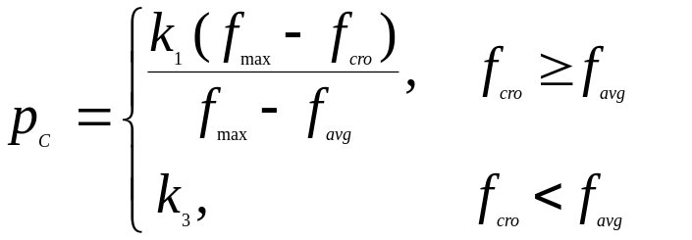
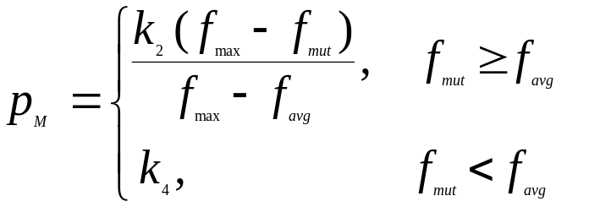




6.2 Parameter Control Approach of GA
  Srinvas and Patnaik’s Approach (IEEE-SMC 1994)
    Heuristic Updating Strategy
This scheme is to control P_{c} and P_{M} using various fitness at each generation.
where : maximum fitness value at each generation.
: average fitness value at each generation.
: the larger of the fitness values of the chromosomes to be
crossed.
: the fitness value of the ith chromosome to which the mutation
with a rate P_{M} is applied.

Slide 90





6.2 Parameter Control Approach of GA
Parameter control approach using conventional heuristics
  Mak et al.’s Approach (Srinvas & Patnaik, 1994)
    Heuristic Updating Strategy
This scheme is to control p_{c} and p_{M} with respect to the fitness of
offspring at each generation.
procedure: Regulation of and using the fitness of offspring (Srinvas & Patnaik, 1994)
input: GA parameters, p_{C}(t-1), p_{M}(t-1)
output: p_{C}(t), p_{M}(t)
begin
if then
if then
if then
end
output p_{C}(t), p_{M}(t);
end

Slide 91


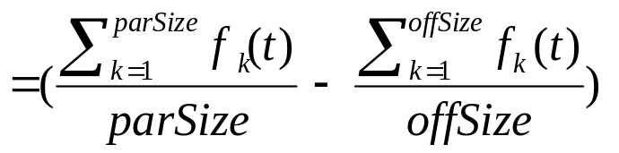
6.３ Parameter Control Approach using Fuzzy Logic Controller
Parameter Control Approach using Fuzzy Logic Controller (FLC)
Song, Y. H., G. S. Wang, P. T. Wang & A. T. Johns: “Environmental/Economic Dispatch Using
Fuzzy Logic Controlled Genetic Algorithms,” IEEE Proceedings on Generation, Transmission and
Distribution, Vol. 144, No. 4, pp. 377-382, 1997.
  Basic Concept
  Heuristic updating strategy for the crossover and mutation rates is to consider changes of average fitness in the GA population of two continuous generations.
  For example, in minimization problem, we can set the change of the average
  fitness at generation t, as follows:
where
parSize : population size satisfying the constraints
offSize : offspring size satisfying the constraints

Slide 92

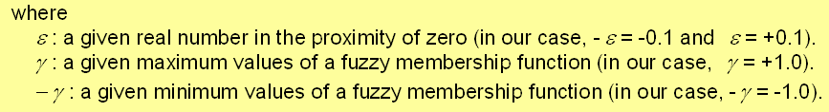
6.３ Parameter Control Approach using Fuzzy Logic Controller
    procedure: regulation of p_{C} and p_{M} using the average fitness
input: GA parameters, p_{C}(t-1), p_{M}(t-1),Δf_{ave}(t-1),Δf_{ave}(t),ε,γ
output: p_{C}(t), p_{M}(t)
begin
    if
    then increase p_{C} and p_{M} for next generation;
    if
    then decrease p_{C} and p_{M} for next generation;
    if
    then rapidly increase p_{C} and p_{M} for next generation;
    output p_{C}(t), p_{M}(t);
    end

Slide 93





6.３ Parameter Control Approach using Fuzzy Logic Controller
  Implementation Strategy for Crossover FLC
  step 1: Input and output of crossover FLC
  The inputs of the crossover FLC are the and
  in continuous two generations, the output of which is a change in the ,
  step 2: Membership functions of , and
  The membership functions of the fuzzy input and output linguistic variables are
  illustrated in Figures 1 and 2, respectively. The input and output results of
  discretization for the and are set at Table 1, and the
  and are normalized into the range [-1.0, 1.0]. The is also
  normalized into the range [-0.1, 0.1] according to their corresponding maximum
  values.

Slide 94
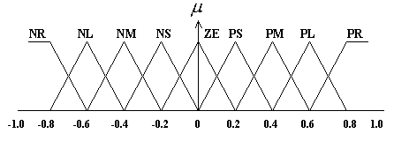
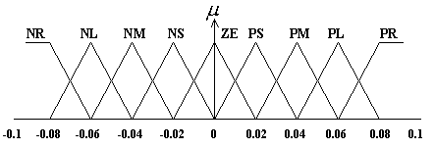
6.３ Parameter Control Approach using Fuzzy Logic Controller
Implementation Strategy for Crossover FLC
  Fig.1.8 Membership functions for Fig. 1.9 Membership function of
  and
  where: NR – Negative larger, NL – Negative large, NM – Negative medium,
  NS – Negative small, ZE – Zero, PS – Positive small,
  PM - Positive medium, PL – Positive large, PR – Positive larger.

Slide 95









6.３ Parameter Control Approach using Fuzzy Logic Controller
Implementation Strategy for Crossover FLC
Table 1.1 Input and output results of discrimination
inputs | outputs
 | -4
 | -3
 | -2
 | -1
 | 0
 | 1
 | 2
 | 3
 | 4

Slide 96
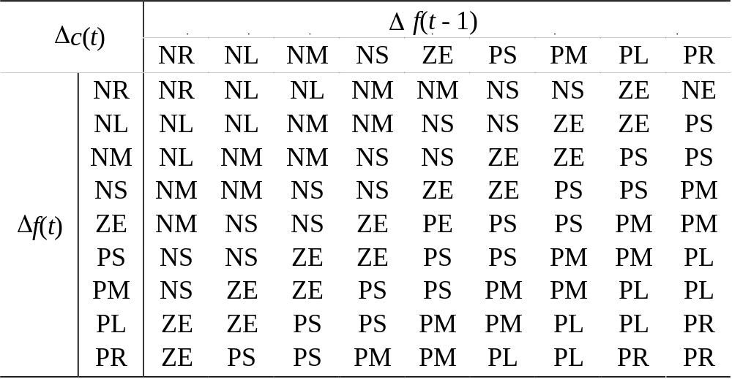
6.３ Parameter Control Approach using Fuzzy Logic Controller
Implementation Strategy for Crossover FLC
  step 3: Fuzzy decision table
  Use the same fuzzy decision table as the conventional work Song, et al.
  (1997), and the table is as follow:
  Table 1.2 Fuzzy decision table for crossover
ZE

Slide 97
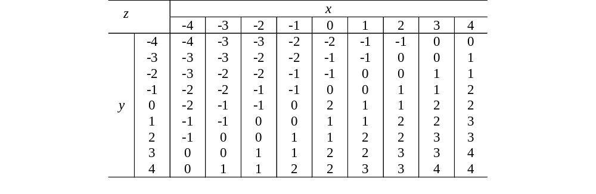
6.３ Parameter Control Approach using Fuzzy Logic Controller
Implementation Strategy for Crossover FLC
  step 4: Defuzzification table for control actions
  For simplicity, the defuzzification table for determining the action of the
  crossover FLC was setup. It is formulated as follows: (Song et al., 1997).
  Table 1.3 Defuzzification table for control action of crossover
0

Slide 98

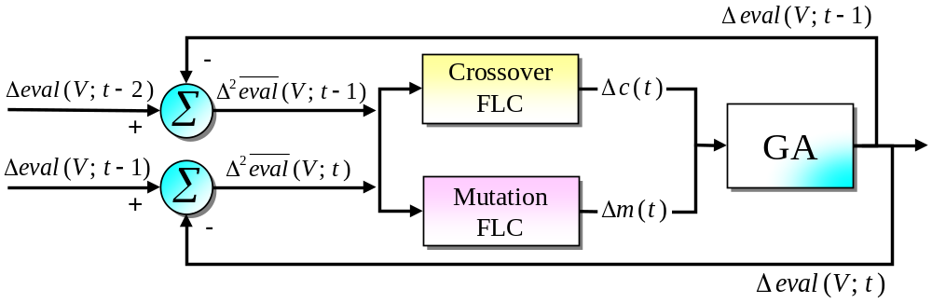
6.３ Parameter Control Approach using Fuzzy Logic Controller
Implementation Strategy for Mutation FLC
  The inputs of the mutation FLC are the same as those of the crossover FLC, and the
  output of which is a change in the , Δm(t).
  Coordinated Strategy between the FLC and GA
Fig. 1.10 Coordinated strategy between the FLC and GA

Slide 99


6.３ Parameter Control Approach using Fuzzy Logic Controller
Detailed procedure for Implementing Crossover and Mutation FLCs
input: GA parameters, p_{C}(t-1), p_{M}(t-1), ,
output: p_{C}(t), p_{M}(t)
  step 1: The input variables of the FLCs for regulating the GA operators are the
  changes of the average fitness in continuous two generations (t -1 and t)
  as follows:
  ,
  step 2: After normalizing and , assign these values to the
  indexes i and j corresponding to the control actions in the defuzzification
  table (see Table 3).

Slide 100









6.3 Parameter Control Approach using Fuzzy Logic Controller
  step 3: Calculate the changes of the crossover rate and the mutation rate
  as follows:
  ,
  where the contents of are the corresponding values of and
  for defuzzification. The values of 0.02 and 0.002 are given values to
  regulate the increasing and decreasing ranges of the rates of
  crossover and mutation operators.
  step 4: Update the change of the rates of the crossover and mutation operators by
  using the following equations:
  ,
  The adjusted rates should not exceed the range from 0.5 to 1.0 for the
  and the range from 0.0 to 0.1 for the

Slide 101
6.4 Design of aHGA using Conventional Heuristics and FLC
Design of adaptive hybrid Genetic Algorithms (aHGAs) using conventional heuristics and FLC
  Implementing process of aHGAs
    Design of Canonical GA (CGA)
    Design of Hybrid GA (HGA)
    Design of various aHGAs

Slide 102
6.4 Design of aHGA using Conventional Heuristics and FLC
Design of Canonical GA (CGA)
For the canonical GA (CGA), we use a real-number representation instead of a bit-string one, and the detailed implementation procedure for the CGA is as follows:
procedure: Canonical GA (CGA) (Gen & Cheng, 2000)
input: GA parameters
output: best solution
begin
t ← 0;
initialize P(t) by random generation based on system constraints;
fitness eval(P);
while (not termination condition) do
crossover P(t) to yield C(t) by non-uniform arithmetic crossover;
mutation P(t) to yield C(t) by uniform mutation;
fitness eval(C);
select P(t+1) from P(t) and C(t) by elitist strategy in enlarged sampling space;
t ← t+1;
end
output best solution;
end

Slide 103
6.4 Design of aHGA using Conventional Heuristics and FLC
Design of Hybrid GA (HGA): CGA with Local Search
For this HGA, the CGA procedure and the iterative hill climbing method
(Yun & Moon, 2003) are used as a mixed type.
procedure: CGA with Local Search (HGA)
input: GA parameters
output: best solution
begin
t ← 0;
initialize P(t) by random generation based on system constraints;
fitness eval(P);
while (not termination condition) do
crossover P(t) to yield C(t) by non-uniform arithmetic crossover;
mutation P(t) to yield C(t) by uniform mutation;
local search C(t) by iterative hill climbing method (Yun & Moon, 2003);
fitness eval(C);
select P(t+1) from P(t) and C(t) by elitist strategy in enlarged sampling space;
t ← t+1;
end
output best solution;
end

Slide 104
6.4 Design of aHGA using Conventional Heuristics and FLC
Design of aHGAs: HGAs with Conventional Heuristics
  aHGA1: CGA with local search and adaptive scheme 1
  For the first aHGA (aHGA1), we use the CGA procedure, the iterative hill climbing method and the procedures of the heuristic by Mak et al. (2000) as a mixed type.
procedure: CGA with Local Search and Adaptive Scheme 1 (aHGA1)
input: GA parameters
output: best solution
begin
t ← 0;
initialize P(t) by random generation based on system constraints;
fitness eval(P);
while (not termination condition) do
crossover P(t) to yield C(t) by non-uniform arithmetic crossover;
mutation P(t) to yield C(t) by uniform mutation;
local search C(t) by iterative hill climbing method;
fitness eval(C);
select P(t+1) from P(t) and C(t) by elitist strategy in enlarged sampling space;
adaptive regulation of GA parameters using heuristic updating strategy (Mak et al., 2000);
t ← t+1;
end
output best solution;
end

Slide 105
6.4 Design of aHGA using Conventional Heuristics and FLC
Design of aHGAs: HGAs with Conventional Heuristics
  aHGA2: CGA with local search and adaptive schema 2
  For the first aHGA (aHGA1), we use the CGA procedure, the iterative hill climbing method and the procedures of the heuristic by Srinivas and Patnaik (1994) as a mixed type.
procedure: CGA with local search and adaptive scheme 2 (aHGA2)
input: GA parameters
output: best solution
begin
t ← 0;
initialize P(t) by random generation based on system constraints;
fitness eval(P);
while (not termination condition) do
crossover P(t) to yield C(t) by non-uniform arithmetic crossover;
mutation P(t) to yield C(t) by uniform mutation;
local search C(t) by iterative hill climbing method;
fitness eval(C);
select P(t+1) from P(t) and C(t) by elitist strategy in enlarged sampling space;
adaptive regulation of GA parameters using heuristic updating strategy (Srinivas and Patnaik, 1994);
t ← t+1;
end
output best solution;
end

Slide 106
6.4 Design of aHGA using Conventional Heuristics and FLC
Design of aHGAs: HGAs with FLC
  flc-aHGA: CGA with local search and adaptive scheme of FLC
  For the first aHGA (aHGA1), we use the CGA procedure, the iterative hill
climbing method and the procedures of the FLC (Song et al., 1997) as a mixed type.
procedure: CGA with Local Search and Adaptive Scheme of FLC (flc-aHGA)
input: GA parameters
output: best solution
begin
t ← 0;
initialize P(t) by random generation based on system constraints;
fitness eval(P);
while (not termination condition) do
crossover P(t) to yield C(t) by non-uniform arithmetic crossover;
mutation P(t) to yield C(t) by uniform mutation;
local search C(t) by iterative hill climbing method;
fitness eval(C);
select P(t+1) from P(t) and C(t) by elitist strategy in enlarged sampling space;
adaptive regulation of GA parameters using FLC (Song et al., 1997);
t ← t+1;
end
output best solution;
end

Slide 107
6.4 Design of aHGA using Conventional Heuristics and FLC
Flowchart of the proposed algorithms
CGA
HGA
aHGA1
aHGA2
flc-aHGA
start
start
start
start
start
initial
population
initial
population
initial
population
initial
population
initial
population
crossover
crossover
crossover
crossover
crossover
mutation
mutation
mutation
mutation
mutation
evaluation
iterative hill
climbing
iterative hill
climbing
iterative hill
climbing
iterative hill
climbing
selection
evaluation
evaluation
evaluation
evaluation
No
termination
condition
selection
selection
selection
selection
Yes
No
adaptive
scheme 1
adaptive
scheme 2
adaptive
FLC
termination
condition
stop
No
No
No
Yes
termination
condition
termination
condition
termination
condition
stop
Yes
Yes
Yes
stop
stop
stop

Slide 108
Conclusion
The Genetic Algorithms (GA), as powerful and broadly applicable stochastic search and optimization techniques, are perhaps the most widely known types of Evolutionary Computation methods or Evolutionary Optimization today.
In this chapter, we have introduced the following subjects:
  Foundations of Genetic Algorithms
    Five basic components of Genetic Algorithms
  Example with Simple Genetic Algorithms
  Encoding Issue
  Genetic Operators
  Adaptation of Genetic Algorithms
    Structure Adaptation and Parameter Adaptation
  Hybrid Genetic Algorithms
    Parameter control approach of GA
    Hybrid Genetic Algorithm with Fuzzy Logic Controller

