Slide 1
Combinatorial Optimization

Slide 2
3. Combinatorial Optimization
1. Knapsack Problem
1.1 Binary Representation Approach
1.2 Order Representation Approach
1.3 Variable-length Representation Approach
1.4 Multiple-choice Knapsack Problem
1.5 Multi-constraints Knapsack Problem
2. Quadratic Assignment Problem
2.1 Problem Description
2.2 Encoding
2.3 Genetic Operators
2.4 GA Procedure for qAP
3. Minimum Spanning Tree Problem
3.1 Quadratic Minimum Spanning Tree Problem
3.2 Degree-constrained Minimum Spanning Tree
3.3 Bicriteria Minimum Spanning Tree Problem

Slide 3
3. Combinatorial Optimization
4. Set Covering Problem
4.1 Genetic Representation
4.2 Genetic Operators
4.3 GA procedure for Set Covering Problem
5. Bin Packing Problem
5.1 Heuristic Algorithms
5.2 Genetic Representation
5.3 Genetic Operators
5.4 Fitness Function
5.5 GA procedure for Bin Packing Problem
6. Traveling Salesman Problem
6.1 Representation
6.2 Crossover Operators
6.3 Mutation Operators
6.4 GA procedure for TSP

Slide 4
3. Combinatorial Optimization
1. Knapsack Problem
1.1 Binary Representation Approach
1.2 Order Representation Approach
1.3 Variable-length Representation Approach
1.4 Multiple-choice Knapsack Problem
1.5 Multi-constraints Knapsack Problem
2. Quadratic Assignment Problem
3. Minimum Spanning Tree Problem
4. Set Covering Problem
5. Bin Packing Problem
6. Traveling Salesman Problem

Slide 5
1. Knapsack Problem
Knapsack Problem
  Knapsack problems have been studied intensively in past decades.
  The theoretical interest arises mainly from their simple structure, which allows exploitation of a number of combinatorial properties.
  This problem can model many industrial situations
    The most classical applications being capital budgeting, cargo loading, and cutting stock.

Slide 6
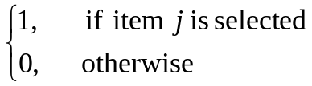
1. Knapsack Problem
Knapsack Problem
  This problem is to fill up a knapsack by selecting some objects among various objects (items).
  There are n different items available and each item j has a weight of w_{j} and a profit of c_{j}.
  The problem is to find an optimal subset of items so as to maximize the total profits subject to the knapsack’s weight capacity.
  This is known as the 0-1 knapsack problem, which is a pure integer programming with single constraint and forms a very important class of integer programming.
Notations
  Indices
    j : the index of item, j = 1, 2,…, n
  Parameters
    n: the total number of items
    W: the weight capacity of the knapsack
    c_{j}: the profit of j-th item
    w_{j}: the weight of j-th item
  Decision Variables
    x_{j} : the 0,1 decision variable;

Slide 7
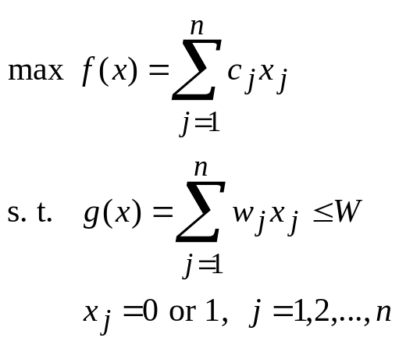

1. Knapsack Problem
Mathematical formulation:
The proposed genetic algorithms can be roughly classified into three classes:
  Binary representation
  Order representation
  Variable-length representation
…
1 … n
(c₁ … c_{n})
(w₁ … w_{n})
where W: weight capacity

Slide 8
1.1 Binary Representation Approach
Binary string is a natural representation of solutions to the 0-1 knapsack problem:
x = [x₁ x₂ x₃ x₄ x₅ x₆ x₇]
= [ 0 1 0 1 0 0 0 ]
  It means that item numbers 2, 4 are selected to be filled
  in the knapsack.
f(x) = 40x₁+ 60x₂+ 10x₃+ 10x₄+ 3x₅+ 20x₆+ 60x₇
= 70
g(x) = 40x₁+ 50x₂+ 30x₃+ 10x₄+ 10x₅+ 40x₆+ 30x₇
= 60 ≤ W
This representation may yield an infeasible solution.
The following two methods have been proposed to handle the infeasibility:
  Penalty method
  Decoder method
Sample of Binary Representation: total number of items n =7
data set
j | c_{j} | w_{j}
1 | 40 | 40
2 | 60 | 50
3 | 10 | 30
4 | 10 | 10
5 | 3 | 10
6 | 20 | 40
7 | 60 | 30
W =100

Slide 9
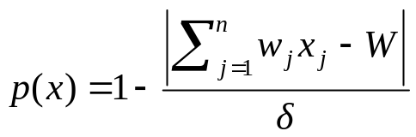
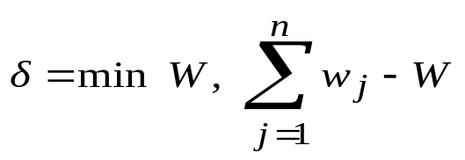



1.1 Binary Representation Approach
Penalty method
  Gordon, V. and D. Whitney: “Serial and parallel genetic algorithms as functions optimizers”, in Forrest, S., editor, Proc. of the 5th International Conference on Genetic Algorithms, Morgan Kaufmann Publisher, San Mateo, CA, pp. 177-183, 1993.
  The penalty value for the chromosome v is equal to the amount in excess of the capacity of the knapsack.
  Fitness Function
  eval(v) = f(x) p(x)
  The penalty function for maximization problem:
p(x)
1
x
{
}
feasible solutions infeasible solutions

Slide 10
1.1 Binary Representation Approach
Decoder method
  Gordon, V. and D. Whitney: “Serial and parallel genetic algorithms as functions optimizers”, in Forrest, S., ed. Proc. of the 5th International Conference on Genetic Algorithms, Morgan Kaufmann Publisher, San Mateo, CA, pp. 177-183, 1993.
input: items, the total number of items,
weight of each item, the cost of each item
output: items in knapsack
step 1: Sort items with the value x_{j} = 1 in descending order
by the ratio of profit to weight.
step 2: Select items using the first fit heuristic until the
knapsack cannot be filled any further.
step 3: Output items in knapsack and stop.

Slide 11



1.1 Binary Representation Approach
Example of Decoder method
input: data set
Item number j | 1 | 2 | 3 | 4 | 5 | 6 | 7
Profit c_{j} | 40 | 60 | 10 | 10 | 3 | 20 | 60
Weight w_{j} | 40 | 50 | 30 | 10 | 10 | 40 | 30
Ratio of c_{j} /w_{j} | 1.0 | 1.2 | 0.33 | 1.0 | 0.3 | 0.5 | 2.0
W =100
1. Select genes of x_{j}=1
selected gene
1 2 3 4 5 6 7
chromosome
0
1
1
0
0
0
1
2. Sort items with the value x_{j} = 1 in descending order by the ratio of profit to weight.
2 3 7
selected genes
1
1
1
ratio of c_{j} /w_{j} 1.2 0.33 2.0
7 2 3
descending order
1
1
1
3. Select items using the first fit heuristic until the knapsack cannot be filled any further.
7
1
output: items in knapsack
7 2
7 2
1
1
1
1
7 2 3
1
1
1

Slide 12
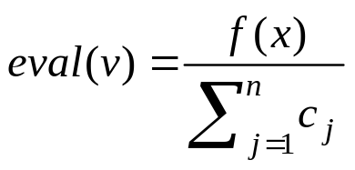
1.2 Order Representation Approach
Hinterding, R.: “Mapping, order-independent genes and the knapsack problem”, in Fogel, D., editor, Proc. of the First IEEE Conference on Evolutionary Computation, IEEE Press, Orlando, FL, pp. 13-17, 1994
For n item problem, a chromosome contains n genes and each gene represents an item with an identical integer number.
The order of an item in the permutation representation can be viewed as the priority for it to be filled into the knapsack.
Fitness function

Slide 13
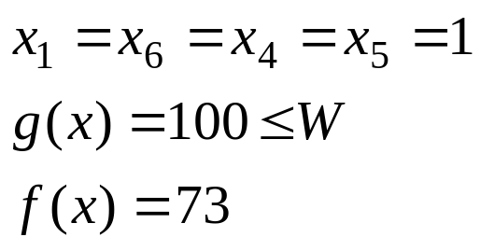
1.2 Order Representation Approach
Example
data set
Item number j | 1 | 2 | 3 | 4 | 5 | 6 | 7
Profit c_{j} | 40 | 60 | 10 | 10 | 3 | 20 | 60
Weight w_{j} | 40 | 50 | 30 | 10 | 10 | 40 | 30
W=100
chromosome [ 1 6 4 7 3 2 5 ]
the feasible solution [ 1 6 4 5 ]

Slide 14
1.3 Variable-length Representation Approach
Hinterding, R.: “Mapping, order-independent genes and the knapsack problem”, in Fogel, D., editor, Proc. of the First IEEE Conference on Evolutionary Computation, IEEE Press, Orlando, FL, pp. 13-17, 1994
The representation belongs to the direct encoding approach.
The genes in the chromosome represent a legal knapsack because the total number of items in a legal knapsack is not fixed, the length of a chromosome is variable.
The order of items in a chromosome has no meaning.
data set
Sample of chromosome
j | c_{j} | w_{j}
1 | 40 | 40
2 | 60 | 50
3 | 10 | 30
4 | 10 | 10
5 | 3 | 10
6 | 20 | 40
7 | 60 | 30
7
g(x)=30≤W, f(x)=60
7
2
g(x)=80≤W, f(x)=120
7
2
3
g(x)=110>W, f(x)=130
gene # :
1 2
chromosome :
7
2
g(x)=80≤W, f(x)=120
W=100

Slide 15
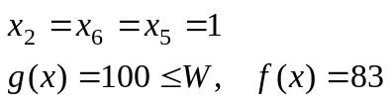
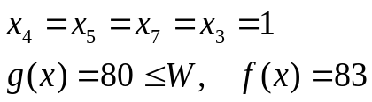
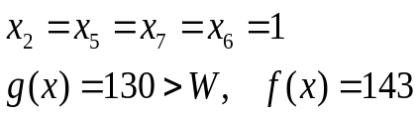
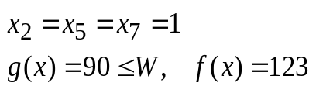
1.3 Variable-length Representation Approach
Injecting crossover
input: parent chromosomes
output: offspring chromosomes
step 1: Choose an insertion point in the first parent,
and choose a segment in the second parent.
step 2: Inject the segment into the first parent at the insertion point.
step 3: Delete duplicate genes outside the segment to get a proto-child.
step 4: Cull genes from the proto-child with the first fit heuristic to yield a
legal knapsack.
step 5: Output offspring chromosomes and stop.
1. Injecting a segment
insert point
data set
parent 1
2
6
5
j | c_{j} | w_{j}
1 | 40 | 40
2 | 60 | 50
3 | 10 | 30
4 | 10 | 10
5 | 3 | 10
6 | 20 | 40
7 | 60 | 30
proto-child
2
5
7
6
5
parent 2
4
5
7
3
segment
2. Deleting duplicated genes
proto-child
2
5
7
6
3. Culling genes with first fit heuristic
W=100
offspring
2
5
7

Slide 16
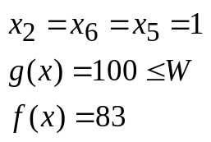
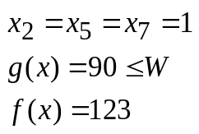
1.3 Variable-length Representation Approach
Mutation procedure
input: parent chromosome
output: offspring chromosome
step 1: Delete a number of genes at random.
step 2: Append the items in random order
that were not present in the chromosome.
step 3: Cull genes from the proto-child with
the first heuristic to yield a legal knapsack.
step 4: Output offspring chromosome and stop.
1. Delete a selected number selected
data set
Selected point
parent
2
6
5
j | c_{j} | w_{j}
1 | 40 | 40
2 | 60 | 50
3 | 10 | 30
4 | 10 | 10
5 | 3 | 10
6 | 20 | 40
7 | 60 | 30
proto-child
2
5
2. Append the items that were not present in the chromosome
proto-child
2
5
7
6
1
3
4
3. Culling genes with first fit heuristic
offspring
2
5
7
W=100

Slide 17
1.3 Variable-length Representation Approach
GA procedure for Knapsack Problem
procedure: GA for Knapsack Problem (KP)
input: KP data set, GA parameters
output: best item set
begin
t ←0;
initialize P(t) by variable-length representation;
fitness eval(P);
while (not termination condition) do
crossover P(t) to yield C(t) by injecting crossover;
mutation P(t) to yield C(t);
fitness eval(C);
select P(t+1) from P(t) and C(t);
t ← t+1;
end
output best item set;
end

Slide 18
1.4 Multiple-choice Knapsack Problem
Akbar, M. M., E. G. Manning, G. C. Shoja and S. Khan,: "Heuristic Solutions for the Multiple-Choice Multi-Dimension Knapsack Problem" , International Conference on Computational Science, San Francisco, 2001
Mohr, A.E.: “Bit allocation in sub-linear time and the multiple-choice knapsack problem”, Proc. of Data Compression Conference, pp. 352-361, 2002
Problem Description
  The multiple-choice knapsack problem is defined as a knapsack problem with the addition of disjoint multiple-choice constraints.

Slide 19
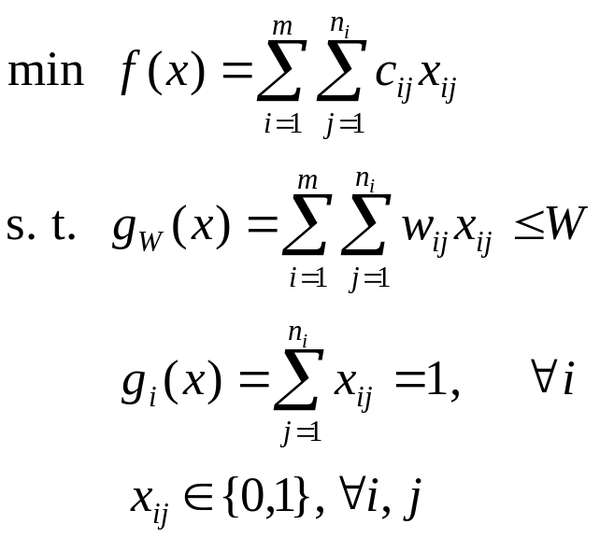
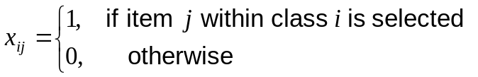
1.4 Multiple-choice Knapsack Problem
  Mathematical formulation
2
3
1
1 … n₁
1 … n₂
1 … n₃
(c₁₁ … c_{1n1})
(w₁₁ … w_{1n1})
(c₂₁ … c_{1n2})
(w₂₁ … w_{1n2})
(c₃₁ … c_{1n3})
(w₃₁ … w_{1n3})
4
m
…
1 … n₄
1 … n_{m}
where
i : the index of class
j : the index of item within each class,
n_{i} : the total number of items within ith class,
c_{ij} : the cost for item j within class i,
m : the total number of classes.
w_{ij} : the weight of item j within class i
W : the limited capacity of the knapsack.
(c₄₁ … c_{1n4})
(w₄₁ … w_{1n4})
(c_{m1} … c_{1nm})
(w_{m1} … w_{1nm})
…
weight capacity: W

Slide 20

1.4 Multiple-choice Knapsack Problem
1.4.1 Genetic Representation
  The ith gene takes an integer number from the mutually exclusive set N_{i}, where N_{i} is a set {1,2,…,n_{i}} at each class i.
  The position of a gene is used to represent one class of object while the value of the gene is used to represent the item selected from the class. An indicator variable V= [v_{i}]_{n} (i=1,2,…,m), is defined as follows:
permutation encoding
1 2 3 4 … m
chromosome v:
v₁
v₂
v₃
v₄
...
v_{m}

Slide 21
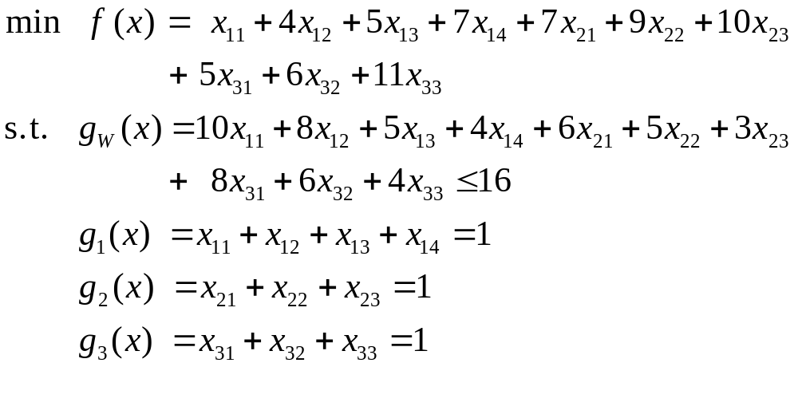
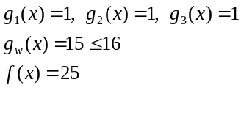
1.4 Multiple-choice Knapsack Problem
  Example
It stands for a solution of x₁₂ = 1, x₂₃ = 1, x₃₃ = 1.
It is easy to verify that it is a feasible solution.
1 2 3
chromosome v:
2
3
3

Slide 22
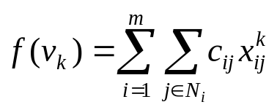
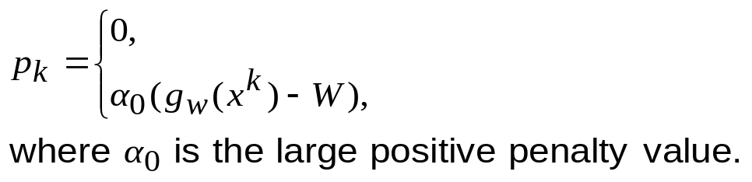

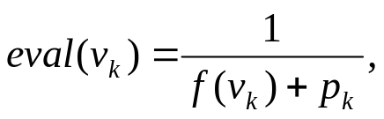
1.4 Multiple-choice Knapsack Problem
1.4.2 Crossover and Mutation
  The uniform crossover and random perturbation can be adopted for the genetic operations. As to the random perturbation, the selected gene y_{i} will be replaced by a random integer only from the set N_{i}.
1.4.3 Evaluation and Selection
  The evaluation function has two terms:
    total cost
    penalty to illegality.
  Evaluation function
if constraint is satisfied
otherwise
k = 1, 2,…, popSize

Slide 23
1.4 Multiple-choice Knapsack Problem
GA procedure for Multiple-choice Knapsack
procedure: Multiple-choice Knapsack Problem (mc-KP)
input: mc-KP data set, GA parameters
output: best item set
begin
t ←0;
initialize P(t) by permutation encoding;
fitness eval(P);
while (not termination condition) do
crossover P(t) to yield C(t) by uniform crossover;
mutation P(t) to yield C(t) by random perturbation;
fitness eval(C);
select P(t+1) from P(t) and C(t);
t ← t+1;
end
output best item set;
end

Slide 24
1.5 Multiconstraint Knapsack Problem
1.5.1 Problem Description
  The multiconstraints knapsack problem is defined as a knapsack problem with a set of constraints such as weight, size, reliability and so on.
  The problem is also denoted as the multiple knapsack problem or multidimensional knapsack problem as it can be described as follows:
    there are m knapsack of capacities W₁, W₂,…, W_{m} and n objects.
    Unlike the simple knapsack problem in which the weights of the objects are fixed, the weight of the j-th object in the ith constraint takes the j object weight w_{ij} and the cost of the j-th object in the ith constraint takes the j object cost c_{ij} when it is considered for possible inclusion in the ith knapsack of capacity W_{i}.
    We are interested in put all objects into knapsack with no knapsack overfilled and yields the minimum total cost.

Slide 25
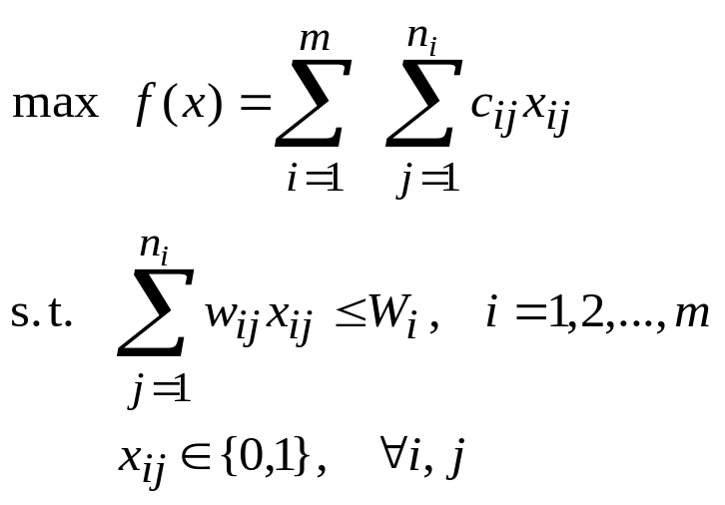
1.5 Multi-constraints Knapsack Problem
Mathematical formulation
1
2
m
…
1 … n₁
1 … n₂
1 … n_{m}
(c₁₁ … c_{1n1})
(w₁₁ … w_{1n1})
(c₂₁ … c_{1n2})
(w₂₁ … w_{1n2})
(c_{m1} … c_{1nm})
(w_{m1} … w_{1nm})
1
2
m
…
W₁
W₂
W_{m}
The multiconstraints knapsack problem is a special case of zero-one
linear programming with a great variety of applications in the areas
such as a resource allocation and capital budgeting.

Slide 26

1.5 Multi-constraints Knapsack Problem
1.5.2 Genetic Algorithm Approach
  Raidl’s method
    Raidl, G. R. and J. Gottlieb: “ Evolutionary Computation in Combinatorial Optimization”, EvoCOP 2004, v. 3004 of LNCS. Springer Verlag, 2004.
    The bit string representation is adopted and the Linear Programming is used to genetic a meaningful starting solution for the problem.
    Based on the solution of the LP-relaxed multiconstraints knapsack problem.

Slide 27

1.5 Multi-constraints Knapsack Problem
Initialize procedure
procedure: Initialize x
input: capacity of each knapsack,
total number of knapsacks
output: x
begin
x ← 0;
p ← random[1, n];
for j = 1 to n do
if then
x_{p(j)} ← 1;
if any W_{i} is violated then
x_{p(j)}← 0;
end
output x;
end
R_{j}: pseudo random number, 0 ≤ R_{j} ≤ 1

Slide 28


1.5 Multi-constraints Knapsack Problem
    Instead to penalizing infeasible solutions created by standard uniform crossover and bit-wise mutation, a repair operator is used and illustrated as follows:
procedure: Repair x
input: capacity of each knapsack,
total number of knapsacks
output: x
begin
p ← random[1, n];
for j = 1 to n do
if x_{p(j)} = 1 and any W_{i} is violated
then x_{p(j)} ← 0;
end
output x;
end
In contrast to the repair operator, the variable x_{j} are now processed in
decreasing order of the LP-solution’ values . As in the initialization
process, each variable will be set to 1 if this does not violate any
constraint.

Slide 29
1.5 Multi-constraints Knapsack Problem
    A local improved technique is adopted to improve each newly generated solution after making it feasible.
    The local improvement is illustrated in the following procedure:
procedure: Locally Improve x
input: capacity of each knapsack,
total number of knapsacks
output: x
begin
p ← random[1, n];
for j =1 to n do
if x_{p(j)} = 0
then x_{p(j)} ← 1;
if any W_{i} is violated
then x_{p(j)} ← 0;
end
end
output x;
end

Slide 30
1.5 Multi-constraints Knapsack Problem
Raidl’s procedure for multi-constraints knapsack problem
procedure: Raidl’s Method for Multiconstraints Knapsack Problem
input: number of total items within each class, the cost for each item,
total number of classes, the weight of each item,
capacity of each knapsack, the total number of knapsacks
output: best item set
begin
t ←0;
initialize P(t) by permutation encoding;
fitness eval(P);
while (not termination condition) do
crossover P(t) to yield C(t) by uniform crossover;
mutation P(t) to yield C(t) by bit-wise mutation;
repair C(t);
locally improve C(t);
fitness eval(C);
select P(t+1) from P(t) and C(t);
t ← t+1;
end
output best item set;
end

Slide 31
1.5 Multi-constraints Knapsack Problem
  Maeda’s method
    Maeda, Y.: “Modified genetic algorithms based on disparity theory of evolution”, Proc. of IFSA World Congress and 20th NAFIPS International Conference, vol. 4 , pp. 2235 – 2240, 2001
    Leading strand and Lagging strand methods are used in parity and disparity models.
    Leading strand
      it compounded to the same direction for opening spiral structure with low mutation probability.
    Lagging strand
      It compounded to opposite direction for opening spiral structure with high mutation probability.
    Parity model
      It has Leading and Lagging strand with same low mutation probability.
    Disparity model
      It has Leading strand with low mutation probability and Lagging strand with high mutation probability.

Slide 32
1.5 Multi-constraints Knapsack Problem
Maeda’s Algorithm 1
Maeda’s Algorithm 1
input: number of total items within each class, the cost for each item,
total number of classes, the weight of each item,
capacity of each knapsack, the total number of knapsacks
output: best item set
step 1: Create initial individuals.
step 2: Make crossover to each individuals.
step 3: Make low mutation of Leading strand to individuals finished
in step 2.
step 4: Add individuals created in step 3 to the genetic pool.
step 5: Make high mutation of Lagging strand to individuals finished
in step 2.
step 6: Add individuals created in step 5 to the genetic pool.
step 7: Evaluate created individuals.
step 8: Select individuals with high fitness value.
step 9: if termination condition is satisfied, output best item set and stop;
Otherwise return to step 2.

Slide 33
1.5 Multi-constraints Knapsack Problem
[ Parity Model]
parent | 1 | 0 | 0 | 1 | 1 | 0 | 1
Leading Strand (Low Mutation Probability)
Leading Strand (Low Mutation Probability)
offspring 1 | 1 | 0 | 0 | 0 | 1 | 0 | 1
offspring 2 | 1 | 0 | 0 | 1 | 1 | 0 | 0
Fitness Value: 600
<
Fitness Value: 700
Evaluation
parent | 1 | 0 | 0 | 1 | 1 | 0 | 0
Selection
New Generation
[ Disparity Model]
parent | 1 | 0 | 0 | 1 | 1 | 0 | 1
Leading Strand (Low Mutation Probability)
Lagging Strand (High Mutation Probability)
offspring 1 | 1 | 0 | 0 | 0 | 1 | 0 | 1
offspring 1 | 0 | 1 | 1 | 0 | 1 | 0 | 0
Fitness Value: 600
<
Fitness Value: 1100
Evaluation
parent | 0 | 1 | 1 | 0 | 1 | 0 | 0
Selection
New Generation

Slide 34
1.5 Multi-constraints Knapsack Problem
Maeda’s Algorithm 2
Maeda’s Algorithm 2
input: number of total items within each class, the cost for each item,
total number of classes, the weight of each item,
capacity of each knapsack, the total number of knapsacks
output: best item set
step 1: Create initial individuals.
step 2: Make crossover to each individuals.
step 3: Create individuals made by bit reverse to individuals finished
in step 2.
step 4: Make low mutation of Leading strand to individuals finished
in step 2.
step 5: Make high mutation of Lagging strand to individuals finished
in step 3.
step 6: Evaluate individuals created in steps 4 and 5.
step 7: Select individuals with high fitness value.
step 8: if termination condition is satisfied, output best item set and stop;
Otherwise return to step 2.

Slide 35
1.5 Multi-constraints Knapsack Problem
[ Parity Model]
parent | 1 | 0 | 0 | 1 | 1 | 0 | 1
Leading Strand (Low Mutation Probability)
Bit reverse
offspring 1 | 1 | 0 | 0 | 0 | 1 | 0 | 1
proto-child 2 | 0 | 1 | 1 | 0 | 0 | 1 | 0
Leading Strand (Low Mutation Probability)
offspring 2 | 0 | 1 | 1 | 0 | 0 | 1 | 1
Fitness Value: 600
<
Fitness Value: 700
Evaluation
parent | 0 | 1 | 1 | 0 | 0 | 1 | 1
Selection
New Generation

Slide 36
1.5 Multi-constraints Knapsack Problem
[Disparity Model]
parent | 1 | 0 | 0 | 1 | 1 | 0 | 1
Leading Strand (Low Mutation Probability)
Bit reverse
offspring 1 | 1 | 0 | 0 | 0 | 1 | 0 | 1
proto-child 2 | 0 | 1 | 1 | 0 | 0 | 1 | 0
Lagging Strand (High Mutation Probability)
offspring 2 | 1 | 0 | 1 | 1 | 1 | 1 | 1
Fitness Value: 600
<
Fitness Value: 1200
Evaluation
parent | 1 | 0 | 1 | 1 | 1 | 1 | 1
Selection
New Generation

Slide 37
3. Combinatorial Optimization
1. Knapsack Problem
2. Quadratic Assignment Problem
3. Minimum Spanning Tree Problem
4. Set Covering Problem
5. Bin Packing Problem
6. Traveling Salesman Problem
6.1 Representation
6.2 Crossover Operators
6.3 Mutation Operators
6.4 GA procedure for TSP

Slide 38
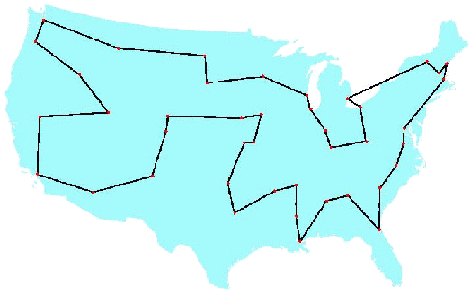
6. Traveling Salesman Problem
The Traveling Salesman Problem (TSP) is one of the most widely studied combinatorial optimization problems.
Its statement is deceptively simple: A salesperson seeks the shortest tour through n cities.
Fig. 3.4 George Dantzig, Ray Fulkerson, and Selmer Johnson (1954)
a description of a method for solving the TSP :49 cities
Table for non-directed graph

Slide 39
6. Traveling Salesman Problem
Existing Instances
  49 city problem
    Dagtzig, G., D. Fulkerson and S. Johnson: “Solution of a large scale traveling salesman problems”, Operations Research, vol. 2, pp. 393-410, 1954.
  120 city problem
    Grötschel, M.: “On the symmetric traveling salesman problem: solution of a 120 city problem”, Mathematical Programming Studies, vol. 12, pp. 61-77, 1980.
  318 city problem
    Crowder, H. and M. Padberg: “Solving large scale symmetric traveling salesman problems to optimality”, Management Science, vol. 22, pp. 15-24, 1995.
  532 city problem
    Padberg, M. and G. Rinaldi: “Optimization of 532 city symmetric traveling salesman problem by branch and cut”, Operations Research Letters, vol. 6, pp. 1-7, 1987.

Slide 40
6. Traveling Salesman Problem
  666 city problem
    Grötschel, M. and O. Holland: “Solution of large scale symmetric traveling salesman problems”, Mathematical Programming Studies, vol. 51, pp. 141-202, 1991.
  2392 city problem
    Padberg, M. and G. Rinaldi: “A branch and cut algorithm for the resolution of large scale symmetric traveling salesman problem”, SIAM Review, vol. 33, pp. 60-100, 1991.
  The earlier studies using the genetic algorithm to solve TSP
    Grefenstette, J.: Proceedings of the First International Conference on Genetic Algorithms, Lawrence Erlbaum Associates, Hillsdale, NJ, 1985.
  TSP has become a target for the genetic algorithm community.
    Michalewicz, Z.: Genetic Algorithm + Data structure = Evolution Programs, 2nd ed.,
    Springer-Verlag, New York, 1994.

Slide 41
6. Traveling Salesman Problem
Notations
  Indices
    i, j : the index of city, i, j =1, 2, …, n
  Parameters
    n: the total number of cities
    d_{ij} : the distance city i to city j, i.e., the distance of route (i,j); the distance matrix (d_{ij}) is symmetric.
  Decision Variables
    x_{ij} : the 0,1 decision variable; 1, if route (i,j) is selected, and 0, otherwise.

Slide 42
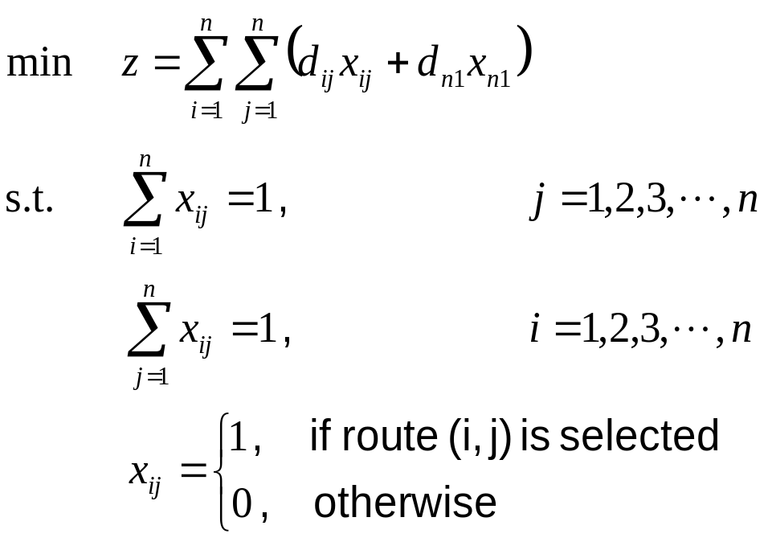
6. Traveling Salesman Problem
Mathematical Model of TSP
data set for non-directed graph
i | j | d_{ij}
1 | 2 | 8
 | 3 | 5
 | 4 | 9
 | 5 | 12
 | 6 | 14
 | 7 | 12
 | 8 | 16
 | 9 | 17
2 | 3 | 9
 | 4 | 15
 | 5 | 17
 | 6 | 8
 | 7 | 11
 | 8 | 18
 | 9 | 14
3 | 4 | 7
 | 5 | 9
 | 6 | 11
i | j | d_{ij}
3 | 7 | 7
 | 8 | 12
 | 9 | 12
4 | 5 | 3
 | 6 | 17
 | 7 | 10
 | 8 | 7
 | 9 | 15
5 | 6 | 8
 | 7 | 10
 | 8 | 6
 | 9 | 15
6 | 7 | 9
 | 8 | 14
 | 9 | 8
7 | 8 | 8
 | 9 | 6
8 | 9 | 11
d₁₂=8 ,x₁₂=1
1
2
d₁₉=17 ,x₁₉=1
8
d₂₃=9 ,x₂₃=1
d₇₈=8 ,x₇₈=1
d₆₈=14 ,x₆₈=1
9
7
6
3
d₅₉=15 ,x₅₉=1
d₄₆=17 ,x₄₆=1
d₅₇=10 ,x₅₇=1
d₃₄=7 ,x₃₄=1
5
4
Fig. 3.5 Simple TSP Model

Slide 43

6.1 Representation
Permutation Representation
  This direct representation is perhaps the most natural representation of a TSP, where cities are listed in the order in which they are visited.
  chromosome
  tour list 3 - 2 - 5 - 4 - 7 - 1 - 6 - 9 – 8
  This representation is also called a path representation or order representation.
1 2 3 4 5 6 7 8 9
3
2
5
4
7
1
6
9
8
procedure: Permutation Encoding
Input: city set, total number of cities N
output: chromosome v
begin
for j=1 to N
v(j)← j;
for i=1 to
repeat
j←random[1, N];
l←random[1, N];
until l≠j
swap(v(j), v(l));
output chromosome v;
end
procedure: Permutation Decoding
Input: chromosome v,
total number of cities N
output: tour list L
begin
L← φ;
for i =1 to N
L ← L ∪v(i);
output tour list L;
end

Slide 44
6.1 Representation
Random Keys Representation
  This indirect representation encodes a solution with random numbers from (0,1).
  These values are used as sort keys to decode the solution.
  chromosome
where position i in the list represents city i.
tour list 6 - 1 - 3 - 7 - 8 - 4 - 9 - 2 - 5
1 2 3 4 5 6 7 8 9
0.23
0.82
0.45
0.74
0.87
0.11
0.56
0.69
0.78
procedure: Random Keys Encoding
Input: city set,
total number of cities N
output: chromosome v
begin
for i =1 to N
v[i] ← random[0,1];
output chromosome v;
end
procedure: Random Keys Decoding
Input: chromosome v,
total number of cities N
output: tour list L
begin
L← φ;
for i =1 to N
L ← L ∪i;
sort L by v[i];
output tour list L;
end

Slide 45
6.2 Crossover Operators
During the past decade, several crossover operators have been proposed for permutation representation, such as partial-mapped crossover (PMX), order crossover (OX), cycle crossover (CX), position-based crossover,
order-based crossover, heuristic crossover, and so on.
These operators can be classified into two classes:
  Canonical approach
    The canonical approach can be viewed as an extension of two-point or multipoint crossover of binary strings to permutation representation.
  Heuristic approach
    The application of heuristics in crossover intends to generate an improved offspring.

Slide 46




6.2 Crossover Operators
1. Partial-Mapped Crossover (PMX)
  procedure : PMX crossover
  input : chromosome v₁, v₂,
  length of chromosome l
  output : offspring ,
  begin
  R ← φ;
  // step 1: select two positions
  at random
  s ← random[1:l-1] ;
  t ← random[s+1:l] ;
  // step 2: exchange two substrings
  ← v₁[1:s-1] // v₂[s: t] // v₁[t +1:l] ;
  ← v₂[1:s-1] // v₁[s: t] // v₂[t +1:l] ;
  // step 3: determine the mapping
  relationship
  R ← relation(v₁[s:t] , v₂[s:t]) ;
  // step 4: legalize offspring
  legalize( , , R );
  output offspring , ;
  end
step 1 : select two positions at random
s
t
parent 1
1
2
3
4
5
6
7
8
9
parent 2
5
4
6
9
2
1
7
8
3
step 2: exchange two substrings
proto-child 1
1
2
6
9
2
1
7
8
9
proto-child 2
5
4
3
4
5
6
7
8
3
step 3 : determine the mapping relationship
6
9
2
1
1 6 3
2 5
9 4
3
4
5
6
step 4 : legalize offspring
offspring 1
3
5
6
9
2
1
7
8
4
offspring 2
2
9
3
4
5
6
7
8
1
v₁ : parent chromosome 1 v₂ : parent chromosome 2
l : length of chromosome : offspring chromosome 1
: offspring chromosome 2 R : relationships
s : start position of substring t : end position of substring
relation(v₁,v₂) : searching relationship between v₁ and v₂
legalize(v₁,v₂,R) change genes value of v₁, v₂ based on relationship R

Slide 47


6.2 Crossover Operators
2. OX crossover
  procedure : Order Crossover (OX)
  input :chromosome v₁, v₂,
  length of chromosome l
  output : offspring
  begin
  w ←1;
  // step 1: select substring at random
  s ← random[1: l-1] ;
  t ← random[s+1: l] ;
  // step 2: produce a proto-child by
  copying the substring
  ← v₁[s: t] ;
  // step 3: produce offspring by filing
  unfixed positions of proto-
  child from parent 2
  for i=1 to s-1
  for j=w to l
  fg ←0;
  for k=s to t
  if v₂[j] =v₁[k] then
  fg ← 1; break;
  if fg=0 then
  [i] ← v₂[j] ;
  w ←j +1; break;
step 1 : select substring at random
s
t
parent 1
1
2
3
4
5
6
7
8
9
step 2 : produce a proto-child by copying the substring
proto-child
3
4
5
6
step 3 : produce offspring by filing unfixed positions
of proto-child from parent 2
offspring
7
9
3
4
5
6
parent 2
5
7
4
9
1
3
6
2
8
v₁ : parent chromosome 1 v₂ : parent chromosome 2
l : length of chromosome : offspring chromosome
w: working data fg : flag
s : start position of substring t : end position of substring

Slide 48
6.2 Crossover Operators
  for i=t+1 to l
  for j=w to l
  fg ←0;
  for k=s to t
  if v₂[j] =v₁[k] then
  fg ← 1; break;
  if fg=0 then
  [i] ← v₂[j] ;
  w ←j +1; break ;
  output offspring ;
  end;
offspring
7
9
3
4
5
6
1
2
8
parent 2
5
7
4
9
1
3
6
2
8
v₁ : parent chromosome 1 v₂ : parent chromosome 2
l : length of chromosome : offspring chromosome
w: working data fg : flag
s : start position of substring t : end position of substring

Slide 49


6.2 Crossover Operators
3. Position-based Crossover (PBX)
  procedure : Position-based Crossover
  input : chromosome v₁, v₂,
  length of chromosome l
  output : offspring
  begin
  T ← φ, S ← φ, w ← 1;
  // step 1: select a set of positions
  from parent 1 at random
  N ← random[1:l] ;
  // step 2: produce proto-child by
  copying values of
  selected positions
  for i=1 to N
  j ← random[1:l];
  ← v₁[j] ;
  T ← T∪j ;
  S ← S ∪ v₁[j] ;
step 1 : select a set of positions from parent 1 at random
j
j
j
j
parent 1
1
2
3
4
5
6
7
8
9
step 2 : produce proto-child by copying
values of selected positions
proto-child
2
5
6
9
v₁ : parent chromosome 1 v₂ : parent chromosome 2
l : length of chromosome : offspring chromosome
N : total number of selected positions
T={t[j]} , j=1,2,…, N : selected positions set
S ={s[m]}, m=1,2,…, N : genes value set of selected positions
fg₁ : flag 1 fg₂ : flag 2
w : working data

Slide 50

6.2 Crossover Operators
// step 3: produce offspring by filing unfixed
  positions of proto-child from parent 2
  for i=1 to l
  fg₁ ← 0;
  for j =1 to N
  if i=t[j] then fg₁ ← 1;
  if fg₁ =1 then continue;
  for k=w to l
  fg₂ ← 0;
  for m=1 to N
  if v₂[k]=s[m] then
  fg₂ ← 1; break;
  if fg₂ =0 then
  ← v₂[k ];
  w ← k +1 ; break ;
  output offspring ;
  end
step 3 : produce offspring by filing unfixed
  positions of proto-child from parent 2
offspring
4
2
3
1
5
6
7
8
9
parent 2
5
4
6
3
1
9
2
7
8
v₁ : parent chromosome 1 v₂ : parent chromosome 2
l : length of chromosome : offspring chromosome
N : total number of selected positions
T={t[j]} , j=1,2,…, N : selected positions set
S ={s[m]}, m=1,2,…, N : genes value set of selected positions
fg₁ : flag 1 fg₂ : flag 2
w : working data

Slide 51
6.2 Crossover Operators
4. Order-Based Crossover (OBX)
procedure : Order-Based Crossover
  input : chromosome v₁, v₂,
  length of chromosome l
  output : offspring
  begin
  S ← φ, T← φ, w ← 1;
  // step 1: select a set of positions
  from parent 1 at random
  N ← random[1:l] ;
  for i=1 to N
  j ← random[1:l];
  S ← S ∪ v₁[j] ;
step 1 : select a set of positions
  from parent 1 at random
j
j
j
j
parent 1
1
2
3
4
5
6
7
8
9
v₁ : parent chromosome 1 v₂ : parent chromosome 2
l : length of chromosome : offspring chromosome
N : total number of selected positions
T={t[j]} , j=1,2,…, N : positions set of assigned genes from v₂ to
S ={s[i]}, i=1,2,…, N : genes value set of selected positions
fg₁ : flag 1 fg₂ : flag 2
w : working data

Slide 52


6.2 Crossover Operators
// step 2: produce proto-child by copying
non-selected value from parent 2
  for i=1 to l
  fg₁←0;
  for j=1 to N
  if v₂[i] = s[j] then
  fg₁←1; break;
  if fg₁=0 then
  ← v₂[i],
  T← T ∪i;
  // step 3: produce offspring by copying selected
  values from parent 1
  for i=1 to l
  fg₂←0;
  for j=1 to N
  if i =t[j] then fg₂←1 ;
  if fg₂=1 then continue;
  ← s[w];
  w ← w+1;
  output offspring ;
  end
step 2: produce proto-child by copying non-selected value from parent 2
parent 2
5
4
6
3
1
9
2
7
8
proto-child
4
3
1
7
8
step 3 : produce offspring by copying selected values from parent 1
parent 1
1
2
3
4
5
6
7
8
9
proto-child
2
4
5
3
1
6
9
7
8
v₁ : parent chromosome 1 v₂ : parent chromosome 2
l : length of chromosome : offspring chromosome
N : total number of selected positions
T={t[j]} , j=1,2,…, N: positions set of assigned genes from v₂ to
S ={s[i]}, i=1,2,…, N : genes value set of selected positions
fg₁ : flag 1 fg₂ : flag 2
w : working data

Slide 53

6.2 Crossover Operators
5. Cycle Crossover (CX)
  procedure : CX crossover
  input : chromosome v₁, v₂,
  length of chromosome l
  output : offspring
  begin
  S ← φ, T ← φ, w ← 1;
  // step 1: find the cycle between parents
  C ← cy (v₁, v₂);
  // step 2: produce proto-child by copying
  gene values in cycle from parent 1
  for i=1 to l
  for j=1 to N-1
  if v₁[i] =c[j] then
  ← v₁[i] ;
  T ← T∪i ;
  S ← S ∪ v₁[i] ;
step 1 : find the cycle between parents
parent 1
1
2
3
4
5
6
7
8
9
parent 2
5
4
6
9
2
3
7
8
1
cycle 1 5 2 4 9 1
step 2 : produce proto-child by copying gene values
in cycle from parent 1
proto-child
1
2
4
5
9
v₁ : parent chromosome 1 v₂ : parent chromosome 2
l : length of chromosome : offspring chromosome
N : total number of values in cycle
T={t[n]} , n=1,2,…, N-1: positions set of S in proto-child
S ={s[k]}, k=1,2,…, N-1: proto-child genes value set in cycle
C={c[j]}, j=1,2,…, N-1: value set of cycle
fg₁ : flag 1 fg₂ : flag 2
w : working data
cy (v₁,v₂):finding the cycle which is defined
by the corresponding positions between parents

Slide 54
6.2 Crossover Operators
  // step 3: produce offspring by filling
  unfixed position from parent 2
  for i=1 to l
  fg₁ ← 0;
  for n=1 to |T|
  if i=t[n] then fg₁ ← 1;
  if fg₁ =1 then continue;
  for j=w to l
  fg₂ ← 0;
  for k=1 to |S|
  if v₂ [j]=s[k] then
  fg₂ ← 1; break;
  if fg₂ =0 then
  ← v₂[j ];
  w ← j +1 ; break;
  output offspring ;
  end
step 3 : produce offspring by filling unfixed position from parent 2
parent 2
5
4
6
9
2
3
7
8
1
offspring
1
2
6
4
5
3
7
8
9
v₁ : parent chromosome 1 v₂ : parent chromosome 2
l : length of chromosome : offspring chromosome
N : total number of values in cycle
T={t[n]} , n=1,2,…, N-1: positions set of S in proto-child
S ={s[k]}, k=1,2,…, N-1: proto-child genes value set in cycle
C={c[j]}, j=1,2,…, N-1: value set of cycle
fg₁ : flag 1 fg₂ : flag 2
w : working data
cycle(v₁,v₂): searching cycle between v₁ and v₂

Slide 55


6.2 Crossover Operators
6. Subtour Exchange Crossover
procedure : Subtour Exchange Crossover
  input : chromosome v₁, v₂,
  length of chromosome l
  output : offspring ,
  begin
  S ← φ, T ← φ;
  // step 1: select subtours in parents
  s ← random[1:l-1] ;
  t ← random[s+1:l] ;
  for i=1 to l
  for j=s to t
  if v₂[i]=v₁[j] then
  S ← S ∪ v₂[i];
  else
  ← v₂[i],
  T ← T ∪i;
step 1 : select subtours in parents
s
t
parent 1
1
2
3
4
5
6
7
8
9
parent 2
3
4
9
7
8
5
2
1
6
v₁ : parent chromosome 1 v₂ : parent chromosome 2
l : length of chromosome : offspring chromosome 1
: offspring chromosome 2
N : total number of values in subtour
S ={s[i]}, i=1,2,…, N: value set of subtour
T={t[j]} , j=1,2,…, N: positions set of S
s : stsrt position of substring in v₁ t : end position of substring v₁
fg : flag

Slide 56
6.2 Crossover Operators
// step 2: exchange subtours
← v₁[1:s-1] // S // v₁[ t+1:l] ;
  k ← s;
  for i=1 to l
  fg ← 0;
  for j=1 to |T|
  if i=t[j] then fg ← 1;break;
  if fg=1 then continue;
  ← v₁[k] ;
  k ← k+1;
  output offspring , ;
  end
step 2 : exchange subtours
offspring 1
1
2
3
4
7
5
6
8
9
offspring 2
3
4
9
5
8
6
2
1
7
v₁ : parent chromosome 1 v₂ : parent chromosome 2
l : length of chromosome : offspring chromosome 1
: offspring chromosome 2
N : total number of values in subtour
S ={s[i]}, i=1,2,…, N: value set of subtour
T={t[j]} , j=1,2,…, N: positions set of S
s : start position of substring in v₁ t : end position of substring v₁
fg : flag

Slide 57
6.3 Mutation Operators
1. Inversion Mutation
  procedure : Inversion Mutation
  input : chromosome v₁, v₂,
  length of chromosome l
  output : offspring
  begin
  // step 1: select subtour at random
  s ← random[1:l-1] ;
  t ← random[s+1:l] ;
  // step 2: produce offspring by
  copying inverse string of
  substring
  S ← invert(v [s: t] ) ;
  ←v [1:s-1] // S // v [ t+1:l] ;
  output offspring ;
  end
step 1: select subtour at random
s
t
parent
1
2
3
4
5
6
7
8
9
step 2 : produce offspring by copying inverse string of substring
offspring
1
2
6
5
4
3
7
8
9
v : parent chromosome l : length of chromosome
: offspring chromosome s : start position of substring
t : end position of substring S : inverse string of substring
invert(string) : inversely changing order of string

Slide 58
6.3 Mutation Operators
2. Insertion Mutation
  procedure : Insertion Mutation
  input : chromosome v₁, v₂,
  length of chromosome l
  output : offspring
  begin
  // step 1 : select a position in
  parent 1 at random
  i ← random[1:l] ;
  // step 2: insert selected value in
  randomly selected
  position parent 2
  j ← random[1:l-1] ;
  W ← v [1:i-1] // v[i+1:l] ;
  ← W [1:j-1] // v[i] // W [ j:l-1];
  output offspring ;
  end
step 1 : select a position in parent 1 at random
i
parent
1
2
3
4
5
6
7
8
9
step 2: insert selected value in randomly
selected position of parent 2
j
offspring
1
2
6
3
4
5
7
8
9
v : parent chromosome l : length of chromosome
: offspring chromosome i : selected position in parent 1
j : selected position in parent 2 W : working data set

Slide 59
6.3 Mutation Operators
3. Displacement Mutation
procedure : Displacement Mutation
  input : chromosome v₁, v₂,
  length of chromosome l
  output : offspring
  begin
  // step 1: select subtour
  s ← random[1:l-1] ;
  t ← random[s+1:l] ;
  // step 2: insert subtour in a
  random position
  n ← t-(s-1);
  i ← random[1:l-n ] ;
  W ←v [1:s-1] // v [t+1:l];
  ← W [1:i-1] // v [s : t ] // W [ i:l-n] ;
  output offspring ;
  end
step 1 : select subtour
s
t
parent
1
2
3
4
5
6
7
8
9
step 2 : insert subtour in a random position
i
offspring
1
2
5
6
7
3
4
8
9
v : parent chromosome l : length of chromosome
: offspring chromosome s : start position of substring
t : end position of substring n : length of subtour
i : insert position
W : working data set

Slide 60
6.3 Mutation Operators
4. Swap Mutation
procedure : Swap Mutation
  input : chromosome v₁, v₂,
  length of chromosome l
  output : offspring
  begin
  // step 1: select two position at random
  i ← random[1:l -1 ] ;
  j ← random[i +1 :l] ;
  // step 2: produce offspring by swapping
  selected positions
  ← v [1: i -1] // v [j] // v [i +1 : j -1]// v [i] // v [j +1 : l];
  output offspring ;
  end
step 1: select two position at random
i
j
parent
1
2
3
4
5
6
7
8
9
step 2 : produce offspring by swapping selected positions
j
i
offspring
1
2
6
4
5
3
7
8
9
v : parent chromosome l : length of chromosome
: offspring chromosome i : selected position
j : selected position

Slide 61
6.3 Mutation Operators
5. Heuristic Mutation
  procedure : Heuristic Mutation
  input : chromosome v₁, v₂,
  length of chromosome l
  output : offspring
  begin
  P← φ ;
  // step 1: select positions and
  produce neighbors
  for i=1 to m {
  r ← random[1:l] ;
  P ← P ∪nb(v[r]) ;
  }
  // step 2: produce offspring by
  evaluating neighbors
  w ← F(p[1]);
  for i=2 to |P|
  if w> F(p[i]) then
  w ← F(p[i]), n ← i;
  ← p[n] ;
  output offspring ;
  end;
step 1 : select positions and produce neighbors
r
r
r
F(p[i])
parent
1
2
3
4
5
6
7
8
9
32
proto-child 1
1
2
3
4
5
8
7
6
9
27
proto-child 2
1
2
8
4
5
3
7
6
9
54
proto-child 3
1
2
8
4
5
6
7
3
9
45
proto-child 4
1
2
6
4
5
8
7
3
9
23
proto-child 5
1
2
6
4
5
3
7
8
9
56
step 2 : produce offspring by evaluating neighbors
offspring
1
2
6
4
5
8
7
3
9
v : parent chromosome l : length of chromosome
: offspring chromosome m : total number of selected positions
r : selected position N : total number of neighbor chromosomes
w :working data
n : position of chromosome with best fitness value in P
P{p[i]}, i=1,2,…,N : neighbor chromosome set
nb(v[r]) : searching neighbors of rth gene
F(p[i]) : fitness value of p[i]

Slide 62
6.4 Overall Algorithm
GA procedure for Traveling Salesperson Problem
procedure: GA for Traveling Salesperson Problem (TSP)
Input: TSP data set, GA parameters
output: best tour route
begin
t ←0;
initialize P(t) by permutation encoding or random keys encoding;
fitness eval(P) by permutation decoding or random keys decoding;
while (not termination condition) do
crossover P(t) to yield C(t) by partial-mapped crossover;
mutation P(t) to yield C(t) by swap mutation;
fitness eval(C) by permutation decoding or random keys decoding;
select P(t+1) from P(t) and C(t);
t ← t+1;
end
output best tour route;
end

Slide 63
3. Combinatorial Optimization
1. Knapsack Problem
2. Quadratic Assignment Problem
2.1 Problem Description
2.2 Encoding
2.3 Genetic Operators
2.4 GA Procedure for qAP
3. Minimum Spanning Tree Problem
4. Set Covering Problem
5. Bin Packing Problem
6. Traveling Salesman Problem

Slide 64
2.1 Problem Description
Uwate, Y., Y. Nishio, T. Ueta, T. Kawabe and T. Ikeguchi,: “Solving ability of Hopfield neural network with chaotic noise and burst noise for quadratic assignment problem”, IEEE International Symposium on Circuits and Systems, vol.3 , 26-29, pp. 465-468, 2002
The assign problem is the special type of linear programming problem where the resources are being allocated to the activities on a one-to-one basis.
Let a_{ijkl} be the relative cost when assignee i performs assignment j and assignee k performs assignment l.

Slide 65
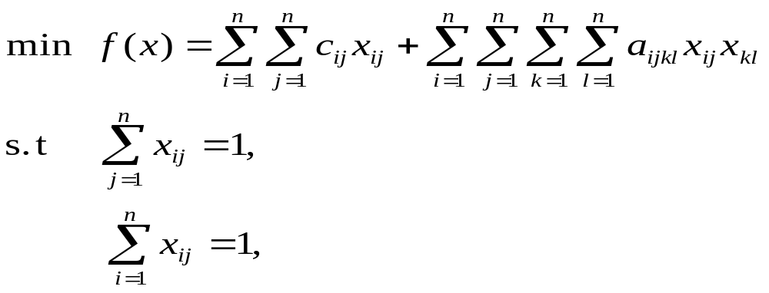
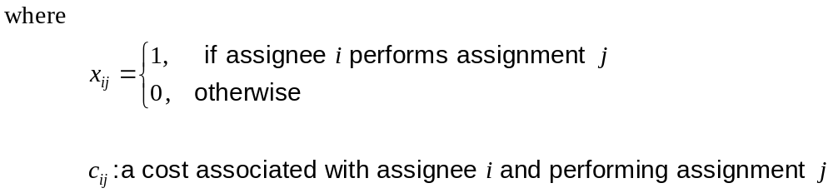
2.1 Problem Description
The quadratic assignment problem (qAP) can be mathematically formulated as follows:
i = 1,2,…,n
j = 1,2,…,n
x_{ij} = 0 or 1, i, j = 1,2,…,n

Slide 66
2.2 Encoding
An order representation is used.
Example:
  The possible sites for assignment were a rectangular lattice of locations in the plane, with the intersite distance computed by either Euclidean norm or Manhattan norm.
  Site were ordered in boustrophedon sequence by rows, establishing a one-to-one correspondence between sequences of {1,2,…,n} and feasible assignment.
  The number of rows and columns was prespecified and fixed.
  9-site problem
1 2 3
7 | 3 | 1
2 | 9 | 5
6 | 8 | 4
1
chromosome:
[ 7 3 1 2 9 5 6 8 4 ]
2
3

Slide 67
2.3 Genetic Operators
Crossover procedure
input: parent chromosomes
output: offspring chromosomes
step 1: Any object assigned to the same site in both parents occupies
the site in the offspring.
step 2: For the remaining sites, one or other objects assigned to that
site in one parent is chosen at random, working left to right
through the sequence of sites.
step 3: Any unassigned objects are then matched with the remaining
unassigned sites.
step 4: Output offspring chromosomes and stop.
parent 1
1
2
3
4
5
6
7
8
9
parent 2
5
4
3
1
6
9
7
8
2
common location
*
*
3
*
*
*
7
8
*
random choice
1
4
3
*
6
9
7
8
2
leftover
5
finished child
1
4
3
5
6
9
7
8
2

Slide 68
2.3 Genetic Operators
Mutation procedure
input: parent chromosome
output: offspring chromosome
step 1: Create an initial population, usually feasible and random.
step 2: Repeat substep 2.1-2.4 until some termination criterion is met.
2.1 Select parents.
2.2 Breed offspring and add them to the population.
2.3 Mutate certain members of the current population.
2.4 Cull certain members of the current population.
step 3: Output offspring chromosome and stop.
select a substring at random
1
2
3
4
5
6
7
8
9
invert the substring
1
2
6
5
4
3
7
8
9

Slide 69
2.4 GA Procedure for qAP
GA Procedure for Quadratic Assignment Problem
procedure: GA for Quadratic Assignment Problem (qAP)
Input: qAP data set, GA parameters
output: best assignment set
begin
t ←0;
initialize P(t) by order based encoding;
fitness eval(P) by order based decoding;
while (not termination condition) do
crossover P(t) to yield C(t) by common location-based crossover;
mutation P(t) to yield C(t) by invert mutation;
fitness eval(C) by order based decoding;
select P(t+1) from P(t) and C(t);
t ← t+1;
end
output best assignment set;
end

Slide 70
3. Combinatorial Optimization
1. Knapsack Problem
2. Quadratic Assignment Problem
3. Minimum Spanning Tree Problem
3.1 Quadratic Minimum Spanning Tree Problem
3.2 Degree-constrained Minimum Spanning Tree
3.3 Bicriteria Minimum Spanning Tree Problem
4. Set Covering Problem
5. Bin Packing Problem
6. Traveling Salesman Problem

Slide 71
3. Minimum Spanning Tree Problem
In a real-life network optimization situation, the problem often requires satisfying additional constraints.
Some researchers used genetic algorithms to deal with them.
Models | Authors
capacitated MST degree-constrained MST stochastic MST quadratic MST probabilistic MST multi-criteria MST leaf-constrained MST | Kershenbaum (1974) Narula and Ho (1980) Ishii et al. (1981) Xu (1984) Bertsimas (1990) Zhou and Gen (1996) Fernandes et al. (1998)
Models | Authors
probabilistic MST degree-constrained MST capacitated MST quadratic MST multi-criteria MST leaf-constrained MST | Palmer and Kershenbaum(1995) Zhou and Gen (1997,1998) Zhou and Gen (1997) Zhou and Gen (1998) Zhou and Gen (1998) Zhou and Gen (1998)

Slide 72
3. Minimum Spanning Tree Problem
Basic Concept of Minimum Spanning Tree Problem
  Minimum Spanning Tree (MST) problem is one of the traditional optimization problems.
  Given a finite connected graph, the problem is to find a least-weight subgraph connecting all vertices.
Data table of example network
(i, j) | w_{ij}
(1, 2) | 2
(1, 6) | 5
(1, 8) | 3
(2, 3) | 4
(2, 8) | 6
(3, 4) | 2
(3, 9) | 2
(4, 5) | 1
(4, 9) | 8
(5, 6) | 6
(5, 7) | 2
(6, 7) | 7
(7, 8) | 1
(7, 9) | 4
(8, 9) | 3
1
2
2
3
6
5
8
4
1
3
6
7
4
2
3
7
9
6
2
8
2
w_{ij}
i
j
1
5
4
Fig. 3.1 Example of network model
Table for non-directed graph
Tavakoly, B.: Gene Expression Data Clustering With Minimum Spanning Tree, Department of Information Systems and Computing, Brunel University, May 2003.

Slide 73
3. Minimum Spanning Tree Problem
Notations
  Indices
    i, j : the index of node, i, j =1, 2, …, n
  Parameters
    n: total number of nodes in the network
    V: finite set of nodes (vertices) representing terminals
    S :subset of nodes
    w_{ij} :weight of connecting node i to node j, i.e., the weight of
    link (i,j); weight matrix (w_{ij}) is symmetric.
  Decision Variables
    x_{ij} : the 0,1 decision variable; 1, if link (i,j) is selected, and 0, otherwise.

Slide 74
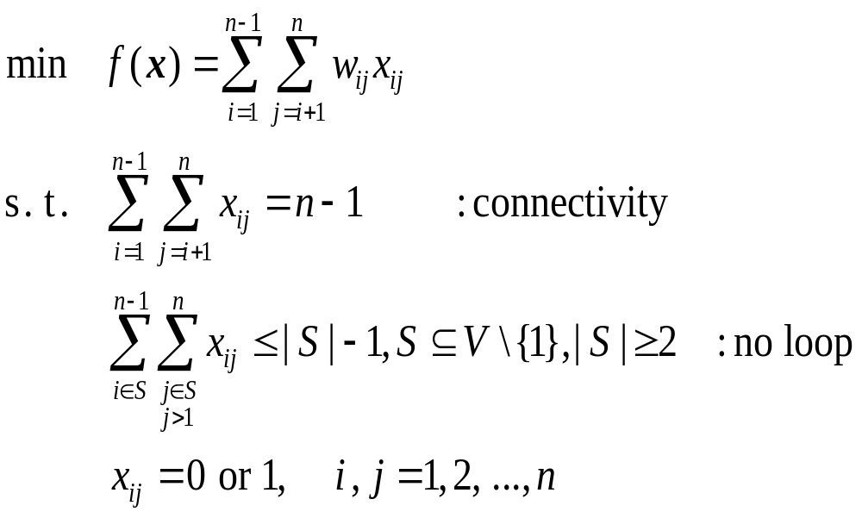
3. Minimum Spanning Tree Problem
Basic Concept of Minimum Spanning Tree Problem
Consider a connected graph G=(V, E), where
V={v₁, v₂, …, v_{n}} or {1, 2, …, n} is a finite set of nodes
E={(i,j) | i,j∈V} is a finite set of edges representing connections between these vertices.
Each edge has a positive real number denoted by W={w₁₂, w₁₃, …, w_{n-1,n}} representing distance or cost.
w₁₂=2 ,x₁₂=1
1
2
w₁₈=3 ,x₁₈=1
8
w₂₃=4 ,x₂₃=1
w₇₈=1 ,x₇₈=1
w₆₇=5 ,x₆₇=1
w₇₉=4 ,x₇₉=1
6
7
9
3
w₅₆=6 ,x₅₆=1
w₄₉=8 ,x₄₉=1
5
4
Fig. 3.2 Simple MST Model

Slide 75
3. Minimum Spanning Tree Problem
Kruskal’s Algorithm
  Kruskal, J. B.: ”On the shortest spanning tree of a graph and the traveling salesman problem”, Proceedings of the American Mathematical Society, vol.7, pp.48-50, 1956.
  Thomas H, E. Charles and L. Rivest,: Introduction to Algorithms, The MIT Press, 1996.
  Horowitz, E., A. Sahni and S. Rajasekaran: Computer Algorithms/C++, Computer Science Press, 1997.
  Drozdek, A.: Data Structures and Algorithms, Brooks/Cole, 2000.
procedure 1: Kruskal’s Algorithm
input: graph G=(V, E), weight w_{ij} , ∀(i, j) ∊A
output: spanning tree T
begin
T←φ;
A←E; // A: eligible edges
while |T|<|V|-1 do
choose an edge (u, v)←argmin{w_{ij} |(i,j)∊A};
A←A-{(u, v)};
If u and v are not yet connected in T then
T←T∪{(u, v)};
end
output spanning tree T;
end

Slide 76
3. Minimum Spanning Tree Problem
Example of Kruskal’s Algorithm
1
2
2
1
2
2
1
2
2
3
6
3
6
3
6
5
8
4
5
8
4
5
8
4
1
3
1
3
1
3
6
7
4
2
3
6
7
4
2
3
6
7
4
2
3
7
9
7
9
7
9
2
8
2
2
8
2
2
8
2
6
6
6
5
1
4
5
1
4
5
1
4
2
2
1
2
2
1
2
1
2
3
6
3
6
3
6
5
8
4
5
8
4
5
8
4
1
3
1
3
1
3
6
7
2
3
6
7
2
3
6
7
4
2
3
7
4
9
7
4
9
7
9
2
2
2
8
2
6
2
8
6
2
8
6
1
1
5
1
4
5
4
5
4
f (x*)= 18

Slide 77
1.2 Introduction of MST Problem
Table 1: Trace table of Kruskal’s Algorithm
step | eligible edges A | weight {w_{ij}} | |T| | edge (u, v) | spanning tree T | fitness z
1 | {(1, 2), (1, 6), (1, 8), (2, 3), (2, 8), (3, 4), (3, 9), (4, 5), (4, 9), (5, 6), (5, 7), (6, 7), (7, 8), (7, 9), (8, 9)} | {2, 7, 3, 4, 6, 2, 2, 1, 8, 6, 2, 5, 1, 4, 3} | 0 | (4, 5) | {(4, 5)} | 1
2 | {(1, 2), (1, 6), (1, 8), (2, 3), (2, 8), (3, 4), (3, 9), (4, 9), (5, 6), (5, 7), (6, 7), (7, 8), (7, 9), (8, 9)} | {2, 7, 3, 4, 6, 2, 2, 8, 6, 2, 5, 1, 4, 3} | 1 | (7, 8) | {(4, 5), (7, 8)} | 2
3 | {(1, 2), (1, 6), (1, 8), (2, 3), (2, 8), (3, 4), (3, 9), (4, 9), (5, 6), (5, 7), (6, 7), (7, 9), (8, 9)} | {2, 7, 3, 4, 6, 2, 2, 8, 6, 2, 5, 4, 3} | 2 | (1, 2) | {(4, 5), (7, 8), (1, 2)} | 4
4 | {(1, 6), (1, 8), (2, 3), (2, 8), (3, 4), (3, 9), (4, 9), (5, 6), (5, 7), (6, 7), (7, 9), (8, 9)} | {7, 3, 4, 6, 2, 2, 8, 6, 2, 5, 4, 3} | 3 | (3, 4) | {(4, 5), (7, 8), (1, 2), (3, 4)} | 6
5 | {(1, 6), (1, 8), (2, 3), (2, 8), (3, 9), (4, 9), (5, 6), (5, 7), (6, 7), (7, 9), (8, 9)} | {7, 3, 4, 6, 2, 8, 6, 2, 5, 4, 3} | 4 | (3, 9) | {(4, 5), (7, 8), (1, 2), (3, 4), (3, 9)} | 8
6 | {(1, 6), (1, 8), (2, 3), (2, 8), (4, 9), (5, 6), (5, 7), (6, 7), (7, 9), (8, 9)} | {7, 3, 4, 6, 8, 6, 2, 5, 4, 3} | 5 | (5, 7) | {(4, 5), (7, 8), (1, 2), (3, 4), (3, 9), (5, 7)} | 10
7 | {(1, 6), (1, 8), (2, 3), (2, 8), (4, 9), (5, 6), (6, 7), (7, 9), (8, 9)} | {7, 3, 4, 6, 8, 6, 5, 4, 3} | 6 | (1, 8) | {(4, 5), (7, 8), (1, 2), (3, 4), (3, 9), (5, 7), (1, 8)} | 13
8 | {(1, 6), (2, 3), (2, 8), (4, 9), (5, 6), (6, 7), (7, 9), (8, 9)} | {5, 4, 6, 8, 6, 7, 4, 3} | 7 | (1, 6) | {(4, 5), (7, 8), (1, 2), (3, 4), (3, 9), (5, 7), (1, 8), (1, 6)} | 18

Slide 78
3. Minimum Spanning Tree Problem
Prim’s Algorithm
  Prim, R. C.: “Shortest connection networks and some generalizations”, Bell Systems Technology Journal, vol.36, pp. 1389-1401, 1957.
  Thomas, H., E. Charles and L. Rivest: Introduction to Algorithms, The MIT Press, 1996.
  Horowitz, E., A. Sahni and S. Rajasekaran: Computer Algorithms/C++, Computer Science Press, 1997.
  Drozdek, A.: Data Structures and Algorithms, Brooks/Cole, 2000
procedure 2: Prim’s Algorithm
input: graph G=(V, E), weight w_{ij} , ∀(i, j) ∊A
output: spanning tree T
begin
T←φ;
choose a random starting node s∊V;
C←C∪{s}; // C: set of connected nodes
A←A∪{(s, v), ∀v ∊V}; // A: eligible edges
while C≠V do
choose an edge (u, v)←argmin{w_{ij} | (i,j)∊A};
A←A-{(u, v)};
If v ∉C then // connect v to the partial tree
T←T∪{(u, v)};
C←C∪{v};
A←A∪{(v, w)| (v, w)⋀w∉C };
end
end
output spanning tree T;
end

Slide 79
3. Minimum Spanning Tree Problem
Example of Prim’s Algorithm
2
1
2
2
1
6
2
3
6
2
3
2
1
2
8
1
2
5
8
4
3
6
5
4
3
6
3
1
3
8
1
5
8
4
5
4
6
7
4
2
3
1
3
6
7
7
4
9
2
3
1
3
7
9
6
7
4
2
3
2
6
7
7
4
9
2
3
2
8
2
7
9
6
2
8
6
2
1
2
8
2
5
1
4
6
2
8
5
4
6
5
1
4
5
1
4
Select a node at random
2
1
2
2
2
1
2
3
6
1
2
3
6
1
2
2
3
6
5
8
3
6
5
8
4
4
1
3
5
8
4
1
3
5
8
4
7
2
1
3
6
7
4
2
3
3
6
7
4
9
3
7
9
1
6
7
7
4
9
2
3
2
6
7
4
2
3
2
8
2
6
2
8
7
9
6
2
8
2
2
5
1
4
6
5
1
4
6
2
8
5
1
4
5
1
4
f (x*)= 18

Slide 80
1.2 Introduction of MST Problem
Table 2: Trace table of Prim’s Algorithm
step | set of connected nodes C | eligible edges A | weight {w_{ij}} | node u | node v | spanning tree T | fitness z
1 | {5} | {(5, 4), (5, 6), (5, 7)} | {1, 6, 2} | 5 | 6 | {(5, 4)} | 1
2 | {5, 4} | {(5, 6), (5, 7), (4, 3), (4, 9)} | {6, 2, 2, 8} | 4 | 3 | {(5, 4), (4, 3)} | 3
3 | {5, 4, 3} | {(5, 6), (5, 7), (4, 9), (3, 9), (2, 3)} | {6, 2, 8, 2, 4} | 3 | 9 | {(5,4), (4, 3), (3, 9)} | 5
4 | {5, 4, 3, 9} | {(5, 6), (5, 7), (4, 9), (2, 3), (7, 9), (8, 9)} | {6, 2, 8, 4, 4, 3} | 5 | 7 | {(5,4), (4, 3), (3, 9), (5, 7)} | 7
5 | {5, 4, 3, 9, 7} | {(5, 6), (4, 9), (2, 3), (7, 9), (8, 9), (6, 7), (7, 8)} | {6, 8, 4, 4, 3, 5, 1} | 7 | 8 | {(5,4), (4, 3), (3, 9), (5, 7), (7, 8)} | 8
6 | {5, 4, 3, 9, 7, 8} | {(5, 6), (4, 9), (2, 3), (7, 9), (8, 9), (6, 7), (1, 8), (2, 8)} | {6, 8, 4, 4, 3, 5, 3, 6} | 8 | 1 | {(5,4), (4, 3), (3, 9), (5, 7), (7, 8), (1, 8)} | 11
7 | {5, 4, 3, 9, 7, 8, 1} | {(5, 6), (4, 9), (2, 3), (7, 9), (8, 9), (6, 7), (2, 8), (1, 2), (1, 6)} | {6, 8, 4, 4, 3, 5, 6, 2, 7} | 1 | 2 | {(5,4), (4, 3), (3, 9), (5, 7),(7, 8), (1, 8), (1, 2)} | 13
8 | {5, 4, 3, 9, 7, 8, 1, 2} | {(5, 6), (4, 9), (2, 3), (7, 9), (8, 9), (6, 7), (2, 8), (1, 6)} | {6, 8, 4, 4, 3, 7, 6, 5} | 1 | 6 | {(5,4), (4, 3), (3, 9), (5, 7),(7, 8), (1, 8), (1, 2), (1, 6)} | 18

Slide 81
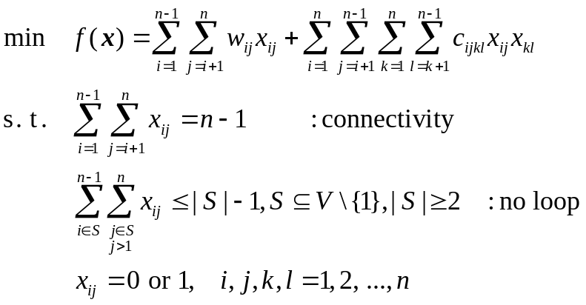
3.1 Quadratic Minimum Spanning Tree Problem
Quadratic Minimum Spanning Tree Problem takes two types of costs into consideration:
  Direct cost
    The cost associated with each edge
  Interactive cost
    The cost occurs due to a pair of edges selected simultaneously within a tree.
    Xu, W.: Quadratic minimum spanning tree problems and related topics, Ph.D. dissertation, University of Maryland, 1984.
Mathematical formulation
c_{122i}
w₁₂ ,x₁₂=1
1
…
2
…
w₂₃ ,x₂₃=0
n
w_{4,n-1} ,x_{4,n-1}=1
3
…
…
…
w_{in} ,x_{in}=1
w_{4i} ,x_{4i}=1
w₃₄ ,x₃₄=1
i
…
4
c_{2i34}
Fig. 3.3 Simple q-MST Model

Slide 82
3.1 Quadratic Minimum Spanning Tree Problem
Genetic Algorithms Implementation
  Zhou, G. and M. Gen: “An Effective Genetic Algorithm Approach to The Quadratic Minimum Spanning Tree Problem”, Computers and Operations Research, vol. 25,
  no. 3, pp. 229-247, 1998.
  Prüfer number is adopted to represent all candidate solutions of the problem.
  Crossover and Mutation
    Prüfer number encoding can always represent a tree after any crossover or mutation operations, simply the uniform crossover operator is adopted.
    Mutation is performed as random perturbation within the range from 1 to n.
1
3
data set
w₁₂=3
w₃₅=6
(i, j) | w_{ij}
(1, 2) | 3
(2, 7) | 5
(2, 5) | 7
(3, 5) | 6
(5, 8) | 2
(6, 8) | 4
(4, 6) | 6
2
w₂₅=7
5
w₅₈=2
8
7
w₂₇=5
w₆₈=4
w_{ij}
w₄₆=6
i
j
6
4
1 2 3 4 5 6
Prüfer number | 2 | 5 | 6 | 8 | 2 | 5

Slide 83
3.1 Quadratic Minimum Spanning Tree Problem
Encoding of Prüfer number
input: spanning tree data set T
output: Prüfer number P
step 1: Let vertex i be the smallest labeled leaf vertex in a labeled tree T.
step 2: Let j be the first digit in the encoding as the vertex j incident to vertex
i is uniquely determined. Here we build the encoding by appending
digits to the right, and thus the encoding is built and read from left to
right.
step 3: Remove vertex i and the edge from i to j; thus we have a tree with
n-1 vertices.
step 4: Repeat the above steps until one edge is left.
step 5: Output a Prüfer number P or an encoding with n-2 digits between 1
and n inclusive and stop.

Slide 84
3.1 Quadratic Minimum Spanning Tree Problem
Example of Prüfer Number encoding
input:
(i, j) | w_{k}
(1, 2) | 3
(2, 7) | 5
(2, 5) | 7
(3, 5) | 6
(5, 8) | 2
(6, 8) | 4
(4, 6) | 6
tree T:
P = [ 2 ]
1
3
3
2
5
8
2
5
8
7
7
P = [ 2 5 ]
6
4
6
4
2
5
8
P = [ 2 5 6 8 ]
P = [ 2 5 6 ]
7
trace table
6
4
2
5
8
2
5
8
i | j | P
1 | 2 | 2
3 | 5 | 2, 5
4 | 6 | 2,5,6
6 | 8 | 2, 5, 6, 8
7 | 2 | 2, 5, 6, 8, 2
2 | 5 | 2, 5, 6, 8, 2, 5
7
7
6
P = [ 2 5 6 8 2 ]
P = [ 2 5 6 8 2 5 ]
output:
P =[ 2 5 6 8 2 5 ]
2
5
8
5
8

Slide 85


3.1 Quadratic Minimum Spanning Tree Problem
Decoding of Prüfer number
input: Prüfer number P
output: spanning tree data set T
step 1: Let P be the original Prüfer number and let be the set of all vertices
not included in P, which designates as eligible vertices for
consideration in building a tree.
step 2: Let i be the eligible vertex with the smallest label. Let j be the
leftmost digit of P. Add the edge from i to j into the tree. Remove
i from and j from P. If j does not occur anywhere in P, put it into .
Repeat the process until no digit are left in P.
step 3: If no digits remain in P, there are exactly two vertices, r and s, still
eligible for consideration. Add edge from r to s into the tree and
form a tree with n-1 edges.
step 4: Output tree data set and stop.

Slide 86









3.1 Quadratic Minimum Spanning Tree Problem
Example of Prüfer Number decoding
3
  input: Prüfer number : P = [ 2 5 6 8 2 5 ]
  Set of all nodes that are not part of
1
2
trace table
P = [ 6 8 2 5 ]
5
i | j | P | P
- | - | 2,5,6,8,2,5 | 1,3,4,7
2 | 1 | 5,6,8,2,5 | 3,4,7
5 | 3 | 6,8,2,5 | 3,7
6 | 4 | 8,2,5 | 6,7
8 | 6 | 2,5 | 7,8
2 | 7 | 5 | 2,8
5 | 2 |  | 8
1
2
P = [ 8 2 5 ]
P = [ 5 6 8 2 5 ]
3
1
2
5
6
4
P =
P = [ 5 ]
3
3
P = [ 2 5 ]
3
1
2
5
8
1
2
5
8
7
6
4
7
6
4
1
2
5
8
output: tree data set
6
4

Slide 87



3.1 Quadratic Minimum Spanning Tree Problem
  Evaluation and Selection
    The evaluation consists of the following:
  1. convert a chromosome into a tree, in which includes the
  transformation of the Prüfer number into a tree in the form
  of edge set;
  2. calculate the total costs of the tree, in which the fitness for
  each chromosome can be directly calculated according to
  the objective function.
    As to selection procedure, the -selection is adopted. It selects best chromosomes from parents and offspring. If there are no distinct chromosomes available, the vacant pool of population is filled up with newly produced individuals.

Slide 88

3.1 Quadratic Minimum Spanning Tree Problem
GA Procedure for qMST Problem
procedure: GA for Quadratic Minimum Spanning Tree (q-MST)
input: q-MST data set, GA parameters
output: best MST solution
begin
t ←0;
initialize P(t) by Prüfer number encoding;
fitness eval(P) by Prüfer number decoding;
while (not termination condition) do
crossover P(t) to yield C(t) by uniform crossover;
mutation P(t) to yield C(t) by random perturbation;
fitness eval(C) by Prüfer number decoding;
select P(t+1) from P(t) and C(t) by -selection method;
t ← t+1;
end
output best MST solution;
end

Slide 89

3.1 Quadratic Minimum Spanning Tree Problem
Numerical Experiments
  The parameters for the GAs are set as follows:
popSize = 300; p_{C} = 0.2; p_{M} = 0.2;
maxGen = 500 and run by 20 times.
Problems Size (number of nodes) | H1 | H2 | Prüfer number based GA | Improved Degree (%)
10 20 30 40 50 | 925 3554* 8500* 15539 25182 | 921 * 3749 9402 14805 * 23487 * | 834 3233 7742 14275 22980 | 9.45 9.03 8.92 3.58 2.16
H1,H2: heuristic algorithm by Xu (1984);
Prüfer number based GA: genetic algorithm by Zhou and Gen (1998);
Improved Degree: (Hbest - GA)/Hbest 100%
Hbest: the best known solution by heuristics.
Mark * indicates the best known solution by heuristic algorithms

Slide 90
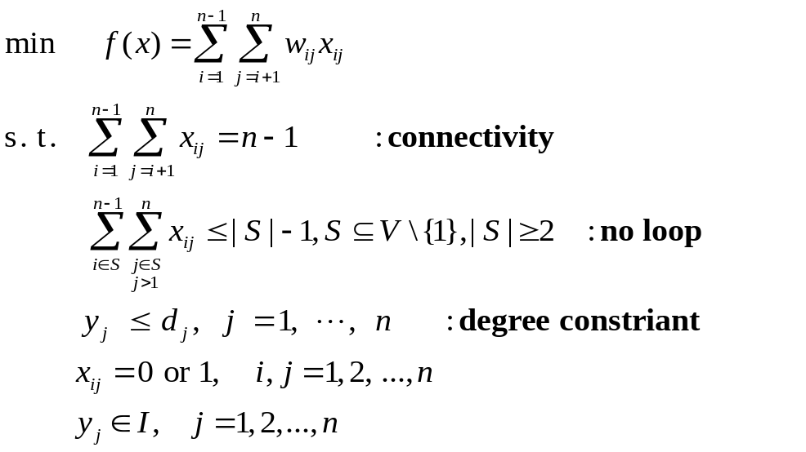
3.2 Degree-constrained Minimum Spanning Tree
If we assume that there is a degree constraint on each vertex such that, at each vertex v_{j}, the degree value y_{j} is at most a given value d_{j}, then the problem can be formulated as follows:
Genetic Algorithm Implementation
  Degree-based Permutation: For the degree-constrained minimum spanning tree problem, two factors should be encoded in a chromosome:
  (1) the connectivity among vertices.
  (2) the degree value of each vertex.
y₁=1≤ d₁
y₂=2 ≤ d₂
1
w₁₂ ,x₁₂=1
2
…
…
y_{n}=1 ≤ d_{n}
y₃=1 ≤ d₃
n
w_{3n},x_{3n}=0
3
…
…
…
w_{jn} ,x_{jn}=1
j
…
…
y_{j}=3 ≤ d_{j}
…

Slide 91

3.2 Degree-constrained Minimum Spanning Tree
  An intuitive idea is to use a two-dimension structure to encode a spanning tree with degree constraint:
    one dimension for the connection among vertices
    the other dimension for the degree value of each vertex.
  It needs a matrix to represent a chromosome for a n vertex tree. The genes in the degree dimension take inclusively the integers from 1 to b the constrained degree value of all vertices. This representation was denoted as degree-based permutation by Zhou and Gen.
    Gen, M. and R. Cheng: Genetic Algorithms & Engineering Optimization, John Wiley & Sons, New York, 2000.
  For an undirected tree, we can take any vertex as the root vertex. All other vertices are then regarded as being connected to it hierarchically.

Slide 92
3.2 Degree-constrained Minimum Spanning Tree
Encoding procedure of Degree-based permutation
input: tree data set
output: chromosome
step 1: Select any vertex (root vertex) in a labeled tree T, put it as the first
digit in the vertex dimension of the permutation and its degree
value as the first digit in the degree dimension, and let that vertex be
the current vertex.
step 2: Check the successor vertex of the current vertex from left branch
to right branch. If there is a successor vertex, put it into the vertex
dimension and its degree value into the degree dimension, and then
go to step 3. If there is no such vertex, let the predecessor vertex be
the current vertex, and return to step 2.
step 3: If the successor vertex is not a leaf vertex, let the successor vertex
be the current vertex, then go to step 2. If the successor vertex turns
to be a leaf vertex, delete it and go to step 4.
step 4: If all vertices have been checked, goto next step;
Otherwise, go to step 2.
step 5: Output chromosome and stop.

Slide 93
3.2 Degree-constrained Minimum Spanning Tree
Example
Tree:
1
data set
w₁₂=5
(i, j) | w_{ij}
(1, 2) | 5
(1, 3) | 3
(1, 4) | 6
(2, 5) | 4
(2, 6) | 3
(4, 7) | 3
(4, 8) | 5
w₁₃=3
w₁₄=6
2
3
4
w₂₅=4
w₂₆=3
w₄₇=3
w₄₈=5
5
6
7
8
Degree-based permutation:
1 2 3 4 5 6 7 8
node ID j
1
2
5
6
3
4
7
8
degree y_{i} at node ID j
3
3
1
1
1
3
1
1
node ID is node number based on the depth first search (DFS),
degree at node ID is the number of connecting nodes.

Slide 94
3.2 Degree-constrained Minimum Spanning Tree
Decoding procedure of Degree-based permutation
input: chromosome
output: tree data set
step 1: Set k ← 1 and j ← 2.
step 2: Select the vertex in P₁(k), say v_{r} where r= P₁(k), select the vertex in
P₁ (j), say vs where s= P₁ (j), add the first edge from r to s into a tree.
step 3: Let P₂ (j) ← P₂(j) - 1.
step 4: If P₂(j) ≥ 1, let k ← j and j ← j+1.
step 5: If k < 1, go to step 9.
step 6: If P₂(k) ≥ 1, select the vertex in P₁(k), say v_{r} where r = P₁(k), and
let P₂(k) ← P₂(k) - 1; Otherwise, let k ← k-1 and go to step 5.
step 7: If P₂(j) ≥ 1, select the vertex in P₁(j), say v_{s} where s = P₁(j), and
let P₂(j) ← P₂(j) - 1; Otherwise, let j ← j+1 and go to step 6.
step 8: Add the edge from r to s into the tree and go to step 4.
step 9: Output tree data set and stop.

Slide 95
3.2 Degree-constrained Minimum Spanning Tree
  Order Crossover
input: parent chromosomes
output: offspring chromosomes
step 1: Select a substring from one parent at
random.
step 2: Produce a proto-child by copying the
sub-string into the corresponding
positions of it.
step 3: Delete the cities which are already in
the sub-string from the second parent.
The result sequence of cities contains
the cities that the proto-child needs.
step 4: Place the cities into the unfixed
positions of the proto-child from left to
right according to the order of the
sequence.
step 5: Output offspring chromosomes and stop.
selected substring
1
2
5
6
3
4
7
8
parent 1
3
3
1
1
1
3
1
1
8
1
5
6
3
4
7
2
offspring
3
3
1
1
1
3
1
1
6
5
8
4
1
7
3
2
parent 2
3
3
1
1
1
3
1
1

Slide 96
3.2 Degree-constrained Minimum Spanning Tree
  Swap Mutation
  input: parent chromosome
  output: offspring chromosome
  step 1: Selects two positions at random.
  step 2: Swaps the values on these positions.
  step 3: Output offspring chromosome and stop.
1
2
5
6
3
4
7
8
1
4
5
6
3
2
7
8
3
3
1
1
1
3
1
1
3
3
1
1
1
3
1
1
1
Swap Mutation
1
2
3
4
4
3
2
5
6
7
8
5
6
7
8

Slide 97
3.2 Degree-constrained Minimum Spanning Tree
  Insertion Mutation
  input: parent chromosome
  output: offspring chromosome
  step 1: Selects a string of genes (branch) at random.
  step 2: Inserts it in a random gene (vertex).
  step 3: Output offspring chromosome and stop.
insertion point
1
2
5
6
3
4
7
8
1
3
2
5
6
4
7
8
3
3
1
1
1
3
1
1
2
2
3
1
1
3
1
1
1
1
3
4
2
3
4
2
7
8
5
6
7
8
5
6

Slide 98
3.2 Degree-constrained Minimum Spanning Tree
GA Procedure for Degree-constrained Minimum Spanning Tree
procedure: GA for Degree-constrained Minimum Spanning Tree (dc-MST)
Input: dc-MST data set, GA parameters
output: best MST solution
begin
t ←0;
initialize P(t) by degree-based permutation encoding;
fitness eval(P) by degree-based permutation decoding;
while (not termination condition) do
crossover P(t) to yield C(t) by order crossover;
mutation P(t) to yield C(t) by swap mutation;
mutation P(t) to yield C(t) by insertion mutation;
fitness eval(C);
select P(t+1) from P(t) and C(t) by -selection method;
t ← t+1;
end
output best MST solution;
end

Slide 99
3.2 Degree-constrained Minimum Spanning Tree
Numerical Experiments
  Table gives a simple example of a nine-vertex complete graph and the constrained degree value for all vertices is 3.
  The parameters for the proposed GAs approach with degree-based permutation are set as:
  the population size popSize = 100
  the crossover probability p_{C} = 0.4
  the mutation probability for swap p_{M1} = 0.2
  the mutation probability for inserting p_{M2} = 0.6
  the maximum generation maxGen = 500.
  It was given by Savelsbergh and Volgenant who solved it using heuristic algorithm denoted as edge exchanges and the optimal solution’s 2256.
node i | 1 2 3 4 5 6 7 8 9
1 2 3 4 5 6 7 8 9 | - 224 224 361 671 300 539 800 943 - 200 200 447 283 400 728 762 - 400 566 447 600 922 949 - 400 200 200 539 583 - 600 447 781 510 - 283 500 707 - 361 424 - 500 -
    Savelsbergh, M. “Local search for routing problem with time windows”,
    Annals of Operations Research, vol. 4, no. 23, pp. 285-305, 1985.

Slide 100
3.2 Degree-constrained Minimum Spanning Tree
  Numerical results
Problems Size (number of nodes) | LBs |  |  | dpGAs
 | minVal | Degree |  | minVal | %
10 20 30 40 50 | 117 233 316 419 513 | 5(2) 4(2) 4(4) 7(3) 6(4) |  | 123 237 321 428 531 | 5.13 1.72 1.58 2.15 3.51
LBs: Lower Bounds
dpGAs: GAs with degree-based permutation

Slide 101
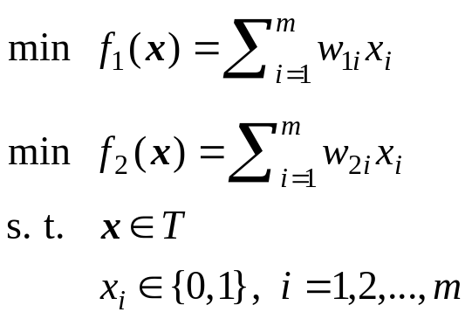
3.3 Bicriteria Minimum Spanning Tree Problem
In the real-world, there are usually such cases that one has to consider simultaneously multi-criteria in determining a minimum spanning tree because there are multiple attributes defined on each edge.
The problem may arise, for instance, when designing a layout for telecommunication system. Besides the cost for connection between cities or terminals, other factors such a the time for communication or construction the complexity for construction and even the reliability are all important and have to be taken into consideration.
If each edge has two associated positive real numbers, representing two attributes defined on it and denoted with w_{i} = (w_{1i}, w_{2i}) (i= 1,2,…,m).

Slide 102
3.3 Bicriteria Minimum Spanning Tree Problem
Conventional Method
  In general, we can not get the optimal solution of the problem because these two objectives usually conflict with each other in practice.
  The solutions to this problem are a set of Pareto optimal solutions.
  A possible way to this problem is to scale two objectives into a single objective like the common method in dealing with the multi-criteria optimization problems.
  But only one single-point Pareto optimal solution can be obtained, not to mention the difficulty in properly transforming the two objective into a single objective.
  Zhou and Gen proposed a conventional method by enumerating all Pareto optimal solution for this problem to verify the effectiveness and efficiency of their genetic algorithm approach.
    Zhou, G. and M. Gen: “Genetic algorithm approach on multi-criteria minimum spanning tree problem”, European Journal of Operational Research, vol. 114, no. 1, pp. 141-152, 1999.

Slide 103














3.3 Bicriteria Minimum Spanning Tree Problem
  Enumeration procedure
input: tree data set
output: minimum spanning tree
step 1: Set t ← 0, Ø , Ø. and .
step 2: Select an arbitary vertex in V, say v₁,
Let contain all edges adjacent to the vertex v₁.
Set r ←1 and t ← t+1. Go to step 6.
step 3: Set r ←1 and t ← t+1. if , go to step 10; Otherwise, continue.
step 4: If , go back to step 3; otherwise continue.
step 5: if is empty, then let r ← r +1 and go back to step 4;
Otherwise, continue.
step 6: Select an edge e_{l} from the set randomly.
Update the edge set with .
step 7: If the edge {e_{l}} forms a cycle with all other edges in ,
go back to step 5; Otherwise, continue.
step 8: Make a temporary subtree with and calculate its
two objective function values with
step 9: Compare the subtree T^{(t)} with all subtrees in the sense
of Pareto optimality.
If it is a nondominated one, update the nondominated set
and the index set of . Go back to step 5.
step 10: Output minimum spanning tree and stop.

Slide 104
3.3 Bicriteria Minimum Spanning Tree Problem
Genetic Algorithm Approach
  Zhou and Gen proposed a genetic algorithm approach to deal with the bicriteria minimum spanning tree problem.
  The Prüfer number was adopted as the tree encoding, as the encoding is capable of equally and uniquely representing all possible spanning trees for a network and easily operated by GA approach.
  By using the Prüfer number, the uniform crossover and perturbation mutation for the genetic operations were used.
  In order to evaluate the fitness of each individual, they adopted two strategies for the GA approach for the bicriteria minimum spanning tree problem.

Slide 105

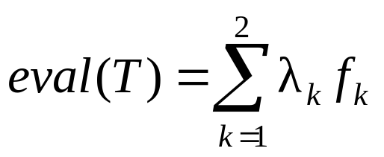
3.3 Bicriteria Minimum Spanning Tree Problem
Evaluation for strategy I procedure
input: chromosomes v
output: fitness values of each chromosome
step 1: Decode all chromosomes and calculate their objective
values in each objective function:
step 2: Determine the fitness value eval(T) of all individuals
according to the following formula:
step 3: Output fitness values of each chromosomes and stop.

Slide 106
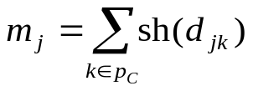
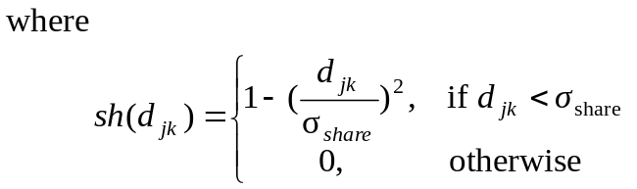

3.3 Bicriteria Minimum Spanning Tree Problem
Evaluation for strategy II procedure
input: chromosomes
output: fitness values of each chromosome
step 1: Determine all nondominated individuals p_{C} from the
current population and assign a large dummy fitness
value to them.
step 2: Calculate each individual’s niche count, m_{j}:
d_{jk} is the phenotypic distance between two individuals j and k in the
current nondominated solution set
is the maximum phenotypic distance allowed between any two
individuals to become members of a niche.
step 3: Calculate the shared fitness value of each individual.
step 4: Ignore all sorted nondominated individuals, go to step 1 and continue the
process until the entire population is all stored.
step 5: Output fitness values of each chromosome and stop.

Slide 107
3.3 Bicriteria Minimum Spanning Tree Problem
GA procedure for Bicriteria Minimum Spanning Tree
procedure: GA for Bicriteria Minimum Spanning Tree (bc-MST)
input: bc-MST data set, GA parameters
output: Pareto optimal solutions E(P,C)
begin
t ←0;
initialize P(t) by Prüfer number encoding;
objectives f₁(P), f₂(P);
create Pareto E(P)
fitness eval(P) by Prüfer number decoding;
while (not termination condition) do
crossover P(t) to yield C(t) by uniform crossover;
mutation P(t) to yield C(t) by random perturbation mutation;
objectives f₁(C), f₂(C);
update Pareto E(P,C)
if (not preference condition)
fitness eval(P,C) by strategy I;
else
fitness eval(P,C) by strategy II;
select P(t+1) from P(t) and C(t) by roulette wheel selection;
t ← t+1;
end
output Pareto optimal solutions E(P,C);
end

Slide 108
3.3 Bicriteria Minimum Spanning Tree Problem
Numerical Example
  The performance of the multi-criteria minimum spanning tree problem by the GA approach is tested on five numerical examples from 10 vertex to 50 vertex complete graph generated randomly.
  Each edge has two weights. The weights are generated randomly and distributed uniformly over [10,100] and [10,50] respectively.
  The parameters for the GA are set as follows:
  the population size popSize = 200
  the crossover probability p_{C} = 0.2
  the mutation probability p_{M} = 0.05
  the maximum generation maxGen = 500
Problems Size (number of nodes) | Enumeration |  |  | GA with strategy I |  |  | GA with strategy II
 | TPO | Run Time (min) |  | Percent | Run Time (min) |  | Percent | Run Time (min)
10 20 30 40 50 | 56 123 262 417 635 | 20 56 132 336 744 |  | 100 100 90 86 80 | 3.02 4.31 6.18 8.05 10.96 |  | 100 100 94 91 85 | 4.02 6.50 9.32 12.12 15.58

Slide 109
3. Combinatorial Optimization
1. Knapsack Problem
2. Quadratic Assignment Problem
3. Minimum Spanning Tree Problem
4. Set Covering Problem
4.1 Genetic Representation
4.2 Genetic Operators
4.3 GA procedure for Set Covering Problem
5. Bin Packing Problem
6. Traveling Salesman Problem

Slide 110
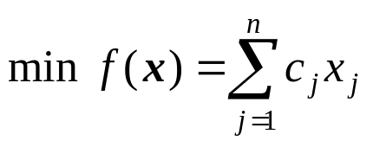
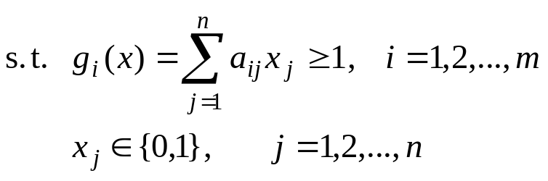
4. Set Covering Problem
The set covering problem (SCP) is one of typical problem in combinatorial optimization.
The problem is to cover A=[a_{ij}], i=1,2,…,m, j=1,2,…,n , zero-one matrix by a subset of columns at minimal cost.
Considering a vector x, such that x_{j} = 1 if column j (with a cost c_{j} > 0) is in the solution and x_{j} = 0 otherwise ( j = 1,2,…,n).
The set covering problem is then formulated as follows:

Slide 111
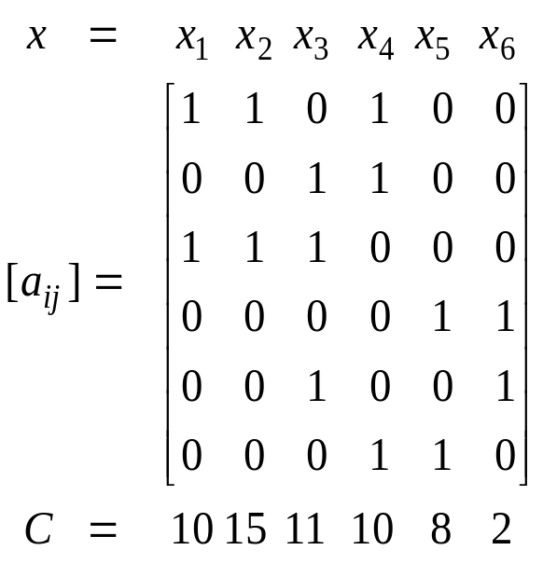
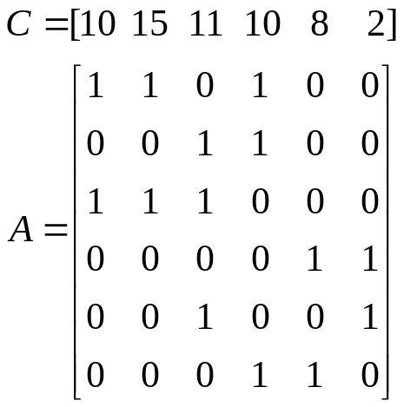

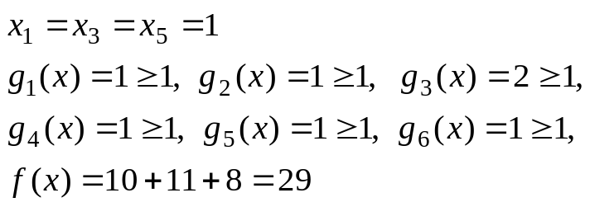
4. Set Covering Problem
Example
Considering the following SCP example with 6 rows and 6 columns:
i
1
2
3
4
5
6
[ ]
A feasible solution to the instance is x = [1 0 1 0 1 0].

Slide 112
4. Set Covering Problem
Applications of the SCP Model:
Authors | Applications
Charnes and Miller (1956) Arabeyre et al. (1969) Balinski and Quandt (1964) Levin (1969) Garginkel (1968) Day (1965) Garrey Johnson (1979) Revelle et al. (1970) Toregas et al. (1971) Rubin (1973) Walker (1974) Salverson (1955) Steinmann and Schwinn (1969) Valenta (1969) Labordere (1969) Busacker and Satty (1965) Bellmore and et al. (1970) Bellmore and Ratliff (1970) Cobham et al. (1961) Balinski (1965) Cobham et al. (1961) Root (1964) Bellmore (1971) | railroad crew scheduling airline crew scheduling trucking dispatching vehicle routing political redistricting information retrieval resource allocation facilities location facilities location assignment problem assignment problem assembly line balancing assembly line balancing capital investment circuit design map coloring network attack and define network attack and define PERT/CPM analysis switching circuit scheduling symbolic logic symbolic login other instances

Slide 113
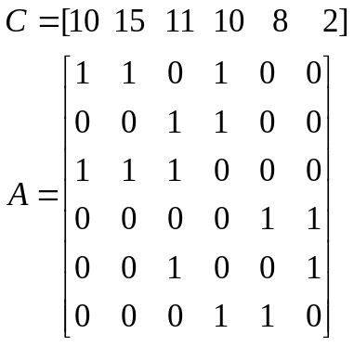
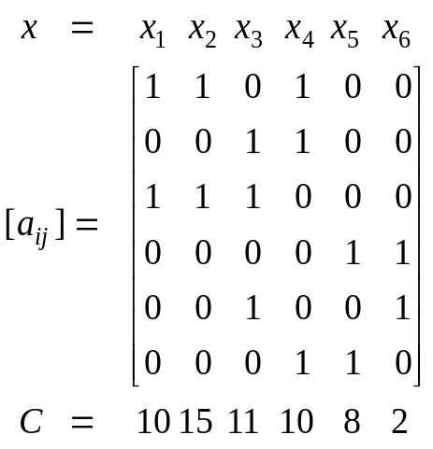
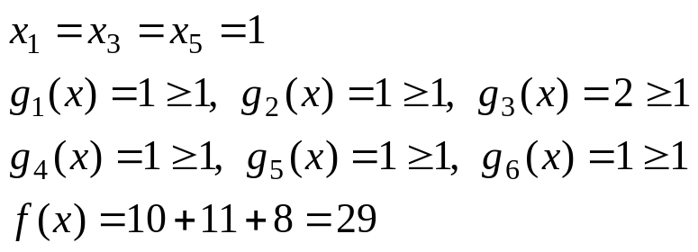
4.1 Genetic Representation
Column-Based Representation
  n bit binary string can be used as the chromosome structure for n column problem.
  A value of 1 for the ith bit implies that column i is in the solution.
  Example:
chromosome
i
1
2
3
4
5
6
column (gene) | x₁ | x₂ | x₃ | x₄ | x₅ | x₆
bit string | 1 | 0 | 1 | 0 | 1 | 0
[ ]

Slide 114
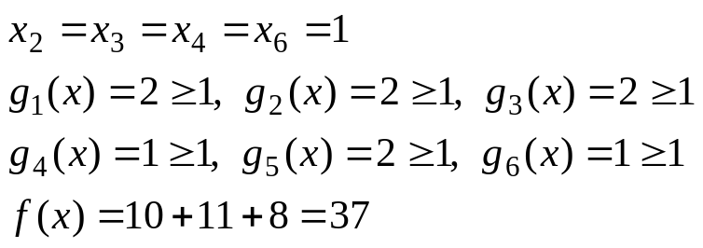
4.1 Genetic Representation
Row-Based Representation
  The Individual’s size is equal to the number of rows for a given problem.
  The location of each gene corresponds to a row and the encoded value of each gene is a column that covers that row.
  Example:
chromosome：
i
1
2
3
4
5
6
row (gene) | 1 | 2 | 3 | 4 | 5 | 6
string | 2 | 3 | 3 | 6 | 3 | 4
[ ]

Slide 115



4.2 Genetic Operators
Procedure of Fusion Operator
procedure: Fusion Operator
input: parents P₁, P₂
output: offspring C
begin
for i=1 to n
if P₁[i]=P₂[i] then
C[i] ← P₁[i]=P₂[i];
else
t←random[0,1];
if t<p then
C[i] ← P₁[i];
else
C[i] ← P₂[i];
output offspring C;
end
P₁, P₂ : parent chromosomes
: fitnesses of parent chromosomes
C : offspring chromosome

Slide 116












4.2 Genetic Operators
Heuristic Operator
input: data set of matrix
output: feasible solution containing no redundant columns
step 1: Initialize
step 2: Initialize
step 3: For each row i in U (in increasing order of i):
(3.1) find the first column j (in increasing order of j) in
that minimizes
(3.2) Add j to S and set ;
set .
step 4: For each column j in S (in decreasing order of j),
if set and set .
step 5: Output a feasible solution containing no redundant columns and stop.
I : set of all rows
J : set of all columns
: set of columns that cover row i,
: set of rows covered by column j,
S : set of columns in a solution
U : set of uncovered rows
W_{i} : number of columns that cover row i, in S

Slide 117
4.3 GA procedure for Set Covering Problem
GA procedure for Set Covering Problem
procedure: GA for Set Covering Problem (SCP)
Input: SCP data set, GA parameters
output: best column set
begin
t ←0;
initialize P(t) by row-based or column-based representation;
fitness eval(P);
while (not termination condition) do
crossover P(t) to yield C(t) by fusion crossover;
mutation P(t) to yield C(t);
heuristic operator C(t);
fitness eval(C);
select P(t+1) from P(t) and C(t);
t ← t+1;
end
output best column set;
end

Slide 118
3. Combinatorial Optimization
1. Knapsack Problem
2. Quadratic Assignment Problem
3. Minimum Spanning Tree Problem
4. Set Covering Problem
5. Bin Packing Problem
5.1 Heuristic Algorithms
5.2 Genetic Representation
5.3 Genetic Operators
5.4 Fitness Function
5.5 GA procedure for Bin Packing Problem
6. Traveling Salesman Problem

Slide 119
5. Bin Packing Problem
The bin packing problem consists of placing n objects into a number of bins (at most n bins).
Each object has a weight (w_{i} > 0) and each bin has a limited bin capacity (c_{i} > 0).
The problem is to find a best assignment of objects to bins such that the total weight of the objects in each bin does not exceed its capacity and the number of bins used is minimized.
The bin packing problem underlies many optimization problems of practical importance.

Slide 120
5. Bin Packing Problem
Notations
  Indices
    i : the index of bin, i =1, 2, …, n
    j : the index of object, j =1, 2, …, n
  Parameters
    n: the total number of objects
    c: the limited bin capacity
    w_{j} : the weight of object j
  Decision Variables
    x_{ij} : the 0,1 decision variable; 1, if object j is assigned to bin i, and 0,otherwise.
    y_{i} : the 0,1 decision variable; 1, if route (i, j) is selected, and 0, otherwise.

Slide 121
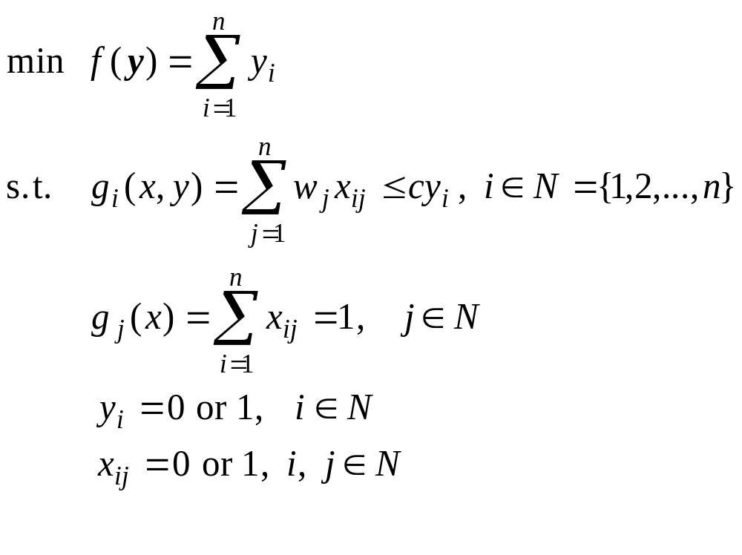
5. Bin Packing Problem
Usually, all bins may have the same capacity (c > 0). Obviously, placing each object into each bin is a feasible solution to the problem but it is not a optimal solution.
…
n
1
(w_{n})
(w₁)
1
…
n
(c₁)
(c_{n})

Slide 122
5.1 Heuristic Algorithms
The bin-packing problem belongs to the class of NP-hard problem.
There is no known optimal algorithm for running it in polynomial time.
A few heuristic algorithms were proposed to deal with bin-packing problem.
Heuristic algorithms
  Next-Fit Heuristic
  First-Fit Heuristic
  Best-Fit Heuristic
  Other Heuristics

Slide 123

5.1 Heuristic Algorithms
Next-Fit Heuristic
  The simplest heuristic approach to the bin packing problem is the Next-Fit (NF) algorithm.
  The first object is assigned to bin 1 and objects 2,…,n are then considered by their increasing indices.
  Each object is assigned to the current bin, if it fits; otherwise, it is assigned to a new bin. The new bin then becomes the current bin.
  The complexity of the algorithm is clearly O(n).
  For a given problem I, it is easy to prove that the solution value NF(I) provided by the algorithm satisfies the following bound.
where f(I) denotes the optimal solution value.

Slide 124
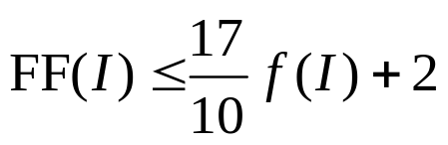
5.1 Heuristic Algorithms
First-Fit Heuristic
  First-Fit (FF) also considers the objects according to their increasing indices. But each object is assigned into the lowest indexed initialized bin which it fits.
  When the current object cannot fit into any initialized bin, a new bin is then introduced.
  It has been proved by Johnson et al.
    Johnson, D. S., A. Demers, J. D. Ullman, M. R. Garey, and R. L. Graham: “Worst-Case Performance Bounds for Simple One-Dimensional Packing Algorithms”, Journal of SIAM, vol. 3, pp. 299-325, 1974.
for all instances I of the bin packing problem.

Slide 125

5.1 Heuristic Algorithms
Best-Fit Heuristic
  Best Fit (BF) algorithm is modified from FF by assigning the current object to the feasible bin having the small residual capacity.
  BF satisfies the same worst-case bounds as FF.
  The time complexity of both FF and BF is O(nlogn).
Other Heuristics
  If the objects are sorted in a descending order
  and then NF or FF, or BF is applied, the resulting algorithms of time complexity O(nlogn), are called Next-Fit Decreasing (NFD), First-Fit Decreasing (FFD) and Best-Fit Decreasing (BFD), respectively.

Slide 126
5.2 Genetic Representation
Kathryn A. D., A. H. Edward, K. Graham and B. Edmund,: “ Using tree search bounds to enhance a genetic algorithm approach to two rectangle packing problems”, European Journal of Operational Research, in Press, 2004.
There are three representation schemes proposed for this problem.
  Bin-based representation
    the position of a gene is used to represent an object and the value of the gene is used to represent a bin in which the corresponding object is put it.
  Object-based representation
    encode the permutations of objects, and then apply a decoder to retrieve the corresponding solution.
  Group-based representation
    chromosomes are item oriented, instead of being group oriented.

Slide 127
5.2 Genetic Representation
Bin-based representation
  This representation has the advantage that the chromosomes are of constant length, which allows for application of standard genetic operators.
  Falkenauer points out, this encoding suffers several drawbacks.
    Falkenauer, E.: “A New Representation and Operators for Genetic Algorithms Applied to Grouping Problems”, Evolutionary Computation, vol. 2, no. 2, pp. 123-144, 1994.
    Firstly, this encoding is highly redundant. Indeed, the cost function depends only in the number of bins, rather than the numbering of the objects to bins.
    Secondly, this encoding leads to the highly undesirable effect of casting context-dependent information out of context under the standard crossover.
    The third drawback is that the representation may yield infeasible solution in a sense that a bin may be assigned too many object exceeding its capacity.
1 2 3 4 5 6
object
chromosome
1
4
2
3
5
2
bin

Slide 128
5.2 Genetic Representation
Object-based representation
  Object-based representation is to encode the permutations of objects and then apply a decoder to retrieve the corresponding solutions.
  Example
    Suppose there are six objects to pack, numbered 1 through 6.
1 2 3 4 5 6
  This encoding also suffers of various drawbacks.
    Firstly, this encoding is also highly redundant.
1 2 3 4 5 6
3 2 1 4 5 6
4 5 2 1 3 6
    Any permutation of the objects having the same bin contents, such as
    encodes the same solution to the bin-packing problem.
    Secondly, the position of a given object strongly depends on the ‘head’ of the chromosome, the object on the leftmost position. However, the position of a given gene provides nothing useful.
    As result, it can not keep the heritage from parents in the evolutionary process.

Slide 129
5.2 Genetic Representation
Group-based representation
  Falkenauer, E.: “A New Representation and Operators for Genetic Algorithms Applied to Grouping Problems”, Evolutionary Computation, vol. 2, no. 2, pp. 123-144, 1994.
  For the bin packing problem, Group-based representation should consist of two parts.
    The first part provides the information which objects belong to bin (group).
    The second part encodes the bins which are used.
  This encoding scheme makes the genes represent both the objects and the groups (bins). Note in particular that this implies that the operators will have to handle chromosomes of variable length.
3,6 5 4 2 1
object
B
E
C
D
A
bin

Slide 130
5.3 Genetic Operators
We focus on the genetic operators for the group-based representation.
Crossover procedure
input: parents
output: offsprings
step 1: Select at random two crossing sites, delimiting the crossing section,
in each of the two parents.
step 2: Inject the contents of the crossing section of the first parent at the
first crossing site of the second parent.
step 3: Eliminate all objects now occurring twice from the bins they were
members of in the second parent, so that the ‘old’ membership of
these objects given way to the membership specified by the ‘new’
injected bins.
step 4: If necessary, adapt the resulting bins, according to the hard
constraints and the cost function to optimize.
step 5: Apply the step 2 through 4 to the two parents with their roles
permuted to generate the second offspring.
step 6: Output offsprings and stop.

Slide 131
5.3 Genetic Operators
1,4,5
2,7,3
6,8
injected bin
E | F | G
B | E | A | C | D
3,7
1,4,5
1,4
2,5
6,8
B | A | C | D
appear twice
3,7
1,4
2,5
6,8
1. Select crossing sections.
2. Inject crossing section.
B | E | D
2
B | E | H
3,7
1,4,5
6,8
left aside
3,7
1,4,5
6,8,2
3. Eliminate empty bin(s) and
bin(s) with doubles.
4.Reinsert missing objects.

Slide 132
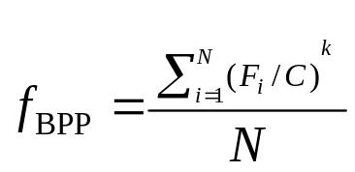
5.4 Fitness Function
There are two ways to evaluate the objective of the bin packing problem in a GAs approach.
  minimize the number of bins used
  minimize the number of bins used and fill all used bins
where
N : the number of bins used in the solution,
F_{i} : the sum of sizes of the objects in the bin i (the fill of the bin),
C : the bin capacity and,
k : a constant, k > 1.
The constant k expresses the concentration on the elite bins in comparison to the less filled ones. According to their limited computational experience, it is found that k = 2 gives good results.

Slide 133
5.5 GA procedure for Bin Packing Problem
GA procedure for Bin Packing Problem
procedure: GA for Bin Packing Problem (BPP)
Input: BPP data set, GA parameters
output: best object set in each bin
begin
t ←0;
initialize P(t) by group-based method;
fitness eval(P);
while (not termination condition) do
crossover P(t) to yield C(t) by group-based crossover;
mutation P(t) to yield C(t);
fitness eval(C);
select P(t+1) from P(t) and C(t);
t ← t+1;
end
output best object set in each bin;
end

Slide 134
Conclusion
Combinatorial optimization problems are characterized by a finite number of feasible solutions and abounded in everyday life, particularly in various engineering design.
One of the most challenging problems in combinatorial optimization is to deal effectively with the combinatorial explosion.
A major trend in solving such difficult problems is to use genetic algorithms.
We explained how to solve the following Combinatorial optimization problems by genetic algorithms:
- Knapsack Problem, - quadratic Assignment Problem - Minimum Spanning Tree, - Set-Covering Problem,
- Bin-Packing Problem, - Traveling Salesman Problem.

