Slide 1
Project: Powa Finance Team: Functor
Team members:
D. Egorov
D. Slobodeniuk
R. Dubinskiy

Slide 2
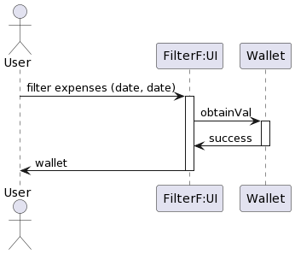

Slide 3
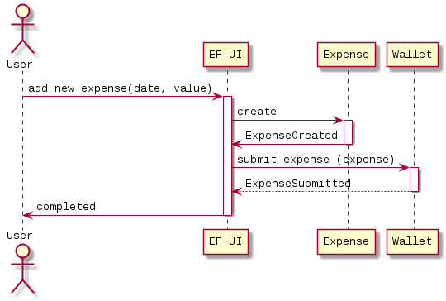

Slide 4
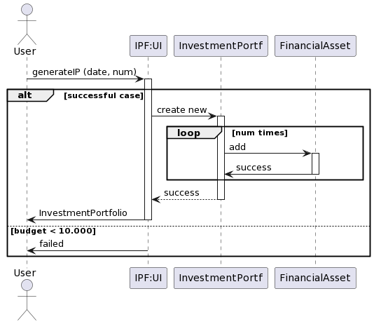

Slide 5
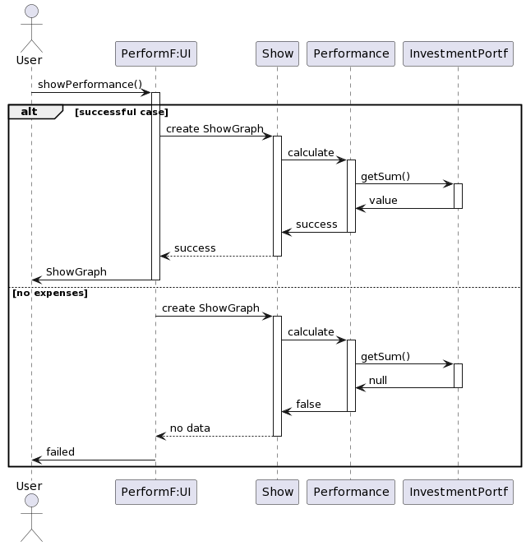

Slide 6
U

