Slide 1
PowaFinance
Requirements and analysis model

Slide 2

Product description
Crisp app for tracking expenses and searching for investment opportunities
Team: Functor
Daniil Slobodeniuk — Project manager, Backend
Dmitry Egorov — Product manager, Android
Roman Dubinskiy — Business analyst, Frontend, Design
Features:
tracking daily expenses
purchasing financial assets via third-party investment platform
projecting expenses for the next quarter
top-notch financial news from news agency
Project repository: https://github.com/SleeplessChallenger/PowaFinance

Slide 3

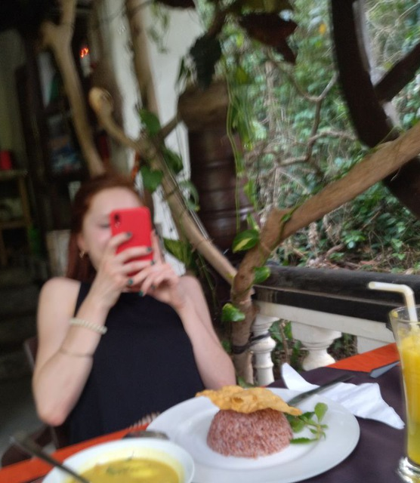
Personas
Pavel Kozlov
24 y.o, Works at Raiffeisen Bank Russia as Software Engineer. Kotlin/Java Backend Developer. Uses financial app without smart tracking features. Has desire to find out more info to manage finances smarter.
LinkedIn
Valentina
23 y.o.e. student from HSE. Works at VK as frontend developer. Interested in finances and want to know more about them.

Slide 4
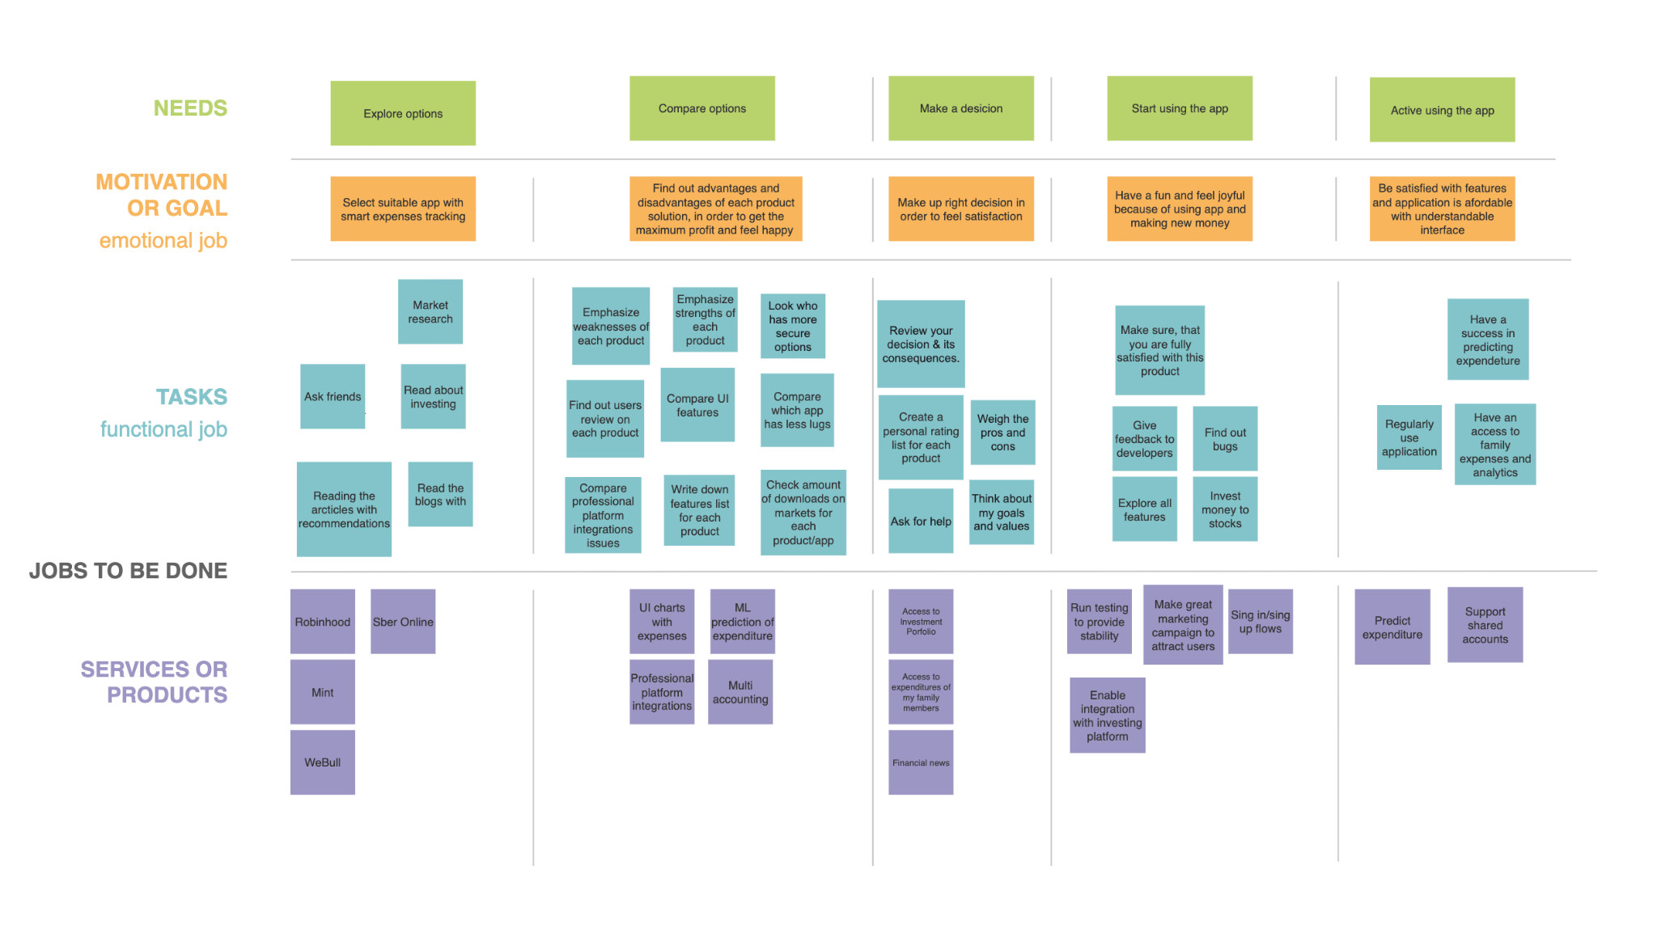
Story map
See more: https://github.com/SleeplessChallenger/PowaFinance/blob/master/project_resources/asd/Task3

Slide 5
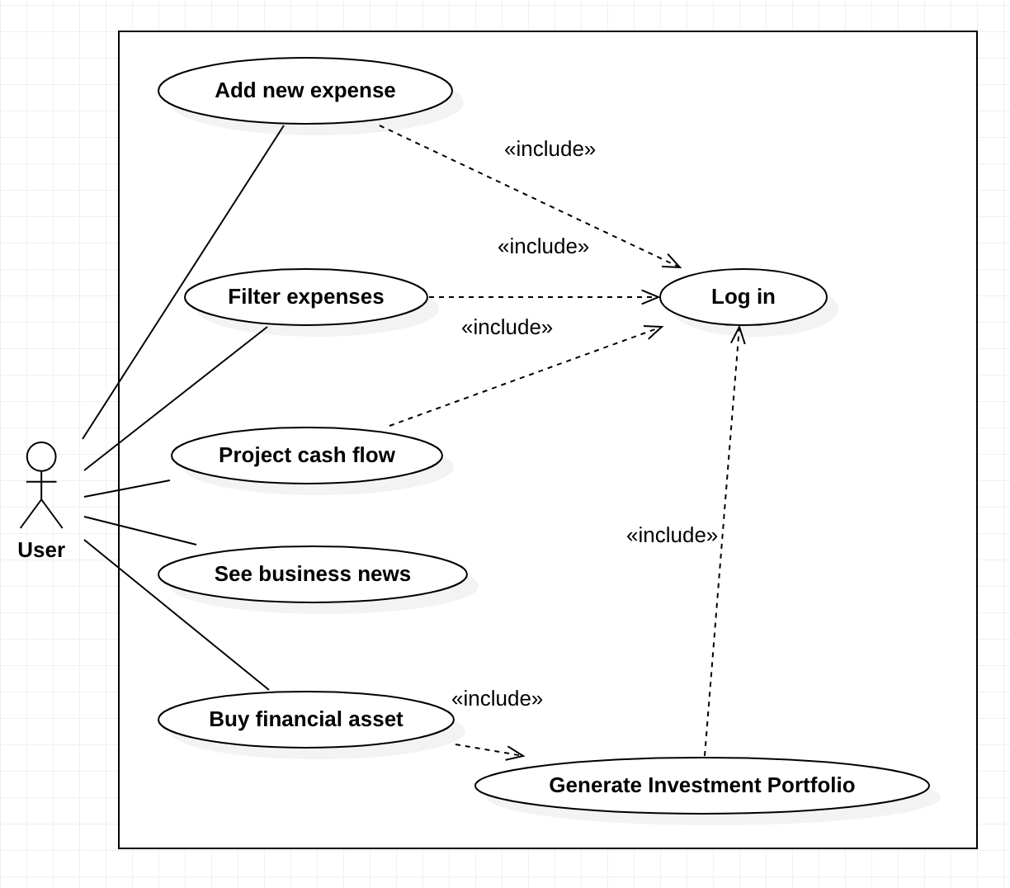
Use case diagram
See more: https://github.com/SleeplessChallenger/PowaFinance/tree/master/project_resources/asd/FinalTask1/UseCases

Slide 6
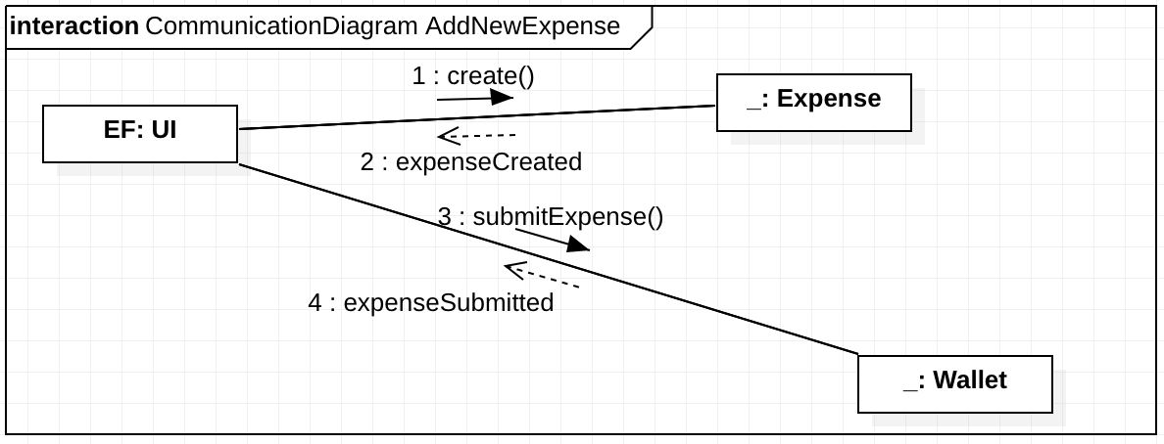
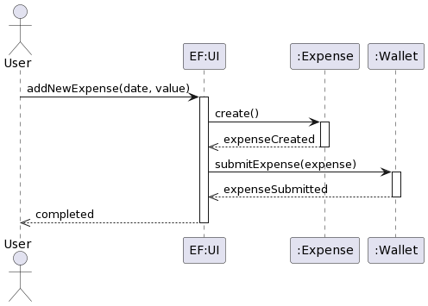
Interaction analysis
Candidate | Criteria | Stored Information | Operations
User | T
Expense | SAU | Date Value | Create
Wallet | SIUT | Expenses | Submit expense
See more: https://github.com/SleeplessChallenger/PowaFinance/tree/master/project_resources/asd/FinalTask1/Diagrams

Slide 7
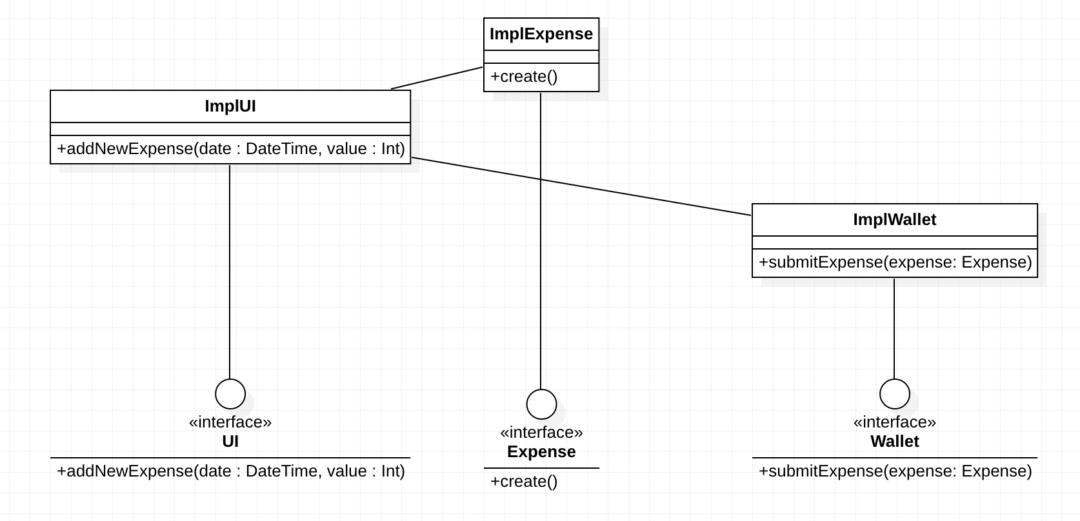
Final class diagram
See more: https://github.com/SleeplessChallenger/PowaFinance/tree/master/project_resources/asd/FinalTask1/Diagrams

Slide 8
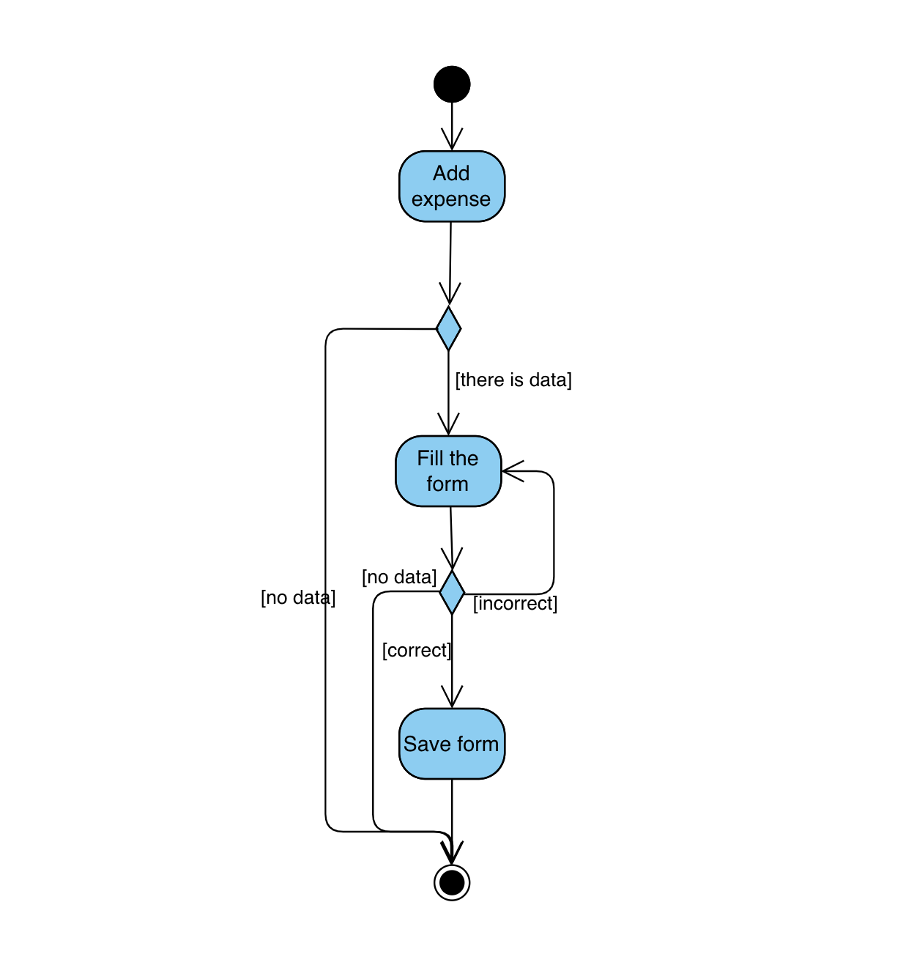
Detailed behavior
Use Case: Add new expense
See more: https://github.com/SleeplessChallenger/PowaFinance/tree/master/project_resources/asd/FinalTask1/Diagrams

Slide 9
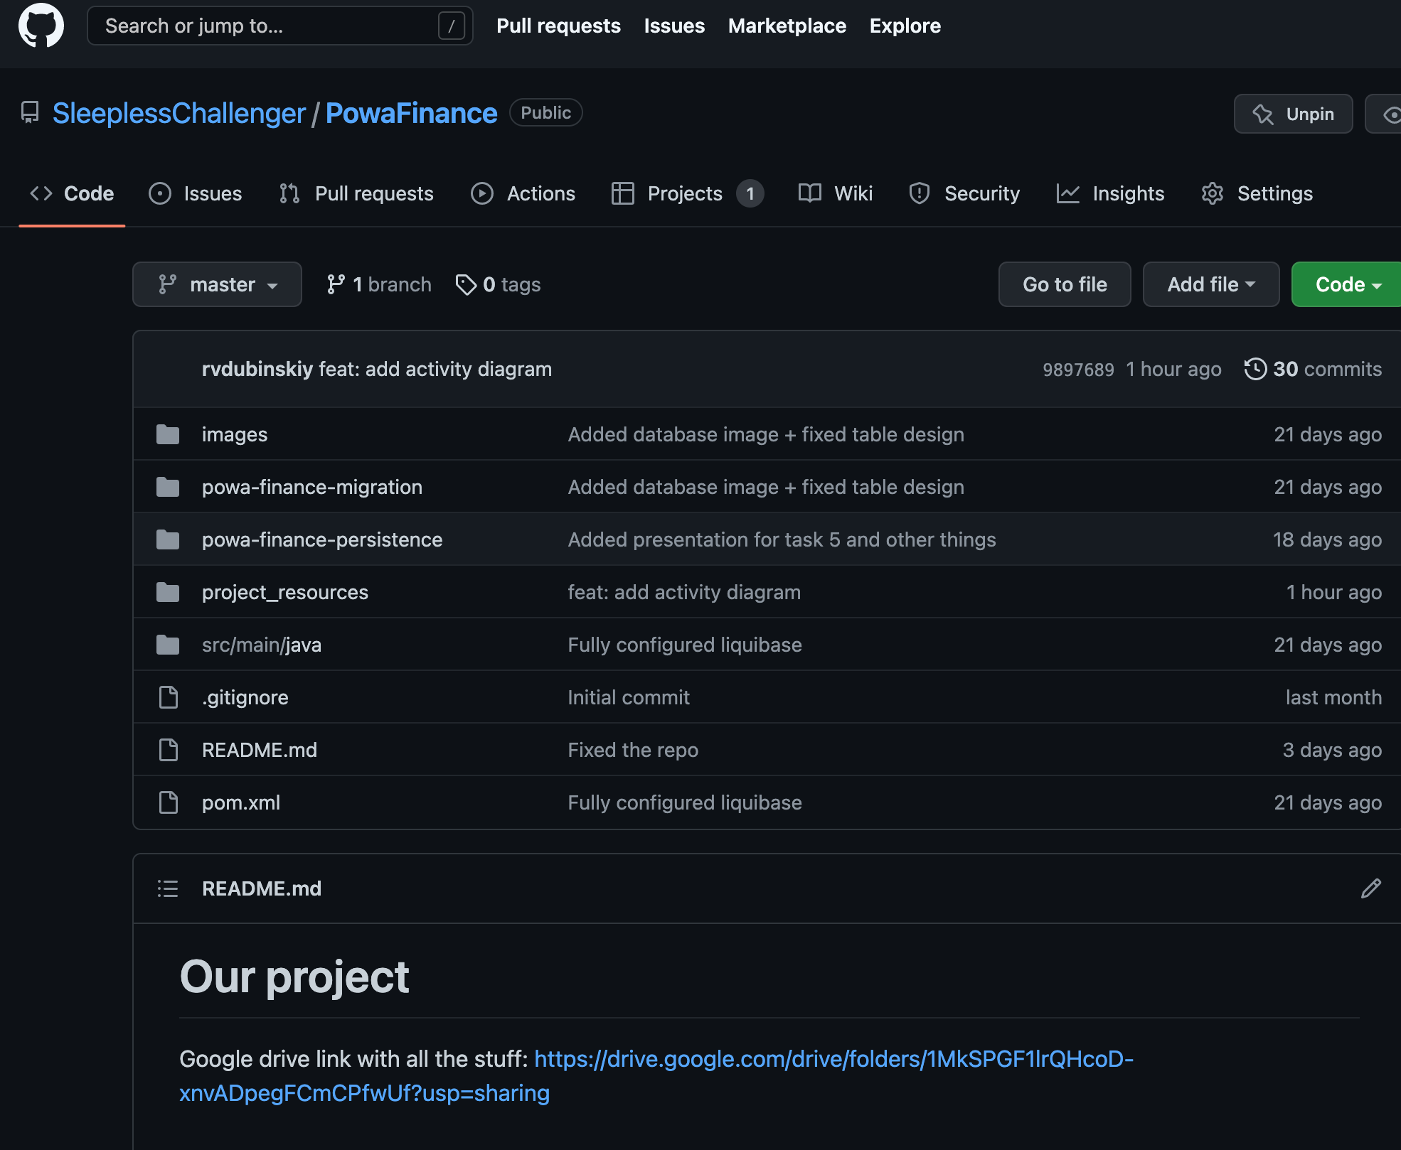
Repository structure
See more: https://github.com/SleeplessChallenger/PowaFinance/tree/master/project_resources/asd/FinalTask1/RepositoryStructure
In the repo you can observe the following structure:
project_resources/asd: all tasks for the topics that we covered
powa-finance-migration: here you can find liquibase migration system which allows our app to keep various changes in the app
src/main/java: is a main part where you can find Application.java which starts our app
powa-finance-persistence: part which has @Entity stuff to map java classes to database. Also known as ORM stuff
README.md: part of the app that documents all the links and has main features of the app described

Slide 10

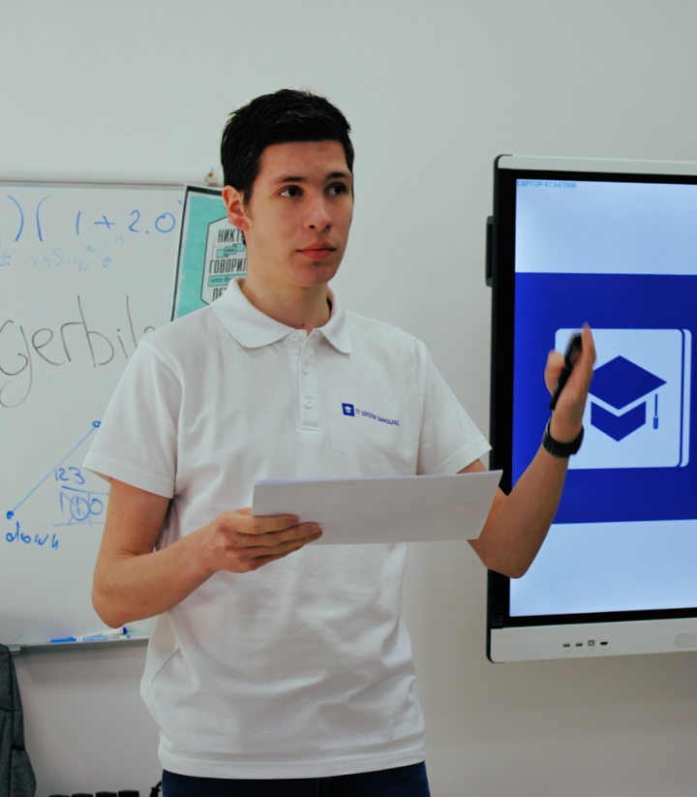

Team and roles
Daniil Slobodeniuk @SleeplessChallenger Resp. for UCs: See BN, Log in, Proj CF
Dmitry Egorov @dmitrijegorow Resp. for UCs: Add NE, Filter E, Gen IP
Roman Dubinskiy @rvdubinskiy Resp. for UCs: Buy FA, Gen IP, See BN

