Slide 1
Project: Powa Finance Team: Functor
Team members:
D. Egorov
D. Slobodeniuk
R. Dubinskiy

Slide 2
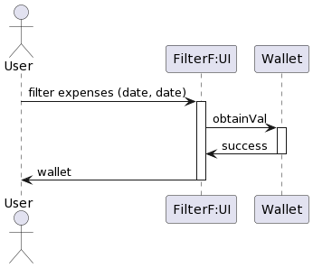

Slide 3
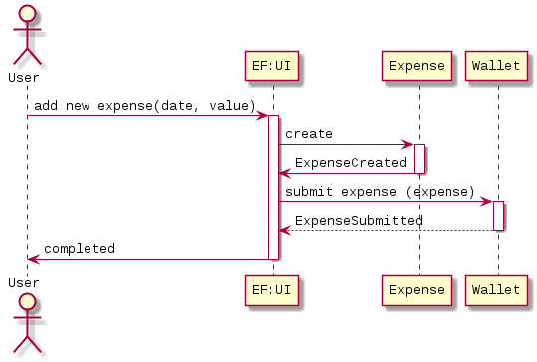

Slide 4
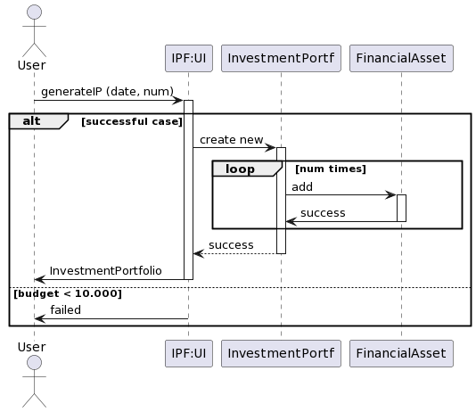

Slide 5
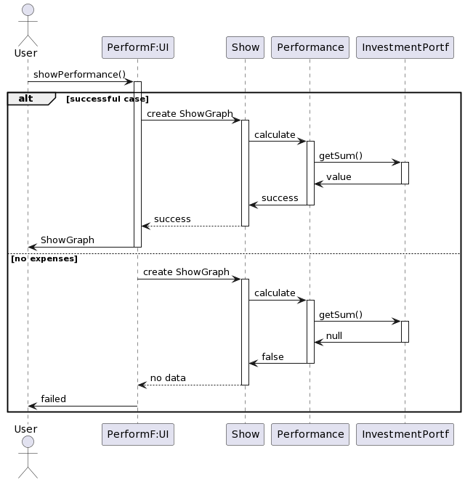

Slide 6
Video link
https://drive.google.com/file/d/1l4G3-U8Ce0sBVTJgwLoh-CZJLcZ5rogw/view?usp=sharing

Slide 7
U

