Slide 1
PowaFinance
Team Functor

Slide 2
Product description
Our product is Android App which purpose to ease up tracking of expenses. Though there are plethora of similar apps there are certain features that differentiate it:
ML model to project expenses for the next quarter
News API to fetch most applicable financial news
Investing API to give user option to invest in the desired stocks/bonds
Sleek design compared to competitors
GitHub repo: https://github.com/SleeplessChallenger/PowaFinance
Participants:
Slobodeniuk Daniil
Egorov Dmitriy
Dubinskiy Roman

Slide 3
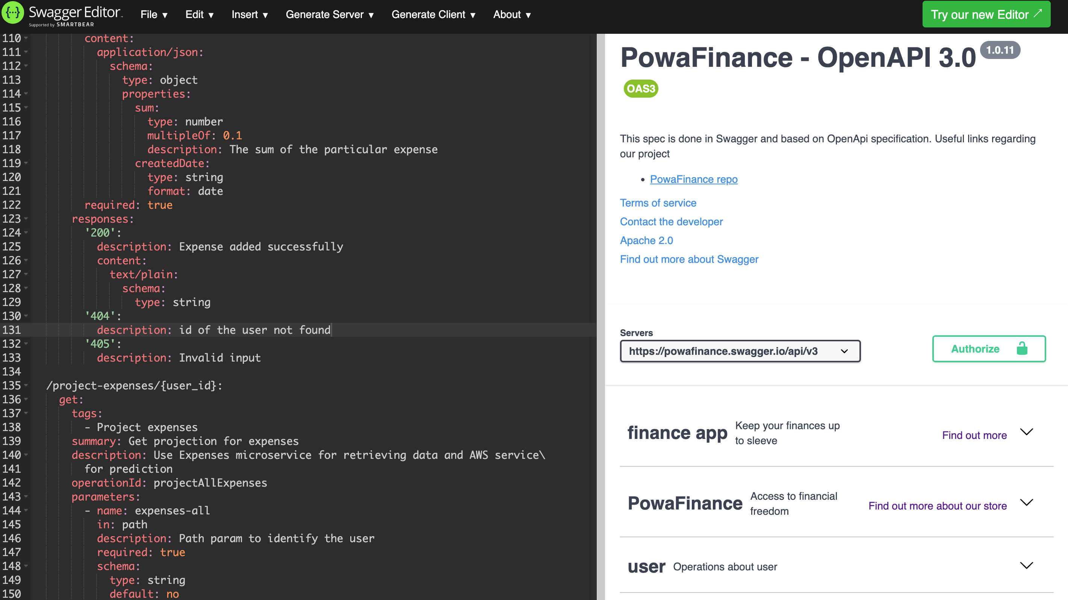
Swagger
Here you can see Swagger diagram. The file itself can be found at the following link: https://github.com/SleeplessChallenger/PowaFinance/blob/master/project_resources/asd/second-module/second-task/powaFinanceSwagger.yaml

Slide 4
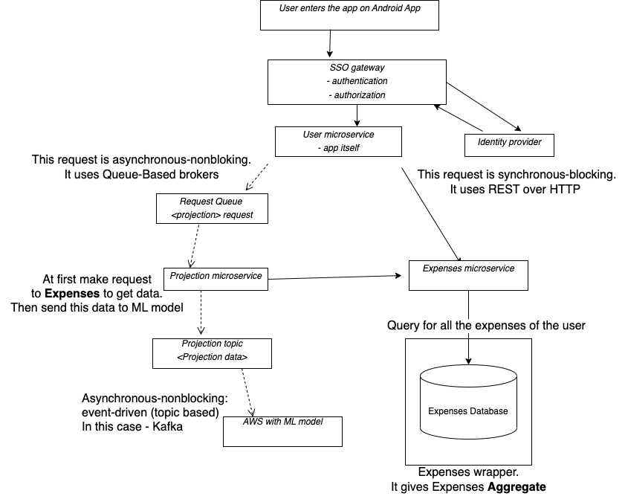
Event flow + use-case diagram
Event-flow diagram
Use-cases: https://github.com/SleeplessChallenger/PowaFinance/blob/master/project_resources/asd/second-module/second-task/use-cases.md
Draw.io file: https://github.com/SleeplessChallenger/PowaFinance/blob/master/project_resources/asd/second-module/second-task/FinalMicroservice.drawio

Slide 5
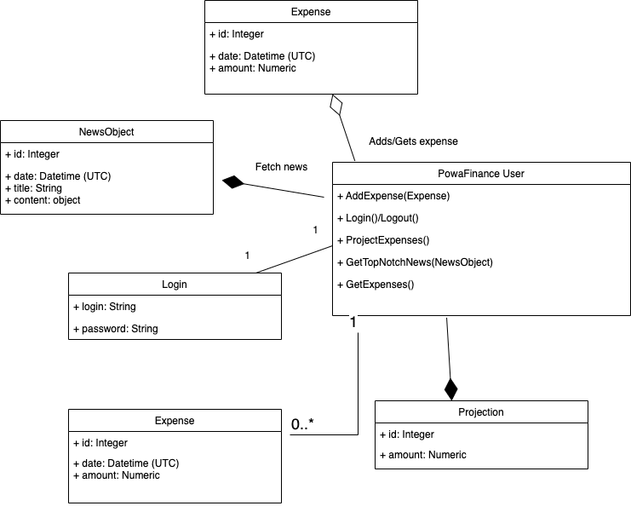
Class diagram
Here you can see the class diagram. Link to the diagram can be found: https://github.com/SleeplessChallenger/PowaFinance/blob/master/project_resources/asd/second-module/second-task/ClassDiagram.drawio.png

Slide 6
Solution stack
Implementation:
Language: Java 11
Framework: SpringBoot + Tomcat
Database: PostgreSQL
Migration: Liquibase
Serialization: JSON
2. Asynchronous interaction:
Events: Kafka
Queue: Rabbit MQ
3. Testing tools:
Junit 5, SpringBootTest, Mockito, Spring MVC
4. Operations:
Build tool: Maven
CI/CD: Jenkins
Delivery: Docker + K8S
Observability:
Logs: Slf4j
Metrics: Micrometer + Actuator Prometheus
Tracing: honeycomb
Visual: Grafana

Slide 7
Resources
Cloudfare about SSO and IdP: https://www.cloudflare.com/learning/access-management/what-is-an-identity-provider/
Building microservices by Sam Newman: https://www.oreilly.com/library/view/building-microservices-2nd/9781492034018/
Daniil’s notes about the book above: https://docs.google.com/document/d/1jilfJR9OmyrUXzp-0dwDkjFsh4RmiisBhNVMydC3mhc/edit?usp=sharing
Swagger OAuth2: https://swagger.io/docs/specification/authentication/oauth2/
UML diagram explanation: https://www.gleek.io/blog/class-diagram-arrows.html

