Slide 1
PowaFinance
Slobodeniuk Daniil - Backend developer and Project Manger
Dmitry Egorov - Android Dev
Ivan Reznik
Roman Dubinskiy - Frontend developer

Slide 2
Project statement neat and crisp app for tracking finances and investing
finance calculation: simple and crisp way to track your daily expenses
projection of expenditures for month/year with AI
adjustment of expenses to current inflation
provides option to create shared account where multiple users can enter their spending
integration with trading platforms where you can evaluate investment opportunities
Project repo: https://github.com/SleeplessChallenger/PowaFinance

Slide 3
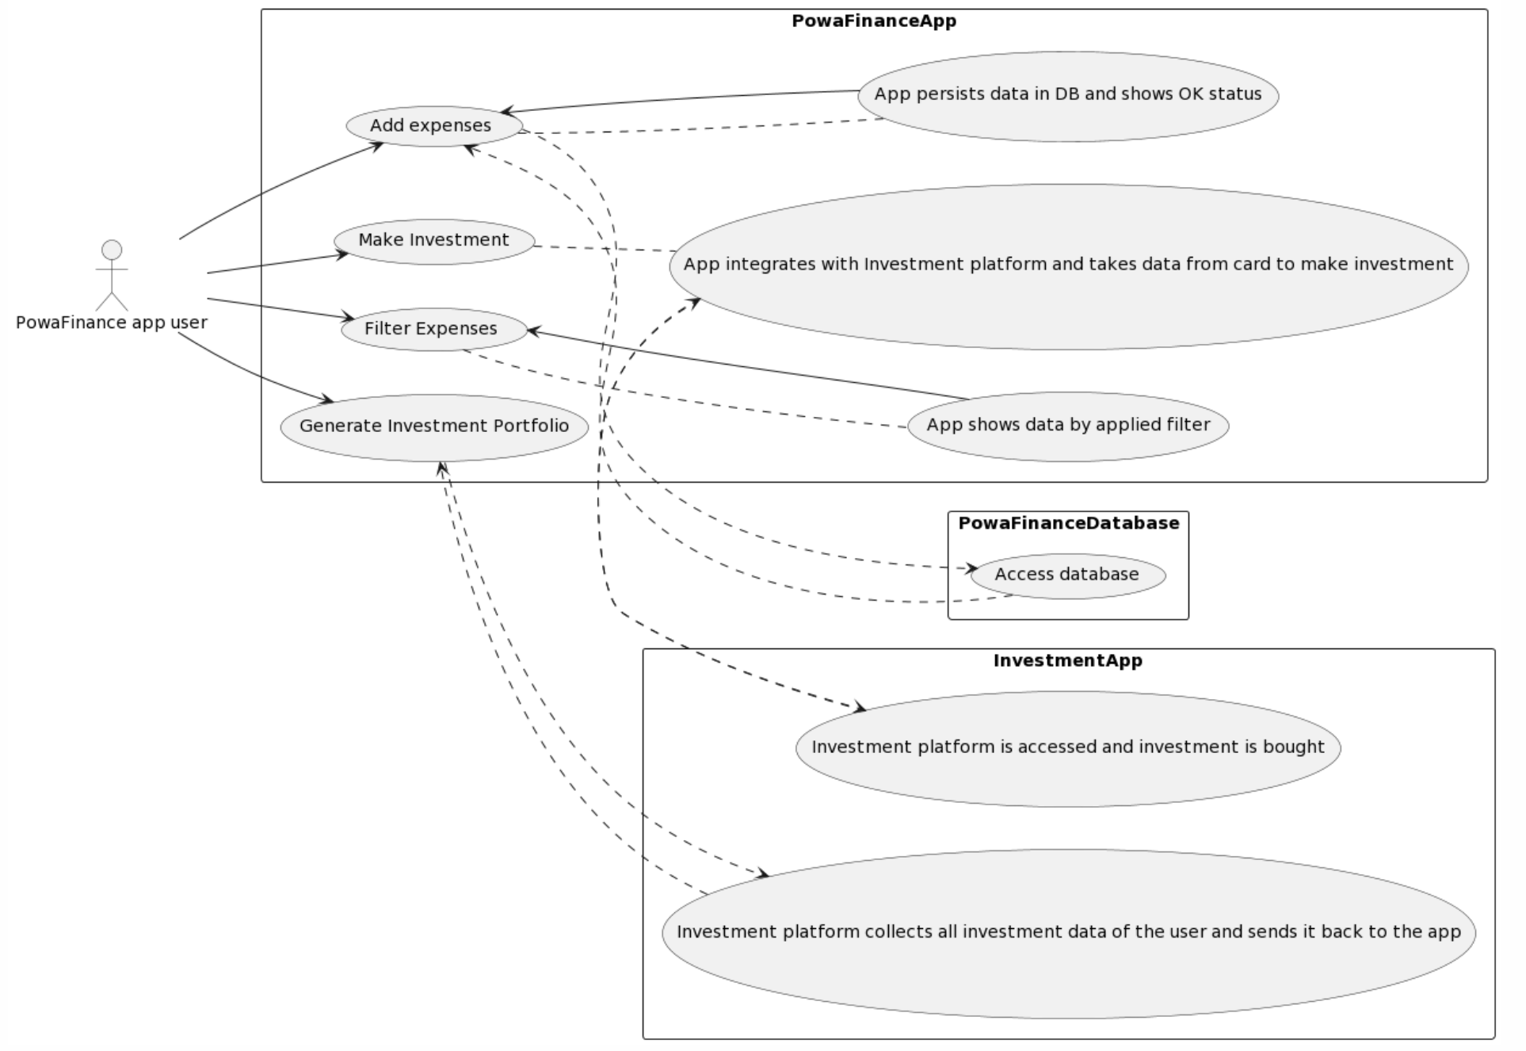
UML Diagram

Slide 4
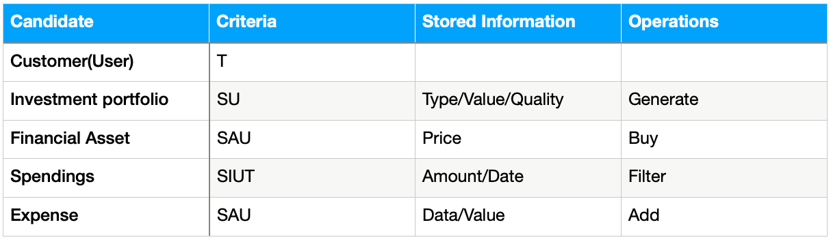
Class candidates (problem domain)

Slide 5
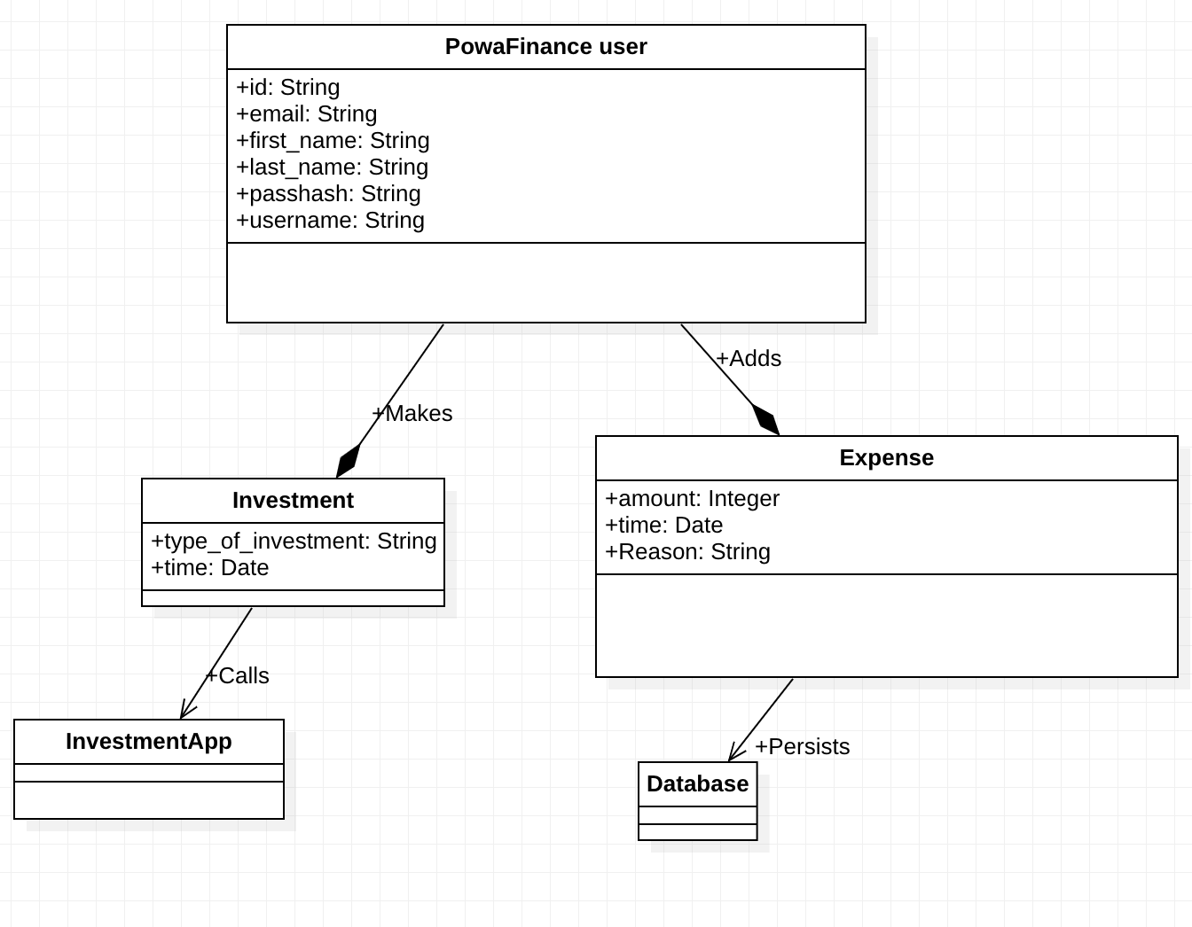
Domain model diagram (Class Diagram)

Slide 6
Thanks for attention

