Slide 1
Hidden Markov Model and
its applications in Signal Processing
Kanru Hua
Univ. of Illinois at Urbana-Champaign
Apr. 27, 2016

Slide 2
What is Hidden Markov Model?
A hidden Markov model (HMM) is a statistical Markov model in which the system being modeled is assumed to be a Markov process with unobserved (hidden) states.
– Wikipedia
Typical applications:
  Speech Recognition/Synthesis
  Part-of-speech Tagging
  Handwriting Recognition
  Automatic Audio/Video Transcription
  Signal Denoising

Slide 3
Outline
Markov Chain
Hidden Markov Model
  Definition
  Algorithms – Inference and Training
  Run HMM in Matlab
Extensions to HMM
  Continuous (and Multivariate) Output
  Multiple Observation Sequences
Applications
  Speech Recognition
  Filtering/Denoising

Slide 4
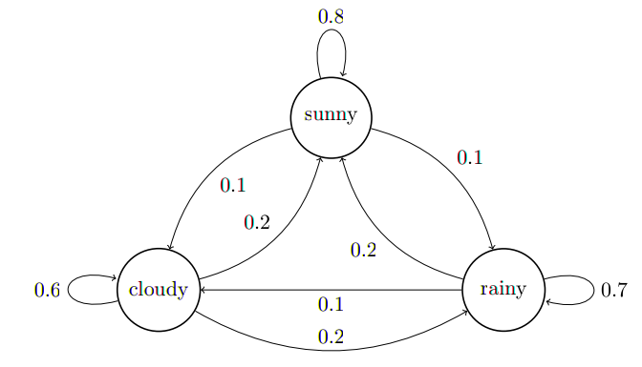
Markov Chain
Random walk example:
→ Sunny → Sunny → Cloudy → Rainy → Rainy → Sunny → Sunny → Sunny → Rainy → Rainy → Cloudy → Sunny → ...

Slide 5
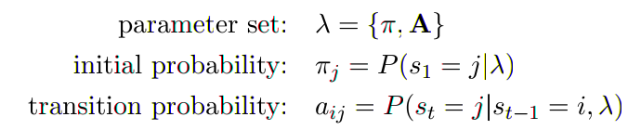
Markov Chain
Definition
Markov Property
Getting into current state only depends on the previous state but not any state before the previous state. (First-order Markov Chain)

Slide 6
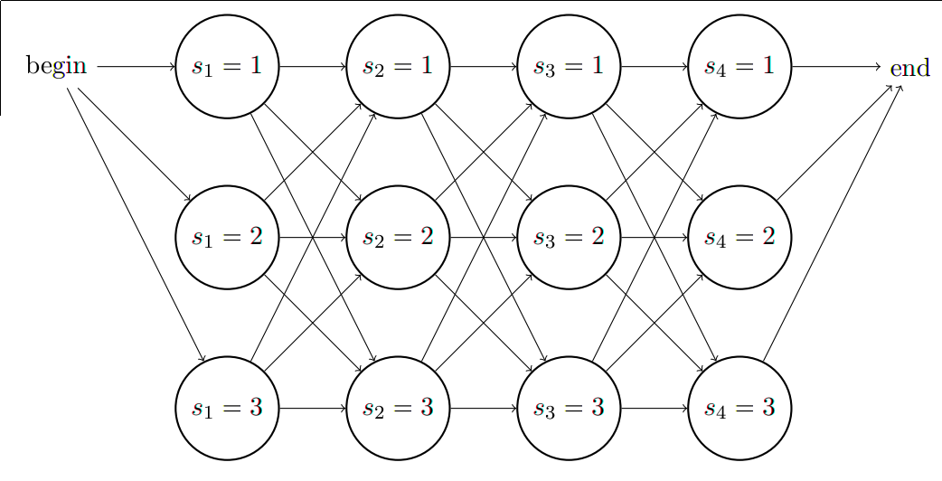
Markov Chain
A lateral view
Total Probability

Slide 7
Hidden Markov Model: an Example
On sunny days I usually go to ECEB by bike;
On cloudy days sometimes I walk.
On rainy days I either walk or take MTD, but I rarely bike.
My behavior can be modelled by a HMM and we can
  Given weather data and my transportation record, train a HMM.
  Given a HMM, generate a weather sequence and corresponding transportation record.
  Given HMM & my transportation record, estimate the most probable weather sequence.
  Given HMM & my transportation record, estimate the probability of having {sunny, cloudy, rainy} weather on each day.
  Given HMM & transportation records of a few people at different locations, pick the one that is most likely to be my record (in Champaign).

Slide 8
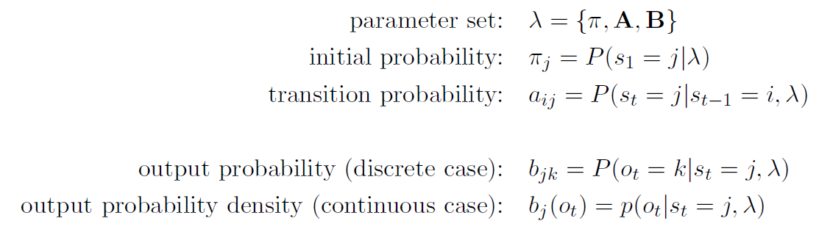
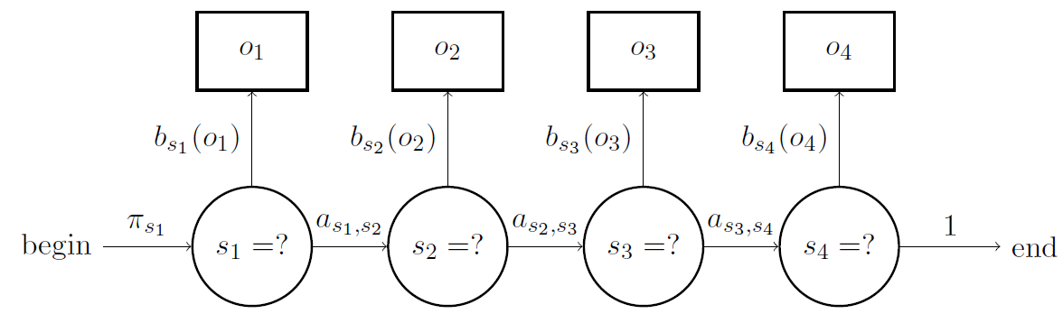
Hidden Markov Model
Definition

Slide 9
Hidden Markov Model
What can we do with HMM?
Generation
  Random walk
Inference
  Forward/Backward algorithm
  Viterbi algorithm (most probable sequence)
  Total probability and probability of a particular state
Parameter estimation (training)
  Initialization
  Viterbi training algorithm
  Baum-Welch algorithm

Slide 10





HMM Inference
What we ultimately want to get:
Some intermediate values we'll be using:
Total Probability
State Occupancy Probability
State Transition Probability
Optimal Sequence
Forward Probability
Backward Probability

Slide 11
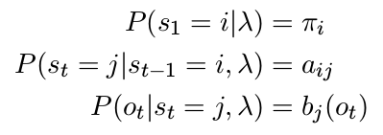
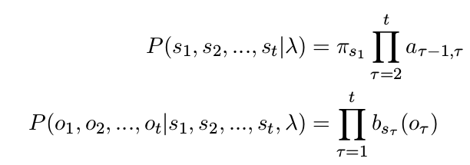
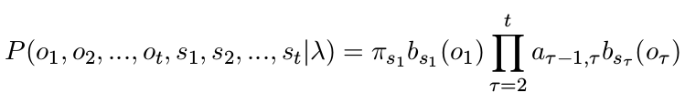
HMM Inference
What we already know:
Directly following Markov property,

Slide 12
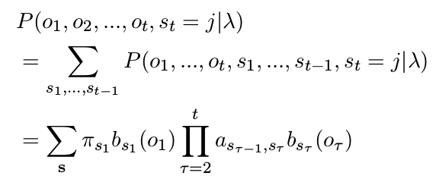
Forward Algorithm
Brute force way of getting forward probability:
Exponential time complexity!

Slide 13
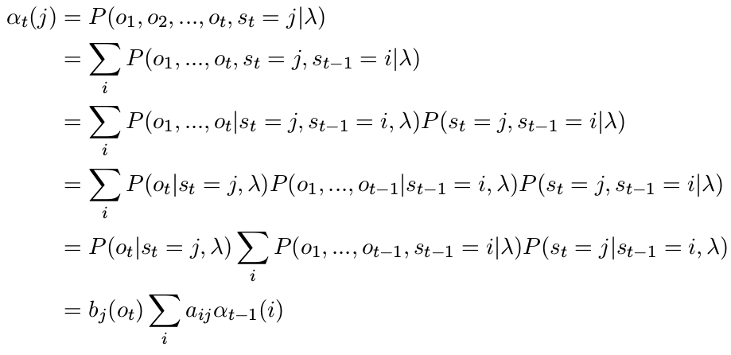
Forward Algorithm

Slide 14
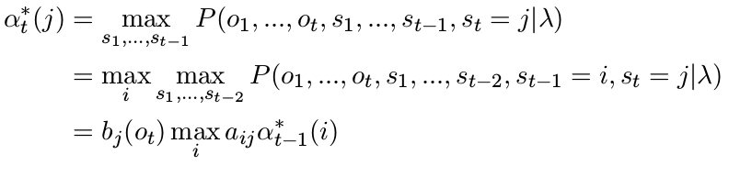

Viterbi Algorithm
Similarly, brute force won't work on
Need to define some intermediate values,
Keep track of the paths we go through:
Finally, backtrack from the last state to the first.

Slide 15

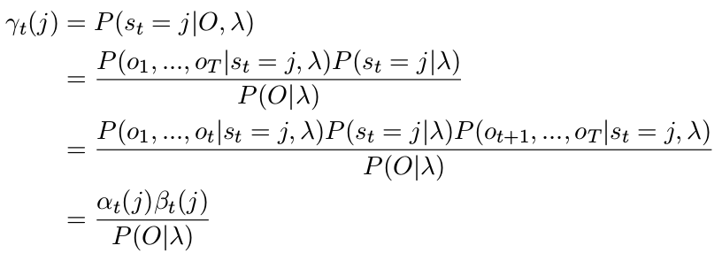
HMM Inference
Total probability
State occupancy probability

Slide 16
Extension – Continuous Output
Use a continuous density distribution for
e.g. normal distribution
Or multivariate normal distribution with dimension k
To reduce number of parameters we often assume diagonal covariance, which significantly simplifies the whole thing.

Slide 17
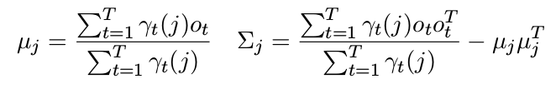
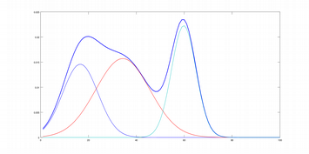
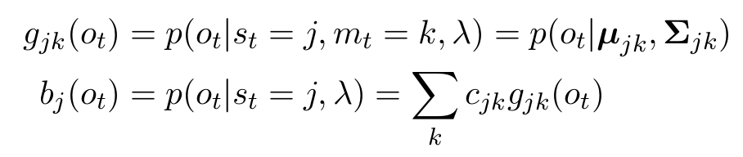
Extension – Continuous Output
The inference algorithms are exactly same as the discrete case (except for function itself, of course).
Maximization step needs a little bit change:
Gaussian Mixture Model as output density distribution

Slide 18
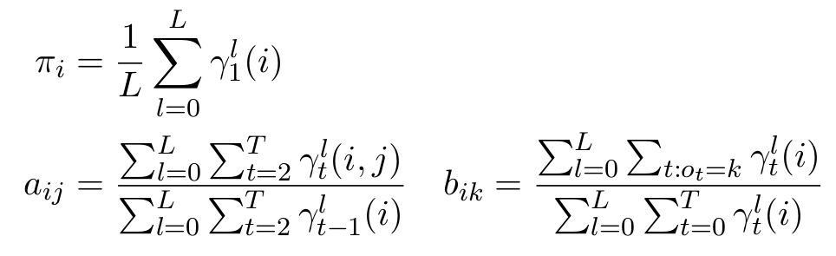
Extension – Multiple Observation Sequences
Training data set often contains more than one sample.
In fact there are often hundreds or even thousands of samples.
Use common sense, just add (average) bunch of things together!
To prove this you can change the “s” under summation in EM algorithm and rederive the whole thing again.

Slide 19
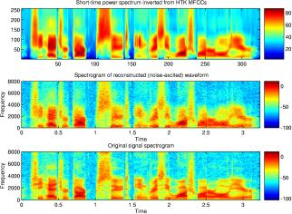
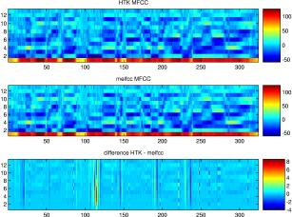
HMM for Speech Recognition
Speech feature
MFCC (Mel-Frequency Cepstral Coefficient)
Output probability function:
(Mixture of) multivariate normal distribution with diagonal covariance,
whose dimension = dimension of each feature vector
Image source: http://labrosa.ee.columbia.edu/matlab/rastamat/mfccs.html

Slide 20
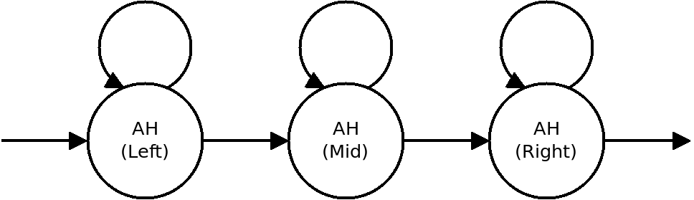
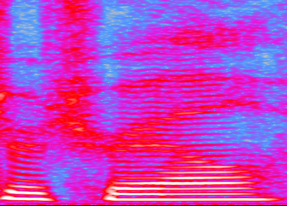
HMM for Speech Recognition
Triphone Models
“LLLMMMMMMMRRN”
 | Left | Mid | Right | Next
Left | 0.7 | 0.3 | 0 | 0
Mid | 0 | 0.9 | 0.1 | 0
Right | 0 | 0 | 0.7 | 0.3
ER
T
R
EY
L
EY

Slide 21
HMM for Speech Recognition
“Hello” → “HH AH L OW”
We don't want the algorithm to consider impossible/confusing transitions (e.g. HH(R) → HH(L) or HH(R) → OW(L))
Then during inference, simply change the transition matrix for each training sample. Each state should only have self transition and transition to the next state. → Left-to-Right HMM
Forced alignment – given phoneme transcription and speech, calculate the starting/ending time of each phoneme (using Viterbi algorithm).

Slide 22
HMM for Speech Recognition
State Tying
What if a phoneme appears more than once in a sample?
e.g. “Hello, world.” → “HH AH L OW, W ER L D”, where we can find L(R) → OW(L) and L(R) → D(L)
Just create a copy of L(R, M, L) states, and name them L1(R, M, L)
HH AH L OW, W ER L1 D
L and L1 share the same output distribution. During maximization step, statistics on L and L1 are collected and grouped together. This trick is called state tying.

Slide 23
HMM for Speech Recognition
Context Dependency
So far we've only seen context-independent (CI) HMM – same L, M, R states are shared across the whole data set.
However pronunciation could vary with respect to context.
Full-context models: represent each occurrence of each phoneme by a unique set of L, M, R states.
Context-dependent (CD) models: cluster full-context models into groups that share both similar context and similar output distribution, then merge & tie them together.
We can use a decision tree for such clustering.

