Slide 1
Super Massive Black Holes
A Talk Given By:
Mike Ewers

Slide 2
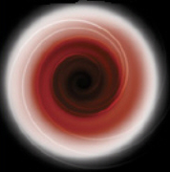
Black Holes: A Theoretical Definition (A Review)
An area of space-time with a gravitational field so intense that its escape velocity is equal to or exceeds the speed of light.
The Important thing is that this area can be of any size.

Slide 3
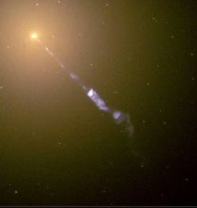
The Finite Speed of Light
As you all know (especially Contemporary people), That the speed of light is a finite value in a vacuum.
(A black-hole-powered jet of sub-atomic particles traveling at nearly the speed of light out of the M87 galaxy)

Slide 4
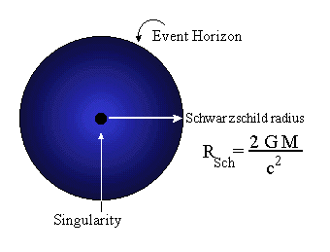
Escape Velocity, Density, and Schwarzschild Radius
In terms of gravitational force, every object has an escape velocity as
vesc = Sqrt[(2 G M)/r].
From that Schwarzschild Radius can be easily found.
All comes down to a matter of density.

Slide 5
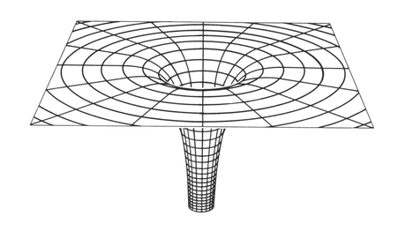
Thinking in Terms of General Relativity
Einstein’s Theory of General Relativity basically says that gravity warps space time.
Rubber Sheet analogue
Down, up, and through the funnel. An embedding diagram is generally a good representation of a black hole's warping of nearby space-time. But such 2-dimensional illustrations can also cause conceptual problems.

Slide 6
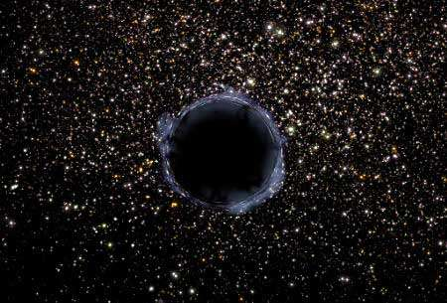
This is a simplified model
The black hole no hair theorem shows that mass, charge, and angular momentum are the only properties a black hole can possess

Slide 7
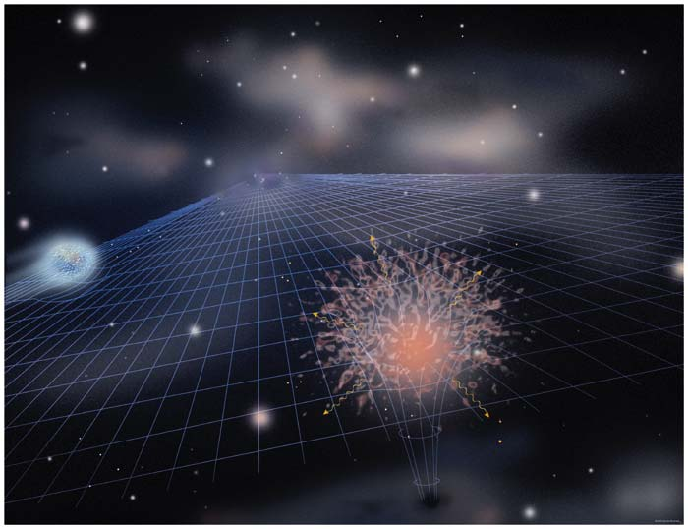
Types of Black Holes
“Normal Sized” Black Holes
Microscopic (Primordial) Sized
Super-Massive Black Holes (On the order of millions to billions of Solar Masses)
(Estimated 3 million solar masses for Milky Way Black Hole)

Slide 8
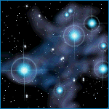
How Normal Black Holes Come About (A Review)
Most Black Holes are believed to come about from the death of massive stars.

Slide 9
Stellar Evolution (Brief)
Star (Mass of Hydrogen) is massive enough (M > 0.1 Msun ) to ignite fusion
Star performs stable core fusion (first H->HE)
Cycle repeats if star is big enough until the core is Fe.
Star is in a kind of onion peel structure of elemental layers

Slide 10
Supernovas!?
After fusion cycles through and star’s core is Fe, if the star now is M < 1.4 Msun , the star will supernova as a Type II supernova. Otherwise, it becomes a white dwarf, supported by degenerate electron pressure.
This mass limit for supernovas is the Chandrasekhar limit.

Slide 11
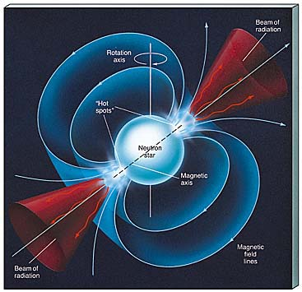
Black Hole or Neutron Star?
If the star the went supernova was between 1.4 and 3 Msun , then the remnant will be a Neutron Star supported by degenerate neutron pressure (Pulsar).
Otherwise,
Mfinal > 3Msun , and the result is a black hole because the is no source of outward pressure strong enough.

Slide 12
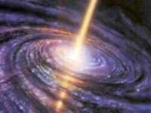
Where Could Super-Massive Black Holes Exist?
The only known places in the Universe where there could be enough mass in one area is in the center of massive galaxies
Not believed to be anywhere else

Slide 13
Quasars: What are They?
In some places where point sources of radio waves were found, no visible source other than a stellar-looking object was found (it looked like a point of like --- like a star does). These objects were called the "qausi-stellar radio sources", or "quasars" for short.
Later, it was found these sources could not be stars in our galaxy, but must be very far away --- as far as any of the distant galaxies seen. We now think these objects are the very bright centers of some distant galaxies, where some sort of energetic action is occurring.

Slide 14
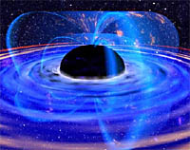
Active Galactic Nuclei
In some galaxies, known as "active galactic nuclei" (AGN), the nucleus (or central core) produces more radiation than the entire rest of the galaxy! Quasars are very distant AGN - the most distant quasars mark an epoch when the universe was less than a billion years old and a sixth of its current size.

Slide 15
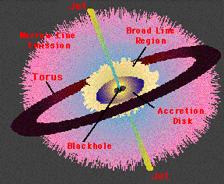
Brief Review of case for Super-Massive Black Holes in these observed AGN
The Time Variation of AGN
The Eddington Luminosity Argument
The Motion of broad line emission medium around the central core

Slide 16
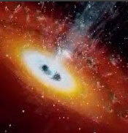
How did Super-Massive Black Holes come about?--theories
From “Lumps” in the early universe
The “Stellar Seed” Model
Collapse of a whole star cluster

Slide 17
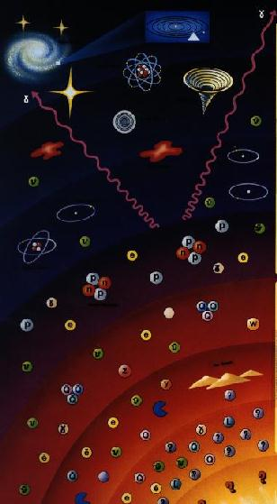
Lumps from the early Universe
In the “Big Bang” the whole universe was in a really dense state. So much that perhaps lumps could have formed and of matter dense enough that a black hole was formed.
There was enough surrounding matter that galaxies formed around the lumps
Could explain why pockets of interstellar gas never became galaxies

Slide 18
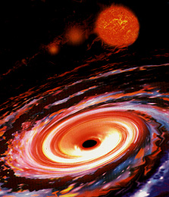
The Stellar Seed Model
Provided that the surrounding environment is sufficiently rich in matter, a giant black hole could result in an initial “stellar seed” of 10 Msun produced during a supernova.

Slide 19
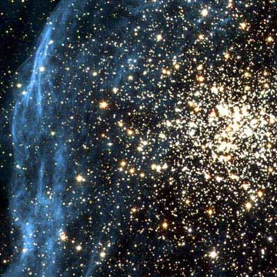
Collapse of a whole cluster
If the stars of a tight knit cluster of the moderately young Universe had all relatively the same size stars (above the Chandrasekhar Limit), there would be quite a few Black Holes forming simultaneously causing smaller stars to be absorbed, and black holes to combine.
NGC 1850 to the right

Slide 20
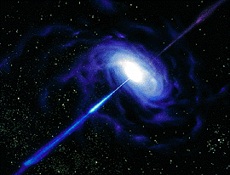
Some Characteristic of AGN
Super Bright: AGN 3C273 (an extreme example) is L = 4.8*10^12 Lsun .
Cosmic Optical Jets
Tidal forces
Cannibalism—they do eat, the source of energy

Slide 21
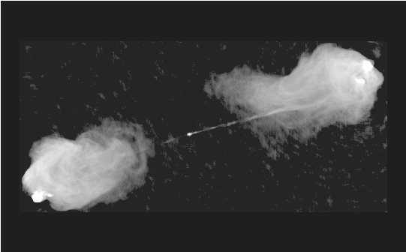
Optical Jets—Why?
The magnetic fields around a black holes that are thought to produce the spectacular jets of high-energy particles rushing away from black holes come from the disk of hot gas around the black hole, not the black hole itself.
The jets are made by the Magnetic field of the matter before it goes in the Black Hole.
Emit Synchrotron radio signals
Cygnus A

Slide 22

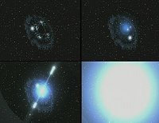
Tidal forces stretch farther, but are weaker
The tidal force is proportional to the mass of the black hole. In other words, as the object gets more massive, the force should get bigger too. But the force is also inversely proportional to the cube of the object's radius. As the hole gets more massive, its size increases, but because of the cube factor, the force decreases much faster than any possible mass increase can account for. The result is that big black holes have weak tidal forces, and small ones have strong tidal forces.
Frames from a NASA computer animation depict one possible cause of gamma ray bursts. A star orbiting a black hole spirals in as it is shredded by tidal forces, generating an intense burst of gamma and other radiation as the its matter is compressed and super-heated on its way to oblivion.

Slide 23
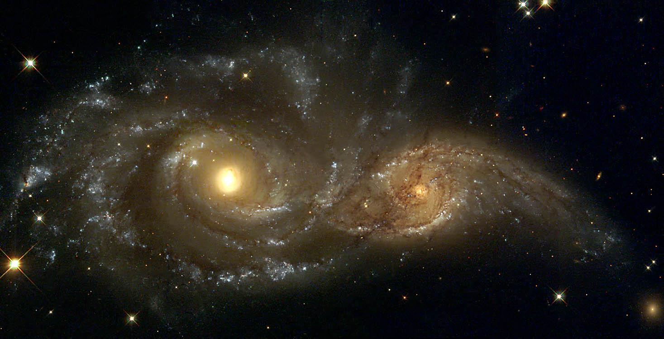
Cannibalism
Apparently, Quasars are only active on order of 100 million years
A dead quasar could be revived with a new source food—by colliding galaxies
Proof—elliptical galaxies have been found to be active in radio transmissions as well.
Collision Galaxies NGC 2207 & IC 2163

Slide 24
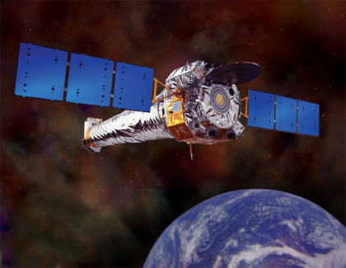
Observations of Super Massive Black Holes
Radio observations at various radio telescopes
X-ray observations from the orbital Chandra Observatory
Optical Observations from Hubble Space Telescope

Slide 25
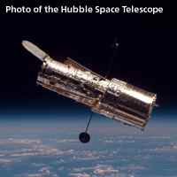
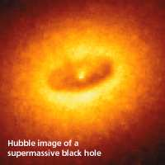
Pictures
NGC4261

Slide 26
Fate of Universe?
All Black Holes Evaporate over time due to Hawking Radiation
Eventually the Universe will have no matter in a cold dark death and all there will be left is radiation.
Evaporation Time:
1 * 10^-7 (M/Msun)^3 Years
On order of 1* 10^20 years

Slide 27
Picture Resources
www.usatoday.com/.../wonderquest/ 2001-08-22-black-holes.htm
www.astronomynotes.com/gravappl/s8.htm
astrosun.tn.cornell.edu/courses/astro201/bh_structure.htm
www.aspsky.org/mercury/mercury/ 9802/lockwood.html
www.abc.net.au/science/slab/ wormholes/default.htm
www.glyphweb.com/esky/ concepts/stars.html
http://heasarc.gsfc.nasa.gov/docs/objects/agn/agntext.html
www.nature.com/nsu/020603/ 020603-1.html
http://www.linnaeus.uu.se/online/fysik/makrokosmos/gifs/bigbangsmall.jpg
www.astrographics.com/GalleryPrints/ GP0053.html
www.abc.net.au/science/news/ stories/s71464.htm
http://imagine.gsfc.nasa.gov/docs/science/know_l2/active_galaxies.html
www.scs.gmu.edu/~tle/ galaxy_galery.html

