Slide 1
CHAPTER 6
GRAPHS (brief)
All the programs in this file are selected from
Ellis Horowitz, Sartaj Sahni, and Susan Anderson-Freed
“Fundamentals of Data Structures in C”,
CHAPTER 6

Slide 2
Definition
A graph G consists of two sets
  a finite, nonempty set of vertices V(G)
  a finite, possible empty set of edges E(G)
  G(V,E) represents a graph
An undirected graph is one in which the pair of vertices in a edge is unordered, (v0, v1) = (v1,v0)
A directed graph is one in which each edge is a directed pair of vertices, <v0, v1> != <v1,v0>
tail
head
CHAPTER 6

Slide 3
Examples for Graph
0
0
0
1
2
1
2
1
3
3
4
5
6
G1
2
G2
complete graph
incomplete graph
G3
V(G1)={0,1,2,3} E(G1)={(0,1),(0,2),(0,3),(1,2),(1,3),(2,3)}
V(G2)={0,1,2,3,4,5,6} E(G2)={(0,1),(0,2),(1,3),(1,4),(2,5),(2,6)}
V(G3)={0,1,2} E(G3)={<0,1>,<1,0>,<1,2>}
complete undirected graph: n(n-1)/2 edges
complete directed graph: n(n-1) edges
CHAPTER 6

Slide 4
Adjacent and Incident
If (v0, v1) is an edge in an undirected graph,
  v0 and v1 are adjacent
  The edge (v0, v1) is incident on vertices v0 and v1
If <v0, v1> is an edge in a directed graph
  v0 is adjacent to v1, and v1 is adjacent from v0
  The edge <v0, v1> is incident on v0 and v1
CHAPTER 6

Slide 5
Figure 6.3
*Figure 6.3:Example of a graph with feedback loops and a
multigraph (p.260)
0
0
2
1
3
1
2
self edge
multigraph:
multiple occurrences
of the same edge
(a)
(b)
CHAPTER 6

Slide 6
Subgraph and Path
A subgraph of G is a graph G’ such that V(G’)
is a subset of V(G) and E(G’) is a subset of E(G)
A path from vertex vp to vertex vq in a graph G,
is a sequence of vertices, vp, vi1, vi2, ..., vin, vq,
such that (vp, vi1), (vi1, vi2), ..., (vin, vq) are edges
in an undirected graph
The length of a path is the number of edges on it
CHAPTER 6

Slide 7
Simple Path and Style
A simple path is a path in which all vertices,
except possibly the first and the last, are distinct
A cycle is a simple path in which the first and
the last vertices are the same
In an undirected graph G, two vertices, v0 and v1, are connected if there is a path in G from v0 to v1
An undirected graph is connected if, for every
pair of distinct vertices vi, vj, there is a path
from vi to vj
CHAPTER 6

Slide 8
connected
0
0
1
2
1
2
3
3
4
5
6
G1
G2
tree (acyclic graph)
CHAPTER 6

Slide 9
Connected Component
A connected component of an undirected graph
is a maximal connected subgraph.
A tree is a graph that is connected and acyclic.
A directed graph is strongly connected if there
is a directed path from vi to vj and also
from vj to vi.
A strongly connected component is a maximal subgraph that is strongly connected.
CHAPTER 6

Slide 10
*Figure 6.5: A graph with two connected components (p.262)
connected component (maximal connected subgraph)
H₁
0
H₂
4
2
1
5
3
6
7
G₄ (not connected)
CHAPTER 6

Slide 11
*Figure 6.6: Strongly connected components of G₃ (p.262)
strongly connected component
(maximal strongly connected subgraph)
not strongly connected
0
0
2
1
1
2
G3
CHAPTER 6

Slide 12
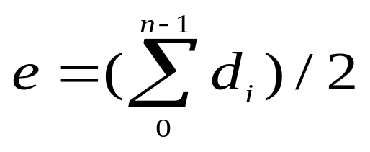
Degree
The degree of a vertex is the number of edges incident to that vertex
For directed graph,
  the in-degree of a vertex v is the number of edges
  that have v as the head
  the out-degree of a vertex v is the number of edges
  that have v as the tail
  if di is the degree of a vertex i in a graph G with n vertices and e edges, the number of edges is
CHAPTER 6

Slide 13
undirected graph
degree
3
0
0
2
1
2
3
1
2
3
3
3
3
4
5
6
3
3
1
G1
1
G2
1
1
0
in:1, out: 1
directed graph
in-degree
out-degree
1
in: 1, out: 2
2
in: 1, out: 0
CHAPTER 6
G3

Slide 14
Graph Representations
Adjacency Matrix (only this one)
Adjacency Lists (in Data Structure)
Adjacency Multilists
CHAPTER 6

Slide 15
Adjacency Matrix
Let G=(V,E) be a graph with n vertices.
The adjacency matrix of G is a two-dimensional
n by n array, say adj_mat
If the edge (vi, vj) is in E(G), adj_mat[i][j]=1
If there is no such edge in E(G), adj_mat[i][j]=0
The adjacency matrix for an undirected graph is symmetric; the adjacency matrix for a digraph
need not be symmetric
CHAPTER 6

Slide 16
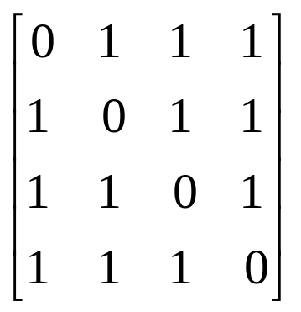
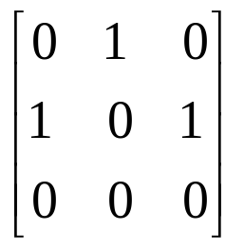
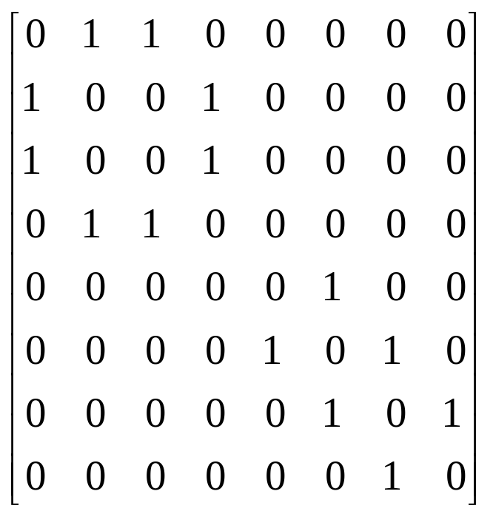
Examples for Adjacency Matrix
0
0
4
0
2
1
5
1
2
3
6
3
1
7
2
G2
G1
symmetric
undirected: n²/2
directed: n²
CHAPTER 6
G4

Slide 17
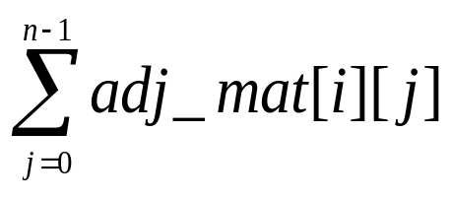
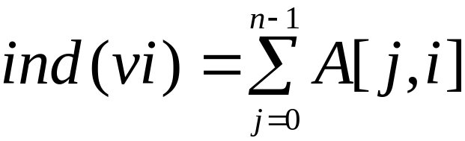

Merits of Adjacency Matrix
From the adjacency matrix, to determine the connection of vertices is easy
The degree of a vertex is
For a digraph, the row sum is the out_degree, while the column sum is the in_degree
CHAPTER 6

Slide 18
Data Structures for Adjacency Lists
Each row in adjacency matrix is represented as an adjacency list.
#define MAX_VERTICES 50
typedef struct node *node_pointer;
typedef struct node {
int vertex;
struct node *link;
};
node_pointer graph[MAX_VERTICES];
int n=0; /* vertices currently in use */
CHAPTER 6

Slide 19
0
0
4
2
1
5
1
2
3
6
3
7
0
1
2
3
1
2
3
0
1
2
3
4
5
6
7
1
2
0
2
3
0
3
0
1
3
0
3
0
1
2
1
2
G1
0
5
4
6
0
1
2
1
5
7
0
2
1
6
G3
G4
2
CHAPTER 6
An undirected graph with n vertices and e edges ==> n head nodes and 2e list nodes

Slide 20
Interesting Operations
degree of a vertex in an undirected graph
  # of nodes in adjacency list
# of edges in a graph
  determined in O(n+e)
out-degree of a vertex in a directed graph
  # of nodes in its adjacency list
in-degree of a vertex in a directed graph
  traverse the whole data structure
CHAPTER 6

Slide 21
Figure 6.13:Alternate order adjacency list for G₁ (p.268)
Order is of no significance.
headnodes vertax link
0
•
3 •
1 •
2 NULL
1
•
2 •
0 •
3 NULL
2
•
3 •
0 •
1 NULL
3
•
2 •
1 •
0 NULL
0
1
2
CHAPTER 6
3

Slide 22
Using array for adjacency list
A practical technique
  Pointer is difficult to debug
  Only for static graphs
Idea:
  Recalling sparse matrix
  Sorting the edges with key (i,j)
  Keeping the starting index for each node
  Easy to find all the neighbors of any node
CHAPTER 6

Slide 23
Using C++ vector
#include <vector>
vector<int> edge[N]
//edge[i] store the neighbor of node i
for (i=0;i<num;i++) {
scanf("%d%d",&x,&y);
edge[x].push_back(y);
edge[y].push_back(x); // undirected
}
CHAPTER 6

Slide 24
weighted graph
Weighted case
vector<pair<int,int> > edge[N]
// edge[i] store the neighbor and the weight
for (i=0;i<m;i++) {
scanf("%d%d%d",&from,&to,&w);
edge[from].push_back({to,w});
}
CHAPTER 6

Slide 25
Some Graph Operations
Traversal
Given G=(V,E) and vertex v, find all w∈V,
such that w connects v.
  Depth First Search (DFS)
  preorder tree traversal
  Breadth First Search (BFS)
  level order tree traversal
Connected Components
Spanning Trees
CHAPTER 6

Slide 26
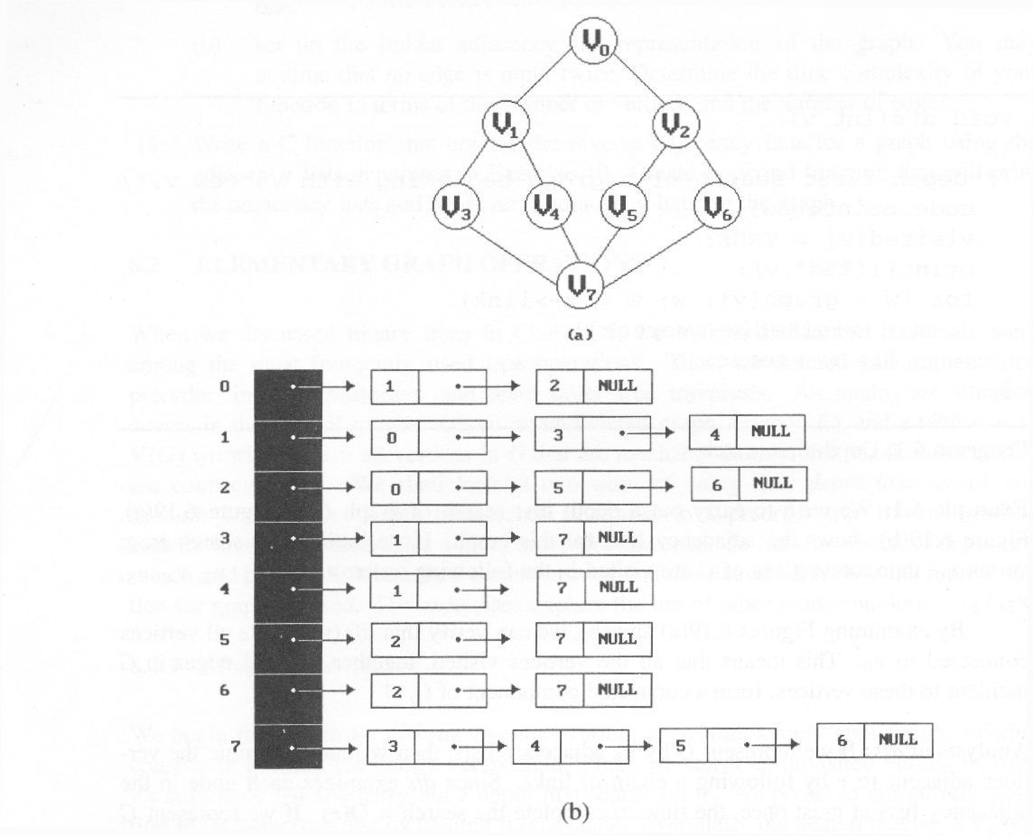
*Figure 6.19:Graph G and its adjacency lists (p.274)
depth first search: v0, v1, v3, v7, v4, v5, v2, v6
breadth first search: v0, v1, v2, v3, v4, v5, v6, v7
CHAPTER 6

Slide 27
Depth First Search
#define FALSE 0
#define TRUE 1
short int visited[MAX_VERTICES];
void dfs(int v)
{
node_pointer w;
visited[v]= TRUE;
printf(“%5d”, v);
for (w=graph[v]; w; w=w->link)
if (!visited[w->vertex])
dfs(w->vertex);
}
Data structure
adjacency list: O(e)
adjacency matrix: O(n²)
CHAPTER 6

Slide 28
Breadth First Search
typedef struct queue *queue_pointer;
typedef struct queue {
int vertex;
queue_pointer link;
};
void addq(queue_pointer *,
queue_pointer *, int);
int deleteq(queue_pointer *);
CHAPTER 6

Slide 29
Breadth First Search (Continued)
void bfs(int v)
{
node_pointer w;
queue_pointer front, rear;
front = rear = NULL;
printf(“%5d”, v);
visited[v] = TRUE;
addq(&front, &rear, v);
adjacency list: O(e)
adjacency matrix: O(n²)
CHAPTER 6

Slide 30
while (front) {
v= deleteq(&front);
for (w=graph[v]; w; w=w->link)
if (!visited[w->vertex]) {
printf(“%5d”, w->vertex);
addq(&front, &rear, w->vertex);
visited[w->vertex] = TRUE;
}
}
}
CHAPTER 6

Slide 31
Connected Components
void connected(void)
{
for (i=0; i<n; i++) {
if (!visited[i]) {
dfs(i);
printf(“\n”);
}
}
}
adjacency list: O(n+e)
adjacency matrix: O(n²)
CHAPTER 6

Slide 32
Spanning Trees
When graph G is connected, a depth first or
breadth first search starting at any vertex will
visit all vertices in G
A spanning tree is any tree that consists solely
of edges in G and that includes all the vertices
E(G): T (tree edges) + N (nontree edges)
where T: set of edges used during search
N: set of remaining edges
CHAPTER 6

Slide 33
Examples of Spanning Tree
0
0
0
0
1
2
1
2
1
2
1
2
3
3
3
3
G1
Possible spanning trees
CHAPTER 6

Slide 34
Spanning Trees
Either dfs or bfs can be used to create a
spanning tree
  When dfs is used, the resulting spanning tree is
  known as a depth first spanning tree
  When bfs is used, the resulting spanning tree is
  known as a breadth first spanning tree
While adding a nontree edge into any spanning
tree, this will create a cycle
CHAPTER 6

Slide 35
DFS VS BFS Spanning Tree
0
0
0
1
2
1
2
1
2
3
4
5
6
3
4
5
6
3
4
5
6
7
7
nontree edge
cycle
7
DFS Spanning
BFS Spanning
CHAPTER 6

Slide 36
DAG: Activity on Vertex (AOV) Network
definition
A directed graph in which the vertices represent tasks or activities and the edges represent precedence relations between tasks.
predecessor (successor)
vertex i is a predecessor of vertex j iff there is a directed path from i to j. j is a successor of i.
partial order
a precedence relation which is both transitive (∀i, j, k, i•j & j•k => i•k ) and irreflexive (∀x ¬x•x).
acylic graph
a directed graph with no directed cycles
CHAPTER 6

Slide 37
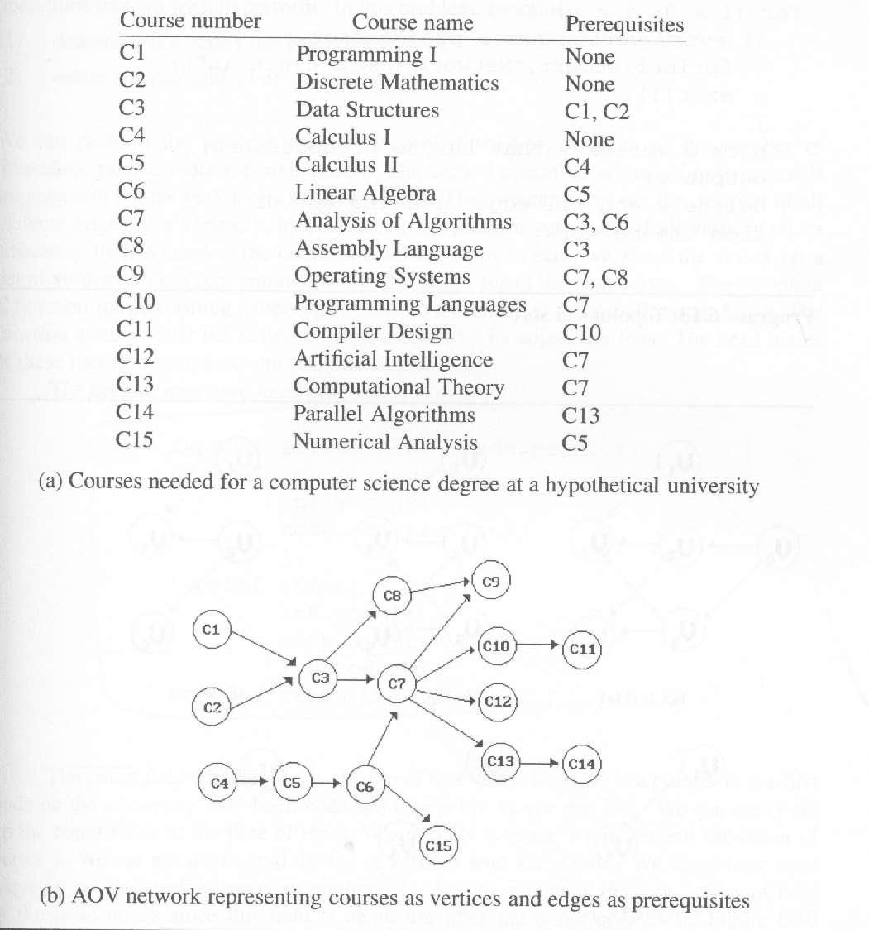
*Figure 6.38: An AOV network (p.305)
Topological order:
linear ordering of vertices
of a graph
∀i, j if i is a predecessor of
j, then i precedes j in the
linear ordering
C1, C2, C4, C5, C3, C6, C8,
C7, C10, C13, C12, C14, C15,
C11, C9
C4, C5, C2, C1, C6, C3, C8,
C15, C7, C9, C10, C11, C13,
C12, C14
CHAPTER 6

Slide 38
*Program 6.13: Topological sort (p.306)
for (i = 0; i <n; i++) {
if every vertex has a predecessor {
fprintf(stderr, “Network has a cycle. \n “ );
exit(1);
}
pick a vertex v that has no predecessors;
output v;
delete v and all edges leading out of v
from the network;
}
CHAPTER 6

Slide 39
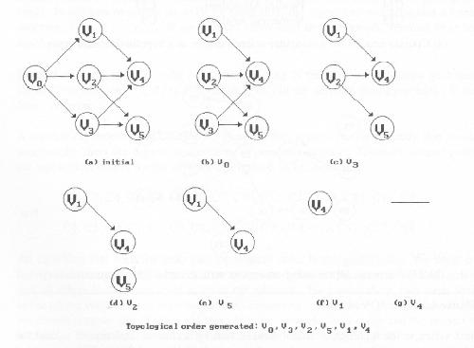
*Figure 6.39:Simulation of Program 6.13 on an AOV network (p.306)
v0 no predecessor
delete v0->v1, v0->v2, v0->v3
v1, v2, v3 no predecessor
select v3
delete v3->v4, v3->v5
select v2
delete v2->v4, v2->v5
select v5
select v1
delete v1->v4
CHAPTER 6

Slide 40
Issues in Data Structure Consideration
Decide whether a vertex has any predecessors.
  Each vertex has a count.
Decide a vertex together with all its incident edges.
  Adjacency list
CHAPTER 6

Slide 41
*Figure 6.40:Adjacency list representation of Figure 6.30(a)
(p.309)
headnodes
node
count
link
vertex
link
V₀
V₁
V₂
0 •
1 •
2 •
3 NULL
1 •
4 NULL
1 •
4 •
5 NULL
V₃
V₄
V₅
1 •
5 •
4 NULL
3 NULL
v1
2 NULL
v0
v2
v4
CHAPTER 6
v3
v5

Slide 42
*(p.307)
typedef struct node *node_pointer;
typedef struct node {
int vertex;
node_pointer link;
};
typedef struct {
int count;
node_pointer link;
} hdnodes;
hdnodes graph[MAX_VERTICES];
CHAPTER 6

Slide 43
*Program 6.14: Topological sort (p.308)
void topsort (hdnodes graph [] , int n)
{
int i, j, k, top;
node_pointer ptr;
/* create a stack of vertices with no predecessors */
top = -1;
for (i = 0; i < n; i++)
if (!graph[i].count) {no predecessors, stack is linked through
graph[i].count = top; count field
top = i;
}
for (i = 0; i < n; i++)
if (top == -1) {
fprintf(stderr, “\n Network has a cycle. Sort terminated. \n”);
exit(1);
}
O(n)
CHAPTER 6

Slide 44
Trees
CHAPTER 6

Slide 45
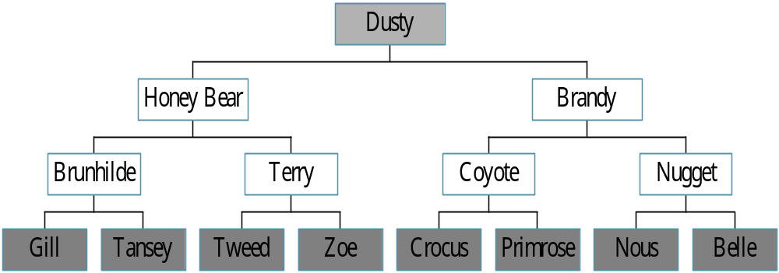
Trees
Root
leaf
CHAPTER 5

Slide 46
Definition of Tree
A tree is a finite set of one or more nodes
such that:
There is a specially designated node called
the root.
The remaining nodes are partitioned into n>=0 disjoint sets T1, ..., Tn, where each of these sets is a tree.
We call T1, ..., Tn the subtrees of the root.
CHAPTER 5

Slide 47
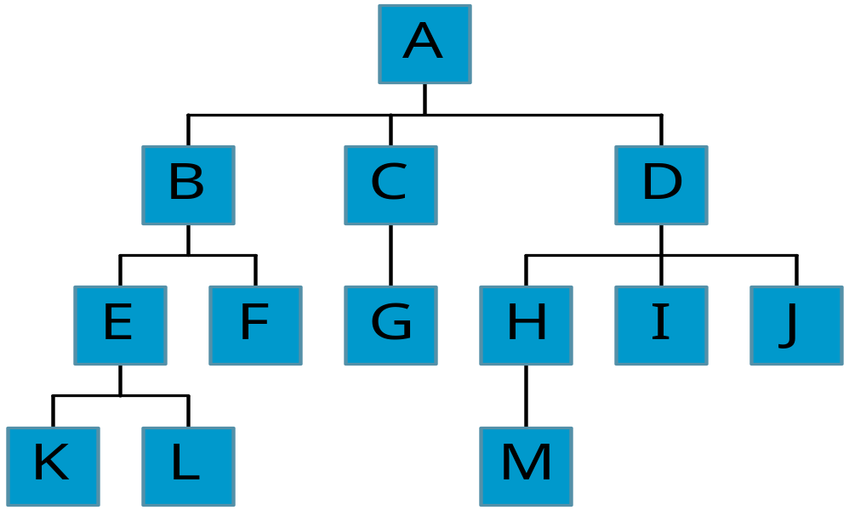
Level and Depth
Level
1
2
3
4
node (13)
degree of a node
leaf (terminal)
nonterminal
parent
children
sibling
degree of a tree (3)
ancestor
level of a node
height of a tree (4)
3
1
2
2
1
2
3
2
2
3
3
3
3
0
1
3
3
0
0
0
0
4
0
4
0
4
CHAPTER 5

Slide 48
Terminology
The degree of a node is the number of subtrees
of the node
  The degree of A is 3; the degree of C is 1.
The node with degree 0 is a leaf or terminal
node.
A node that has subtrees is the parent of the
roots of the subtrees.
The roots of these subtrees are the children of
the node.
Children of the same parent are siblings.
The ancestors of a node are all the nodes
along the path from the root to the node.
CHAPTER 5

Slide 49
TREE – BOTTOM UP DP
CHAPTER 6

Slide 50
Problems on Trees
Many algorithms solving problems on trees uses the bottom-up DP
  Compute all subtrees rooted at all nodes
  Dominating set, vertex cover, diameter
How to find a bottom-up traversal
CHAPTER 6

Slide 51
To find a bottom-up sequence
Different data formats for a tree
  Parent for each node
    Parent ID is smaller than its children
      for (i=n; i>0; i--)
    Any labelling
      Parent array P[]
  As a graph
    Give you the edges or adj matrix
CHAPTER 6

Slide 52
To find a bottom-up sequence
Parent array p[i]
  Similar like dag
  Compute the num of alive children for each node nc[i];
  Put all x with nc[x]==0 into a queue Q;
  Repeat
    Choose the next node x in Q, and nc[p[x]]--;
    if nc[p[x]]==0, then add p[x] into Q
The queue contains a post-order
CHAPTER 6

Slide 53
To find a bottom-up sequence
  The input are the edges (as a graph)
    Pick any node as the root and make a BFS
    The BFS tree is a rooted tree and we know the parent of each node.
  See caterpillar in a tree
CHAPTER 6

Slide 54
Total distance in a tree
By a transformation of the formula, we only need to find the number of nodes in each subtree.
See the blackboard
CHAPTER 6

Slide 55
Tree diameter
Bottom-up
For each node, compute the longest two paths from it to its descendent, and we know the longest path in the subtree rooted at it. Choose the maximum among all nodes.
Another way: check this when visiting its children.
See the sample code.
Another algorithm: the furthest of the furthest.
CHAPTER 6

