Slide 1


git
Realized by : Soukaina FATH-ALLAH & Hamza SIBELLA

Slide 2
Planning
What is git ?
How to download and install git ?
How to use git ?
Practical work

Slide 3
What is git?

Slide 4

Definition
Git is a free and open source distributed version control system designed to handle everything from small to very large projects with speed and efficiency.

Slide 5

About git
Created by Linus Torvalds, creator of Linux, in 2005
Came out of Linux development community
Designed to do version control on Linux kernel
(A "git" is a cranky old man. Linus meant himself.)

Slide 6
How to download and install git?

Slide 7
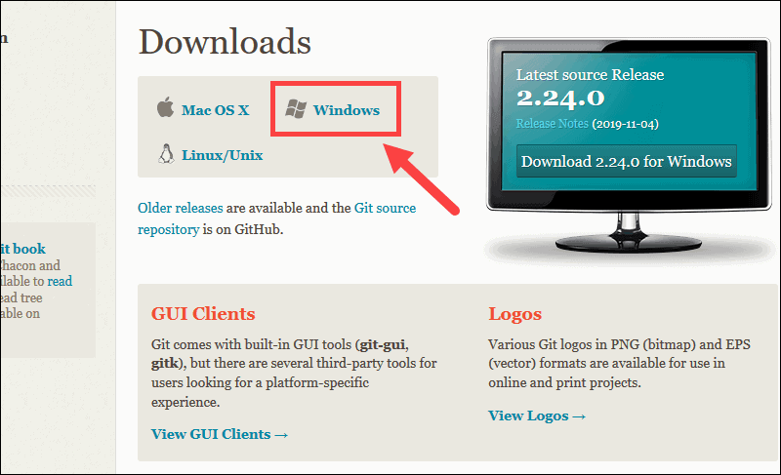

1. Browse to the official Git website: https://git-scm.com/downloads
Download git for windows
2. Click the download link for Windows and allow the download to complete

Slide 8
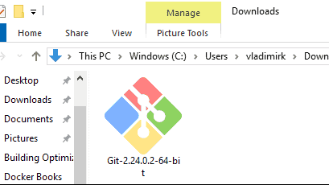
Install git
3. Browse to the download location (or use the download shortcut in your browser). Double-click the file to extract and launch the installer.

Slide 9
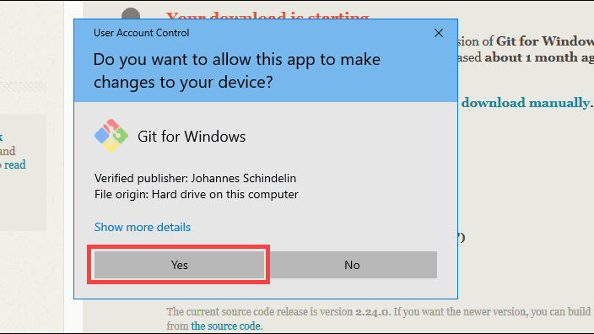
Install git
4. Allow the app to make changes to your device by clicking Yes on the User Account Control dialog that opens.

Slide 10
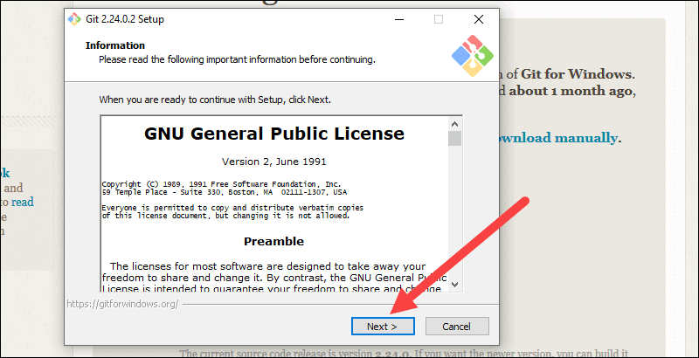
Install git
5. Review the GNU General Public License, and when you’re ready to install, click Next

Slide 11
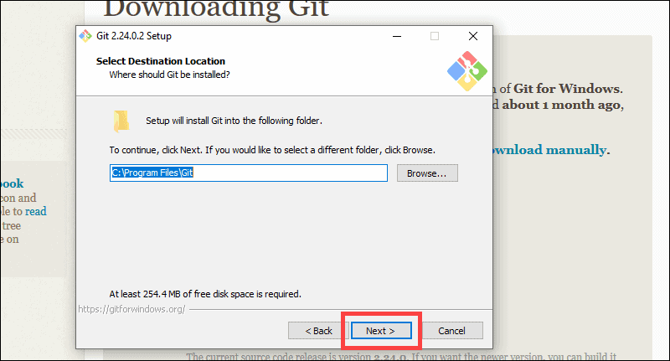
Install git
6. The installer will ask you for an installation location. Leave the default, unless you have reason to change it, and click Next.

Slide 12
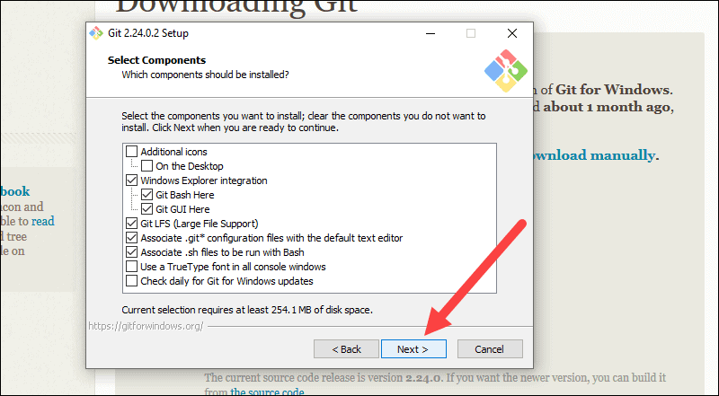
Install git
7. A component selection screen will appear. Leave the defaults unless you have a specific need to change them and click Next.

Slide 13
Install git
7. A component selection screen will appear. Leave the defaults unless you have a specific need to change them and click Next.

Slide 14
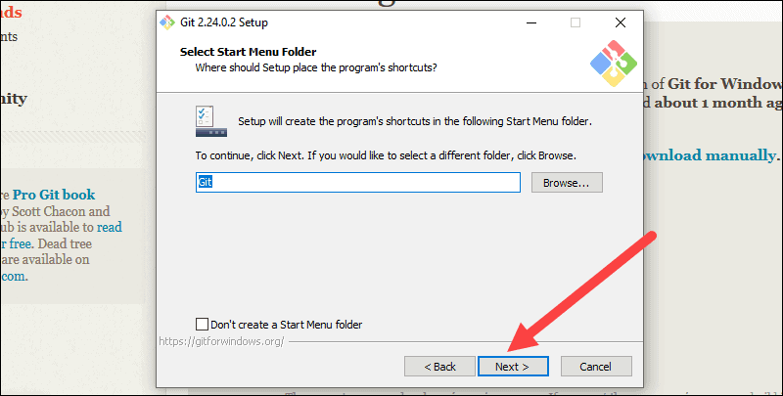
Install git
8. The installer will offer to create a start menu folder. Simply click Next.

Slide 15
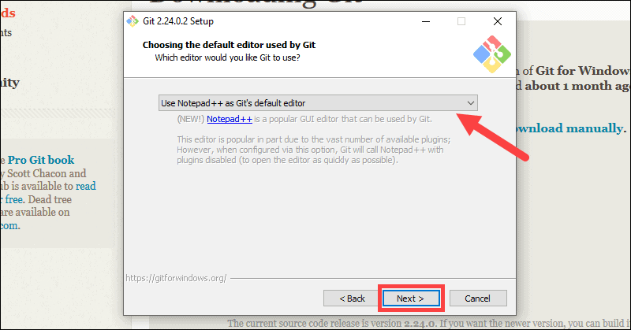
Install git
9. Select a text editor you’d like to use with Git. Use the drop-down menu to select Notepad++ (or whichever text editor you prefer) and click Next..

Slide 16
Install git
9. Select a text editor you’d like to use with Git. Use the drop-down menu to select Notepad++ (or whichever text editor you prefer) and click Next..

Slide 19
Created by Linus Torvalds,
creator of Linux, in 2005
– Came out of Linux development community
– Designed to do version control on Linux kernel

Slide 22
Participation in GirlsCode competition
2nd place among the best submissions of a problem in arena plateform

Slide 23







Slide 24
Enrolling in a gym
Descovering new technologies
managing my time
Completing some online courses
Creating new stuffs
Meeting some old friends
Week 3 : Setting some goals

Slide 25

:
“your success will be determined by your own confidence and fortitude.”
-Michelle Obama
“The most beautiful thing you can wear is confidence.”
-Blake Lively
“When you have confidence, you can do anything.”
-Sloane Stevens

Slide 26





Slide 27
Conclusion

Slide 28
Thanks for your attention

