Slide 1
FA University – Basic HTML
December 2017
Steve Schierholz

Slide 2
Objectives
Outcome
Learn the basics of HTML to help you start building your own site
Topics
What is HTML?
Tools for writing HTML
Structure of HTML
Styling with HTML
Links and images
Tables
Best practices

Slide 3
What is HTML?
What does HTML stand for?
Hyper Text Markup Language
What is used for?
The language that web browsers use to display web sites
Works in conjunction with CSS, Java, and Javascript to name a few
Any site you go to uses HTML

Slide 4
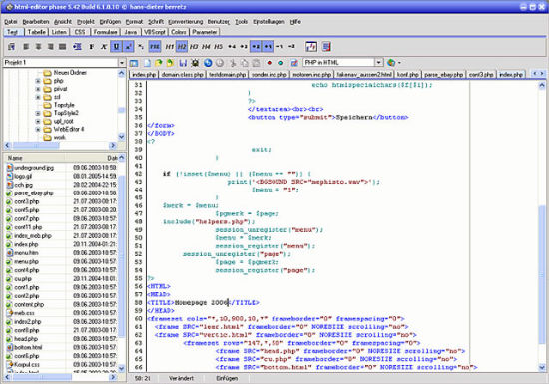
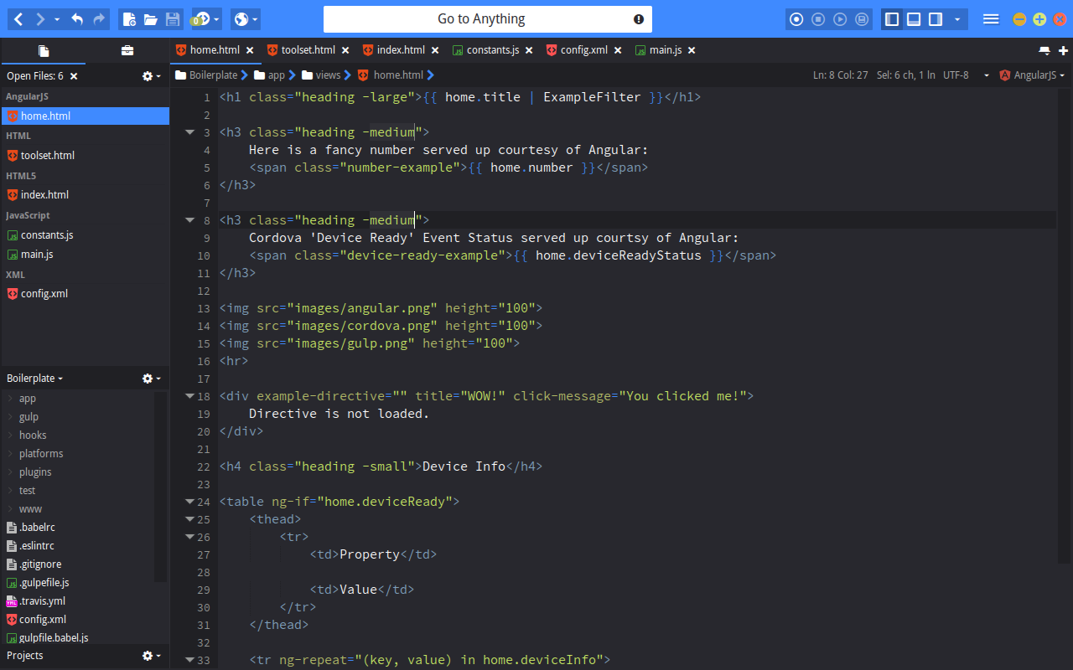
Tools for writing HTML
Phase 5
Free
A lot of features such as tag completion, an integrated image viewer and syntax debugger
Komodo Edit
Free and open source
A lot of features such as auto complete, toolbox, and tracking changes

Slide 5
Structure of HTML
Step 1:
Structuring the code correctly
Example:
<p>Sleeve Shirtholes</p>
<p>: Opening tag
Element after opening tag
</p>: Closing tag
Most tags require opening and closing with some exceptions

Slide 6
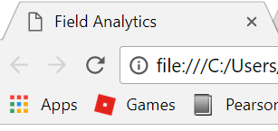
Structure of HTML
Step 2:
Start out your coding with
<!DOCTYPE HTML>
<html>
<head>
<title>Field Analytics</title>
</head>
</html>
Notes:
<!DOCTYPE HTML> - Tells the browser what version of HTML the website is using

Slide 7
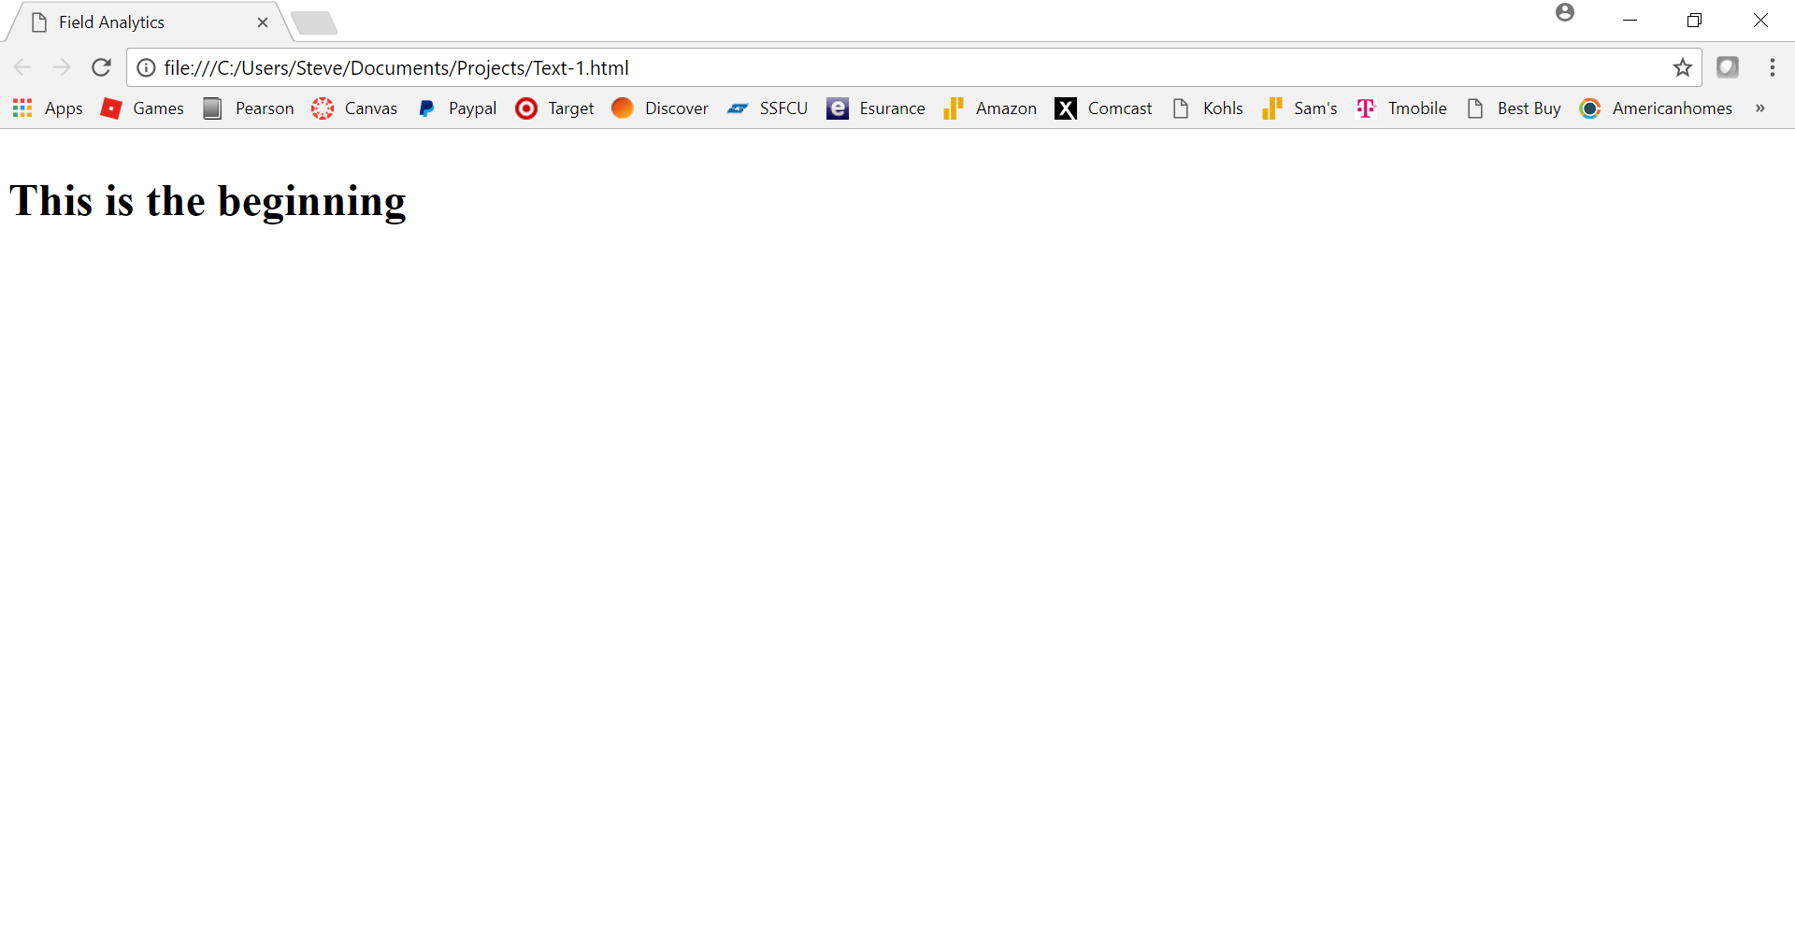
Structure of HTML
Step 3:
Adding content to your page
<!DOCTYPE HTML>
<html>
<head>
<title>Field Analytics</title>
</head>
<body>
<h1>
<p>This is the beginning</p>
</h1>
</body>
</html>

Slide 8
Styling with HTML
<i>Steve</i> - Italicizes text
<b>Steve</b> - Bolds text
<u>Steve</u> - Underlines text
<s>Steve</s> - Strikethroughs text
<center>Steve</center> - Centers text
<font size=“5” color=“#FF0000”>Steve</font>
Changing aspects of text
<h1 style="background-color:Orange;">Steve</h1>
Heading text sizes
<br> - Starts text on another line

Slide 9
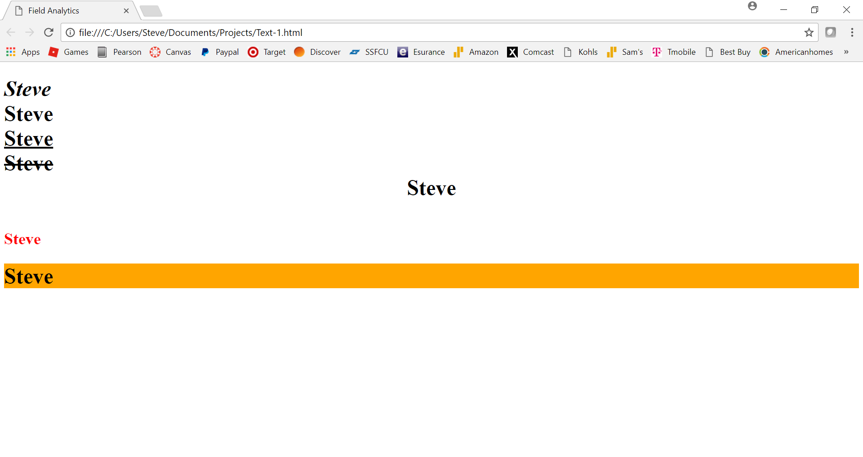
Styling with HTML

Slide 10
Links and images
<a href=“http://www.discover.com”>This is a link</a>
The a identifies it as a link and href tells the browser the actual link
<img src=“logo.jpg” alt=“Field Analytics” style=“width:500px;height:500px;”>
The img tells the browser that it is a image
The src tells it where to find the image
The alt tells it to add a caption to the image
The style tells it the format of the image
<a href=“http://www.discover.com”><img src=“logo.jpg” alt=“Field Analytics” style=“width:500px;height:500px;”></a>
You can make images links

Slide 11
Links and images

Slide 12
Tables
<table style="width:50%" border="1"></table>
Beginning tells the browser that it is a table
Style tells it the format of the table
<tr></tr>
Tells it that it is a new table row
<th></th>
Tells it that it is a new column

Slide 13
Tables
<table style="width:50%" border="1">
<tr>
<th><center>First Name</center></th>
<th><center>Last Name</center></th>
<th><center>Number of Years</center></th>
</tr>
<tr>
<td><center>Steve</center></td>
<td><center>Schierholz</center></td>
<td><center>7</center></td>
</tr>
</table>

Slide 14
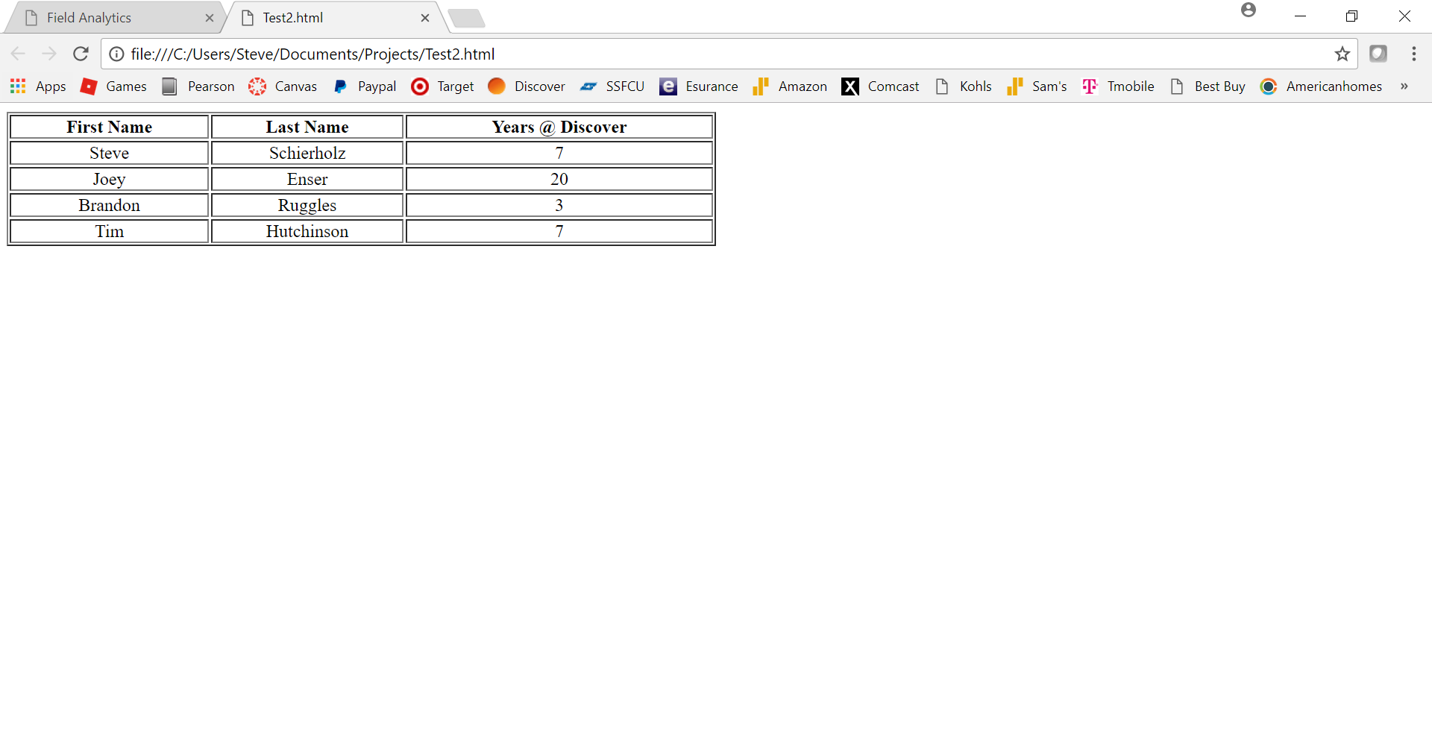
Tables

Slide 15
Putting it all together

Slide 16
Best Practices
Indention
W3C is responsible for setting standards
2 spaces when writing HTML
When code is nested inside, add additional 2 spaces
Comments
<!-- Opening tag and closing tag-->
Adding comments whenever necessary
Helps others know what's happening with code
<!DOCTYPE HTML>
<html>
<head>
<title>Field Analytics</title>
</head>
<body>
<h1>
<!-- Starting the webpage with a paragraph -->
<p>This is the beginning</p>
</h1>
</body>
</html>

