Slide 1

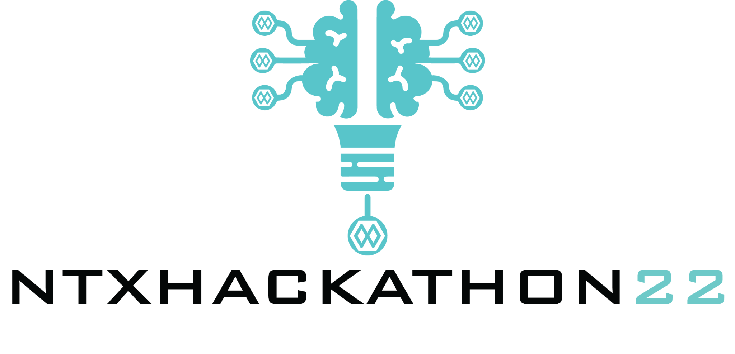


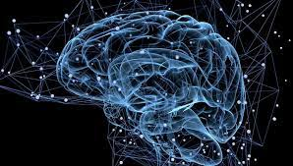
NovaBrain
Paris
Team 42 - Rapsberry
Adrien
Dani
Seb
Samy
Laurence

Slide 2

How to make an immersive link between computer interface and human body signals improves life?
Our first goal is to help people with a lack or loss of autonomy: paralysed, disabled, elderly.
= enabling to regain their autonomy and a certain level of freedom to act at a very simple level.
Who is affected? People with defective or reduced or absent mobility of the upper limbs:
paralytics, hemiplegics, Parkinson’s disease, neuropathies etc. ....
NovaBrain allows the processing of signals from the jaw and / or posterior areas of the brain - electroencephalogram - and the association to a menu allowing actions.
Applications:
activate home automation elements: switch on a light, close a door ....
guide the movement of his wheelchair
activate the movements of his hexoskeleton
Reducing dependency, increasing autonomy seems to us
an important challenge to be solved.
Rapsberry_NTXHACK22

Slide 3
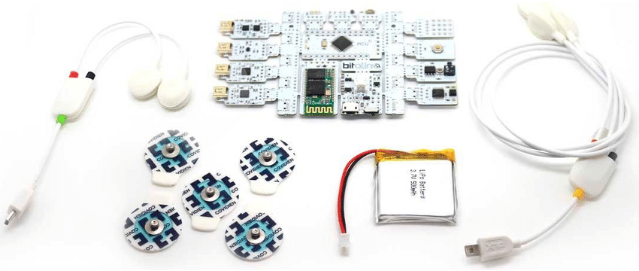
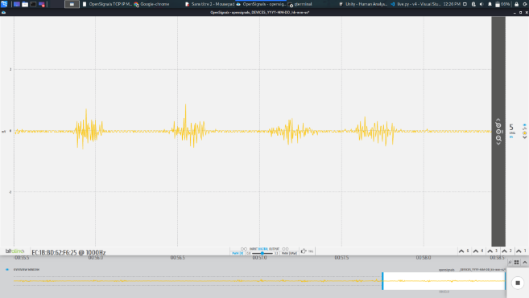
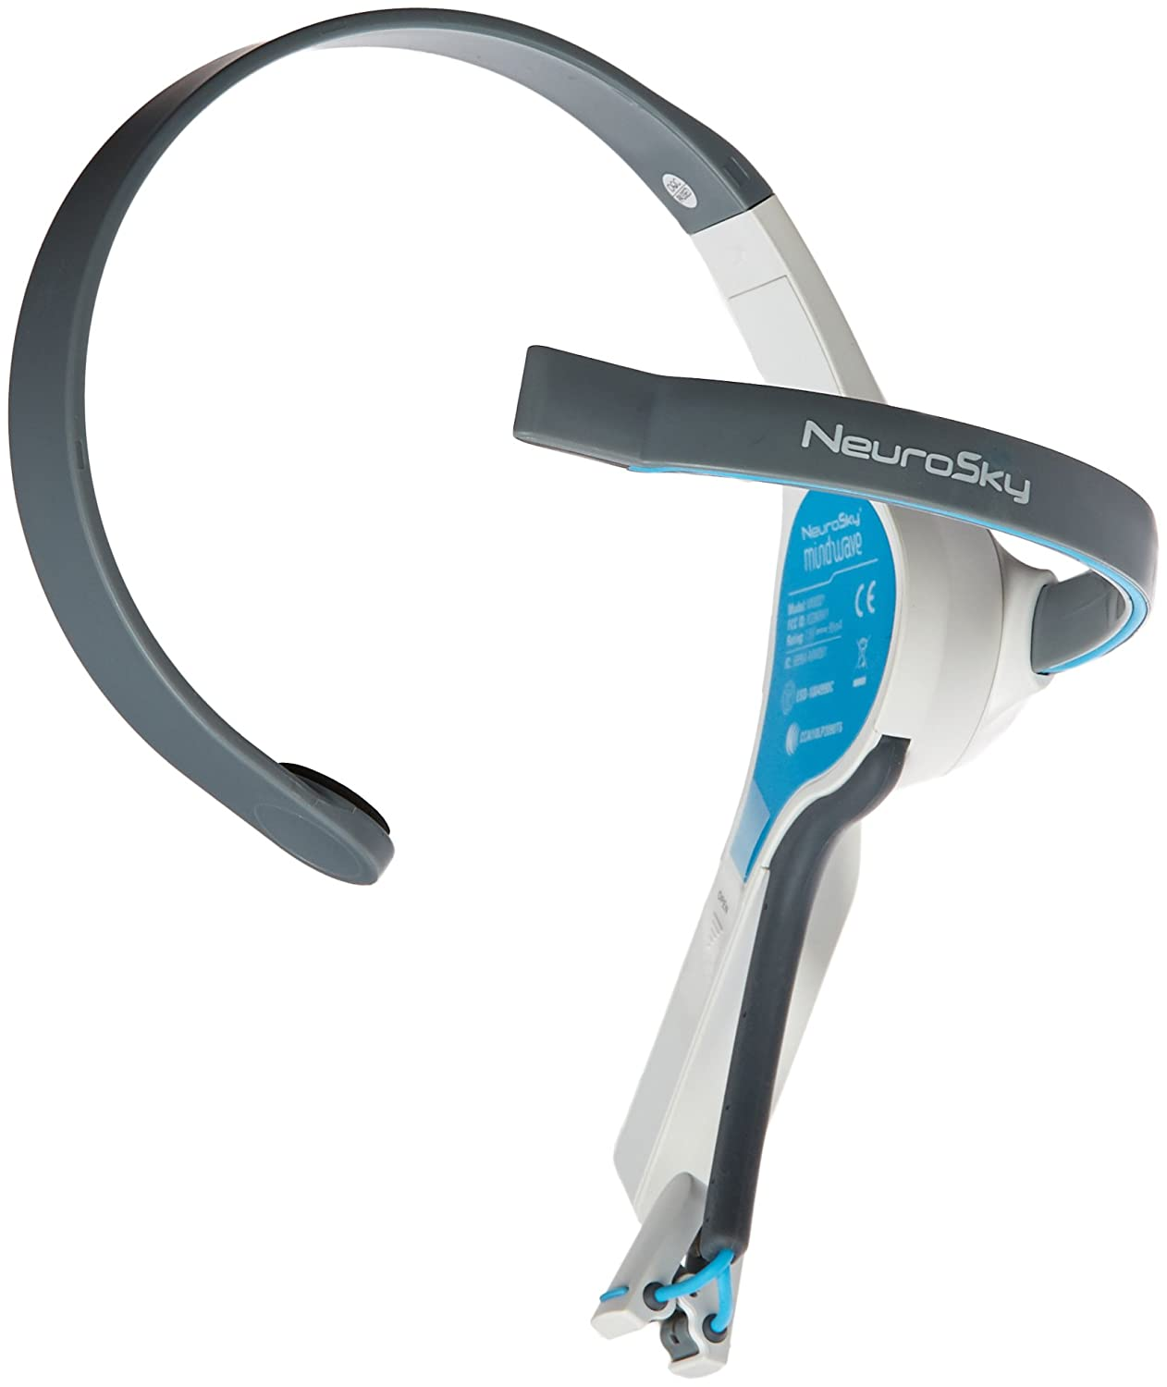
How does it address the problem?
A Python application which acts as a virtualy assistant that converts signals into output for various applications.
The input are either a signal from the jaws, or from the brain or from both (distinct signal profiles).
An ON/OFF sequence to activate recording signals transmitted from electrodes (3 or 5) or a helmet.
A customizable menu that propose items to choose from.
Rapsberry_NTXHACK22

Slide 4
Current developments
How successfully can it solve different aspects of the problem?
activate the acquisition system on demand
customize the content of the proposed menus and applications with API
choose the activation mode according to a motor deficit or a contemporary activity (e.g. do not activate the brain module when it is busy with another function)
What benefits and limitations are there?
benefits: autonomy, mobility,
limitations : pre-selected menus to be adjusted according to needs and uses
Our second goal is to developp applications for people with normal mobility: domotic, activate services
Driving: using the jaw module requires less neurological capacity than a mobile phone or a conversation and improve road safety
Assistance in certain areas of activity when the hands are busy doing something
Algorithms:
finer analysis of the signal from the brain
propose more developed algorithms and functionalities on logical or more complex modes (e.g. propose a series of linked actions such as turning off the lights, closing the door and the shutters)
Rapsberry_NTXHACK22

Slide 5
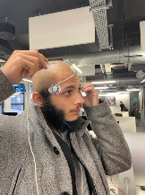
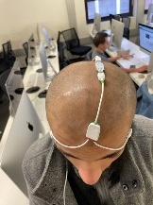
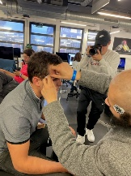
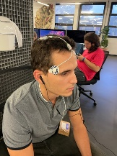
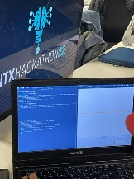
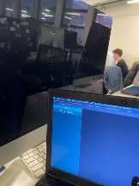
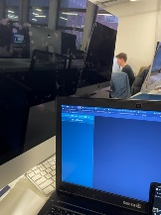
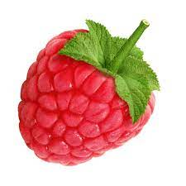
Documentation
Description of solution
NovaBrain is a python application which acts as a virtual assistant interacting between the user and the phone.
A menu is left at the disposal of the user, and commands are enumerated vocally to the user. NovaBrain captures the signals from the jaw to validate one of the options listed vocally.
To make this possible, a BITalino device is used, and the expected signal is captured using Opensignal. .
Rapsberry_NTXHACK22

Slide 6
Documentation
Github / Design link if applicable
https://github.com/lbenatta/NTXHACKATHON22-_Novabrain
Bibliography
Won, K., Kwon, M., Ahn, M. et al. EEG Dataset for RSVP and P300 Speller Brain-Computer Interfaces. Sci Data 9, 388 (2022). https://doi.org/10.1038/s41597-022-01509-w
Helfrich RF, Knight RT. Cognitive neurophysiology: Event-related potentials. Handb Clin Neurol. 2019;160:543-558. doi: 10.1016/B978-0-444-64032-1.00036-9. PMID: 31277875.
Rapsberry_NTXHACK22

Slide 7
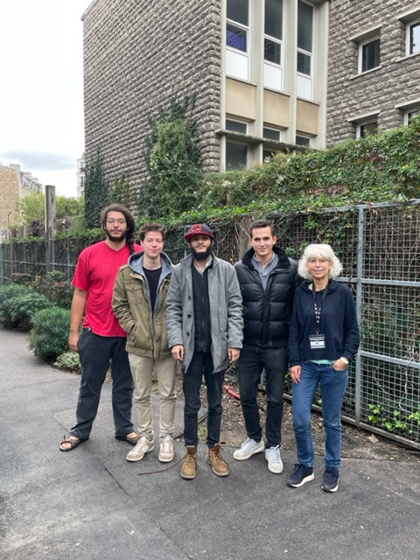
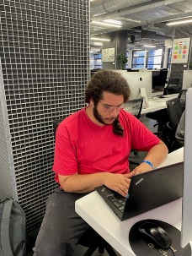
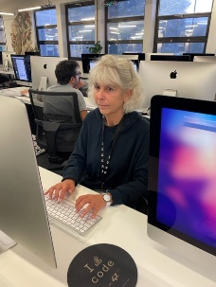
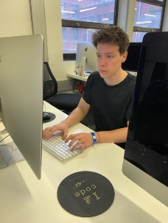
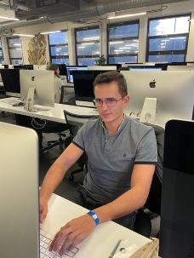
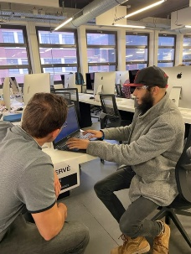
Documentation
Thank you !
Rapsberry_NTXHACK22

