Slide 1
Snakes & Ladders Game Project Michael Campise Johnny Myers Jr cOP2006::Spring2025 Dr. SunnY

Slide 2
Our Goal
Create a program for the classic Snakes and Ladders game that uses a graphical user interface.
Our game is just as fun as the board game and it gives off a creative, user-friendly interface!
Software requisites:
Any integrated development environment for C++ (preferably CLion)
SFML Downloaded

Slide 3

Introduction & Why WE Chose this project:
Our project is a take on the classic game, snakes and ladders, that was created with a user-friendly experience in mind.
We chose this project because we love video games and even though this program is simple compared to modern video games, it has allowed us to create what we love.

Slide 4

Existing technique and Our improvisations to the existing concept
The existing concept is a simple snakes and ladders game that is played in the console of an integrated development environment and asks the user each time they want to roll.
Our improvisation is a graphical user interface that allows the player to see the board and dice clearly and roll with a simple click of a button. We also added a fun game mechanic where the user must roll the exact number of spaces to finish the game.

Slide 5
Pseudo code
PROGRAM SnakesAndLaddersGUI
SET windowWidth TO 800
SET windowHeight TO 800
SET rows TO 10
SET cols TO 10
SET currentTile TO 0
SET totalTiles TO rows * cols
LOAD font from "font.otf"
CREATE window of size (1200, 800) titled "My window"
LOAD 6 dice textures from dice1.png to dice6.png INTO diceTextures[]
LOAD board texture from "board.png"
LOAD player sprite texture from "sprite.png"
CREATE board sprite, position at (0, 0)
CREATE pawn sprite, set size to (80, 80), position at (0, 710)
SET UP die1 sprite with initial dice texture​
POSITION die1 at (850, 250), scale to 0.25​
CREATE roll dice button at (850, 445), size (120, 50), label it "Roll Dice"​
SET UP "You Win!" text with large red font​
INITIALIZE random number generator for dice rolls (1 to 6)​
DEFINE ladders: tile mappings where player moves up​
DEFINE snakes: tile mappings where player moves down​
SET hasWon TO FALSE​
WHILE window is open DO
FOR each event in window DO
IF event is "window closed" THEN
CLOSE window
ENDIF
IF event is "mouse button pressed" AND click is inside roll dice button THEN
ROLL dice to get value from 1 to 6
DISPLAY corresponding dice image
CALCULATE tempTile = currentTile + dice value
IF tempTile > totalTiles THEN​
PRINT "Cannot move, need exact roll"​
CONTINUE to next loop​
ENDIF​
IF tempTile is on a ladder THEN​
MOVE player to ladder destination​
ELSE IF tempTile is on a snake THEN​
MOVE player to snake destination​
ELSE​
SET currentTile = tempTile​
ENDIF​
CALCULATE board position:​
row = (currentTile - 1) / cols​
col = (currentTile - 1) % cols​
IF row is odd THEN​
col = (cols - 1) - col // zigzag movement​
ENDIF​
SET sprite position based on row and col​
IF currentTile == totalTiles THEN​​
SET hasWon TO TRUE​​
PRINT "You Win!"​​
ENDIF​​
ENDIF​​
ENDFOR​​
CLEAR screen with brown color​
DRAW board grid (horizontal and vertical lines)​
DRAW board, die, pawn, button, and text​
IF hasWon THEN​
DISPLAY "You Win!" message​
ENDIF​
DISPLAY updated frame​
ENDWHILE​
ENDPROGRAM

Slide 6
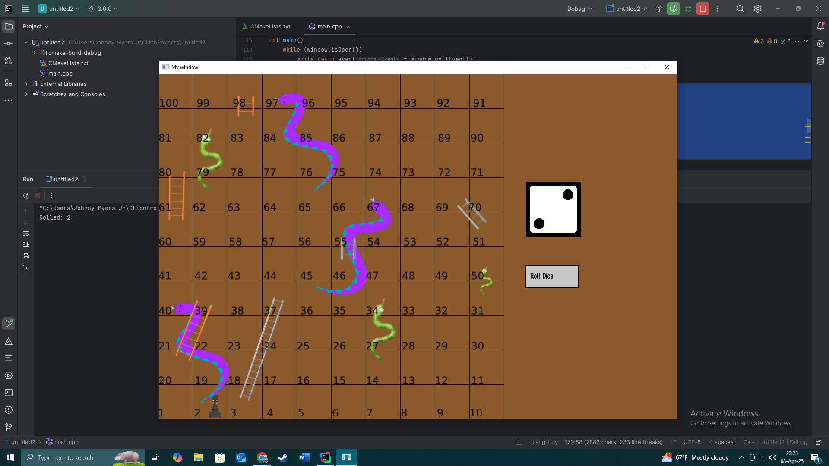
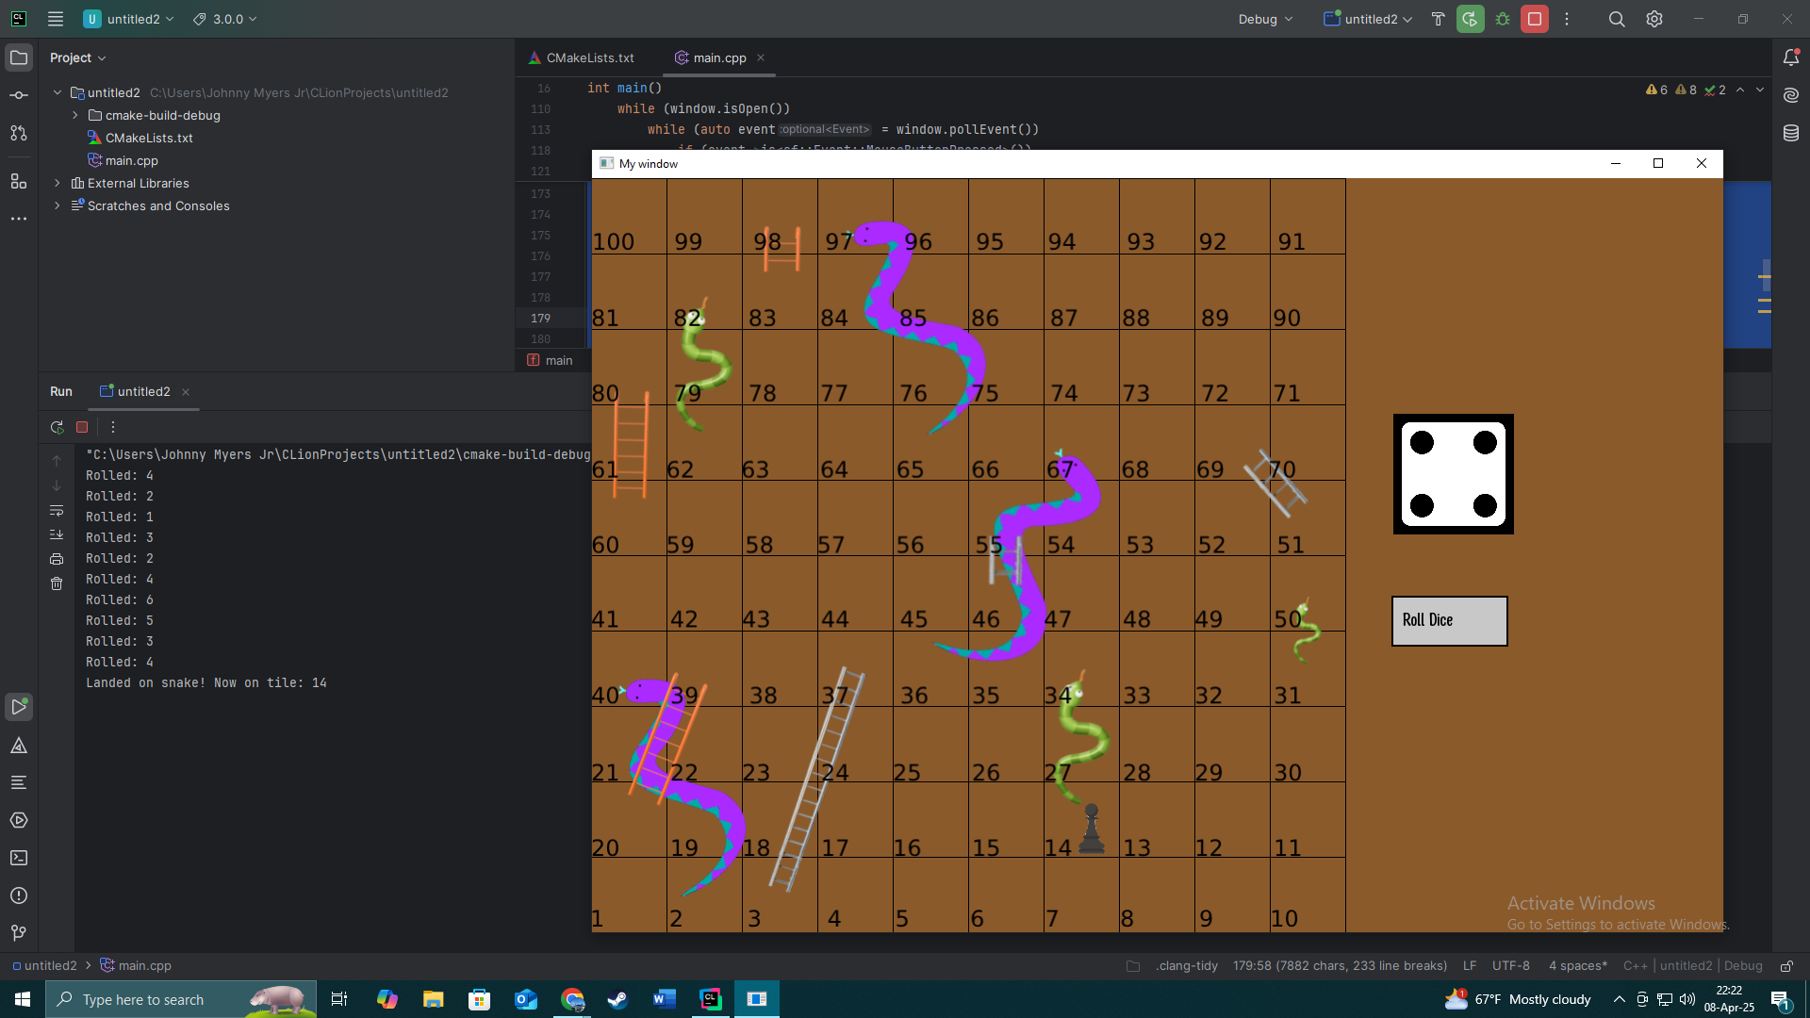
Code Outputs Pt1

Slide 7
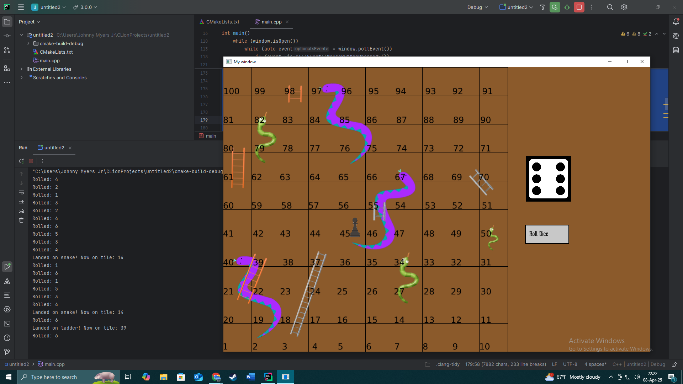
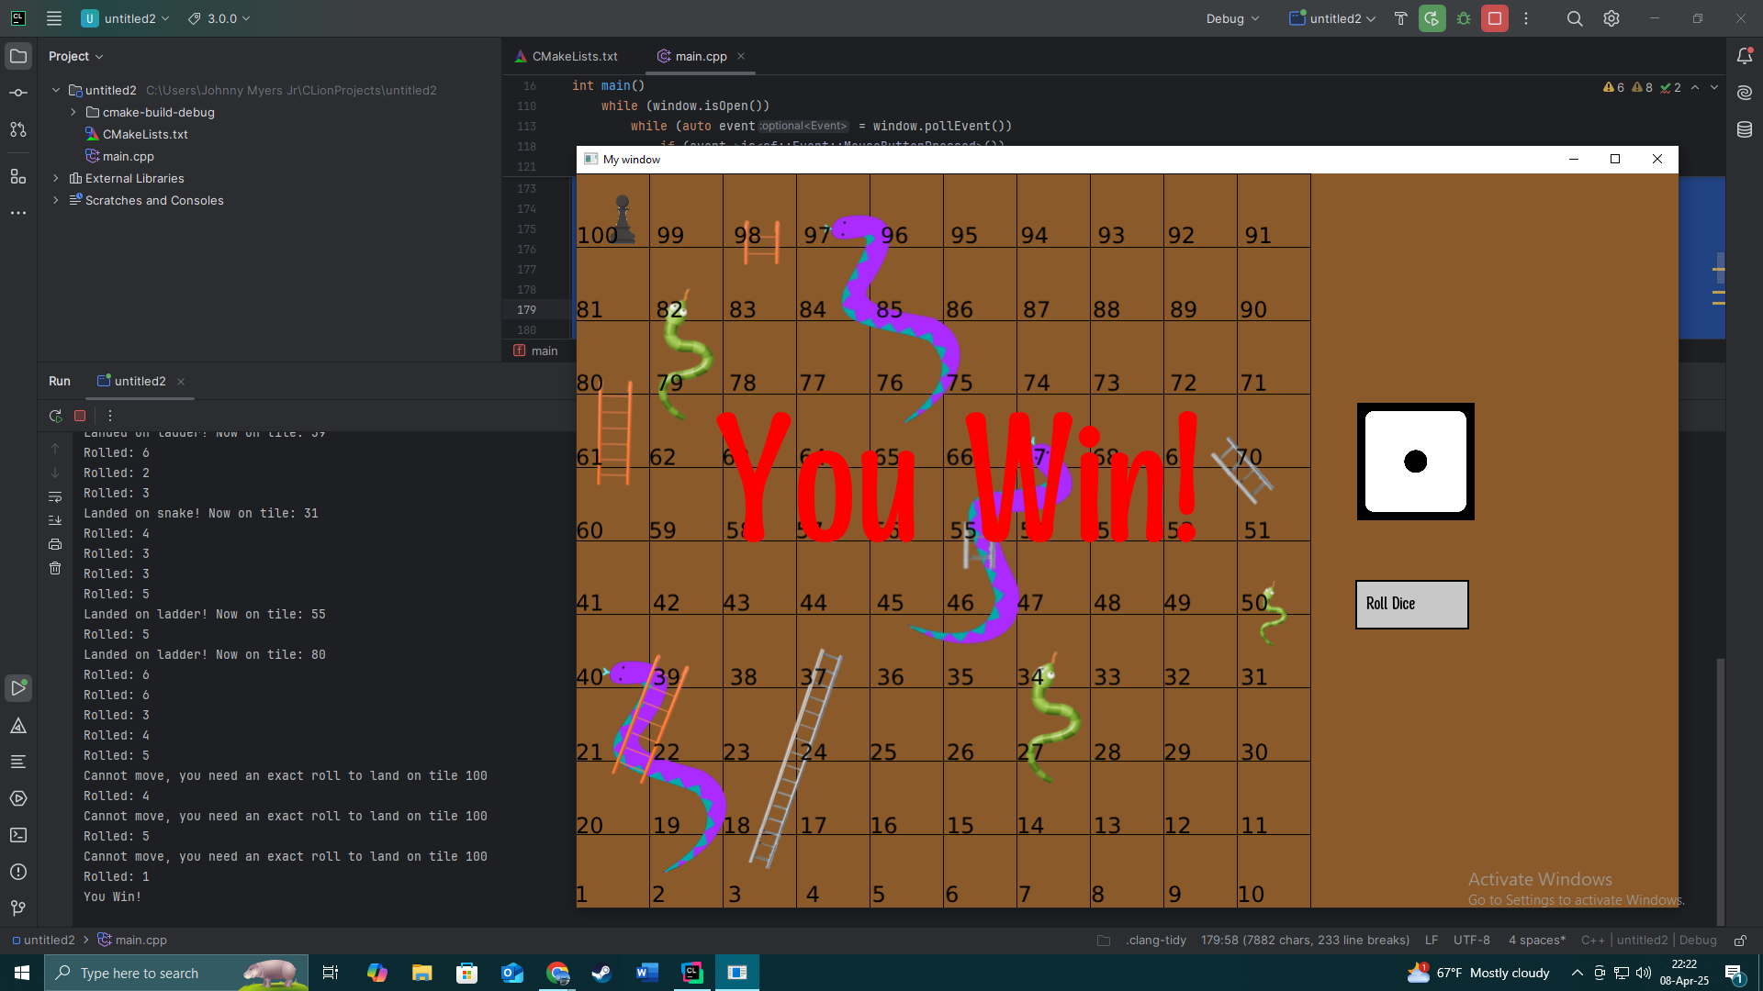
Code Outputs Pt2

Slide 8
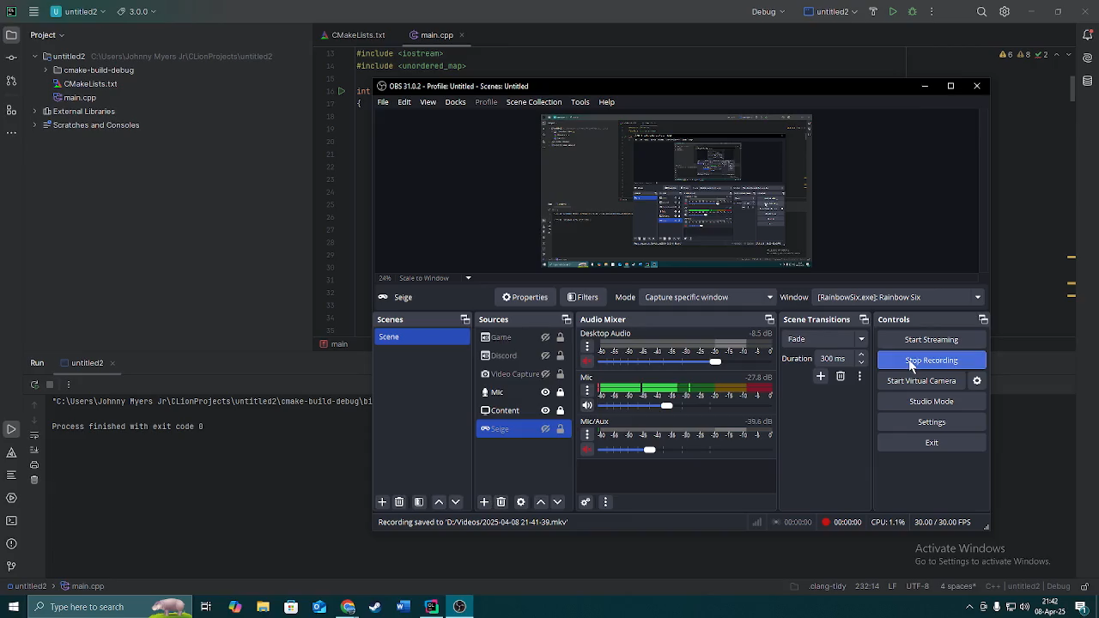
Video:

Slide 9
Conclusion
From our work, we have learned many new skills in coding like integrating SFML, the graphical user interface we used, into C++. Creating a game from scratch is a daunting task but using the skills we have learned in this class has allowed us to overcome this challenge.
Some techniques we could use to improve our work would be coding this project in Microsoft Visual Code, which allows for easier integration with the graphical user interface we used and creating a more visual appealing graphical user interface.

Slide 10
References
https://www.sfml-dev.org/
https://www.geeksforgeeks.org/cpp-gui-programming/?ref=gcse_outind
https://github.com/SFML/SFML-Game-Development-Book
https://github.com/SFML/cmake-sfml-project0
https://github.com/SFML/SFML

