Slide 1
Data correction

Slide 2
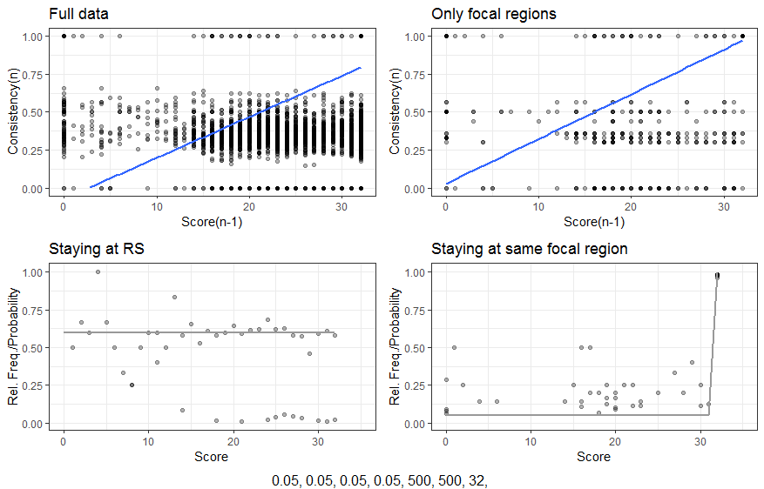
Full data

Slide 3
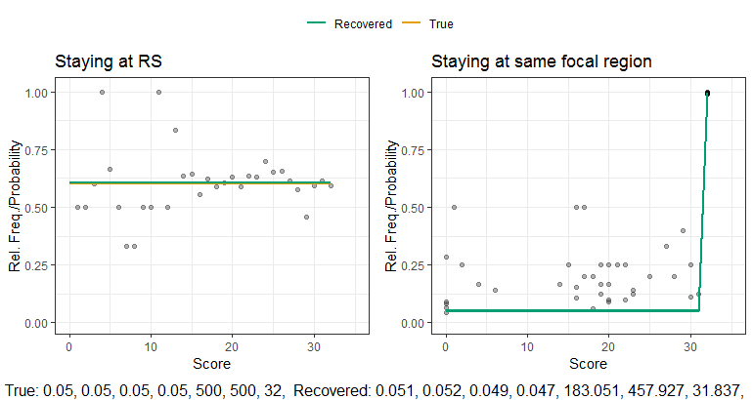
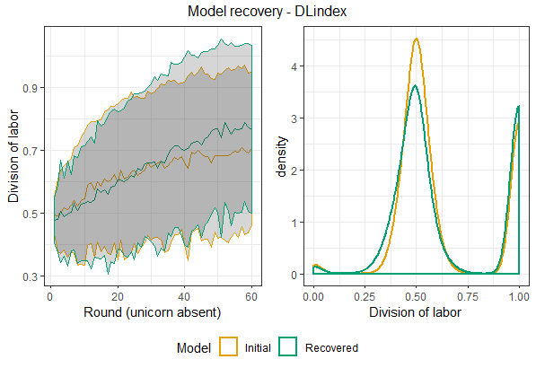
Model recovery full data
Behavior at the individual level
Behavior at the dyad level

Slide 4
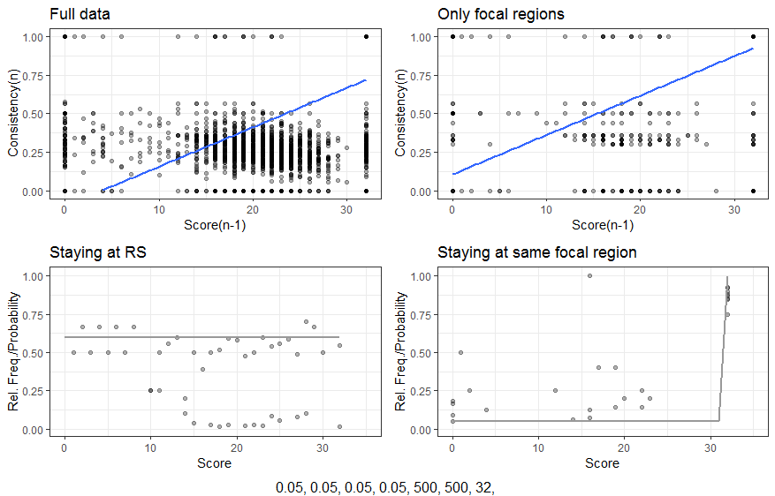
Only Unicorn Absent
False
negatives
Insufficient
data

Slide 5
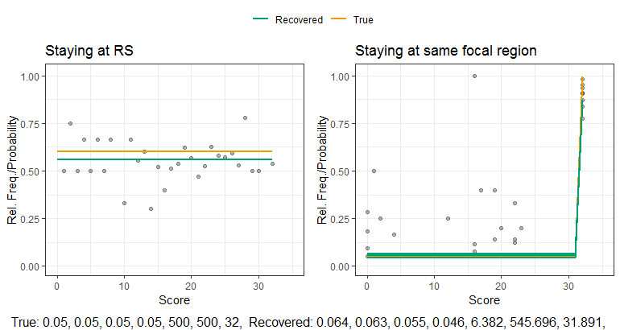
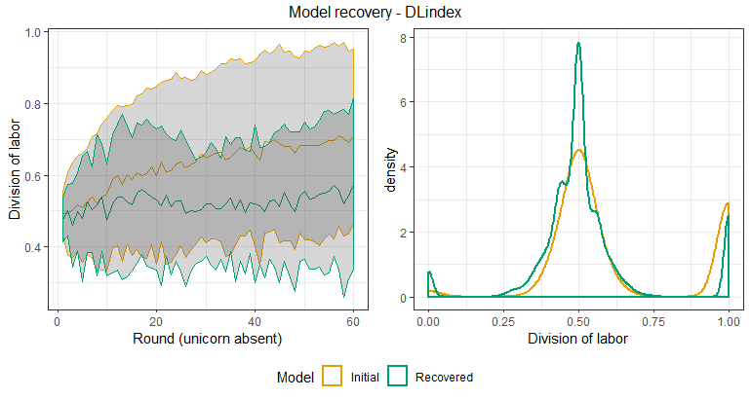
Effect on parameter recovery
α is too low!

Slide 6
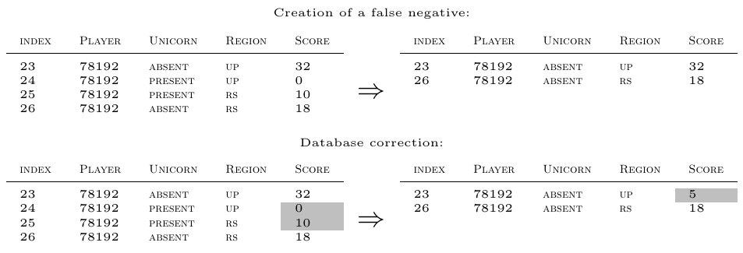
Score correction

Slide 7
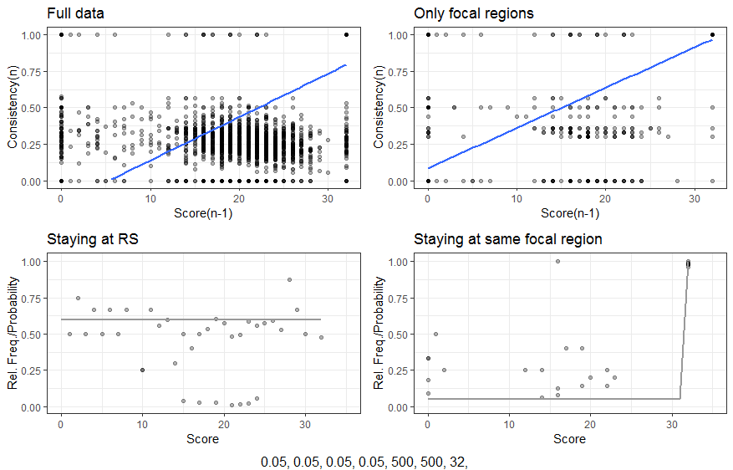
Score correction
False
negatives
Less false
negatives
False
Negatives
and
insufficient data

Slide 8
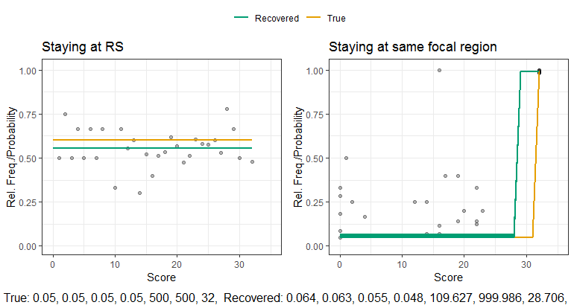
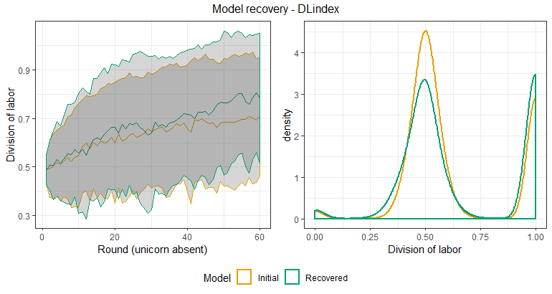
Effect on parameter recovery (Score correction)
γ = 28,7

Slide 9
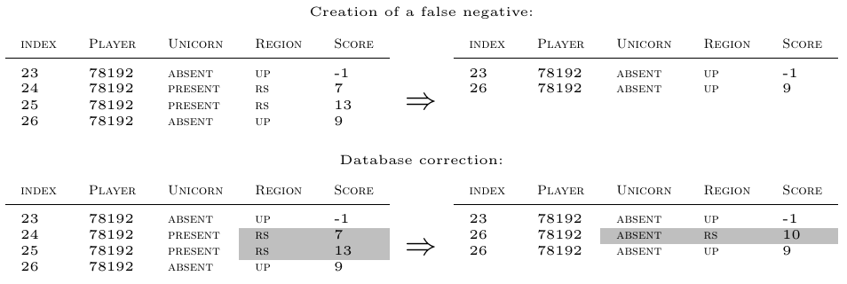
Estimating Unicorn-Present-Blocks and score correction

Slide 10
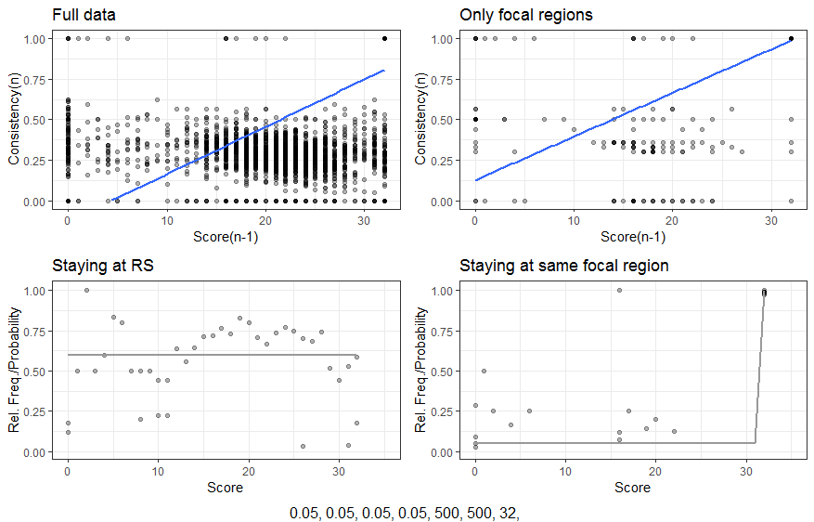
Estimating Unicorn-Present-Blocks and score correction
Less false
negatives
Insufficient
data

Slide 11
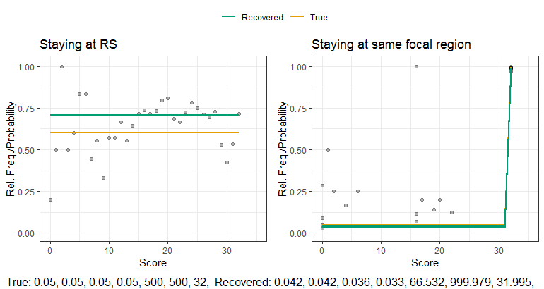
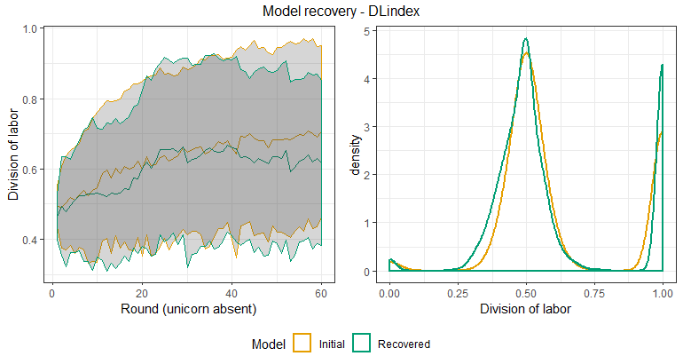
Effect on parameter recovery (Block estimation)
Good enough?

