Slide 1
Data correction

Slide 2
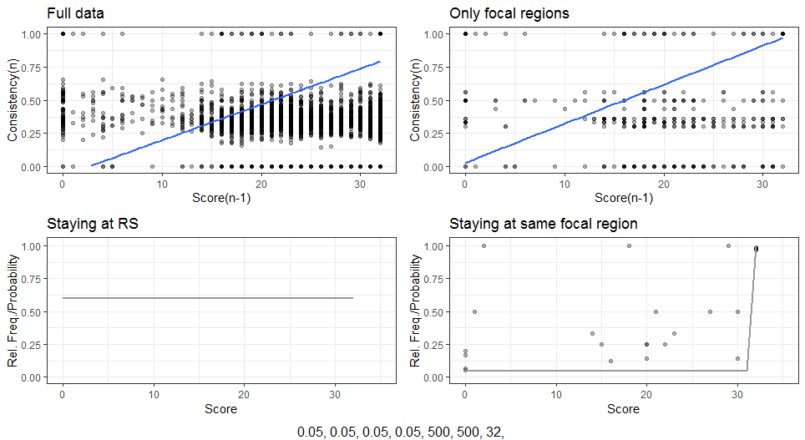
No corrections – Full data

Slide 3
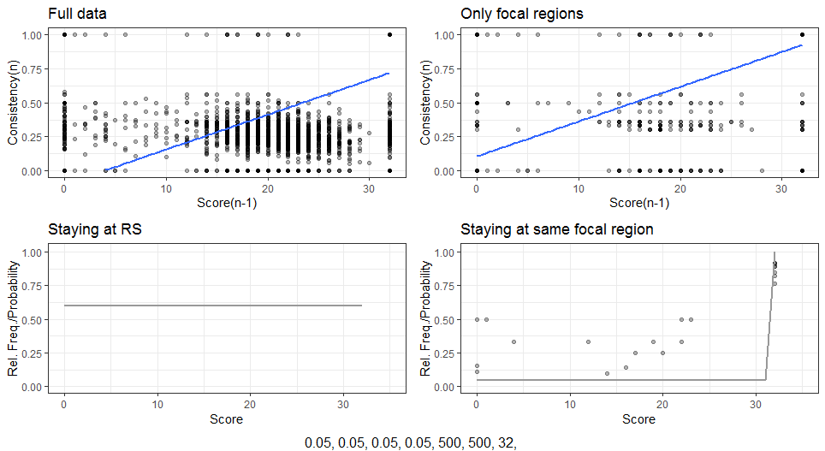
No corrections – Only Unicorn Absent
False
negatives
Insufficient
data

Slide 4
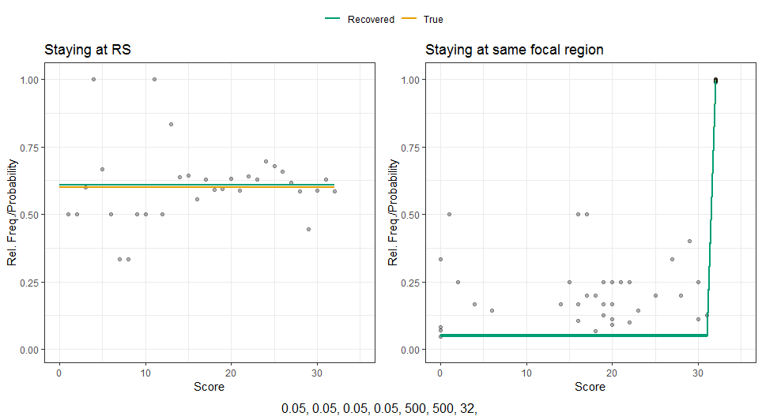
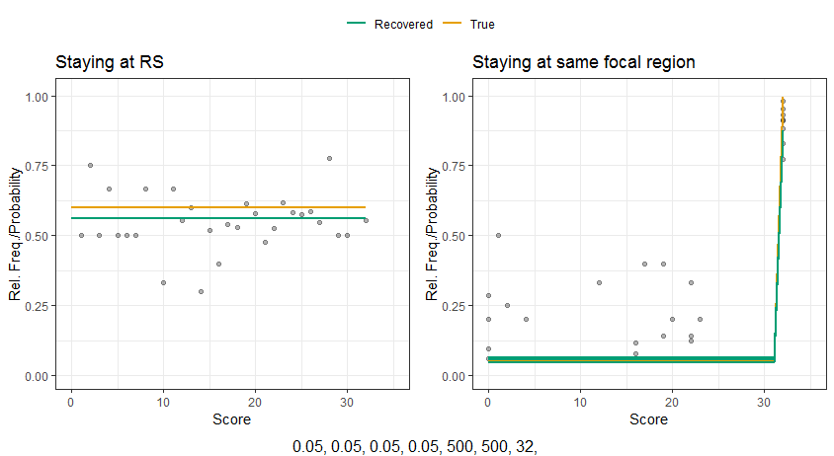
Effect on parameter recovery
Full data
Only rounds with unicorn absent
α = 6,32

Slide 5
No corrections – Only Unicorn Absent
False
negatives
Insufficient
data

Slide 6
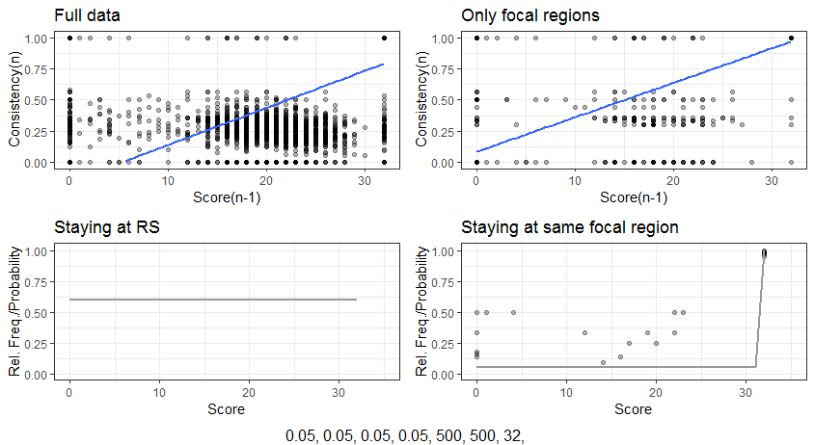
Score correction only
False
negatives
Less false
negatives
False
Negatives
and
insufficient data

Slide 7
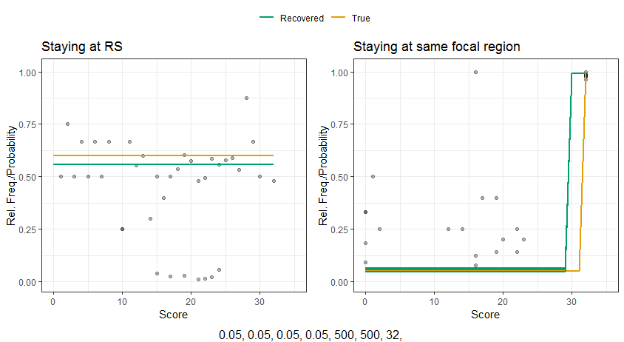
Effect on parameter recovery (Score correction)
Full data
Only rounds with unicorn absent
γ = 29,43

Slide 8
No corrections – Only Unicorn Absent
False
negatives
Insufficient
data

Slide 9
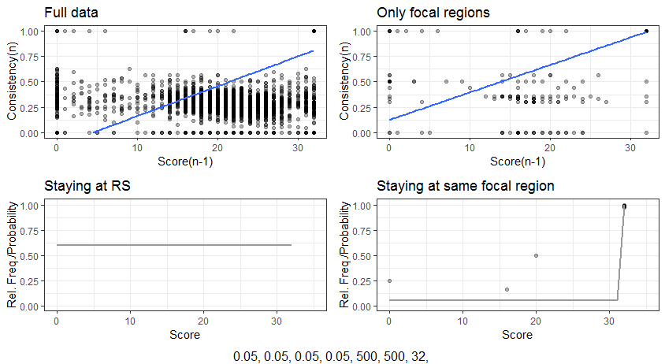
Estimating Unicorn-Present-Blocks and score correction
Less false
negatives
Insufficient
data

Slide 10
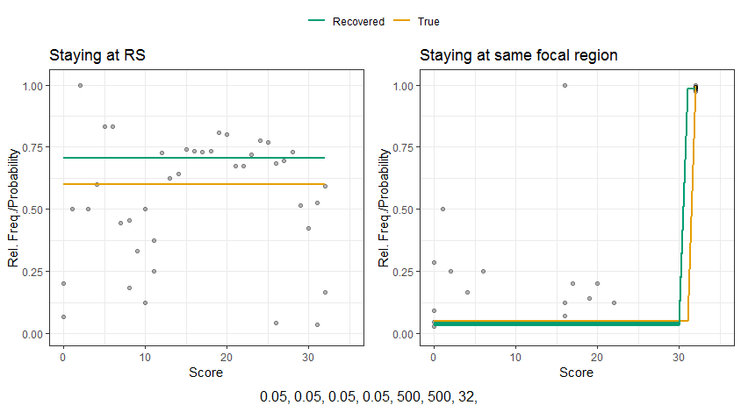
Effect on parameter recovery (Block estimation)
Full data
Only rounds with unicorn absent

