Slide 1
Data correction

Slide 2
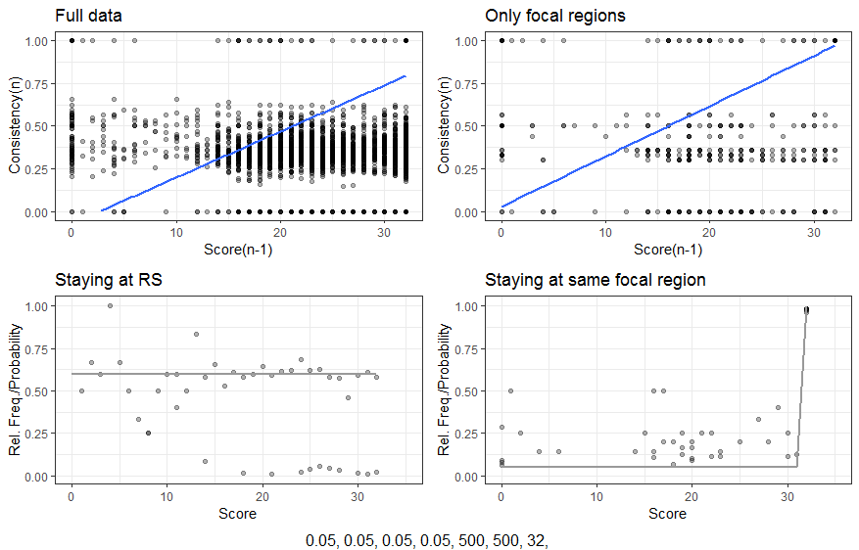
Full data

Slide 3
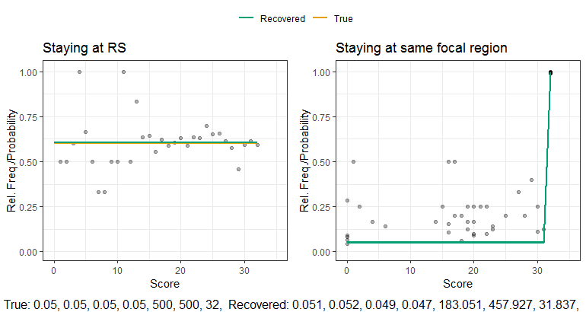
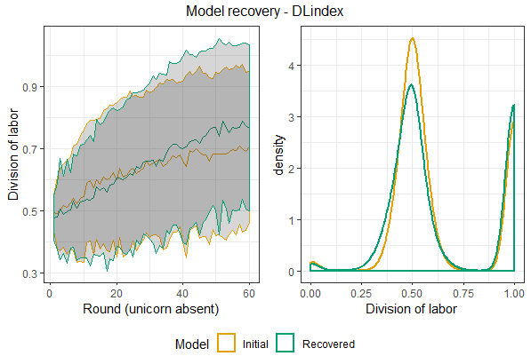
Model recovery full data
Behavior at the individual level
Behavior at the dyad level

Slide 4
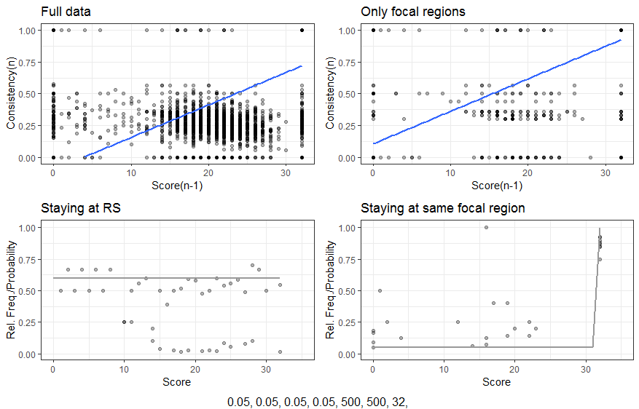
Only Unicorn Absent
False
negatives
Insufficient
data

Slide 5
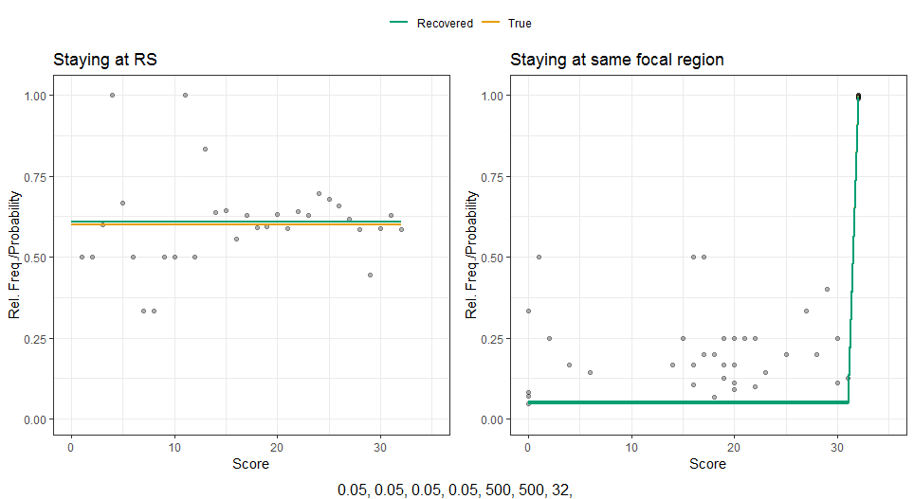
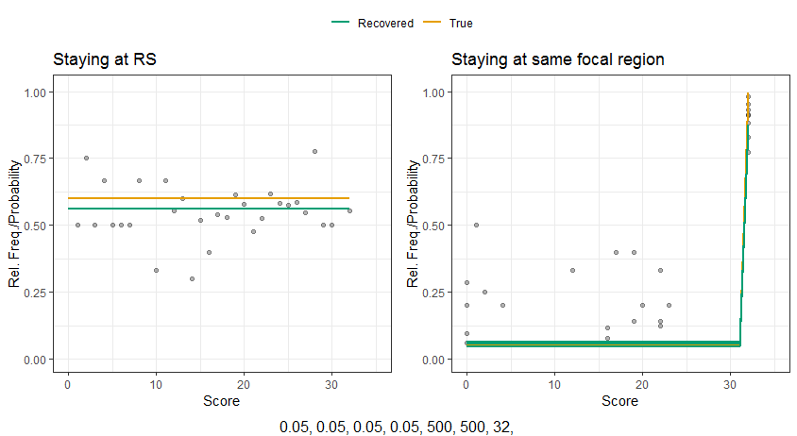
Effect on parameter recovery
Full data
Only rounds with unicorn absent
α = 6,32

Slide 6
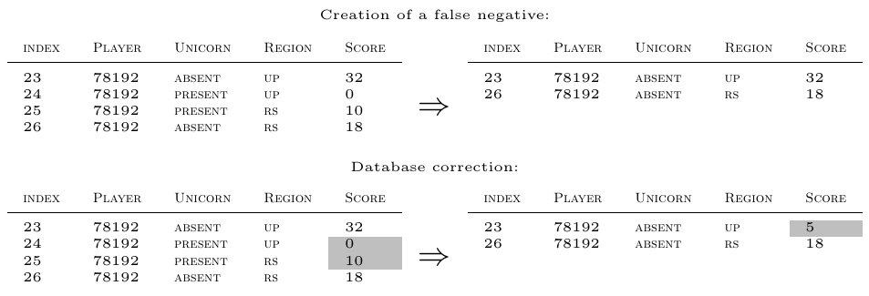
Score correction

Slide 7
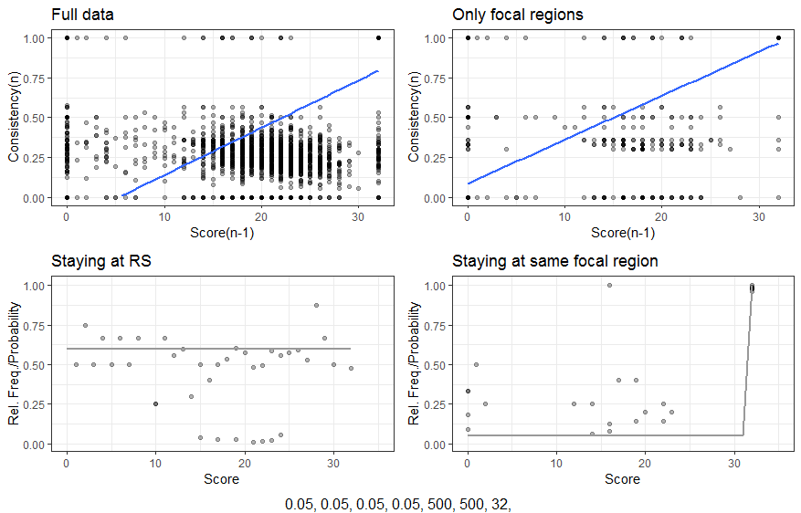
Score correction
False
negatives
Less false
negatives
False
Negatives
and
insufficient data

Slide 8
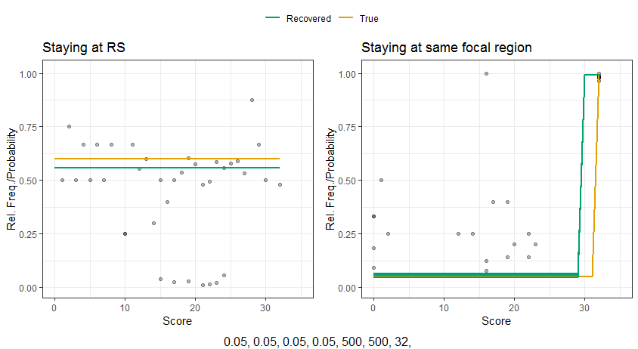
Effect on parameter recovery (Score correction)
Full data
Only rounds with unicorn absent
γ = 29,43

Slide 9
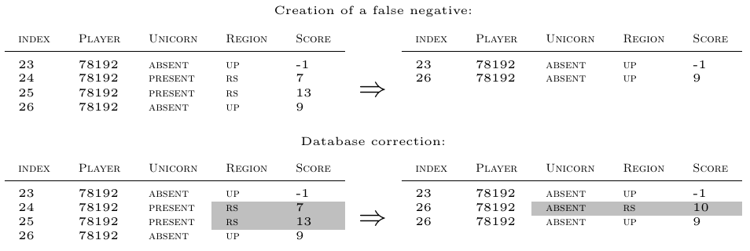
Estimating Unicorn-Present-Blocks and score correction

Slide 10
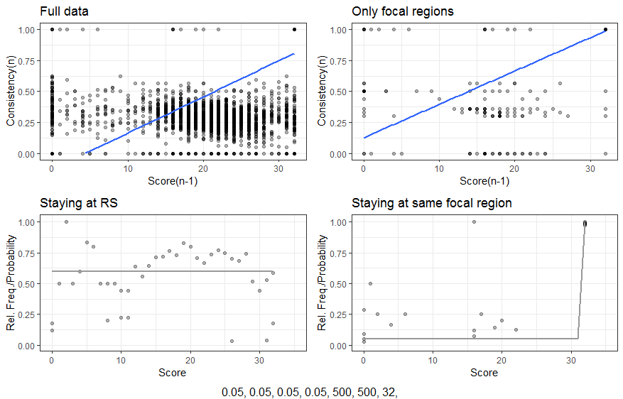
Estimating Unicorn-Present-Blocks and score correction
Less false
negatives
Insufficient
data

Slide 11
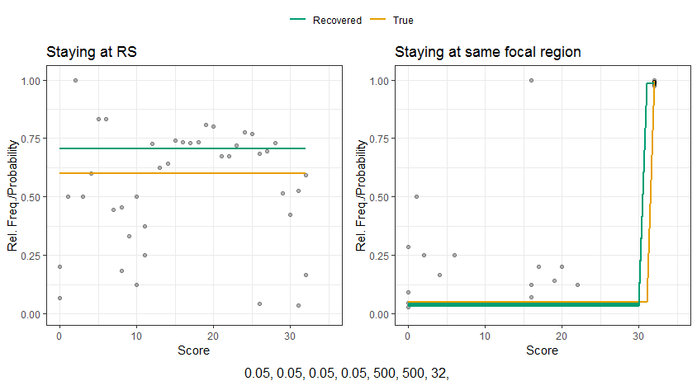
Effect on parameter recovery (Block estimation)
Full data
Only rounds with unicorn absent
Good enough?

Slide 12
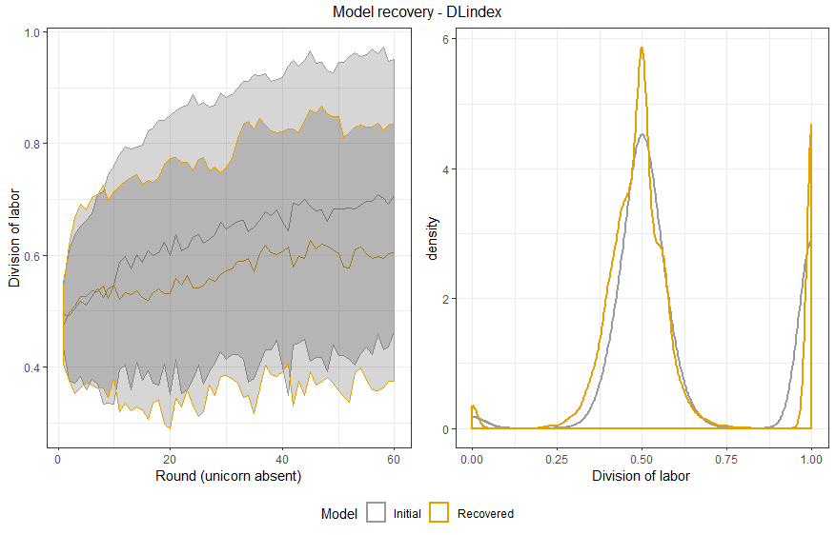
Model recovery (corrected data)

