Slide 2
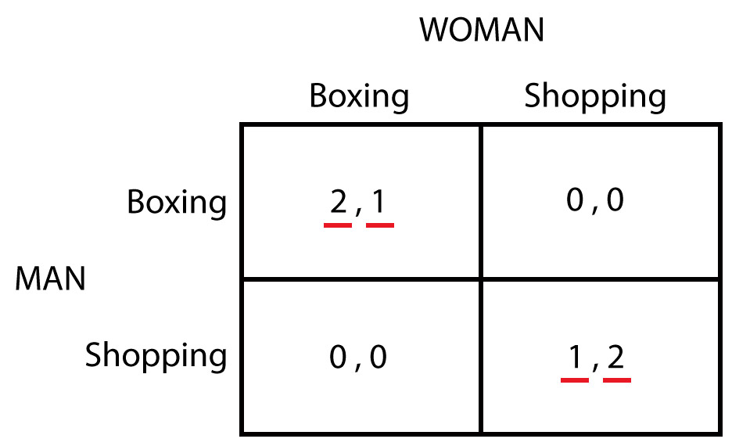
Batalla de los sexos
Iteraciones: Un fin de semana shopping y el otro boxing.

Slide 3
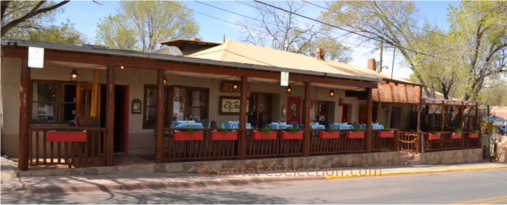
El Farol
100 people decide independently each week whether to go to a bar. Space is limited, and the evening is enjoyable if fewer than 60% of the possible 100 are present.

Slide 4
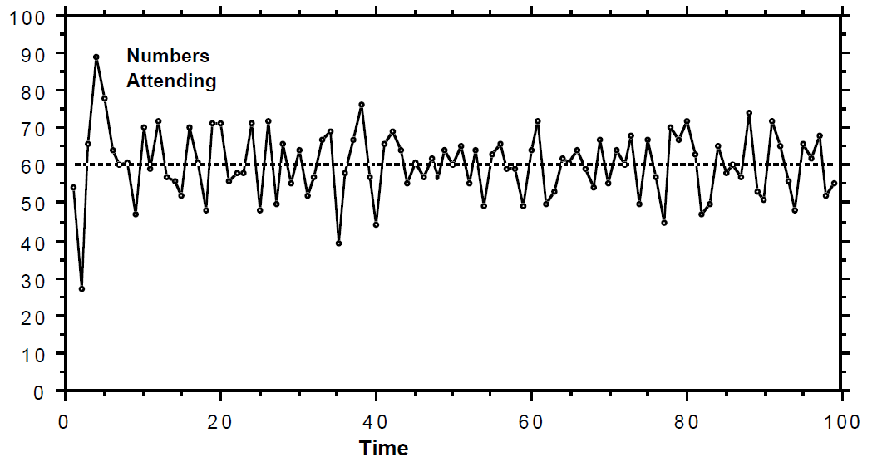
Bounded rationality
And particular hypotheses or predictors might be: predict next week’s number to be:
– the same as last week’s [35]
– a mirror image around 50 of last week’s [65]
– 67 [67]
– a (rounded) average of the last four weeks [49]
– the same as 2 weeks ago (2-period cycle detector) [22]
– etc. …

Slide 5
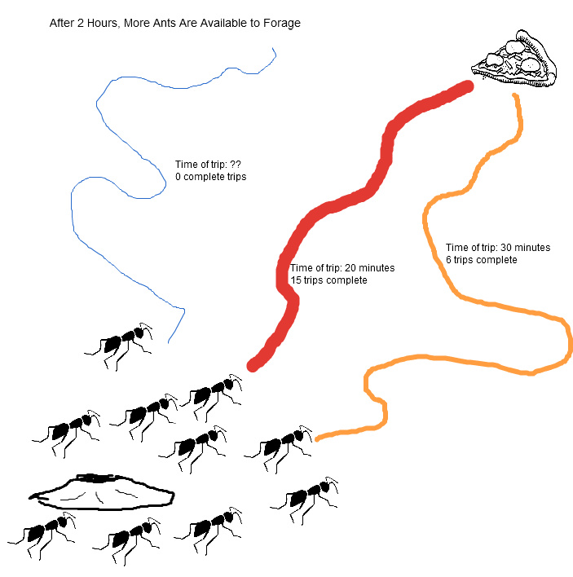
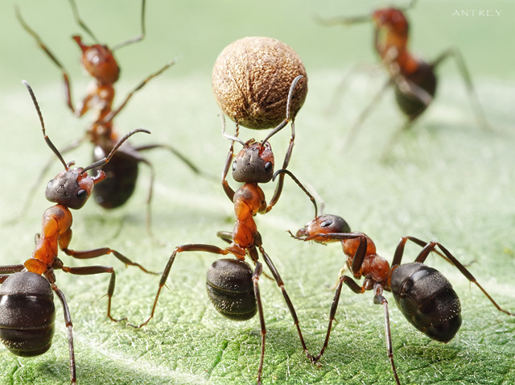
Medio

Slide 6
Teoría de juegos vs. Bounded Rationality
Carga excesiva sobre los recursos cognitivos de los agentes
Heurísticas en lugar de deducciones
Parte de la carga puede ser llevada por:
Las iteraciones
El entorno

Slide 7
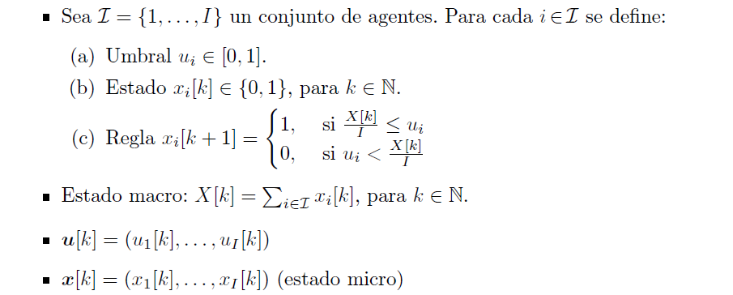
Modelo downward causation

Slide 8
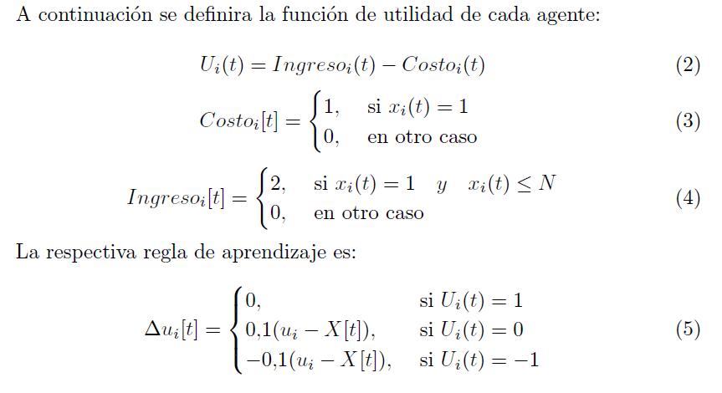
Modelo downward causation

