Slide 1

Note: The data and information in this document is reflective of a hypothetical situation and client. This document is to be used for KPMG Virtual Internship purposes only.
Sprocket Central Pty Ltd
Data analytics approach
[Division Name] - [Engagement Manager], [Senior Consultant], [Junior Consultant]

Slide 2
Note: The data and information in this document is reflective of a hypothetical situation and client. This document is to be used for KPMG Virtual Internship purposes only.
Agenda
Introduction
Data Exploration
Model Development
Interpretation

Slide 3
Note: The data and information in this document is reflective of a hypothetical situation and client. This document is to be used for KPMG Virtual Internship purposes only.
Introduction
Data Pre-Processing
Handled Missing values
Variable Creation(‘Profit’, ’Age’)
Merge all sheets with unique values
Visualization
Data insights

Slide 4
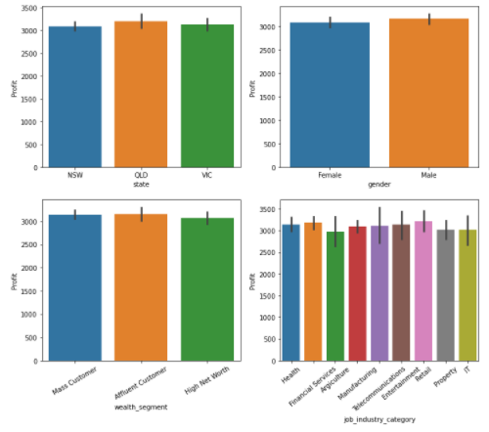
Note: The data and information in this document is reflective of a hypothetical situation and client. This document is to be used for KPMG Virtual Internship purposes only.
Data Exploration
Gender wise Profit.
Job industry category wise Profit
Wealth segments wise Profit
State Wise Profit

Slide 5
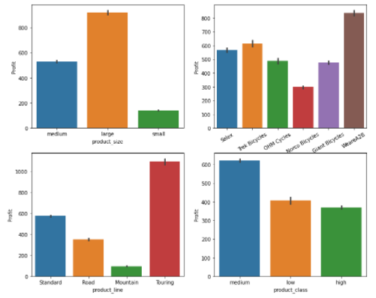
Note: The data and information in this document is reflective of a hypothetical situation and client. This document is to be used for KPMG Virtual Internship purposes only.
Data Exploration
Product_size wise Profit.
Brand category wise Profit
Product_line wise Profit
Product_class Wise Profit

Slide 6
Note: The data and information in this document is reflective of a hypothetical situation and client. This document is to be used for KPMG Virtual Internship purposes only.
Model Development
Variable name Age Creation using DOB
Variable Profit creation done using list price & standard price
Profit based on Customer_id using Groupby
Unique entries in all the sheets
Changing Same attributes into same format

Slide 7
Note: The data and information in this document is reflective of a hypothetical situation and client. This document is to be used for KPMG Virtual Internship purposes only.
Interpretation
QLD(QueensLand) has the maximum profit.
Male has maximum profit as compared to Female.
Affluent Customer has more Profit as compared to others.
Retail has maximum Profit than others.
Large Product_size has maximum profit
Brand name “WeareA2B” has maximum profit.
Touring Product line as maximum profit.
Medium product class has maximum profit.

Slide 8
Note: The data and information in this document is reflective of a hypothetical situation and client. This document is to be used for KPMG Virtual Internship purposes only.
Appendix

Slide 9
Note: The data and information in this document is reflective of a hypothetical situation and client. This document is to be used for KPMG Virtual Internship purposes only.
Appendix
All supporting items in that attachment.

