Slide 1
Module: ACPC Transform

Slide 2
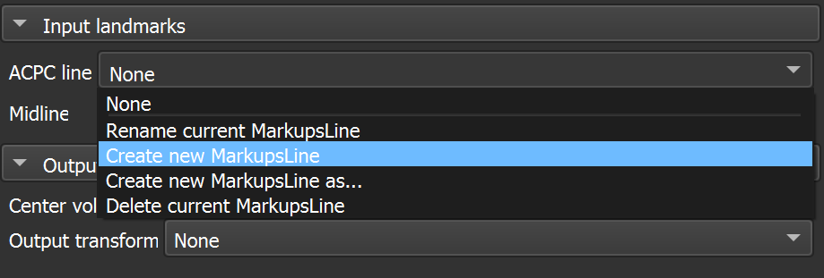
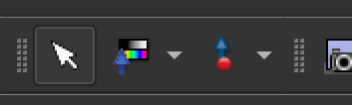
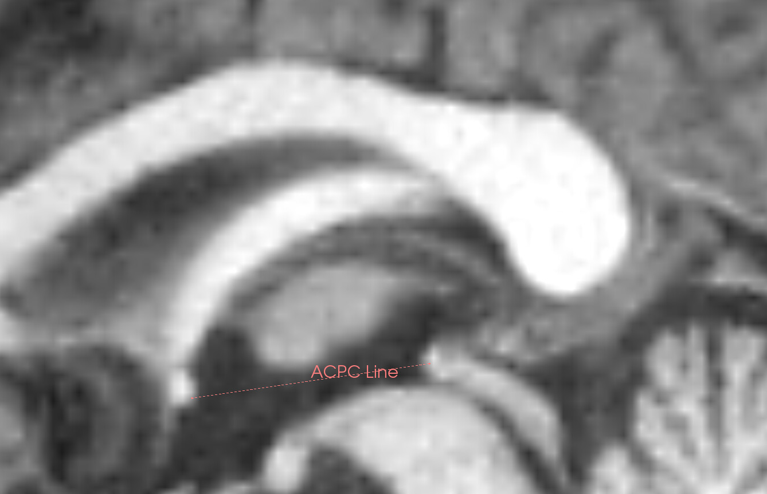
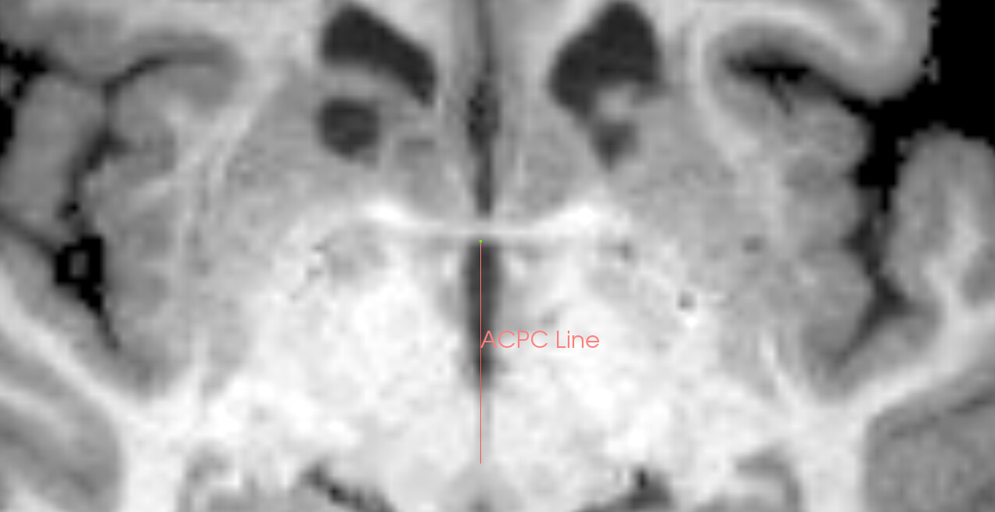
module_acpctransform_1.png
1
3, 5
2
7: verify/adjust placement in sagittal view
4, 6: place AC and PC points in axial view

Slide 3
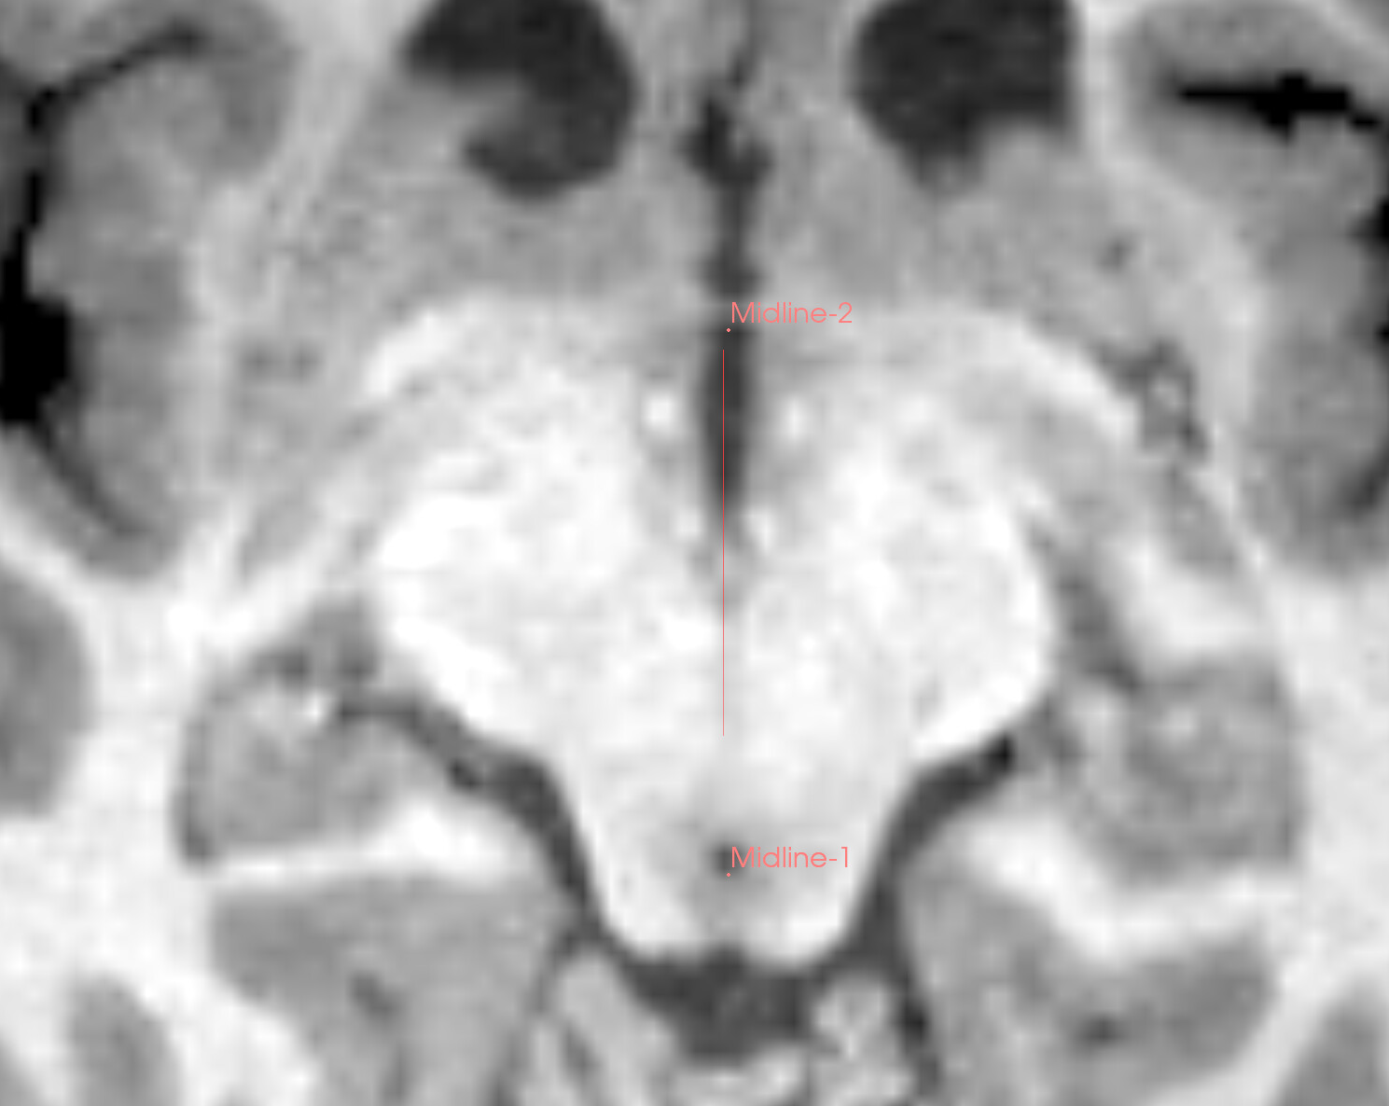
module_acpctransform_2.png

Slide 4
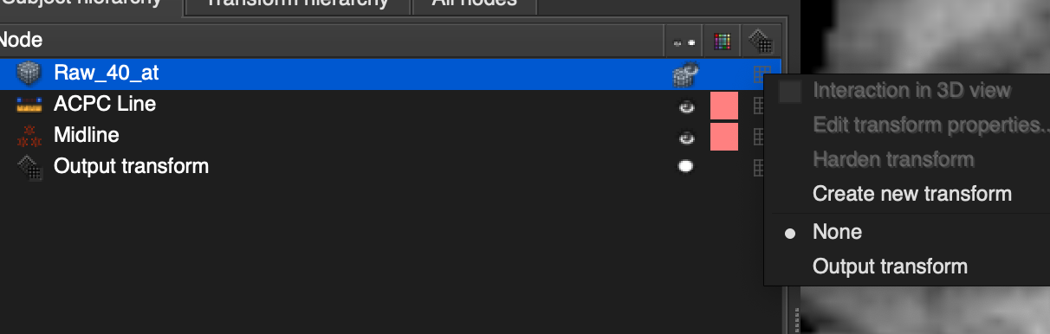
module_acpctransform_3.png
1, 3: right-click
4
2

