Slide 1

DICOM Tractography Converter
Ye Wu^{1,2}, Fan Zhang¹, Isaiah Norton¹, Lauren J. O'Donnell¹
¹ Brigham and Women’s Hospital, Harvard Medical School, USA
² Zhejiang University of Technology, China

Slide 2
Learning Objectives
The aim is to convert between DICOM TrackSet and Slicer-style VTK tractography.
Following this tutorial, you’ll be able to:
Save DICOM format tractography files in 3D Slicer
Load DICOM format tractography files into 3D Slicer
Convert between VTK format tractography files and DICOM format using command line
For more information about Tractography Supplement DICOM standard, please visit this website: http://www.dclunie.com

Slide 3
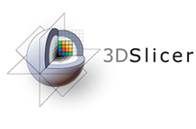
3D Slicer
The tutorial uses the 3D Slicer (Version 4.8.1, revision 26813, Stable Release) software available at:
http://download.slicer.org
Disclaimer:
It is the responsibility of the user of 3DSlicer to comply with both the terms of the license and with the applicable laws, regulations and rules. Slicer is a tool for research, and is not FDA approved.

Slide 4
Slicer dMRI
An open-source project to improve and extend diffusion magnetic resonance imaging software in 3D Slicer:
http://dmri.slicer.org
Please visit the following website to install Slicer dMRI:
http://dmri.slicer.org/download/

Slide 5
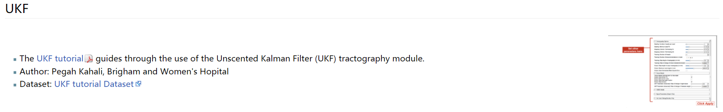
Tutorial Data
Download sample data, at:
https://www.na-mic.org/Wiki/images/f/fc/Example_data.zip
The following data are provided:
DICOM image
Whole brain tractography (conducted using UKF tractography from the same data) in VTK format.
NOTE: Both use cases require a reference diffusion-weighted MRI DICOM scan. The reference scan must be the DICOM data from which the tractography was created.
For more information about UKF tractography, please follow this tutorial:
https://dmri.slicer.org/docs/tutorials/UKFTractography.pdf

Slide 6
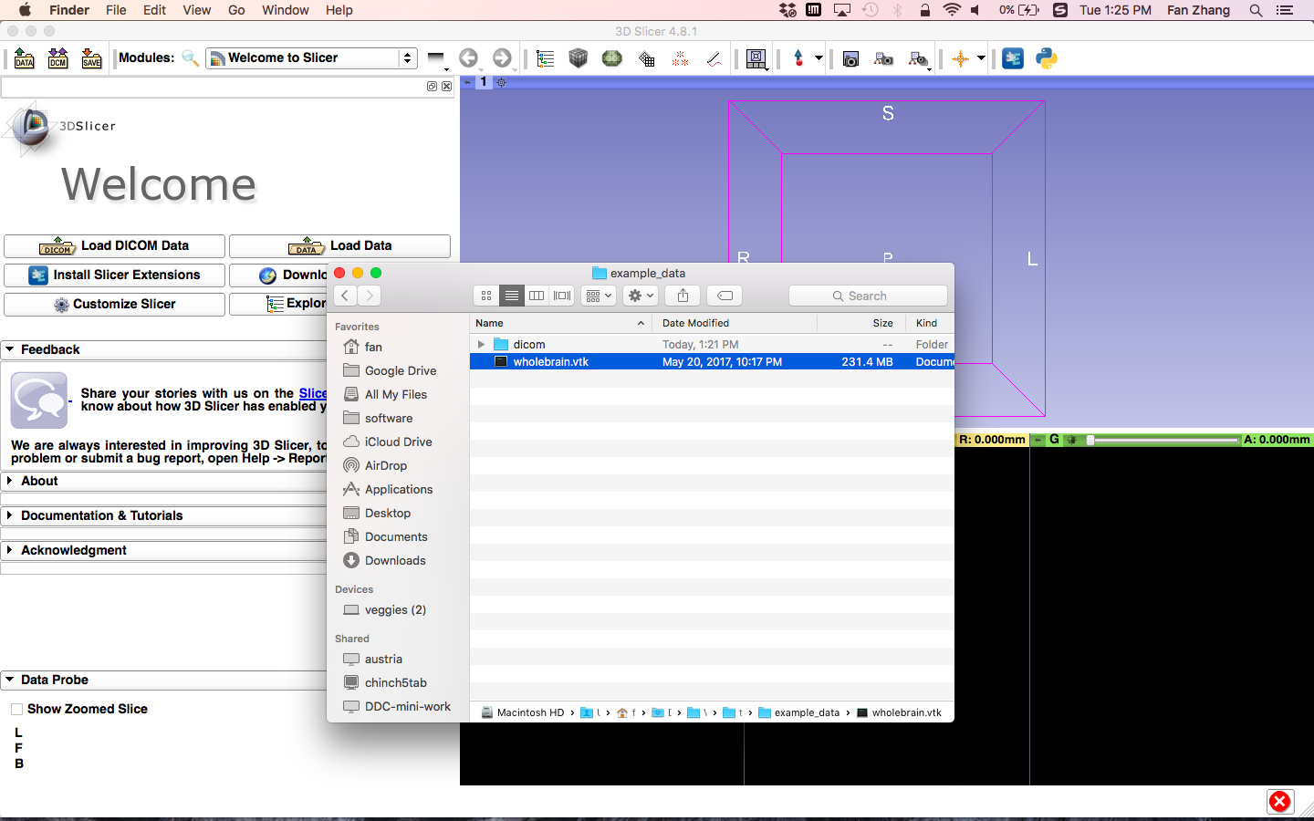
Tractography DICOM Save
Load VTK file
Drag and drop the file wholebrain.vtk onto the viewer of the Slicer application

Slide 7
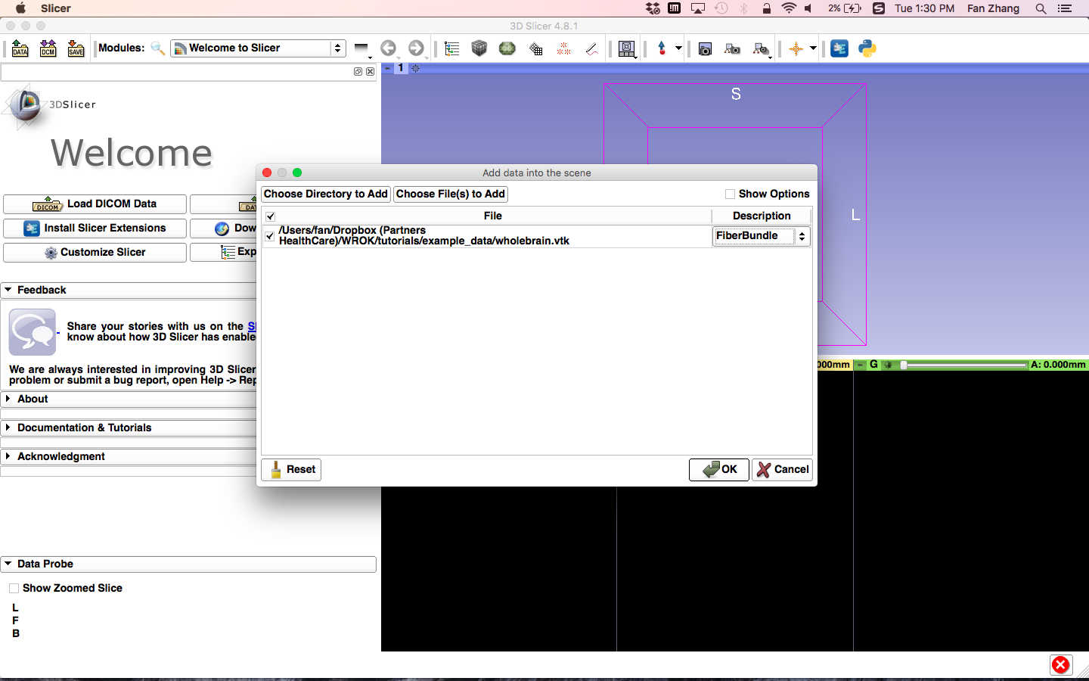
Tractography DICOM Save
Load VTK file
Load the tractography as FiberBundle
Click "OK" to load the dataset to Slicer

Slide 8
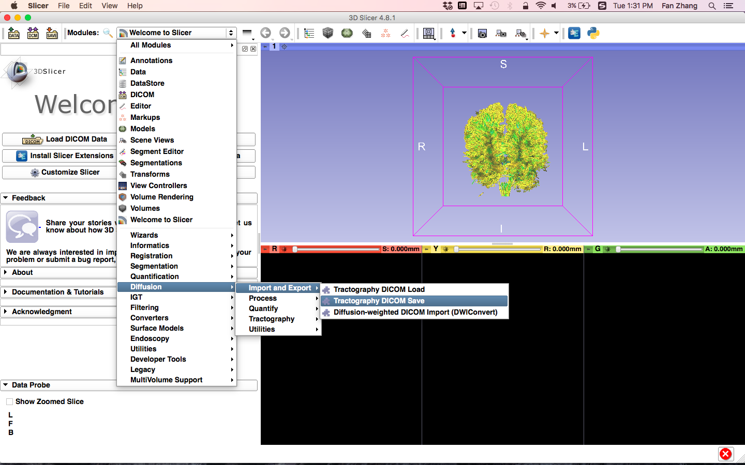
Tractography DICOM Save
Select the module
Click on the Modules menu, then select Diffusion -> Import and Export -> Tractography DICOM Save

Slide 9
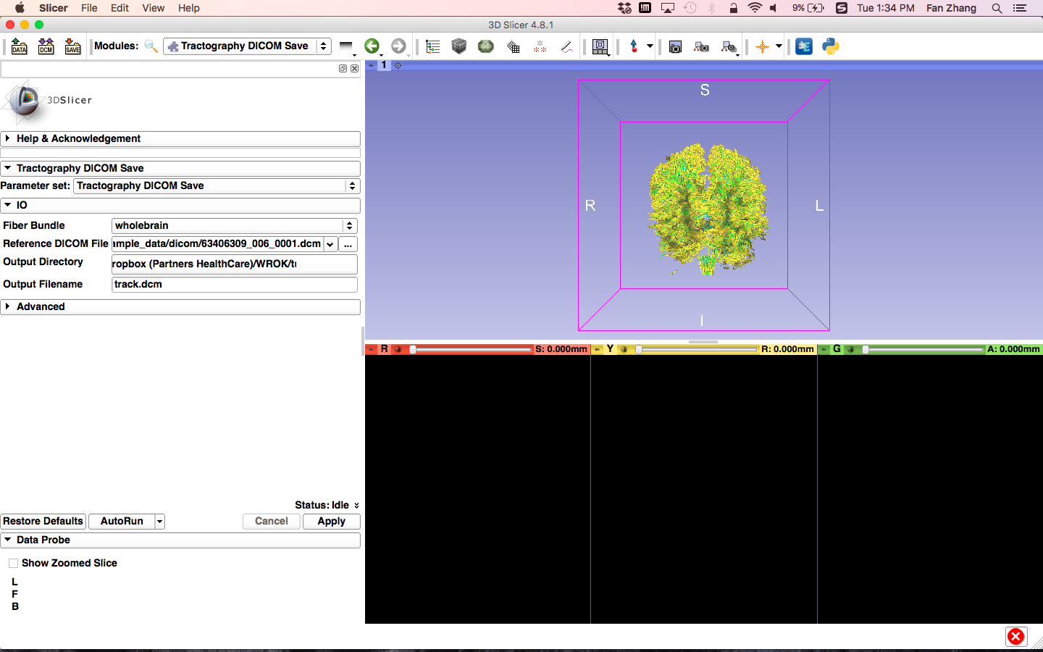
Tractography DICOM Save
Set parameters
Set the Tractography DICOM Save parameters:
Parameter set: Tractography DICOM Save
Fiber Bundle: wholebrain
Reference DICOM File: Path/to/example_data/dicom/any_one_dicom.dcm
Output Directory: Path/to/eample_data/
- Output Filename: tract.dcm
Click the button Apply

Slide 10
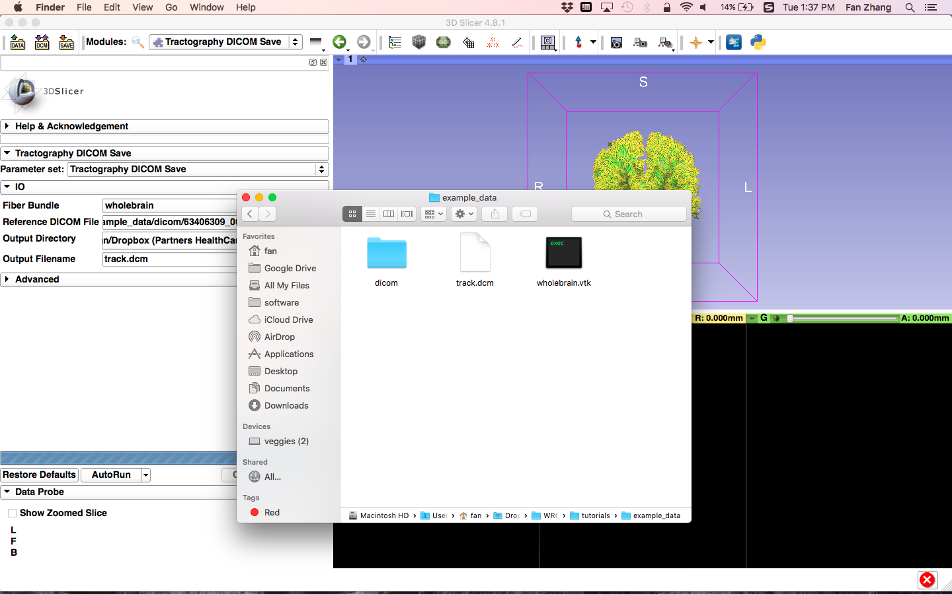
Tractography DICOM Save
Output
Output the DICOM tractography file.

Slide 11
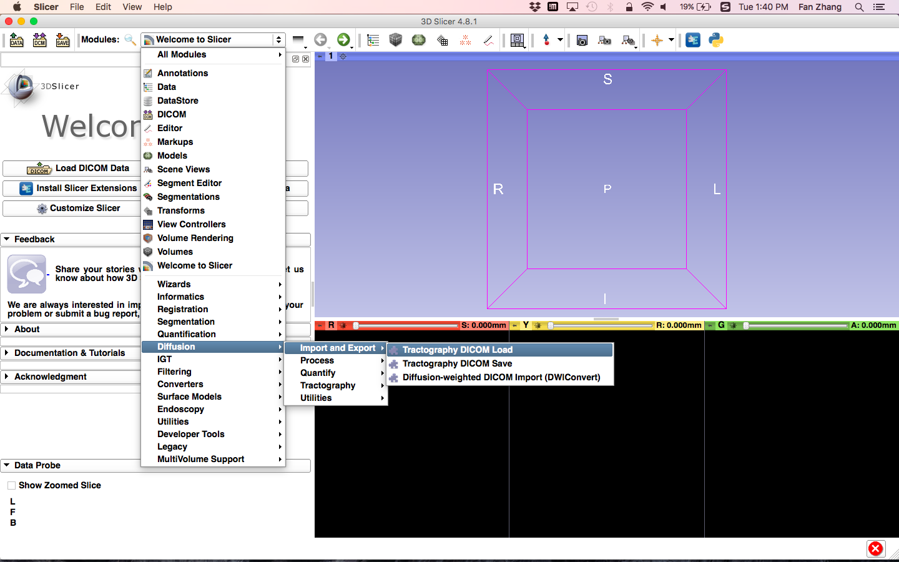
Tractography DICOM Load
Select the module
Select File and Close Scene
Click on the Modules menu, then select Diffusion -> Import and Export -> Tractography DICOM Load

Slide 12
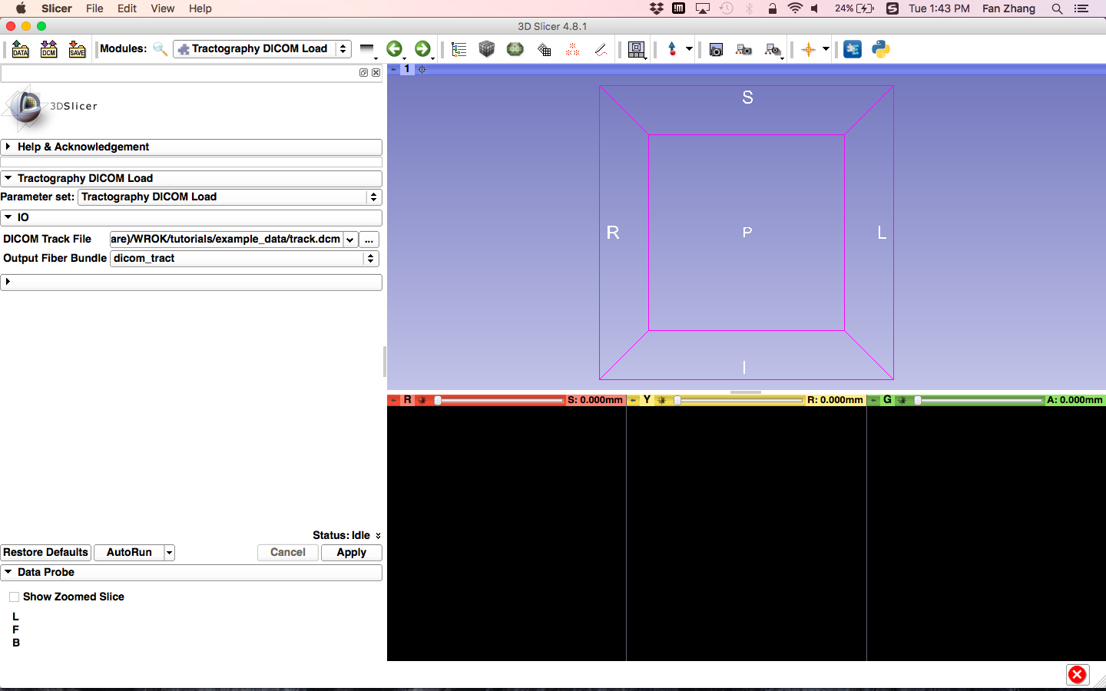
Tractography DICOM Load
Set parameters
Set the Tractography DICOM Load parameters:
Parameter set: Tractography DICOM Load
DICOM Track File: Path/to/example_data/track.dcm
Output Fiber Bundle: Create new FiberBundle as dicom_track
Click the button Apply

Slide 13
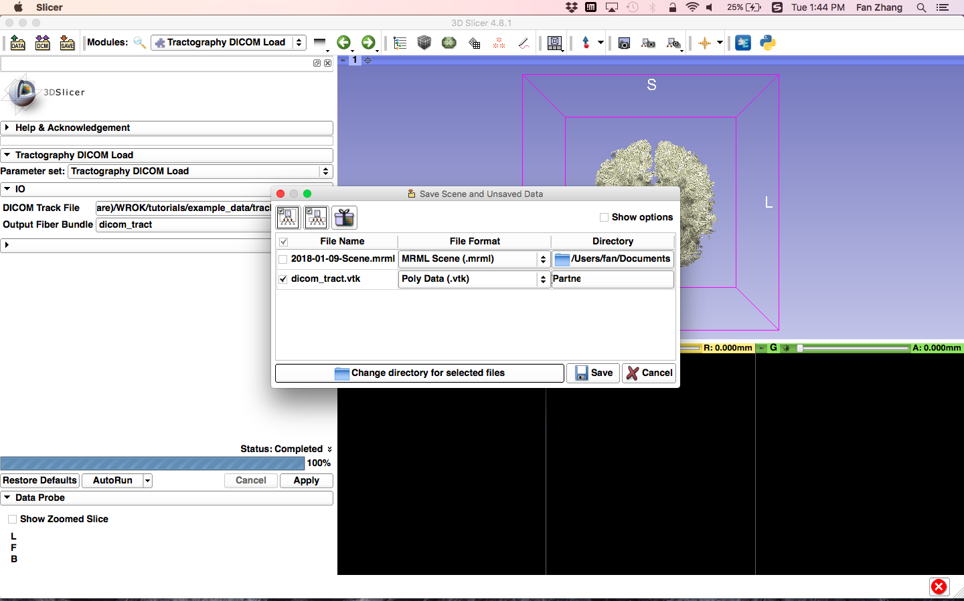
Tractography DICOM Load
Save tractography as VTK
Click the button Save
Select the file and file format you want to save
Click the button Save

Slide 14
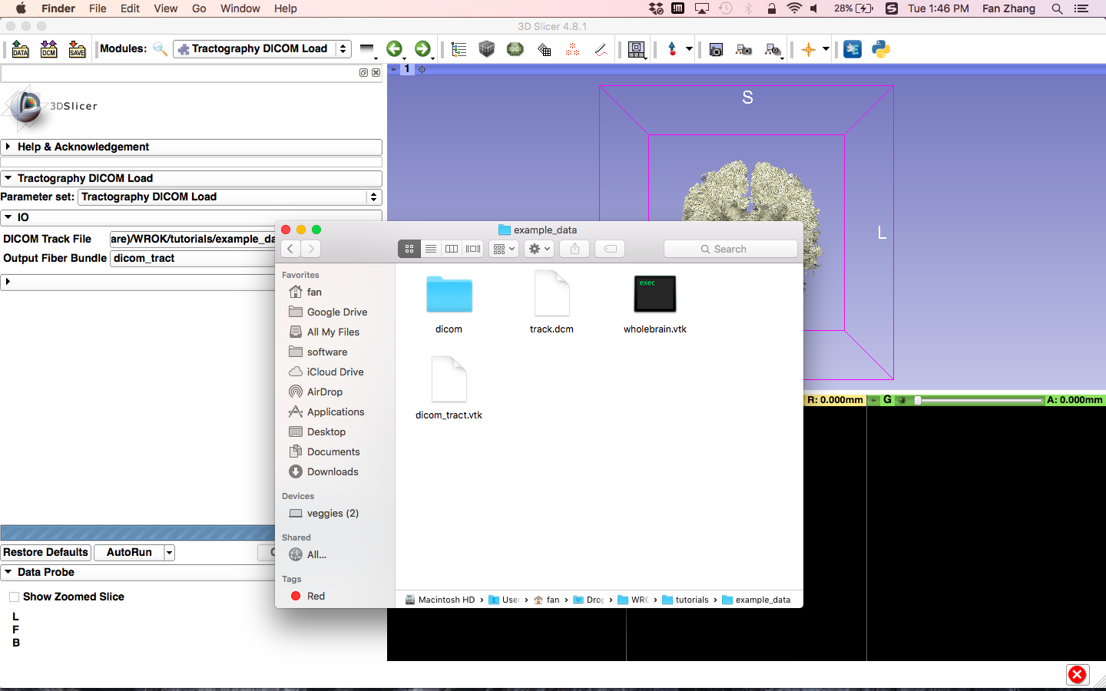
Tractography DICOM Save
Output
Output the vtk tractography file.

Slide 15
Command Line Interface (CLI)
Convert between DICOM TrackSet and Slicer-style VTK tractography in CLI mode.
SlicerDMRI_CLI_FOLDER=/Applications/Slicer.app/Contents/Extensions-26813/SlicerDMRI/lib/Slicer-4.8/cli-modules/
EXAMPLE_DATA_FOLDER=/Users/fan/Desktop/example_data/
# help information
${SlicerDMRI_CLI_FOLDER}/VTK_to_DICOMTract -h
# Tractography DICOM Save
${SlicerDMRI_CLI_FOLDER}/VTK_to_DICOMTract --vtk_fiberbundle ${EXAMPLE_DATA_FOLDER}/dicom_tract.vtk --reference_dicom ${EXAMPLE_DATA_FOLDER}/dicom/63406309_006_0001.dcm --output_dicom ${EXAMPLE_DATA_FOLDER}/ --output_filename ${EXAMPLE_DATA_FOLDER}/track.com
# help information
${SlicerDMRI_CLI_FOLDER}/DICOMTract_to_VTK -h
# Tractography DICOM Load
${SlicerDMRI_CLI_FOLDER}/DICOMTract_to_VTK --input_track_dicom ${EXAMPLE_DATA_FOLDER}/track.dcm --output_vtk ${EXAMPLE_DATA_FOLDER}/dicom_tract.vtk
Command for Tractography DICOM Save:
Command for Tractography DICOM Load:

Slide 16
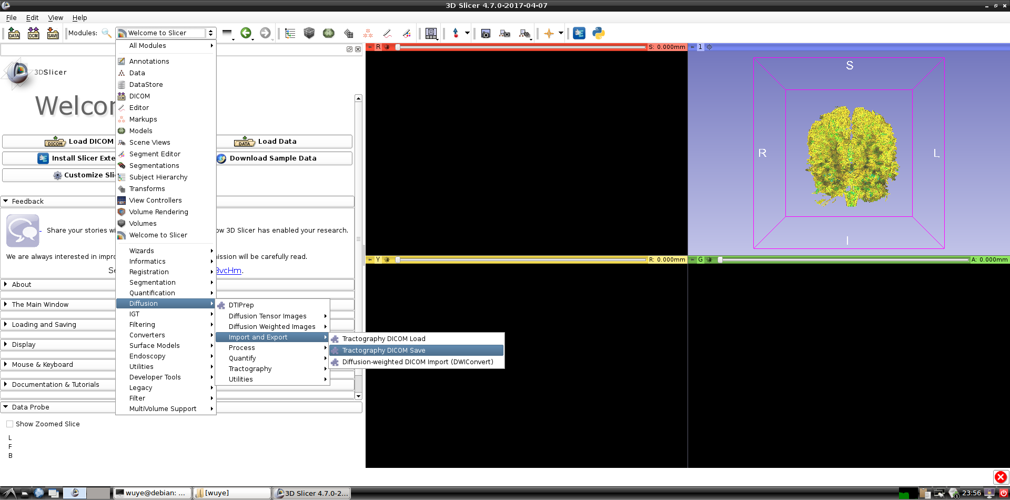
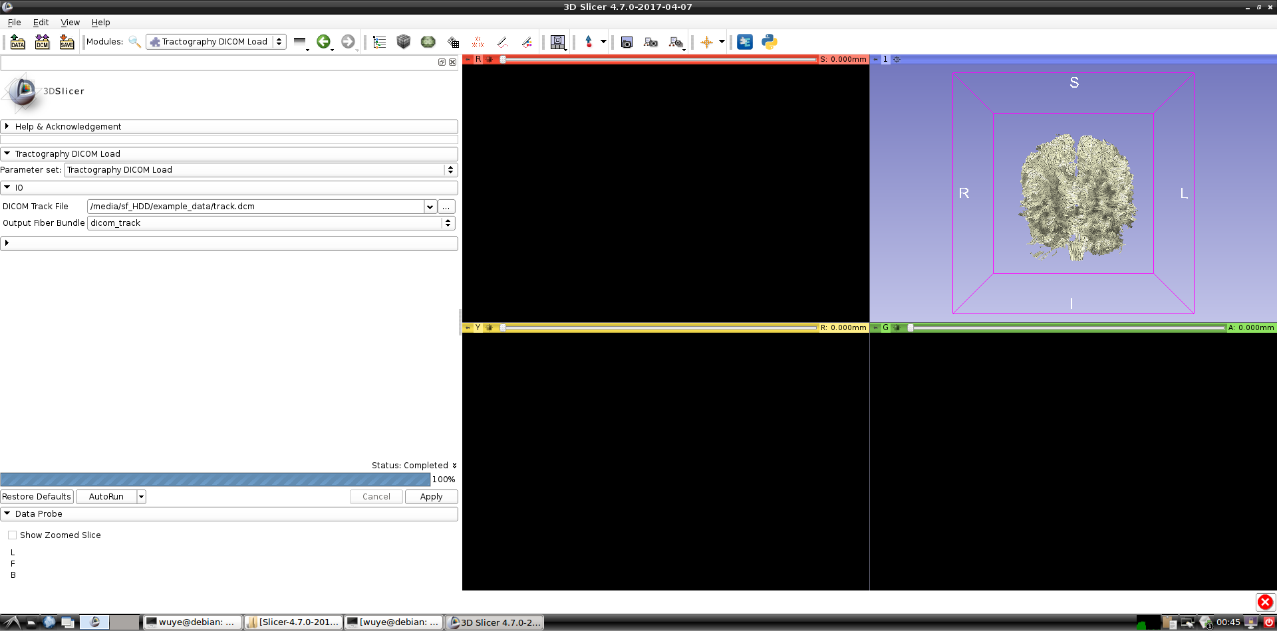
Conclusion
This tutorial guided you to convert between DICOM TrackSet and Slicer-style VTK tractography.
Support: https://discourse.slicer.org

Slide 17
Acknowledgments
Open Source Diffusion MRI Technology For Brain Cancer Research
NIH U01CA199459
National Center for Image Guided Therapy (NCIGT)
NIH P41EB015898
Neuroimage Analysis Center (NAC)
NIH P41EB015902
Zhejiang University of Technology, China, CSC/NSFC
China Scholarship Council, NO. 201608330254
National Nature Science Foundation of China, NO. 61379020

