Slide 1




DWI Converter Tutorial
Surgical Planning Laboratory
Harvard Medical School

Slide 2
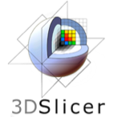
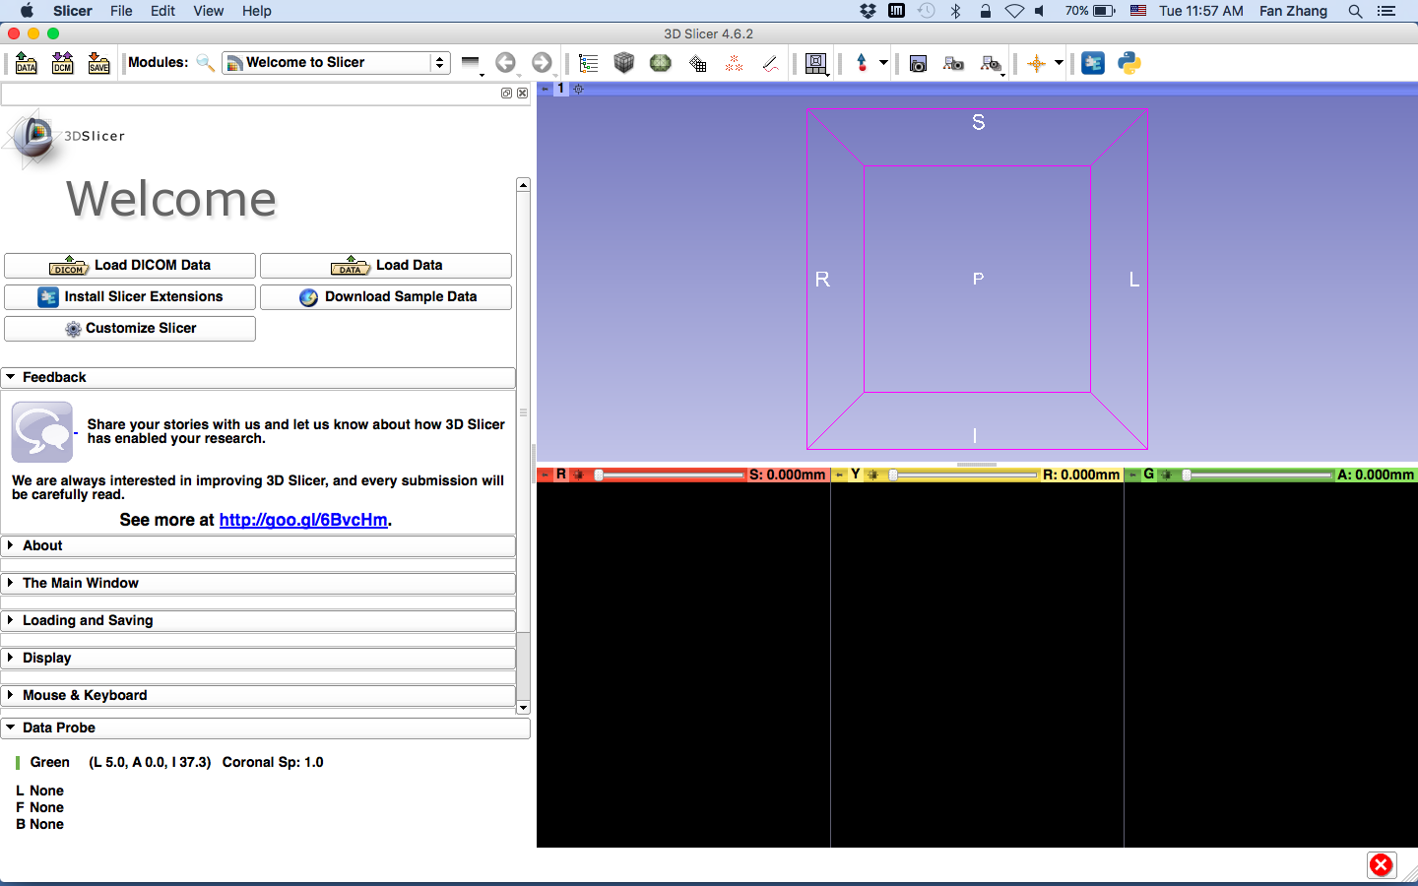
3DSlicer

Slide 3
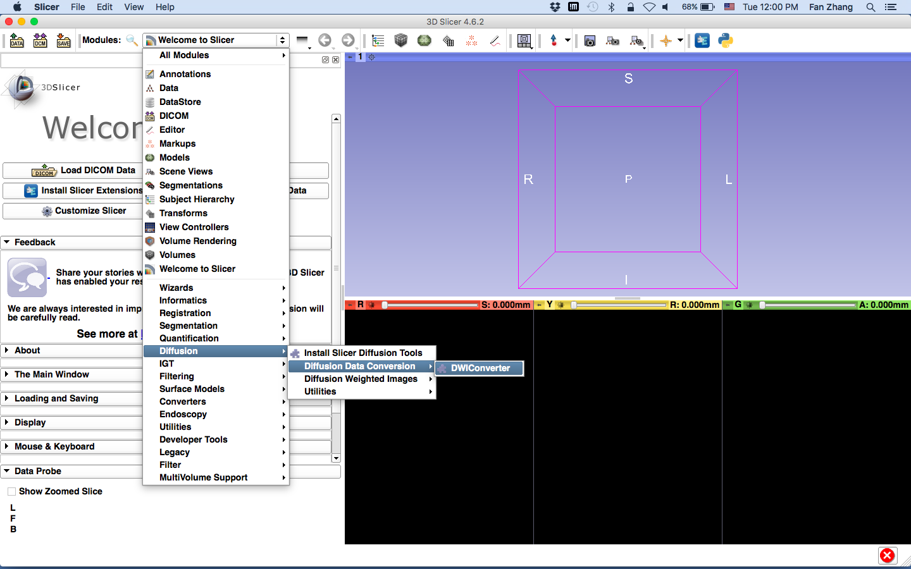
DWI Converter Module
Select the DWIConverter module under Diffusion section

Slide 4
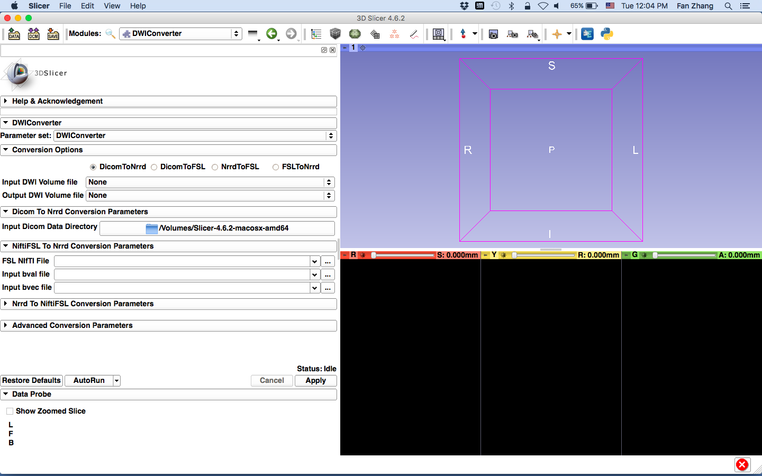
DWI Converter
This module enables different types of conversion:
Dicom to Nrrd
Dicom to FSL
Nrrd to FSL
FSL to Nrrd

Slide 5
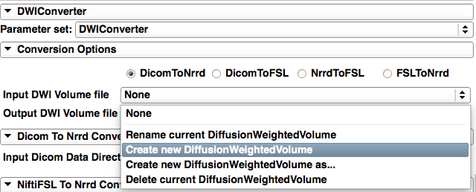
DWI Converter
Select DicomToNrrd conversion
Create and name your output (Nrrd file)

Slide 6
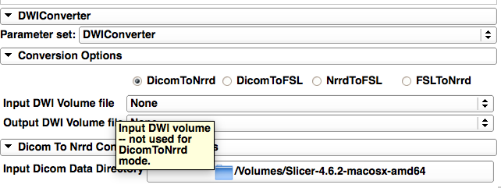
DWI Converter
This box should remain empty for Dicom to Nrrd conversion
Select the directory of your Dicom data
(the directory that you select should only contain DWI Dicom files)

Slide 7
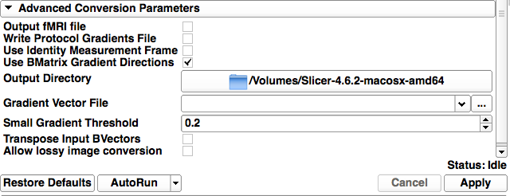
DWI Converter
Check this box only for Siemens data
The Nrrd file will be automatically loaded in Slicer and it’s not necessary to select an output directory
Leave all the other parameters as default and click “Apply”

Slide 8
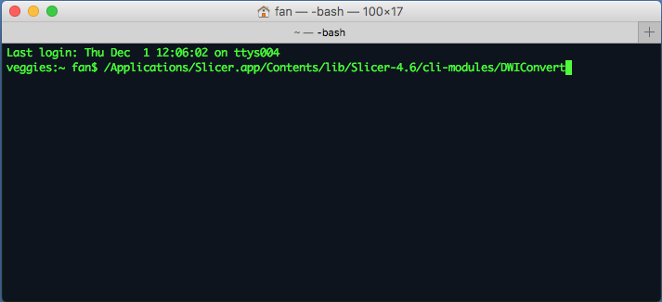
Using DWI Converter in CLI
- Open a terminal (The tutorial is based on Mac system: GotoApplication->Utilities-> Terminal.app)
- Locate the CLI module path of DWIConvert

Slide 9
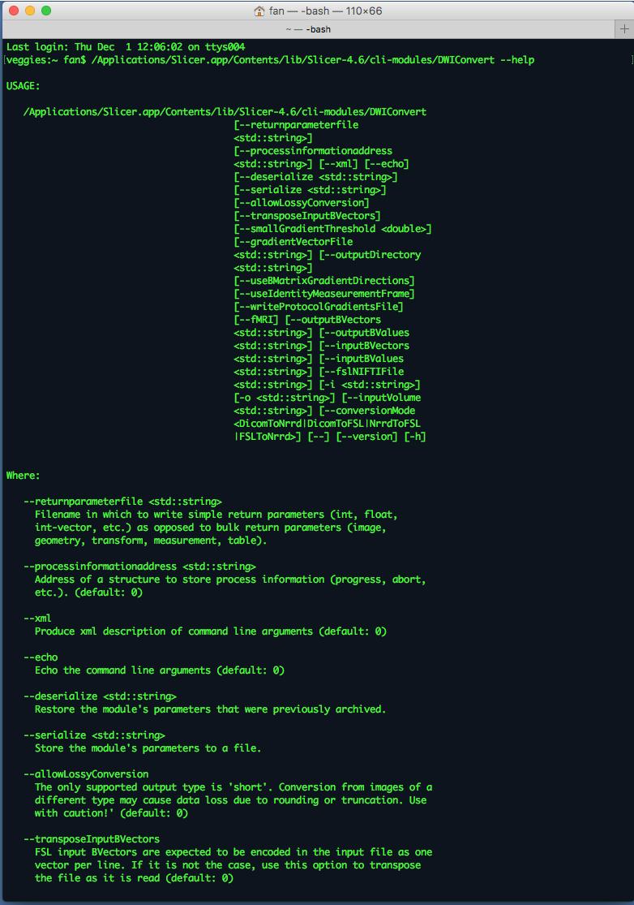
Using DWI Converter in CLI
Run ‘/Applications/Slicer.app/Contents/lib/Slicer-4.6/cli-modules/DWIConvert --help’ to find detailed documentation of the usage of DWIConvert

Slide 10
Acknowledgements
U01CA199459, Open Source Diffusion MRI Technology For Brain Cancer Research
P41EB015898, National Center for Image Guided Therapy (NCIGT)
P41EB015902, Neuroimage Analysis Center (NAC)

