Slide 1
DWI Converter Tutorial
Surgical Planning Laboratory
Harvard Medical School

Slide 2
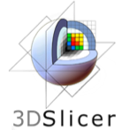
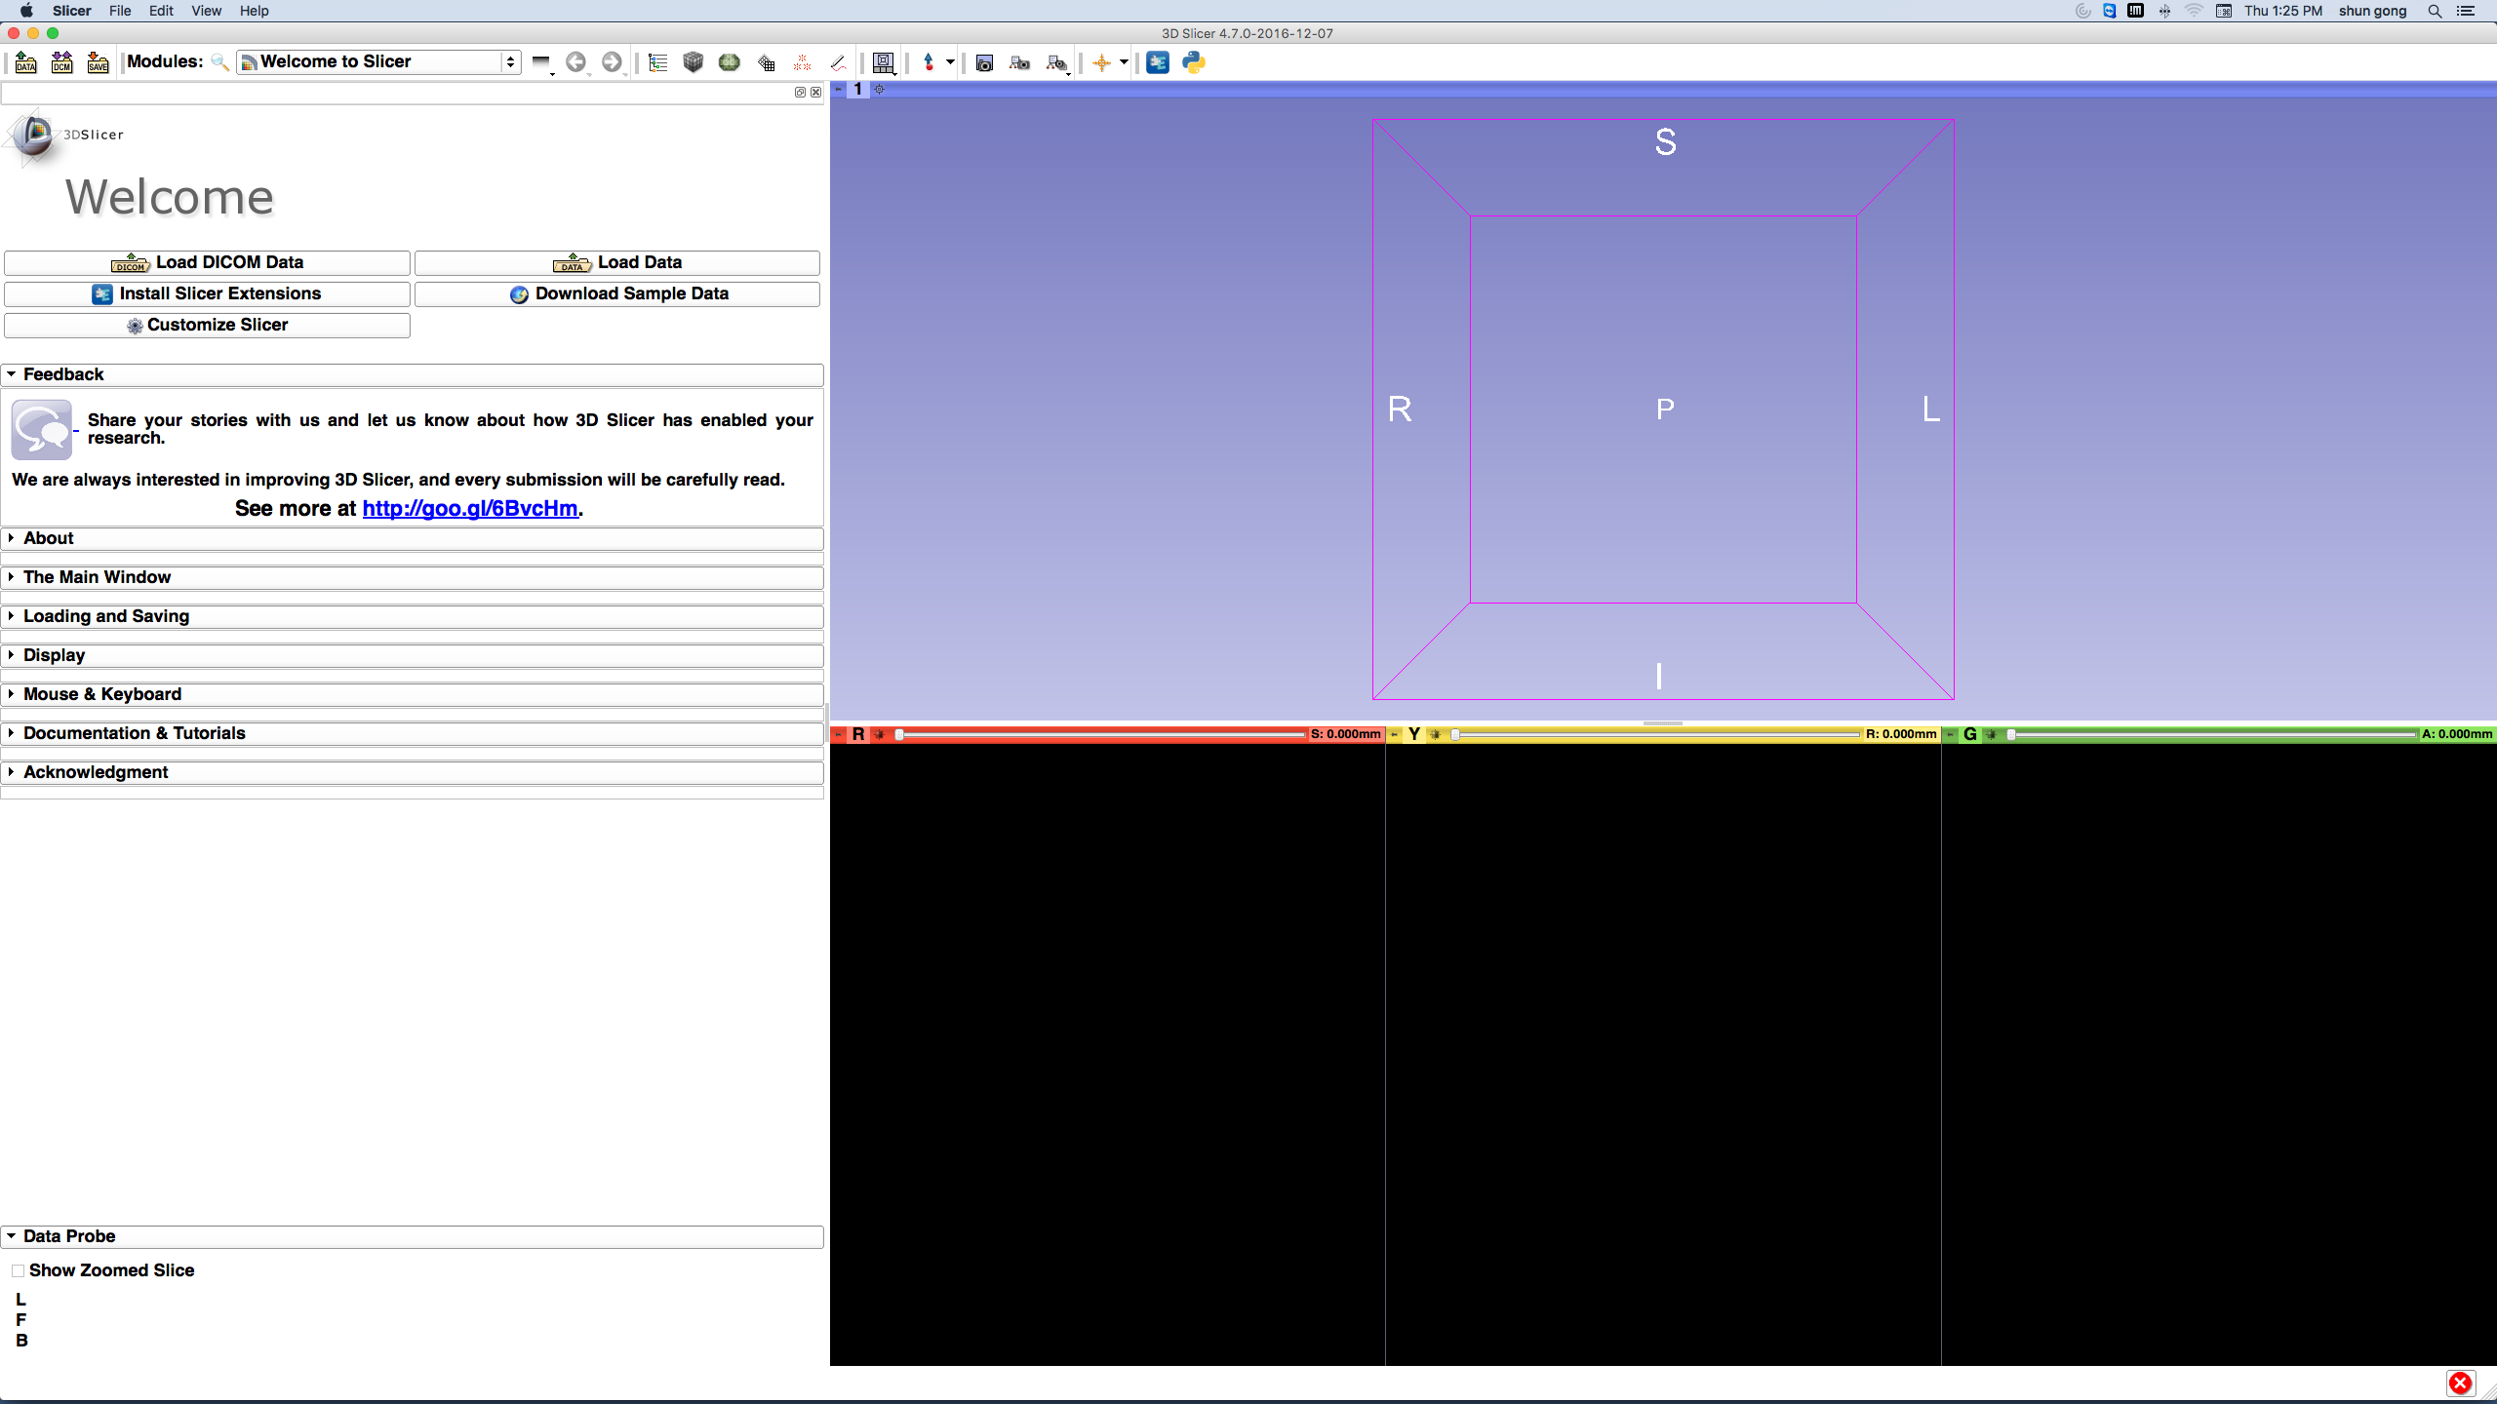
3DSlicer

Slide 3
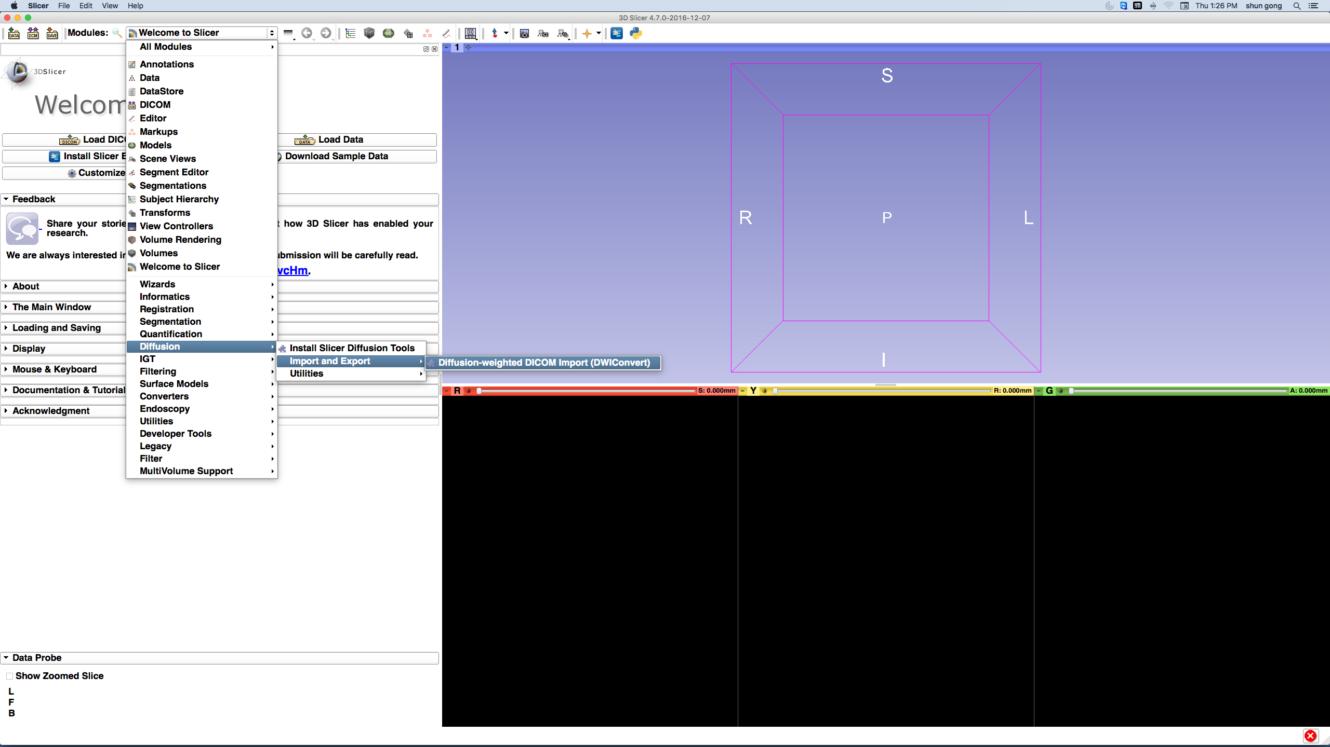
DWI Converter Module
Modules
Diffusion
Import and Export
Diffusion Weighted DICOM Import (DWIConvert)

Slide 4
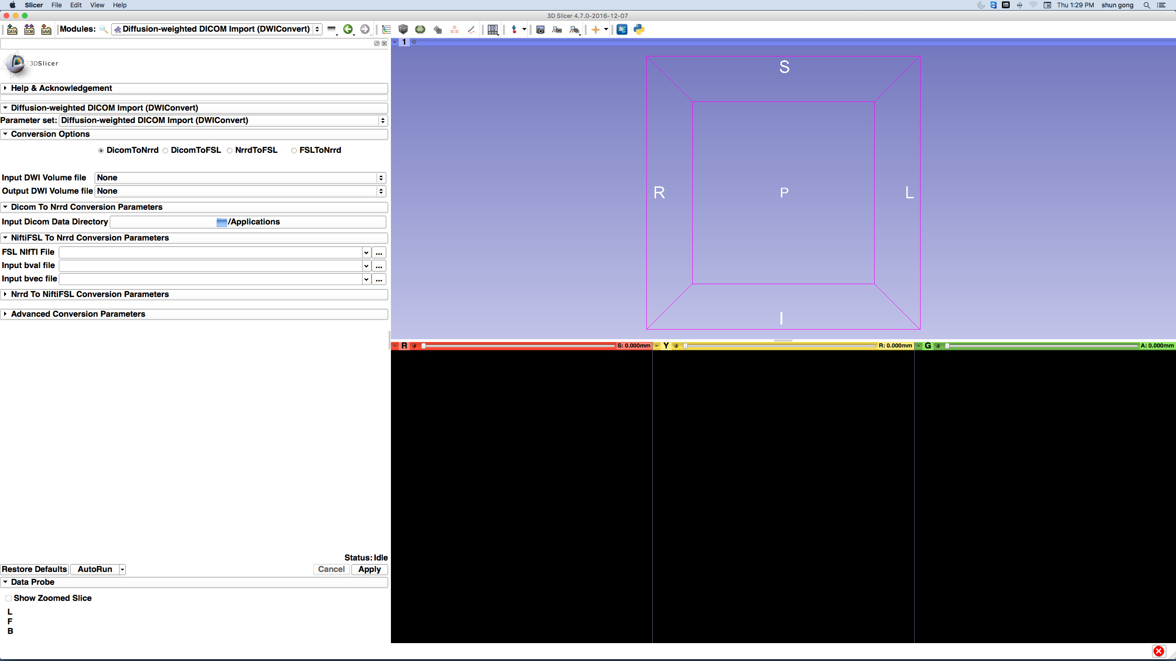
DWI Converter
This module enables different types of conversion:
Dicom to Nrrd
Dicom to FSL
Nrrd to FSL
FSL to Nrrd

Slide 5
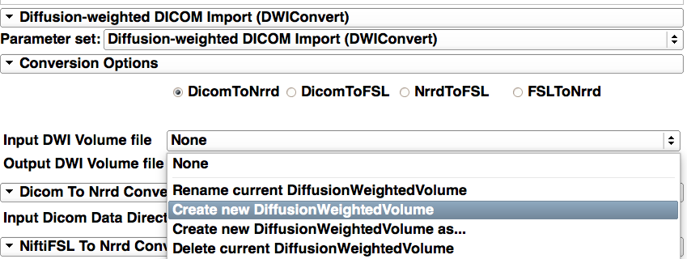
DWI Converter
Select DicomToNrrd conversion
Create and name your output (Nrrd file)

Slide 6
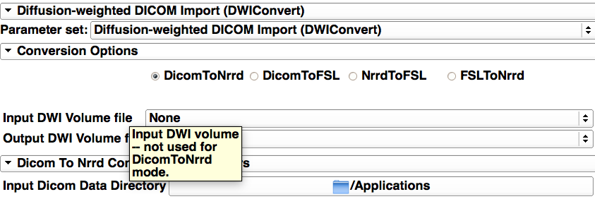
DWI Converter
The Input DWI Volume file selection should be None as it not used for this operation
In your file archive select the directory that only contains the DWI Dicom files that you want to convert

Slide 7
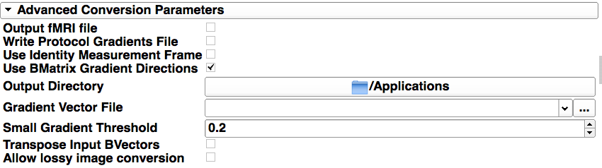
DWI Converter
Check this box only for Siemens data
The Nrrd file will be automatically loaded in Slicer and it’s not necessary to select an output directory
Leave all the other parameters as default and click “Apply”

Slide 8
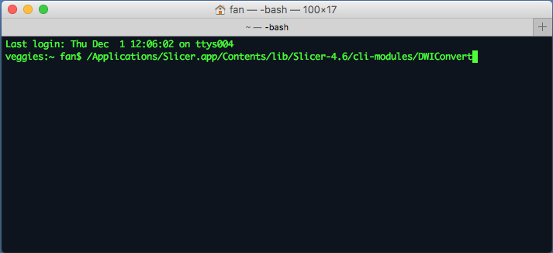
Using DWI Converter in CLI
- Open a terminal (The tutorial is based on Mac system: GotoApplication->Utilities-> Terminal.app)
- Locate the CLI module path of DWIConvert

Slide 9
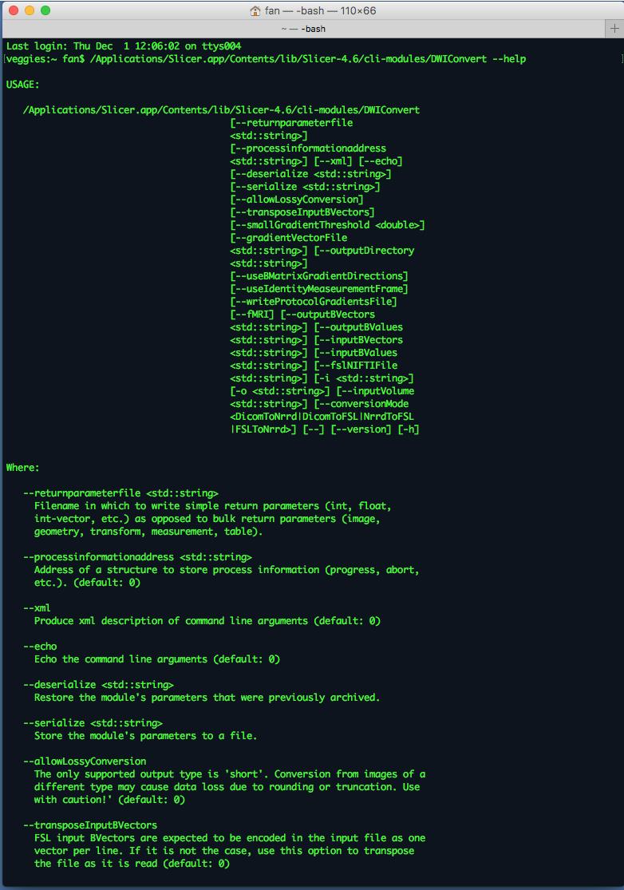
Using DWI Converter in CLI
Run ‘/Applications/Slicer.app/Contents/lib/Slicer-4.6/cli-modules/DWIConvert --help’ to find detailed documentation of the usage of DWIConvert

Slide 10




Acknowledgements
U01CA199459, Open Source Diffusion MRI Technology For Brain Cancer Research
National Alliance for Medical Image Computing (NA-MIC) namic.org
National Center for Image Guided Therapy (NCIGT) ncigt.org
Neuroimage Analysis Center (NAC) nac.spl.harvard.edu
Surgical Planning laboratory (SPL) spl.harvard.edu

