Slide 1
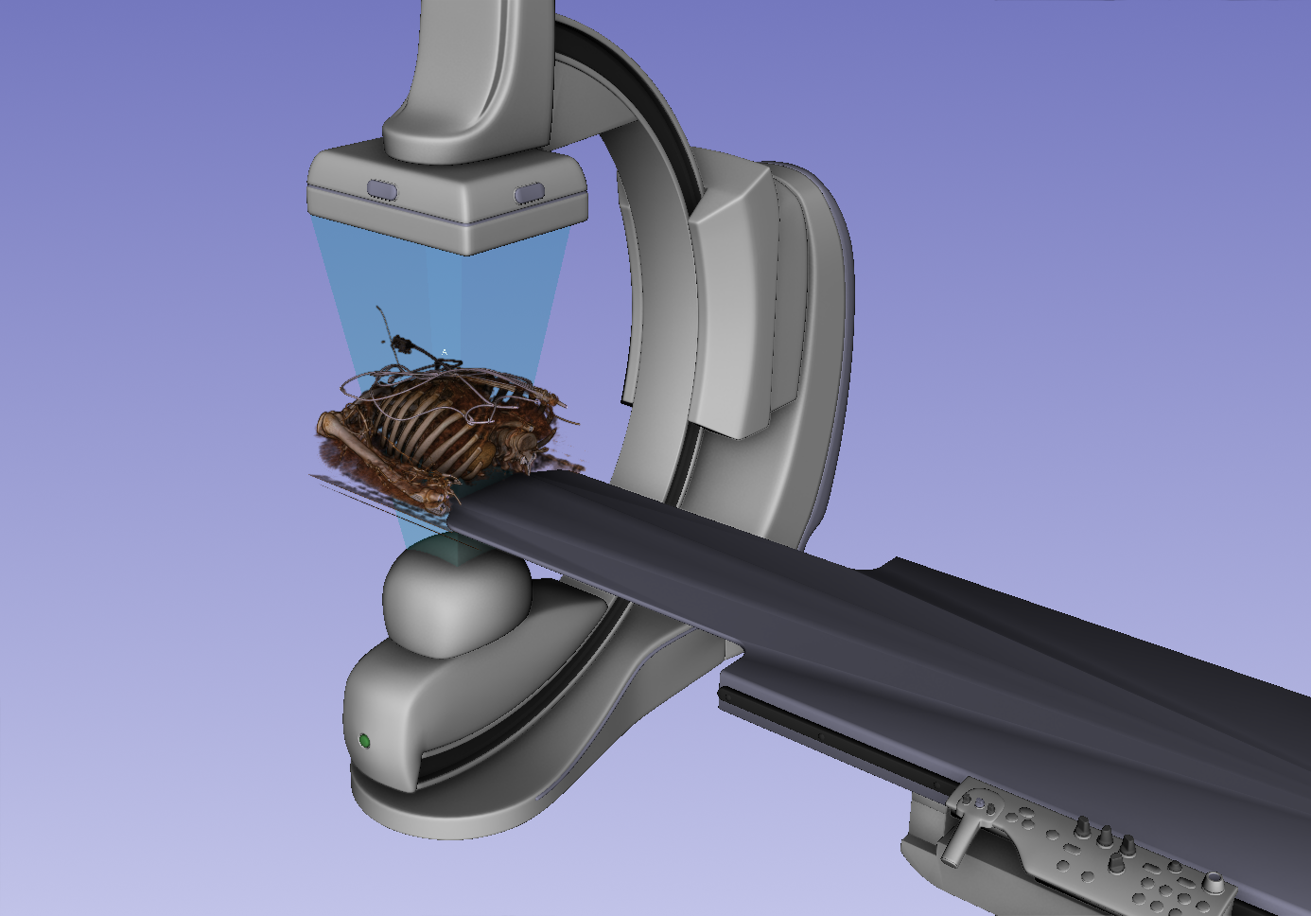
Detector coordinate system axes are RAS.
Frontal Detector Y
Frontal Detector Z
Frontal Detector X
Camera coordinate system axes are right-handed.
Camera view up = Y = patient S.
Camera view direction = Z.
Camera Z
Camera Y
Camera X

Slide 2
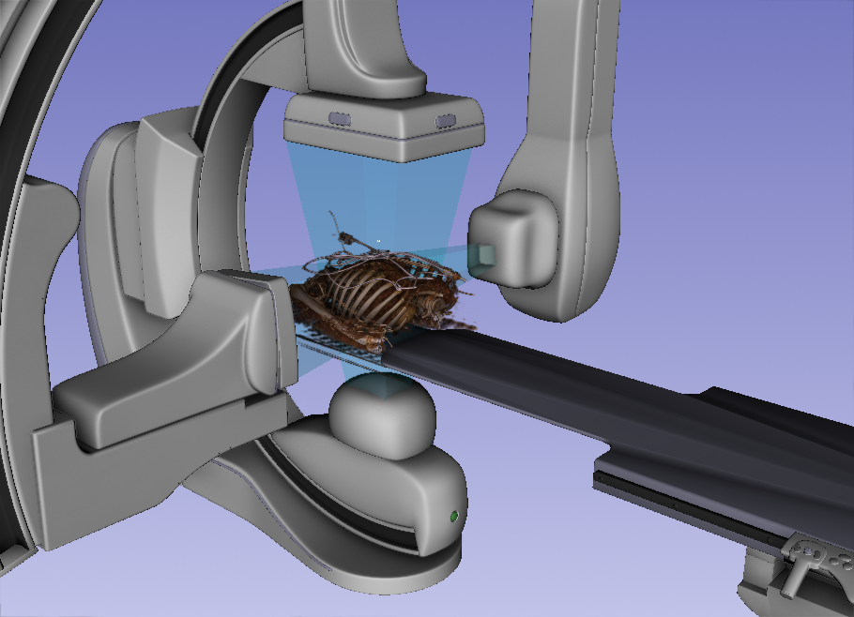
Frontal Detector Y
Frontal Detector Z
Frontal Detector X
Camera X
Lateral Detector Y
Camera Y
Camera Z
Lateral Detector Z
Lateral Detector X
Camera Z
Camera X
Camera Y

